Slide 1

Notes:
Cover

Slide 2
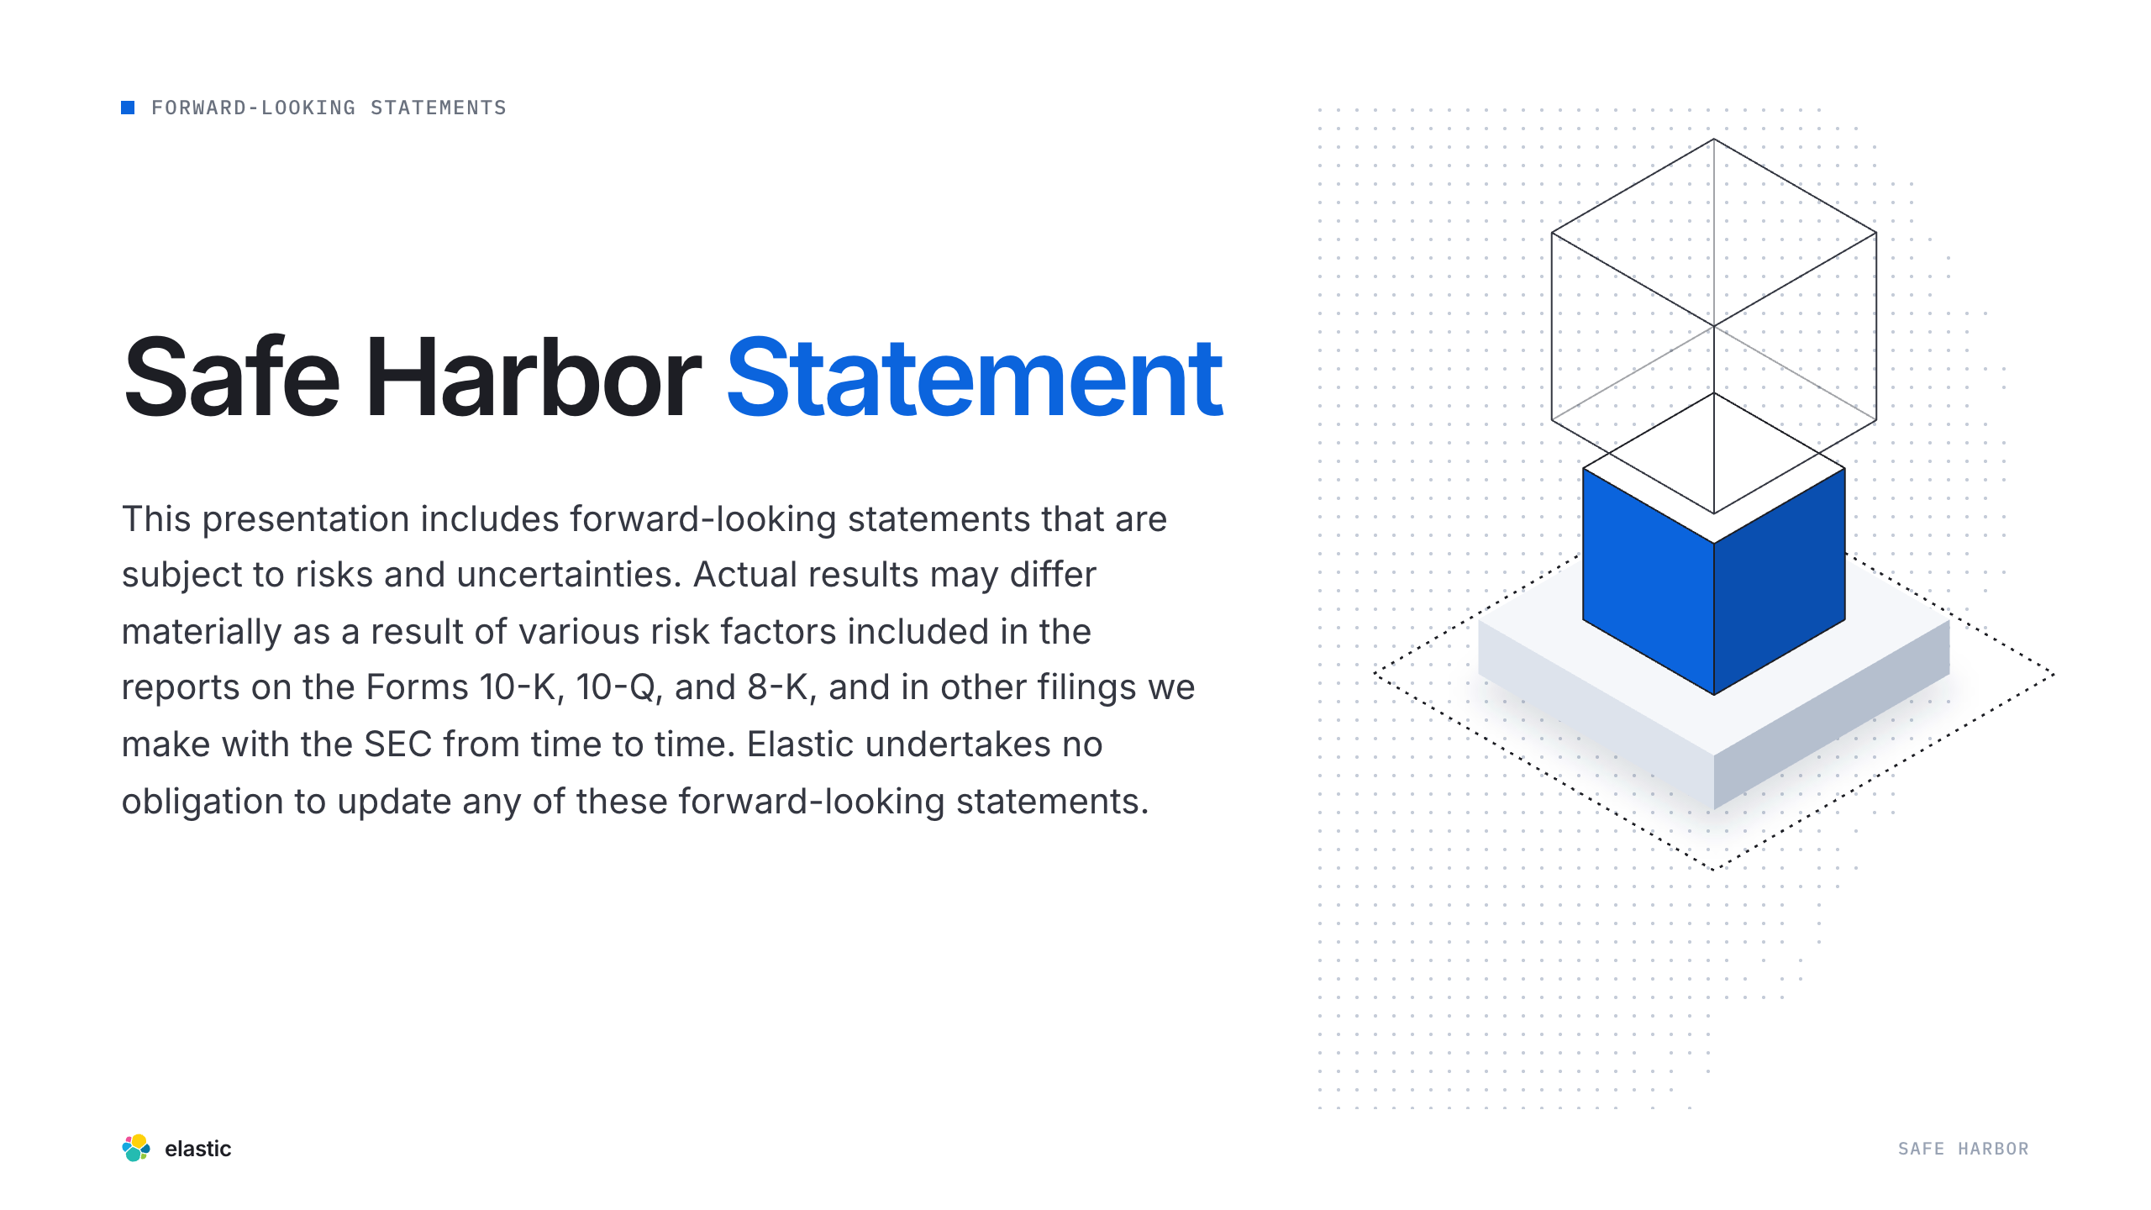
Notes:
Safe Harbor

Slide 3
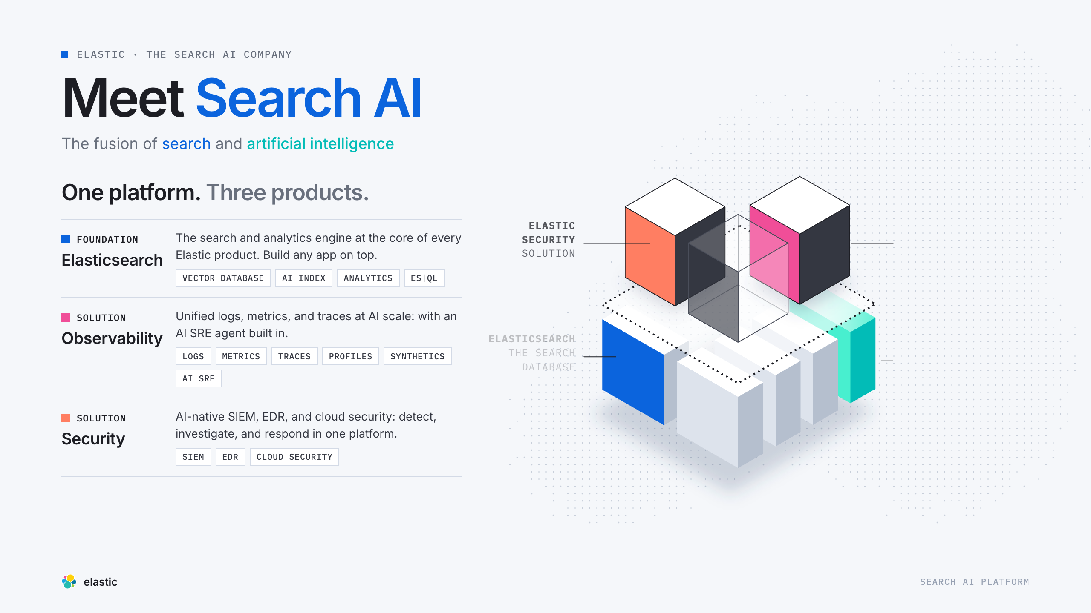
Notes:
Portfolio

Slide 4
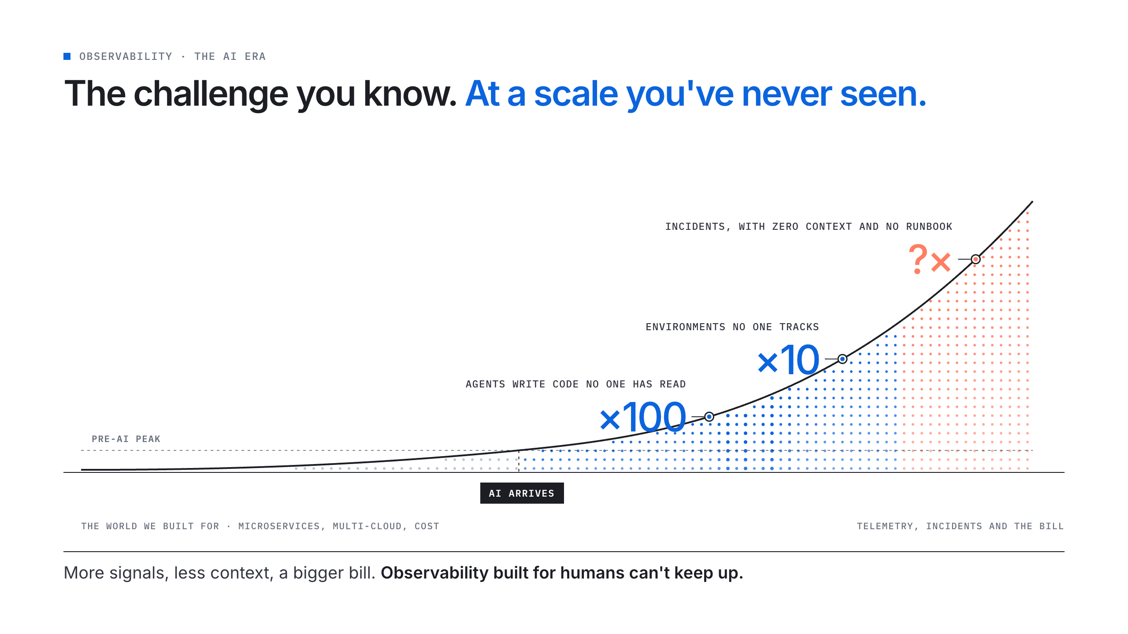
Notes:
The Challenge

Slide 5
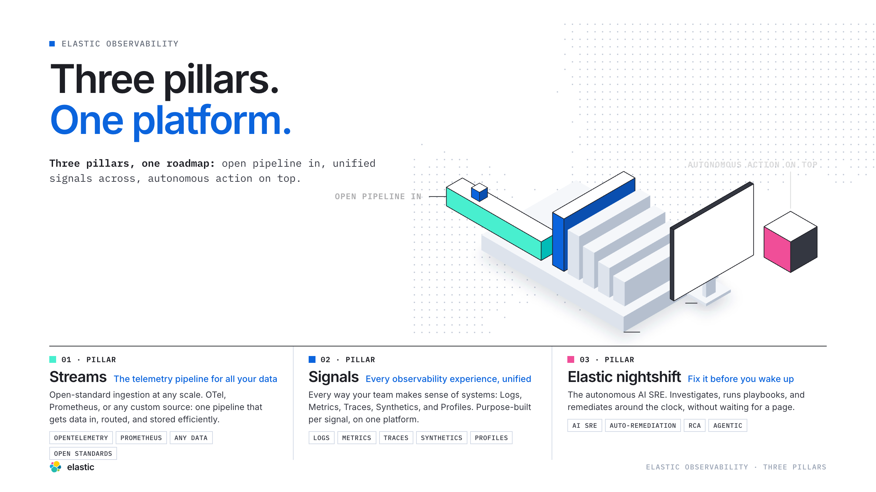
Notes:
3 Pillars

Slide 6
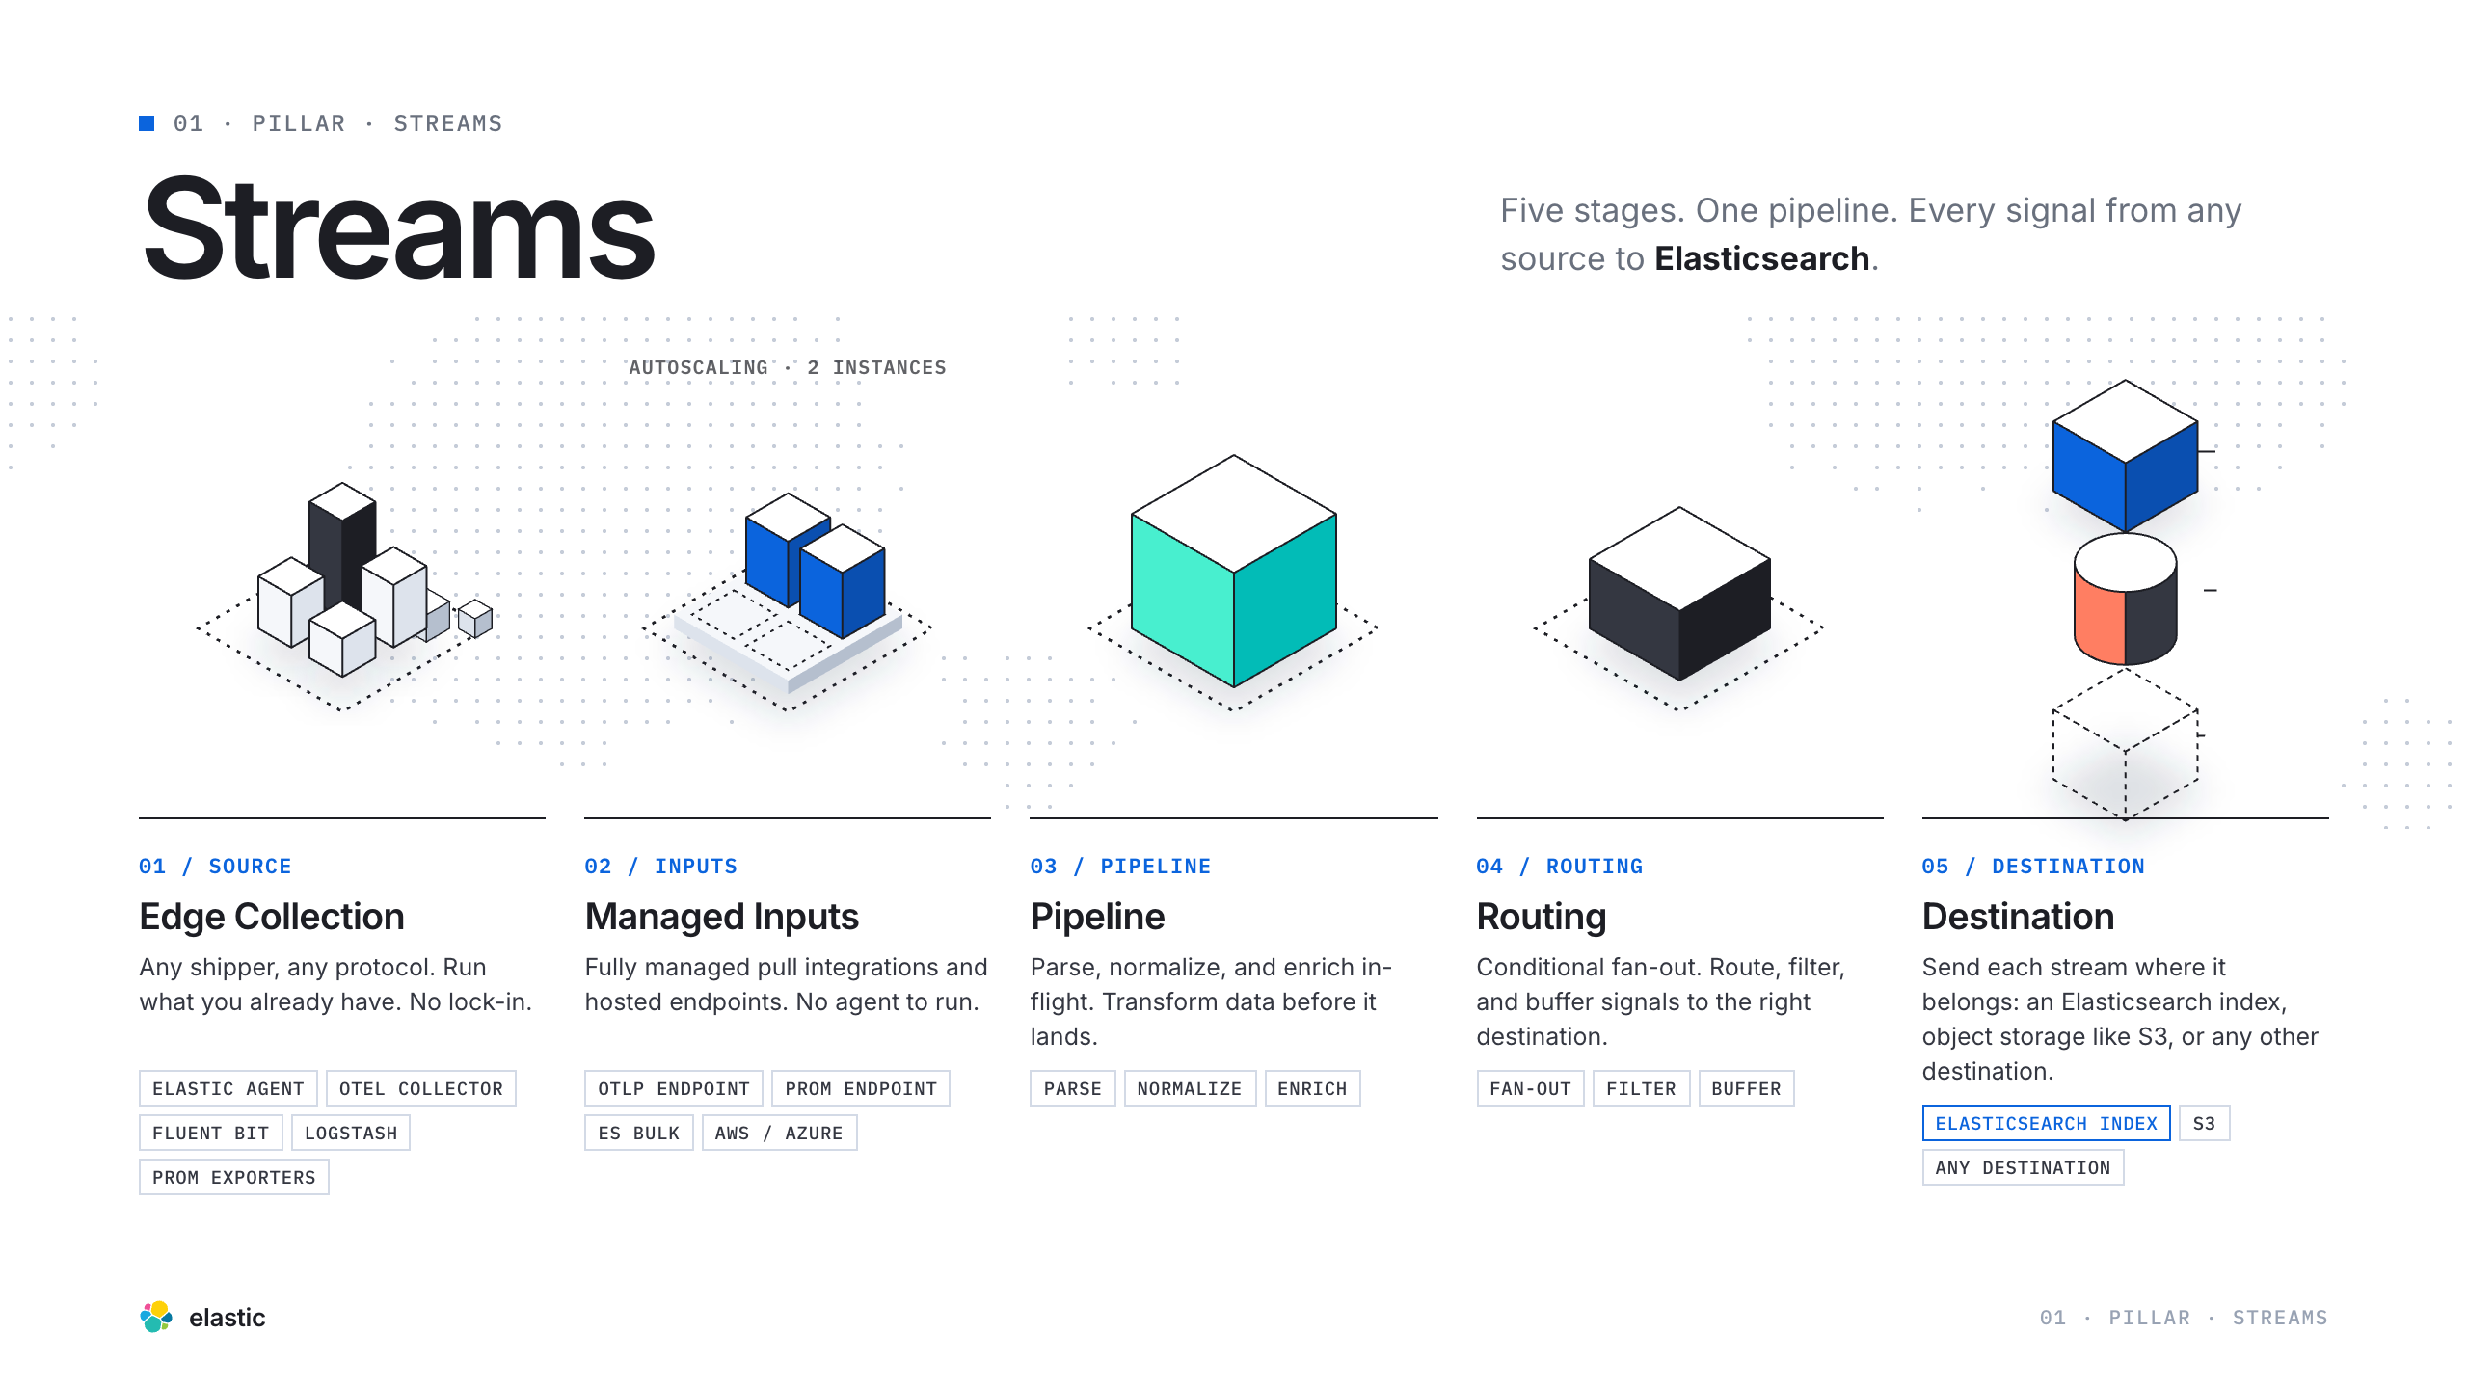
Notes:
Streams Intro

Slide 7
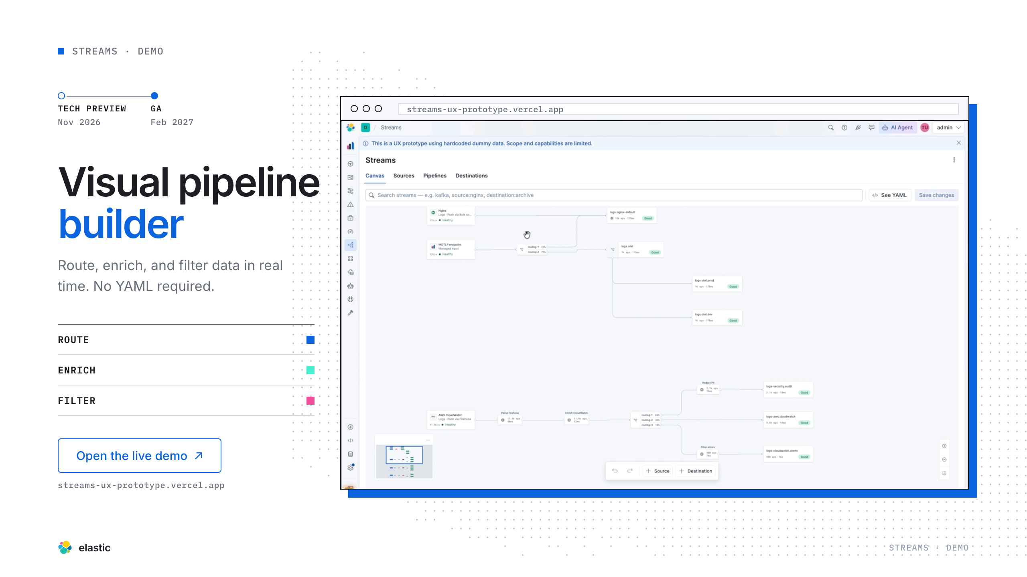
Notes:
Streams Demo

Slide 8
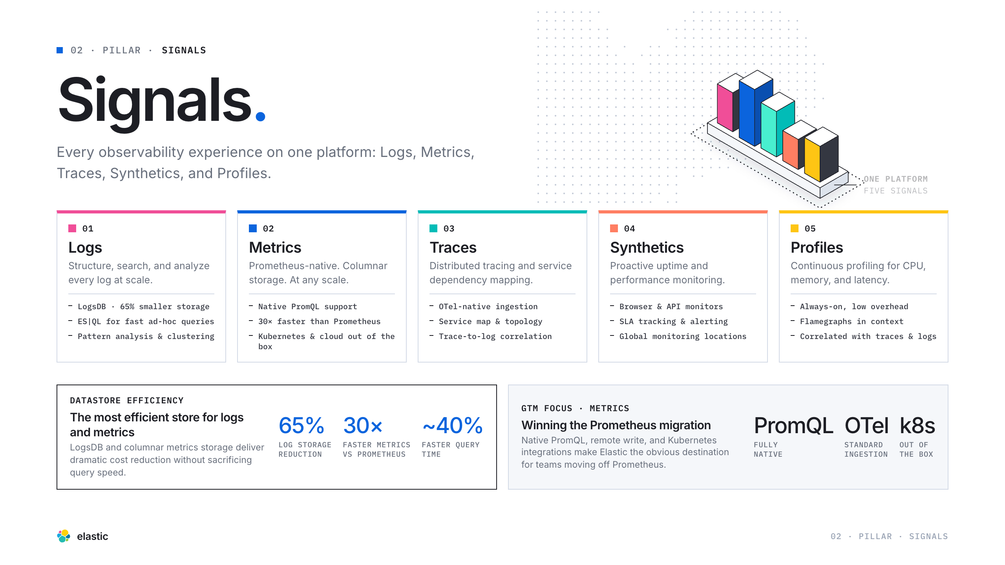
Notes:
Signals Intro

Slide 9
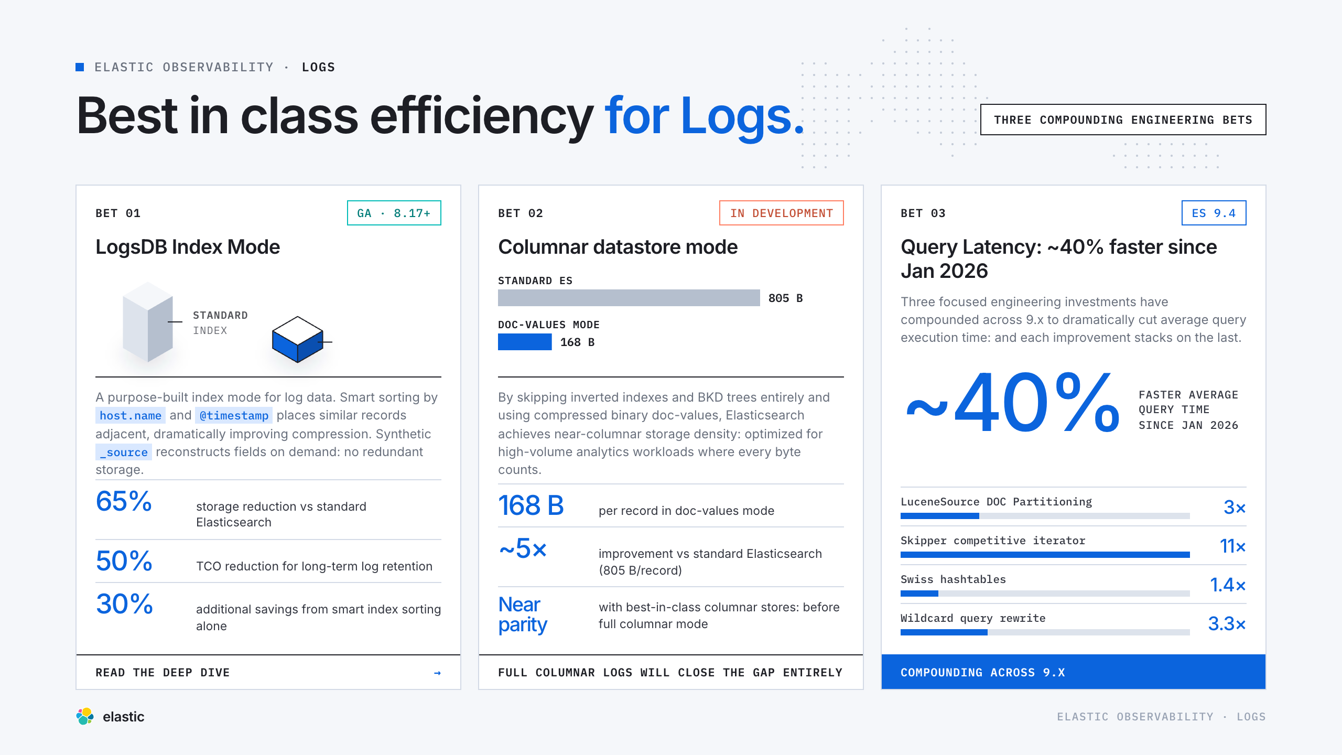
Notes:
Logs Pitch

Slide 10
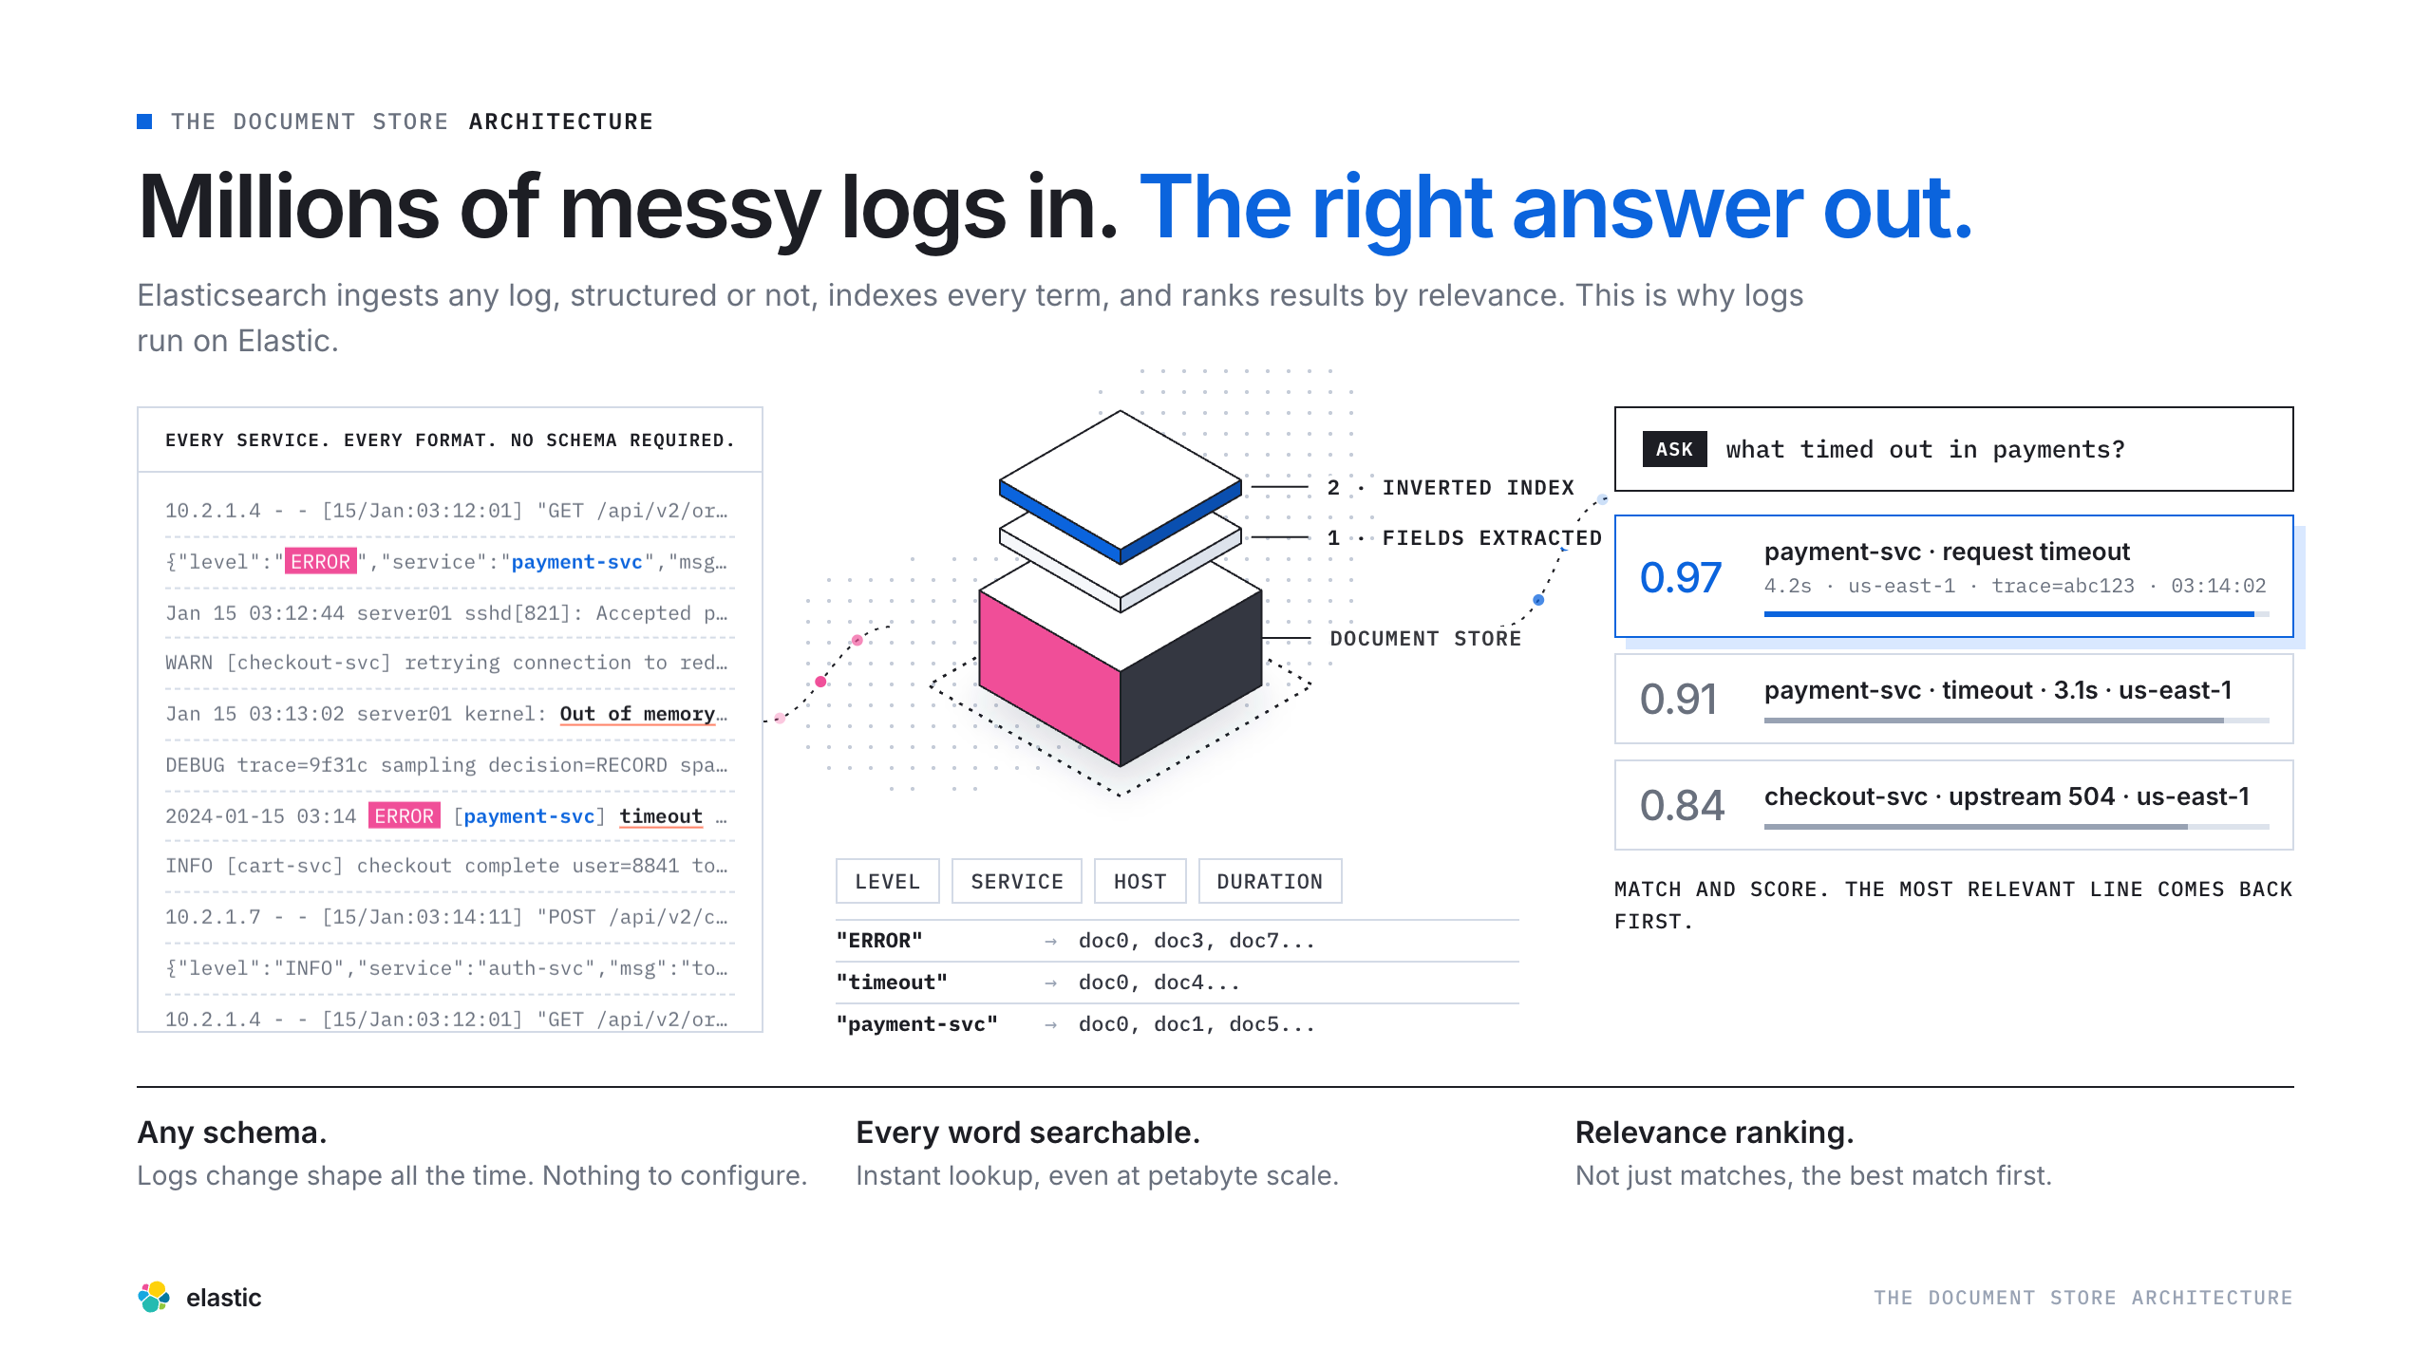
Notes:
The Foundation

Slide 11
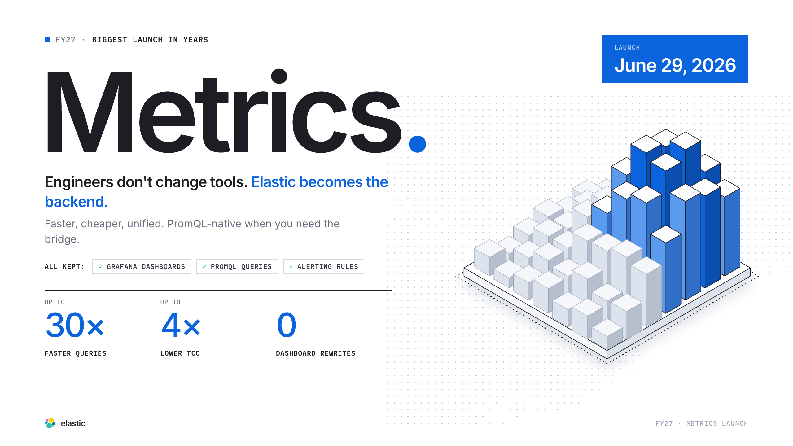
Notes:
GA Launch

Slide 12
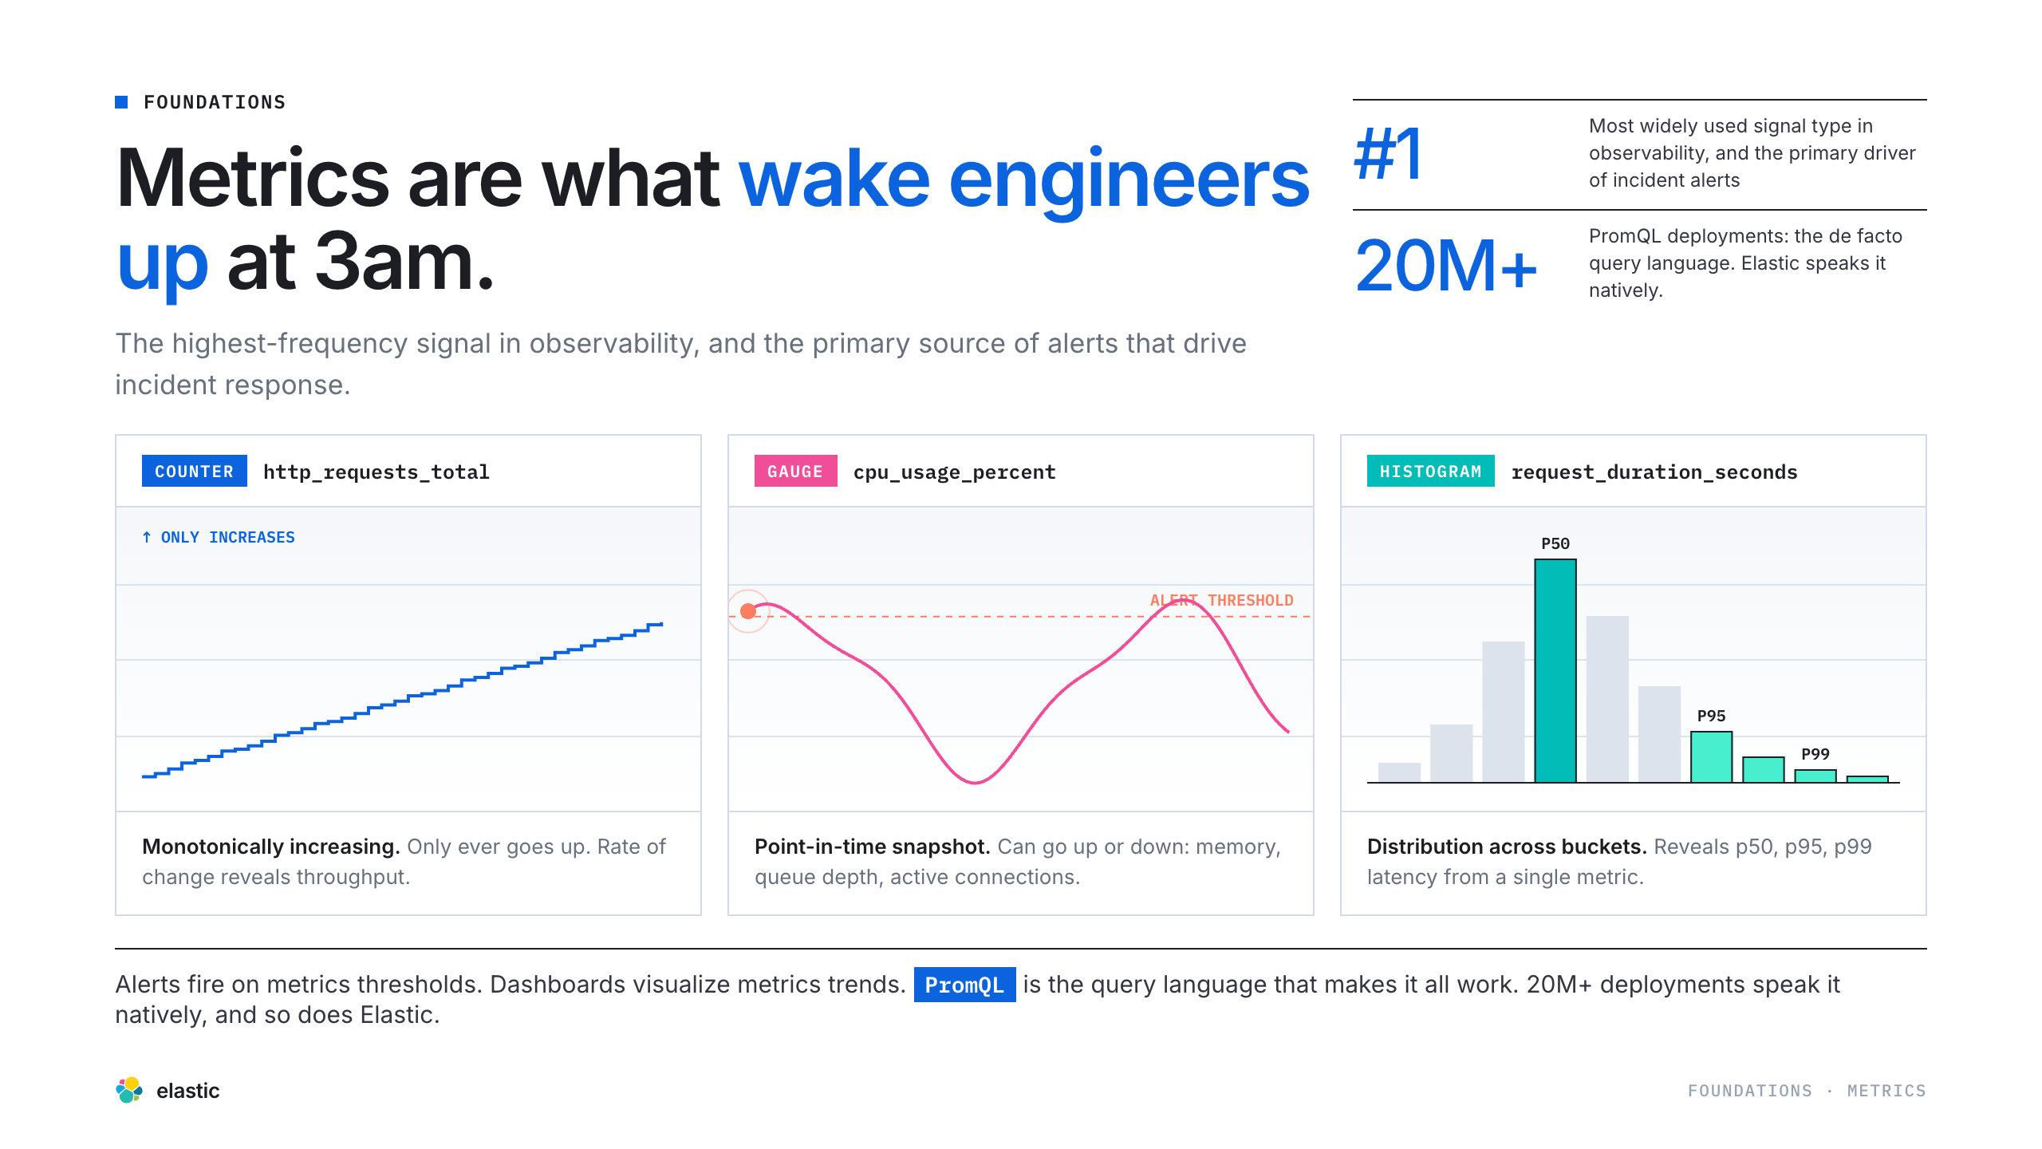
Notes:
What Are Metrics?

Slide 13
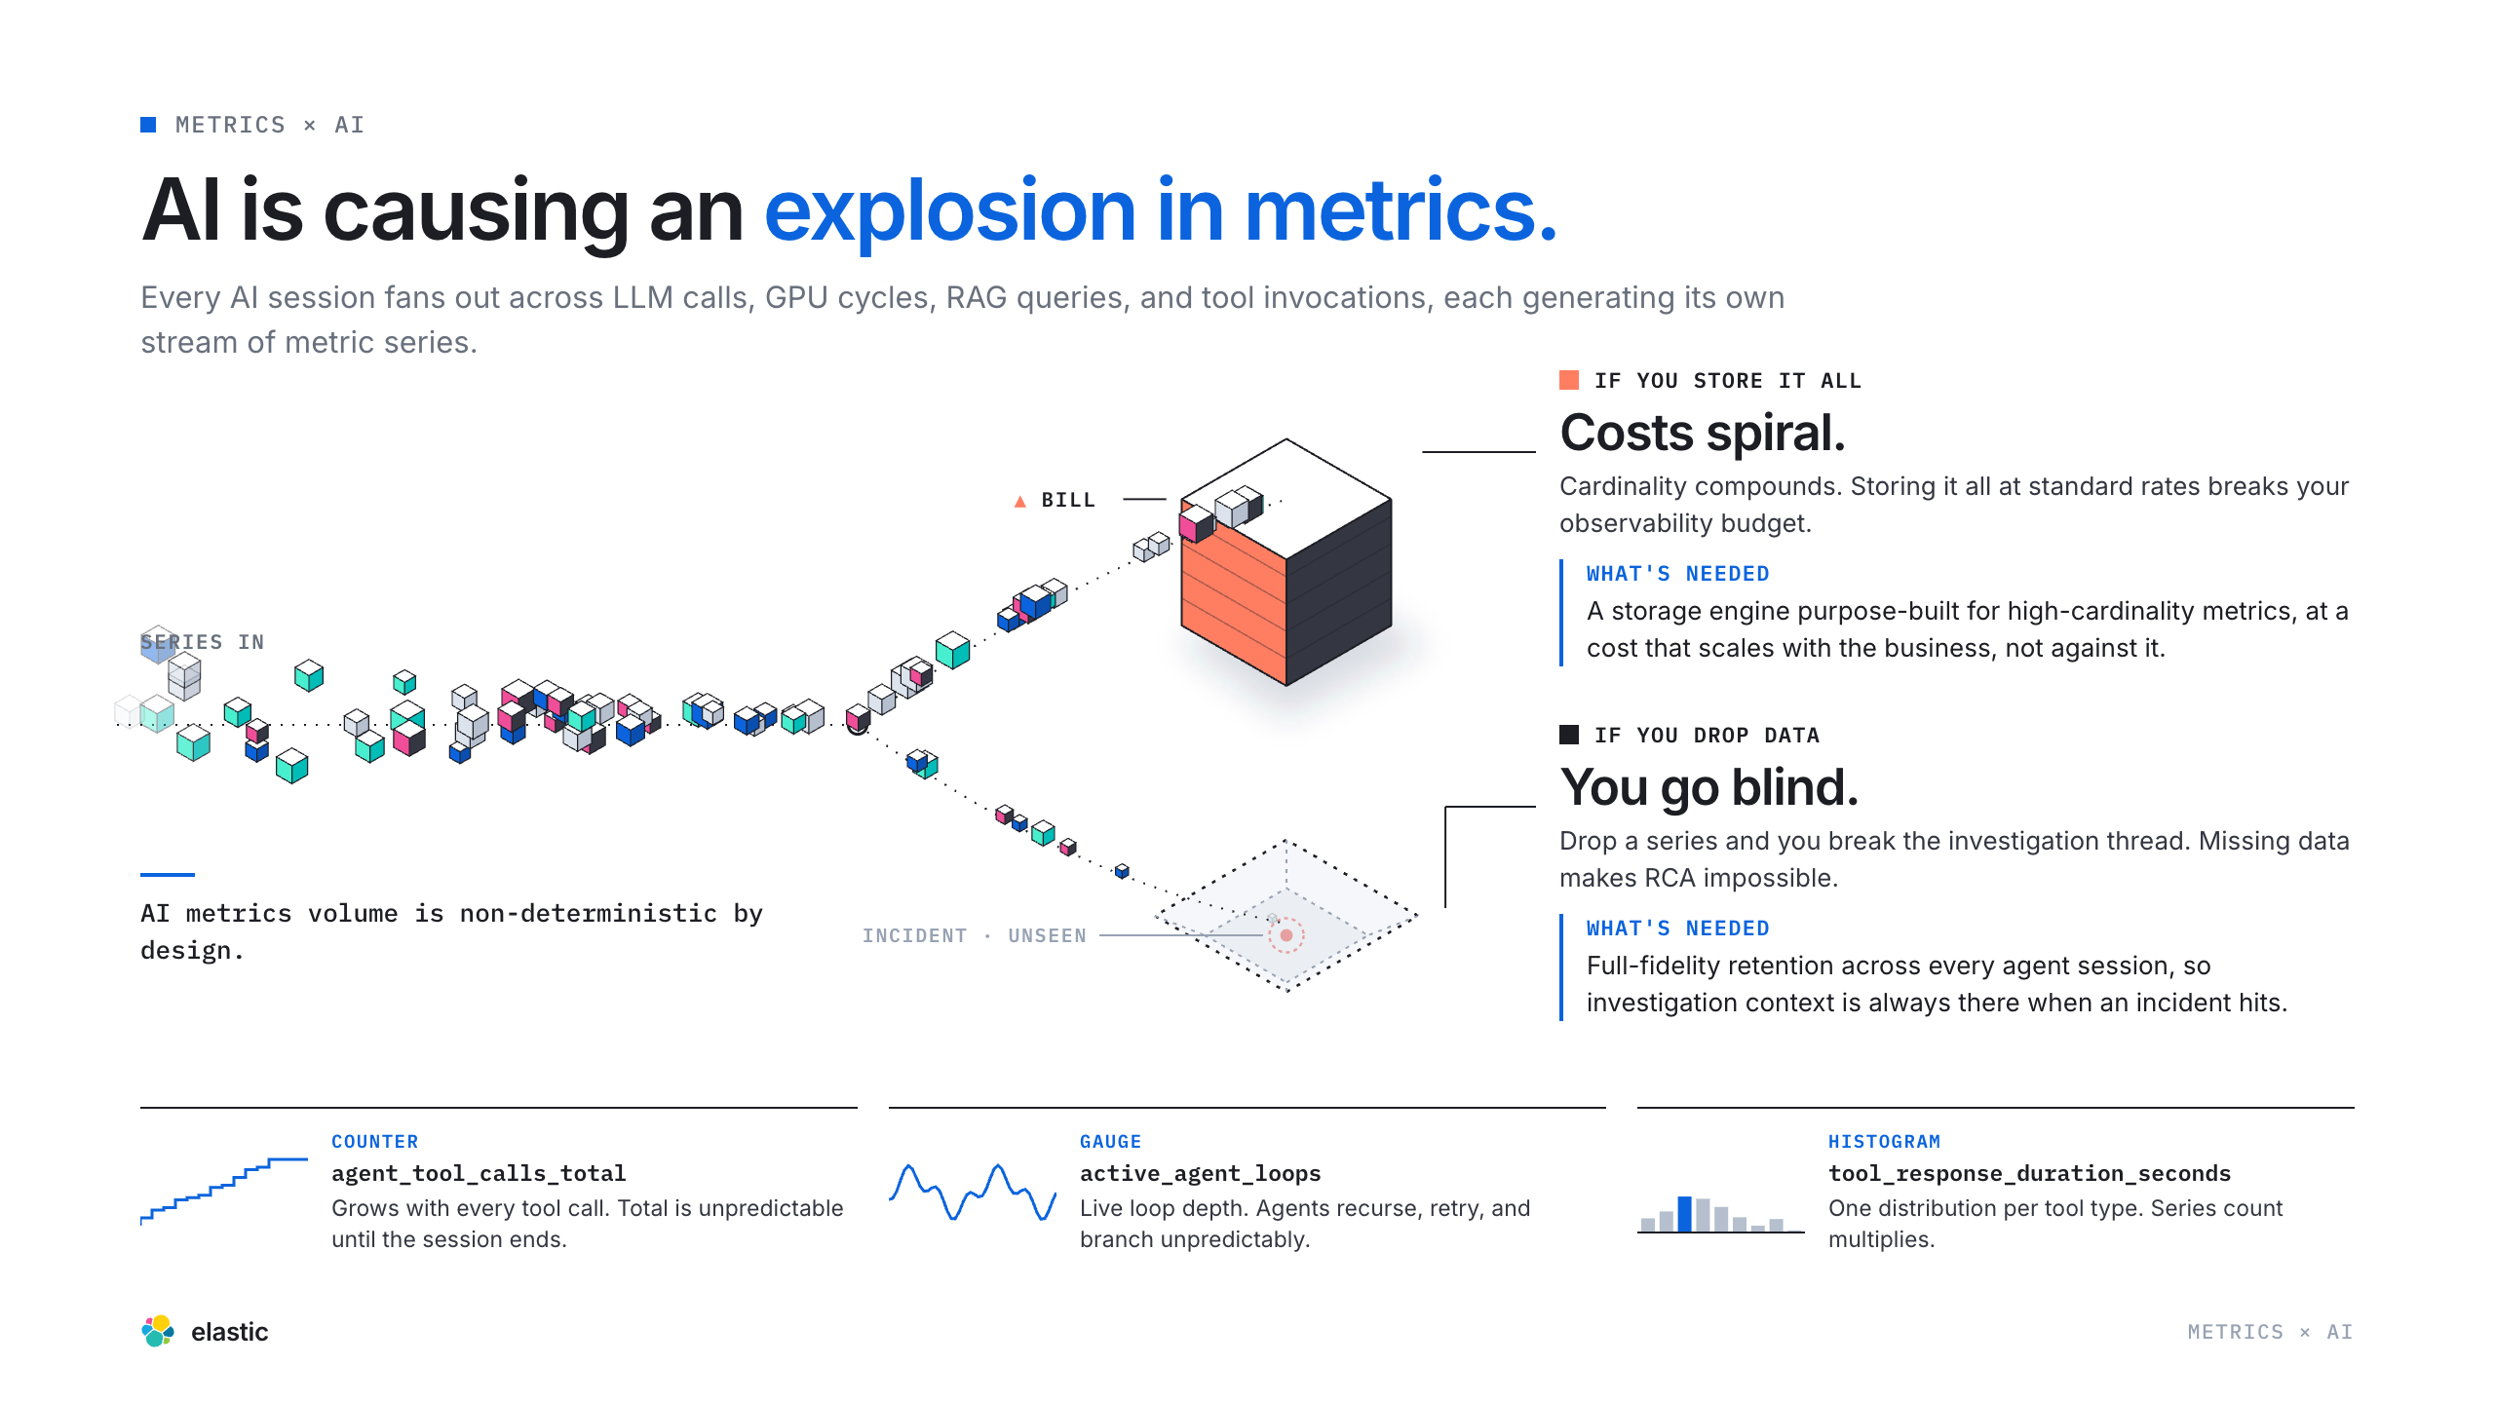
Notes:
Metrics × AI

Slide 14
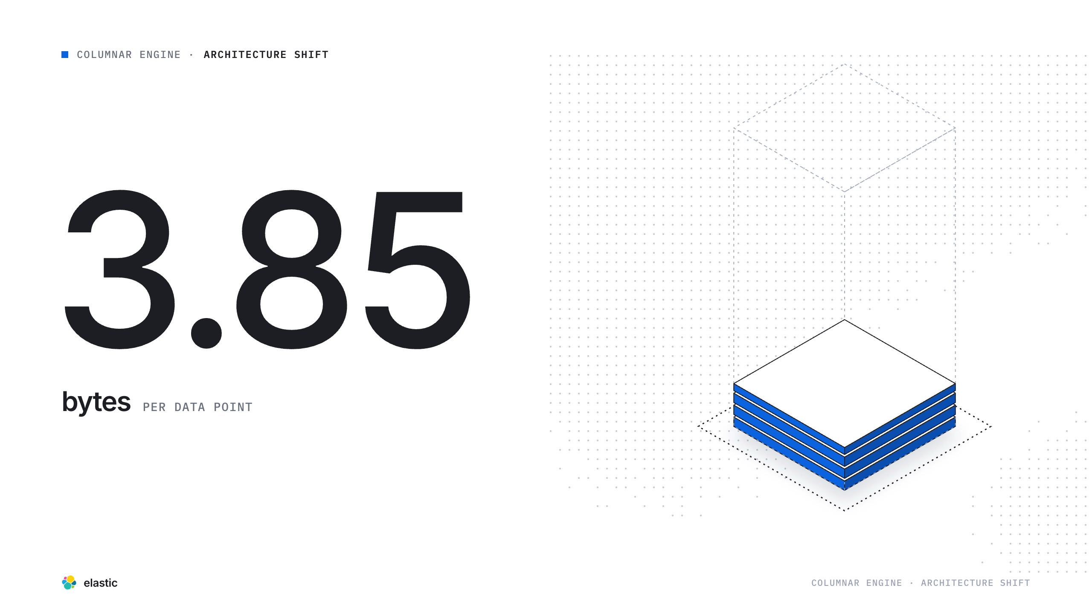
Notes:
25 → 3.75

Slide 15
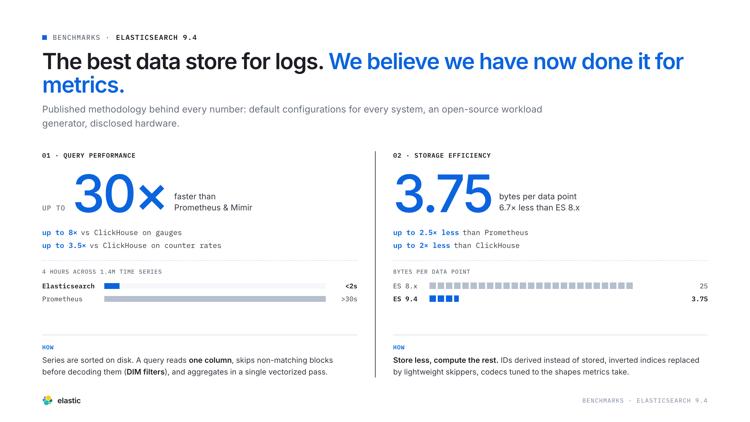
Notes:
Benchmarks

Slide 16
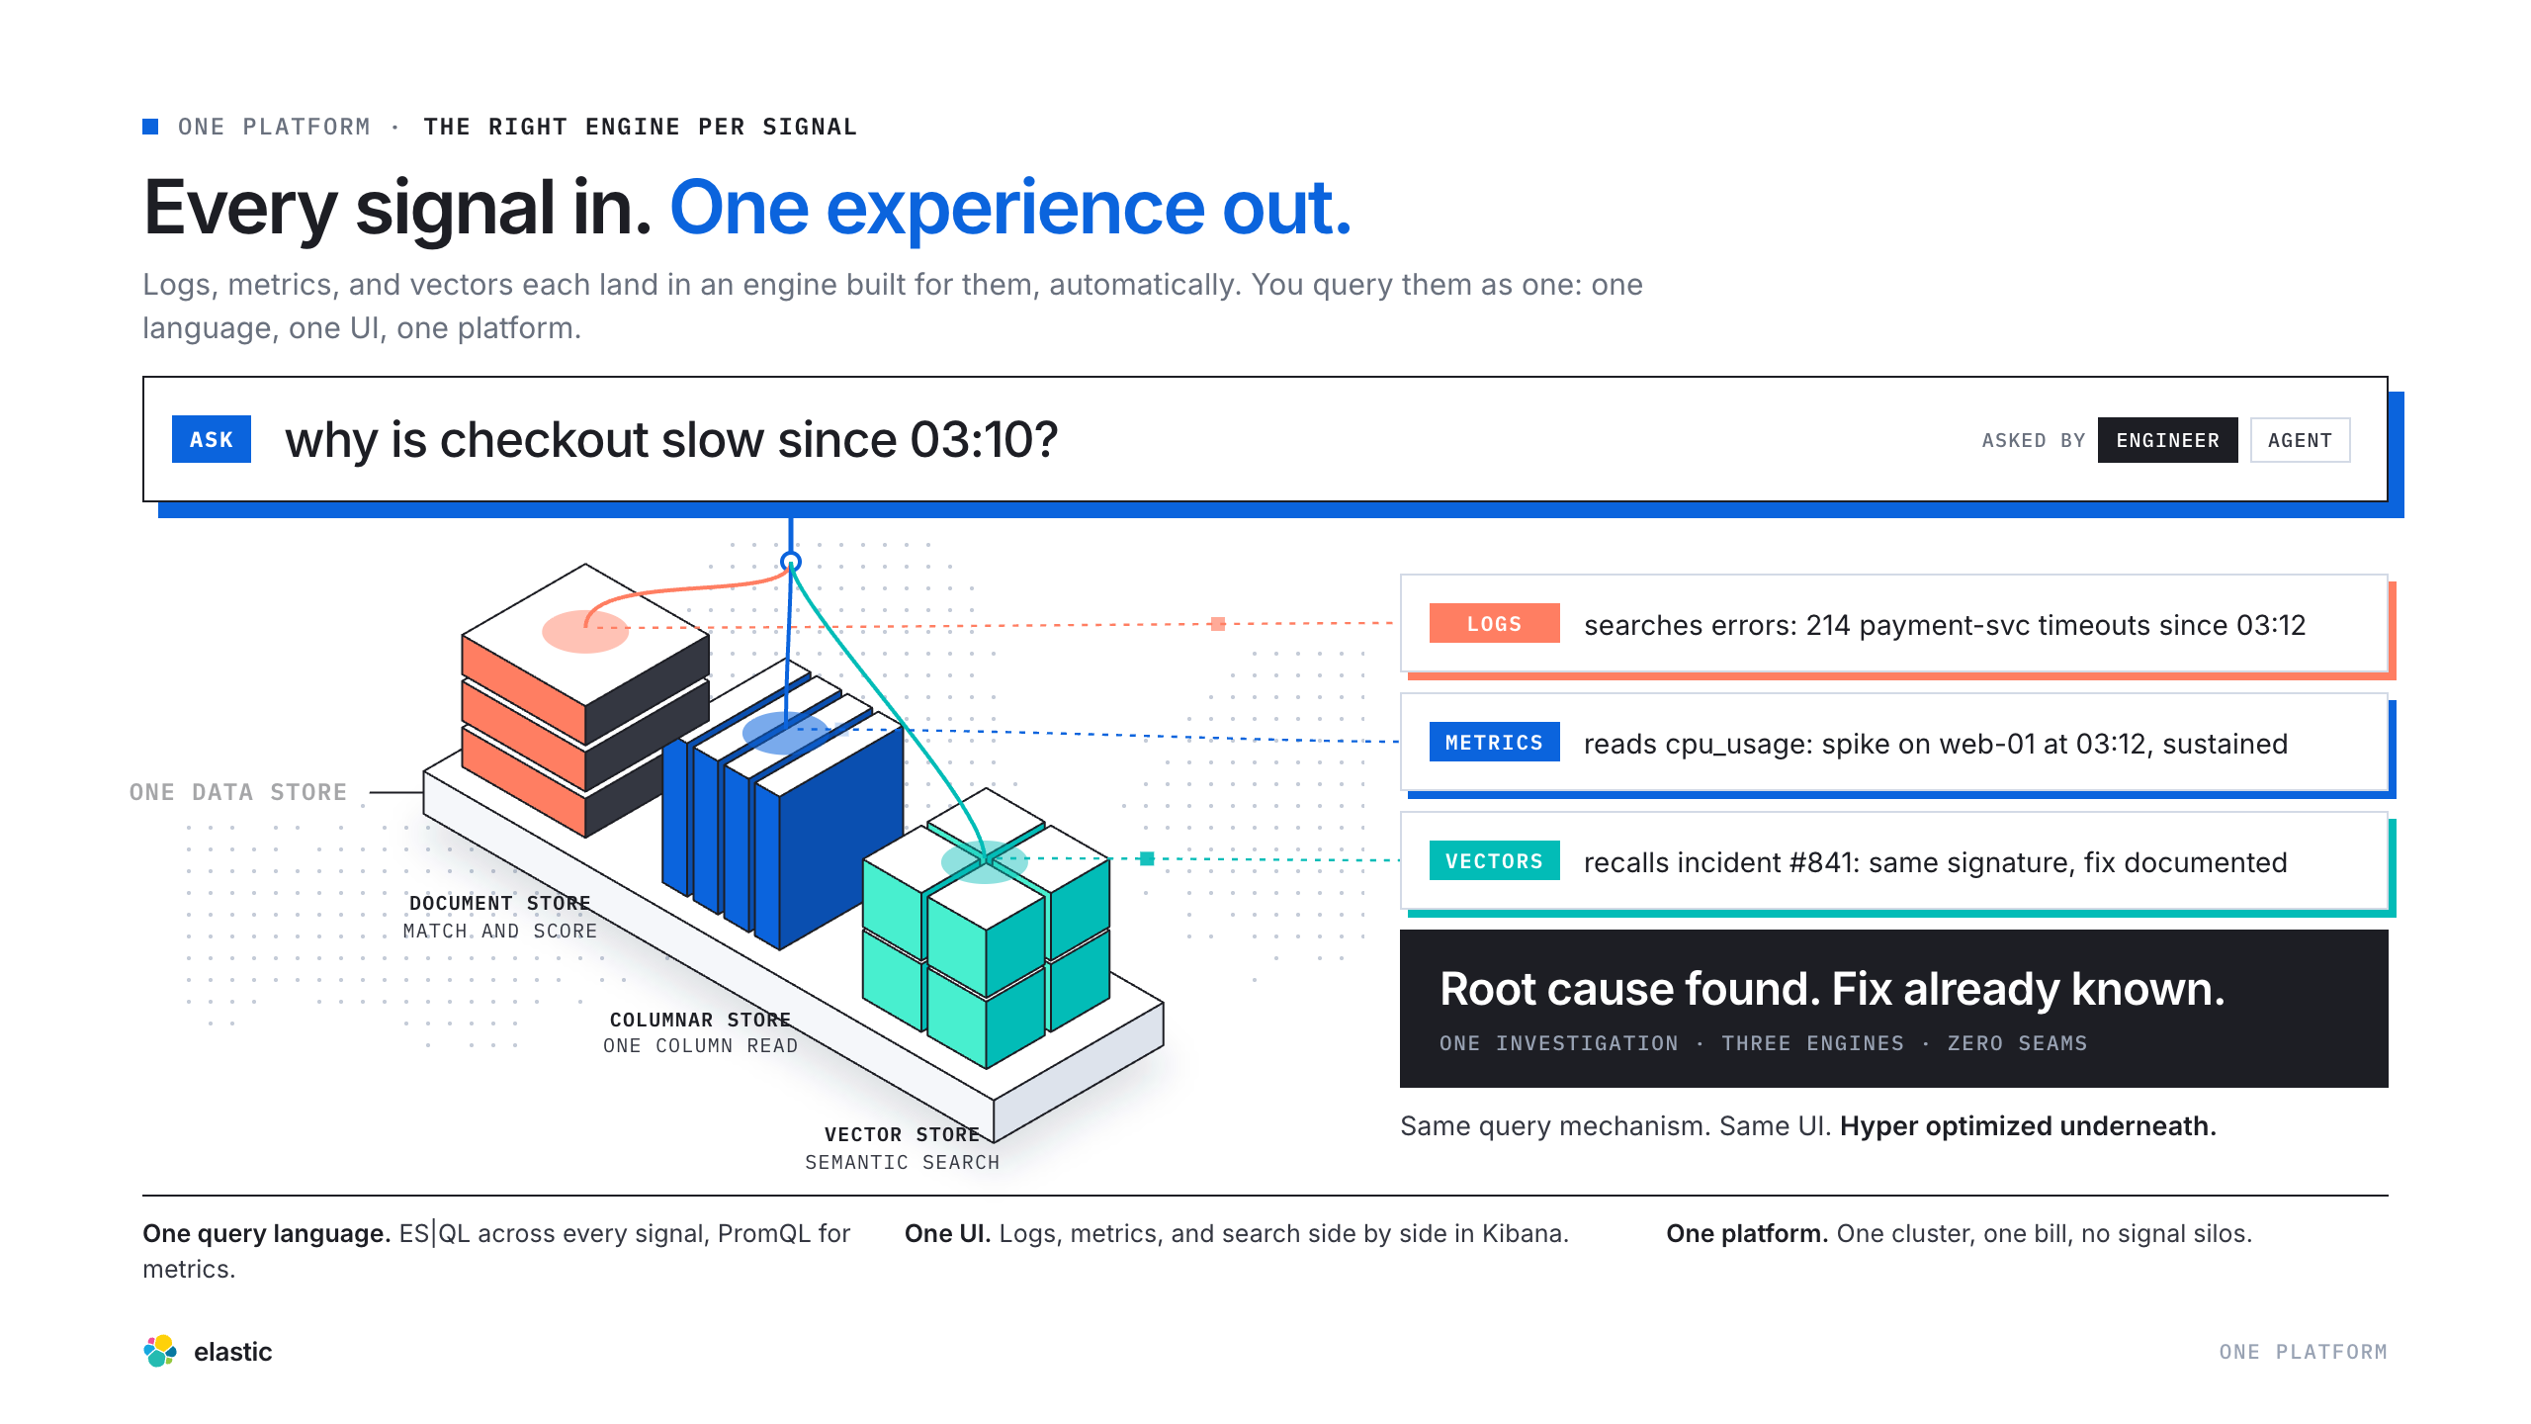
Notes:
One Platform

Slide 17
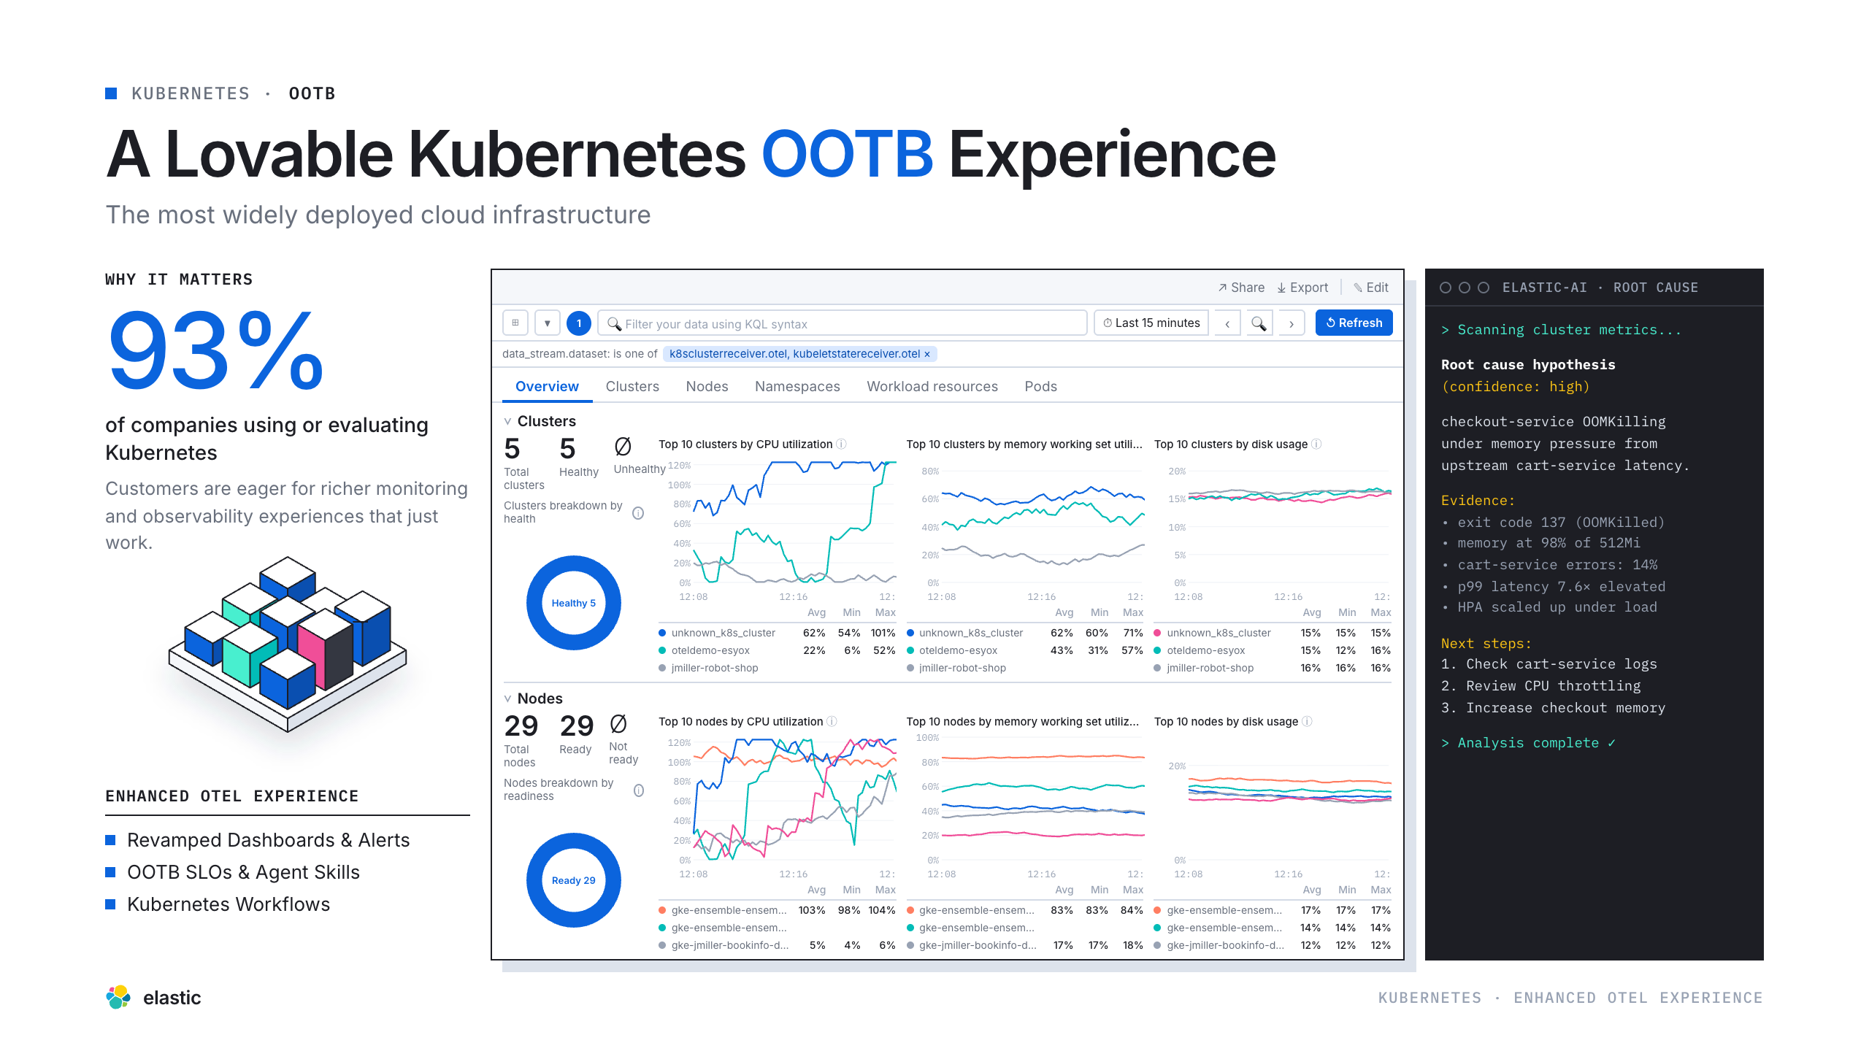
Notes:
Kubernetes

Slide 18
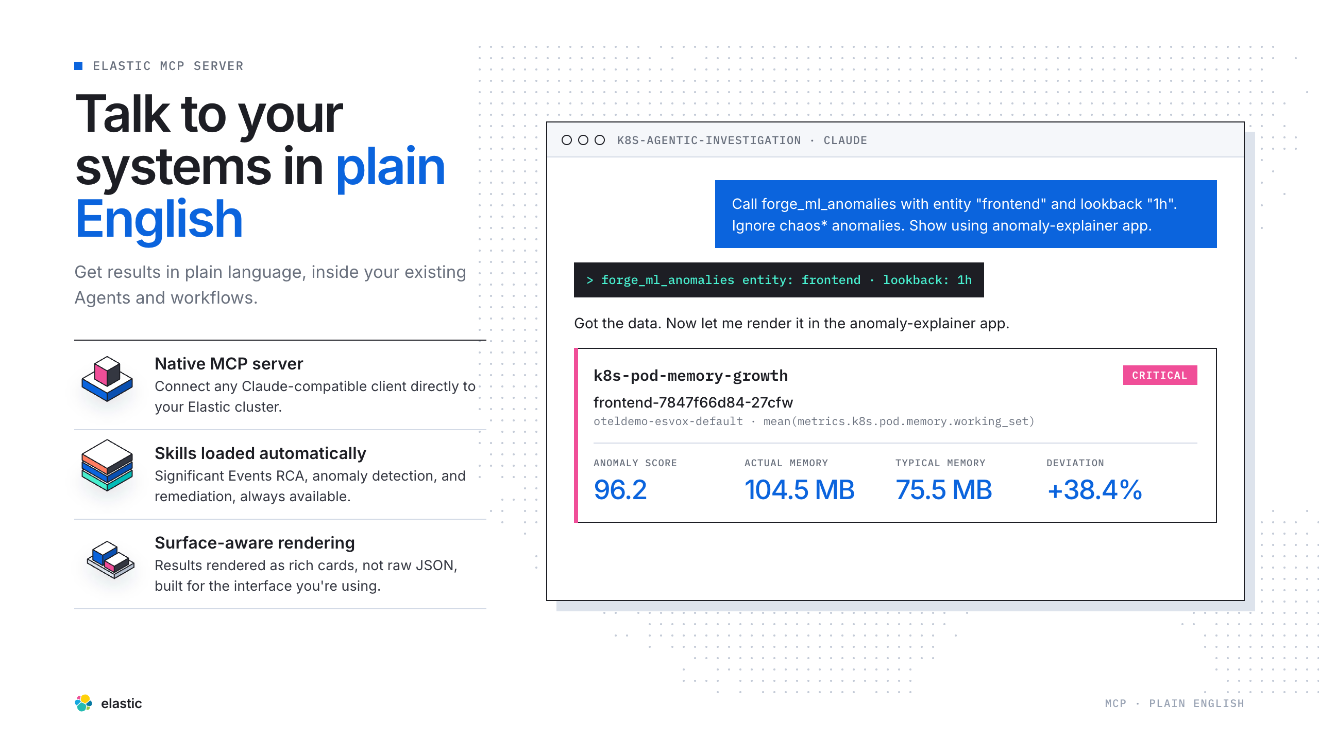
Notes:
Plain English

Slide 19
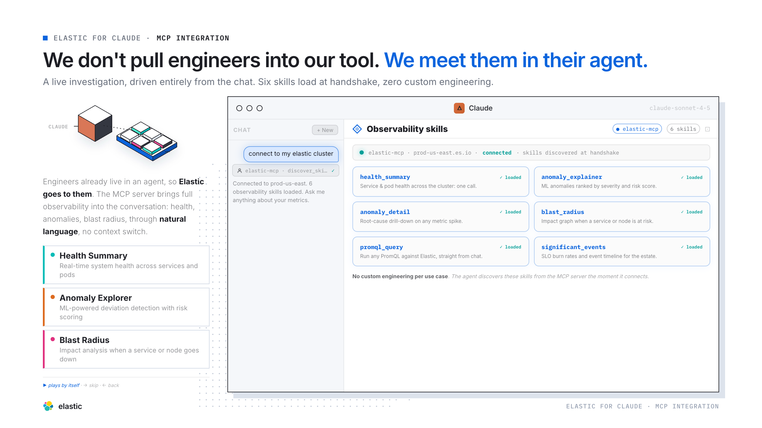
Notes:
In Their Agent

Slide 20
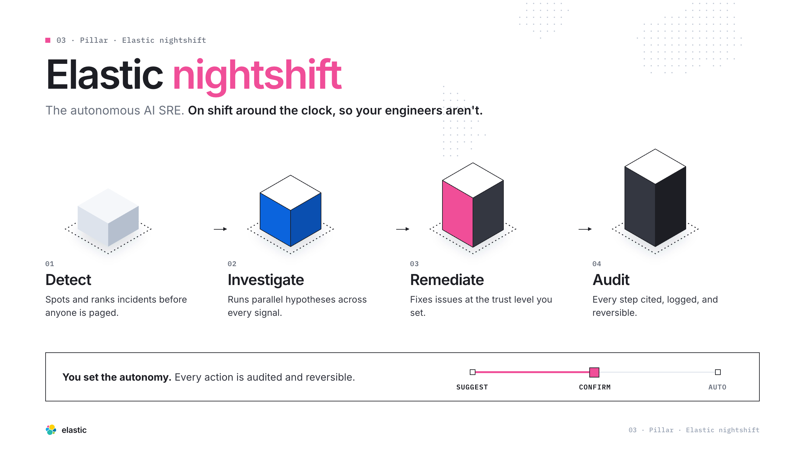
Notes:
Elastic nightshift Intro

Slide 21
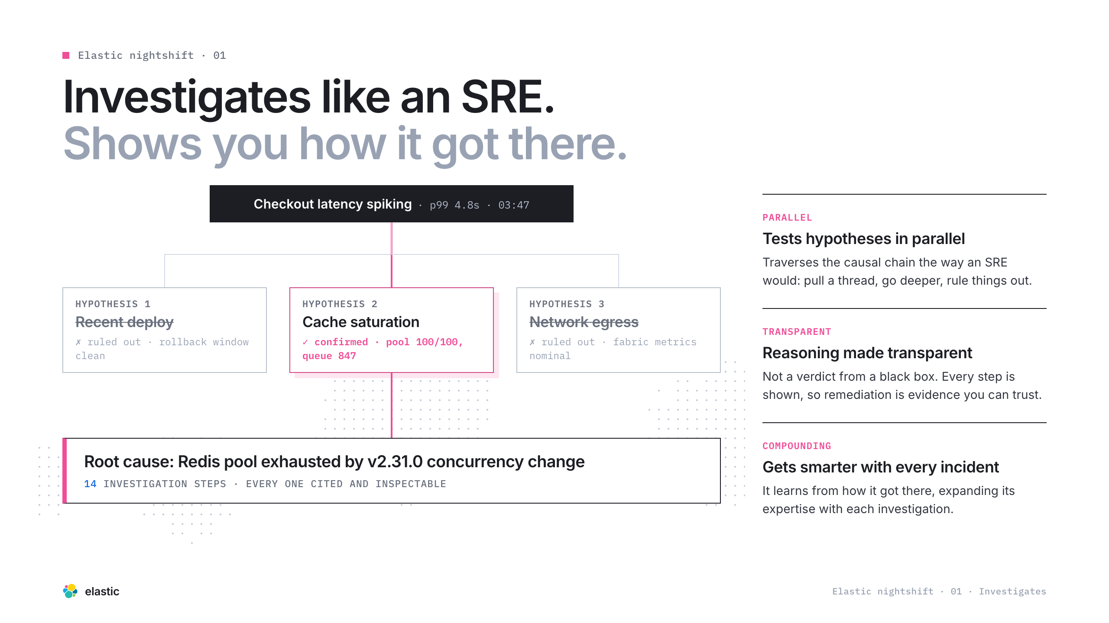
Notes:
NS · Investigates

Slide 22
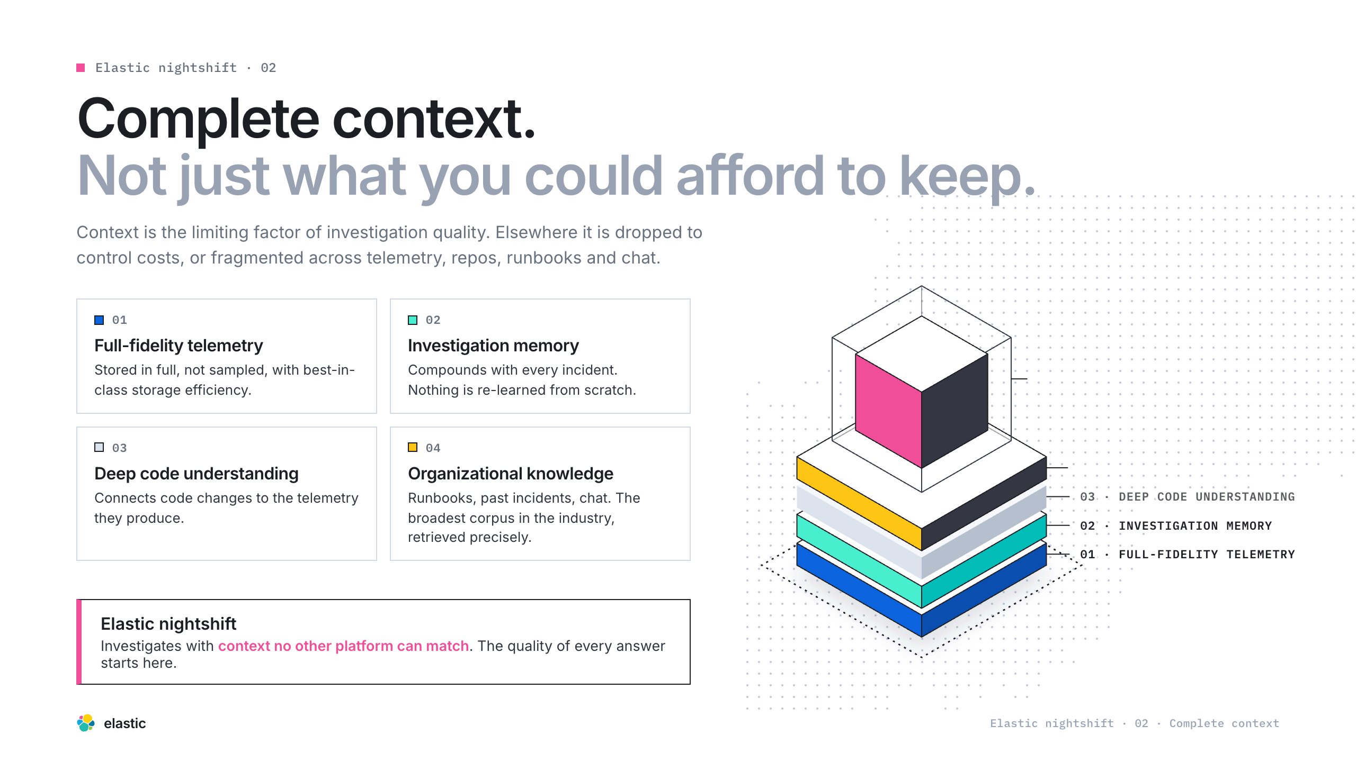
Notes:
NS · Context

Slide 23
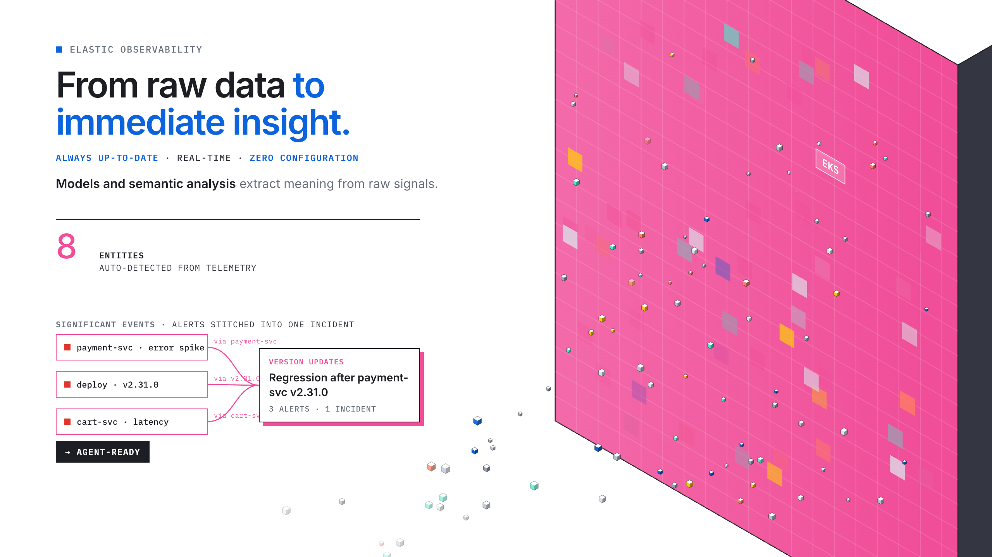
Notes:
Streams

Slide 24
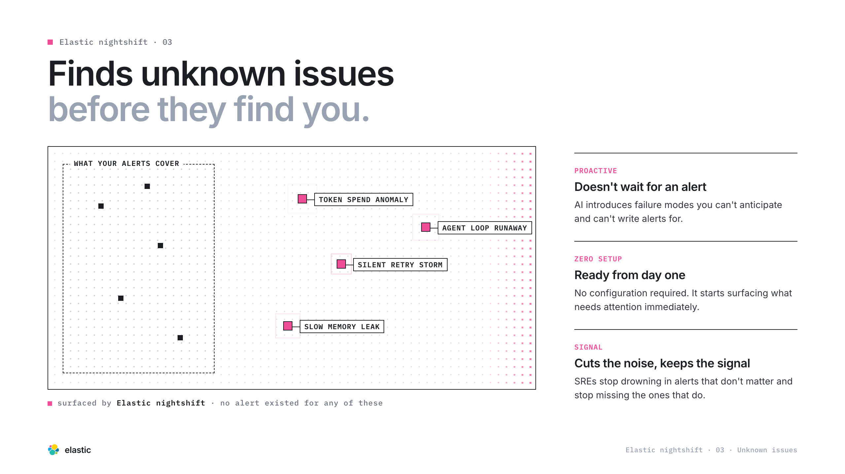
Notes:
NS · Unknowns

Slide 25
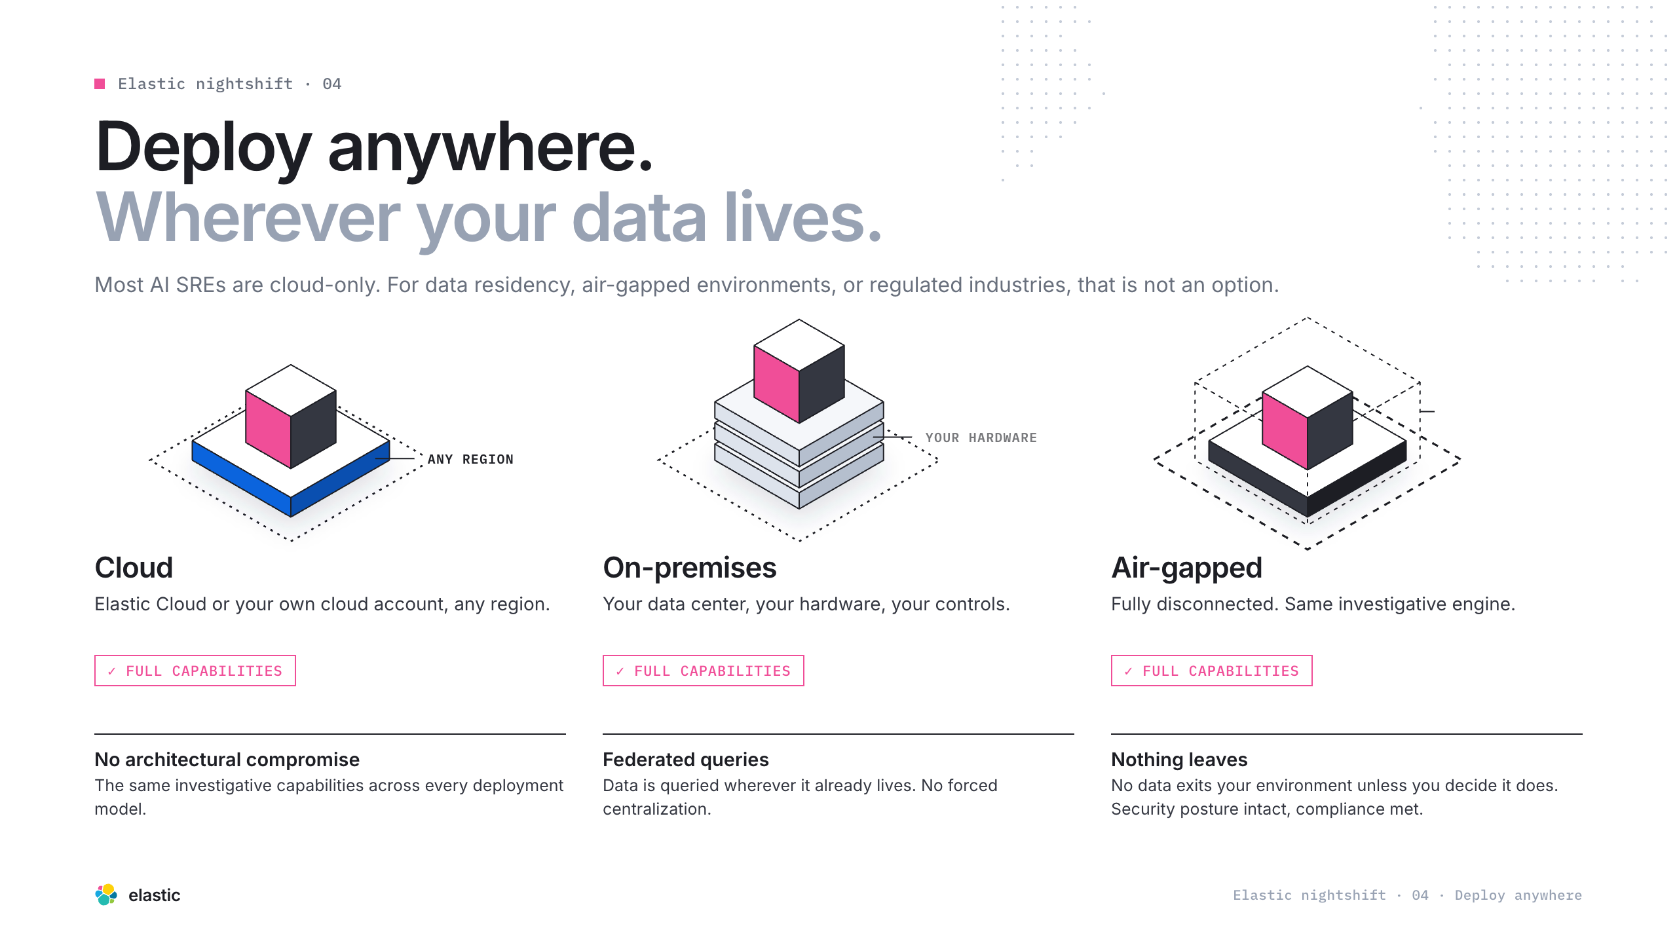
Notes:
NS · Anywhere

Slide 26
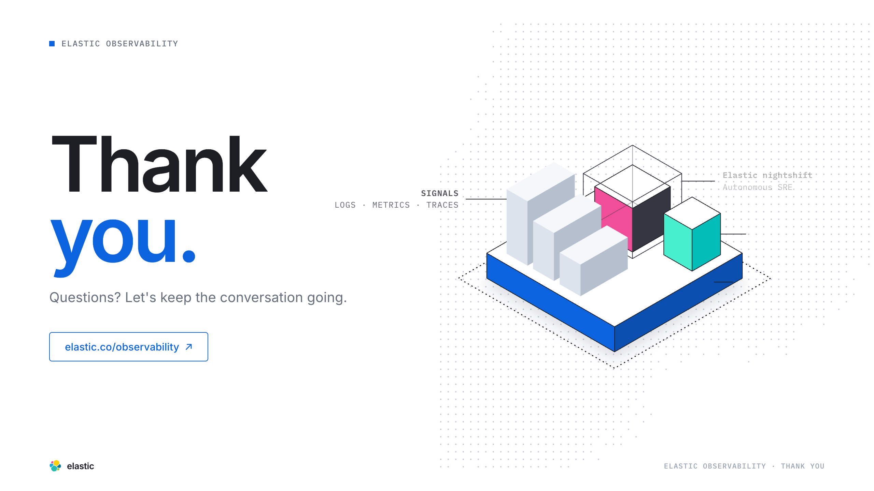
Notes:
Thank You

