Slide 1


NEXTPATH
Opportunity-intelligence + application-readiness platform for students
10-minute pitch • Executive overview for judges & mentors

Slide 2

The Problem
Discovery gap
Eligibility gap
Opportunities scattered across platforms
Students unsure if they qualify
Action gap
Applications are repetitive, slow, error-prone

Slide 3
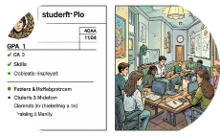

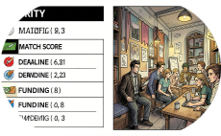
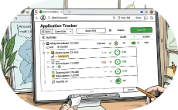

What NEXTPATH Does
Aggregates
Determines Eligibility
Prioritizes
Assists
Unified feed from universities, NGOs, companies
Match score, deadline, funding, goals
Autofill, draft letters, track applications
Rule-based engine → clear verdict + reason

Slide 4
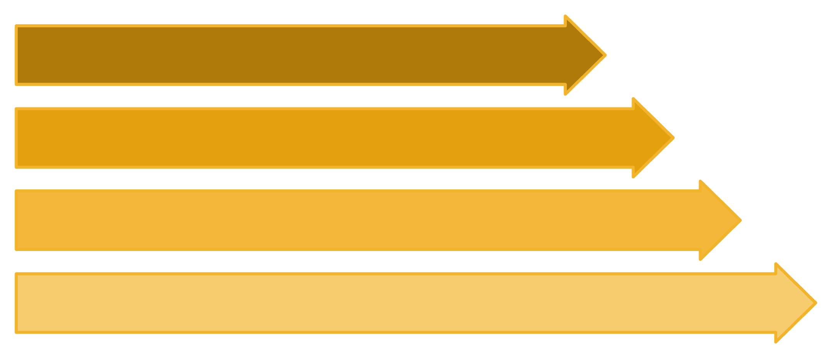
Core Architecture (one sentence)
Build Profile
Profile → verified opportunity DB → eligibility & match engines → AI explains → application assistant → tracker
Match Database
Eligibility & Scoring
Application Assistant
Golden rule: AI explains. Rules + DB = source of truth. AI does NOT decide eligibility.

Slide 5





Key Features
Discovery
Eligibility Engine
Match Engine
Searchable feed, NL AI search, filters
Rule-based; 4-state verdict + "Why not?" feedback
Score broken down by skills, major, goals
Application Assistant
Profile Gap Analysis
Reusable profile, autofill, draft letters, tracker
Shows missing items to unlock more opportunities

Slide 6
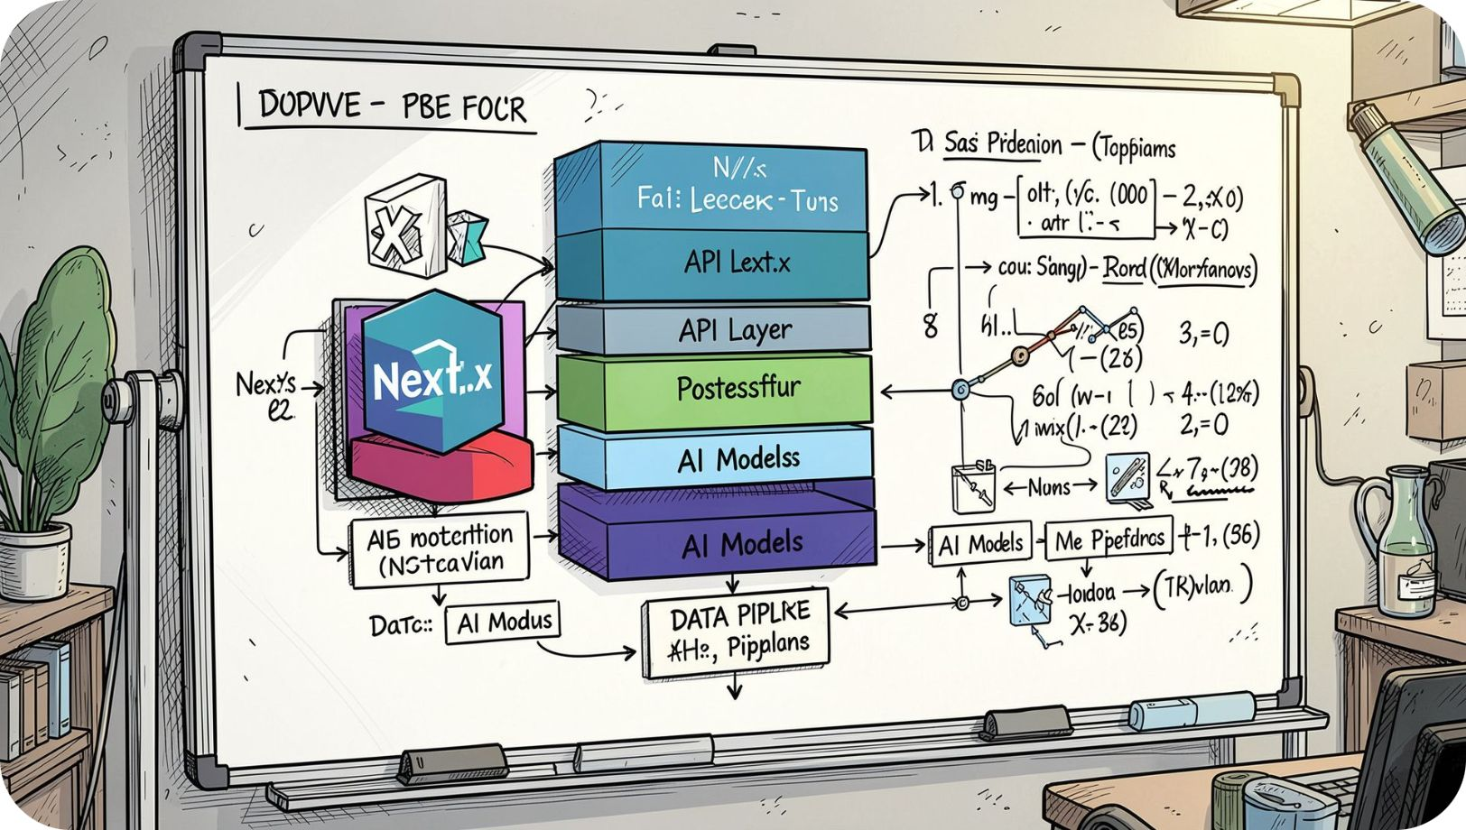
Tech Stack & Team
Frontend
Backend
Next.js
Custom API, Supabase (PostgreSQL)
AI & Data
NL search, requirement extraction, explanation
Team: 4 people — Frontend/Product · Backend/DB · AI/Data

Slide 7
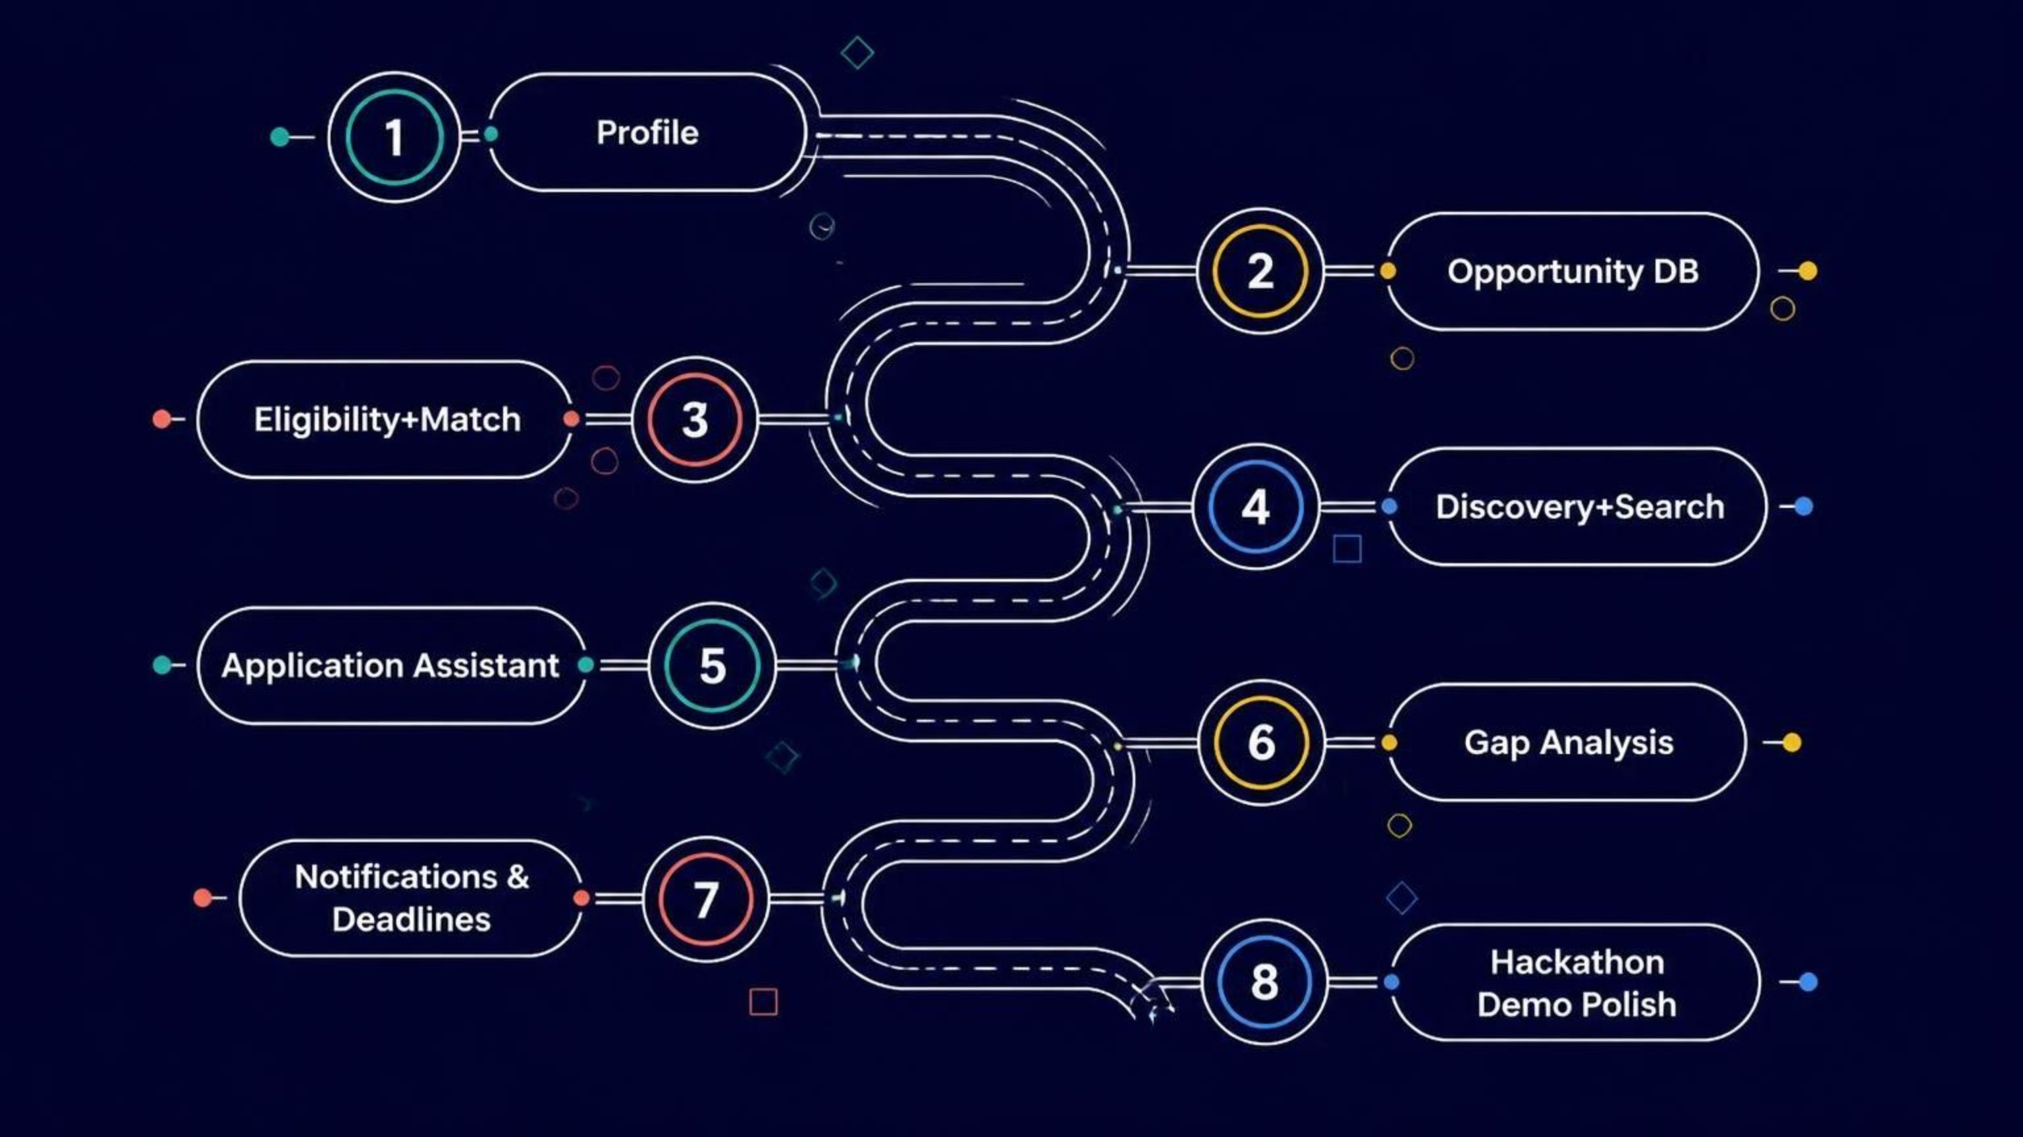
Roadmap (8 phases)
Focus: Build MVP for hackathon (phases 1–8 prioritized). Skip social features and premature microservices.

Slide 8

How NEXTPATH Wins
DISCOVER
UNDERSTAND
Find opportunities globally
Tell students if they can apply — and why
ACT
Turn matches into prepared, trackable applications

