Slide 1

mohalla
INVESTOR + CUSTOMER DECK • JULY 2026
Pakistan’s verified
neighborhood
operating system.
Private communities. Public value.
Illustrative planning scenario • no current traction or financial claims
Notes:
Open with the category claim: Mohalla is not another chat group or a back-office society tool. It is a verified digital layer for everyday neighborhood life. The presentation intentionally separates implemented product capabilities from planning assumptions.
Sources:
• Mohalla product audit, July 2026; supplied City Feed and Events screenshots.

Slide 2
THE THESIS
Pakistan is digitally connected.
Neighborhoods are not.
The infrastructure exists. The trusted local operating layer does not.
147.2m
93.8m
15.0m
broadband subscribers
urban residents
urban households
March 2025
2023 census
2023 census
Sources: Pakistan Economic Survey 2024–25; Pakistan Bureau of Statistics, Census 2023.
02
Notes:
The timing thesis is simple: smartphones and connectivity are already mainstream, but neighborhood coordination still lives across unverified chat groups, paper notices, personal contacts, and disconnected tools.
Sources:
• https://finance.gov.pk/survey/chapter_25/15_Information_Technology.pdf
• https://www.pbs.gov.pk/sites/default/files/population/2023/Pakistan.pdf

Slide 3

THE DAILY REALITY
A gated society is
physically organized—
and digitally chaotic.
URGENT
Safety alerts vanish inside chat threads.
TRUST
Outsiders, tenants and stale contacts blur access.
COMMERCE
Reliable local services depend on word of mouth.
GOVERNANCE
Notices, polls and complaints live in separate places.
ONE NEIGHBORHOOD • FIVE DISCONNECTED SYSTEMS
Notes:
Frame the pain as coordination cost, not simply inconvenience. Fragmented communication slows response, weakens accountability, and reduces participation. Research on Lahore communities links social interaction and resident participation with stronger community cohesion.
Sources:
• https://journals.umt.edu.pk/index.php/JAABE/article/view/4426

Slide 4
THE COMPARISON
WhatsApp is a channel. Mohalla is infrastructure.
STATUS QUO
COORDINATED OUTCOMES
WhatsApp group
Mohalla
×
Anyone can join
✓
Verified residents only
×
Messages get buried
✓
Organized by category
×
No emergency workflow
✓
One-tap emergency access
×
No structured marketplace
✓
Buy and sell locally
×
No community-wide safety alerts
✓
Safety alerts delivered to all
Chat optimizes for conversation. Mohalla optimizes for coordinated outcomes.
Comparison reflects product architecture, not a claim about WhatsApp’s broader capabilities.
04
Notes:
Use this slide to clarify the category. WhatsApp remains useful, but it lacks verified community membership, role-based workflows, discoverable categories, local commerce structure, and purpose-built safety distribution.

Slide 5
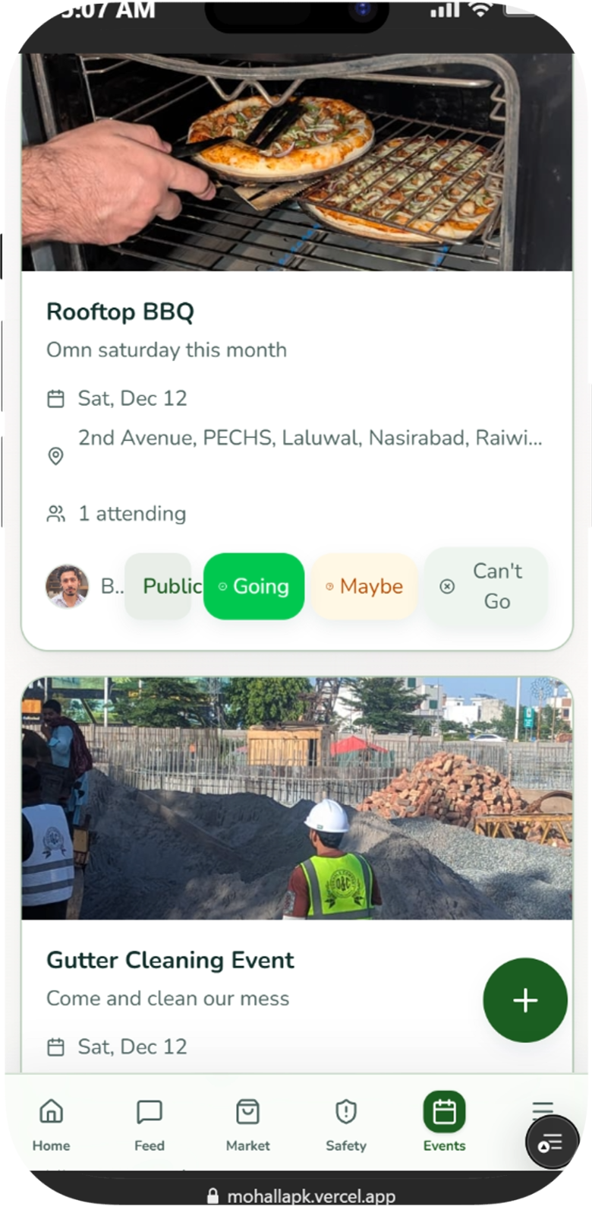
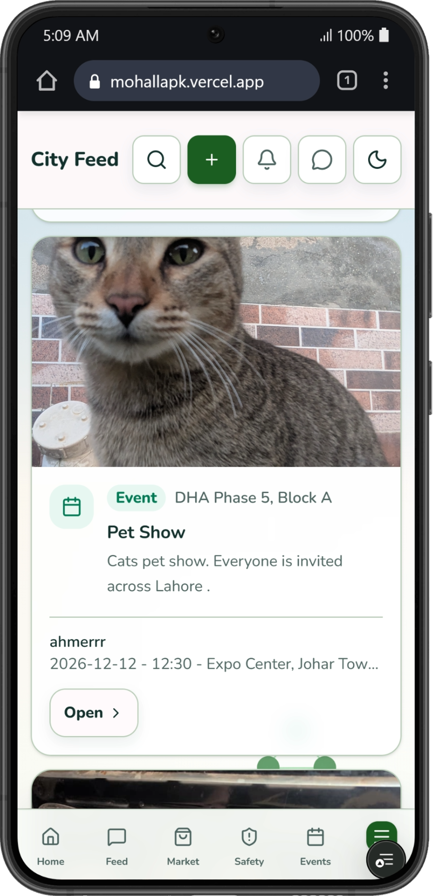
THE SOLUTION
One verified layer
for the entire
neighborhood.
Relevant local updates—not message overload.
Safety, events, commerce and conversations in context.
Admins keep control; residents gain everyday utility.
WORKING PRODUCT
CITY FEED
EVENTS
Screens from the current Mohalla product: Events and City Feed.
05
Notes:
Demonstrate that Mohalla is already a tangible product, not only a concept. The two screens show structured local events and a city feed inside the same resident experience.
Sources:
• Supplied Mohalla product screenshots; application audit, July 2026.

Slide 6
THE PRODUCT SYSTEM
Six everyday loops. One trusted identity.
01
Feed
02
Safety
03
Participate
Relevant local updates and city-level discovery.
Alerts, emergency contacts and push delivery.
Events, polls, announcements and volunteering.
04
Trade
05
Connect
06
Operate
Local marketplace, shops and service discovery.
Private messages and contextual notifications.
Approvals, roles, moderation and admin controls.
DAILY UTILITY FOR RESIDENTS • OPERATIONAL CONTROL FOR ADMINISTRATORS
Source: current Mohalla application routes and product audit, July 2026.
06
Notes:
Position the breadth as an integrated system of resident habits rather than a feature checklist. Every loop runs on the same verified identity and community context.

Slide 7
TRUST ARCHITECTURE
1
Resident verification
Trust is not a badge.
It is the product
architecture.
An admin validates who belongs.
2
Permissioned access
Pending users cannot see community data.
The network becomes valuable because access, context and accountability are designed in.
3
Moderated participation
Roles and controls keep behavior accountable.
PRIVATE BY COMMUNITY
ROLE-BASED
4
Targeted delivery
AUDITABLE
Safety and operational alerts reach the right people.
Source: current Mohalla verification, role, moderation and notification flows.
07
Notes:
Trust is the moat only if it is operational. Explain the verification gate, private community boundary, role-based administration, moderation, and targeted alerts.

Slide 8

VISION
A trusted digital layer for every neighborhood in Pakistan—where residents, administrators and local businesses coordinate daily life in real time.
MISSION
Help verified neighbors communicate, respond, trade and participate through one private, locally relevant platform.
PURPOSE • MAKE LOCAL LIFE WORK BETTER
Notes:
The vision is national infrastructure; the mission is concrete daily coordination. Keep the language human: people communicate, respond, trade and participate.

Slide 9
WHY NOW
The habit is already digital. The neighborhood layer is missing.
91%
81%
59.8%
cellular coverage
3G / 4G reach
broadband penetration
of Pakistan’s population
of Pakistan’s population
March 2025
The opportunity is not teaching people to use digital tools.
It is giving an existing digital habit trusted local context.
Source: Pakistan Economic Survey 2024–25, Information Technology & Telecommunication.
09
Notes:
Smartphone behavior and network access are already established. Mohalla can focus on trust, relevance and local utility instead of creating a new digital habit.
Sources:
• https://finance.gov.pk/survey/chapter_25/15_Information_Technology.pdf

Slide 10
MARKET POTENTIAL
Start with 15.0m urban households.
Win a dense, reachable wedge.
TAM
15.0m
All urban households
SAM
3.0m
Planning scenario: 20% initial reachable wedge
SOM
1.0m
Five-year household target
URBAN HOUSEHOLDS • MILLIONS
ASSUMPTION LAYER
SAM and SOM are planning assumptions—not current market share or forecasts.
TAM source: PBS Census 2023. SAM/SOM: illustrative Mohalla planning assumptions.
10
Notes:
Keep the sizing honest. TAM is the official urban household base. SAM is a 20% planning scenario for reachable gated and apartment communities; SOM is a five-year target. They are not current performance.
Sources:
• https://www.pbs.gov.pk/sites/default/files/population/2023/Pakistan.pdf

Slide 11
FOUR-SIDED VALUE
One network. Benefits across the neighborhood economy.
Residents
Society managers
Less noise. Faster answers. Safer response.
A single operating view for community life.
Relevant updates • Trusted local help • Private participation
Targeted notices • Resident approvals • Participation signals
Local businesses
Strategic partners
Discovery inside a trusted local market.
A consent-based path into local services.
Verified audience • Shorter response loops • Repeat neighborhood demand
Safety integrations • Service partnerships • City-cluster reach
BETTER COORDINATION BECOMES BETTER COMMUNITY EXPERIENCE
Benefit model based on current product capabilities and proposed ecosystem expansion.
11
Notes:
This is a B2B2C value proposition. Society leaders can buy or sponsor the operating layer, while resident engagement creates value for businesses and future partners.

Slide 12
COMPETITIVE LANDSCAPE
The wedge is verified resident utility—not generic admin software.
MOHALLA
Mohalla combines
VERIFIED LOCAL NETWORK →
Admin-only
software
01
Verified community identity
02
Daily resident utility
Chat groups
03
Admin operating controls
Open social
platforms
04
Local commerce + safety loops
The category is emerging. The question is who earns local trust and weekly habit first.
LOW
HIGH RESIDENT UTILITY →
Illustrative positioning from publicly described category offerings; not a feature-by-feature audit.
12
Notes:
Avoid framing competitors as proof of a crowded market. Their presence validates the category. Mohalla's strategic wedge is combining verified membership, resident engagement, and administrative control in one network.
Sources:
• https://www.manzhil.com/pakistan
• https://smartgate.pk/
• https://hsmp.pk/
• https://www.nizamco.com/
• https://kunji.pk/
• https://hamarisociety.pk/
• https://mysociety.pk/

Slide 13
BUSINESS MODEL
Monetization follows trust and density.
A staged B2B2C model protects the resident experience while expanding revenue per community.
1
Society subscription
Core administration, communication and premium workflow tiers.
FIRST
2
Local business services
Verified listings, promoted inventory and neighborhood discovery.
NEXT
3
Platform services
Payments and service partnerships when engagement thresholds are proven.
LATER
4
APIs + integrations
Developer, civic, emergency and ecosystem connections.
SCALE
TRUST RULE
Private resident data is never the product.
Proposed model. Current core product positioning and pricing require validation.
13
Notes:
Do not monetize too early. First prove resident habit and admin value. Then layer society tiers, local business services, and transaction or integration revenue without compromising private resident data.

Slide 14
GO-TO-MARKET
Win the neighborhood before winning the city.
01
02
03
04
05
Land
Verify
Seed
Prove
Expand
Admin champion
Households
Essential utility
Weekly habits
Adjacent societies
CITY-CLUSTER PLAYBOOK
Sell B2B. Activate B2C. Compound locally.
Islamabad / Rawalpindi
Lahore
Karachi
GTM framework informed by local network-effect expansion principles.
14
Notes:
Local network effects do not become national by launching everywhere at once. Win dense communities, prove a repeatable onboarding and retention loop, then expand through adjacent societies and city clusters.
Sources:
• https://www.nfx.com/post/marketplace-expansion-framework
• https://a16z.com/the-dynamics-of-network-effects/

Slide 15
GROWTH ENGINE
Density turns a useful app into a defensible network.
What should improve
with neighborhood density
Verified
residents
→
↑
TRUST
+
DENSITY
Weekly active resident rate
Organic invites
+ lower CAC
Relevant content
+ local supply
Response time to local needs
30-day retention
↓
Organic household invitations
Community-level unit economics
←
Faster response
+ retention
Atomic unit: one verified neighborhood/community.
15
Notes:
For a local network, density—not national download count—is the leading indicator. Measure organic acquisition, retention, response rates and unit economics at the community level.
Sources:
• https://a16z.com/16-ways-to-measure-network-effects/
• https://a16z.com/13-metrics-for-marketplace-companies/

Slide 16
PROJECTED GROWTH
An illustrative path to 2.5m verified residents.
Y1
30
communities • 10k residents
Y3
600
communities • 300k residents
Y5
4,000
communities • 2.5m residents
VERIFIED RESIDENTS • MILLIONS
ILLUSTRATIVE OPERATING SCENARIO
Targets for strategic planning—not current performance, a forecast or financial guidance.
Scenario assumptions: Y1 30 communities / 10k residents → Y5 4,000 / 2.5m.
16
Notes:
This is an operating scenario designed to test capacity, capital needs and milestone logic. It is deliberately not presented as current traction or a guaranteed forecast.

Slide 17
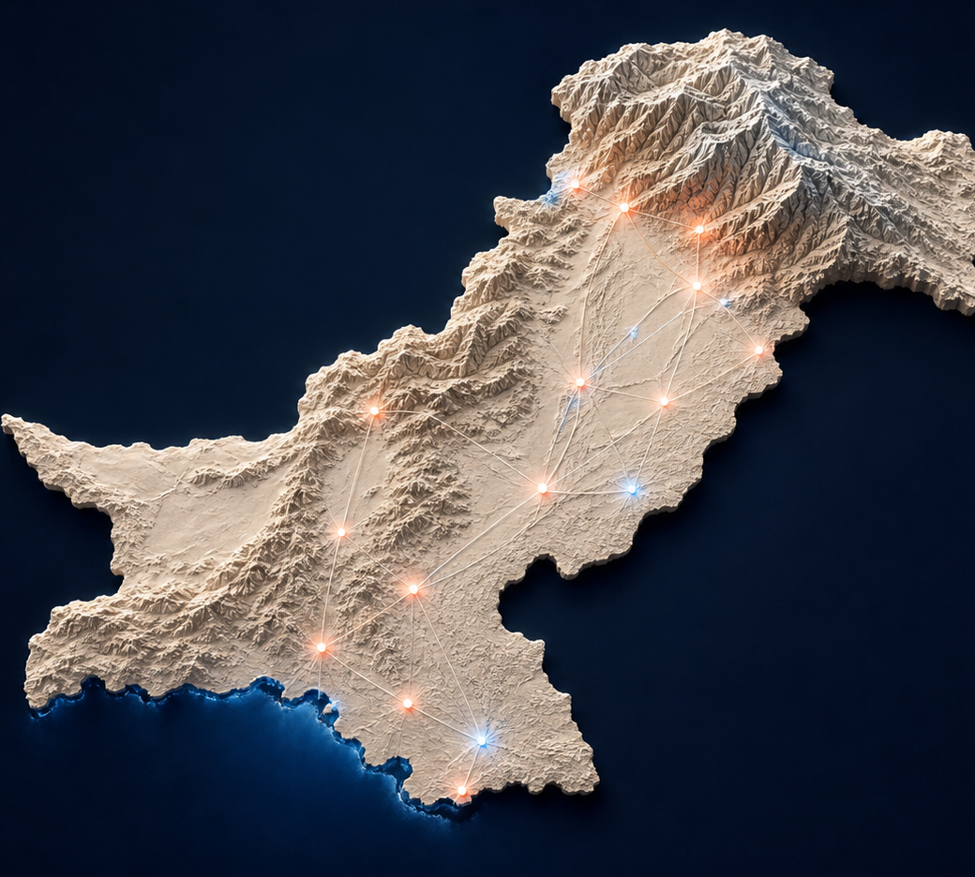
NATIONWIDE ROADMAP
Scale by city cluster,
not by national splash.
0–12m
Prove density
Islamabad/Rawalpindi, Lahore, Karachi • 30 communities
12–24m
Replicate
Seven-city playbook • 150 communities
24–36m
Regionalize
Local operations, Urdu/localization, partner integrations • 600 communities
36–60m
National platform
APIs and ecosystem partnerships • 4,000 communities
Roadmap and community counts are illustrative execution targets.
17
Notes:
The nationwide plan is a sequence of proven local markets. Each phase should unlock only after activation, retention and unit-economics gates are met in the previous cluster.
Sources:
• https://www.nfx.com/post/marketplace-expansion-framework

Slide 18
SWOT ANALYSIS
A strong wedge—with honest execution constraints.
S
Strengths
W
Weaknesses
• Pakistan-first resident experience
• Verified community graph
• Broad working product + installable PWA
• Cold-start in every neighborhood
• Monetization and CAC/LTV unproven
• Admin-champion dependence
O
Opportunities
T
Threats
• 15.0m urban households
• Local services and commerce
• Developer, civic, safety and payment partners
• Chat-platform inertia
• Emerging local software category
• Privacy/security and fragmented procurement
STRATEGIC IMPLICATION
Win on trust + weekly utility; scale only after the neighborhood unit is repeatable.
SWOT combines current product evidence, official market data and explicit planning risks.
18
Notes:
Investors expect candor. The strengths are product and positioning; the weaknesses are the unproven parts of the business. The strategic answer is disciplined local pilots, trust-and-safety hardening, and staged monetization.

Slide 19
SCALE GATES
Before nationwide scale, prove one repeatable neighborhood unit.
90-DAY PILOT SCORECARD
RISK → MITIGATION
≥65%
households activated
≥45%
30-day resident retention
Cold start
→
Admin-led onboarding + seeded essential utility
Trust incident
→
Least-privilege roles + moderation + audit
≥60%
new invitations organic
≥70%
weekly admin activity
Weak monetization
→
Delay paid layers until engagement gates
<5m
safety-alert delivery
<24h
marketplace first response
Fragmented procurement
→
Standardized pilot contract + proof pack
GATES, NOT VANITY METRICS
All pilot metrics are proposed targets for validation, not current performance.
19
Notes:
These are decision gates. The goal of a pilot is not downloads; it is household activation, retention, admin habit, organic invitations, fast safety delivery and useful marketplace response.

Slide 20
THE PARTNERSHIP CASE
ASK
Build the category with us.
One pilot. One cluster. A national network.
SOCIETY LEADERS
Nominate an admin champion, verify households, and measure the scorecard.
Run a 90-day pilot
STRATEGIC PARTNERS
Explore safety, local services, payments, developer or civic integrations.
Connect critical services
INVESTORS
Product hardening, trust & safety, city-cluster expansion and monetization experiments.
Fund the repeatable unit
PRIVATE RESIDENT TRUST REMAINS NON-NEGOTIABLE
Specific funding round, team and traction details are intentionally not invented.
20
Notes:
Tailor the ask to the room. Customers can sponsor pilots, partners can deepen service utility, and investors can fund the transition from a working product to a repeatable city-cluster model. Insert verified founder, traction, round-size and use-of-funds details before formal fundraising circulation.
Sources:
• Narrative structure informed by https://sequoiacap.com/article/writing-a-business-plan/

Slide 21

mohalla
The digital front door
to every neighborhood
in Pakistan.
Pilot • Partner • Invest
mohallapk.vercel.app
Your neighborhood, connected.
Notes:
Close on the human outcome: a trusted digital front door for daily neighborhood life. Invite the audience to choose the next action—pilot, partner or invest.

Slide 22
APPENDIX
Sources, methodology and claim boundary.
PRIMARY DATA
FRAMEWORKS + CATEGORY
Pakistan Bureau of Statistics
7th Population & Housing Census 2023
Pakistan Economic Survey 2024–25
Information Technology & Telecommunication
State Bank of Pakistan
Annual Payment Systems Review FY2024–25
UMT / Journal of Applied and Emerging Sciences
Community interaction research in Lahore
Sequoia: company-purpose and pitch narrative
a16z: local-network and marketplace metrics
NFX: city-cluster expansion logic
Pakistan category references:
Manzhil • SmartGate • HSMP • Nizam • Kunji • Hamari Society • MySociety
CLAIM BOUNDARY
Market census facts are sourced. SAM, SOM, growth and pilot metrics are explicitly illustrative. No users, revenue, funding or team credentials are claimed.
Full URLs and slide-specific citations are included in presenter notes.
22
Notes:
Full source list and methodology. Before external fundraising circulation, add verified founder biographies, current traction, revenue, burn, runway, round size and detailed use of funds.
Sources:
• https://www.pbs.gov.pk/sites/default/files/population/2023/Pakistan.pdf
• https://finance.gov.pk/survey/chapter_25/15_Information_Technology.pdf
• https://www.sbp.org.pk/PS/PDF/Annual-Payment-Systems-Review-FY25.pdf
• https://journals.umt.edu.pk/index.php/JAABE/article/view/4426
• https://sequoiacap.com/article/writing-a-business-plan/
• https://a16z.com/the-dynamics-of-network-effects/
• https://a16z.com/13-metrics-for-marketplace-companies/
• https://a16z.com/16-ways-to-measure-network-effects/
• https://www.nfx.com/post/marketplace-expansion-framework

