Slide 1
Classification of Products on Shelves
Ahmet Bağlan
Notes:
...today I’ll be talking to you about how we conduct machine learning experiments here at Sift.

Slide 2
Agenda
What we have done?
What’s New?
Bag Of Words
Bag Of Colors
Classification Algorithms
Our Questions!
Your Questions?
Notes:
I’ll start with the necessary background on Sift, and then touch on why this is such an important topic before diving into our experiences with this topic, where I’ll cover how we run experiments correctly, how we compare experiments correctly, and how we have built tools that ensure all experiments have this correctness baked in.

Slide 3

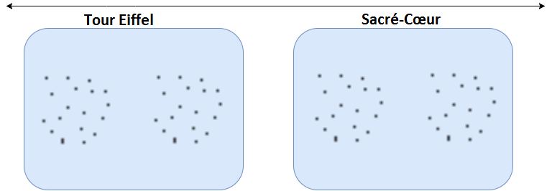
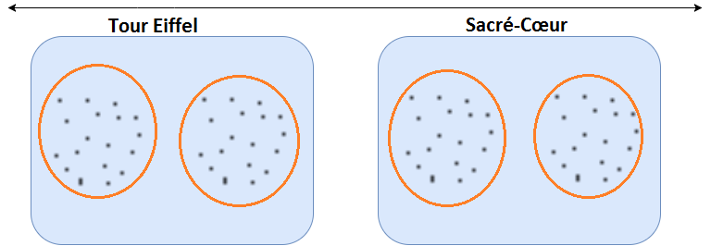
How we tried to take the first step? (Naive Method)
Training Pipeline
Paris just after feature extraction
Paris just after clustering
Notes:
Sample integration
Have another slide w/ workflows?

Slide 4

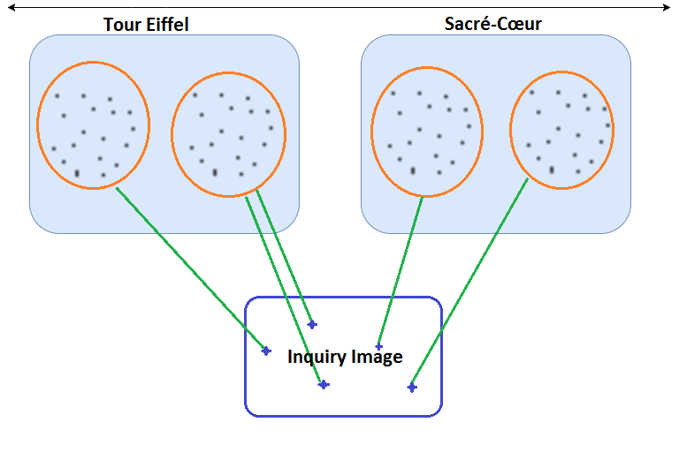
How we tried to take the first step? (Naive Method)
Prediction Pipeline
Paris
Notes:
Ok, so here is the motivation for the talk, starting with the basics:
We must conduct experiments to improve a machine learning system
We need our evaluation system to indicate experiments that help the system are good, and those that hurt the system are bad. You can think of your evaluation framework as a sort of meta loss function for your entire ML stack; you want changes to your system allowed by the evaluation framework to be minimizing error over time.
However, conducting these experiments without introducing bias is often very tricky. Getting this wrong can lead to wasted effort and in the worst case optimizing a system away from its ideal operating point. E.g. ignoring class skew and using precision/recall of the dominant class leads to the always positive classifier
Must run experiments
Experiments must be correct
Easy to get them wrong, which is why you should think about this

Slide 5

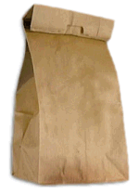
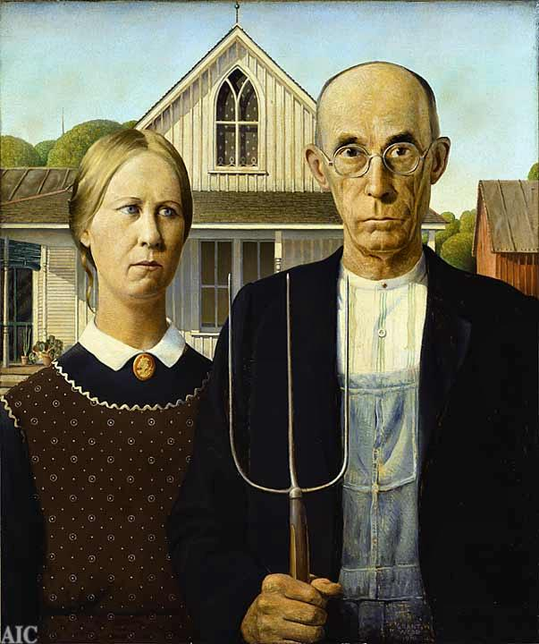














New Method: Bag Of Words
-The image is represented as a bag of details. Similar to representing a text as a sum of keywords.
Of all the sensory impressions proceeding to the brain, the visual experiences are the dominant ones. Our perception of the world around us is based essentially on the messages that reach the brain from our eyes. For a long time it was thought that the retinal image was transmitted point by point to visual centers in the brain; the cerebral cortex was a movie screen, so to speak, upon which the image in the eye was projected.
sensory, brain,
visual, perception,
retinal, cerebral cortex,
eye, cell, optical
nerve, image
Hubel, Wiesel
$$\sim$$

Slide 6
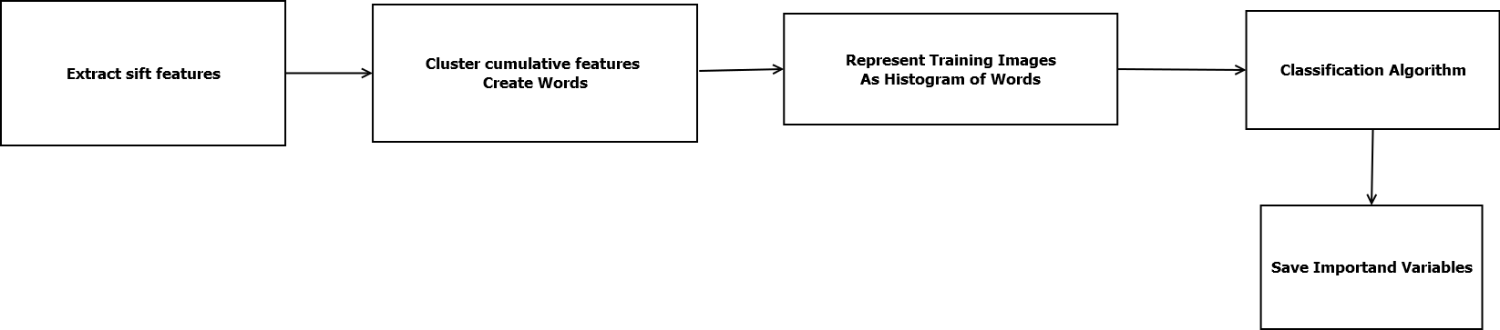
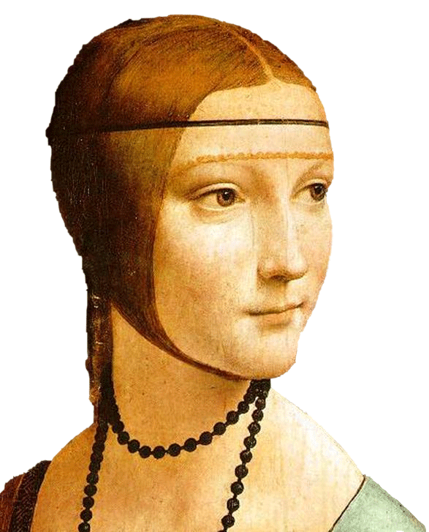
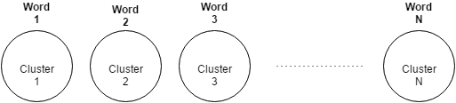
Training
Training Pipeline
w1 w2 w3 .. wN

Slide 7

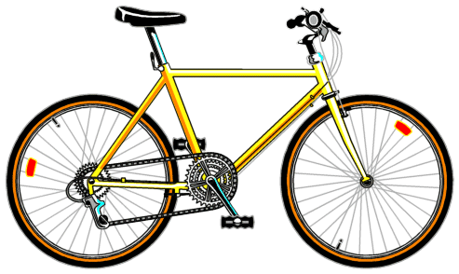
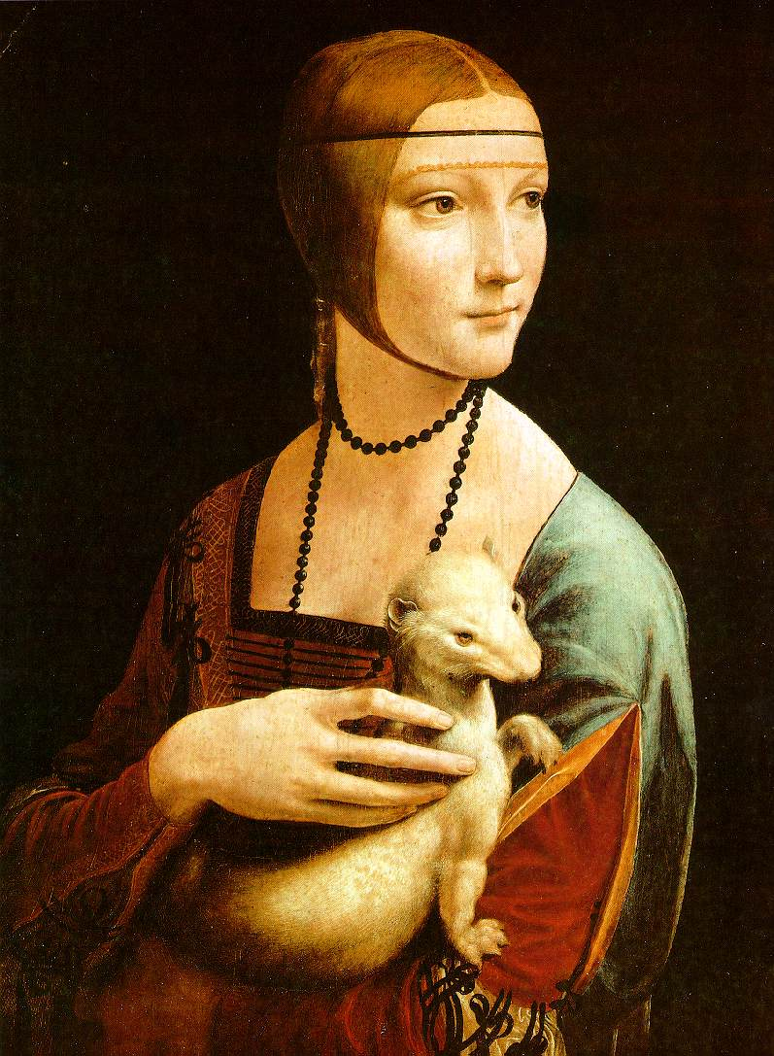
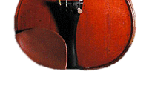
Prediction
- After representing the inquiry image as a bag of words, the classification estimation algorithm is run
Prediction Pipeline
Predict

Slide 8
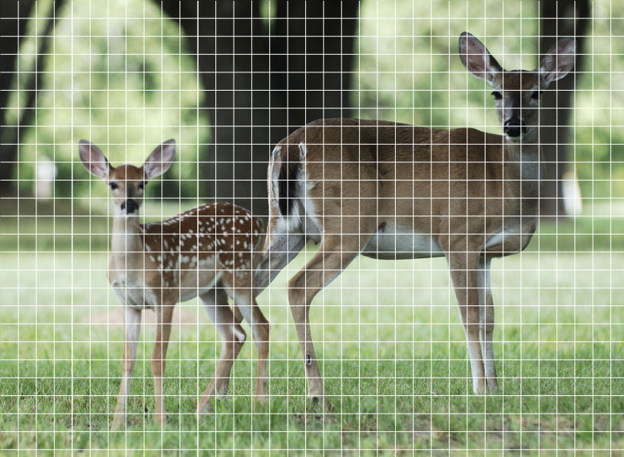
Bag of Colors
Take RGB Values of Pixels:
Uniformly
Randomly
Create a bag of colors

Slide 9
Classification Algorithms Used
Correlation
Logistic Regression
Support Vector Machine

Slide 10
Correlation
Create representative histogram for each of classes
Choose the class which gives maximum dot product
Inquiry Image
Class Representatives

Slide 11
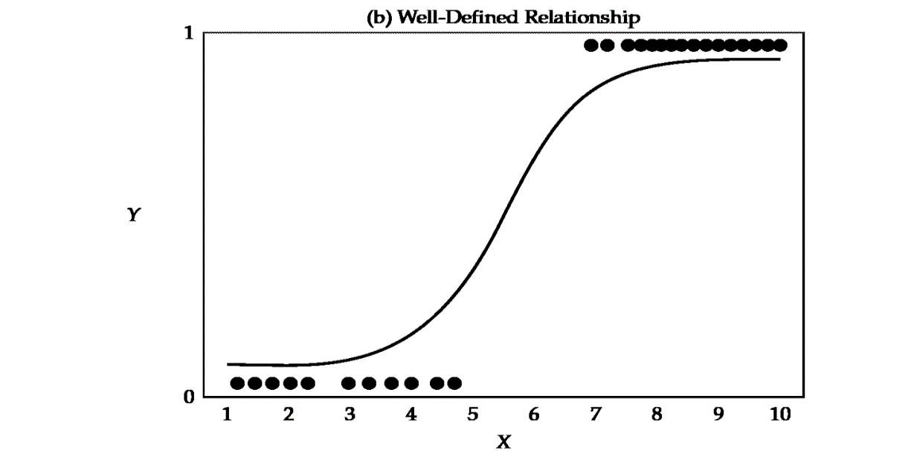
Logistic Regression
Y = Dependent Variables
ß˚ = Constant
ß₁ = Coefficient of variable X₁
X₁ = Independent Variables
E = Error Term

Slide 12
A Small Demo
Notes:
Ok, so we’ve said it’s important to get evaluation right. The first step along that path is running correct, representative experiments. Here’s how we do this at Sift.

Slide 13
Our Questions!
What to improve?

Slide 14
Questions?

