Slide 1
Sunum Akışı
01
Problem Statement
Berhan
2 dk
02
EDA & Pipeline
Turkey Hourly Electricity Consumption Forecast
3 dk
Furkan
03
Features & Models
Yusuf
2 dk
Decision Tree + AdaBoost · Short-Term Load Forecasting
04
Results
Tekgül
3 dk
05
Review & Demo
3 dk
Ahmet

Slide 2
01
Problem Statement
STLF · Regression · EPİAŞ data

Slide 3
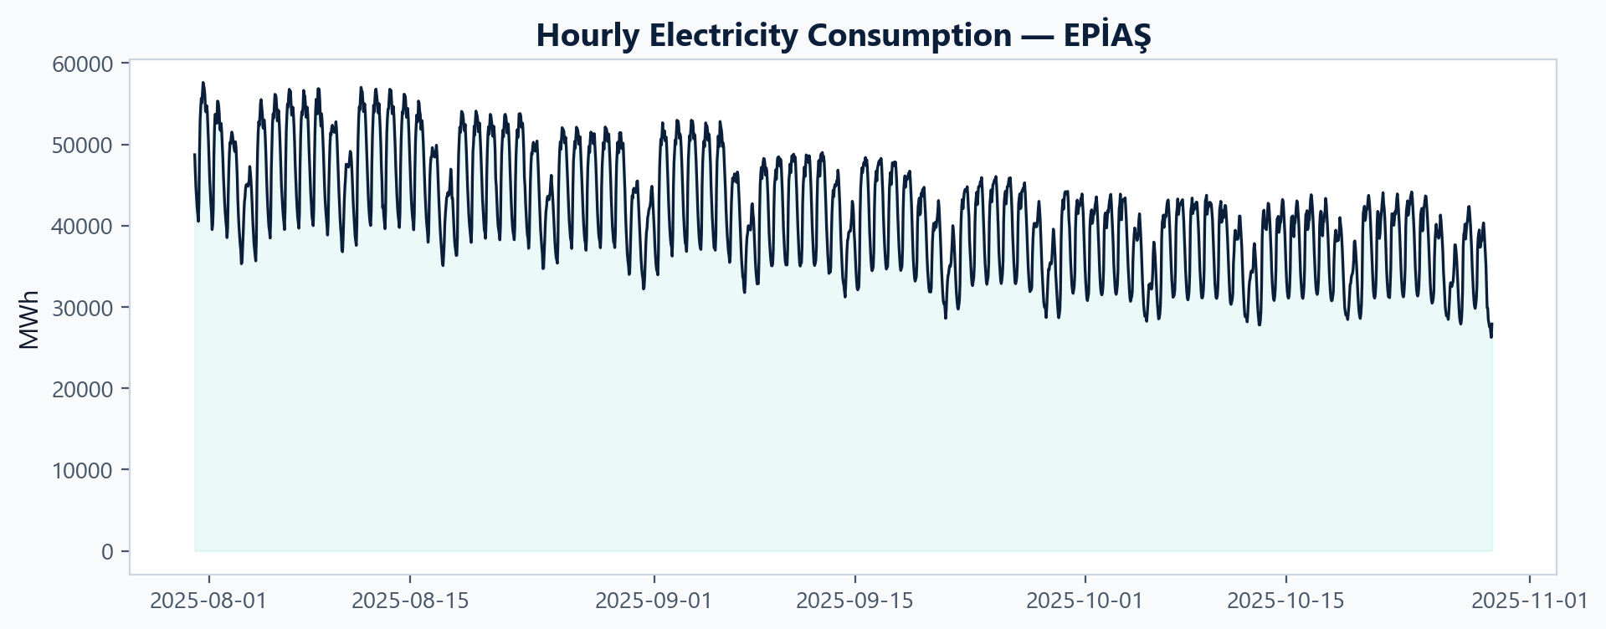
Problem & Motivation
G05 · MEE344
Saatlik elektrik tüketimi (MWh)
What is the problem?
We need to forecast hourly electricity consumption in Turkey (MWh) for the near future. Load is highly variable: it changes by hour, day of week, and season. Operators and markets must match supply to demand every hour; large forecast errors mean higher balancing costs, inefficient generation, and grid risk.
Formally, this is a regression task: predict consumption_mwh from past consumption and related inputs. We evaluate with RMSE, MAE, R² (and MAPE). Our data are real EPİAŞ records (production by source + consumption), not synthetic. Operational value — Better STLF supports unit commitment, renewable integration, and day-ahead / intraday decisions.
Scientific honesty — Use generation sources as exogenous features only; the target is consumption, so we avoid predicting production total and calling it “load” (no leakage).
Evidence — The time series (right) shows strong daily cycles and changing peaks; simple averages fail — we need models that learn weekly and hourly structure.
3 months of real hourly load (Jul–Oct 2025): strong daily cycles and week-to-week variation.
Clear day/night and weekday/weekend structure → motivates lag and cyclic time features.
Peaks often evening hours; troughs at night — STLF must track ramps, not only averages.
Motivation: better forecasts → lower imbalance cost and safer grid operations.
EPİAŞ STLF · Decision Tree + AdaBoost

Slide 4
02
EDA & Pipeline

Slide 5
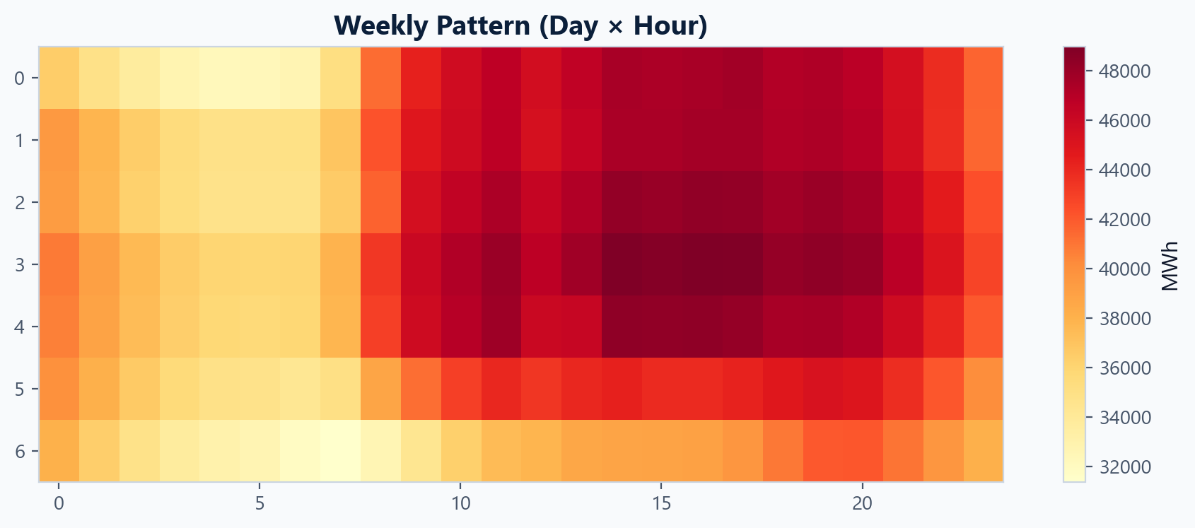
Dataset & EDA — Consumption Patterns
G05 · MEE344
31.07.2025 – 29.10.2025
What do we learn from EDA?
Load is strongly periodic: high during daytime weekdays, lower nights and weekends.
Evening peaks and morning ramps repeat every day → motivates hour cycle + lag_1h / lag_24h / lag_168h.
Week × hour structure is stable in the heatmap → weekly seasonality is a core signal.
The series shows gradual level change across months → models must generalize on a short but real window, not one flat average.
Source: EPİAŞ Transparency Platform — real-time production by source + hourly consumption (MWh).
Window: 31.07.2025 – 29.10.2025 (~3 months), hourly granularity.
Target: consumption_mwh · 16 generation columns used as exogenous inputs (not as the prediction target).
Split: 1,665 h train · 336 h test (last ~14 days, time-ordered hold-out).
EPİAŞ STLF · Decision Tree + AdaBoost

Slide 6
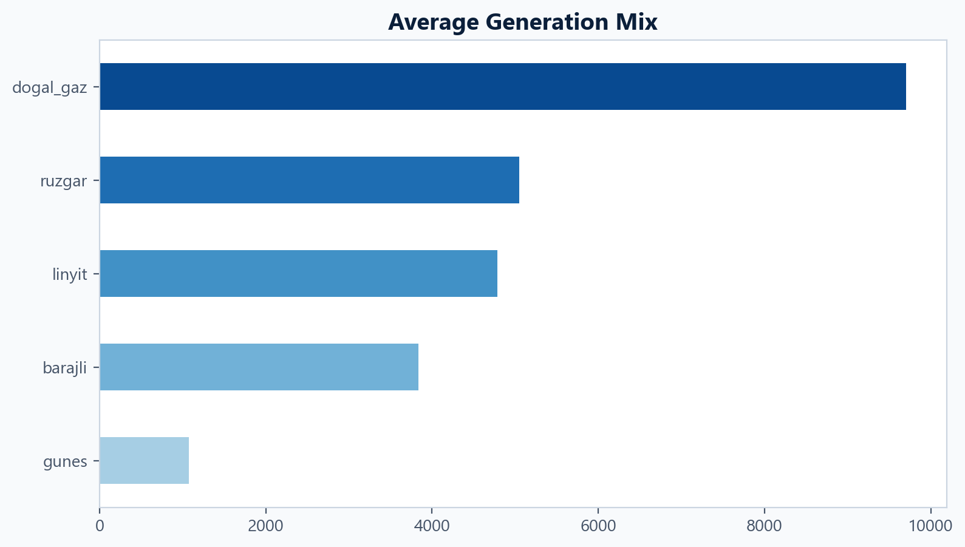
EDA — Production Mix
G05 · MEE344
Fossil Fuels vs. Renewable Energy
What do we see?
Natural gas & coal (lignite) dominate the average mix — flexible fossil backbone.
Solar rises at midday — low at night, visible daytime bump in hourly data.
Wind is variable — meaningful on average but unstable hour-to-hour.
Gas ~10k MWh (avg) leads; wind & lignite ~5k; hydro ~4k; solar ~1k on average but timing-critical.
Thermal-heavy system → load forecasting still driven mainly by consumption history, but mix adds real-world context.
Renewables introduce ramps (solar noon, wind gusts) — supports using hourly exogenous + tree models.
We do not predict production total — only demand, with generation columns as inputs (no target leakage).
EPİAŞ STLF · Decision Tree + AdaBoost

Slide 7
03
Features & Models

Slide 8
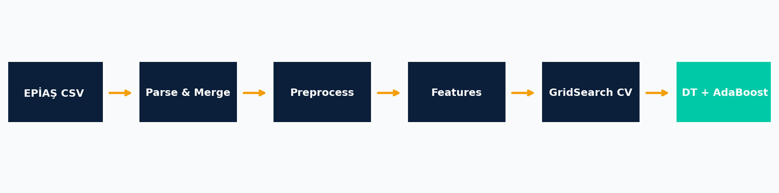
Data Pipeline
G05 · MEE344
End-to-end reproducible
Reproducible: random_state=42 · time-ordered split (no shuffle).
Time-aware CV: TimeSeriesSplit(5) — past trains, future validates; no leakage.
Locale: Turkish decimal/date parsing handled in code.
Output: models/*.joblib, reports/metrics.json, figures, slides.
Why it matters: One pipeline → easy to defend, re-run, and demo (local + Vercel).
Step | Meaning
EPİAŞ CSV | Real-time production + consumption export
Parse & Merge | Turkish locale, timestamps, hourly alignment
Preprocess | Reindex, outliers (3×IQR), train/test split
Features | 26 cols: cyclic, lags, rolling, exogenous
GridSearch CV | TimeSeriesSplit(5), tune hyperparameters
DT + AdaBoost | Fit both models, save joblib + reports
EPİAŞ STLF · Decision Tree + AdaBoost

Slide 9
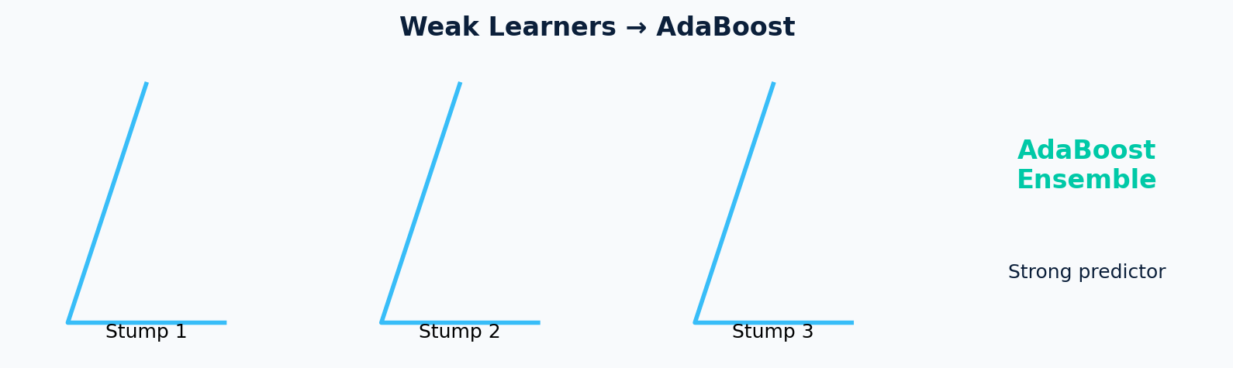
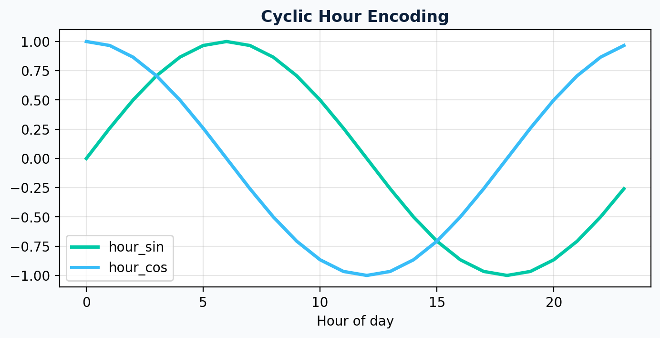
Modeling
G05 · MEE344
Decision Tree + AdaBoost
What is our modeling approach?
G05 allocation: Two regressors on the same 26 features — no neural nets / XGBoost.
Decision Tree: Single non-linear, interpretable baseline (splits, feature importance).
AdaBoost: 200 shallow stumps (weak learners), square loss — each stump corrects previous errors → strong ensemble.
Validation: TimeSeriesSplit (5-fold) + grid search; hold-out last 336 h for final metrics.
Decision Tree | AdaBoost
Easy to explain to the jury | Higher accuracy
Shows baseline with same data | Combines many small trees
CV RMSE ~1,473 MWh | CV RMSE ~1,079 MWh
EPİAŞ STLF · Decision Tree + AdaBoost

Slide 10
04
Results

Slide 11
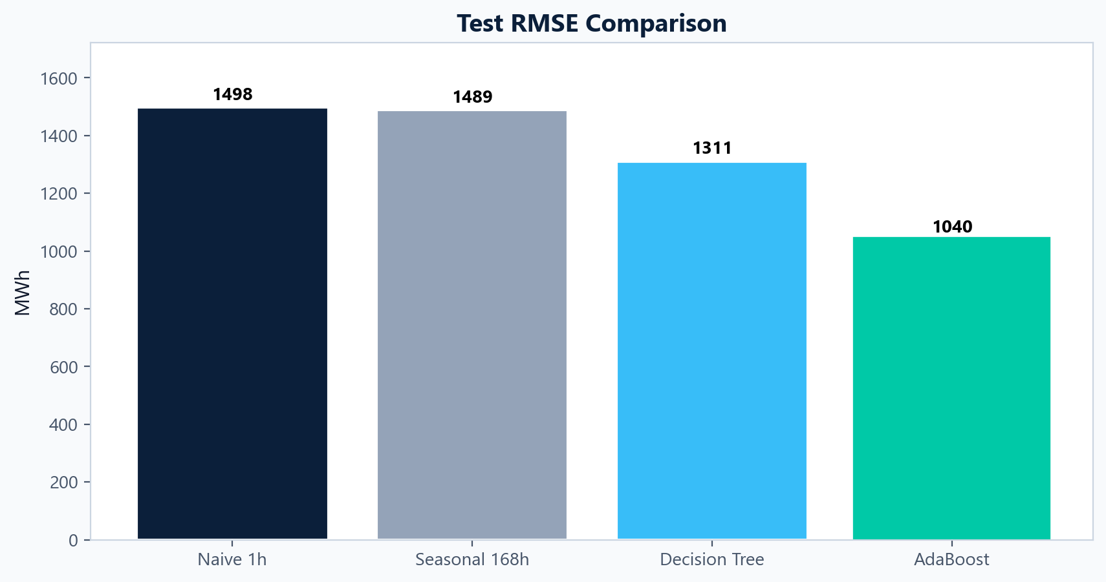
Model Karşılaştırması
G05 · MEE344
Test seti performansı
AdaBoost RMSE
AdaBoost R²
DT RMSE
MAPE
1040
0.951
1311
1.67%
MWh
test
MWh
AdaBoost
EPİAŞ STLF · Decision Tree + AdaBoost

Slide 12
Detaylı Metrik Tablosu
G05 · MEE344
Hold-out test · 336 saat
Model
RMSE
MAE
R²
MAPE
Naive 1h
1498
1162
0.899
3.19%
Seasonal 168h
1489
888
0.900
2.49%
Decision Tree
1311
833
0.923
2.38%
AdaBoost
1040
596
0.951
1.67%
Test setup: Last 336 hours (~14 days) held out; models trained only on earlier data.
Baselines: Naive 1h and Seasonal 168h ~RMSE 1,490 MWh, R² ~0.90 — simple lag rules.
Decision Tree: RMSE 1,311 MWh, R² 0.923 — clear gain over baselines.
AdaBoost : RMSE 1,040 MWh, MAE 596 MWh, R² 0.951, MAPE 1.67% — lowest error on all metrics.
vs DT: ~21% lower RMSE; ~28% lower MAE.
Message: Boosting improves the same feature set; AdaBoost is our final model.
EPİAŞ STLF · Decision Tree + AdaBoost

Slide 13
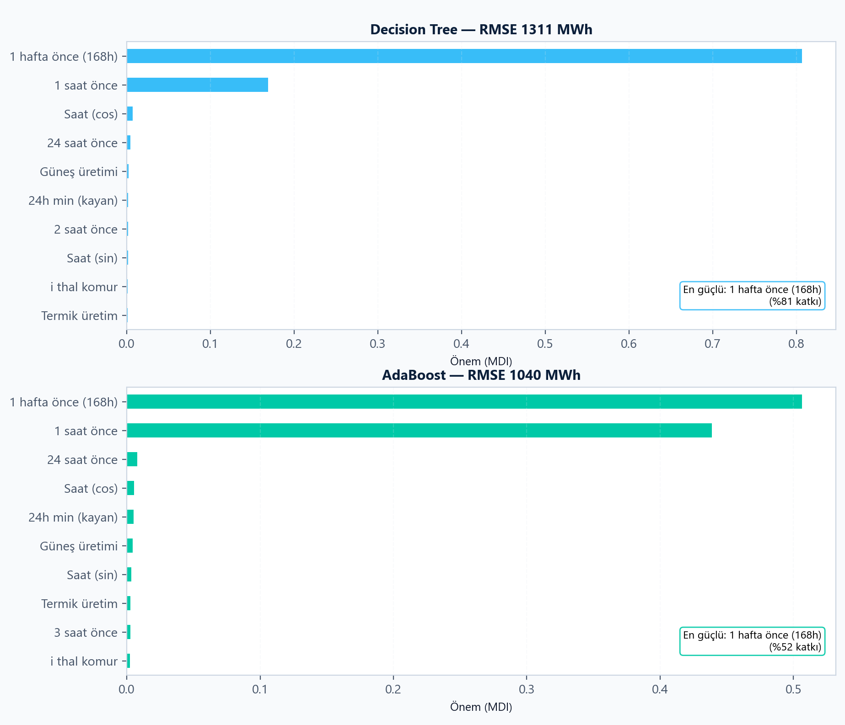
Decision Tree & AdaBoost
G05 · MEE344
Test RMSE DT 1311 MWh · AdaBoost 1040 MWh
Decision Tree: Mostly lag_168h (~81%) — same hour last week; lag_1h (~17%) second. Simple, interpretable baseline.
AdaBoost: lag_168h (~51%) + lag_1h (~44%) — weekly + hourly lags together.
Result: RMSE 1,311 → 1,040 MWh, R² 0.923 → 0.951, MAPE 1.67%.
Takeaway: Same features; boosting uses both lags → better peaks, lower error.
Solar / time features: small MDI; history drives the forecast.
EPİAŞ STLF · Decision Tree + AdaBoost

Slide 14
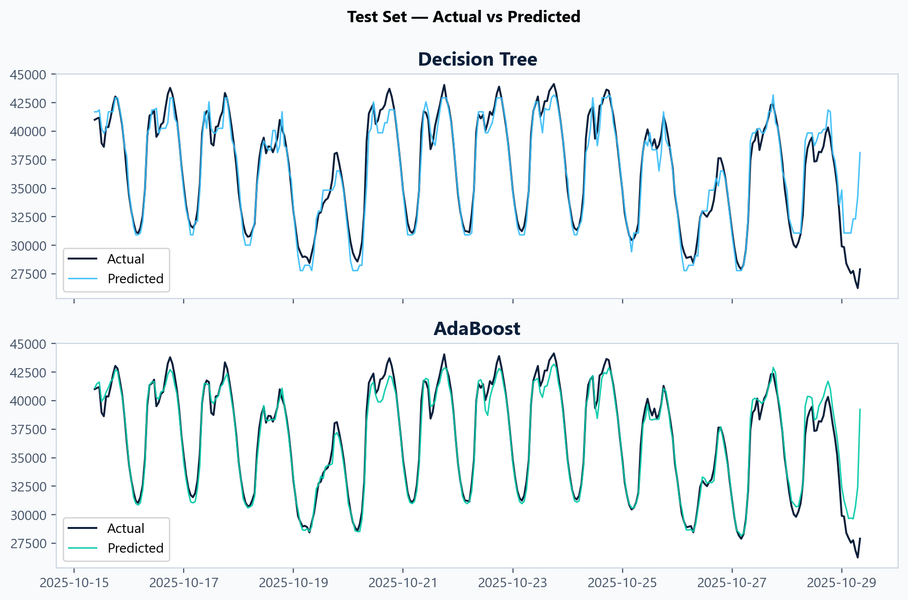
Quality
G05 · MEE344
14 days hold-out
What this shows: Last 14 days of the test set — actual hourly load (gray) vs model forecast (blue / teal).
Decision Tree (top): Tracks daily cycles (morning ramp, evening peak) well; some peak overshoot and error at the end of the window (e.g. Oct 29 drop).
AdaBoost (bottom): Closer fit on peaks and dips; same weekly pattern, smaller gap to actual — matches lower RMSE in the table.
Pattern: Both capture weekday rhythm; hardest points = steep ramps and sharp drops (holidays / end-of-series).
Takeaway: Visual proof that boosting refines the same lags — not a different dataset, better tracking on hold-out.
What are we looking at?
Not the forecast target — how electricity is produced in the same EPİAŞ window. We use these series as exogenous features for consumption forecasting (G05: Decision Tree + AdaBoost). The mix explains when the system is thermal-heavy vs. renewable-heavy.
EPİAŞ STLF · Decision Tree + AdaBoost

Slide 15
05
Review & Demo
Importance · Web

Slide 16
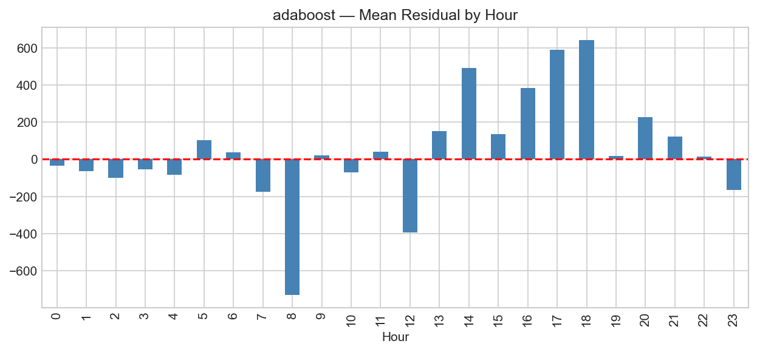
Interpretation & Error
G05 · MEE344
Feature importance · residual
Test RMSE Comparison
Naive / seasonal ~1,490 MWh — simple lag baselines.
Decision Tree 1,311 — clear improvement.
AdaBoost 1,040 — ~21% lower RMSE than DT; our final model.
AdaBoost — Mean residual by hour
Under-predicts (~08:00, ~12:00): morning ramp / midday — actual load higher than forecast.
Over-predicts (~14:00–18:00): afternoon–evening peak — forecast too high.
Near zero (night 00–04, 22–23): stable low load — easiest hours.
Implication: Add hour-specific features or tune peaks; not random noise.
EPİAŞ STLF · Decision Tree + AdaBoost

Slide 17

Live Forecast — Web Demo
G05 · MEE344
FastAPI · ML in the browser
You can scan the QR code to experience the live site for yourself
https://github.com/ahmetbtopcu/mee344-g05-stlf
EPİAŞ STLF · Decision Tree + AdaBoost

Slide 18
Thank you
Do you have any questions?
Berhan Kaya Ahmet Bayram Topçu Yusuf Duman Furkan Efe Demirbel Tekgül Eroğlu
github.com · mee344-g05-stlf

