Slide 1
Quantum Natural
Language Processing
Sentence Classification
Ahmet Buğra Ertürk · PHYS 450 Quantum Computing · Spring 2026 · Koç University

Slide 2
INTRODUCTION
Motivation & Hypothesis
The Problem
Task Definition
Classical NLP (LSTMs, Transformers) learns compositionality from data — it is never structurally enforced.
As vocabulary N and rule count M grow, any classical model requires latent dimension d ≥ 2M log N to avoid catastrophic interference (Srikumar, 2025 — Theorem 1).
This is a hard mathematical lower bound. With scarce data, the model learns spurious correlations instead.
Input:
Tokenized strings (text or musical sequences)
Output:
P(y=1|S) ∈ [0,1] — binary classification
Dataset 1:
Synthetic: Adj+Noun+Verb grammar
Hypothesis
Dataset 2:
SST-2: Stanford Sentiment Treebank
QNLP models using the DisCoCat framework will exhibit superior compositional generalization vs classical LSTMs, especially in low-data regimes, due to the native tensor product structure of Hilbert space.
Dataset 3:
Bach: Major / Minor key chorales
Baseline:
LSTM vs QNLP (DisCoCat / IQP)
Metric:
F1, Accuracy, Overfit Gap

Slide 3
METHODOLOGY — CLASSICAL ALGORITHM
Classical Baseline: LSTM Network
Architecture & Equations
Implementation Details
Forget gate
fₜ = σ(Wf · [hₜ₋₁, xₜ] + bf)
Embed dim:
16
Input gate
iₜ = σ(Wi · [hₜ₋₁, xₜ] + bi)
Hidden dim:
32
Candidate
C̃ₜ = tanh(WC · [hₜ₋₁, xₜ] + bC)
Dropout:
0.5 on embeddings
Cell state
Cₜ = fₜ ⊙ Cₜ₋₁ + iₜ ⊙ C̃ₜ
Optimizer:
Adam, lr=0.01
Output gate
oₜ = σ(Wo · [hₜ₋₁, xₜ] + bo)
Regularization:
L2 weight decay 10⁻⁴
Hidden state
hₜ = oₜ ⊙ tanh(Cₜ)
Batch size:
16
Classification
P(y=1|S) = σ(W·h_{t} + b)
Loss:
Binary Cross-Entropy
Checkpointing:
Best validation epoch
Complexity: O(|V|·dₑ + dₕ²) — grows polynomially as vocabulary and grammar expand. Catastrophic interference is mathematically unavoidable.

Slide 4
METHODOLOGY — QUANTUM ALGORITHM
Quantum Algorithm: DisCoCat Framework
Raw
Sentence
cups_reader
diagram
IQP Ansatz
(lambeq)
PennyLane
Model
P(y=1|S)
→
→
→
→
pregroup grammar
H · Rz · H + CNOT
prob=True
BCE loss
Core Mathematical Relationships
Pregroup contraction
n · (nʳ·s·nˡ) · n ≤ s
sentence type validity
Functor
F : Preg → FHilb (nouns → qubits, cups → Bell measurements)
Quantum state
|ψ(S)⟩ = U(θq)|0⟩^⊗n where U(θq) encodes the parse tree
Classification
P(y=1|S) = |⟨1|ψS(θq)⟩|²
measured on sentence wire
Word embedding
|ψwᵢ(θwᵢ)⟩ = H · Rz(θwᵢ) · H |0⟩
IQP ansatz per word
Design: IQP ansatz · 1 qubit/type · n_layers={1, 2} · Adam lr=0.1 · L2=10⁻⁴ · Qubits = 2k+1 per k-token sentence · 7–27 trainable params

Slide 5
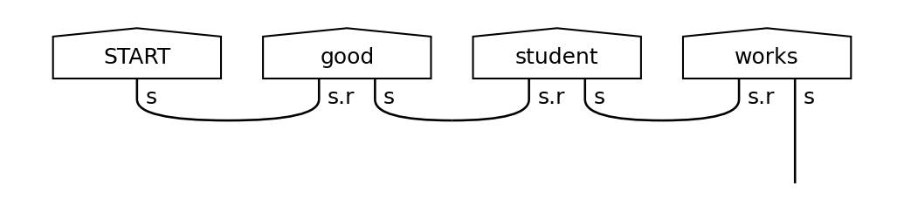
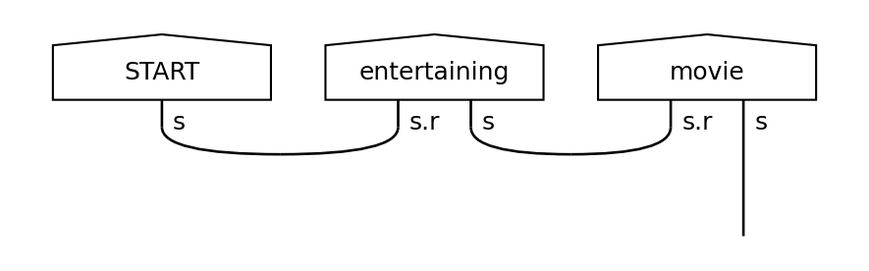
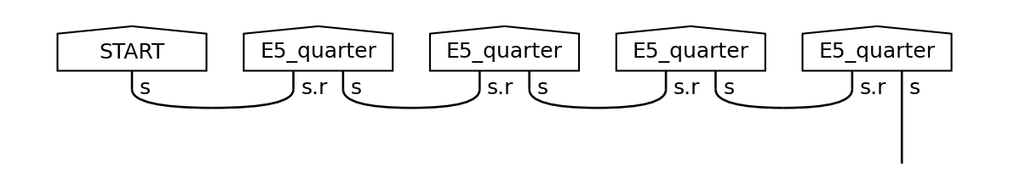
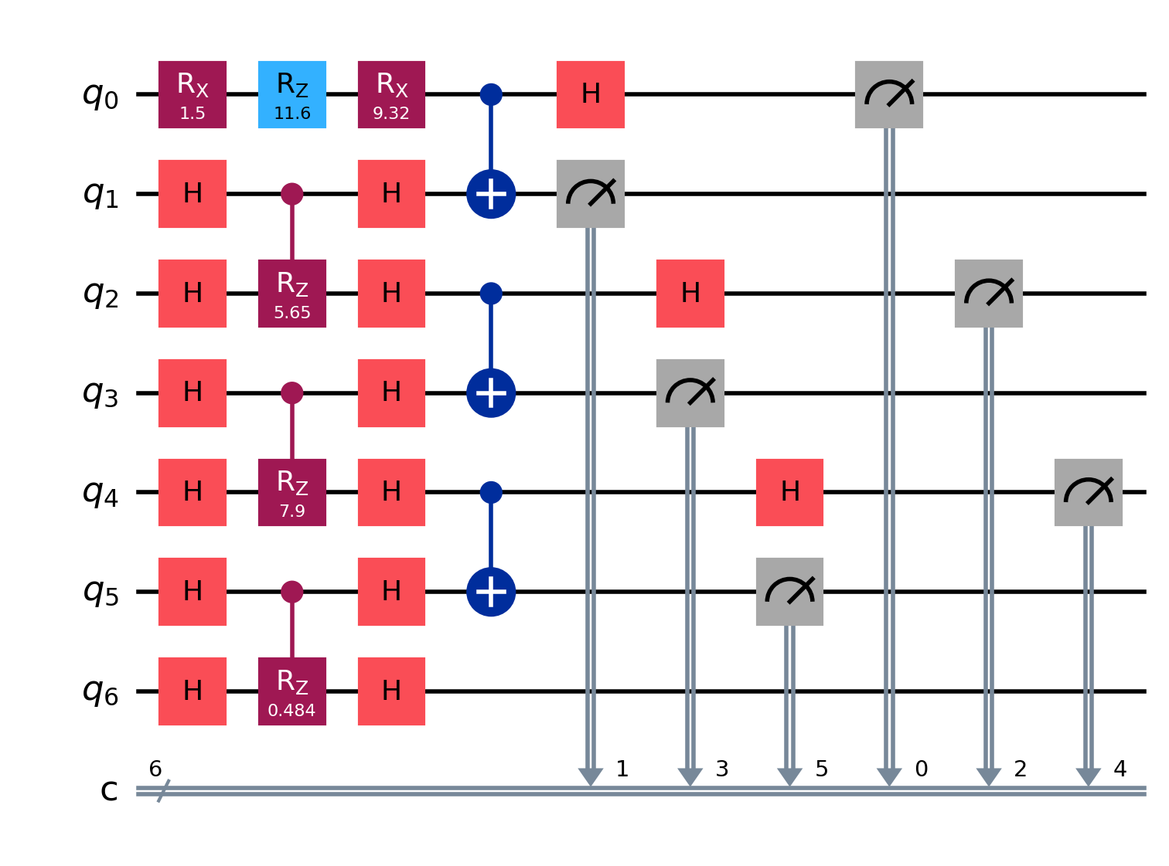
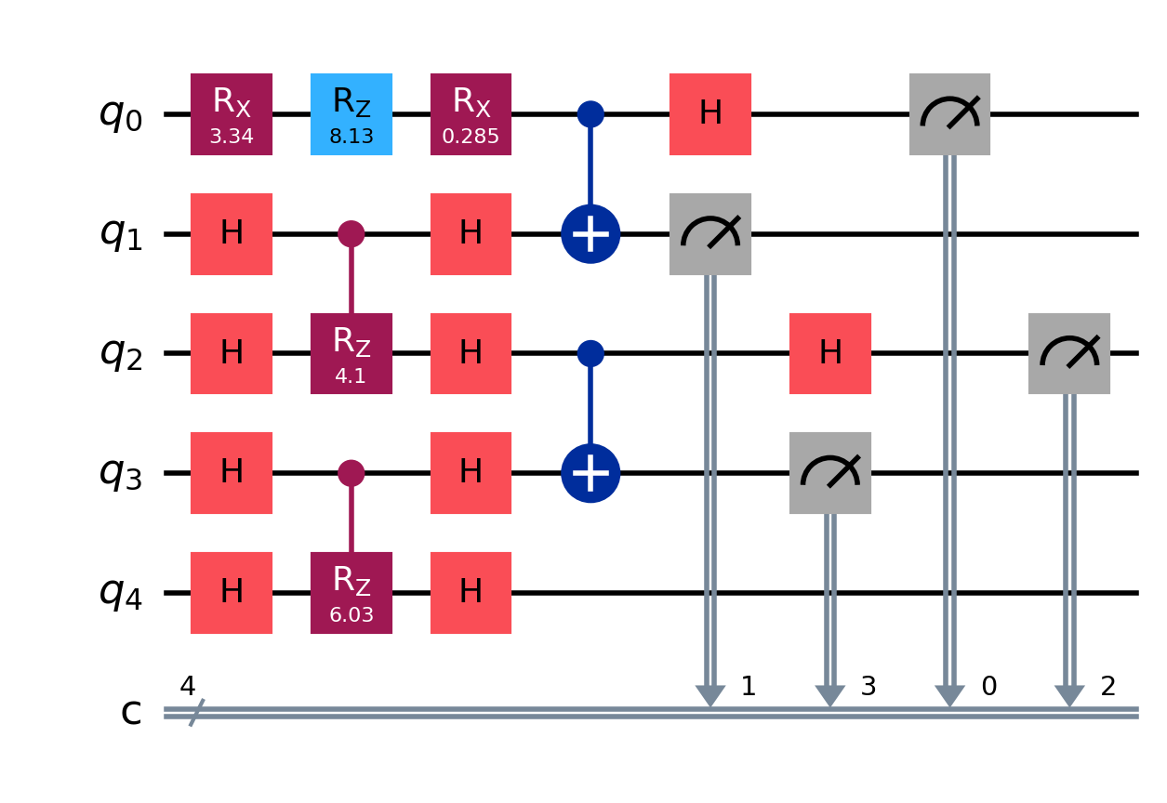
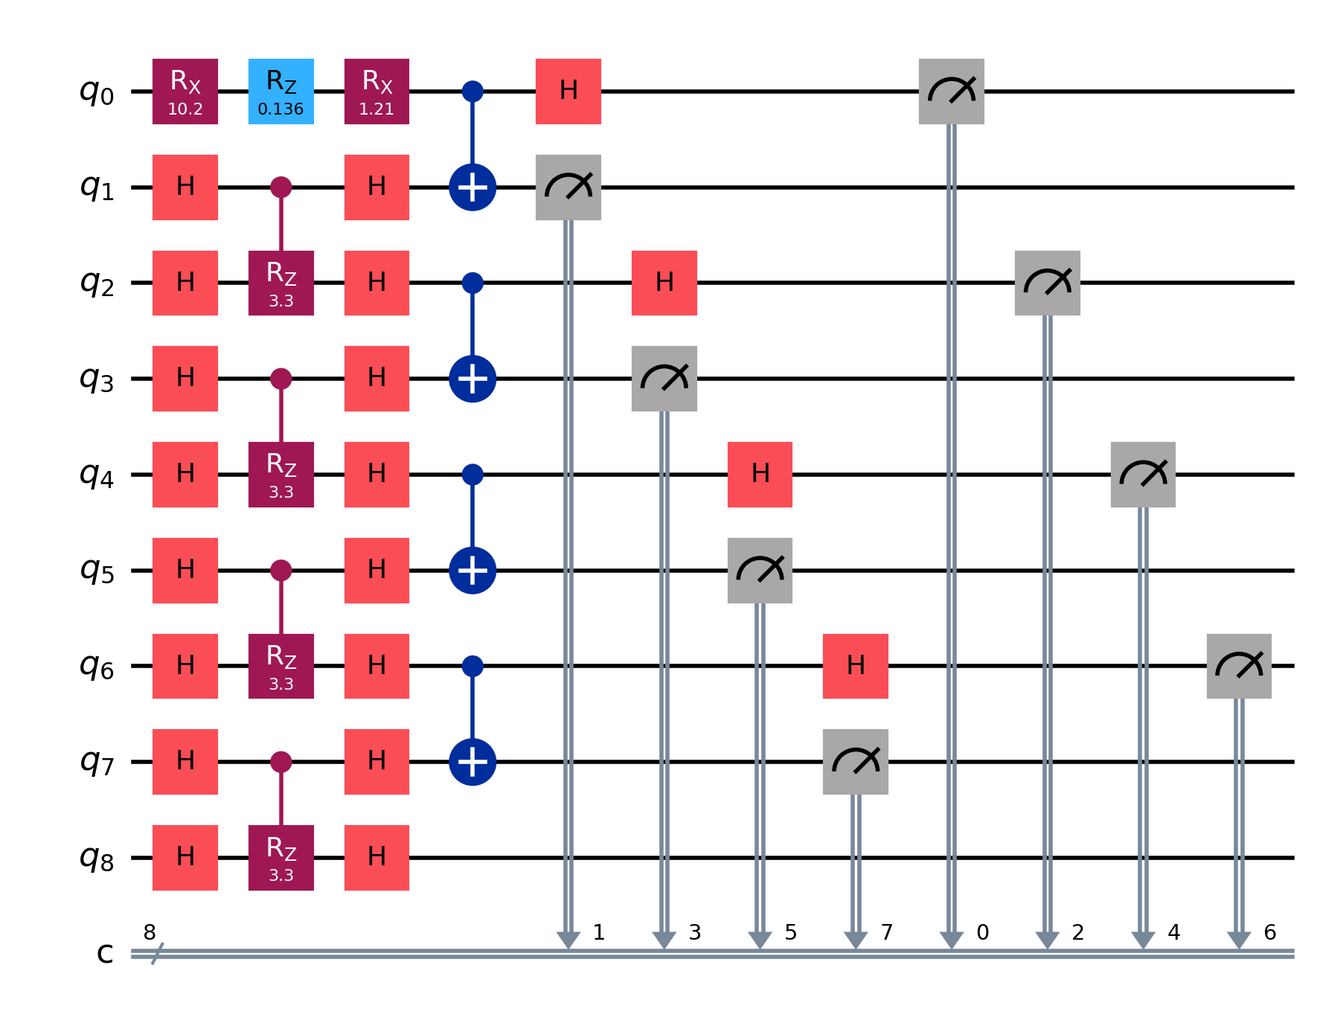
METHODOLOGY — QUANTUM ALGORITHM
Circuit Structure Across All Three Datasets
Each dataset produces a structurally different circuit. Qubit count = 2k+1 for k tokens. Odd qubits = cup wires (measured immediately). Even qubits = word wires (trainable Rz).
Synthetic — "good student works"
SST-2 — "entertaining movie"
Bach — "E5_quarter × 4"
(label = 1)
(label = 1)
(Minor, label = 0)
String diagram
String diagram
String diagram
7 qubits (2×3+1) · 6 trainable Rz
5 qubits (2×2+1) · 5 trainable Rz
9 qubits (2×4+1) · 7 trainable Rz

Slide 6
METHODOLOGY — DATASETS
Datasets & Experimental Setup
Synthetic Grammar
SST-2 (Stanford Sentiment Treebank)
Bach Chorales ★ (Primary Evidence)
Structure:
Adj + Noun + Verb grammar
Source:
Movie review parse trees
Source:
J.S. Bach via music21 library
Size:
160 unique sentences total
Filter:
≤5 tokens (density matrix limit)
Encoding:
Pitch+duration → NLP string tokens
Labels:
Positive adj → 1, Negative adj → 0
Type:
Sub-phrases dominate
Labels:
Major key → 1, Minor key → 0
Valid range:
N=10 only (no train/test overlap)
Labels:
Positive / Negative sentiment
Transposition:
Unified to C Major / A Minor
Role:
Sanity check + variance test
Role:
Real-world unstructured text
Role:
Deterministic Baroque rules test
Grid search: N_train ∈ {10, 50, 100, 250, 500} · N_val = 50 · N_test = 100 · 3 seeds {42, 100, 2026} · Results reported as mean ± std

Slide 7
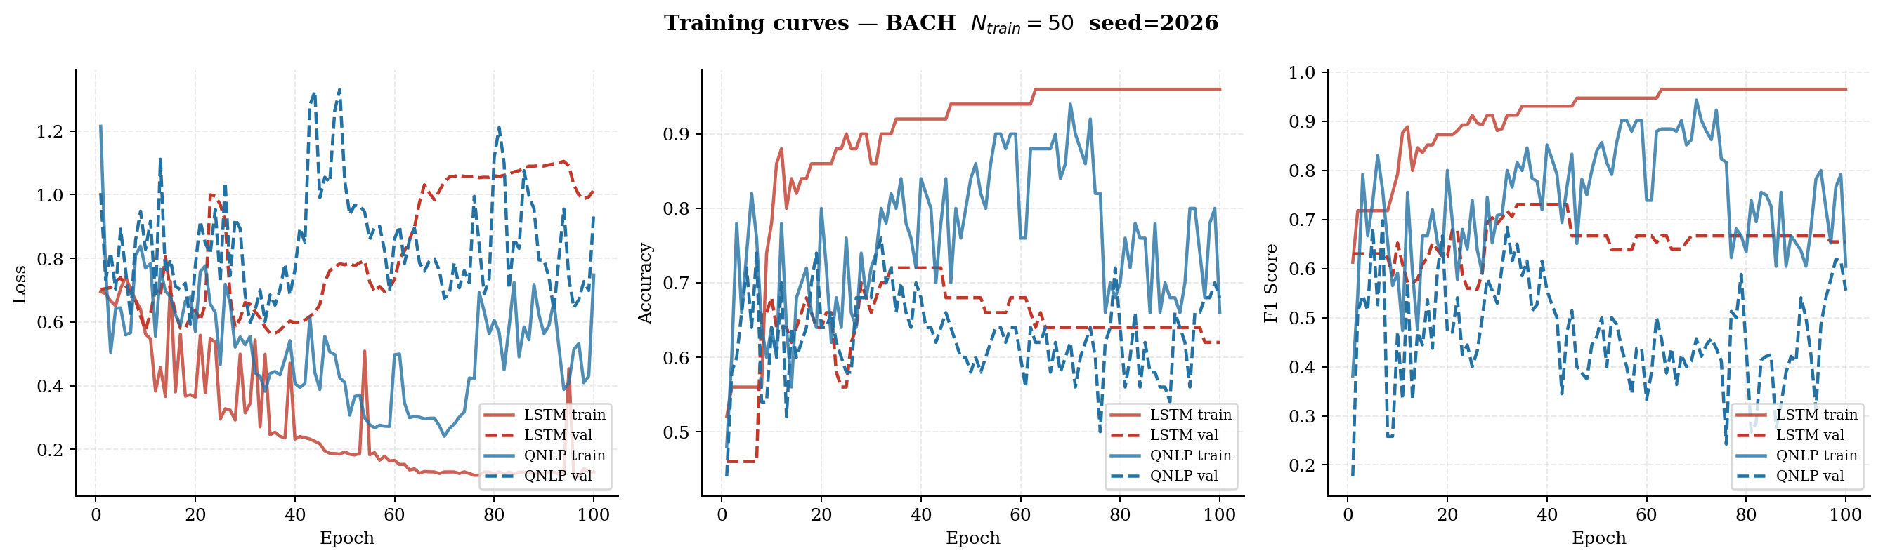
RESULTS — BACH CHORALES
Bach Chorales — Primary Evidence
0.665
0.503
−0.027
+0.128
QNLP Test F1 @ N=50
LSTM Test F1 @ N=50
(below random (0.555)!)
QNLP Overfit Gap
negative = generalizes!
LSTM Overfit Gap
positive = overfitting
seed=2026 · LSTM val loss diverges (overfitting) while QNLP train & val losses remain in same range — correct inductive bias

Slide 8
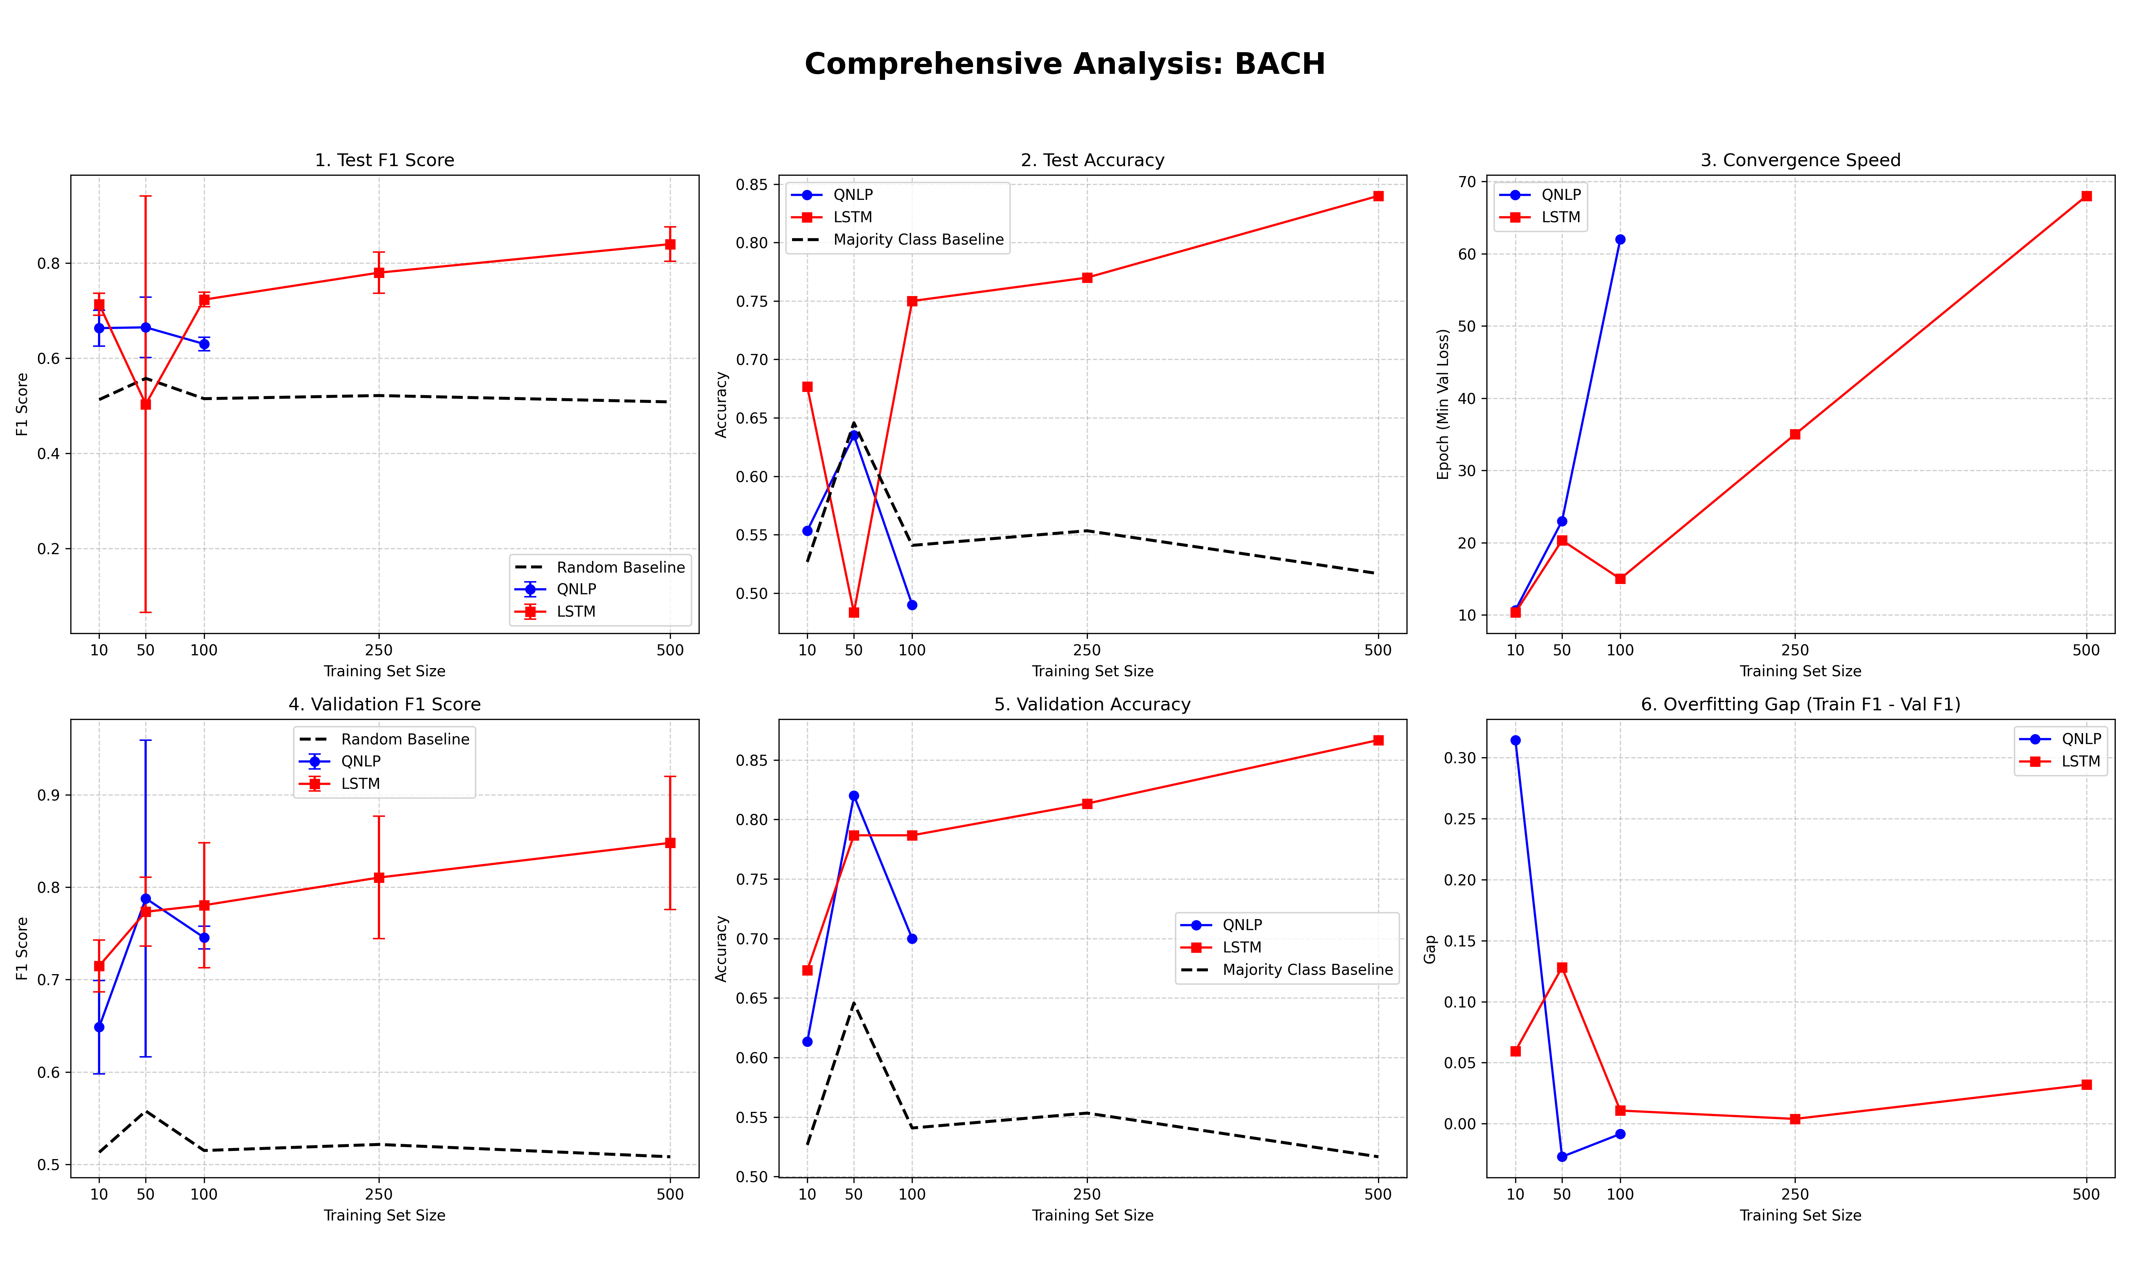
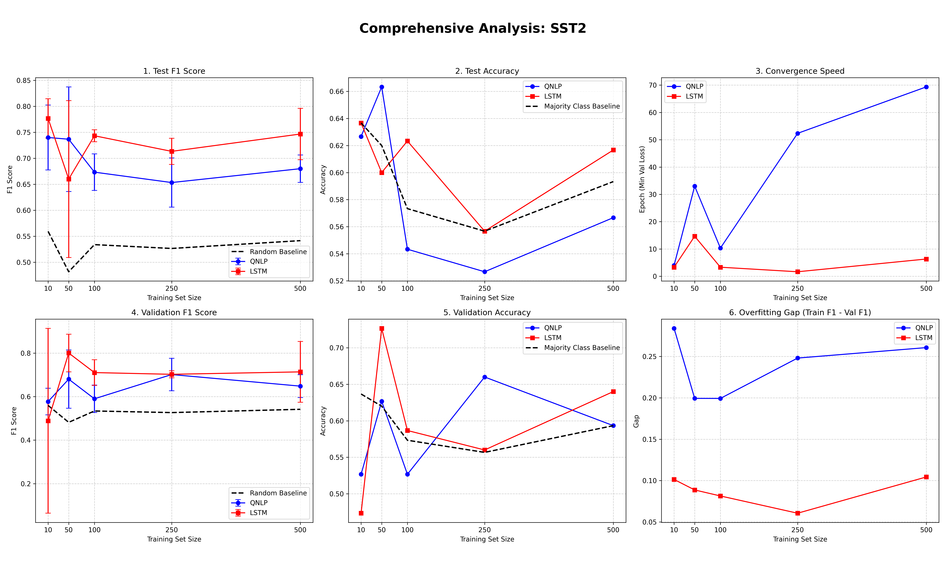
RESULTS
Comprehensive Scaling Analysis
Test F1, Test Accuracy, Convergence Speed, Validation Metrics, and Overfit Gap across all training sizes
LSTM collapses below random baseline at N=50 (Test F1=0.503). QNLP maintains stable generalization. Quantum advantage is specifically a low-data phenomenon.

Slide 9
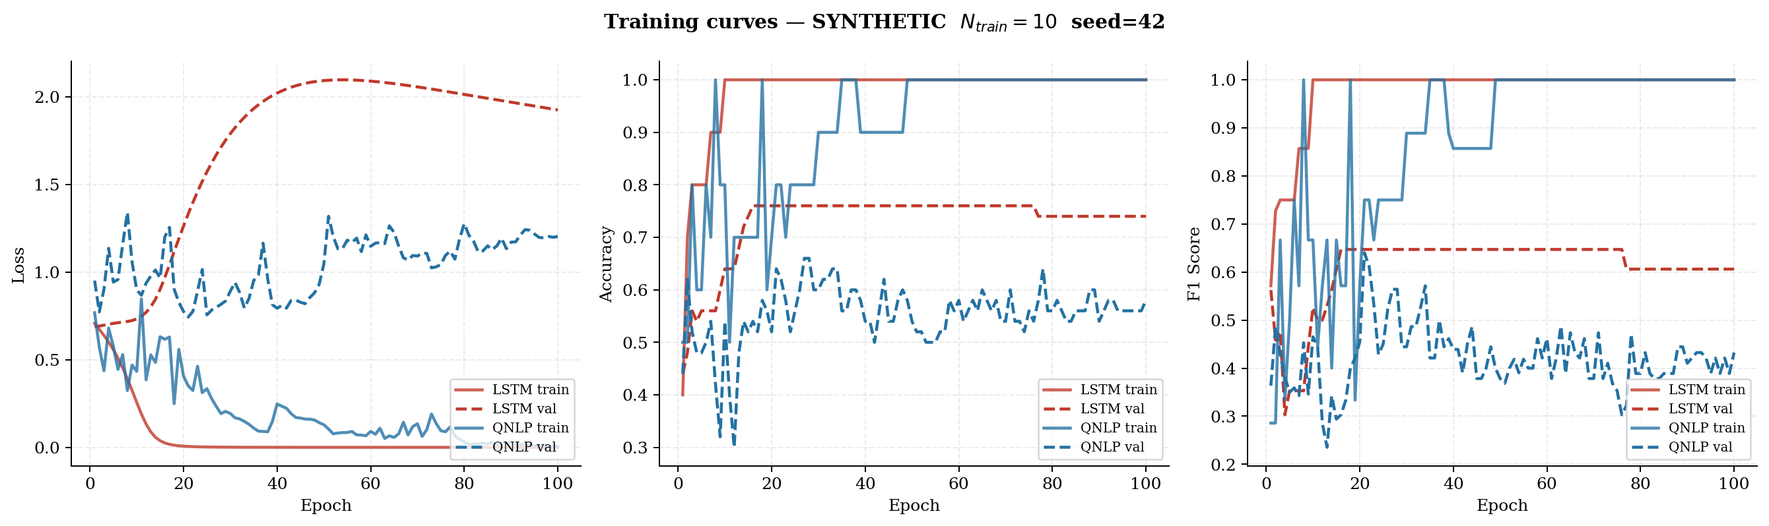
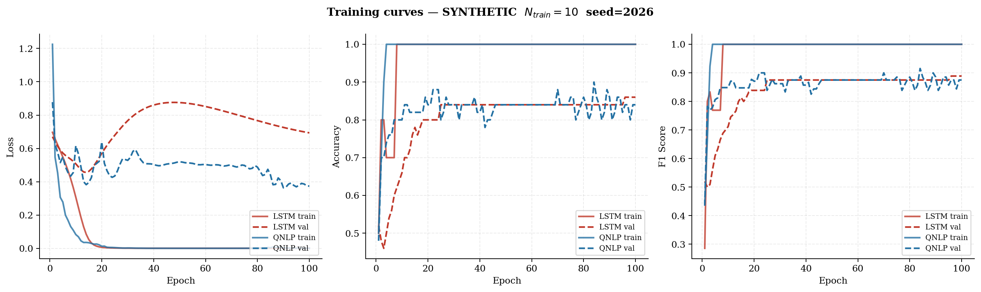
RESULTS — SYNTHETIC DATASET
Synthetic N=10 — Stability Under Minimal Data
N≥50 results are excluded due to train/test pool overlap in the 160-sentence dataset. N=10 is the only overlap-free, interpretable result.
Seed 42 — LSTM val loss diverges > 2.0, QNLP stays bounded
Seed 2026 — LSTM converges cleanly; opposite behavior from seed 42
LSTM Test F1 Std Dev
QNLP Test F1 Std Dev
0.4456
0.1097
nearly as large as the mean — unpredictable
4× lower — circuit topology bounds worst-case

Slide 10
RESULTS — SST-2
SST-2 — Where the Classical Model Recovers
Test F1 by N
QNLP
LSTM
N=10
0.740
0.777
N=50
0.737
0.660
N=100
0.673
0.743
N=250
0.653
0.713
N=500
0.680
0.747
Why LSTM wins at scale:
SST-2 phrase fragments lack the compositional structure that cups_reader's sequential pairing assumes. An inherent limitation of the dataset, not a theoretical QNLP failure.
Persistently high overfit gap (0.20–0.28) across all N: QNLP circuit topology mismatch with unstructured text.

Slide 11
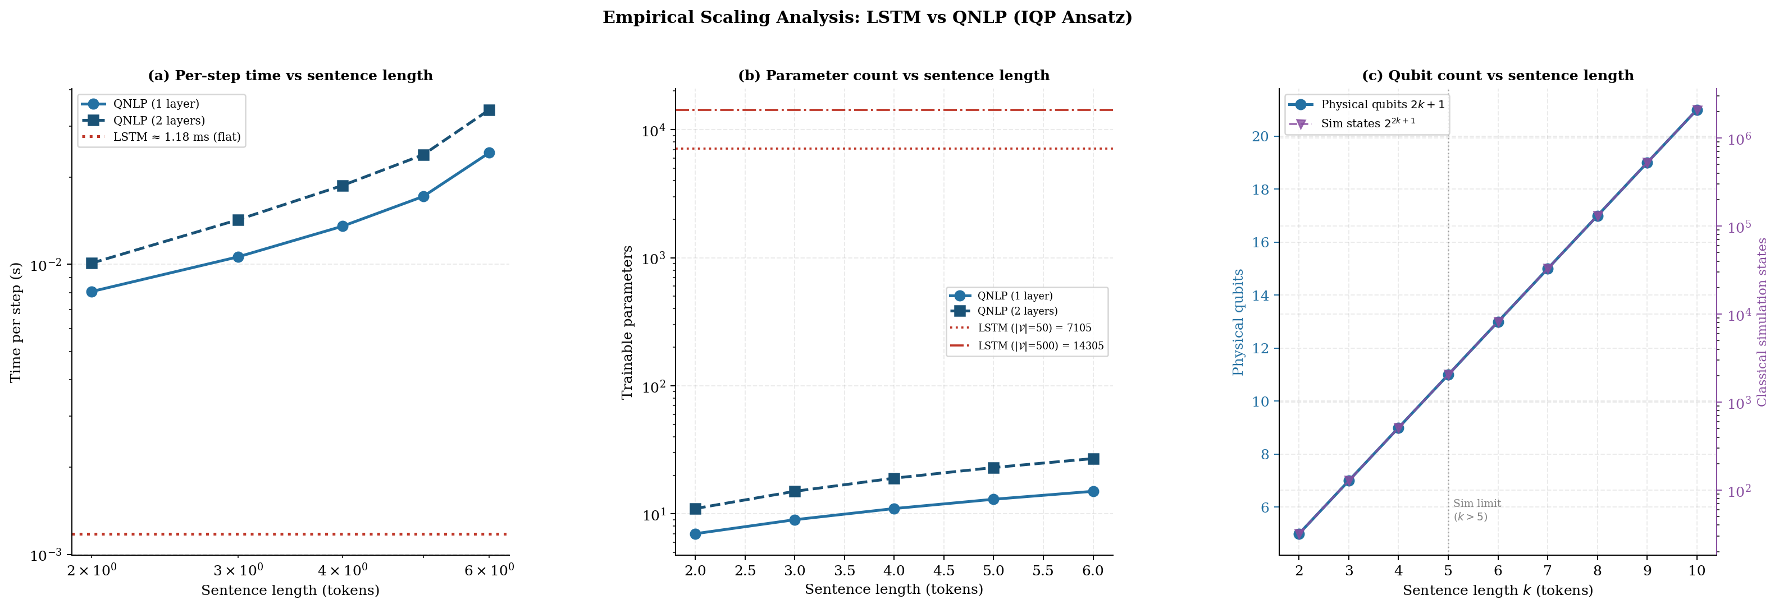
SCALING & COMPLEXITY ANALYSIS
Scaling Analysis & Theoretical Quantum Advantage
Classical lower bound
d ≥ 2M log N
latent dim grows linearly
Quantum (Srikumar 2025, Thm. 2)
n = O(log log N
+ log M)
doubly-logarithmic growth
(a) Per-step time · (b) Parameter count · (c) Physical qubit count vs classical simulation states
Tokens k | Qubits | QNLP params | LSTM params
2 (SST-2 min) | 5 | 7 | ≈ 16,000
3 (Synthetic) | 7 | 9 | ≈ 16,000
4 (Bach Minor) | 9 | 11 | ≈ 16,000
6 (Bach Major) | 13 | 15 | ≈ 16,000
50 (projected) | 101 | 103 | ≈ 22,000
Empirical confirmation:
QNLP is 7–29× slower per step on CPU simulation but uses 300–500× fewer parameters. On real NISQ hardware the simulation overhead vanishes — only 2k+1 physical qubits needed.

Slide 12
CONCLUSION
Conclusion
Bach chorales — hypothesis conditionally accepted
✓
N=50: QNLP F1=0.665 (overfit gap=−0.027) vs LSTM F1=0.503 (below random, gap=+0.128). Negative overfit gap proves the structural prior generalizes beyond what training data warrants.
4× variance reduction — synthetic N=10
~
QNLP std=0.110 vs LSTM std=0.446. IQP circuit topology acts as a structural regularizer bounding worst-case performance regardless of random seed.
SST-2 at scale — LSTM wins from N=100 onward
✗
SST-2 phrase fragments lack compositional structure. cups_reader's sequential pairing cannot leverage structural inductive bias on shallow, non-compositional text.
Limitations & future work
!
Classical simulation requires O(2^{2k+1}) memory → limits k≤5. Barren plateaus at n_layers=2. NISQ hardware access needed for full exponential advantage.

Slide 13
Thank You
Questions & Discussion
GitHub:
github.com/ahmetbugraerturk/qnlp-bach/
Drive:
drive.google.com/drive/folders/1FXpkBapBCj_hTNx4AakAjno5KYYcsoe1
Key Reference:
Srikumar (2025) — QuantumNLP Workshop, ACL 2025
Framework:
lambeq (Quantinuum) + PennyLane (Xanadu) + music21 (MIT)

