Slide 1
SC2001 SCSD Lab 3
Team 5:
LEE TENG YEE SHERILYN(U2422203D)
KUS AHMET BUGRA (N2503674F)
LEE ZHENG JIE (U2422750F)

Slide 2
Content
1. Recursive Definition
Define the recursive formula for P(C)
2. Subproblem Graph
Draw the subproblem structure for P(14) with given wᵢ and pᵢ
3. Dynamic Programming Algorithm
Develop a Bottom-Up DP solution to compute the maximum profit
4. Implementation & Results
(a) Show running result of P(14) using given data
(b) Show running result of P(14) with new weights and profits

Slide 3
Part 1

Slide 4
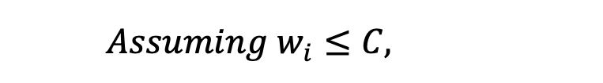
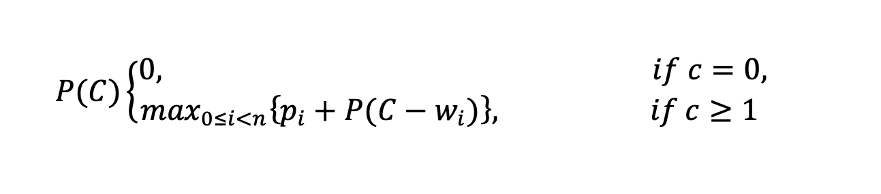
Recursive definition of P(C)

Slide 5
Part 2

Slide 6
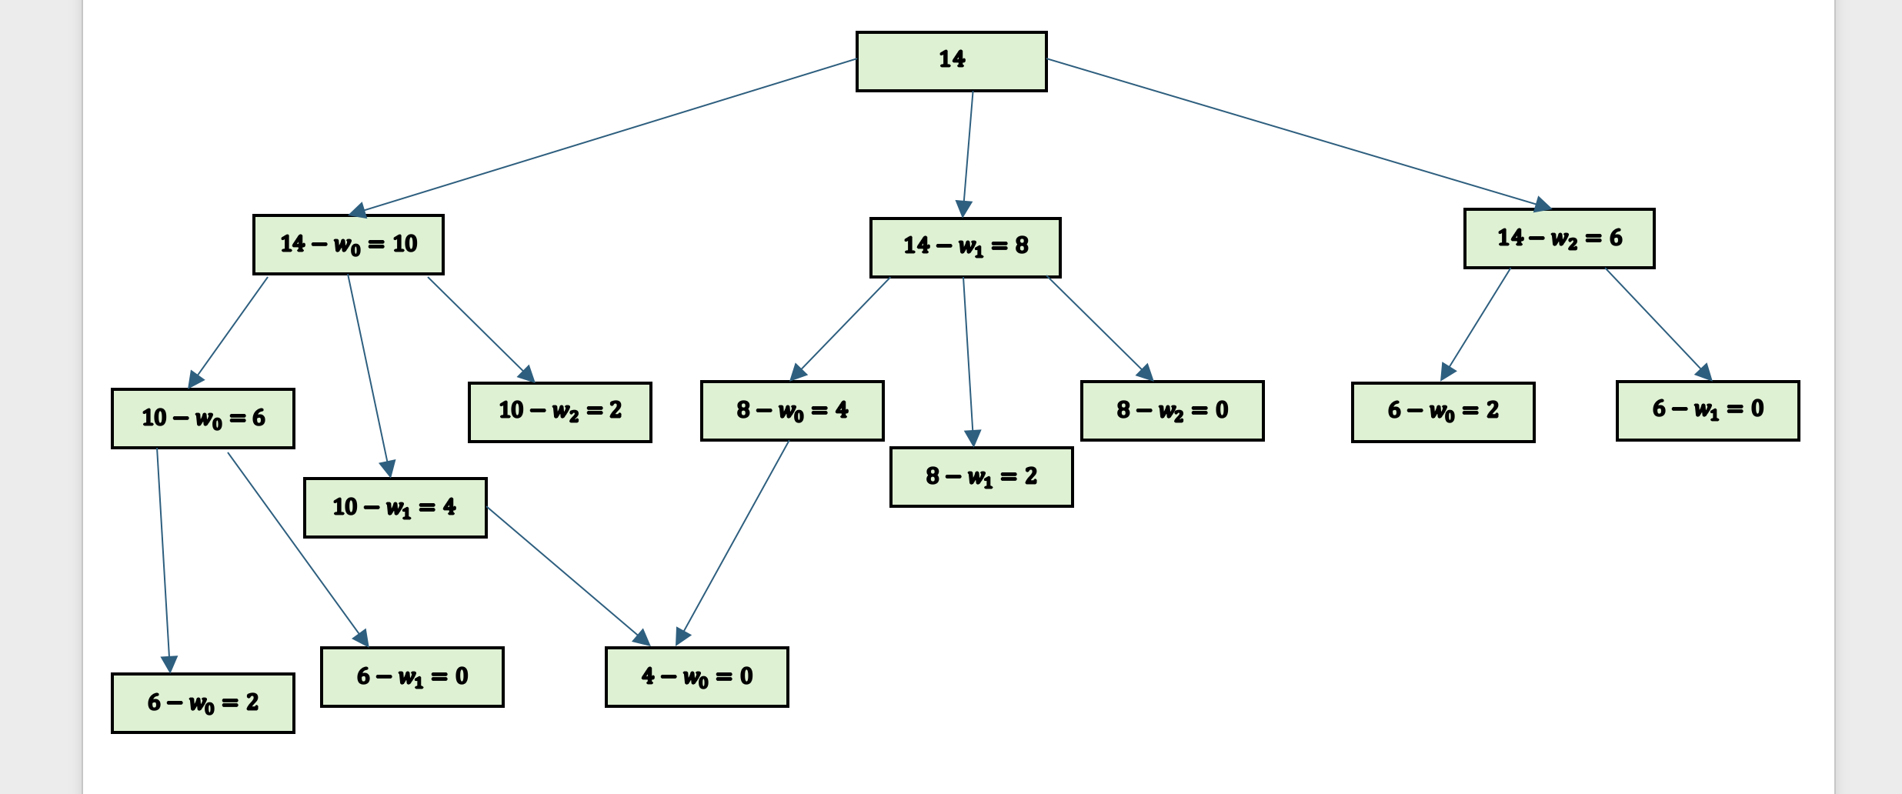
Subproblem graph 1

Slide 7
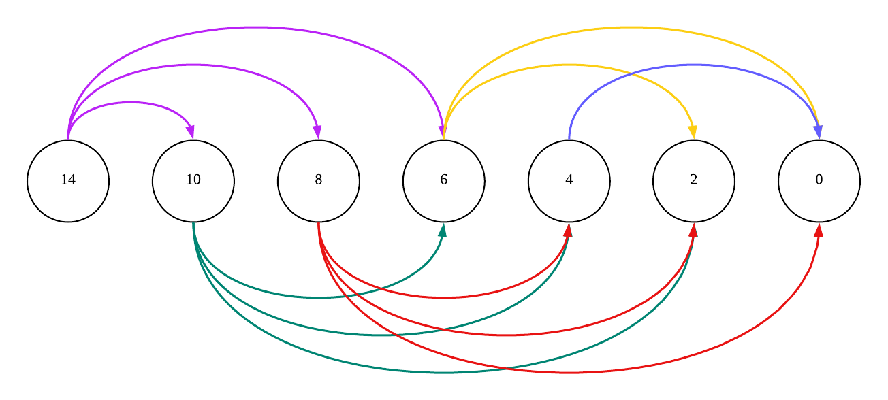
Subproblem graph 2

Slide 8
Part 3

Slide 9
Unbounded Knapsack (Concept)
• Goal
- Find the maximum profit without exceeding capacity C
• Given
- n item types
- Each item has weight w[i] and profit p[i]
- Unlimited supply of each item
• Approach
- Use Dynamic Programming (Bottom-Up)
- Build from small capacities → larger ones

Slide 10
Algorithm & DP Relation
• DP Formula
- P[c] = max(P[c], p[i] + P[c – w[i]]) if w[i] ≤ c
• Explanation
- For each capacity c, check all item types i
- Update the best profit using results from smaller subproblems
- Uses a bottom-up table P[c] that stores best profit for each capacity

Slide 11
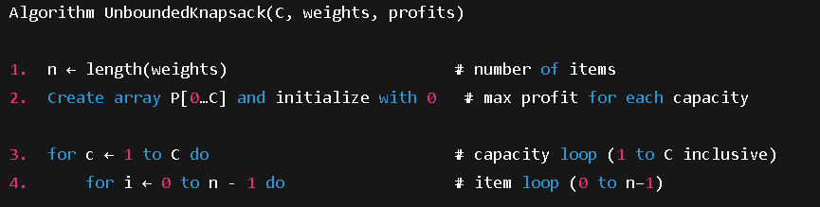
Unbounded Knapsack – Pseudocode (Part 1)
• Line 1: Determines number of items n
• Line 2: Creates DP table P[0…C] initialized with zeros → uses O(C) space
• Line 3: Outer loop builds results bottom-up (small → large capacities)
• Line 4: Inner loop iterates through each item

Slide 12
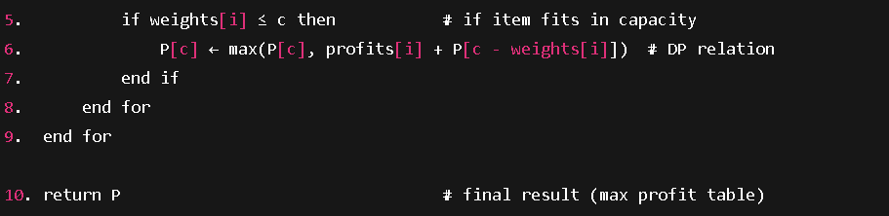
Unbounded Knapsack – Pseudocode (Part 2)
• Lines 5–6: Check if item fits and apply DP relation profits[i] + P[c - weights[i]]
• Line 7: Skips item if it does not fit in current capacity
• Lines 8–9: Ends both loops → DP table fully computed
• Line 10: Returns array P, storing max profit for each capacity
• Complexity: Time O(n×C) | Space O(C)

Slide 13
Conclusion
• Applies DP with a Bottom-Up approach for the Unbounded Knapsack
• Builds from smaller to full capacities efficiently
• Reuses subproblem results to save time
• Produces the optimal total profit
• Complexity: Time O(n×C), Space O(C)

Slide 14
Part 4

Slide 15
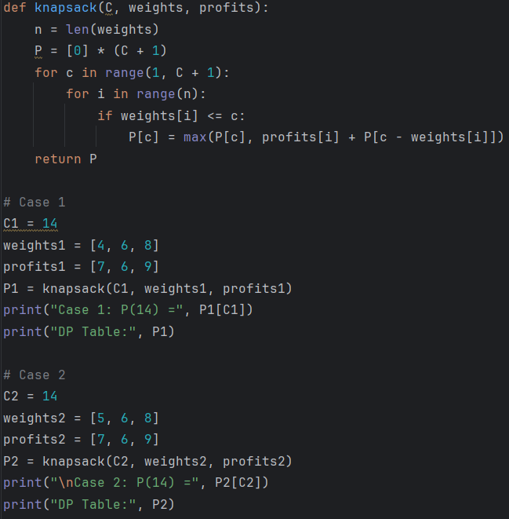
Part 4
Code

Slide 16

Knapsack Algorithm (Initialization)
Legend
C = Capacity
Weight = Capacity of Item
Profit = Value of Item
N = no. Of items
P = initialise array of Profits = 0 for each Capacity:
e.g. [0,0,0]
P = return updated array of Profits for each Capacity:
e.g.[0, 7, 16]

Slide 17

Knapsack Algorithm (Finding the largest Profit based on capacity)
For each capacity size, iterate through all the items and if the item's weight is less than the capacity:
profits[i] : profit gained from taking the current item.
P[c - weights[i]] : best profit achievable with the remaining capacity after including this item
Then compare the current best profit for this capacity, P[c], with the new profit obtained by adding more item without exceeding the capacity.
The larger of the two values is stored in P[c], ensuring that P[c] always holds the maximum profit achievable for capacity c.

Slide 18
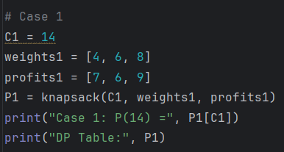


4a) show the running result of P(14) with weights and profits given in (2)
Table
Code
Output :

Slide 19
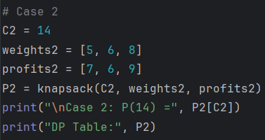


4b) show the running result of P(14) with weights and profits given below
Code
Table
Output :

Slide 20
THANK YOU

