Slide 1
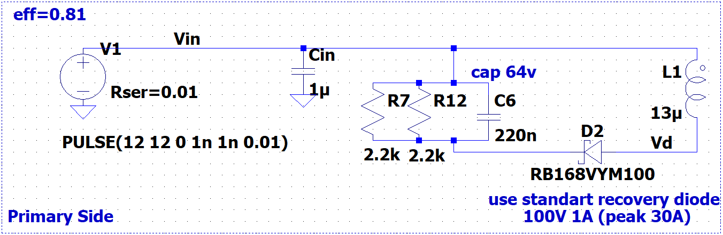
! 1W resistors will be used for snubbers
DIODE STAND. Single 1A 100V THT DO41

Slide 2
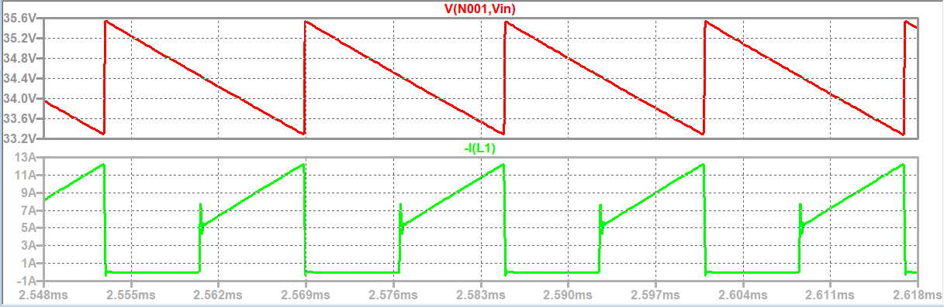
Snubber Voltage and Primary Winding Current (12V input – Maximum Load)
Snubber ripple is %10Vin and Vsnub=35V

Slide 3
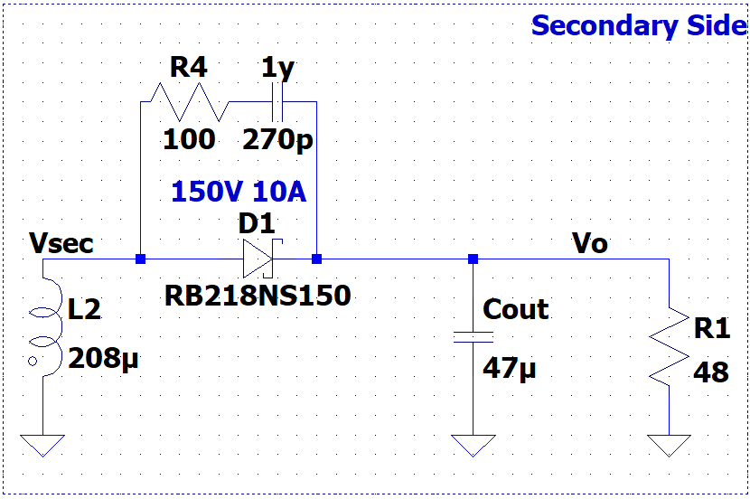
DIODE SCHOTTKY 10A 150V TO220AC THT

Slide 4
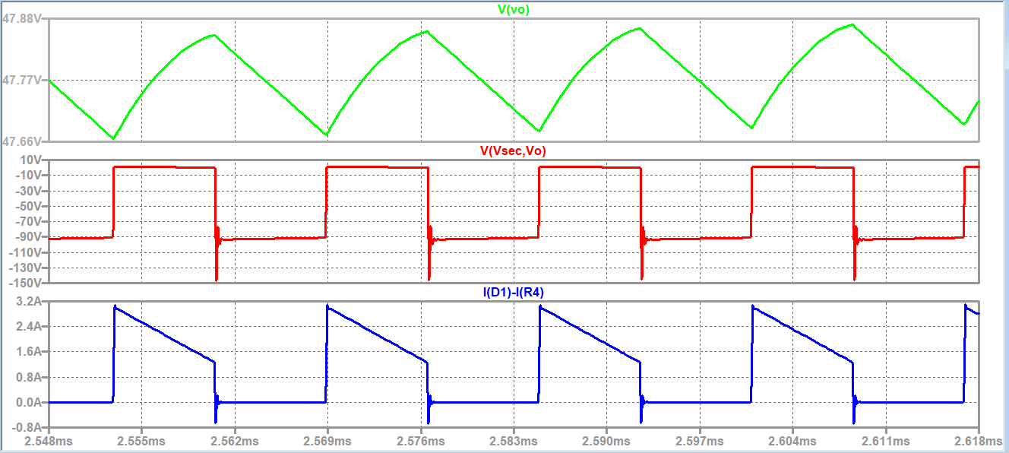
Output Voltage,Secondary Diode Voltage and Winding Current (12V input – Maximum Load)

Slide 5
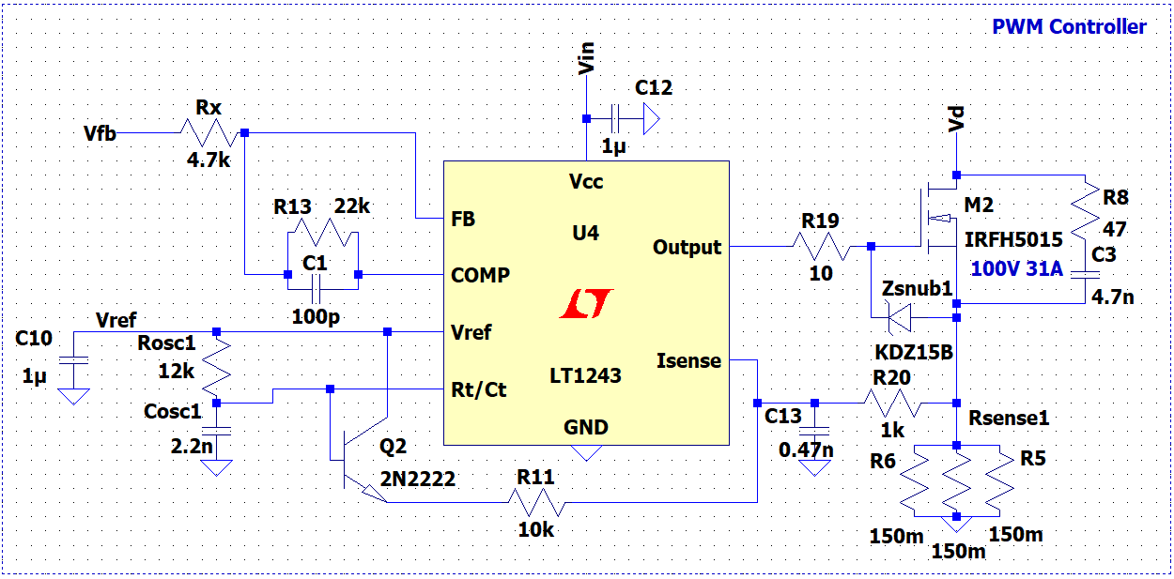
! 4W sense resistors will be used
MOSFET DIS.31A 100V N-CH TO252(DPAK) HEXFET SMT

Slide 6
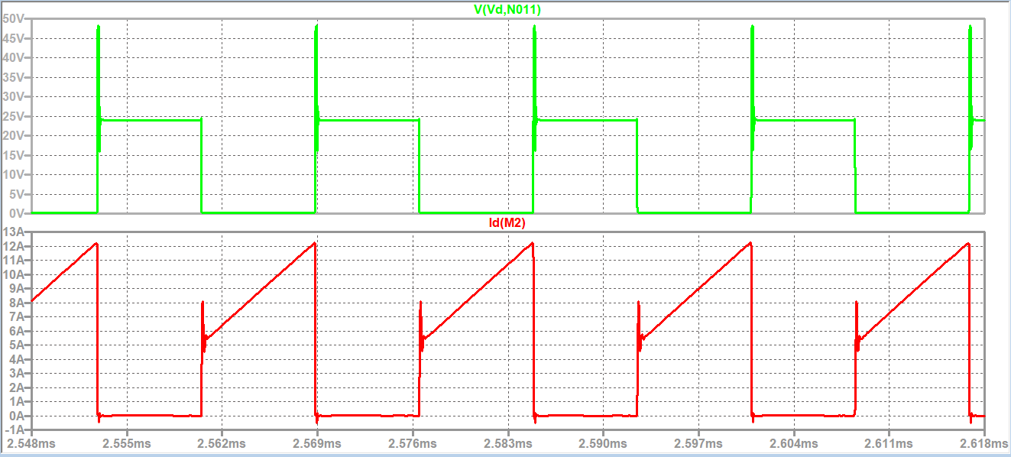
MOSFET Voltage and Current(12V input – Maximum Load)

Slide 7
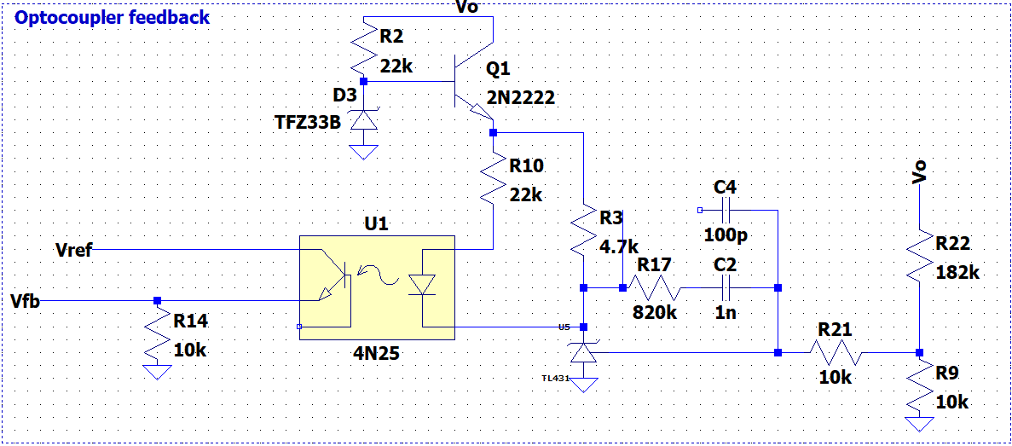
! Linear regulator will be used to protect TL431

Slide 8
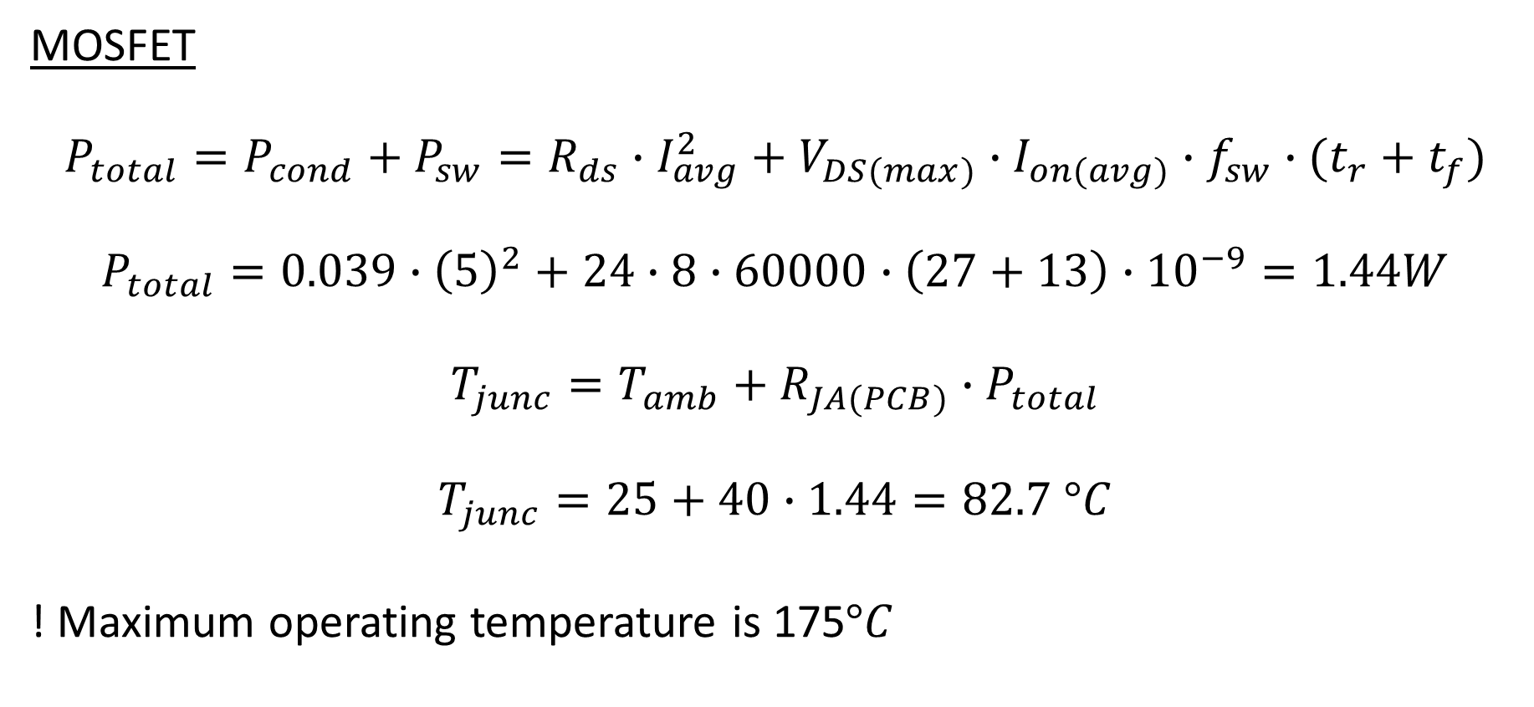
Thermal Calculations
MOSFET
$$P_{total}=P_{cond}+P_{sw}=R_{ds}∙I_{avg}^{2}+V_{DS(max)}∙I_{on(avg)}∙f_{sw}∙(t_{r}+t_{f})$$
$$P_{total}=0.039∙{\left(5\right)}^{2}+24∙8∙60000∙\left(27+13\right)∙{10}^{−9}=1.44W$$
$$T_{junc}=T_{amb}+R_{JA(PCB)}∙P_{total}$$
$$T_{junc}=25+40∙1.44=82.7 °C$$
! Maximum operating temperature is 175$°C$

Slide 9

Thermal Calculations
Secondary Diode
$$P_{total}=P_{cond}+P_{sw}=V_{on}∙I_{out}+0 (Schottky)$$
$$P_{total}=0.9∙1=0.9W$$
$$T_{junc}=T_{amb}+R_{JA(PCB)}∙P_{total}$$
$$T_{junc}=25+3∙0.9=27.7 °C$$
! Maximum operating temperature is 175$°C$

