Slide 1
EE 464 Hardware Project Optimus Primary Winding
Atilla Can Aydemir 2374510
Ahmetcan Akuz 2025468
Barış Özgören 2375558

Slide 2
Outline
Topology Selection
Magnetic Design
Simulation & Results
Component Selection

Slide 3
Topology Selection
What we considered?
Why did we choose flyback topology?

Slide 4
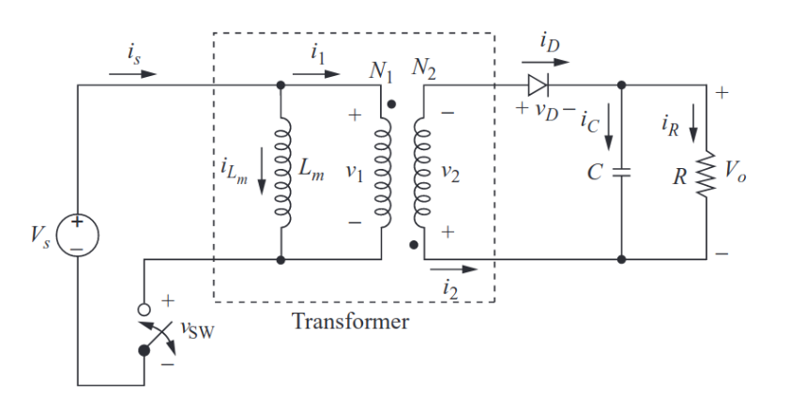
Flyback Converter

Slide 5
Duty Cycle Selection
Stress on Switch when D is high
Stress on the primary side because of N1/N2 ratio when D is high
Output Voltage Ripple increases when D is high
Size of Output Capacitance increases when D is high
Secondary Peak Current is high when D is high.

Slide 6
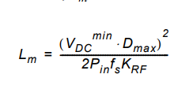
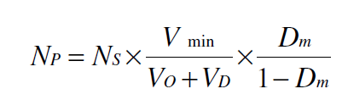

Magnetic Design
Magnetizing Inductance& Turns Ratio
Lm=13.2uH $\frac{N_{p}}{N_{s}}=4$

Slide 7
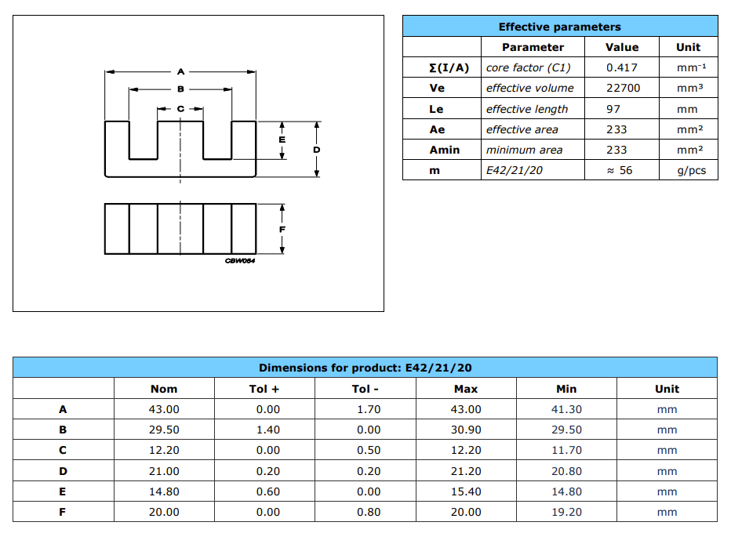
Magnetic Design
Core Selection
E42/21/20-3C94
Ae=233 mm^2
Aw=374 mm^2

Slide 8

Magnetic Design
Number of turns
$N_{p}=\frac{L_{m}I_{p}}{B_{sat}A_{e}}{10}^{6}$
Np=4turns Ns=16 turns

Slide 9
Magnetic Design
Cable Selection
G gauge | Conductor | Conductor | Conductor cross section in mm² | Ohms per 1000 ft. | Ohms per km | Maximum amps for chassis wiring | Maximum amps for | Maximum frequency for | Breaking force Soft Annealed Cu 37000 PSI
 | Diameter Inches | Diameter mm |  |  |  |  | power transmission | 100% skin depth for solid conductor copper
15 | 0.0571 | 1.45034 | 1.65 | 3.184 | 10.44352 | 28 | 4.7 | 8250 Hz | 94 lbs
16 | 0.0508 | 1.29032 | 1.31 | 4.016 | 13.17248 | 22 | 3.7 | 11 k Hz | 75 lbs
17 | 0.0453 | 1.15062 | 1.04 | 5.064 | 16.60992 | 19 | 2.9 | 13 k Hz | 59 lbs
18 | 0.0403 | 1.02362 | 0.823 | 6.385 | 20.9428 | 16 | 2.3 | 17 kHz | 47 lbs
19 | 0.0359 | 0.91186 | 0.653 | 8.051 | 26.40728 | 14 | 1.8 | 21 kHz | 37 lbs
20 | 0.032 | 0.8128 | 0.519 | 10.15 | 33.292 | 11 | 1.5 | 27 kHz | 29 lbs
21 | 0.0285 | 0.7239 | 0.412 | 12.8 | 41.984 | 9 | 1.2 | 33 kHz | 23 lbs
22 | 0.0253 | 0.64516 | 0.327 | 16.14 | 52.9392 | 7 | 0.92 | 42 kHz | 18 lbs
23 | 0.0226 | 0.57404 | 0.259 | 20.36 | 66.7808 | 4.7 | 0.729 | 53 kHz | 14.5 lbs
24 | 0.0201 | 0.51054 | 0.205 | 25.67 | 84.1976 | 3.5 | 0.577 | 68 kHz | 11.5 lbs
25 | 0.0179 | 0.45466 | 0.162 | 32.37 | 106.1736 | 2.7 | 0.457 | 85 kHz | 9 lbs
26 | 0.0159 | 0.40386 | 0.128 | 40.81 | 133.8568 | 2.2 | 0.361 | 107 kHz | 7.2 lbs

Slide 10
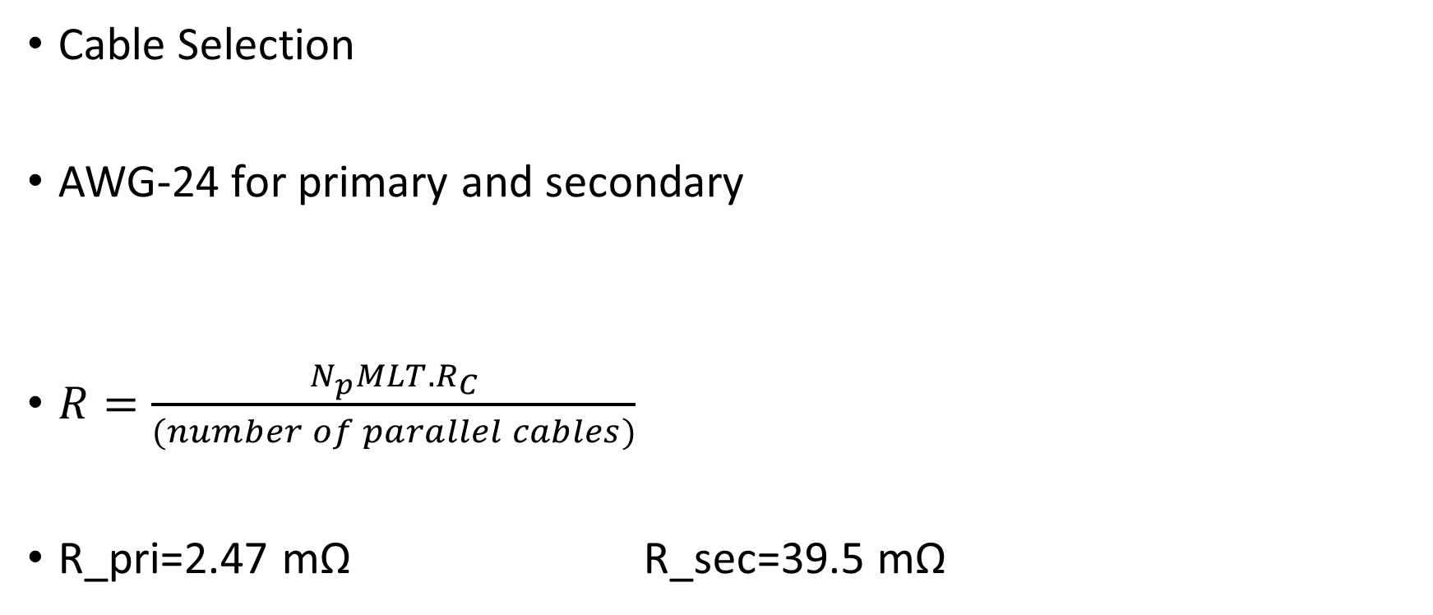
Magnetic Design
Cable Selection
AWG-24 for primary and secondary
$R=\frac{N_{p}MLT.R_{C}}{(number of parallel cables)}$
R_pri=2.47 mΩ R_sec=39.5 mΩ
primary cable AWG | 24 | Area | 0.205 | mm^2 | Diameter | 0.51054 | mm | Parallel | 8 | R_pri | 0.084198 | Ohm/m
secondary cable AWG | 24 | Area | 0.205 | mm^2 | Diameter | 0.51054 | mm | Parallel | 2 | R_sec | 0.084198 | Ohm/m

Slide 11
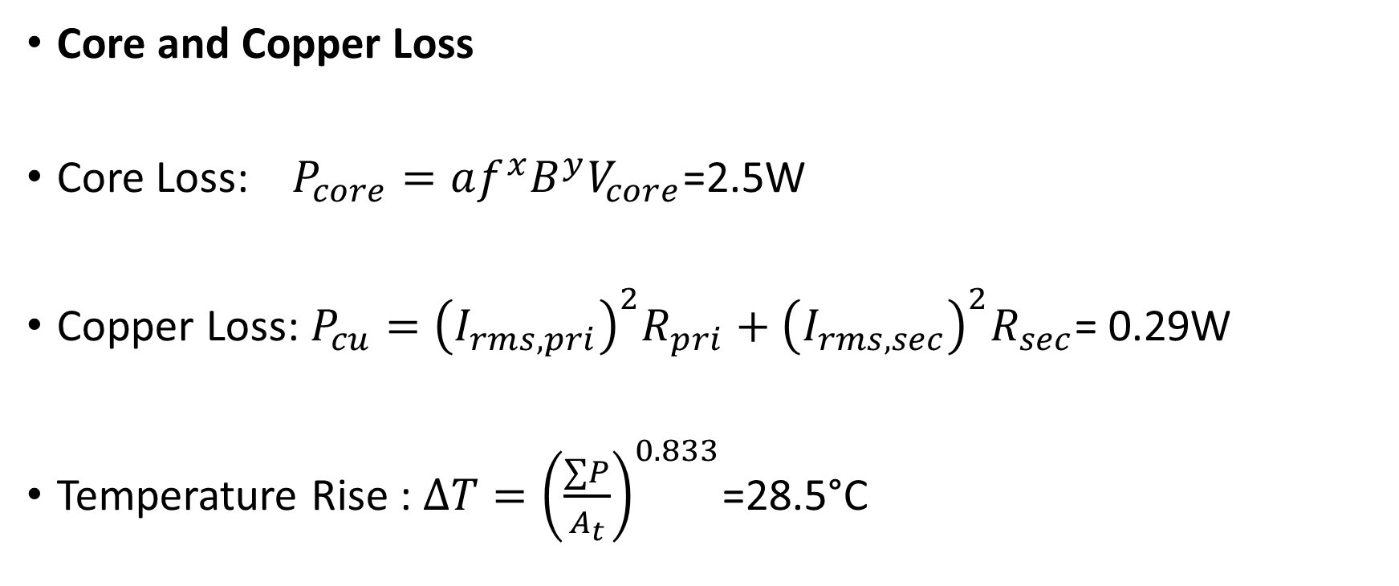
Magnetic Design
Core and Copper Loss
Core Loss: $P_{core}=af^{x}B^{y}V_{core}$=2.5W
Copper Loss: $P_{cu}={\left(I_{rms,pri}\right)}^{2}R_{pri}+{\left(I_{rms,sec}\right)}^{2}R_{sec}$= 0.29W
Temperature Rise : $∆T={\left(\frac{∑P}{A_{t}}\right)}^{0.833}$=28.5°C

Slide 12
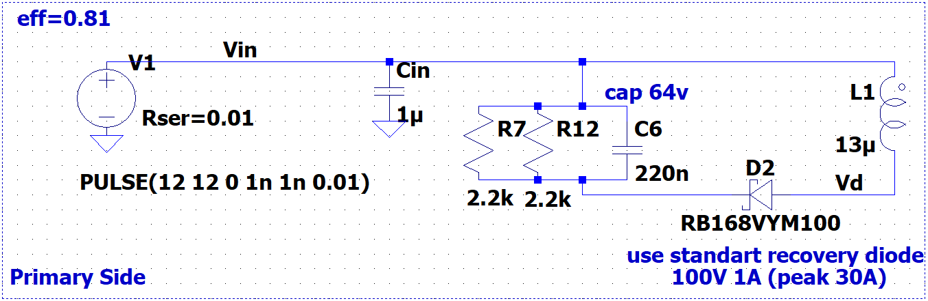
! 1W resistors will be used for snubbers
DIODE STAND. Single 1A 100V THT DO41

Slide 13
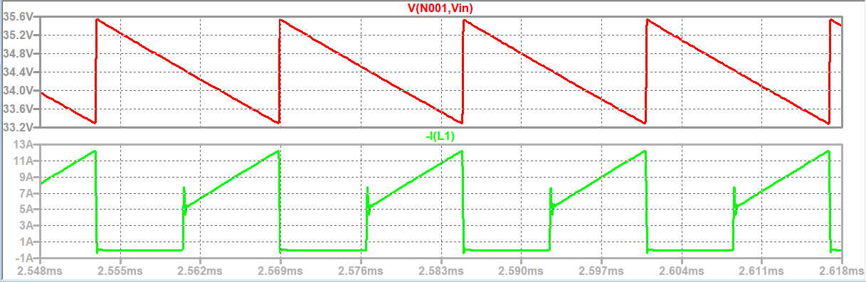
Snubber Voltage and Primary Winding Current (12V input – Maximum Load)
Snubber ripple is %10Vin and Vsnub=35V

Slide 14
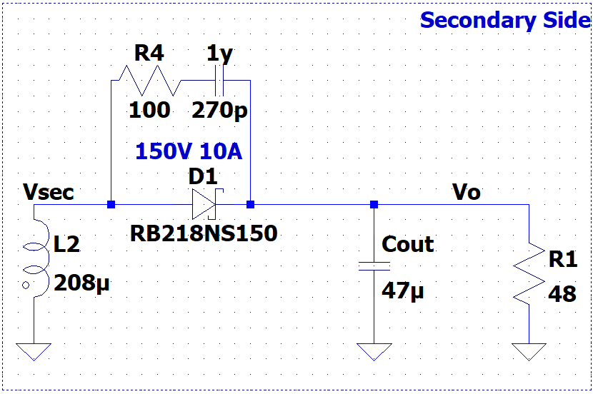
DIODE SCHOTTKY 10A 150V TO220AC THT

Slide 15
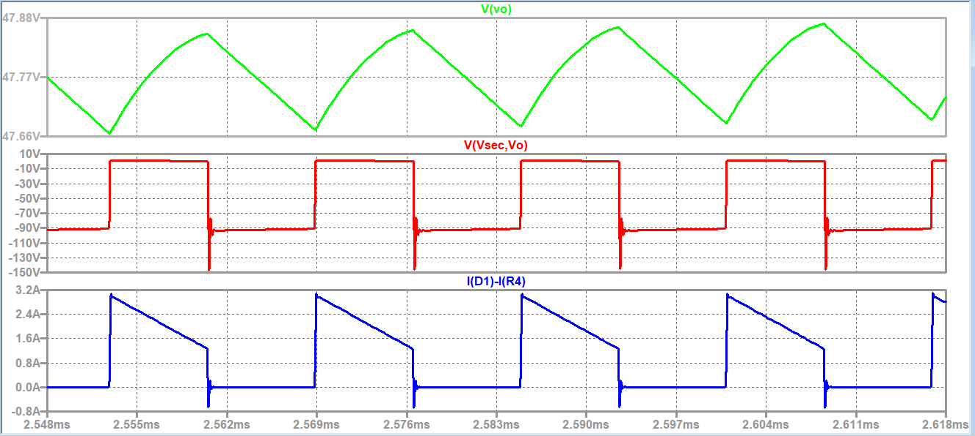
Output Voltage,Secondary Diode Voltage and Winding Current (12V input – Maximum Load)

Slide 16
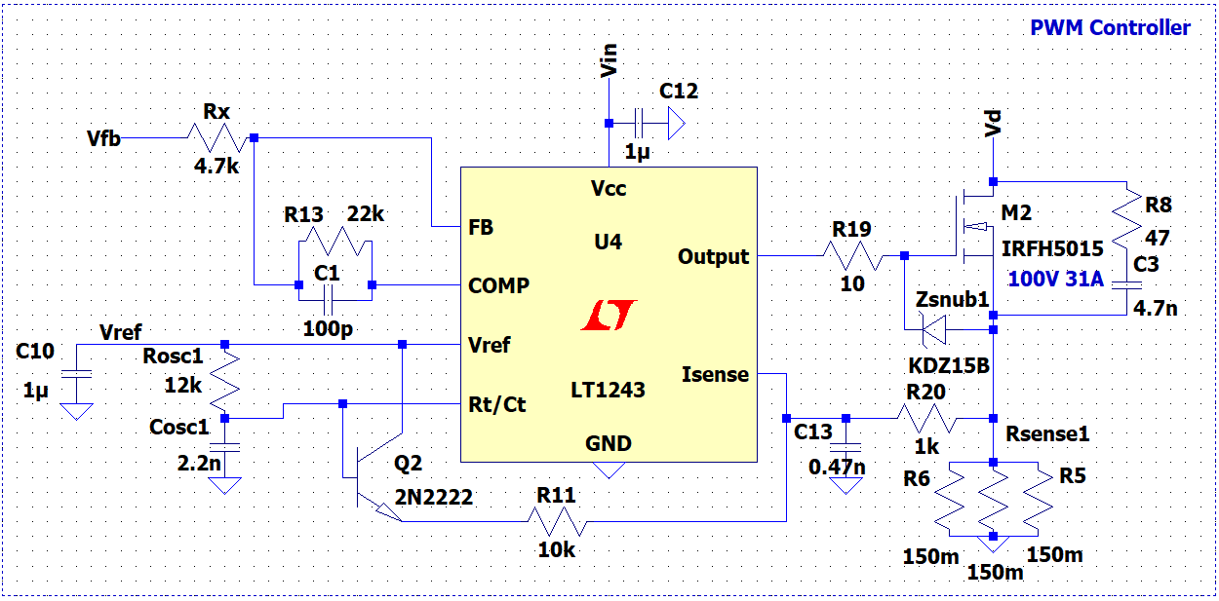
! 4W sense resistors will be used
MOSFET DIS.31A 100V N-CH TO252(DPAK) HEXFET SMT

Slide 17
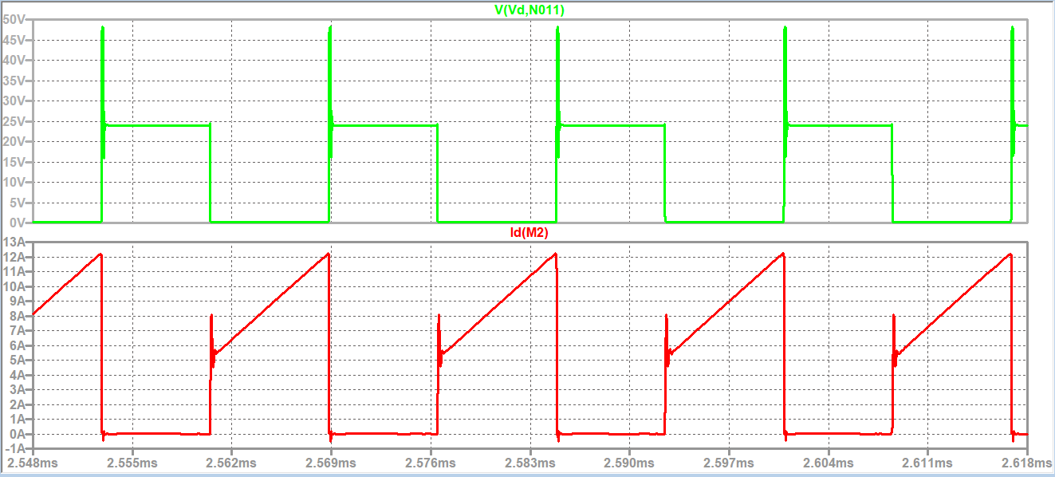
MOSFET Voltage and Current(12V input – Maximum Load)

Slide 18
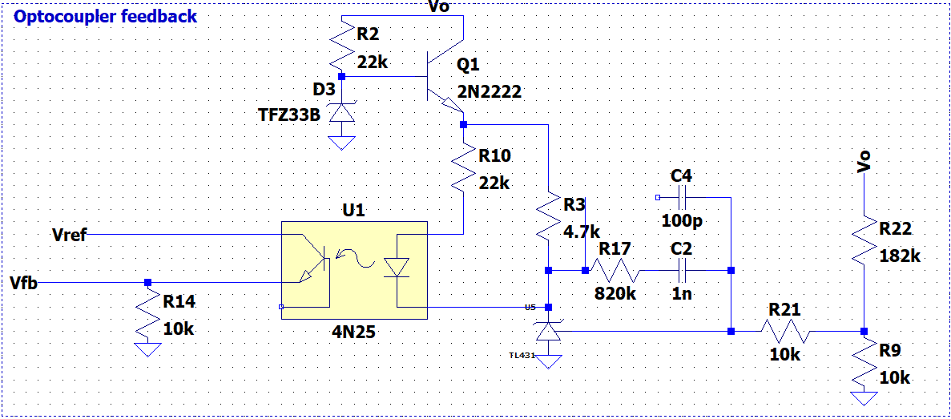
! Linear regulator will be used to protect TL431

Slide 19
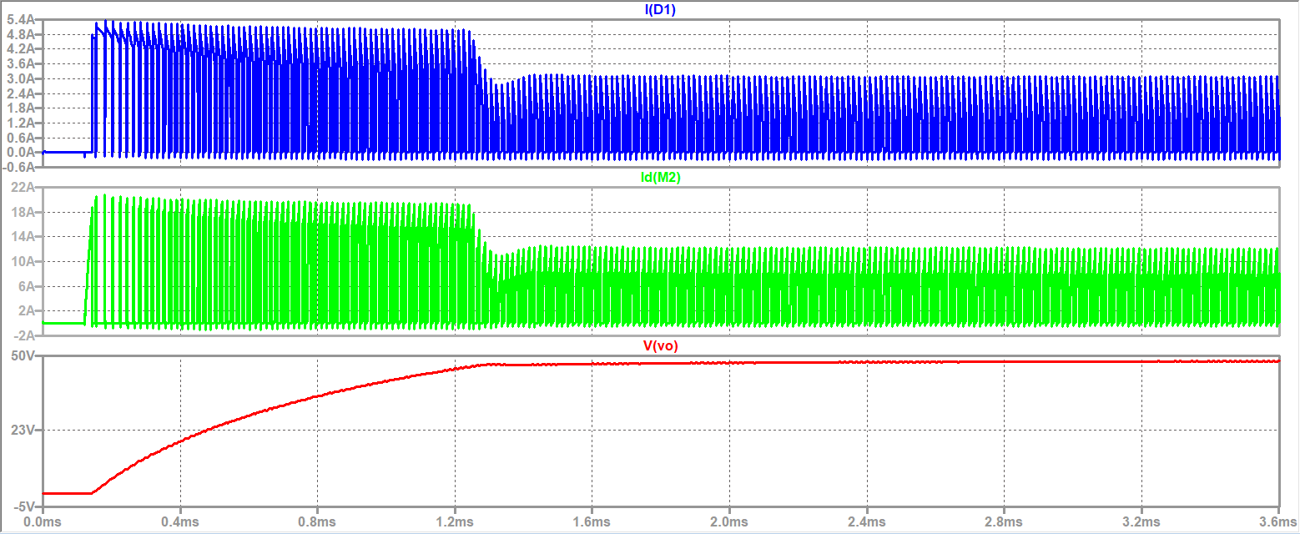
Output Voltage,Secondary Diode Current and MOSFET Current (12V input – Maximum Load – t=0)

Slide 20
Thermal Calculations
MOSFET
$$P_{total}=P_{cond}+P_{sw}=R_{ds}∙I_{avg}^{2}+V_{DS(max)}∙I_{on(avg)}∙f_{sw}∙(t_{r}+t_{f})$$
$$P_{total}=0.039∙{\left(5\right)}^{2}+24∙8∙60000∙\left(27+13\right)∙{10}^{−9}=1.44W$$
$$T_{junc}=T_{amb}+R_{JA(PCB)}∙P_{total}$$
$$T_{junc}=25+40∙1.44=82.7 °C$$
! Maximum operating temperature is 175$°C$

Slide 21
Thermal Calculations
Secondary Diode
$$P_{total}=P_{cond}+P_{sw}=V_{on}∙I_{out}+0 (Schottky)$$
$$P_{total}=0.9∙1=0.9W$$
$$T_{junc}=T_{amb}+R_{JA(PCB)}∙P_{total}$$
$$T_{junc}=25+3∙0.9=27.7 °C$$
! Maximum operating temperature is 175$°C$

Slide 22
References
keysan.me
“Design Guidelines for Off-line Flyback Converters Using Fairchild Power Switch (FPS)”,2003 [Online] Available: https://www.all-electronics.de/wp-content/uploads/migrated/document/167525/46fbe8c82a6.pdf
“Predicting Temperature Rise of Ferrite Cored Transformers”[Online], Available: https://elnamagnetics.com/wp-content/uploads/library/TSC-Ferrite-International/Predicting_Temperature_Rise_of_Ferrite_Cored_Transformers.pdf

