Slide 1
Fault Tolerance

Slide 2
Definition
Fault Tolerance: is ability of a system to maintain proper operation in the event of failures or faults in one or more of its components.
Detection of faults: Due to the high number of components, the detection of a fault can be complicated in principle. However, the availability of powerful microprocessors made it possible to develop very intelligent methods for fault detection. Some examples of these advanced methods are techniques based on frequency analysis [4], [5], the use of neural networks (NNs) to search for some specific patterns [6], and the study of the time behavior in voltages and currents at the load [7]–[9].

Slide 3
Operation with Faults
Some methods include additional hardware to keep operating.
Topology can be changed.
the cascaded inverter uses its modularity advantageously to introduce the idea of redundancy of cells instead of using redundancy of components.

Slide 4
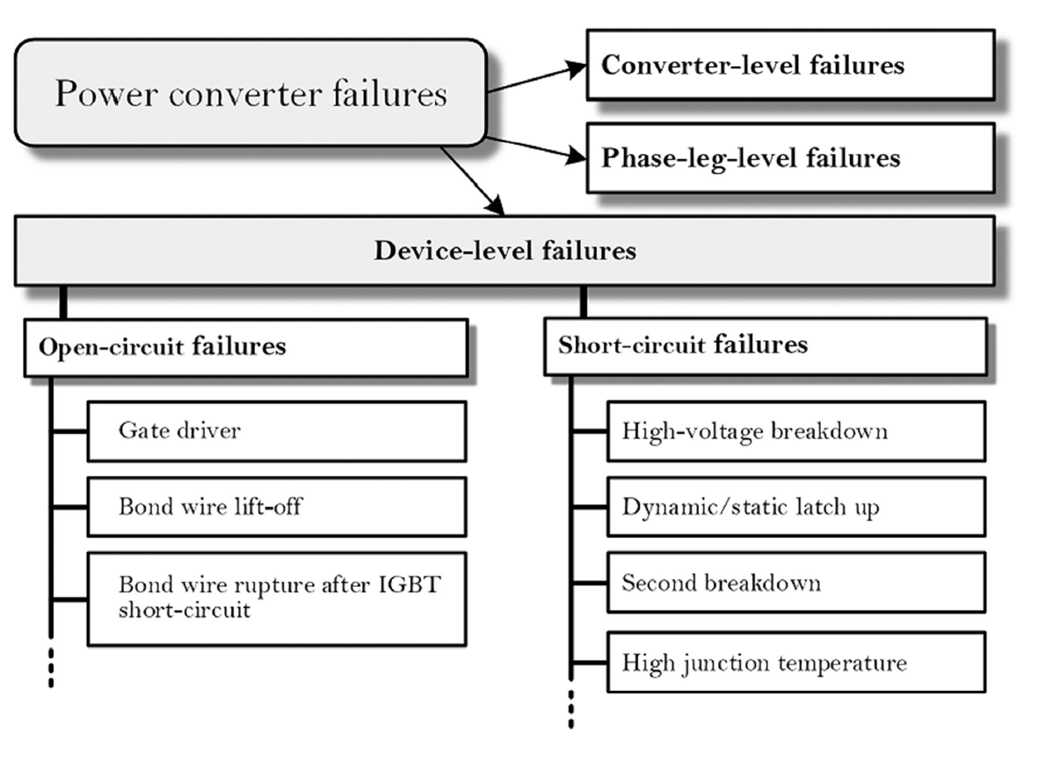
Fault Diagnosis
Two main diagnosis solutions
Switch Measurements: No extra hardware needed. Measurements came from sensors. It is possible to determine open or short circuit.
Output Waveform Analysis: solutions based on the measurements of output phase voltages or currents.
Typical Failures for Inverters

Slide 5
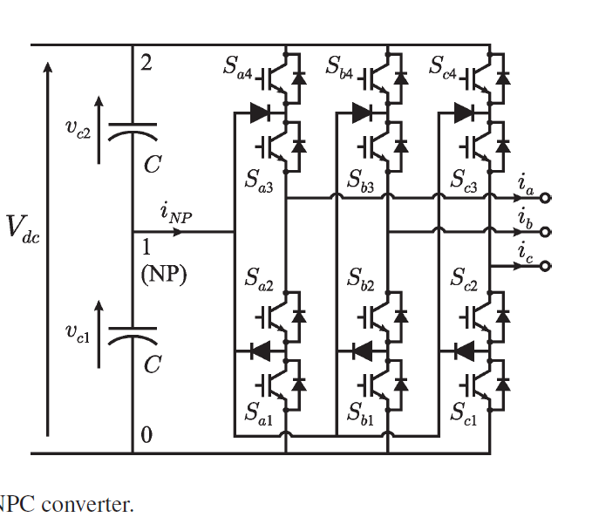
Solutions for NPC Converters
3 Level NPC Converter

Slide 6
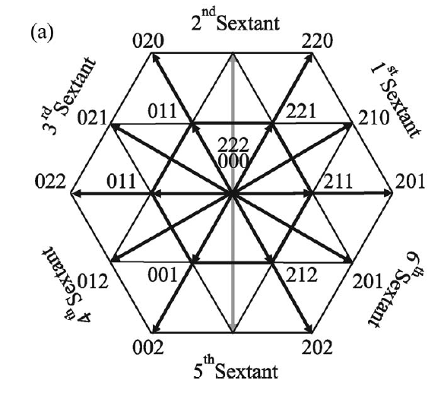
Solution I
- capable of coping with short-circuit faults.
- No need extra hardware.
- The fault tolerant capacity is achieved due to the redundancy of voltage vectors present in NPC converters. due to the redundancy of these voltage vectors, the converter is still able to continue working. Nevertheless, the switches have to withstand the total dc-link voltage.
Vector Diagram when Sa4 fails.

Slide 7
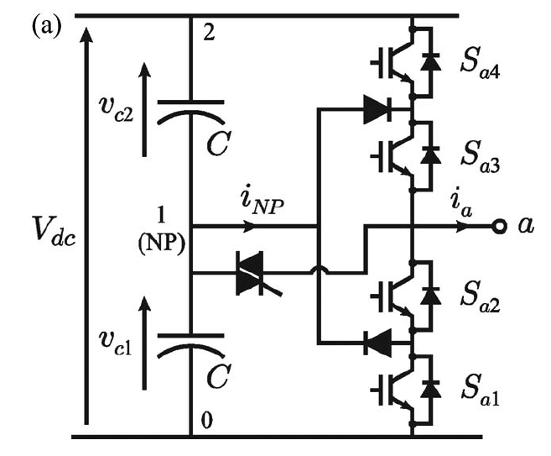
Solution II
provides open-circuit fault tolerance capabilities.
Additional thyristor
The purpose of these new elements is to connect the faulty leg to the NP of the converter when any of its switches fail in open circuit.

Slide 8
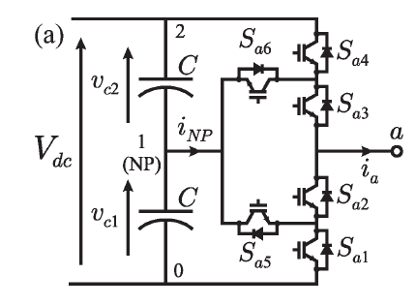
Solution III
For both short circuit and open circuit.
Additional IGBT replacing with diodes.
One leg of Solution III

Slide 9
Matrix-Based Approach
For Open-Circuit Fault Tolerant (OCFT)

Slide 10
Multiple Fault Switches

Slide 11
Diagnosis and Tolerant Strategy of T-Type 3Level Inverters
*under open-switch fault conditions
State | Vout | Sa1 | Sa2 | Sa3 | Sa4
P | +Vdc/2 | ON | ON | OFF | OFF
0 | 0 | OFF | ON | ON | OFF
N | -Vdc/2 | OFF | OFF | ON | ON

Slide 12
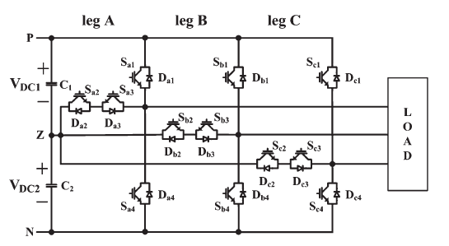
Diagnosis and Tolerant Strategy of T-Type 3LI
The location of the faulty switch can be identified by the average of the normalized phase current and the change of the neutral-point voltage.
T-Type Inverter: Half bridge switches block the full DC-link voltage.
Switches between NP and each output block half of DC-link voltage.
Conduction losses are less than NPC Inverters (2 switches for Vdc in NPC, 1 switch in T-Type.)
Simplified structure of T-Type inverter

Slide 13
Analysis of T-Type 3LI During Open-Switch Fault
Sa1 open-switch.
a: Ia>0 & b: Ia<0
State: [P]
Sa3 open-switch.
a: Ia>0 & b: Ia<0
State: [0]
Sa2 open-switch.
a: Ia>0 & b: Ia<0
State: [0]
Sa4 open-switch.
a: Ia>0 & b: Ia<0
State: [N]
Because of an open-switch fault, the undesirable output pole voltage is produced, and the phase current is distorted. It causes an unbalance of neutral-point voltage.

Slide 14
Fault-Tolerant Control Strategy
Divided to two parts:
Half-bridge switches
Neutral-point switches

Slide 15
Diagnosis and Tolerant Strategy of 3Level NPC Inverters
Paper: Open-circuit fault detection method for Grid-side Three-level NPC Inverter

Slide 16
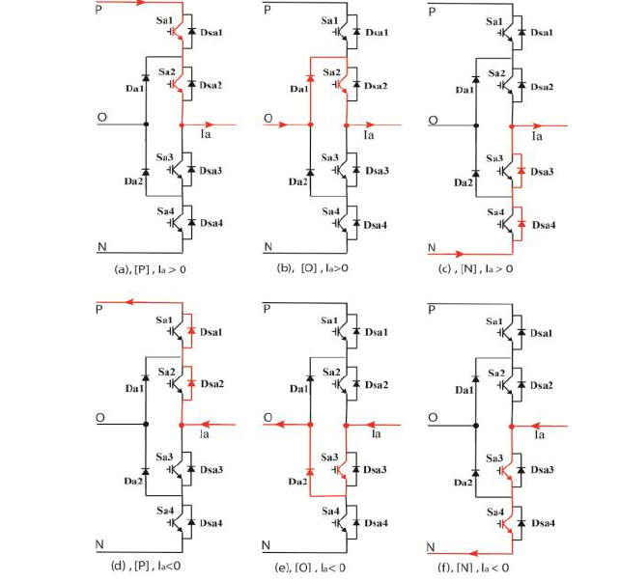
Normal Operation of NPC 3-Level Inverter
State | Vout | Sa1 | Sa2 | Sa3 | Sa4
P | +Vdc/2 | ON | ON | OFF | OFF
0 | 0 | OFF | ON | ON | OFF
N | -Vdc/2 | OFF | OFF | ON | ON

Slide 17
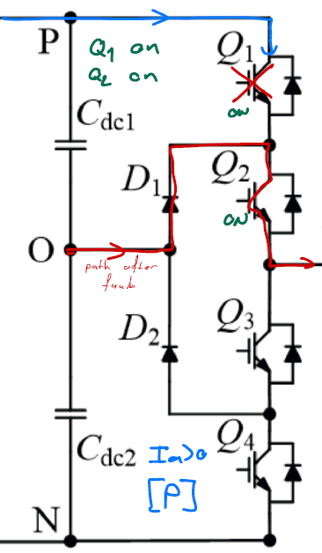
NPC Under Fault Operation – Sa1/Q1 fault
The

Slide 18
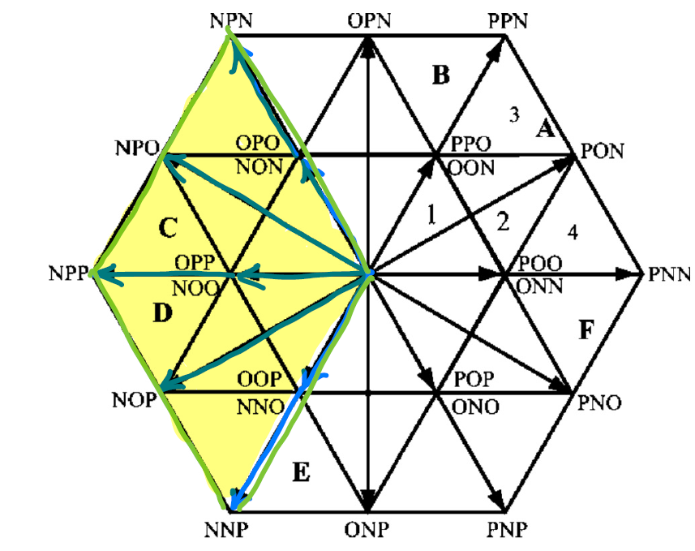
NPC Under Fault Operation – Sa1/Q1 fault

Slide 19
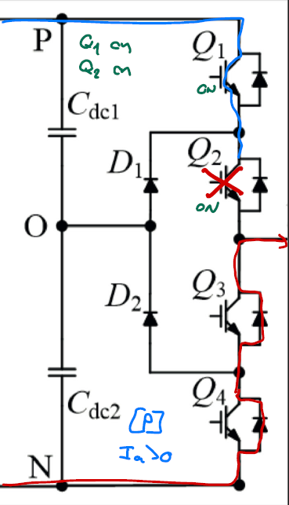
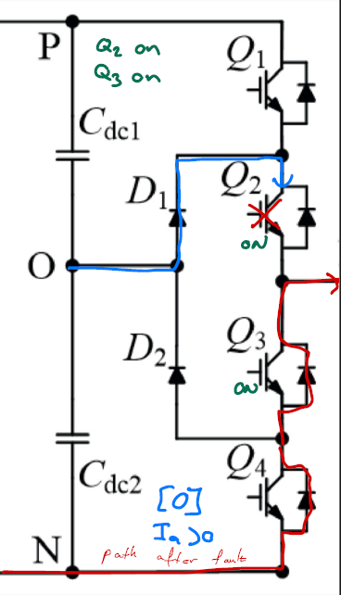
NPC Under Fault Operation – Sa2/Q2 fault

Slide 20
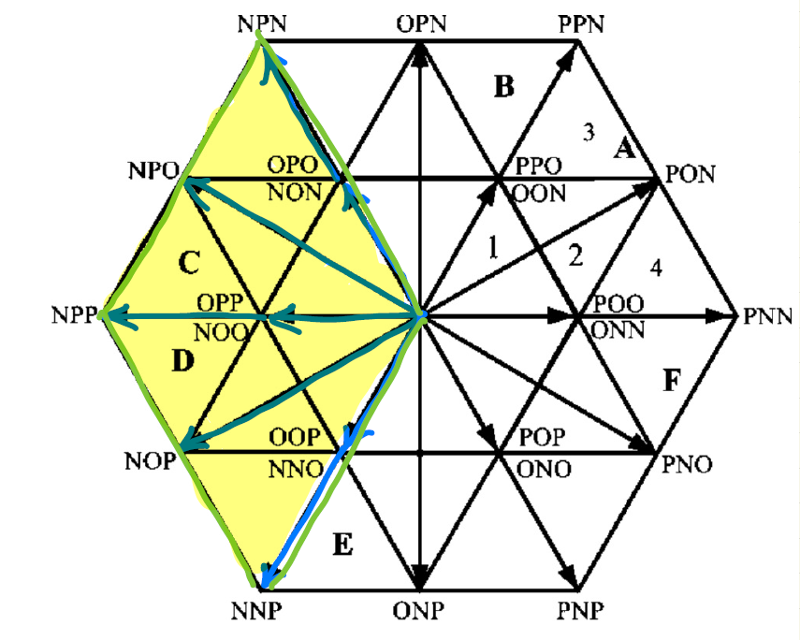
NPC Under Fault Operation – Sa2/Q2 fault

Slide 21
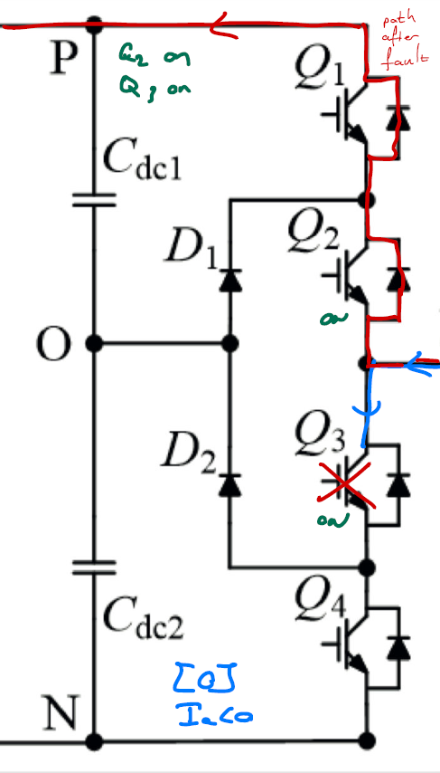
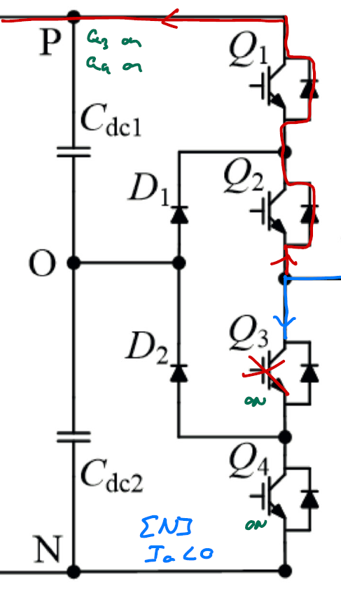
NPC Under Fault Operation – Sa3/Q3 fault

Slide 22
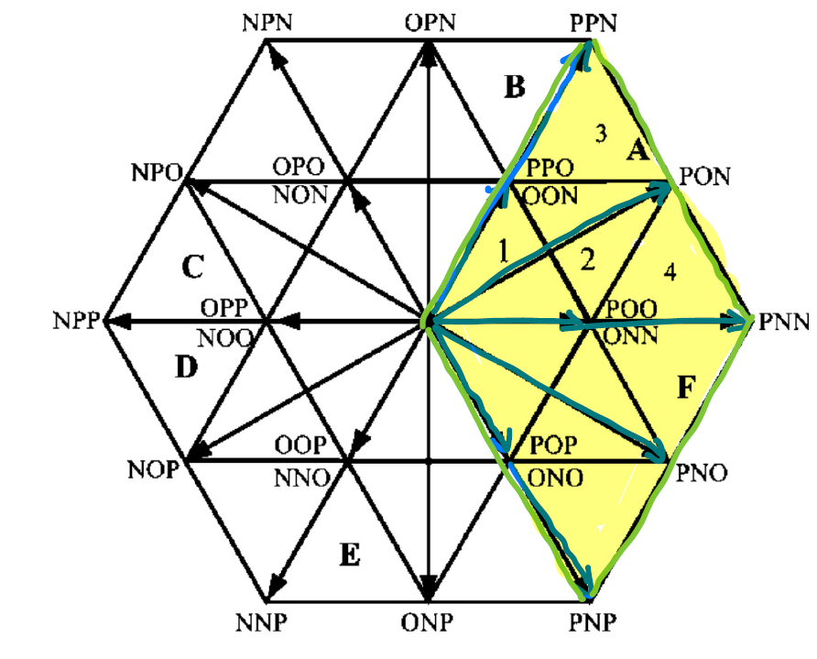
NPC Under Fault Operation – Sa3/Q3 fault

Slide 23
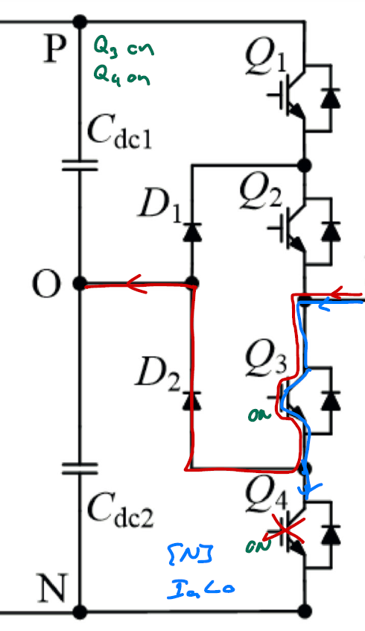
NPC Under Fault Operation – Sa4/Q4 fault

Slide 24
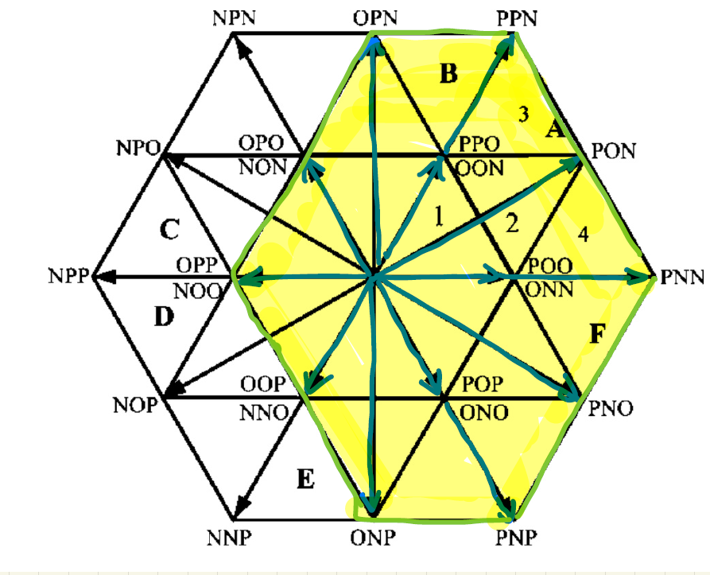
NPC Under Fault Operation – Sa4/Q4 fault

