Slide 1


Slide 3
Outline
Electrical Machine Drives
Inverters
Aim of the Study
Inverter Control Techniques
3- Level NPC Inverters & Drive Methods
Possible Fault States
Operation Vector Under Fault States
Conclusion
References

Slide 4
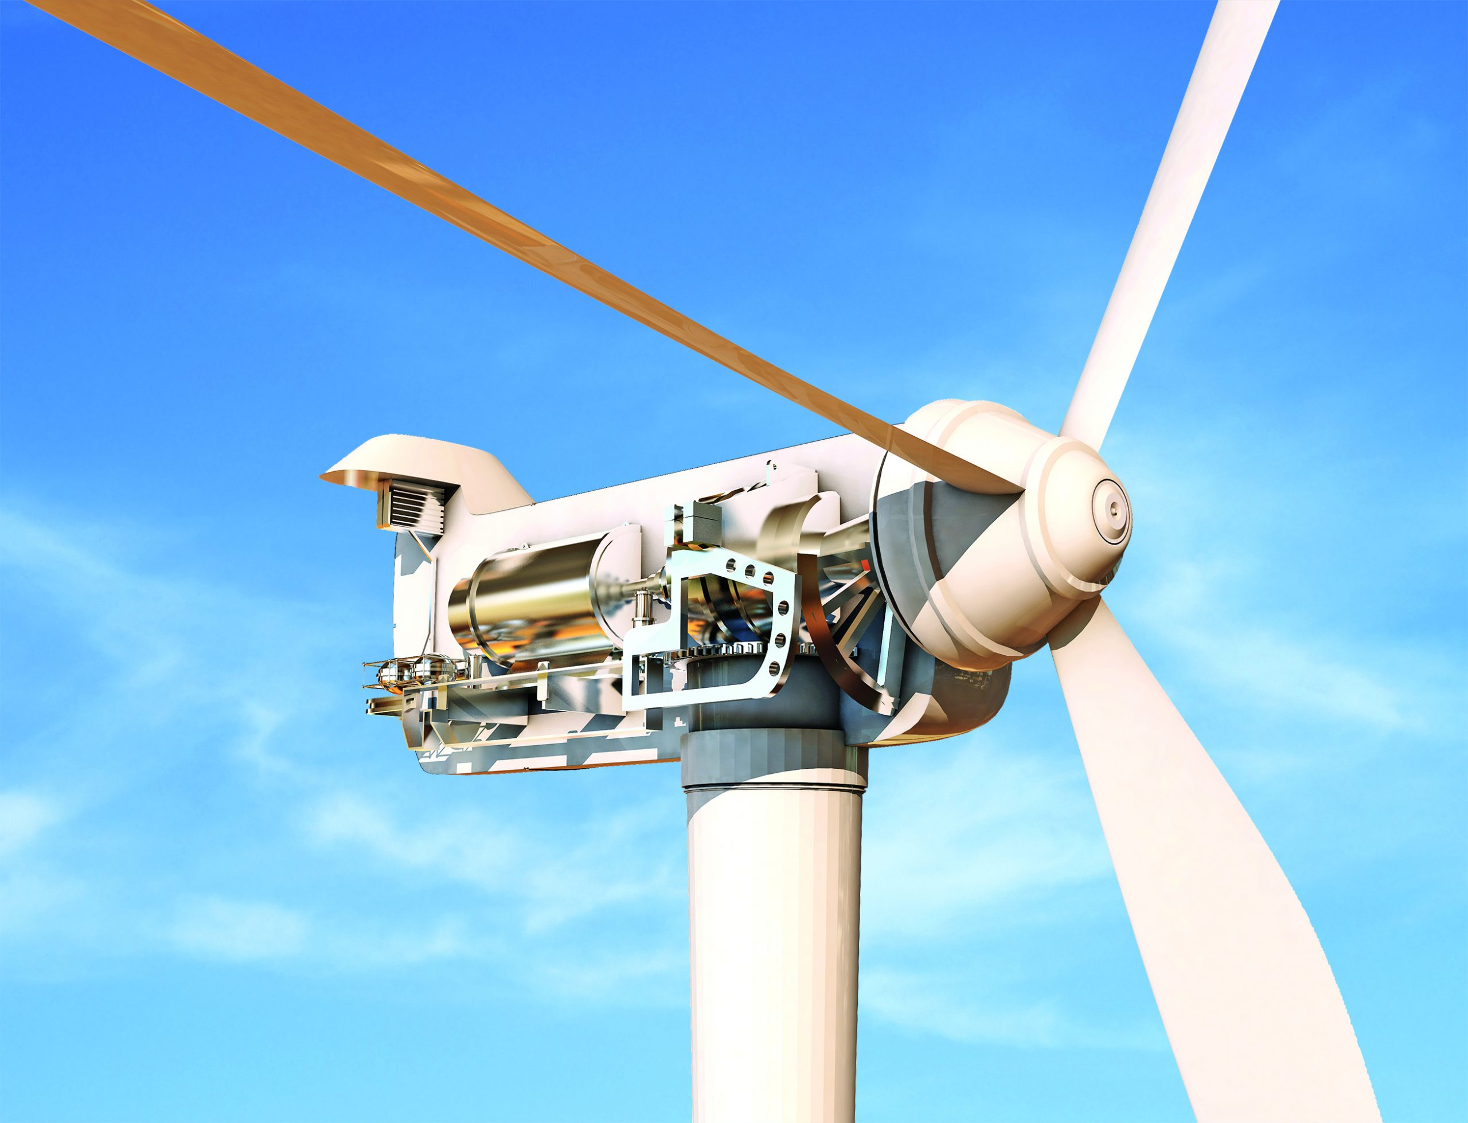
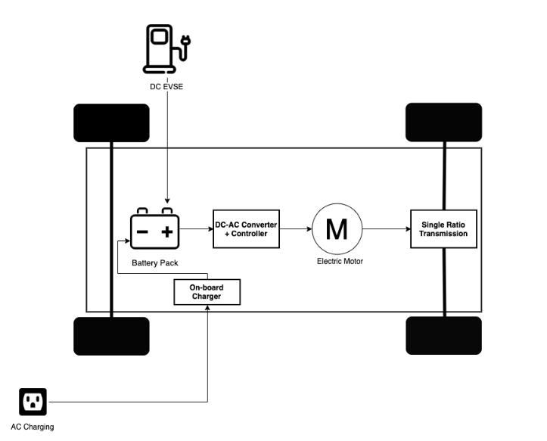
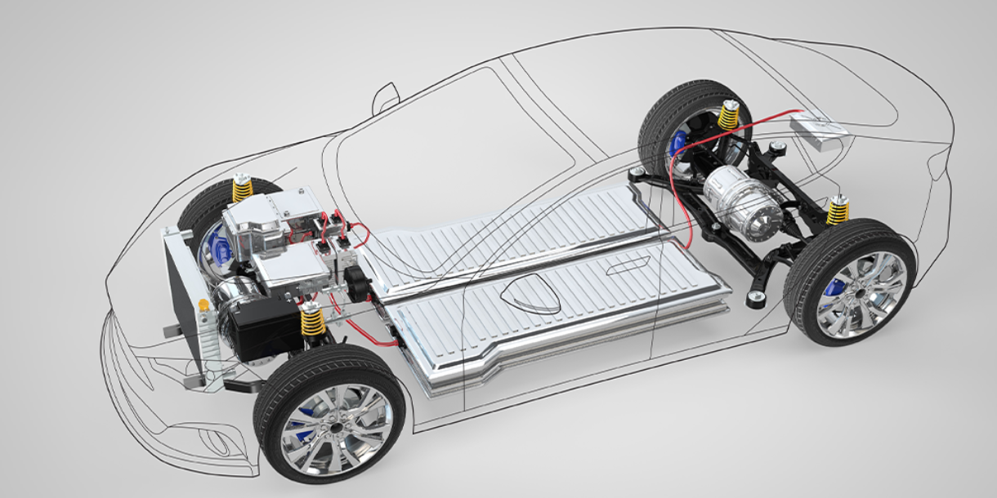
Electrical Machine Drives
AC Machine Applications,
Electrical Vehicles
Renewable Energy Systems
Control of an AC Machine for
desired Speed, Torque
DC/AC Converters (Inverters)

Slide 5
Inverters

Slide 6
Inverters
2-level Inverters
3-Level Inverters
6 switches
[Vdc/2, -Vdc/2] voltage levels
Voltage stress of switch: Vdc
Different Types( T-type, NPC etc.)
[Vdc/2, 0, -Vdc/2] voltage levels [1]
Voltage stress of switch: Vdc/2

Slide 7
Aim of the Study

Slide 8
3-Level NPC Inverters
12 switches
6 diodes for 0-states
Capacitor voltages can be different.
Neutral Point must be controlled.
3-Level NPC Inverter Circuit

Slide 9
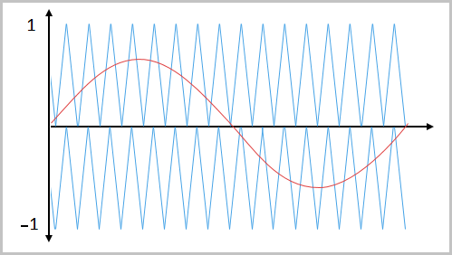
Control Techniques
Sinusoidal PWM
2 carrier triangular signals
3 reference signal with 120° phase shift
Not control the neutral point

Slide 10
Control Techniques
Space Vector PWM (SVPWM)
Totally 27 switching states [2]
Required output vector is obtained by using four vectors.
Six major regions. Each major regions have six sub regions.
State | Vout | Sa1 | Sa2 | Sa3 | Sa4
P | +Vdc/2 | ON | ON | OFF | OFF
0 | 0 | OFF | ON | ON | OFF
N | -Vdc/2 | OFF | OFF | ON | ON
Space Vector Diagram of 3-Level NPC Inverter

Slide 11
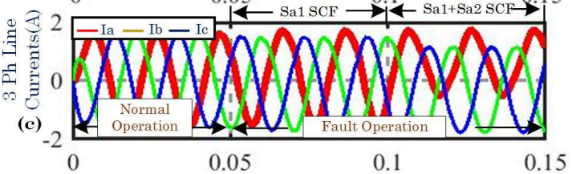
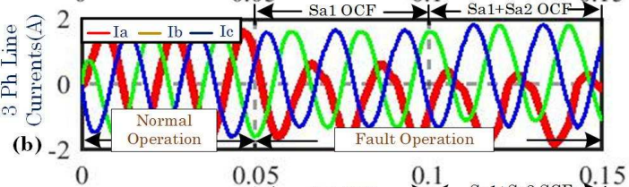
Possible Fault Scenarios
Short Circuit
Open Circuit
Overcurrent condition
Current distortion observed significantly.
Magnitudes of the current reduces [3].
Effect of fault of middle switches is larger

Slide 12
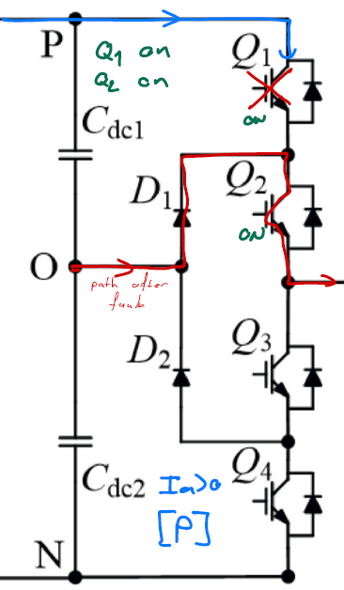
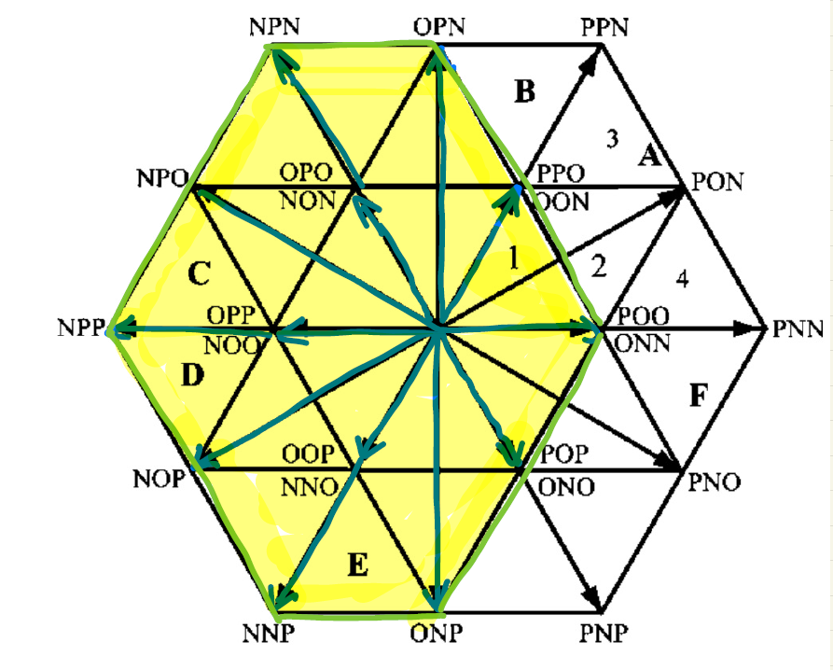
Space Vectors Under Fault States
Q1 open circuit
Current flow of phase-a when Ia>0 and at P-state
Space Vector Diagram for Q1 fault

Slide 13
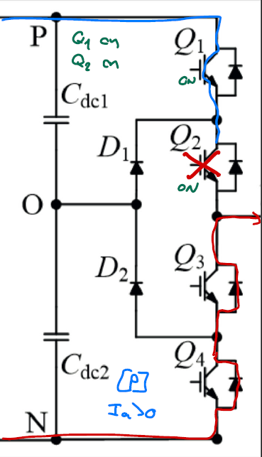
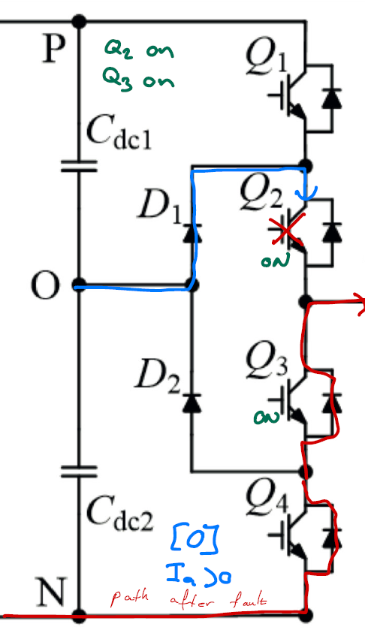
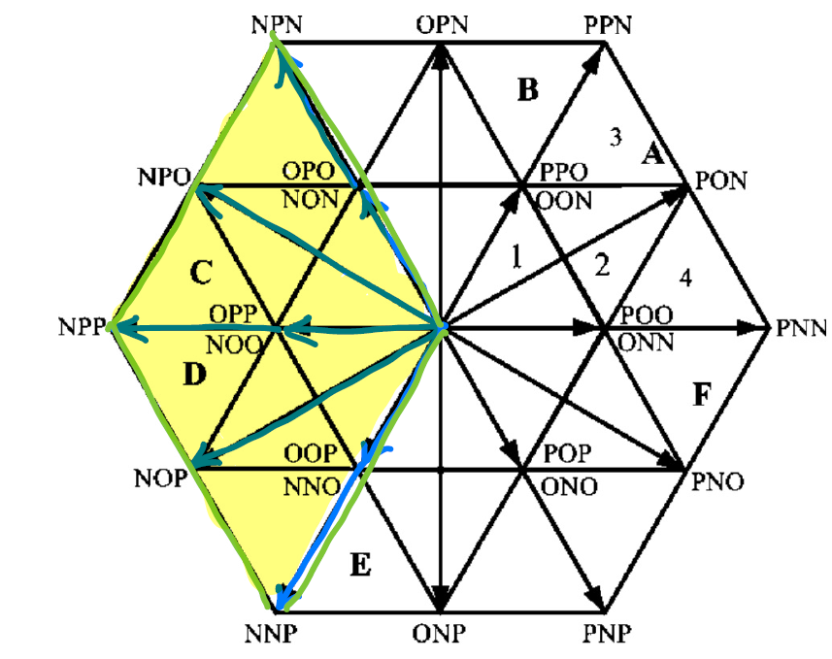
Space Vectors Under Fault States
Q2 open circuit
Current flow of phase-a when Ia>0 and at
P-state
Current flow of phase-a when Ia>0 and at
O-state
Space Vector Diagram for Q2 fault

Slide 14
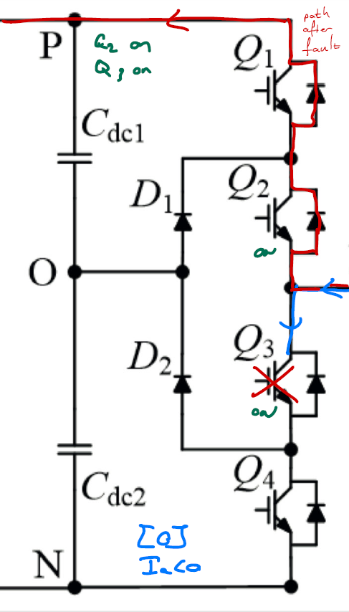
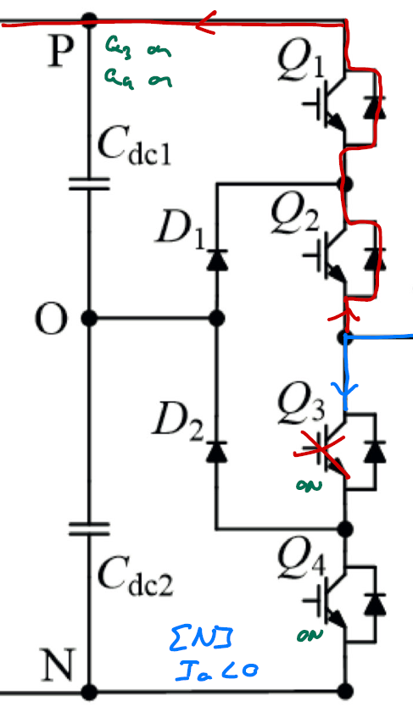
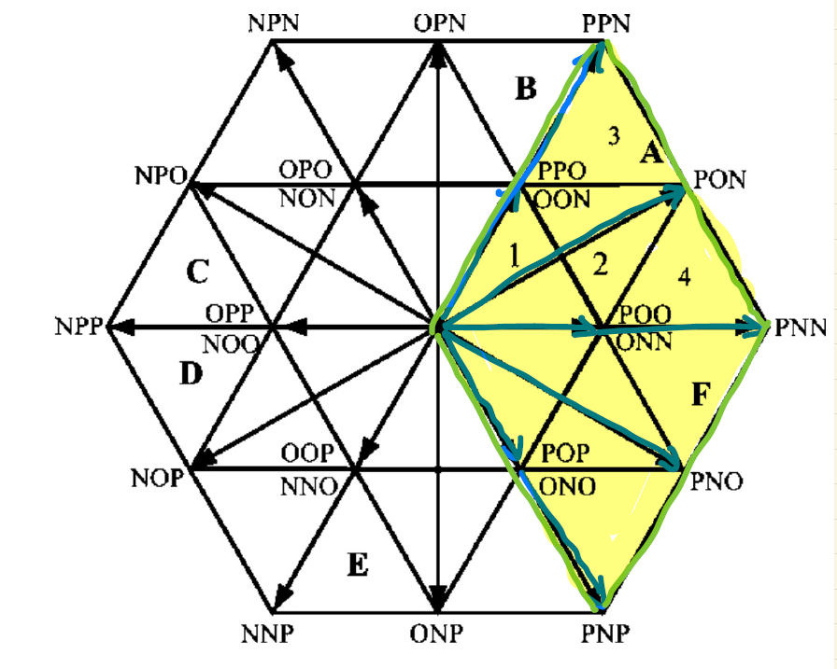
Space Vectors Under Fault States
Q3 open circuit
Space Vector Diagram for Q3 fault
Current flow of phase-a when Ia<0 and at
O-state
Current flow of phase-a when Ia<0 and at
N-state

Slide 15
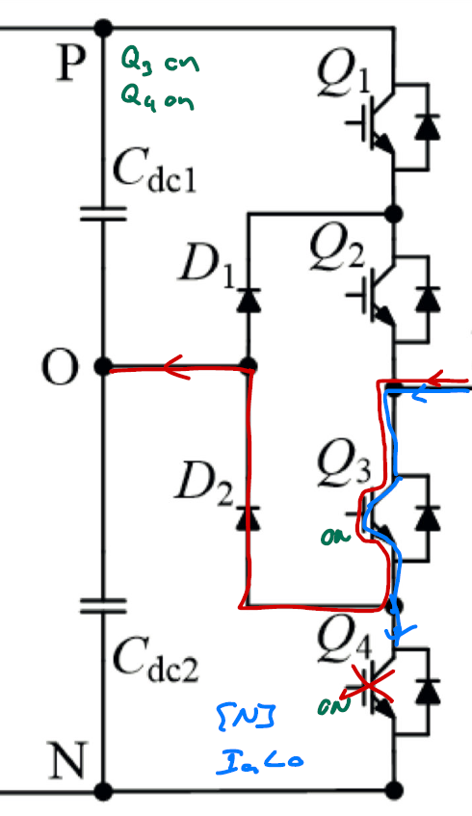
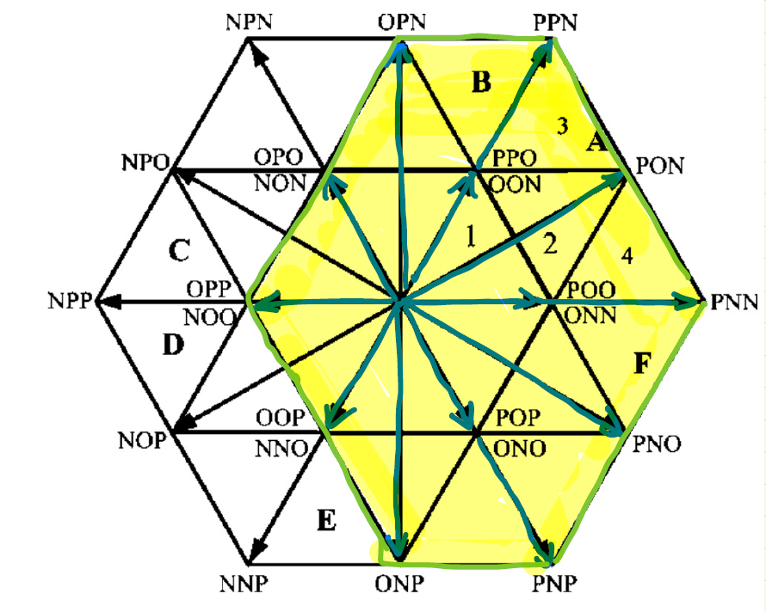
Space Vectors Under Fault States
Q4 open circuit
Space Vector Diagram for Q4 fault

Slide 16
Fault Tolerant Control Strategy for 3-Level Inverters

Slide 17
Conclusion

Slide 18
Reference
[1] J. Rodriguez, S. Bernet, P. K. Steimer and I. E. Lizama, "A Survey on Neutral-Point-Clamped Inverters," in IEEE Transactions on Industrial Electronics, vol. 57, no. 7, pp. 2219-2230, July 2010
[2] Keqing Qu, Xi Jin, Yuehong Xing, Zuojin Ding and W. Chen, "A SVPWM control strategy for NPC three-level inverter," 2011 IEEE Power Engineering and Automation Conference, Wuhan, China, 2011
[3] K. Patel, S. Borole, R. Manikandan and R. R. Singh, "Short Circuit and Open Circuit Fault Identification Strategy for 3-Level Neutral Point Clamped Inverter," 2021 Innovations in Power and Advanced Computing Technologies (i-PACT), Kuala Lumpur, Malaysia, 2021
[4] A. Alili, A. A. Ameri, M. B. Camara and B. Dakyo, "Open-circuit fault detection method for Grid-side Three-level NPC Inverter," 2021 10th International Conference on Renewable Energy Research and Application (ICRERA), Istanbul, Turkey, 2021
[5] K. Yamanaka, A. M. Hava, H. Kirino, Y. Tanaka, N. Koga and T. Kume, "A novel neutral point potential stabilization technique using the information of output current polarities and voltage vector," in IEEE Transactions on Industry Applications, vol. 38, no. 6, pp. 1572-1580, Nov.-Dec. 2002
[6] A. Benevieri, L. Carbone, S. Cosso, F. Gallione and S. Hussain, "A New Strategy for Detection and Management of Faults in High Power NPC Converter Systems," 2023 13th International Symposium on Advanced Topics in Electrical Engineering (ATEE), Bucharest, Romania, 2023

