Slide 1

Dual-Approach Stock Forecasting Prophet and LSTM Applications
SEDS 482
Erhan ALASAR
Ahmet Can KARATAŞ

Slide 2
PROBLEM DEFINITION & PURPOSE
Stock price forecasting is a complex challenge due to the volatile nature of financial markets, driven by economic, political, and social factors.
Investors need reliable tools to predict price trends across broad market indices like BIST 50 to support diversified investment strategies.
Purpose:
Develop a user-friendly tool to forecast prices for all BIST 50 stocks, making it accessible for investors and analysts.
Build a detailed predictive model for THYAO to capture complex price patterns, aiding precise investment decisions.

Slide 3






tools
Data Science & Analysis
numpy, pandas, scikit-learn
Deep Learning & AI
tensorflow, keras
Time Series & Forecasting
prophet
Data Collection
yfinance
Visualization
matplotlib, seaborn, plotly
Web Application
streamlit
API & Web Tools
requests, urllib
Environment & Configuration
python-dotenv

Slide 4
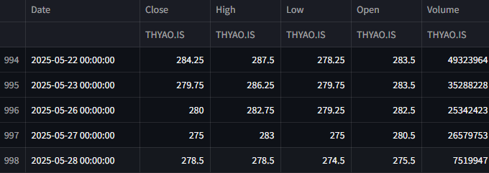
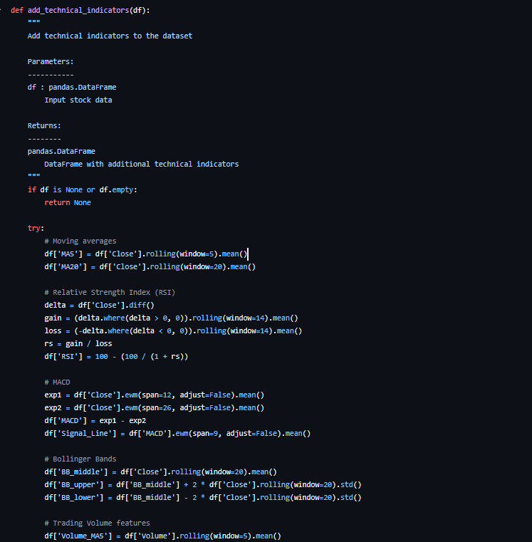
Data Work
BIST 50 Data Preparation
Dynamically fetched four years of daily closing prices for the user-selected BIST 50 stock in real-time when the forecast is requested, ensuring up-to-date data.
Simplified the data to focus solely on date and closing price to meet the forecasting model’s requirements.
Ensured data reliability by leveraging a robust data source that minimizes incomplete or erroneous entries.
THYAO Data Preparation
Gathered four years of daily price data for THYAO to establish a robust historical baseline.
Enhanced the dataset with extra market details, including:
Moving Averages (5-day and 20-day) to identify short- and long-term price trends.
Relative Strength Index (RSI) to measure momentum and overbought/oversold conditions.
MACD (Moving Average Convergence Divergence) to detect trend changes and momentum shifts.
Bollinger Bands to assess price volatility and potential breakout points.
Volume-based indicators to capture trading activity and its impact on price movements.
Analysis Preparation Processes:
Removed missing or invalid data points resulting from indicator calculations to ensure data quality.
Structured the data into 60-day sequences to enable the model to learn from historical patterns over a consistent time window.
Normalized the data to standardize values, improving model performance and prediction reliability.

Slide 5
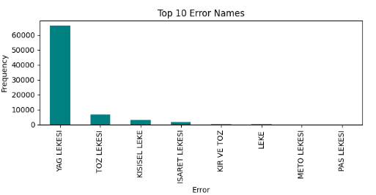
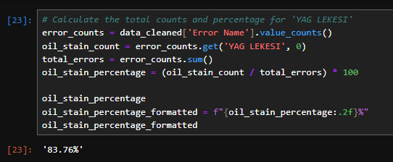
EDA (Exploratory Data AnalysIs)
We can focus «Oil Stain»
Oil Stain → %83,76

Slide 6
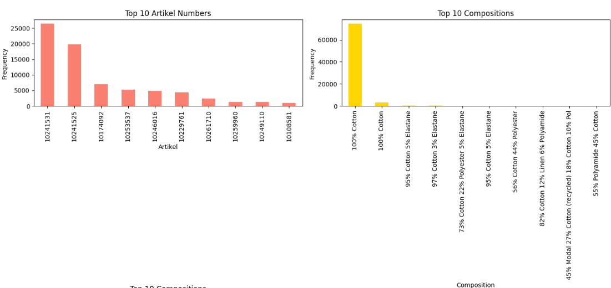
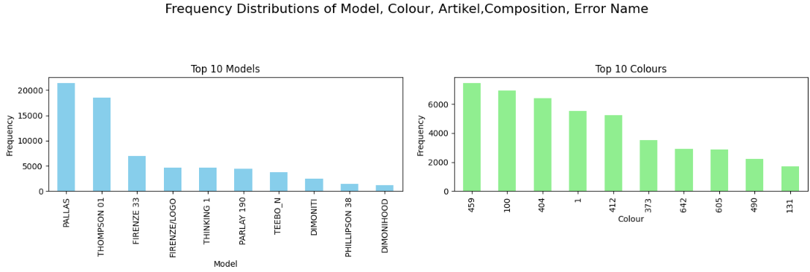
EDA (Exploratory Data AnalysIs)

Slide 7
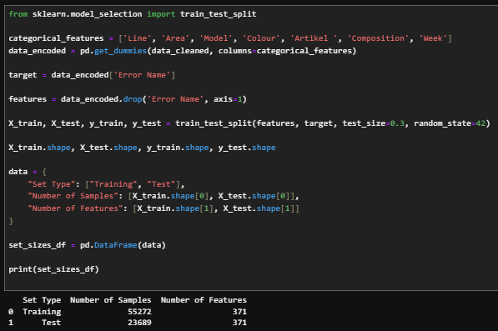
Data modellıng
Categorical Data Encoding
&
Training & Test Data
Target Variable:
Error Name
Features:
Line
Area
Model
Colour
Artikel
Composition
Week

Slide 8
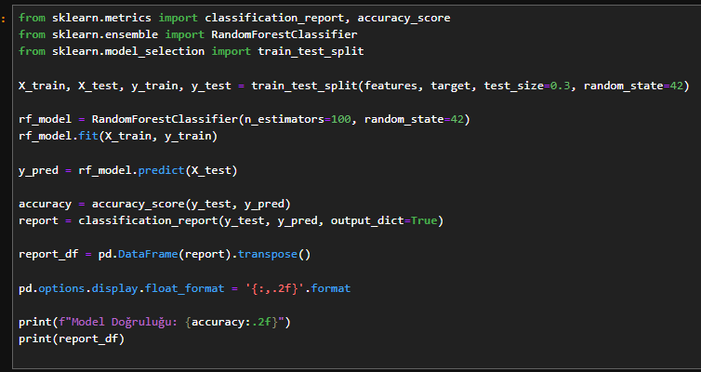
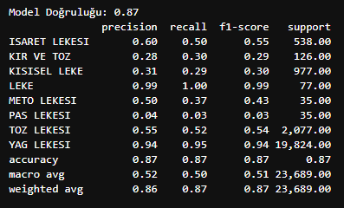
Data modellıng & Results
Random Forests Classification
Precision: The ratio of correctly predicted positive observations to the total predicted positives.
Recall: The ratio of correctly predicted positive observations to all observations in the actual class.
F1 Score: The harmonic mean of precision and recall, balancing the two metrics.
Support: The number of actual occurrences of the class in the dataset

Slide 9

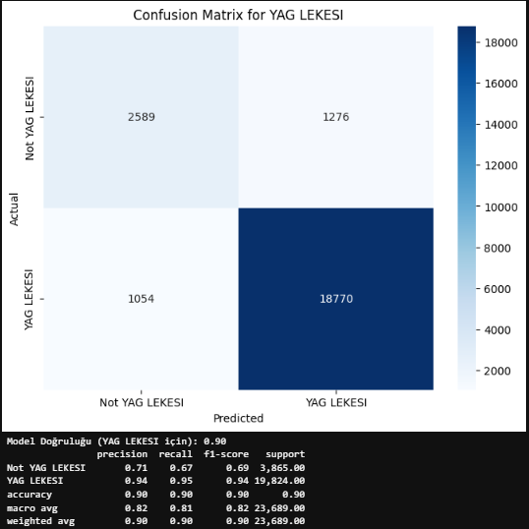
Data modellıng VISUALIZATION
Confusion Matrix

Slide 10

ACTIONS
According to the random forest model, the highest accuracy rate was found for machine oil stains. This indicates that we can predict oil stains in advance.
Actions;
Special machines were cleaning every 2 hours. Based on this model, the cleaning frequency of the machines will be increased under the specified conditions.
The frequency of machine oil maintenance checks will also be increased.

Slide 11
Thank you ☺

