Slide 1
Spotify Consumption Analysis
Ahmet Can Toksoy, 30885

Slide 2
Motivation
Understand habits, preferences, and trends.
Explore evolution of musical engagement over years.
Enrich portfolio with data analysis skills.
Initial broader scope reduced due to time constraints.

Slide 3
Data Source
Data obtained from Spotify's streaming history (JSON format).
Includes timestamps, track titles/artists, listening durations, platforms, etc.
Combined data spans 2016-2024.
Limited use of Spotify API due to deprecated endpoints.

Slide 4
Data Preprocessing
Key Steps:
Converted timestamps to datetime; extracted features (date, time, day).
Removed missing/irrelevant values.
Standardized and encoded categorical data (e.g., platforms).
Created sessions based on 30-min gaps (short, medium, long).

Slide 5
Exploratory Data Analysis (EDA)
Aggregate statistics: Total listening time, top tracks/artists.
Temporal patterns: Weekly, hourly trends visualized.
Yearly breakdowns to detect behavior changes.
Skipped vs. completed tracks: Insights from pie charts.
Session durations and platform preferences explored.

Slide 6
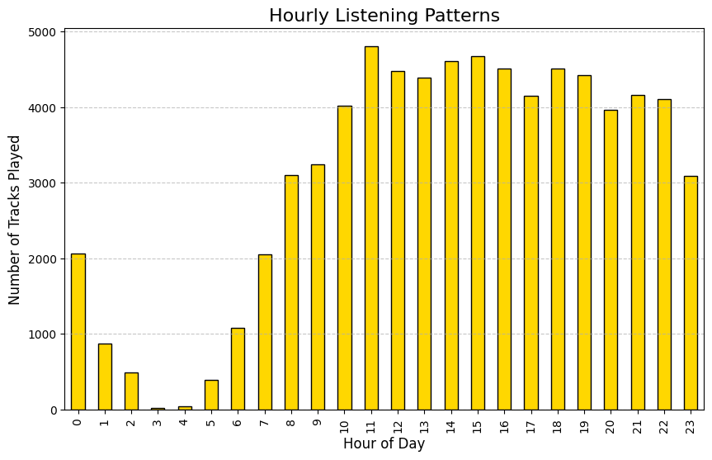
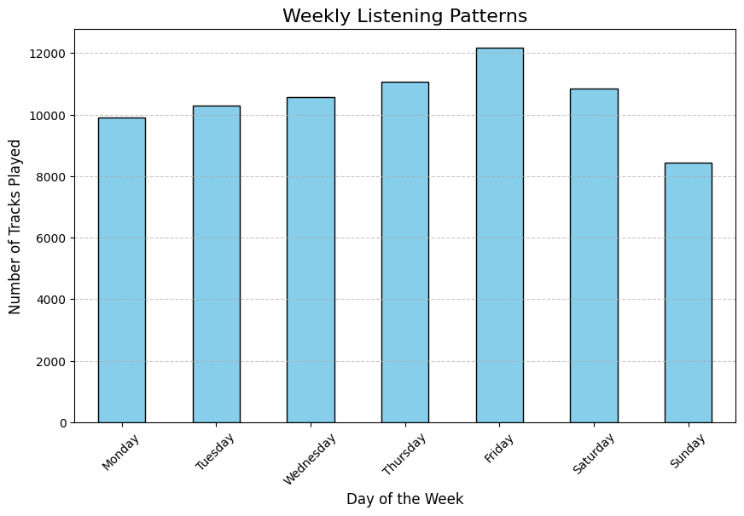
Data Visualization
Line plots, bar charts, scatter plots, stack plots

Slide 7
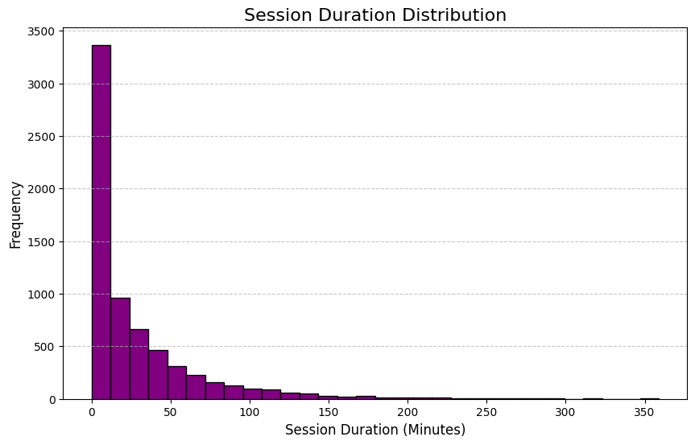
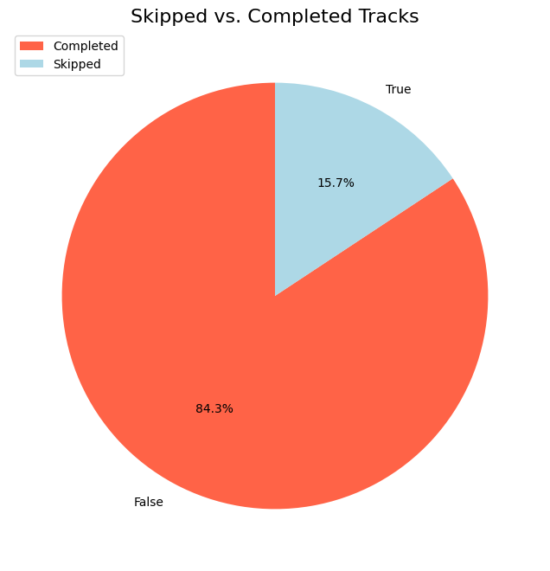
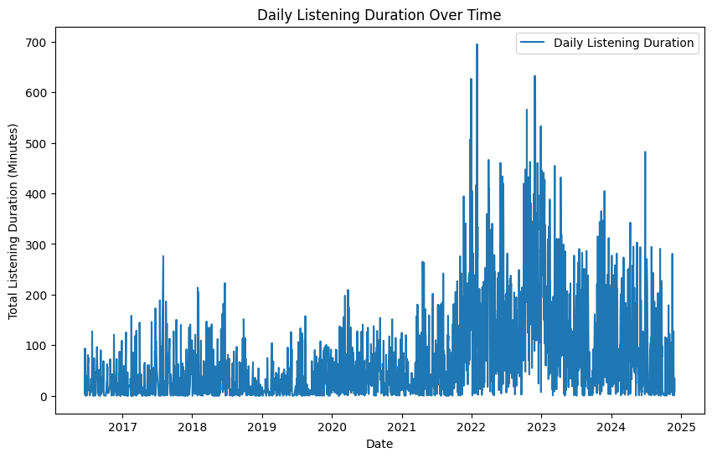

Slide 8
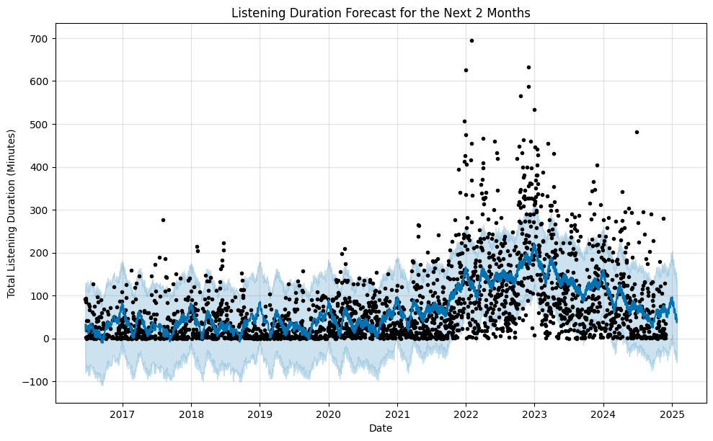
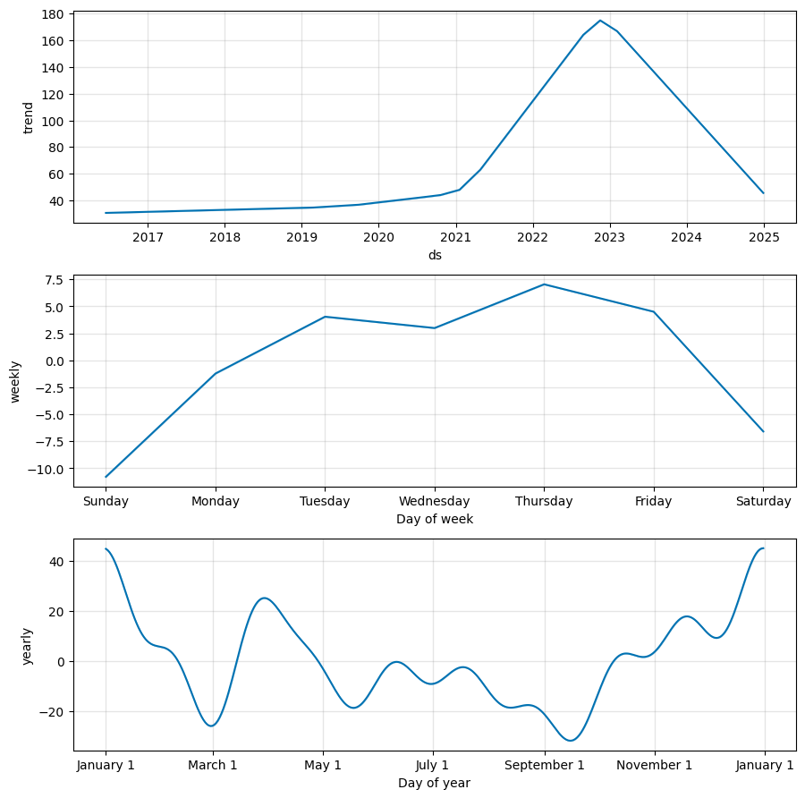
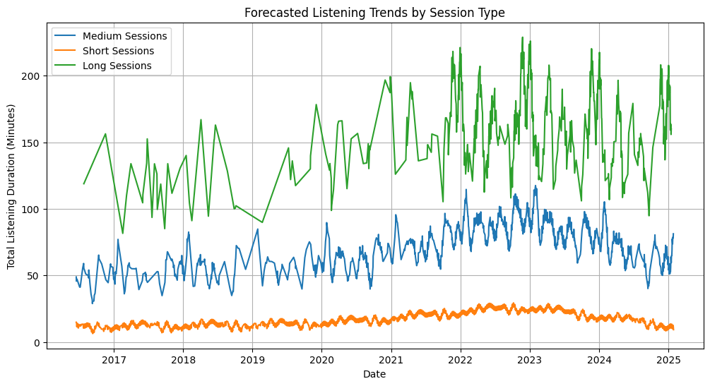

Slide 9
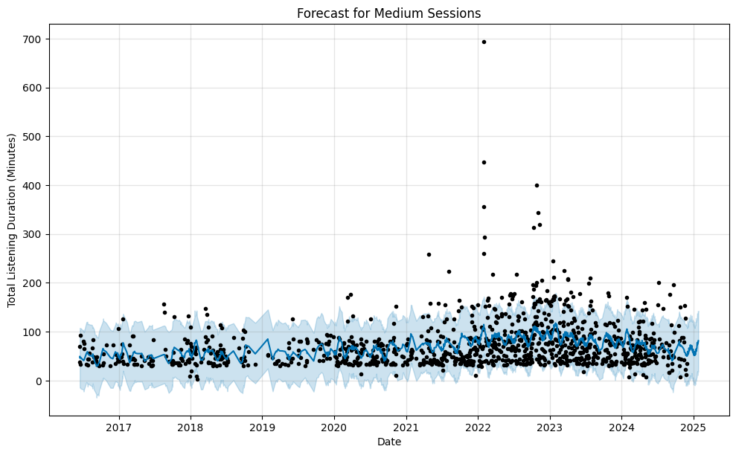
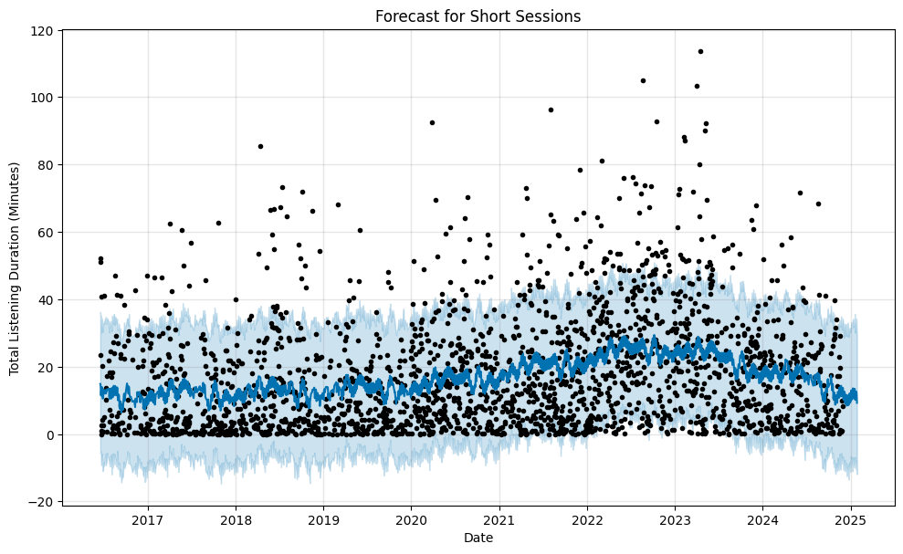
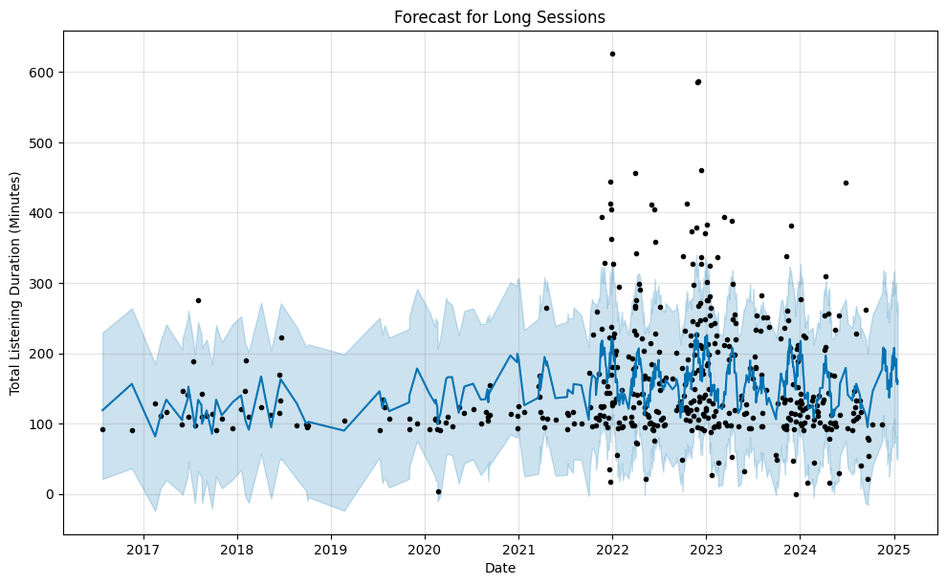

Slide 10
Hypothesis Testing
Yearly Listening Trends: One-way ANOVA test.
Shuffle vs. Non-Shuffle Modes: Normality test + parametric/non-parametric tests.
Repeat vs. Unique Listening: Statistical comparison.

Slide 11
Time Series Analysis
Forecasted total listening duration for next 60 days using Prophet.
Session-based forecasting: Short, medium, long session growth/decline.
Highlighted session contributions using stack plots.

Slide 12
Classification Techniques
Built XGBoost classifier to predict platforms.
Features: Listening hour, day of week, duration, time block.
Addressed class imbalance using SMOTE.
Achieved 59% accuracy :(

Slide 13
Key Findings
Total listening time: 3,173 hours (29 tracks/day average).
Most played artists: Hayko Cepkin, Nightwish, Rammstein.
Genre evolution: Metal, alternative, pop (2016-2018); heavy rock/metal (2019+).
Most active listening day: Fridays.
Listening peaks: Evenings (18:00-22:00).
Platforms: iOS > Windows > Partner platforms.

Slide 14
Limitations and Future Work
Limitations:
Limited data scope due to API changes.
Machine learning model's low accuracy.
Future Improvements:
Broader analysis of other social media platforms.
Use external data for song features (e.g., danceability, mood labels).
Train better models with more suitable data.

