Slide 1
Docker and Containers
MLOps - YZV448E
Ahmet Enes Topçu - topcua21@itu.edu.tr

Slide 2
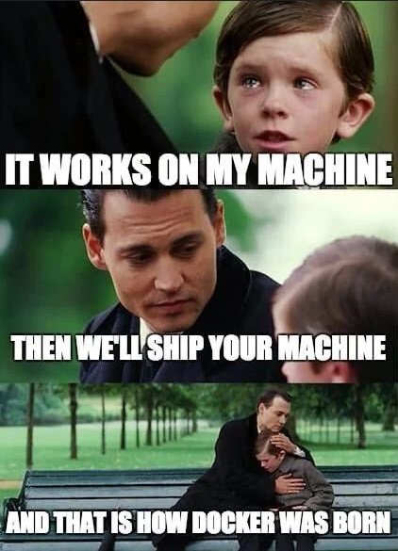
The "It Works on My Machine" Problem
Development Environment: Works perfectly on the developer's laptop.
Testing Environment: Fails due to a different OS or missing dependencies.
Production Environment: Crashes because of a slightly different library version.
This inconsistency leads to delays, bugs, and frustration.

Slide 3
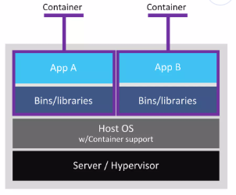

What is a Container?
A standard unit of software that packages up code and all its dependencies.
The application runs quickly and reliably from one computing environment to another.
It isolates the application from its surroundings.
Think of it like a shipping container: it doesn't matter what's inside, it can be shipped and run anywhere.

Slide 4
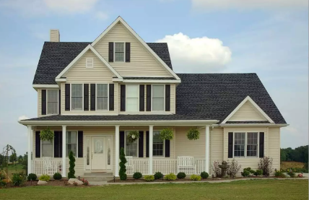
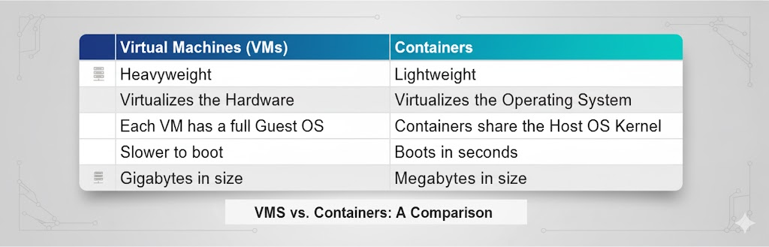
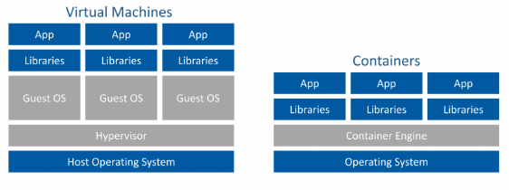
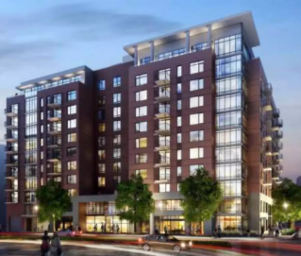
Containers vs. Virtual Machines
VMS
Containers

Slide 5
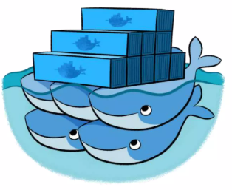
What is Docker?
Docker is a platform for developing, shipping, and running applications in containers.
It provides the tools to build, manage, and run containers easily.
It is the most popular containerization technology in the world.
Docker makes it easy to create and use containers.

Slide 6
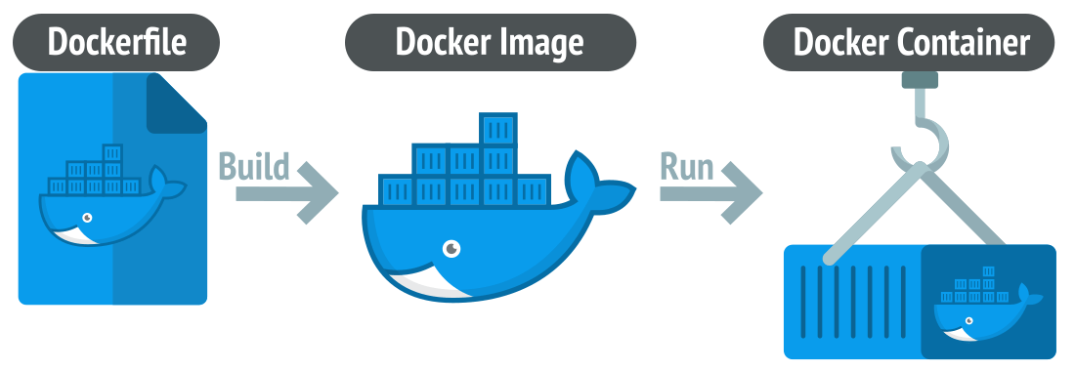
Core Docker Concepts: Image & Container
Docker Image:
A read-only template with instructions for creating a container.
Like a "blueprint" or a "recipe".
Contains the application code, libraries, and dependencies.
Stored in a registry like Docker Hub.
Docker Container:
A runnable instance of an image.
The "living" version of the blueprint.
You can create, start, stop, and delete multiple containers from the same image.

Slide 7
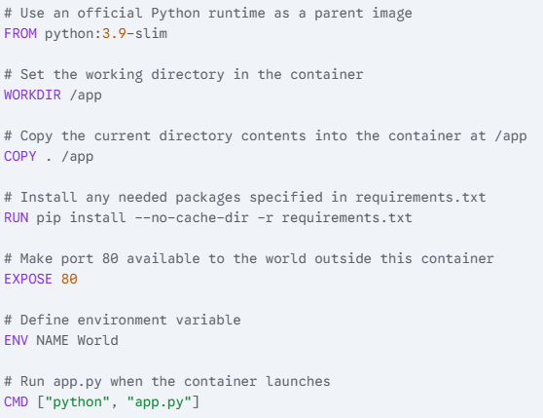
The Dockerfile: Building Your Own Image
A Dockerfile is a text file that contains commands to assemble an image.
Example Dockerfile for a simple Python app:

Slide 8
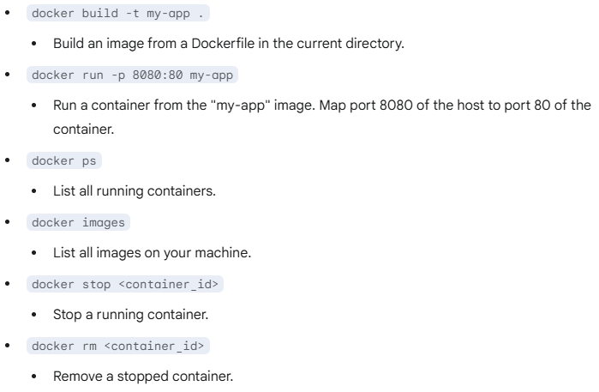
Basic Docker Commands

Slide 9
Why Use Docker? The Benefits
Portability: Runs the same everywhere (Development, Testing, Production).
Efficiency: Uses fewer resources than VMs, allowing more applications to run on the same hardware.
Isolation: Applications are isolated from each other and the host system, improving security.
Scalability: Easy to create and destroy containers to scale applications up or down.
Rapid Deployment: Speeds up the development and release cycle.
Rich Ecosystem: Docker Hub provides thousands of pre-built images to start with.

Slide 10
Links
Docker get-started link
https://docs.docker.com/get-started/docker-overview/
Download Docker
https://docs.docker.com/get-started/introduction/get-docker-desktop/
Comprehensive Youtube Video
https://youtu.be/DQdB7wFEygo?si=QGPBbPm6I3HLuJoR
Github Repo
https://github.com/ahmetenestopcu/Docker101.git

