Slide 1

EE584: Machine Vision
Term Project
Ahmet Ertürkmen

Slide 2
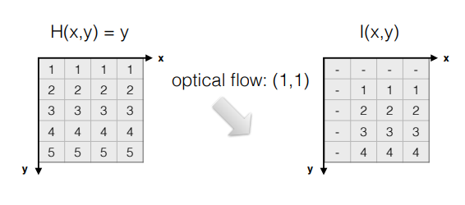
Notes:
Optical flow is estimation of two dimensional vector that indicates motion of objects, surfaces and edges in scene(Figure 1). In this paper, for estimation of optical flow Lucas Kanade algorithm and HCVFlow model is examined and compared.

Slide 3
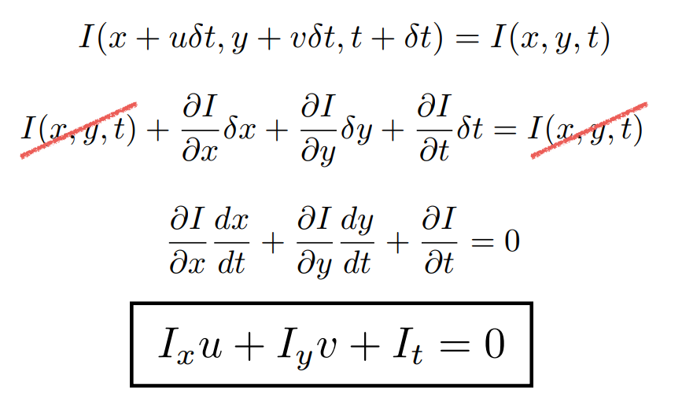
Notes:
Classical methods dates back to early 80’s. Improving on the brightness constancy assumption, the Lucas-Kanade algorithm formulates optical flow estimation as a local least-squares problem, assuming that motion is constant within a small neighborhood around each pixel [1]. This statement yields derivation in Figure 2

Slide 4
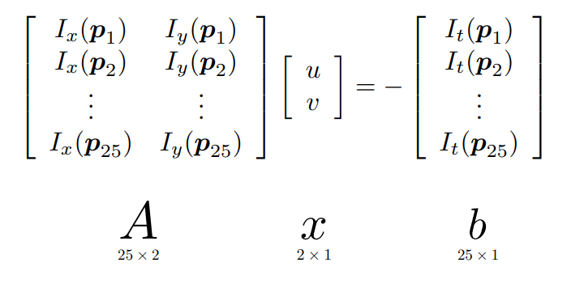

Slide 5
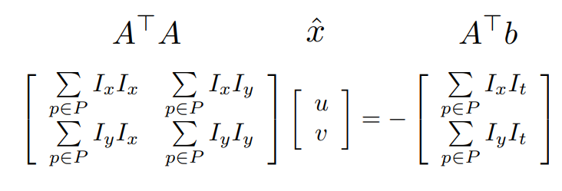

Slide 6
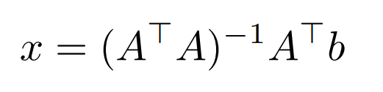

Slide 7
Modern Approaches
Most of the state of the art papers are based on cost volumes.
Leads to computational problems (O(HxWxHxW).

Slide 8
HCVFlow
Instead of 4D cost volumes, two 3D global cost volumes are used. Also 4D local cost volume with local search space is introduced.

Slide 9
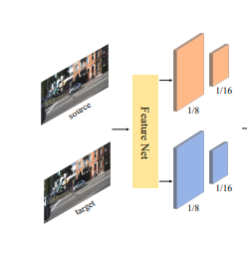
Notes:
algorithm starts with FeatureNet block that extracts feature map of source and target images in ¹⁄₁₆ and ⅛ resolution of original images.

Slide 10
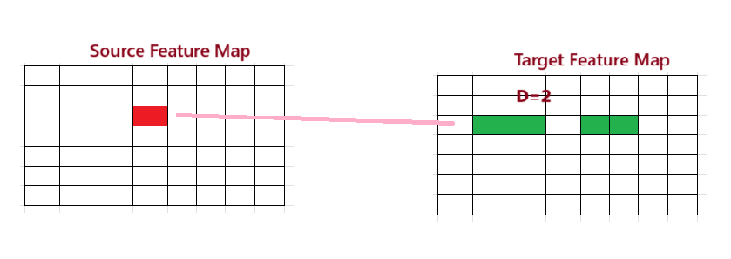
Notes:
For each pixel in source feature map, HCVFlow calculates its correlation with pixels along the same row limited to window in length of D. This gives horizontal cost volume

Slide 11
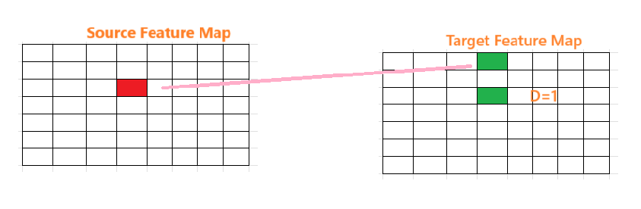

Slide 12
“Top-k” strategy is implemented. Instead of keeping all the correlation scores, only k most relevant pixels are kept. This significantly reduces memory usage. As a result cost volume with dimensions HxWxkxD are created. Note that H and W values are ¹/₁₆ of original image resolution.

Slide 13
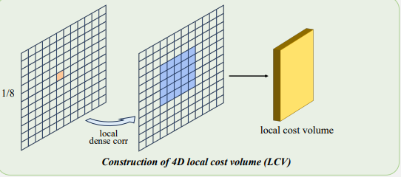
Notes:
. It is calculated between every pixel in source image feature map and corresponding small local search window in target image feature map.

Slide 14
Concatanated hybrid cost volume is then fed into convolutional gated recurrent unit.

Slide 15
Experiments

