Slide 1
BACKFLYP
Md Shazid Hasan - 1824572
Ahmet Furkan Gürsoy - 2375061

Slide 2
Why Flyback
Good Isolation
Wide Input Range
High Efficiency
Fewer Component Comparing Other Topologies
Many Design Guides

Slide 3

Design Parameters
$V_{Qmax}=V_{RO}+$ $V_{in,max}$
$V_{RO}=V_{Qmax}−$ $V_{in,max}$
$$V_{RO}=42−18=24V$$
$$V_{RO}=\frac{N_{1}}{N_{2}}∗V_{out} →\frac{N_{1}}{N_{2}}=\frac{1}{2}$$

Slide 4

$L_{p}=\frac{V_{in,min}^{2}∗D_{max}^{2}∗eff}{2∗P_{out}∗f_{sw}}=\frac{{(12∗0.5)}^{2}∗0.9}{2∗48∗60kHz}=5.625 μH$
$I_{p,peak}=\frac{V_{in}∗D_{max}}{L_{p}∗f_{sw}}=\frac{12∗0.5}{5.625μ∗60k}=17.78 A$
$I_{p,rms}=17.78∗\sqrt{\frac{0.5}{3}}=7.26 A$
$I_{s,peak}=\frac{17.78}{2}=8.89 A$
$I_{s,rms}=8.89∗\sqrt{\frac{0.5}{3}}=3.63 A$

Slide 5
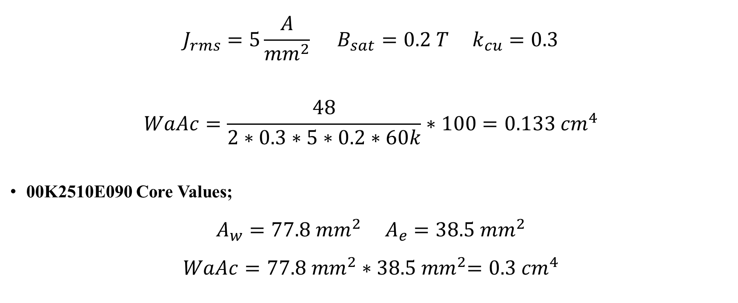
Magnetic Design
$$J_{rms}=5\frac{A}{{mm}^{2}} B_{sat}=0.2 T k_{cu}=0.3$$
$$WaAc=\frac{48}{2∗0.3∗5∗0.2∗60k}∗100=0.133 {cm}^{4}$$
00K2510E090 Core Values;
$$A_{w}=77.8{ mm}^{2}{ A}_{e}=38.5{ mm}^{2}$$
$$WaAc=77.8{ mm}^{2}∗{ 38.5 mm}^{2}=0.3 {cm}^{4}$$

Slide 6
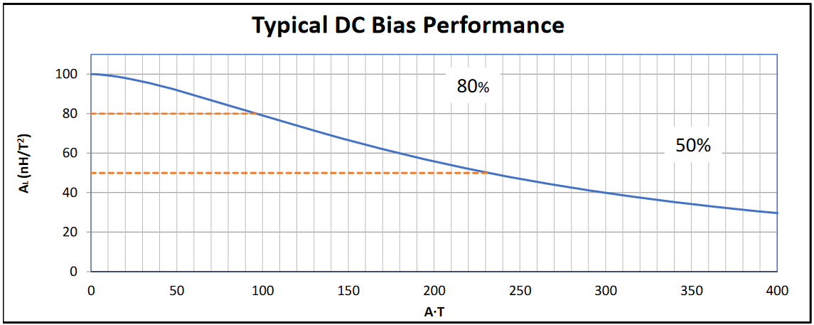
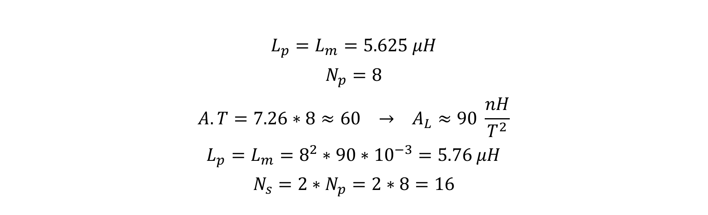
$$L_{p}=L_{m}=5.625 μH$$
$$N_{p}=8$$
$$A.T=7.26∗8≈60 → A_{L}≈90 \frac{nH}{T^{2}}$$
$$L_{p}=L_{m}=8^{2}∗90∗{10}^{−3}=5.76 μH$$
$$N_{s}=2∗N_{p}=2∗8=16$$

Slide 7
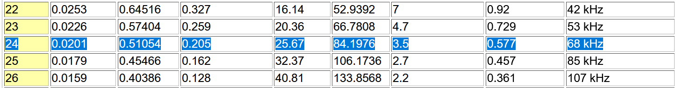

$$A_{pri}=\frac{7.26}{5}=1.452 {mm}^{2} A_{sec}=\frac{3.63}{5}=0.726 {mm}^{2}$$
$$n_{pri}=\frac{1.452}{0.205}≈7 n_{sec}=\frac{0.726}{0.205}≈4$$

Slide 8

Semiconductors
FQP30N6;
$$V_{ds}=60V I_{D}=30A {R_{ds(on)}=40mΩ Q_{g}=19nC R}_{θjc}=1.9\frac{℃}{W}$$
MBR20100;
$$V_{RRM}=100V I_{F}=10A V_{F}=0.8V R_{θjc}=2\frac{℃}{W}$$

Slide 9
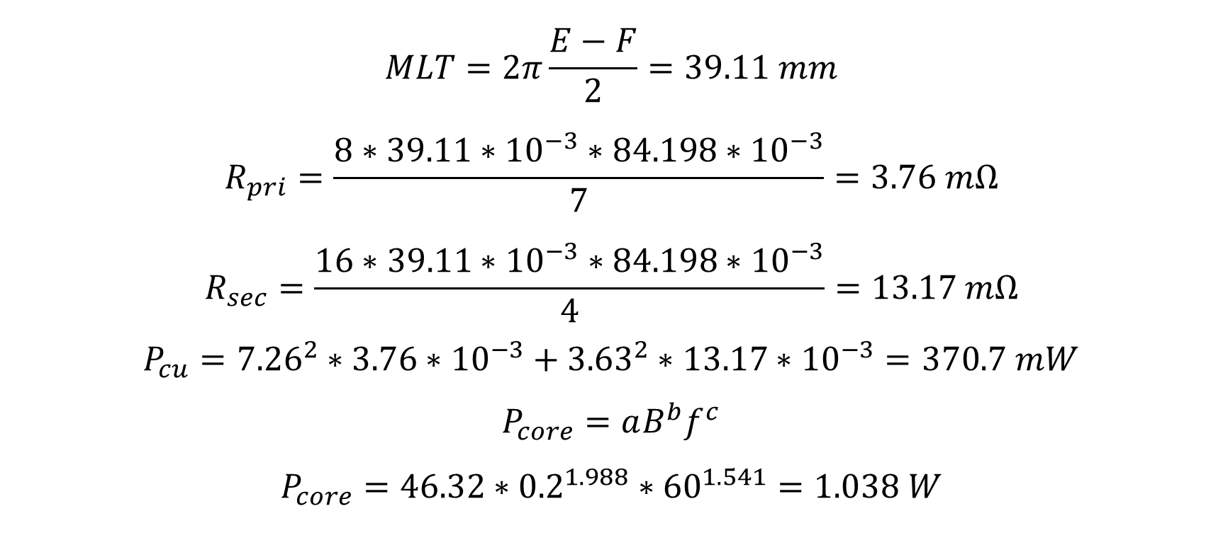
Losses
$$MLT=2π\frac{E−F}{2}=39.11 mm$$
$$R_{pri}=\frac{8∗39.11∗{10}^{−3}∗84.198∗{10}^{−3}}{7}=3.76 mΩ$$
$$R_{sec}=\frac{16∗39.11∗{10}^{−3}∗84.198∗{10}^{−3}}{4}=13.17 mΩ$$
$$P_{cu}={7.26}^{2}∗3.76∗{10}^{−3}+{3.63}^{2}∗13.17∗{10}^{−3}=370.7 mW$$
$$P_{core}=aB^{b}f^{c}$$
$$P_{core}=46.32∗{0.2}^{1.988}∗{60}^{1.541}=1.038 W$$

Slide 10

$$P_{cond,MOS}={(\frac{17.78}{4})}^{2}∗0.04=0.79 W$$
$$P_{sw,MOS}=V_{in}∗I∗f∗\left(t_{r}+t_{f}\right)$$
$$P_{sw,MOS}=18∗\frac{17.78}{4}∗60∗{10}^{3}∗\left(85+40\right)∗{10}^{−9}=0.6 W$$
$$P_{cond,max,Diode}=\frac{8.89}{4}∗0.8=1.78 W$$
Snubber Loss?

Slide 11
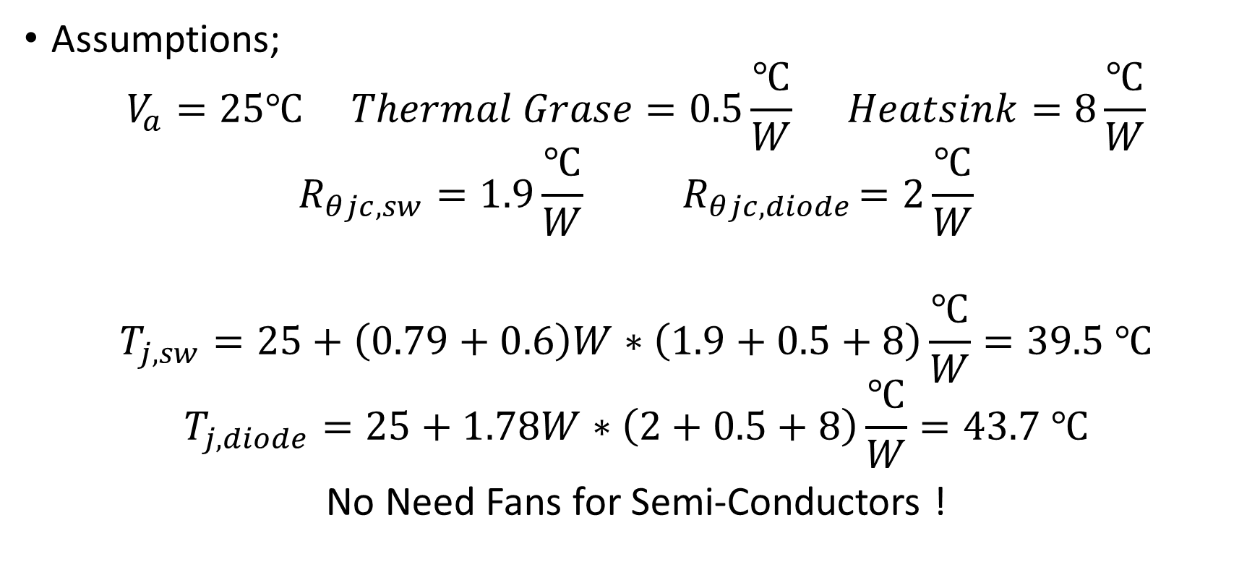
Thermal Calculations
Assumptions;
$$V_{a}=25℃ Thermal Grase=0.5\frac{℃}{W} Heatsink=8\frac{℃}{W}$$
$$R_{θjc,sw}=1.9\frac{℃}{W}{ R}_{θjc,diode}=2\frac{℃}{W}$$
$$T_{j,sw}=25+\left(0.79+0.6\right)W∗\left(1.9+0.5+8\right)\frac{℃}{W}=39.5 ℃$$
$$T_{j,diode}=25+1.78W∗\left(2+0.5+8\right)\frac{℃}{W}=43.7 ℃$$
No Need Fans for Semi-Conductors !

Slide 12
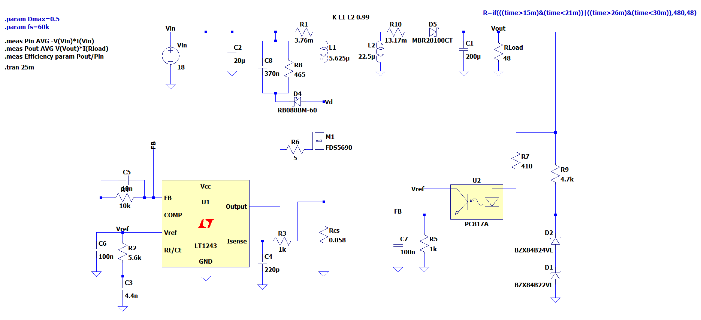

Slide 13
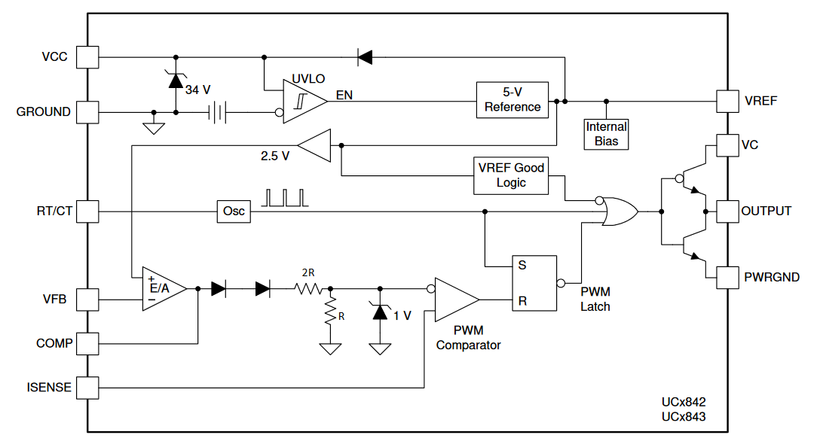
UC3843
12-28V Input
Current Mode Control
Up to 500 kHz
No Need for Additional Gate Driver

Slide 14
UC3843

Slide 15
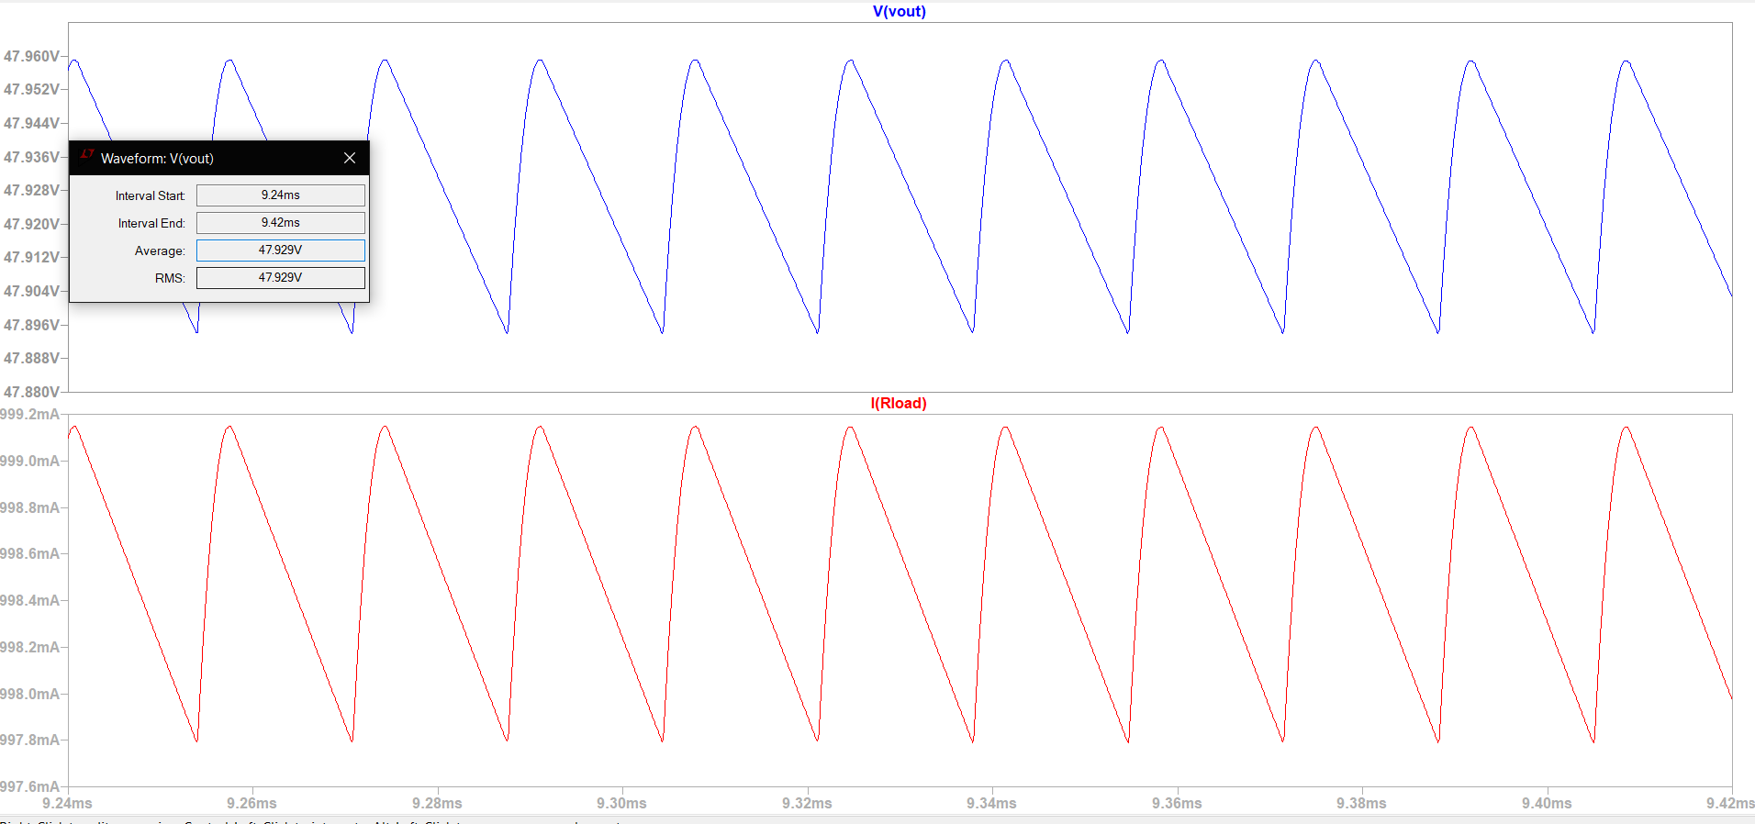
18V-100% Load

Slide 16
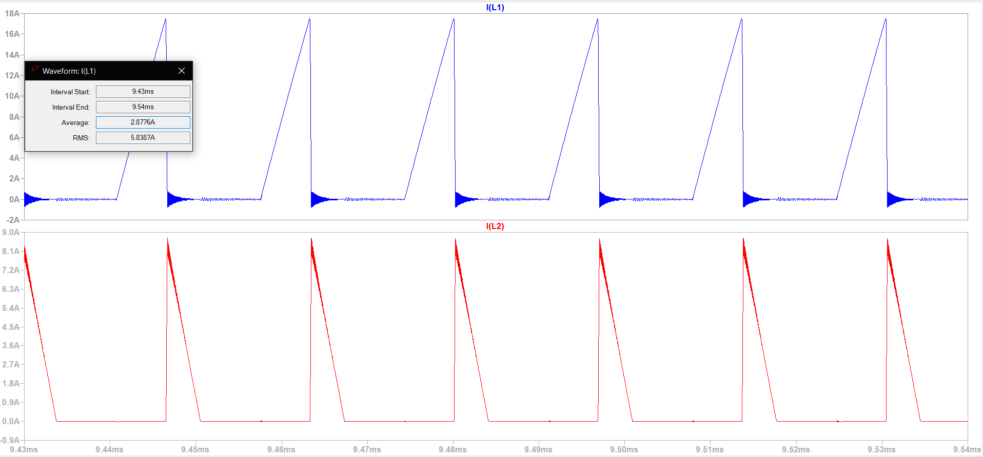

Slide 17
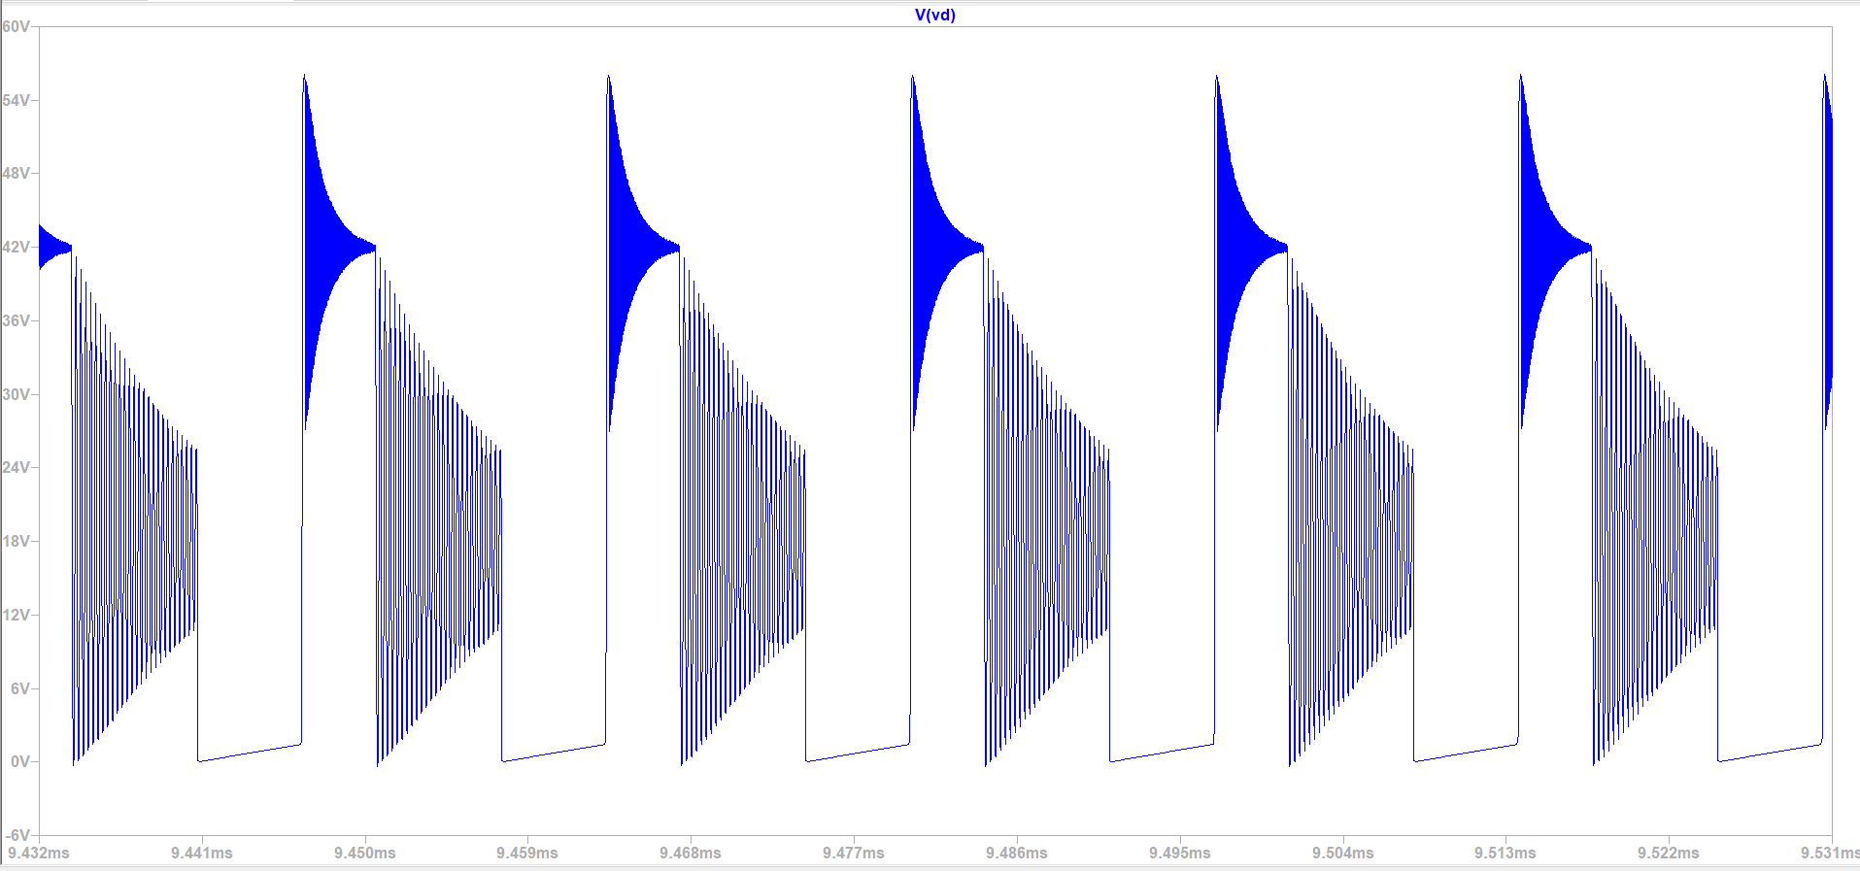

Slide 18
Pin | 55.36 W
Pout | 47.86 W
Efficiency | 86.45%

Slide 19
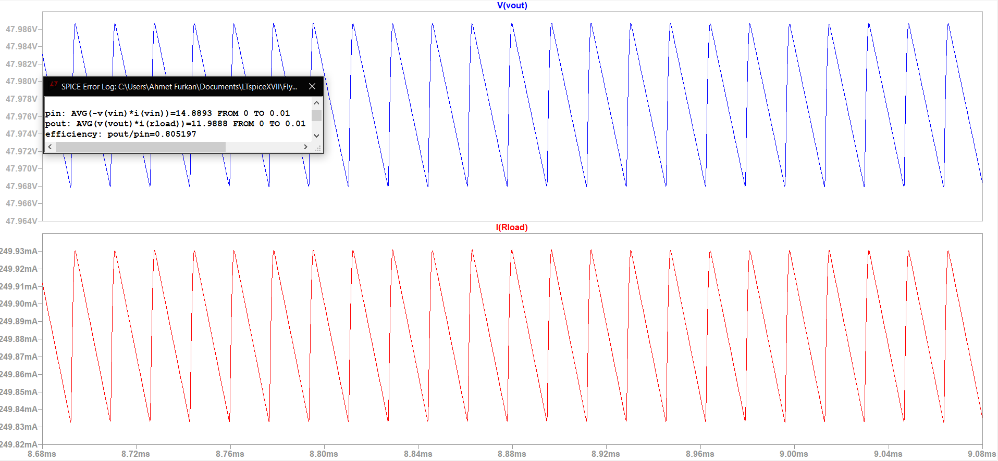
12V - 25% Load

Slide 20
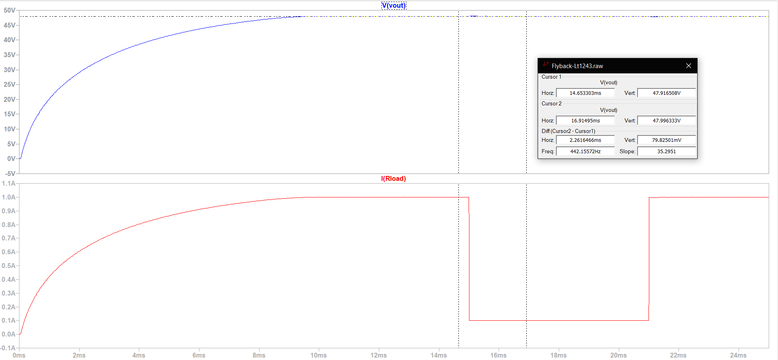
Instant Load Change

Slide 21
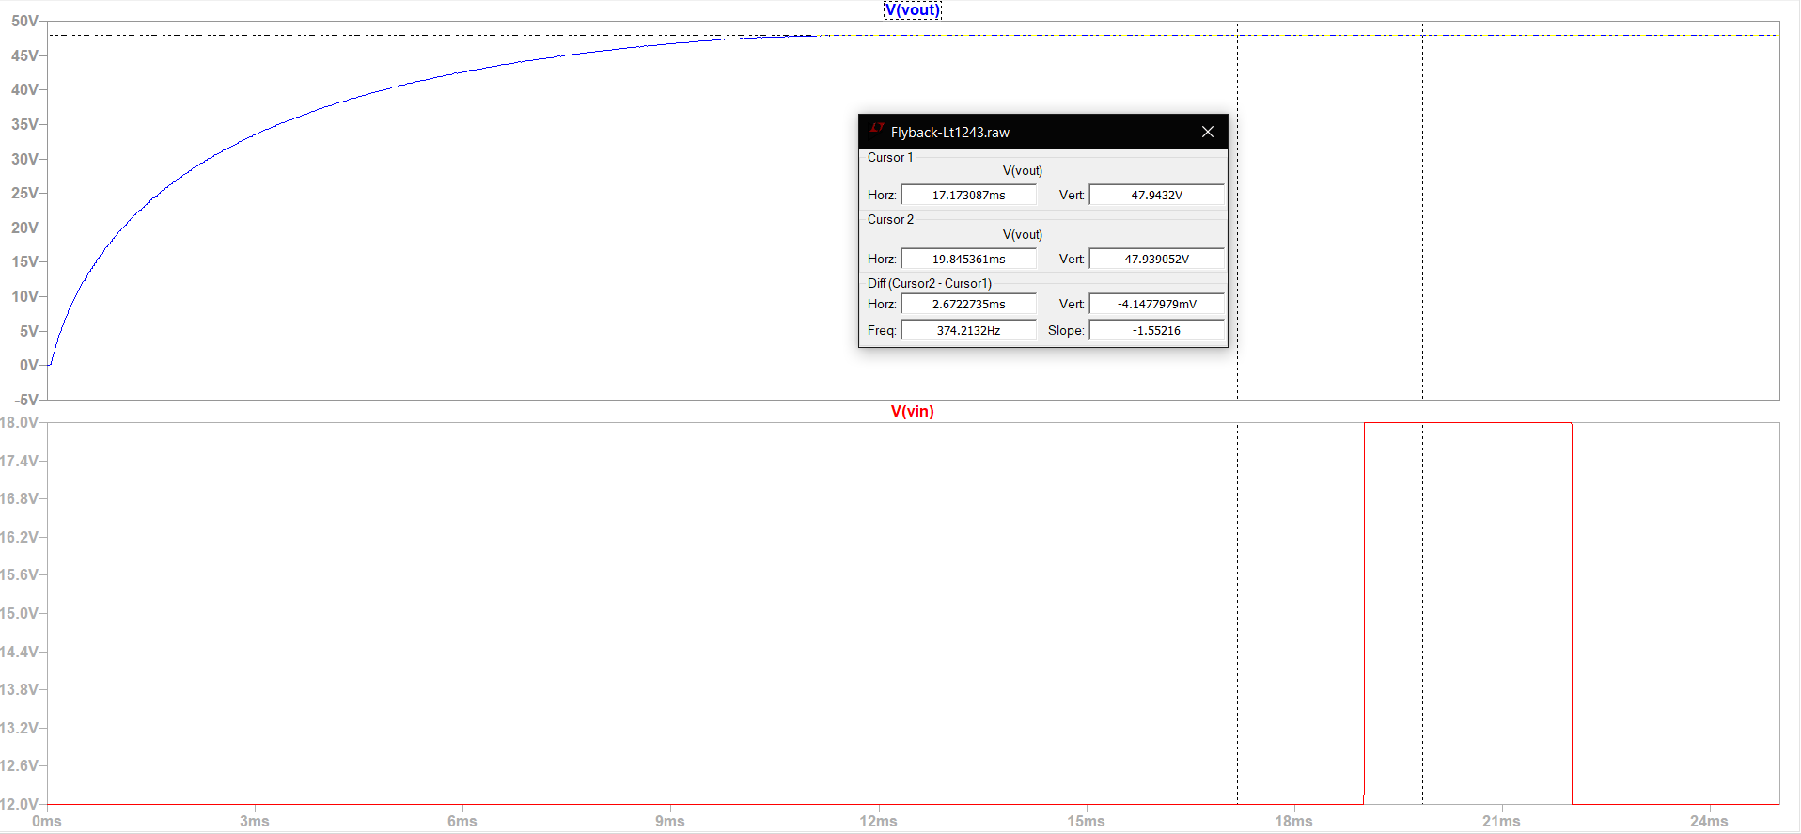
Instant Input Change

Slide 22
Possible Bonuses
Single Supply
Current Mode Control
Efficiency
Analog Controller IC
PCB
Industrial Design

Slide 23
Questions
What would happen if we overdesign using one of the large cores (00K3515E090) in the lab?
What would happen if we put a large core into a small coil former?
We get higher efficiency (87.27%) at 100kHz in simulation. In practice, if we use the 24 awg cable at 100 kHz, will we lose too much because of the skin depth?

