Slide 1
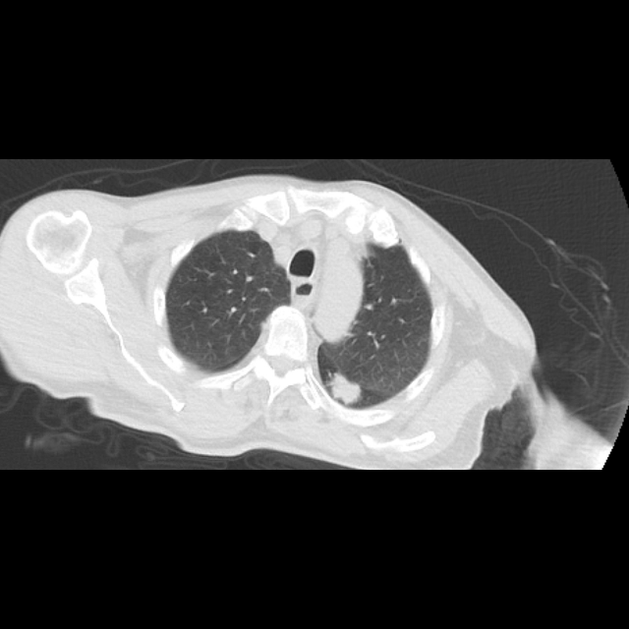
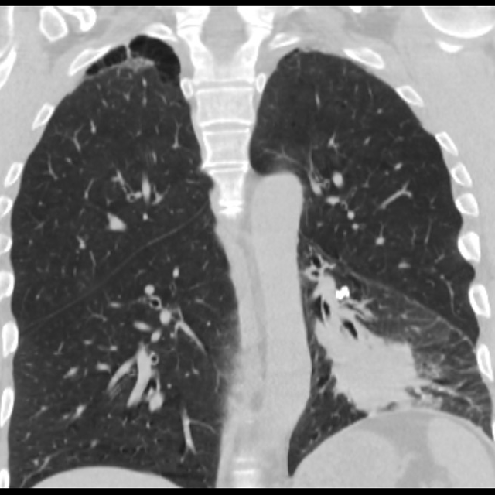
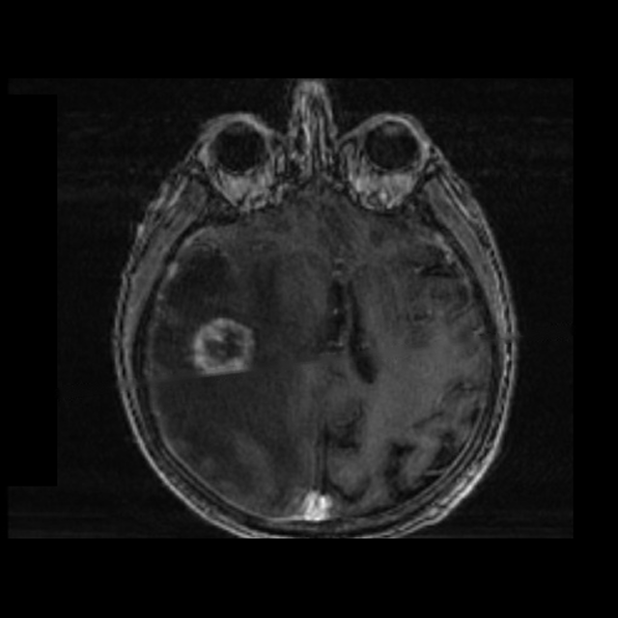
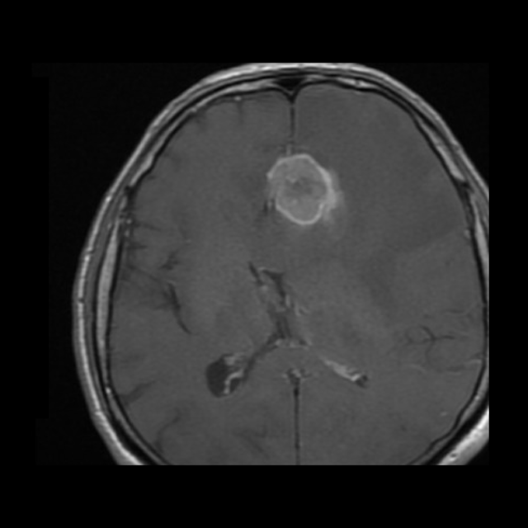
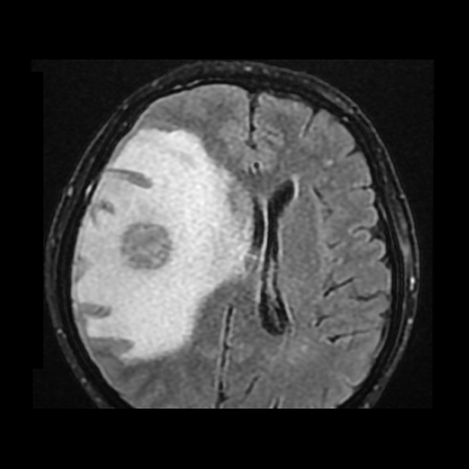
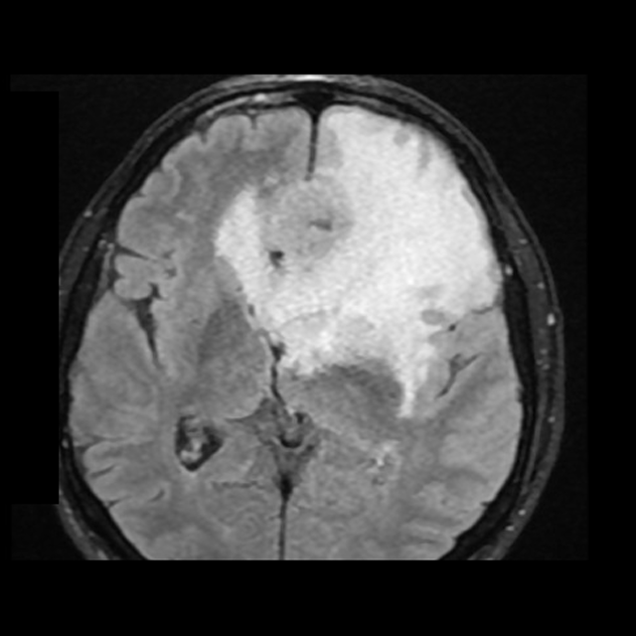
From Lung to Brain:
Linking Chest CT Tumour Characteristics with Brain MRI Metastatic Patterns in Adenocarcinoma, Squamous Cell, Small Cell and Neuroendocrine Lung Cancer
[First Name Surname]¹, [Co-author]¹, [Co-author]²
¹ [Department of Radiology, University / Hospital, Istanbul, Türkiye] ² [Department of Thoracic Oncology / Neurosurgery]
Corresponding author: [email]
Keywords: brain metastases · lung cancer · adenocarcinoma · squamous cell · SCLC · MRI · CT
Ethics committee approval and written patient consent for scientific publication obtained.
Chest CT · T1+C · FLAIR (SCLC, left; adenocarcinoma, right)
ECR 2027 · EPOS™ | 1/12
Notes:
EPOS: cover page / title, authors and affiliations.

Slide 2
Purpose & Objectives
To illustrate how brain MRI features of metastases vary with the histological subtype of the primary lung cancer.
1
Recognise the chest CT appearance of adenocarcinoma, squamous cell, small cell and large cell neuroendocrine carcinoma.
2
Describe multi-sequence MRI patterns (T1+C, T2/FLAIR, DWI) of the associated brain metastases.
3
Compare number, location, enhancement, oedema and diffusion behaviour between subtypes.
4
Identify mimics and pitfalls, e.g. an incidental meningioma alongside metastases.
5
Understand how imaging supports staging, PCI/SRS decisions and follow-up.
ECR 2027 · EPOS™ | 2/12
Notes:
EPOS (scientific exhibit): Aims and objectives. (Educational exhibit: Aims and objectives.)

Slide 3
Introduction & Clinical Background
Lung cancer is the leading source of brain metastases (BM), about 40–50% of all BM [1,2].
Cumulative BM risk is higher in small cell lung cancer (SCLC) than in non-small cell lung cancer (NSCLC) [1,2].
Histology shapes risk and behaviour
Adenocarcinoma: commonest NSCLC subtype with BM; risk increased with EGFR/ALK alterations [8].
SCLC: highly proliferative; frequent BM; MRI surveillance and prophylactic cranial irradiation (PCI) are debated [5,6].
Squamous cell carcinoma: BM less frequent [10]; primaries often central, cavitating or necrotic.
LCNEC: large cell neuroendocrine carcinoma, biologically closer to SCLC [4].
Contrast-enhanced MRI is the most sensitive modality; lesion number, size and site decide surgery, stereotactic radiosurgery (SRS) or whole-brain radiotherapy (WBRT) [6,7].
Primary lung tumour
Chest CT: histology-related morphology
Haematogenous spread
Brain
Grey–white junction · watershed · cerebellum
ECR 2027 · EPOS™ | 3/12
Notes:
EPOS (scientific exhibit): Aims and objectives, background paragraph. (Educational exhibit: Background.)

Slide 4
Materials & Methods
Patient selection
n = 10, histologically proven lung cancer with brain metastases
Chest CT review
Primary tumour: site, size, margin, cavitation
Brain MRI review
Number, site, enhancement, oedema, diffusion
Pattern comparison
Descriptive, by histological subtype
Design: retrospective, descriptive pictorial case series.
Approvals: ethics committee; written informed consent for publication of anonymised images.
Cohort: adenocarcinoma (ADC) n = 5; small cell carcinoma (SCLC) n = 3; LCNEC n = 1; squamous cell carcinoma (SCC) n = 1.
Illustrated: six representative cases (ADC-2, ADC-3, SCLC-1, SCLC-2, LCNEC-1, SCC-1).
Inclusion: histological diagnosis, chest CT and brain MRI available.
Imaging: chest CT (axial, coronal; lung and mediastinal windows) and brain MRI: axial post-contrast T1 (T1+C), T2, FLAIR, DWI with apparent diffusion coefficient maps.
Analysis: consensus review; descriptive statistics only.
ECR 2027 · EPOS™ | 4/12
Notes:
EPOS: Methods and materials.

Slide 5

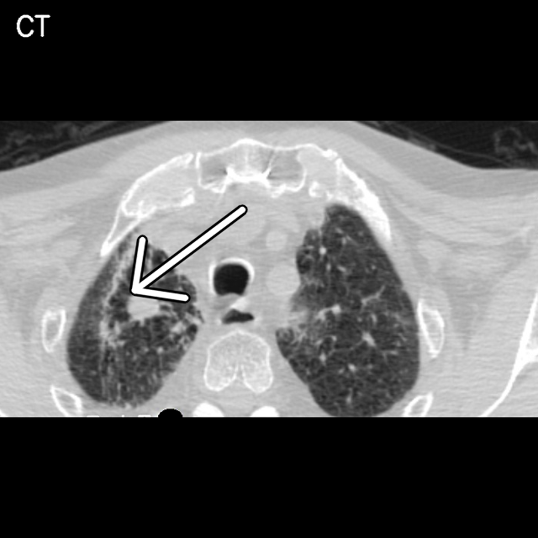
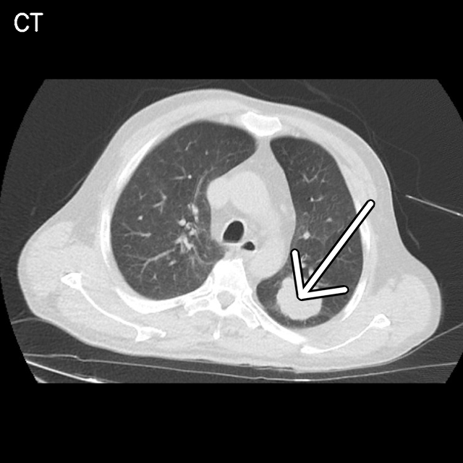

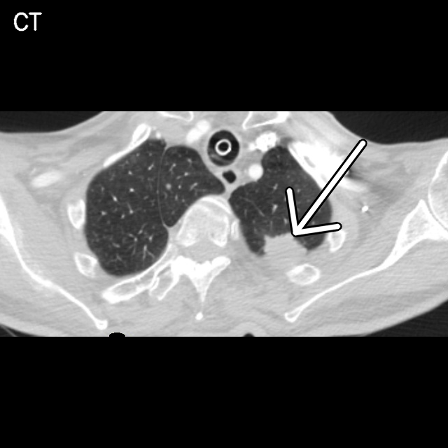
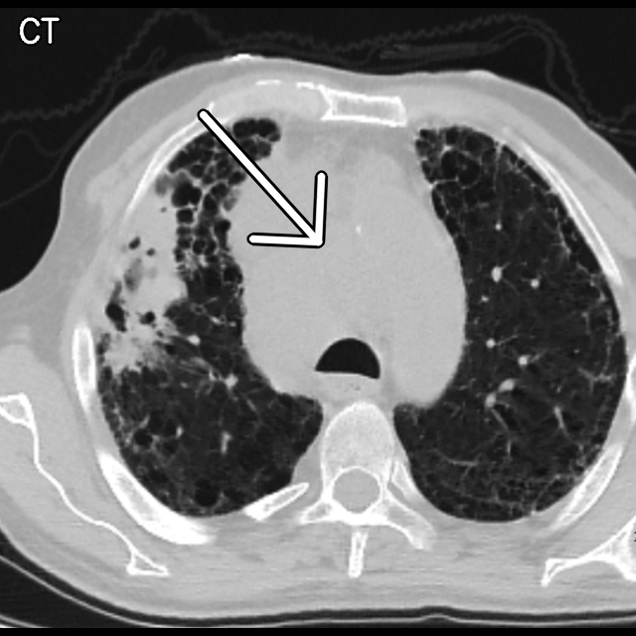
Primary Lung Tumour Profiles
Case | Histology | Primary tumour (chest CT) | Brain metastasis (MRI)
ADC-2 | Adenocarcinoma | Left perihilar mass, lower lobe collapse (coronal CT) | Left medial frontal
ADC-3 | Adenocarcinoma | Small spiculated right apical nodule; emphysema | Right temporal
SCLC-1 | Small cell carcinoma | Lobulated left upper lobe mass, posterior, pleura-based | Right paramedian frontoparietal
SCLC-2 | Small cell carcinoma | Small left upper lobe nodule, posterior, pleura-based | Right frontoparietal
LCNEC-1 | Large cell neuroendocrine | Left apical–posterior soft-tissue mass abutting pleura | Left frontal
SCC-1 | Squamous cell carcinoma | Very large central mediastinal mass; tracheal compression; bullous emphysema | Left cerebellar hemisphere
Primary tumours (white arrows)
ADC-2
ADC-3
SCLC-1
SCLC-2
Not illustrated: adenocarcinoma n = 3, small cell carcinoma n = 1. Sides follow radiological convention.
LCNEC-1
SCC-1
ECR 2027 · EPOS™ | 5/12
Notes:
EPOS: Results, Table 1 and Fig. 1.

Slide 6
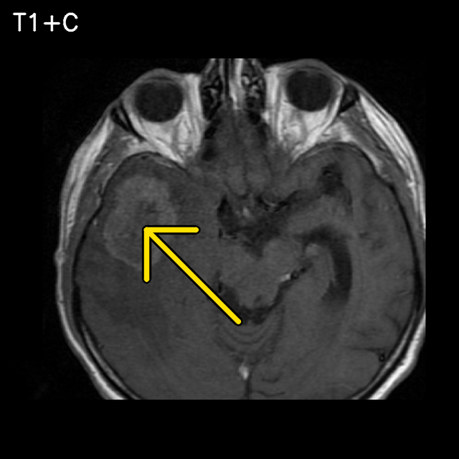
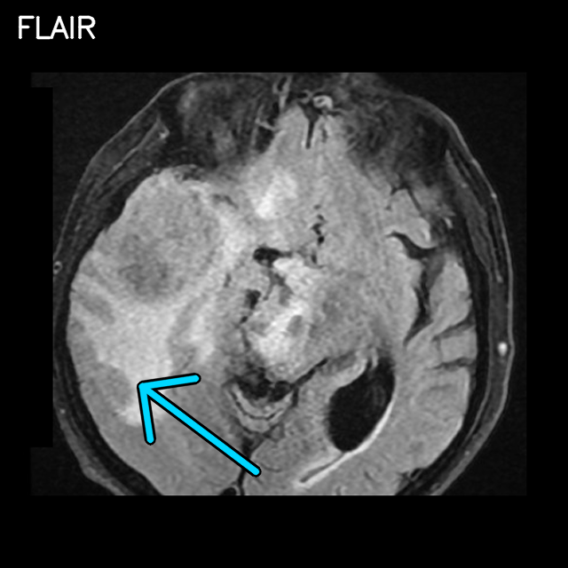
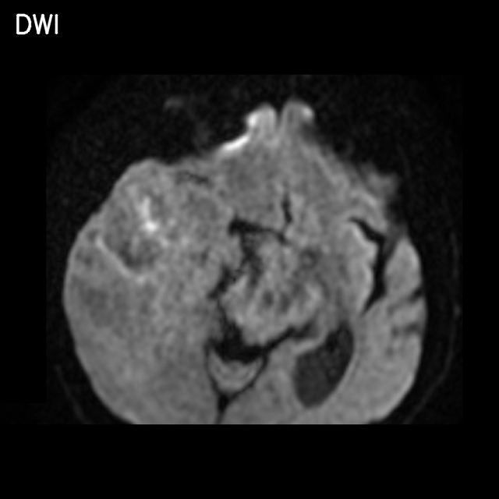
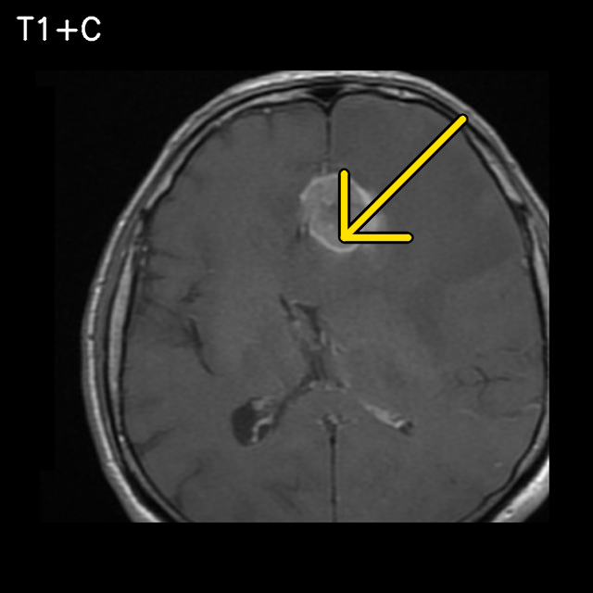
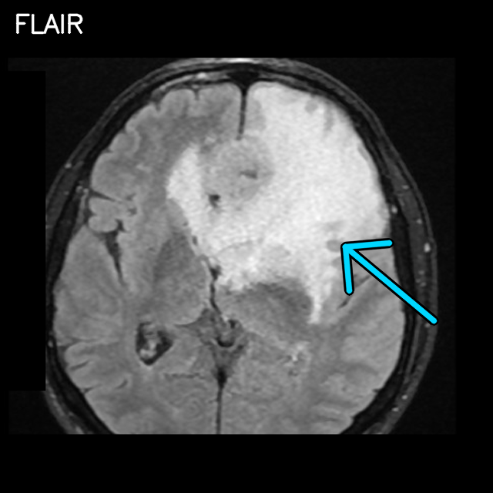
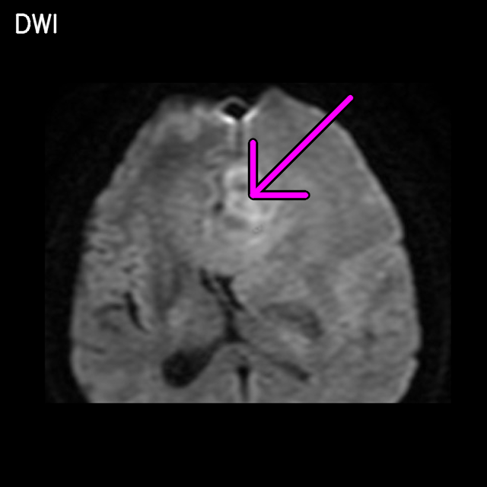
Neuroimaging Spectrum: Adenocarcinoma Brain Metastases
Key imaging features
Feature | ADC-3 | ADC-2
Site | Right temporal | Left medial frontal
T1+C | Ill-defined ring/heterogeneous | Thick irregular ring, necrotic centre
FLAIR | Extensive vasogenic oedema | Extensive vasogenic oedema
DWI | No restriction | Rim restriction
ADC-3: chest CT, axial T1+C, FLAIR, DWI
Teaching points
Small primaries can present with large brain lesions; oedema is disproportionate to lesion size.
Correlate with EGFR/ALK status where available [8].
ADC-2: chest CT (coronal), axial T1+C, FLAIR, DWI
Arrows
Enhancing lesion
Vasogenic oedema
DWI restriction
Primary lung tumour
ECR 2027 · EPOS™ | 6/12
Notes:
EPOS: Results, Figs. 2-3 (adenocarcinoma).

Slide 7
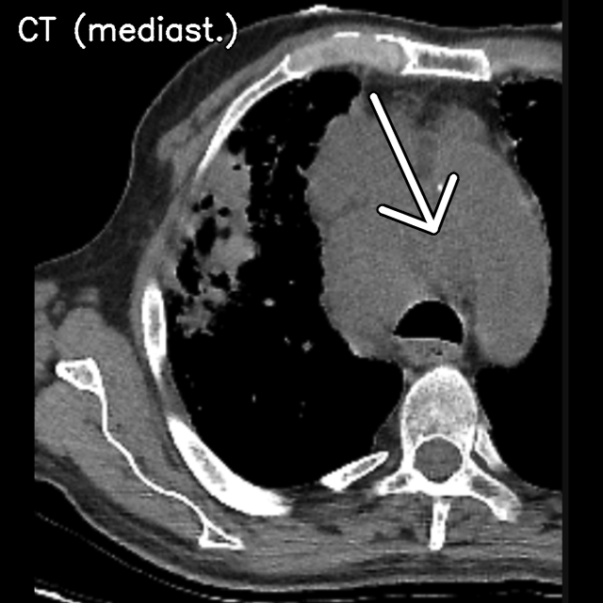
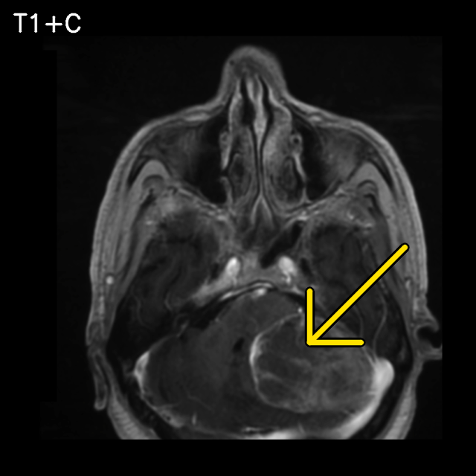
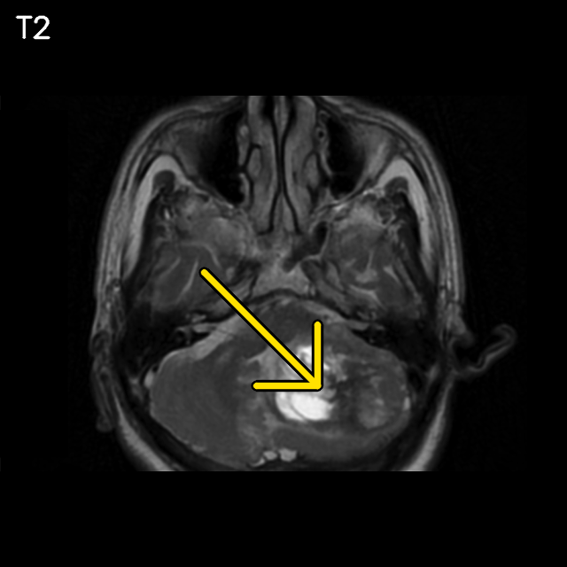
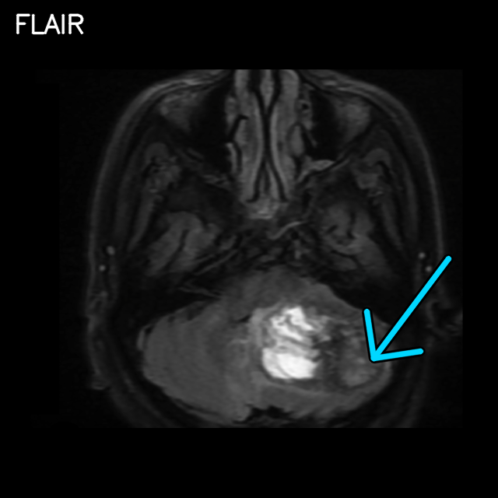
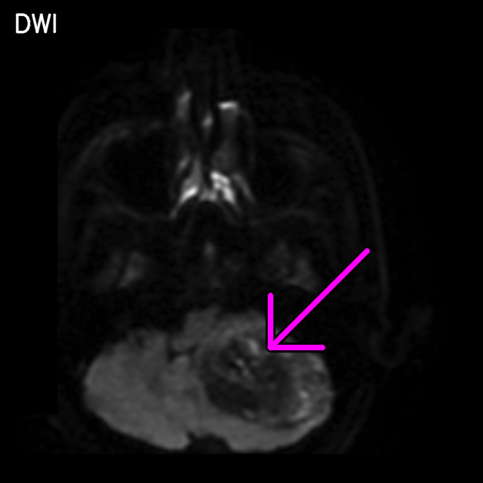
Neuroimaging Spectrum: Squamous Cell Carcinoma Brain Metastases
Key imaging features
Primary: very large central mediastinal mass compressing the trachea; background bullous emphysema.
Site: posterior fossa, left cerebellar hemisphere; single lesion shown.
T1+C: large cystic/necrotic lesion with enhancing wall.
T2/FLAIR: fluid-signal component with surrounding oedema.
DWI: heterogeneous; restriction at the rim.
Teaching points
Squamous BM are less frequent than adenocarcinoma [10]; necrotic or cystic ring-enhancing morphology is described.
Posterior fossa lesions: assess mass effect and hydrocephalus.
Single illustrative case (n = 1).
SCC-1: chest CT (lung, mediastinal window), T1+C, T2, FLAIR, DWI
Arrows
Enhancing lesion
Vasogenic oedema
DWI restriction
Primary lung tumour
ECR 2027 · EPOS™ | 7/12
Notes:
EPOS: Results, Fig. 4 (squamous cell carcinoma).

Slide 8
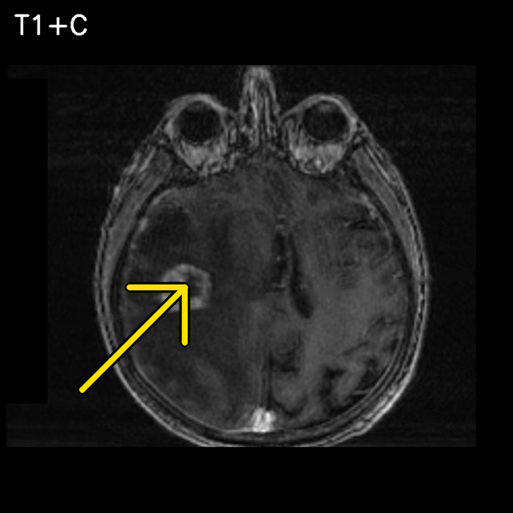
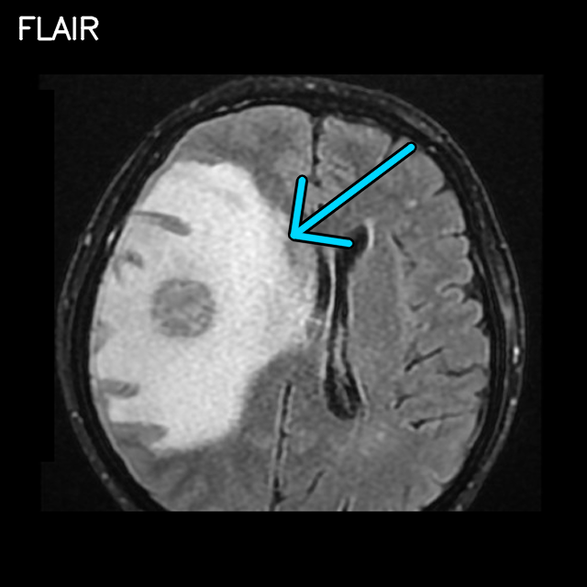
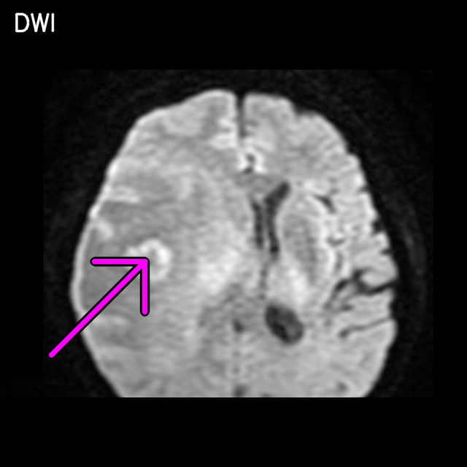
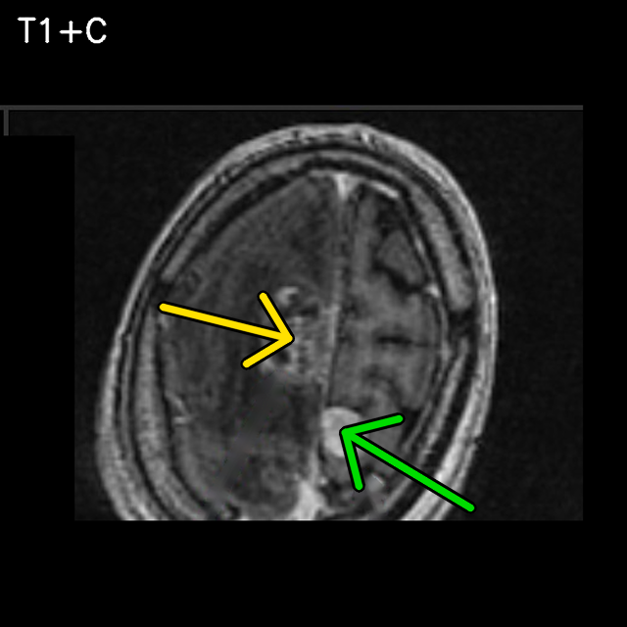
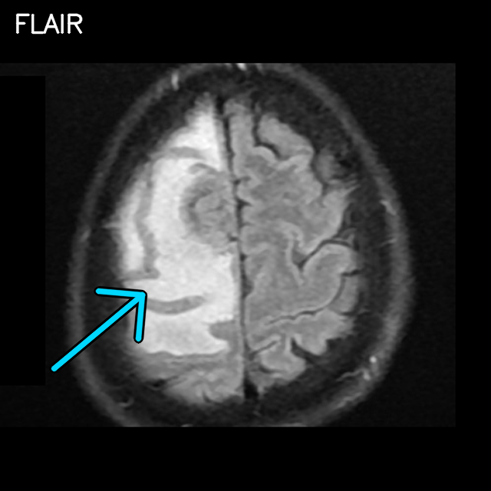
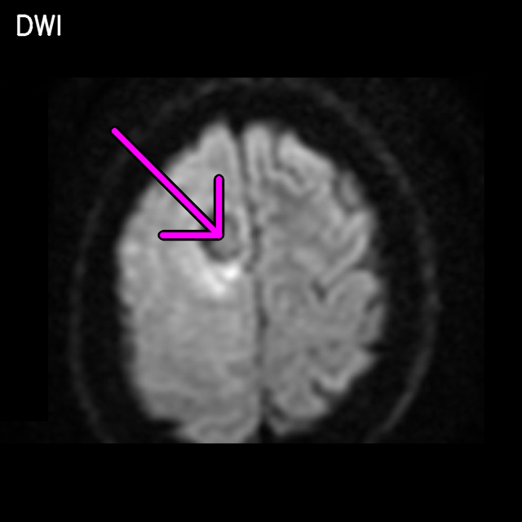
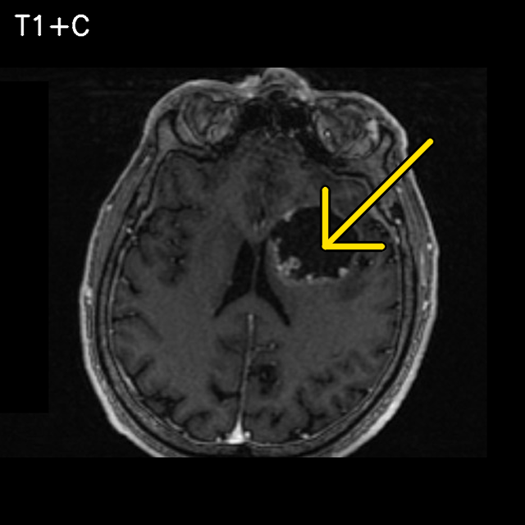
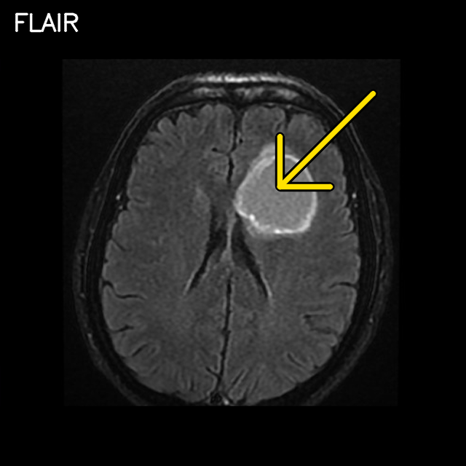
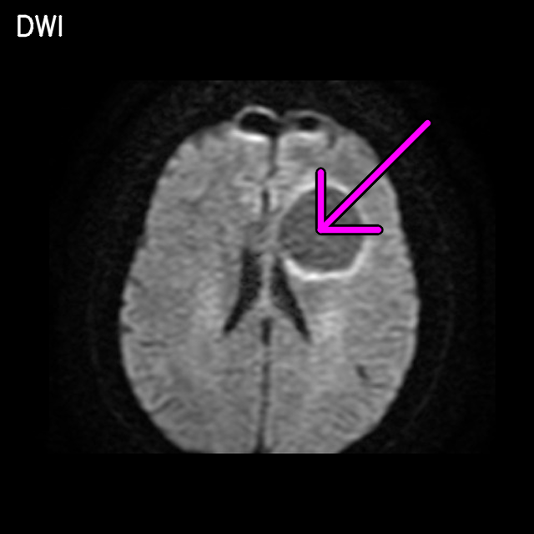
Neuroimaging Spectrum: SCLC & Neuroendocrine Brain Metastases
Key imaging features
Feature | SCLC-2 | SCLC-1 | LCNEC-1
Site | Right frontoparietal | Right paramedian frontoparietal | Left frontal
T1+C | Small ring | Small, heterogeneous | Large necrotic, thick wall
Oedema | Extensive | Extensive | Minimal
DWI | Rim restriction | Focal restriction | Rim restriction
SCLC-2: chest CT, T1+C, FLAIR, DWI
Teaching points
MRI detects more and smaller lesions than CT: always scan the post-contrast series [5].
Pitfall (SCLC-1): an extra-axial enhancing lesion may be an incidental meningioma, not a metastasis.
LCNEC behaves like SCLC; imaging overlaps, so histology cannot be inferred from MRI.
SCLC-1: chest CT, T1+C (metastasis + incidental meningioma), FLAIR, DWI
Arrows
Enhancing lesion
Vasogenic oedema
DWI restriction
LCNEC-1: chest CT, T1+C, FLAIR, DWI
Primary lung tumour
Meningioma
ECR 2027 · EPOS™ | 8/12
Notes:
EPOS: Results, Figs. 5-7 (SCLC and LCNEC).

Slide 9
Comparative Matrix
Feature | Adenocarcinoma (2 of 5 shown) | SCLC (2 of 3 shown) | LCNEC (n = 1) | SCC (n = 1) | Literature-expected pattern
Number | 1 shown | 1 shown | 1 shown | 1 shown | SCLC: often multiple, 1–3 cm [11,12]; adenocarcinoma: variable
Location | Right temporal; left medial frontal | Right frontoparietal (2/2) | Left frontal | Left cerebellar (posterior fossa) | Grey–white junction, cerebellum, watershed [7,12]
Enhancement | Ring/heterogeneous | Ring or nodular | Cystic/necrotic, thick wall | Cystic, ring | NSCLC necrotic/ring [12]; SCLC homogeneous [11]
Peritumoral oedema | Extensive (2/2) | Extensive (2/2) | Minimal | Moderate | NSCLC: peripheral oedema common [12]
DWI restriction | 1/2 (rim) | 2/2 | Rim | Rim | Variable; frequent in SCLC [11], about 55% of NSCLC [12]; not histology-specific [9]
Substantial overlap between subtypes: no single feature is pathognomonic. One lesion illustrated per case.
T1+C montage: adenocarcinoma · SCLC · LCNEC · squamous cell carcinoma
ECR 2027 · EPOS™ | 9/12
Notes:
EPOS: Results, Table 2 and Fig. 8.

Slide 10
Discussion
Biology shapes the imaging phenotype, but overlap is large.
Adenocarcinoma
Highest BM propensity among NSCLC; frequent in oncogene-driven disease [8]. Marked vasogenic oedema plausibly reflects VEGF-mediated permeability.
SCLC/LCNEC
High proliferative index and early haematogenous spread [4]; SCLC often shows multiple, small lesions [11]. Contrast MRI is superior to CT for detection (staging, PCI) [5].
Squamous cell carcinoma
Less frequent BM [10]; necrotic/cystic ring-enhancing lesions described.
This series
In the illustrated cases, SCLC primaries were peripheral, not central, with extensive brain oedema; LCNEC was cystic with little oedema. DWI restriction was frequent (5 of 6) but does not predict histology [9].
Pitfalls
Meningioma, abscess, glioma, radionecrosis, second primary.
Limitations
n = 10 (6 illustrated), retrospective, heterogeneous protocols, no inferential statistics.
Pitfall: metastasis (yellow) vs incidental meningioma (green), SCLC-1
ECR 2027 · EPOS™ | 10/12
Notes:
EPOS: Conclusion (discussion part) with Fig. 9.

Slide 11
Conclusion & Clinical Take-Home Message
Contrast-enhanced multi-sequence MRI for lung cancer patients at staging and with new neurological symptoms [6].
1
Report lesion number, location, oedema and diffusion: they guide SRS, WBRT and surgery [3,6].
2
Adenocarcinoma: look for conspicuous oedema. SCLC/neuroendocrine: look for many small lesions.
3
No single feature is histology-specific; beware mimics (e.g. meningioma) and correlate with pathology.
4
Histology suggests, but does not predict, the MRI pattern.
ECR 2027 · EPOS™ | 11/12
Notes:
EPOS: Conclusion.

Slide 12
References & Declarations
Schouten LJ, et al. Incidence of brain metastases in a cohort of patients with carcinoma of the breast, colon, kidney, and lung and melanoma. Cancer 2002;94:2698–2705.
Nayak L, et al. Epidemiology of brain metastases. Curr Oncol Rep 2012;14:48–54.
Sperduto PW, et al. Survival in patients with brain metastases: summary report on the updated diagnosis-specific graded prognostic assessment and definition of the eligibility quotient. J Clin Oncol 2020;38:3773–3784.
Nicholson AG, et al. The 2021 WHO classification of lung tumors: impact of advances since 2015. J Thorac Oncol 2022;17:362–387.
Seute T, et al. Detection of brain metastases from small cell lung cancer: consequences of changing imaging techniques (CT versus MRI). Cancer 2008;112:1827–1834.
Le Rhun E, et al. EANO–ESMO clinical practice guidelines for diagnosis, treatment and follow-up of patients with brain metastasis from solid tumours. Ann Oncol 2021;32:1332–1347.
Fink KR, et al. Imaging of brain metastases. Surg Neurol Int 2013;4(Suppl 4):S209–S219.
Rangachari D, et al. Brain metastases in patients with EGFR-mutated or ALK-rearranged non-small-cell lung cancers. Lung Cancer 2015;88:108–111.
Jung WS, et al. Diffusion-weighted imaging of brain metastasis from lung cancer: correlation of MRI parameters with the histologic type and gene mutation status. AJNR Am J Neuroradiol 2018;39:273–279.
Mujoomdar A, et al. Clinical predictors of metastatic disease to the brain from non-small cell lung carcinoma: primary tumor size, cell type, and lymph node metastases. Radiology 2007;242:882–888.
Zhu D, et al. Magnetic resonance imaging characteristics of brain metastases in small cell lung cancer. Cancer Med 2023;12:15199–15206.
Pomohaci D, et al. Magnetic resonance imaging characteristics of small cell and non-small cell lung cancer brain metastases: a retrospective study. J Med Life 2025;18:563–574.
Conflict of interest
The authors declare no conflict of interest.
Funding
None.
Ethics & consent
Ethics committee approval; written informed consent for image publication obtained from all patients.
Image origin
Authors' own clinical material, anonymised; arrows and labels added by the authors.
Contact
[name, email]
ECR 2027 · EPOS™ | 12/12
Notes:
EPOS: References and Personal information (declarations).

