Slide 1
DIGITAL OSCILLOSCOPE DESIGN
ANIL ÇETİN, 151220212097
AHMET MELİH BOZ ,151220202108
22.05.2025

Slide 2
Outline
INTRODUCTION
SYSTEM OVERVIEW
METHODOLOGY
FEATURES
FINAL DESIGN
FUTURE WORKS & CONCLUSION

Slide 3
INTRODUCTION
Purpose:
To design and implement a digital oscilloscope using FPGA board and VHDL.
Motivation:
To deepen skills in FPGA design, VHDL programming, and real-time system development.
Key Technologies:
Spartan-6 FPGA, AD9226 ADC, Raspberry Pi 3A+.

Slide 4
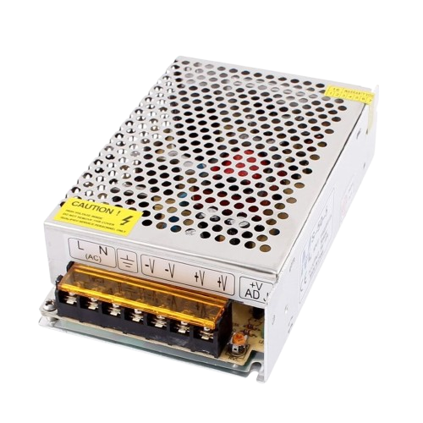
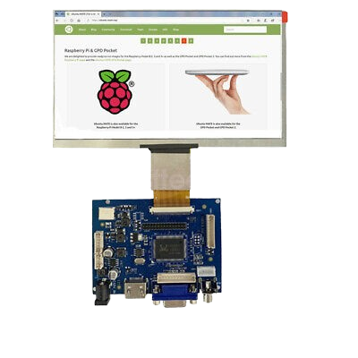
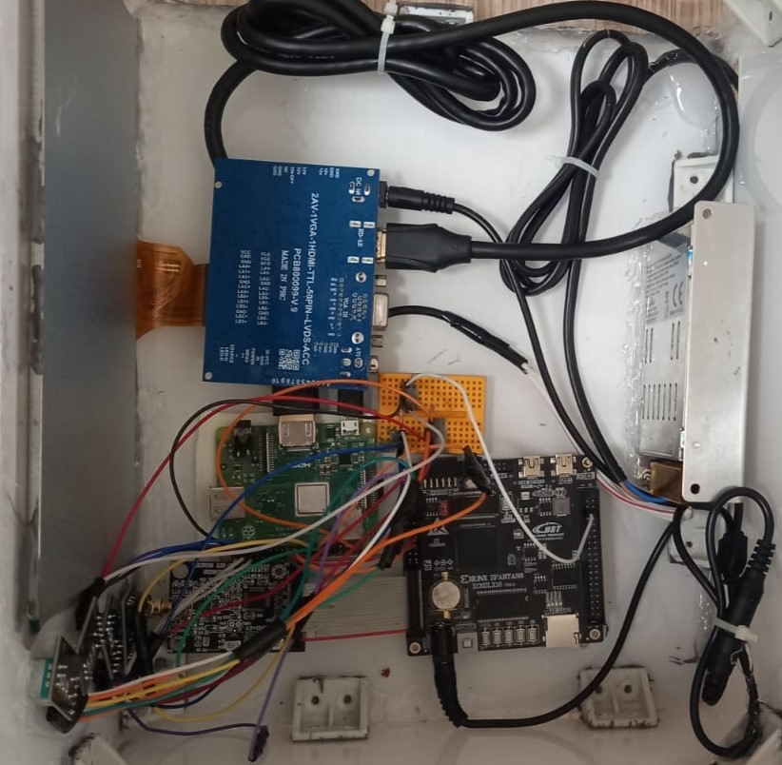
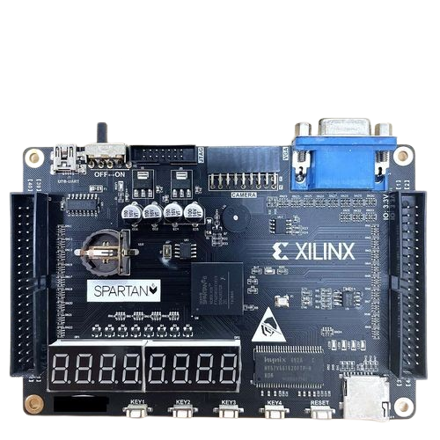
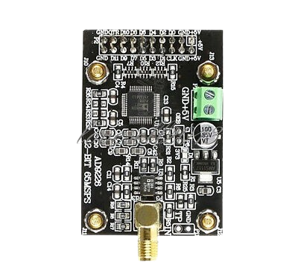
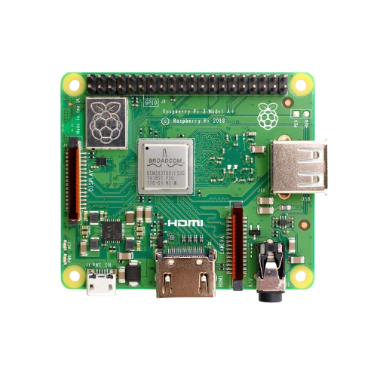
SYSTEM OVERVIEW

Slide 5
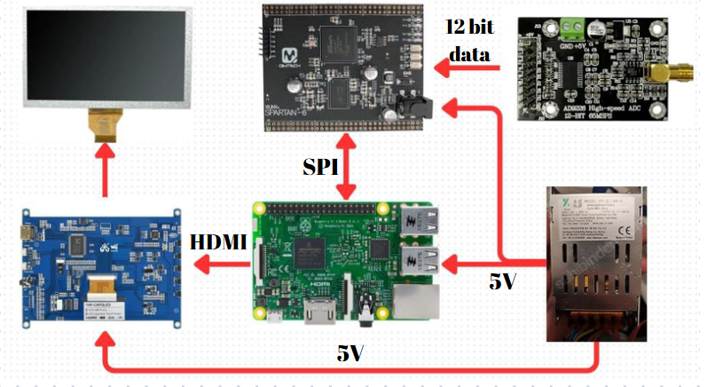
SYSTEM OVERVIEW

Slide 6
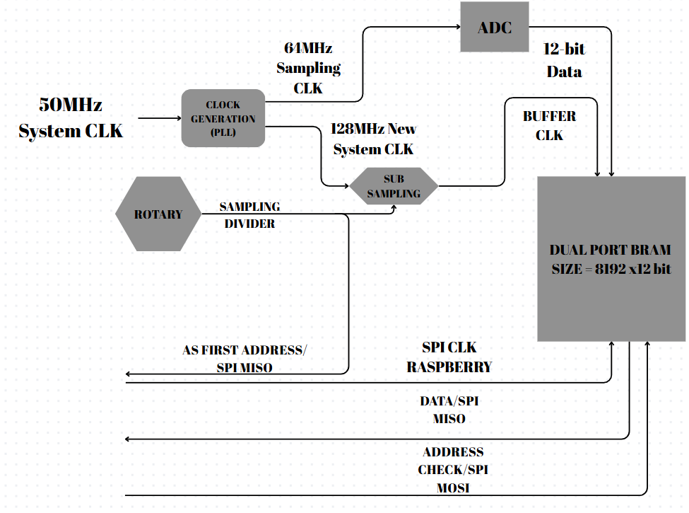
METHODOLOGY (VHDL PART)

Slide 7
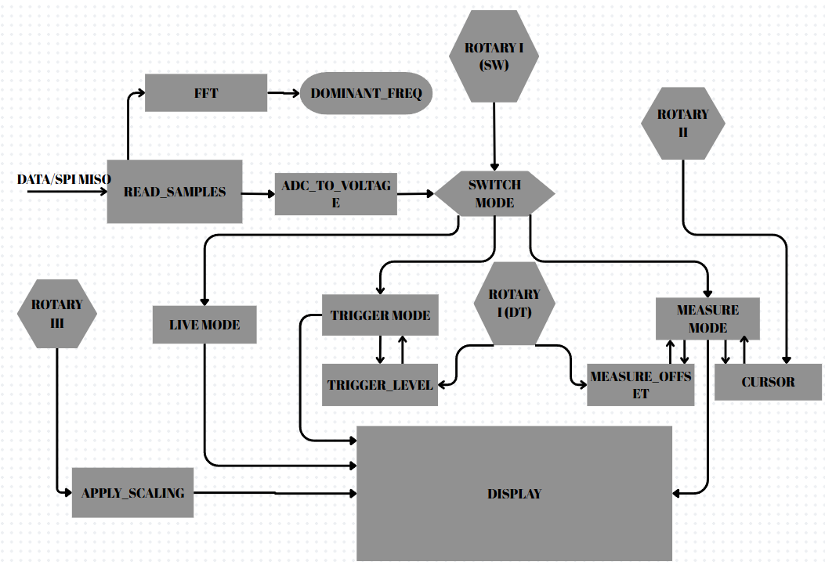
METHODOLOGY (PYTHON PART)

Slide 8
FEATURES
TRIGGER MODE:
Rising edge trigger detection
Captures pre- and post-trigger samples
MEASURE MODE:
Displays the stored data and gives opportunity to observe it in a certain time interval.
Any amplitude on signal can be measured via Cursor.

Slide 9
FEATURES
SCALE:
User can arrange time and amplitude grid intervals to have a closer look on signal.
SAMPLING RATE:
With the help of arrangable sampling rate wide range of frequencies can be displayed and analyzed successfully.
Vpp, Frequency of Signal, Vmax values are also displayed on screen.

Slide 10
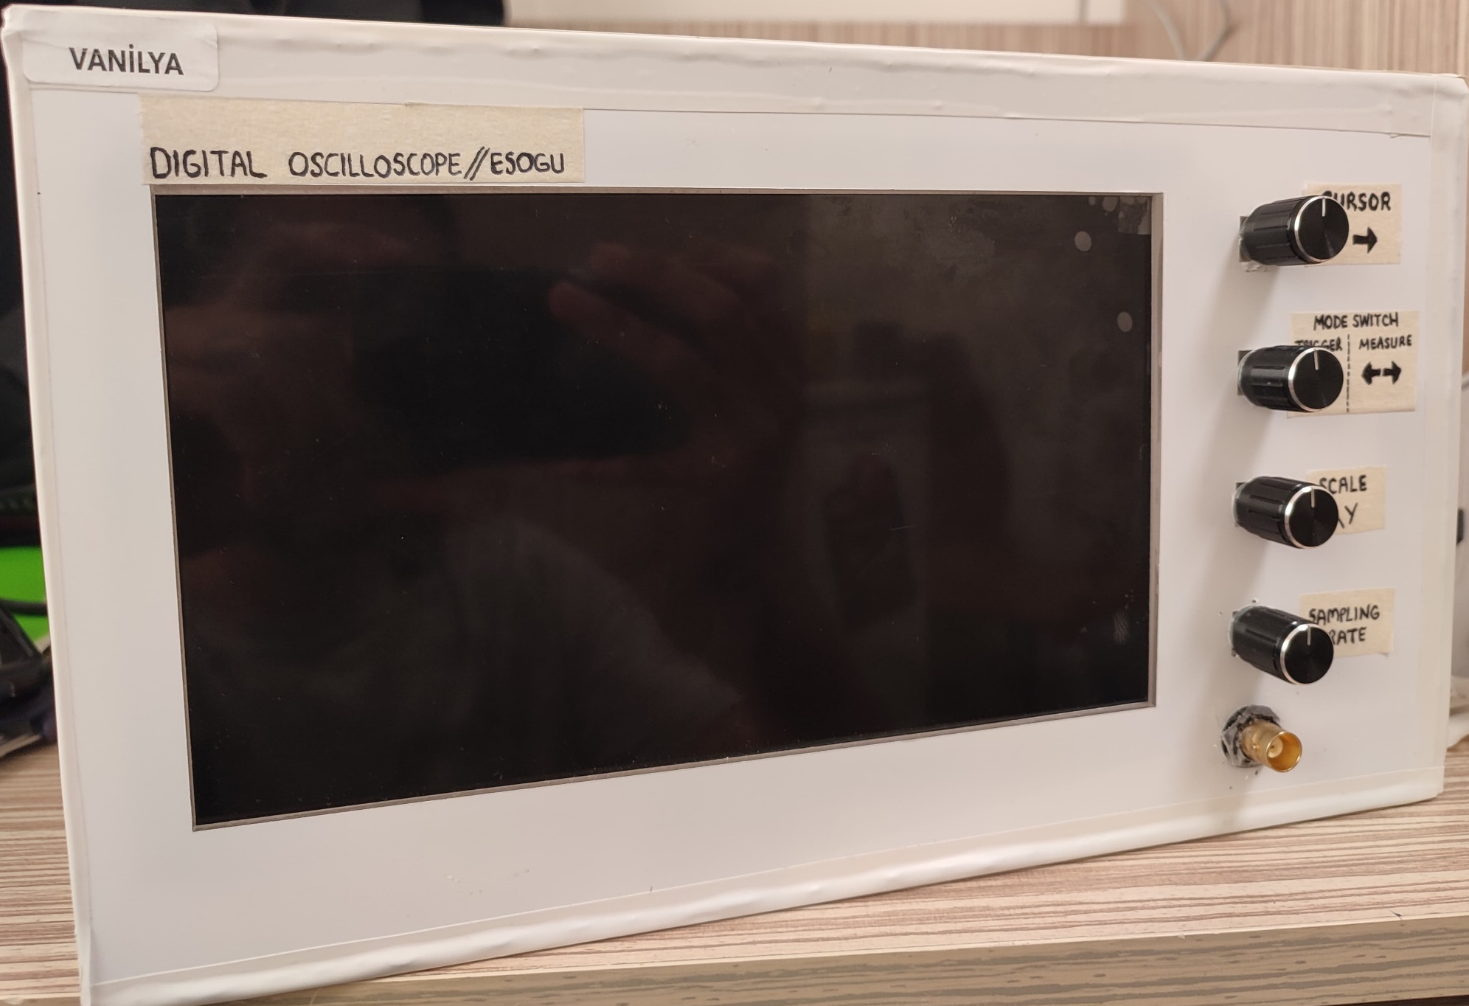
FINAL DESIGN

Slide 11
FUTURE WORKS
Dual channel supoort can be added.
A useful menu can be added.
UI can be improved by using a touch screen.
Adjustable Trigger Mode.

Slide 12
THANKS FOR LISTENING

