Slide 1
Reading Text Files
Berk Gökberk

Slide 2
Reading Data from Text Files
You can read data from text files using File and Scanner classes
Place the input file at location: YourEclipseWorkspace\YourApp\input.txt
Import the following libraries: import java.io.File; import java.io.FileNotFoundException; import java.util.Scanner;
input.txt
#City xCoordinate yCoordinate Population
Istanbul 41.00 28.97 32000
Izmir 38.41 27.12 18000
Athens 37.98 23.72 9000
Rome 41.90 12.49 3200

Slide 3
Example: Reading Text File Part 1/2
import java.io.File;
import java.io.FileNotFoundException;
import java.util.Scanner;
public class AppFile {
public static void main(String[] args) throws FileNotFoundException {
// Filename of the input file
String fileName = "input.txt";
// file object is required to open the file
File file = new File(fileName);
// if the file is not found, issue an error message and quit
if (!file.exists()) {
System.out.printf("%s can not be found.", fileName);
System.exit(1); // exit the program
}
// code continues
}

Slide 4
Example: Reading Text File Part 2/2
public class AppFile {
public static void main(String[] args) throws FileNotFoundException {
// code continues from here
// scanner object is required to read the contents of the file
Scanner inputFile = new Scanner(file);
// continue reading file contents if there is a line to be read
while (inputFile.hasNextLine()) {
String line = inputFile.nextLine(); // get the current line as a string
System.out.println(line); // print the line
}
inputFile.close(); // close the scanner object
}
}
Program output
#City xCoordinate yCoordinate Population
Istanbul 41.008240 28.978359 32000
Izmir 38.418720 27.129601 18000
Athens 37.983810 23.727539 9000
Rome 41.902782 12.496365 3200

Slide 5
Reading Data from Text Files
In the previous example, we use inputFile.nextLine() to read the complete line and store it in a string variable
Now, let’s try to get each city information in a corresponding variable:
City name to a String variable: cityName
x and y coordinates to double variables: xCoor, yCoor
Population to an integer variable: population
#City xCoor yCoor Population
Istanbul 41.00 28.97 32000
Izmir 38.41 27.12 18000
Athens 37.98 23.72 9000
Rome 41.90 12.49 3200
String cityName;
double xCoor, yCoor;
int population;
input.txt

Slide 6
Reading Data from Text Files
// read the explanation line first
String firstLine = inputFile.nextLine();
while (inputFile.hasNextLine()) {
String cityName = inputFile.next();
double xCoor = inputFile.nextDouble();
double yCoor = inputFile.nextDouble();
int population = inputFile.nextInt();
System.out.printf("City name: %10s, ", cityName);
System.out.printf("x: %.2f, y: %.2f, ", xCoor, yCoor);
System.out.printf("Population: %4d\n", population);
}
inputFile.close(); // close the scanner object
#City xCoor yCoor Population
Istanbul 41.00 28.97 32000
Izmir 38.41 27.12 18000
Athens 37.98 23.72 9000
Rome 41.90 12.49 3200
input.txt

Slide 7
Reading Data from Text Files
// read the explanation line first
String firstLine = inputFile.nextLine();
while (inputFile.hasNextLine()) {
String cityName = inputFile.next();
double xCoor = inputFile.nextDouble();
double yCoor = inputFile.nextDouble();
int population = inputFile.nextInt();
System.out.printf("City name: %10s, ", cityName);
System.out.printf("x: %.2f, y: %.2f, ", xCoor, yCoor);
System.out.printf("Population: %4d\n", population);
}
inputFile.close(); // close the scanner object
next() reads a string
#City xCoor yCoor Population
Istanbul 41.00 28.97 32000
Izmir 38.41 27.12 18000
Athens 37.98 23.72 9000
Rome 41.90 12.49 3200
input.txt

Slide 8
Reading Data from Text Files
// read the explanation line first
String firstLine = inputFile.nextLine();
while (inputFile.hasNextLine()) {
String cityName = inputFile.next();
double xCoor = inputFile.nextDouble();
double yCoor = inputFile.nextDouble();
int population = inputFile.nextInt();
System.out.printf("City name: %10s, ", cityName);
System.out.printf("x: %.2f, y: %.2f, ", xCoor, yCoor);
System.out.printf("Population: %4d\n", population);
}
inputFile.close(); // close the scanner object
nextDouble() reads a double
#City xCoor yCoor Population
Istanbul 41.00 28.97 32000
Izmir 38.41 27.12 18000
Athens 37.98 23.72 9000
Rome 41.90 12.49 3200
input.txt

Slide 9
Reading Data from Text Files
// read the explanation line first
String firstLine = inputFile.nextLine();
while (inputFile.hasNextLine()) {
String cityName = inputFile.next();
double xCoor = inputFile.nextDouble();
double yCoor = inputFile.nextDouble();
int population = inputFile.nextInt();
System.out.printf("City name: %10s, ", cityName);
System.out.printf("x: %.2f, y: %.2f, ", xCoor, yCoor);
System.out.printf("Population: %4d\n", population);
}
inputFile.close(); // close the scanner object
nextDouble() reads a double
#City xCoor yCoor Population
Istanbul 41.00 28.97 32000
Izmir 38.41 27.12 18000
Athens 37.98 23.72 9000
Rome 41.90 12.49 3200
input.txt

Slide 10
Reading Data from Text Files
// read the explanation line first
String firstLine = inputFile.nextLine();
while (inputFile.hasNextLine()) {
String cityName = inputFile.next();
double xCoor = inputFile.nextDouble();
double yCoor = inputFile.nextDouble();
int population = inputFile.nextInt();
System.out.printf("City name: %10s, ", cityName);
System.out.printf("x: %.2f, y: %.2f, ", xCoor, yCoor);
System.out.printf("Population: %4d\n", population);
}
inputFile.close(); // close the scanner object
nextInt() reads an integer
#City xCoor yCoor Population
Istanbul 41.00 28.97 32000
Izmir 38.41 27.12 18000
Athens 37.98 23.72 9000
Rome 41.90 12.49 3200
input.txt

Slide 11
Reading Data from Text Files
// read the explanation line first
String firstLine = inputFile.nextLine();
while (inputFile.hasNextLine()) {
String cityName = inputFile.next();
double xCoor = inputFile.nextDouble();
double yCoor = inputFile.nextDouble();
int population = inputFile.nextInt();
System.out.printf("City name: %10s, ", cityName);
System.out.printf("x: %.2f, y: %.2f, ", xCoor, yCoor);
System.out.printf("Population: %4d\n", population);
}
inputFile.close(); // close the scanner object
Program output
City name: Istanbul, x: 41.01, y: 28.98, Population: 32
City name: Izmir, x: 38.42, y: 27.13, Population: 18
City name: Athens, x: 37.98, y: 23.73, Population: 9
City name: Rome, x: 41.90, y: 12.50, Population: 55

Slide 12
Methods of the Scanner Class
You can read string, double, integer, float etc. using the scanner class
nextDouble() for reading a double number
nextInt() for reading an integer
next() for reading a single string
nextLine() for reading the complete line as a string
hasNext() method returns true if there is more data to be read
Usually used as a loop condition
close() closes the scanner object.
It is recommended to use the close() method when reading is finished

Slide 13
hasNext() vs hasNextLine()
You can also read data using hasNext() as a loop condition
hasNext() returns true if there is still data to be read in the input text file
while (inputFile.hasNext()) {
String studentName = inputFile.next();
int age = inputFile.nextInt();
}

Slide 14
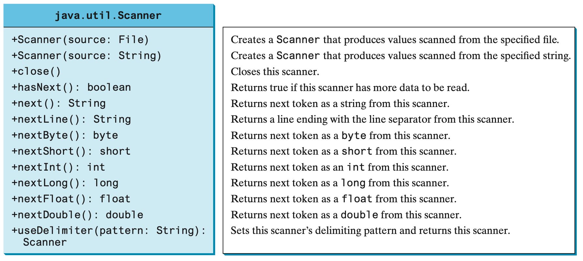
Scanner Class

Slide 15
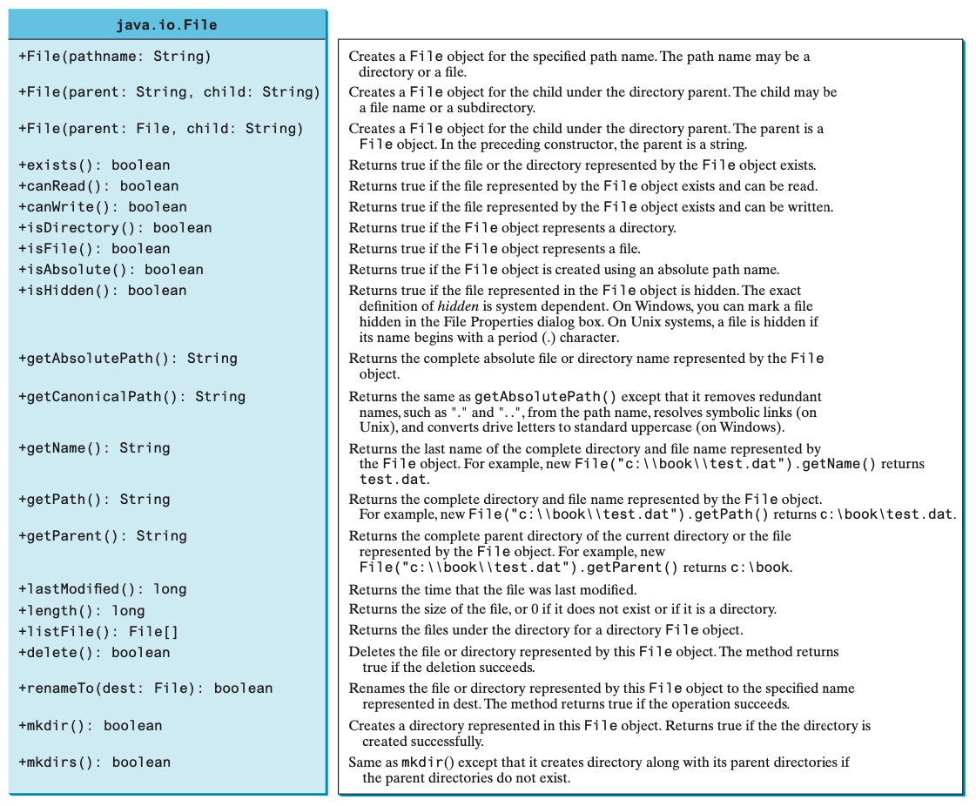
File Class
The File class can be used to obtain file and directory properties, to delete and rename files and directories, and to create directories

Slide 16
Example
Reading text from a file using delimiters

Slide 17
Example: Using Delimiters to Parse Data
When the line to be read contains data separated by a special delimiter symbol, you can use split() (in the String class) method to automatically split string into parts
Example:
File contains student info name, surname and grades separated by the ; symbol
Each student has different number of grades
%Explanation of rows: Name;Surname;Grades
Robert;Fripp;30;40;60;10;20;30;55;33;12;40;12
John;Wetton;20;90;70
Bill;Bruford;80;10;40;40;40
input.txt

Slide 18
Example: Using Delimiters to Parse Data
When the line to be read contains data separated by a special delimiter symbol, you can use split() (in the String class) method to automatically split string into parts
Split() method returns a string array: String personInfo = “Bill;Bruford;80;10;40”; String[] parts = personInfo.split(“;”) // ; is the delimiter
Input string personInfo
“Bill;Bruford;80;10;40”
Output of personInfo.split(“;”)
“Bill”
“Bruford”
“80”
“10”
“40”
parts[] array

Slide 19
Converting String to Integer/Double
You can convert a string to an integer using Integer.parseInt() method int grade = Integer.parseInt(“69”) // converts the string “69” to an integer
Similarly, you can convert a string to a double using Double.parseInt() double height = Double.parseInt(“1.92”) // converts the string ”1.92” to double
public class AppStringConversion {
public static void main(String[] args) {
String str1 = "12"; // string containing an integer value
String str2 = "2.4"; // string containing a double value
int val1 = Integer.parseInt(str1);
double val2 = Double.parseDouble(str2);
System.out.println(2 * val1);
System.out.println(2 * val2);
}
}

Slide 20
Example: Using Delimiters to Parse Data
String firstLine = inputFile.nextLine(); // read the first explanation line
while (inputFile.hasNextLine()) {
String line = inputFile.nextLine(); // get the current line as a string
String[] strParts = line.split(";"); // split the line into strings
String name = strParts[0]; // first and second items are name and surname
String surname = strParts[1];
// rest of the array elements are grades. Place them into an integer array
int[] grades = new int[strParts.length-2]; // create the array
for (int i = 2; i < strParts.length; i++)
grades[i-2] = Integer.parseInt(strParts[i]); // convert string to an integer
System.out.printf("Name %7s, Surname: %7s, " , name, surname);
System.out.println("Grades: " + Arrays.toString(grades));
}
Program output
Name Robert, Surname: Fripp, Grades: [30, 40, 60, 10, 20, 30, 55, 33, 12, 40, 12]
Name John, Surname: Wetton, Grades: [20, 90, 70]
Name Bill, Surname: Bruford, Grades: [80, 10, 40, 40, 40]

