Slide 1


Bilgisayar Mühendisliği Bölümü
GTU GRADUATION PROJECT
SECOND PRESENTATION
Training Environment for Machine Learning Algorithms
Ahmet Özdemir
Project Consultants:
Dr. Alp Arslan Bayrakçı
Notes:
1.7.2013
<number>
‹#›

Slide 2
Contents
Project Overview
Interface
System Architecture
Project Outputs and Evaluation
References
GTU - Computer Engineering Department
CSE 496 Graduation Project
Notes:
1.7.2013
<number>
‹#›

Slide 3
Project Overview
Purpose: This project provides an interactive, user-friendly educational platform for machine learning. It demystifies algorithm training and evaluation by enabling code-free experimentation with various models, datasets, and parameters, fostering a practical understanding of their interactions and impact on results.
Problem: Experimenting with machine learning models is often complex, requiring environment setup and extensive boilerplate code for data handling and model operations. Understanding the nuanced impact of different datasets, model choices, hyperparameters, and evaluation strategies can be a significant barrier for learners and practitioners seeking rapid comparisons.
Goal: The goal is to deliver an accessible web platform for visual selection and configuration of classification models, datasets (including varying sizes like full/subset MNIST), and global run settings. The backend will process these user-defined experiments, with the aim to (eventually) display comparative results and metrics directly in the UI, offering a practical "sandbox" for machine learning exploration.
GTÜ - Bilgisayar Mühendisliği Bölümü
BİL 495/496 Bitirme Projesi
GTU - Computer Engineering Department
CSE 496 Graduation Project

Slide 4
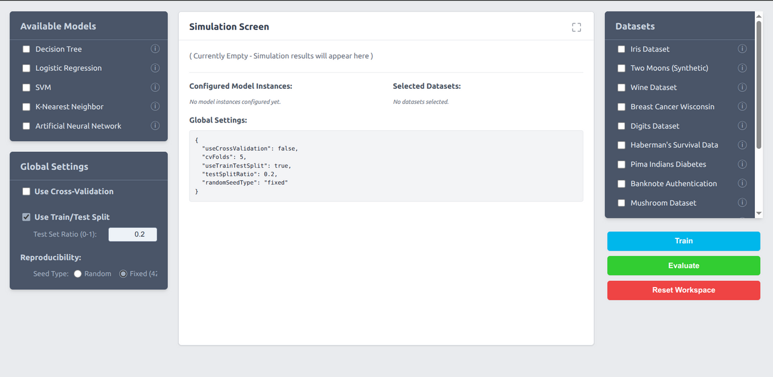
Interface
GTÜ - Bilgisayar Mühendisliği Bölümü
BİL 495/496 Bitirme Projesi
GTU - Computer Engineering Department
CSE 496 Graduation Project

Slide 5
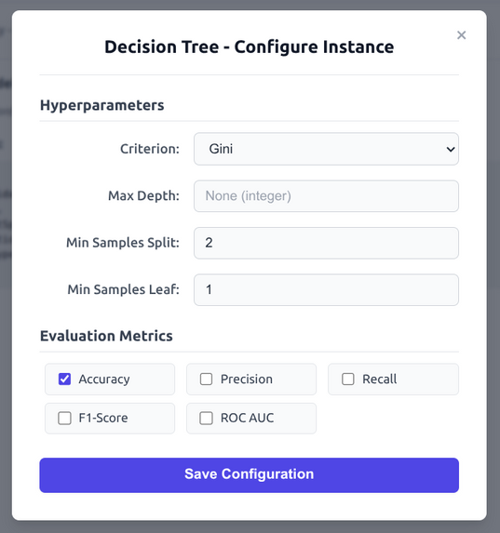
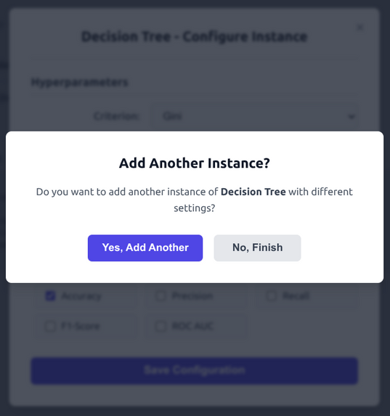
Interface - Selecting a Model
GTÜ - Bilgisayar Mühendisliği Bölümü
BİL 495/496 Bitirme Projesi
GTU - Computer Engineering Department
CSE 496 Graduation Project

Slide 6
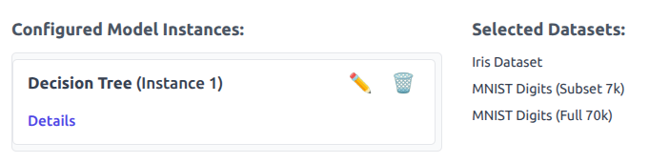
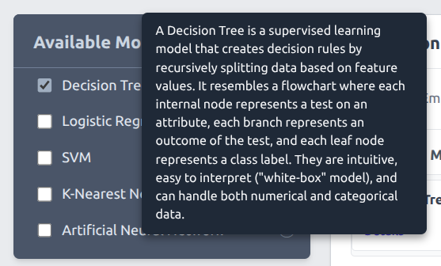
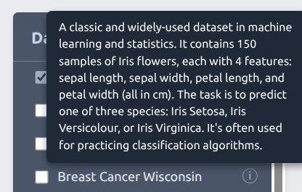
Interface - Selecting a Model
GTÜ - Bilgisayar Mühendisliği Bölümü
BİL 495/496 Bitirme Projesi
GTU - Computer Engineering Department
CSE 496 Graduation Project

Slide 7
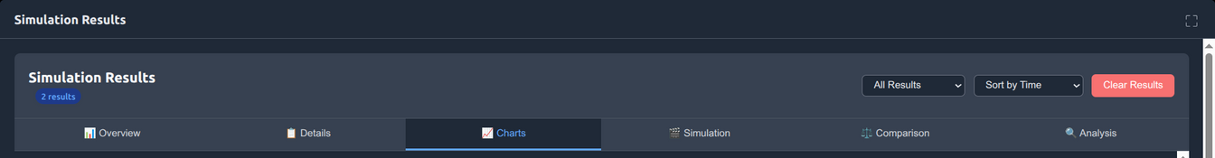
Interface - Main Menu of Simulation
Overview: This is the introductory section that summarizes how many models are used, which datasets are used, etc.
Details: In this section, we select the models we want to analyze in the following sections, and there is also a list with information such as whether or not each model is in the cache.
Charts: In this section, you can generally find the charts of the metrics selected in the configuration section, the display and some other charts. Also, in almost every section, there is a button called `Explain With Gemini`, which discusses what the charts mean and the evaluation of the results.
Simulation: This section includes some simulation images where the selected items are put in an accuracy race against each other and the accuracy-loss values ​​of each model are presented as live demos. There are also graphs for Decision Tree and Artificial Neural Network showing how these architectures grow.
Comparison: This section contains tables showing which model gives better results in which dataset.
Analysis: This section shows which models are generally good. In addition, the source codes of the selected models are presented to the users.
GTÜ - Bilgisayar Mühendisliği Bölümü
BİL 495/496 Bitirme Projesi
GTU - Computer Engineering Department
CSE 496 Graduation Project

Slide 8
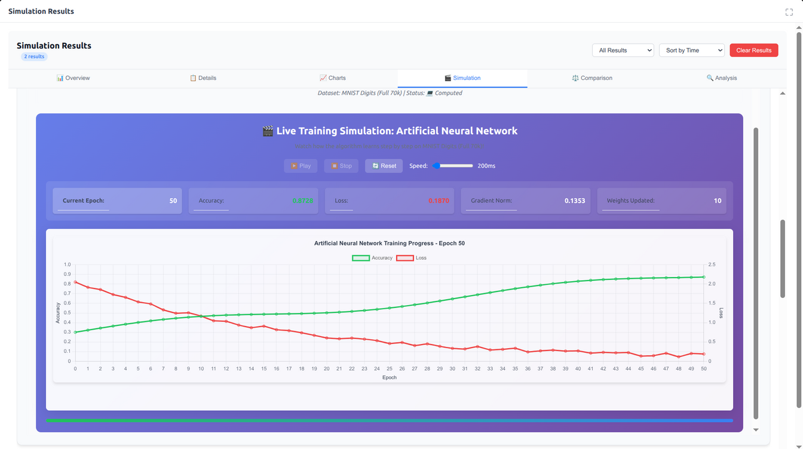
Interface - Simulation of accuracy-loss Changes
GTÜ - Bilgisayar Mühendisliği Bölümü
BİL 495/496 Bitirme Projesi
GTU - Computer Engineering Department
CSE 496 Graduation Project

Slide 9
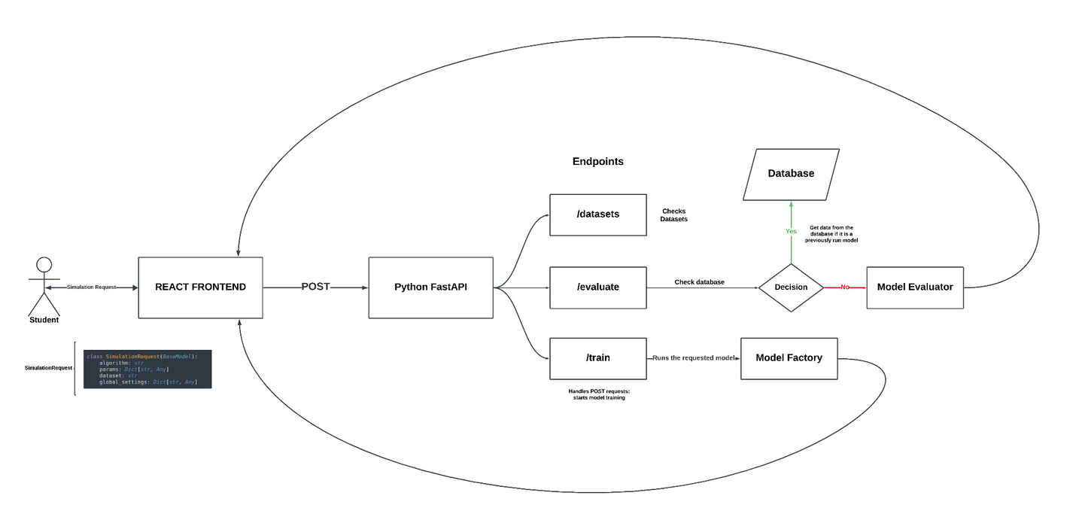
System Arhitecture
GTÜ - Bilgisayar Mühendisliği Bölümü
BİL 495/496 Bitirme Projesi

Slide 10
Project Outputs and Evaluation
Criterion 1: Creating an Interactive and Easy-to-Use Educational Platform
Goal: To enable students and beginners to experiment with machine learning without complex setups or programming knowledge.
Result: Successfully achieved. It consists of a modern and user-friendly distribution that can be separated with React and a powerful backend based on Python/FastAPI, it has the feel of a web-based platform. Users can manage the entire process by simply making selections from the sections.
Criterion 2: Present Model Results in a Clear and Visual Form
Goal: To transform abstract metrics (accuracy, precision, etc.) and results (complexity matrix) into visual formats that everyone can understand.
Results Achieved: Successfully achieved. The system produces dynamic graphs comparing the performance metrics of all trained models and detailed result tables for each model (e.g. complexity matrix), allowing easy interpretation of results.
GTÜ - Bilgisayar Mühendisliği Bölümü
BİL 495/496 Bitirme Projesi
GTU - Computer Engineering Department
CSE 496 Graduation Project

Slide 11
Additional things done
Bridging the Interface Selections with Real Code
Goal: To put theory into practice by showing the real Python code that runs behind each choice made by the user.
Result: Successfully achieved. One of the most innovative features of the platform is that it instantly generates Python (Scikit-learn/Tensorflow) code based on the algorithm, dataset and parameters selected by the user. This feature embodies the learning process.
Providing Automatic Explanations for Generated Code and Results
Goal: To maximize educational value by not only displaying the code and results, but also explaining what they mean.
Result: Successfully achieved. Thanks to the Google Gemini (LLM) integration, a system has been developed that explains the meaning of the generated code and the results obtained in a simple and understandable language. This has transformed the platform from a standard tool to an intelligent educational assistant.
GTÜ - Bilgisayar Mühendisliği Bölümü
BİL 495/496 Bitirme Projesi
GTU - Computer Engineering Department
CSE 496 Graduation Project

Slide 12
Additional things done
Providing Easy Installation and Accessibility
Goal: To eliminate complex dependency and installation processes of the project and ensure that it can be easily run by everyone. Even though we cannot run it on a server, we want to be able to run this project with all its dependencies with just a single command.
Result: Successfully achieved. The entire project (frontend and backend) is containerized with Docker. In this way, users can effortlessly launch the entire system on their own computers with a single docker-compose command.
GTÜ - Bilgisayar Mühendisliği Bölümü
BİL 495/496 Bitirme Projesi
GTU - Computer Engineering Department
CSE 496 Graduation Project

Slide 13
References
Alpaydın, E. (2010). Introduction to Machine Learning (2nd ed.). The MIT Press.
Note: This standard book citation is used for the machine learning model concepts.
FastAPI Team. (n.d.). FastAPI documentation. Retrieved May 2025, from https://fastapi.tiangolo.com/
Note: Used for backend development framework guidance.
Docker Inc. (n.d.). Docker Documentation. Retrieved May 2025, from https://docs.docker.com/
Note: Used for containerization and deployment setup.
GTÜ - Bilgisayar Mühendisliği Bölümü
BİL 495/496 Bitirme Projesi
GTU - Computer Engineering Department
CSE 496 Graduation Project

