Slide 1


Bilgisayar Mühendisliği Bölümü
GTU GRADUATION PROJECT
SECOND PRESENTATION
Training Environment for Machine Learning Algorithms
Ahmet Özdemir
Project Consultants:
Dr. Alp Arslan Bayrakçı
Notes:
<number>

Slide 2
Contents
Project Overview
Current Status and Achievements
Interface
System Architecture
Next Steps and Future Work
References
GTU - Computer Engineering Department
CSE 496 Graduation Project
Notes:
<number>

Slide 3
Project Overview
Purpose: This project provides an interactive, user-friendly educational platform for machine learning. It demystifies algorithm training and evaluation by enabling code-free experimentation with various models, datasets, and parameters, fostering a practical understanding of their interactions and impact on results.
Problem: Experimenting with machine learning models is often complex, requiring environment setup and extensive boilerplate code for data handling and model operations. Understanding the nuanced impact of different datasets, model choices, hyperparameters, and evaluation strategies can be a significant barrier for learners and practitioners seeking rapid comparisons.
Goal: The goal is to deliver an accessible web platform for visual selection and configuration of classification models, datasets (including varying sizes like full/subset MNIST), and global run settings. The backend will process these user-defined experiments, with the aim to (eventually) display comparative results and metrics directly in the UI, offering a practical "sandbox" for machine learning exploration.
GTÜ - Bilgisayar Mühendisliği Bölümü
BİL 495/496 Bitirme Projesi
GTU - Computer Engineering Department
CSE 496 Graduation Project

Slide 4
Current Status
Our interface allows users to select classification algorithms, adjust hyperparameters, and create experiments, with helpful tips on models and data. Users can control general training settings like data splitting and scaling.
The platform allows users to define general training settings (such as how the dataset will be split, random state, and feature scaling) to conduct their experiments in a more controlled manner. Thanks to Docker technology, the system has a structure that can be easily installed and run on any computer, which increases the project's accessibility.
Currently, the Decision Tree algorithm is fully integrated, and model training and the calculation of performance metrics are successfully performed on the prepared data. In summary, we've successfully implemented a core, user-friendly ML workflow from interface to model training and evaluation using defined settings.
GTÜ - Bilgisayar Mühendisliği Bölümü
BİL 495/496 Bitirme Projesi
GTU - Computer Engineering Department
CSE 496 Graduation Project

Slide 5
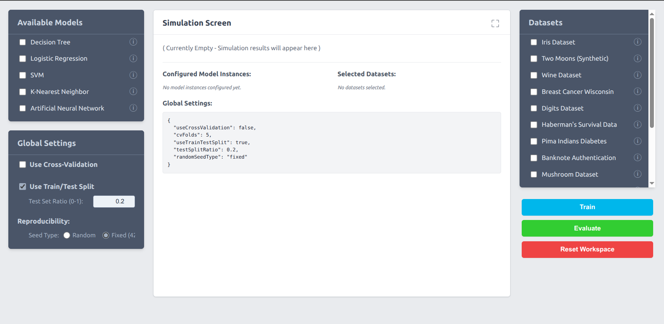
Interface
GTÜ - Bilgisayar Mühendisliği Bölümü
BİL 495/496 Bitirme Projesi
GTU - Computer Engineering Department
CSE 496 Graduation Project

Slide 6
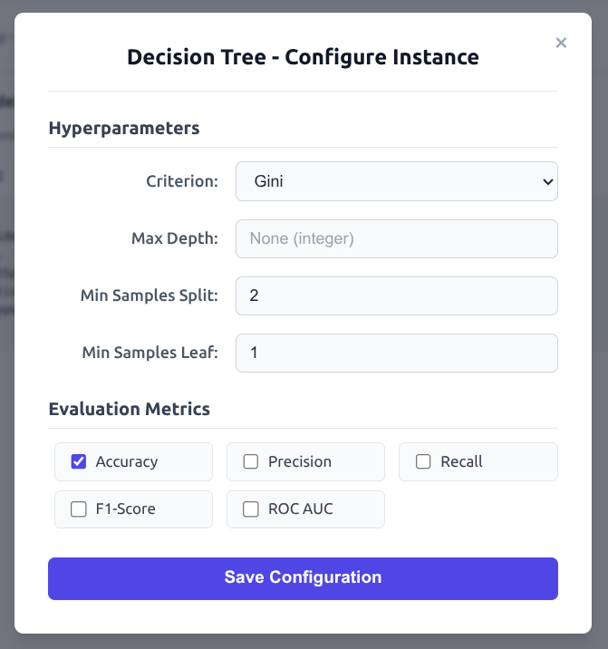
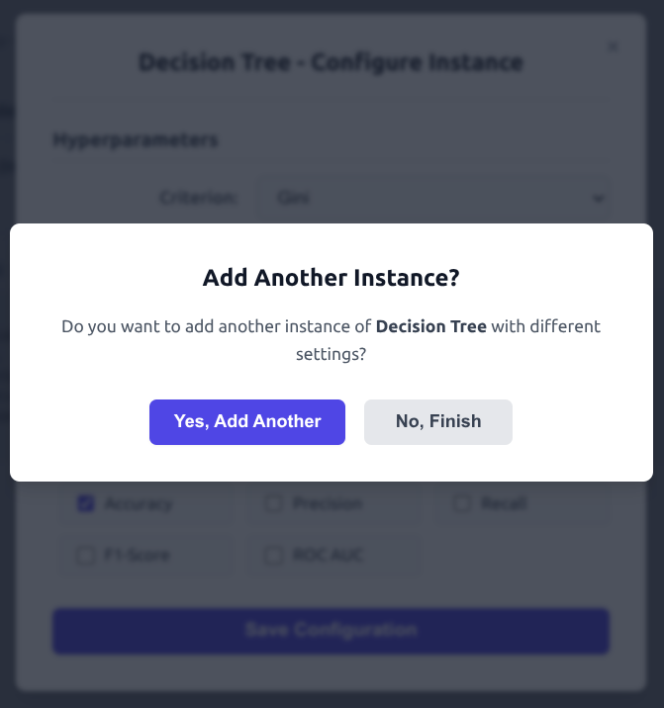
Interface - Selecting a Model
GTÜ - Bilgisayar Mühendisliği Bölümü
BİL 495/496 Bitirme Projesi
GTU - Computer Engineering Department
CSE 496 Graduation Project

Slide 7
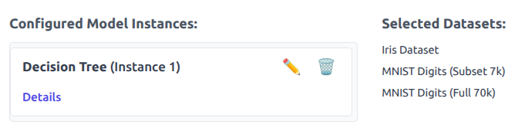
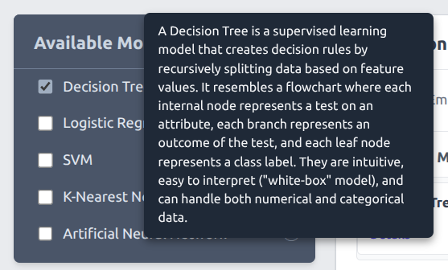
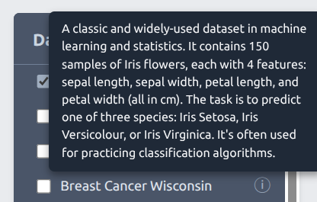
Interface - Selecting a Model
GTÜ - Bilgisayar Mühendisliği Bölümü
BİL 495/496 Bitirme Projesi
GTU - Computer Engineering Department
CSE 496 Graduation Project

Slide 8
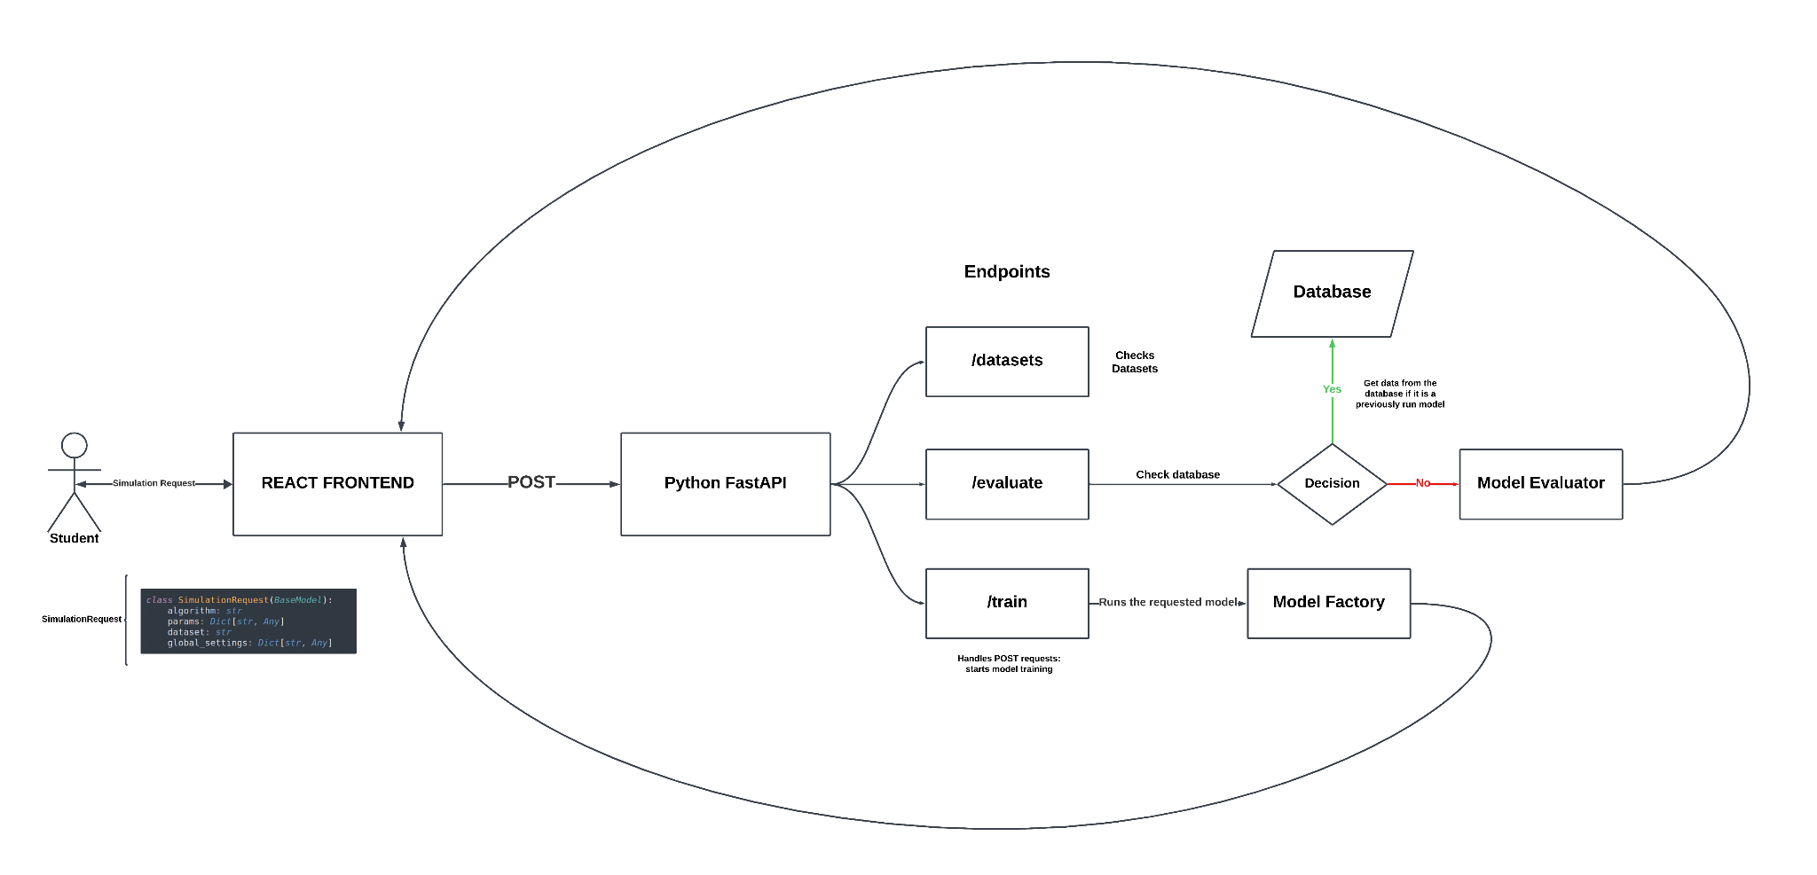
System Arhitecture
GTÜ - Bilgisayar Mühendisliği Bölümü
BİL 495/496 Bitirme Projesi

Slide 9
Next Steps and Future Works
In the next phase, we will focus on the following critical steps to enrich the user experience and maximize the project's educational value:
Comprehensive Model Integration (Backend): Expand our backend infrastructure, currently supporting only Decision Tree, to include all initially planned classification models (Logistic Regression, SVM, KNN, and Artificial Neural Networks).
Displaying Simulation Results on the Interface (Frontend): Clearly and effectively present the simulation results returned from the backend (metrics, training times, notes, etc.) to the user on the "Simulation Screen" panel.
Database Storage and Caching of Simulation Results (Backend & Database): Persistently store the metrics, parameters, and global settings from each "Train" and "Evaluate" operation in a database with a unique ID. This will allow results from identical past simulations to be quickly retrieved (cached) directly from the database, avoiding re-computation.
GTÜ - Bilgisayar Mühendisliği Bölümü
BİL 495/496 Bitirme Projesi
GTU - Computer Engineering Department
CSE 496 Graduation Project

Slide 10
References
Alpaydın, E. (2010). Introduction to Machine Learning (2nd ed.). The MIT Press.
Note: This standard book citation is used for the machine learning model concepts.
FastAPI Team. (n.d.). FastAPI documentation. Retrieved May 2025, from https://fastapi.tiangolo.com/
Note: Used for backend development framework guidance.
Docker Inc. (n.d.). Docker Documentation. Retrieved May 2025, from https://docs.docker.com/
Note: Used for containerization and deployment setup.
GTÜ - Bilgisayar Mühendisliği Bölümü
BİL 495/496 Bitirme Projesi
GTU - Computer Engineering Department
CSE 496 Graduation Project

