Slide 1
DATA ENGİNEER PROJECT
AHMET GÜNAY

Slide 2
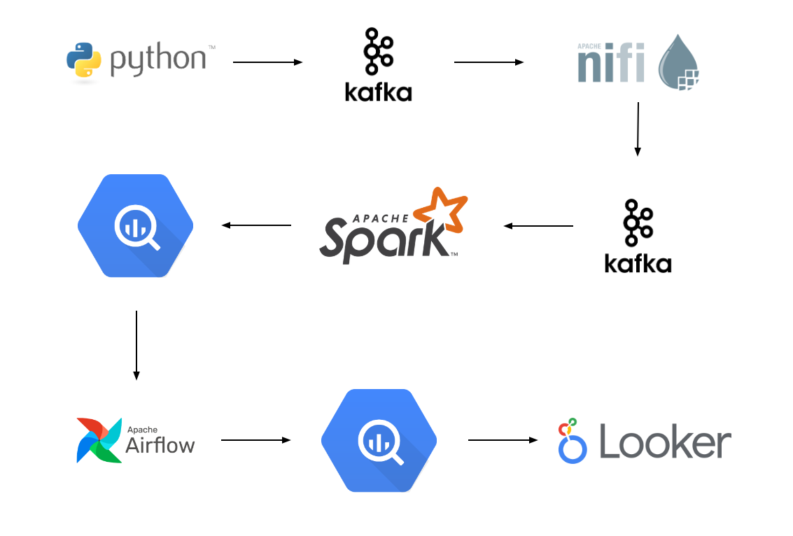
PROJECT SCHEMA

Slide 3
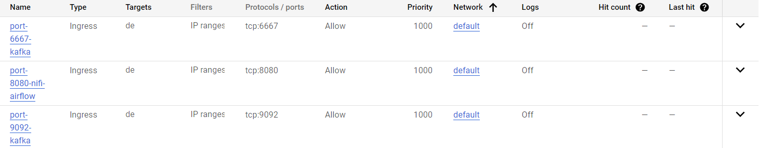
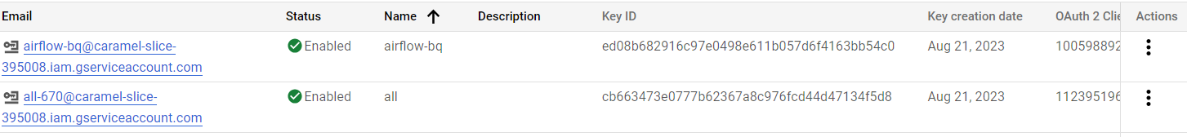
VPC Network and IAM
We set the necessary ports from the firewall rule in the vpc network
We give the necessary permissions from the Service accounts section
in IAM Admin and download the keys in json format

Slide 4
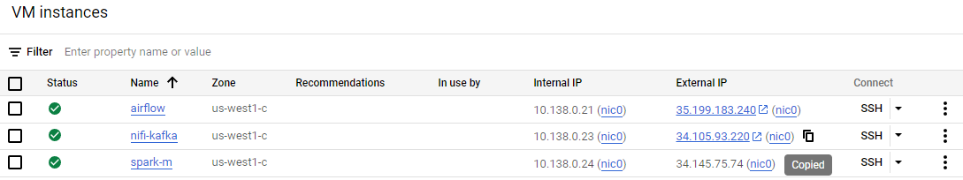
Create VMs
We set up the virtual machines required for the project

Slide 5
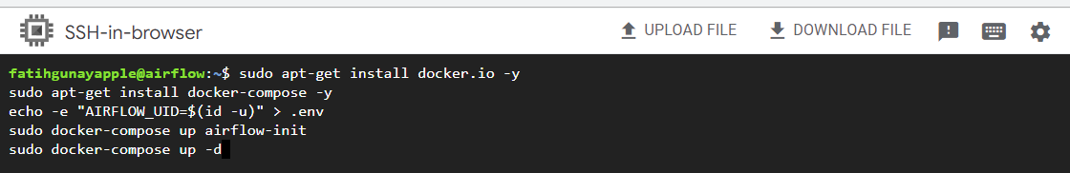
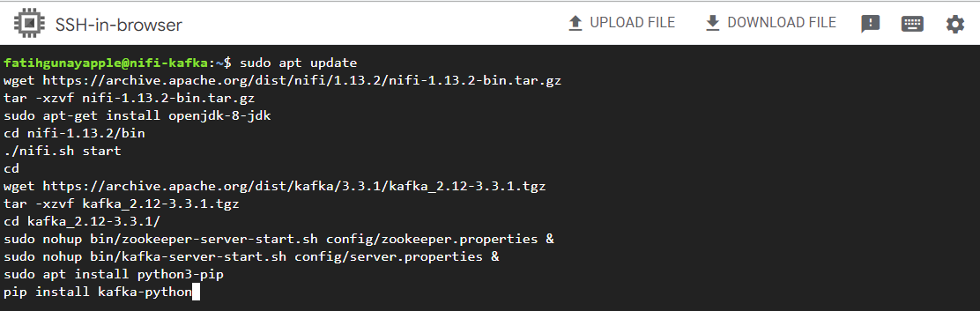
Get created VMs ready for use
We install airflow on the virtual machine using our docker-compose.yml file
We install Nifi and Kafka on another virtual machine with the wget command

Slide 6
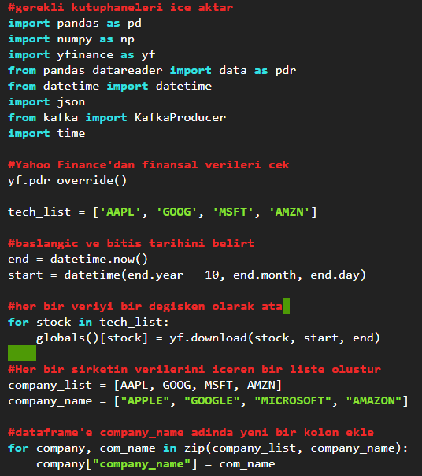
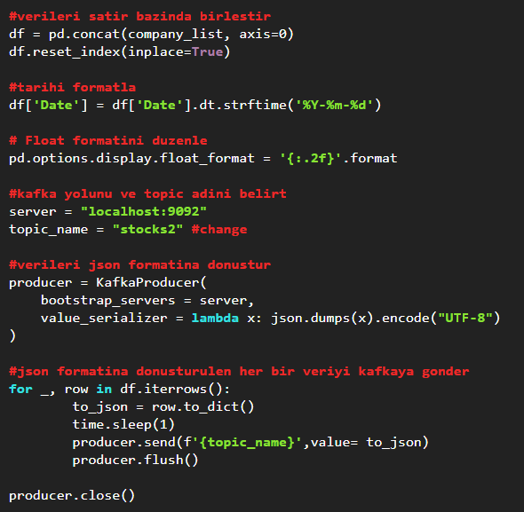
Python -> Kafka
We import data from python to kafka using yfinance library

Slide 7
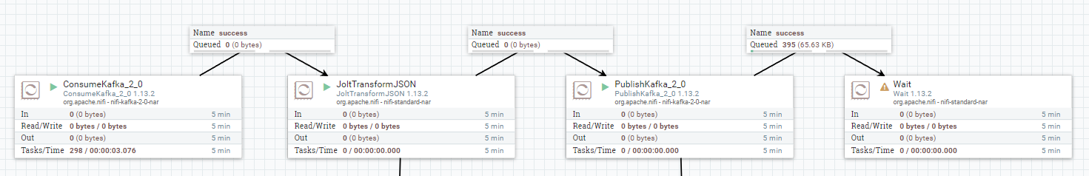
Kafka to Nifi to Kafka
After getting the data from Kafka using Nifi and bringing it to the format we want,
we send it to a different kafka topic.

Slide 8
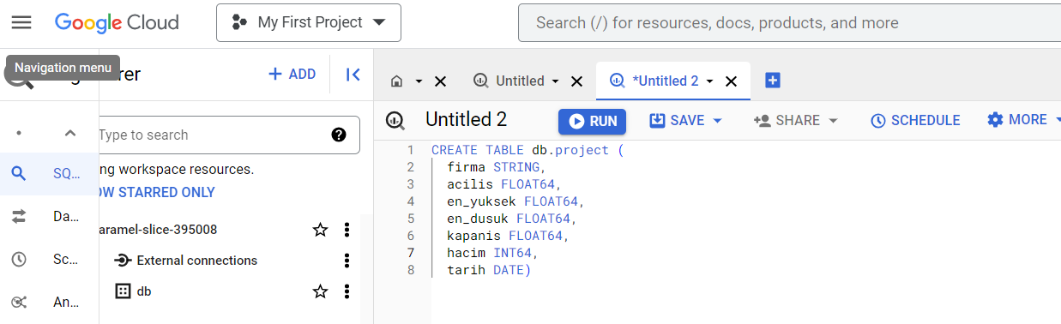
Bigquery
We create a table in the format we need to use in spark

Slide 9
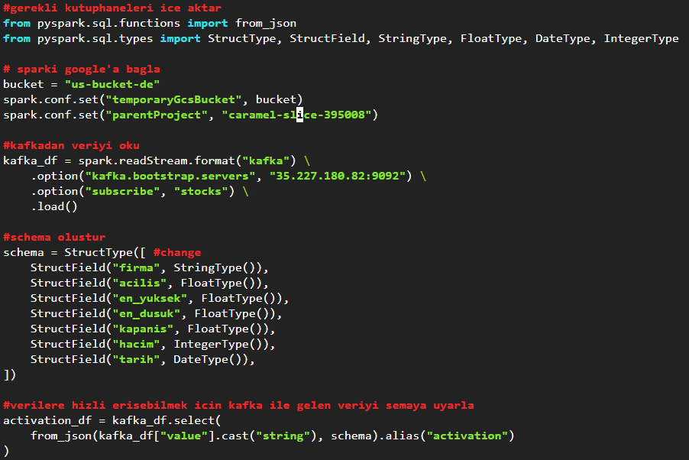
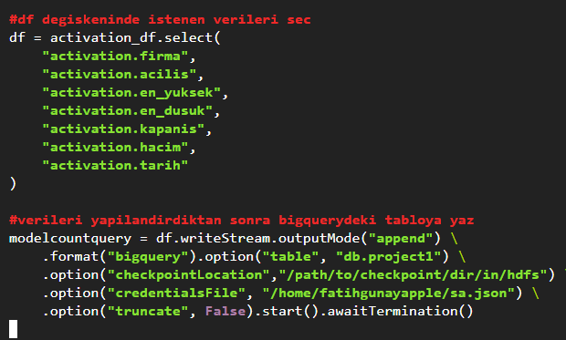
Spark
We get the data from kafka topic with spark and add data as a stream to the existing table in bigquery

Slide 10
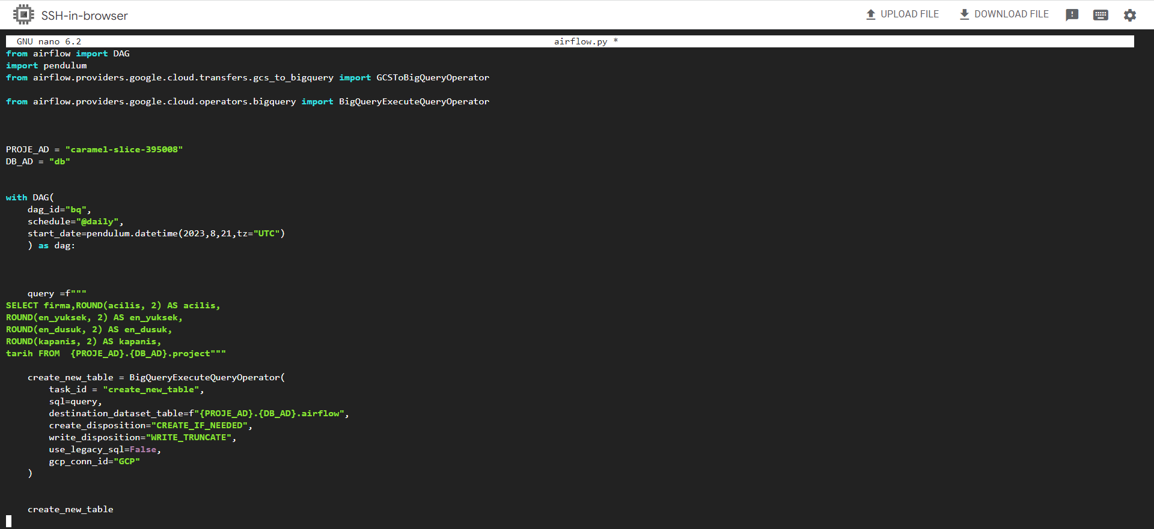
Airflow
We create a new table by using the query we want through
aiflow to the project table in Bigquery.

Slide 11
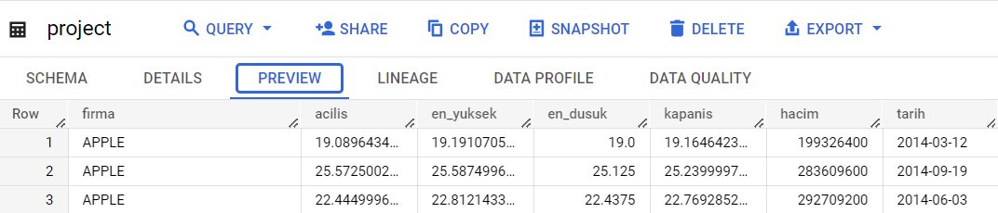
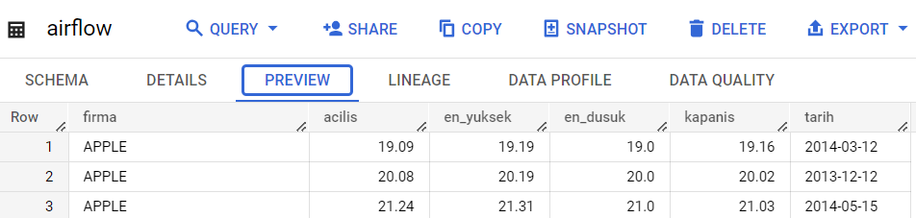
Bigquery
The data we added to the project table as a stream with spark
The data is the final state of transform the table with airflow after the stream is finished.

Slide 12
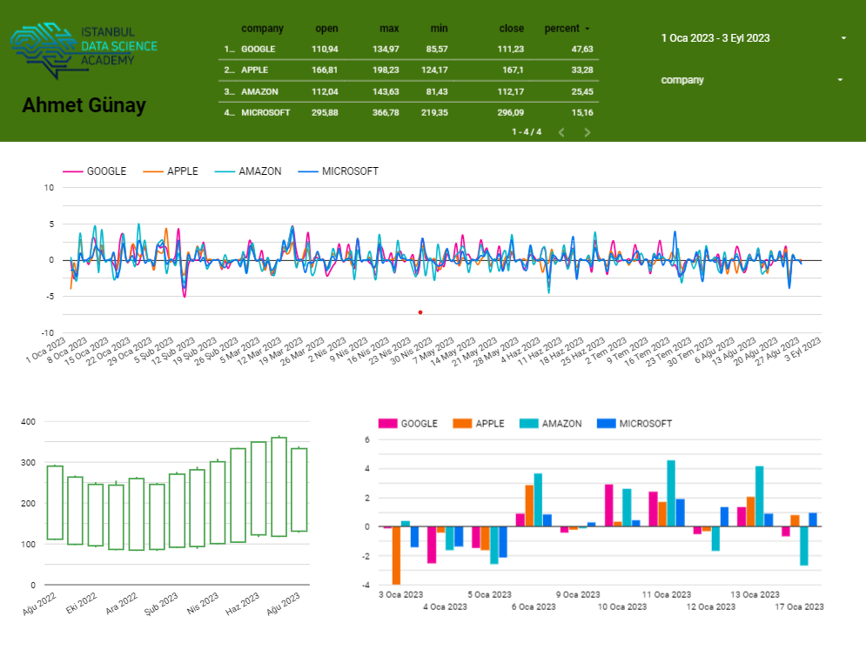
Looker
We send our data to Looker Studio for analysis

