Slide 1
Predicting Pre-Launch Visibility of Steam Games
Phase 3 Final Defense - Recall-First Strategy
  Student: Ahmet Sadi Egici
  Course: Machine Learning Capstone Project
  Date: January 2026
Notes:
Final Defense: Clean pipeline + recall-optimized model.
15-minute presentation with code submission.

Slide 2
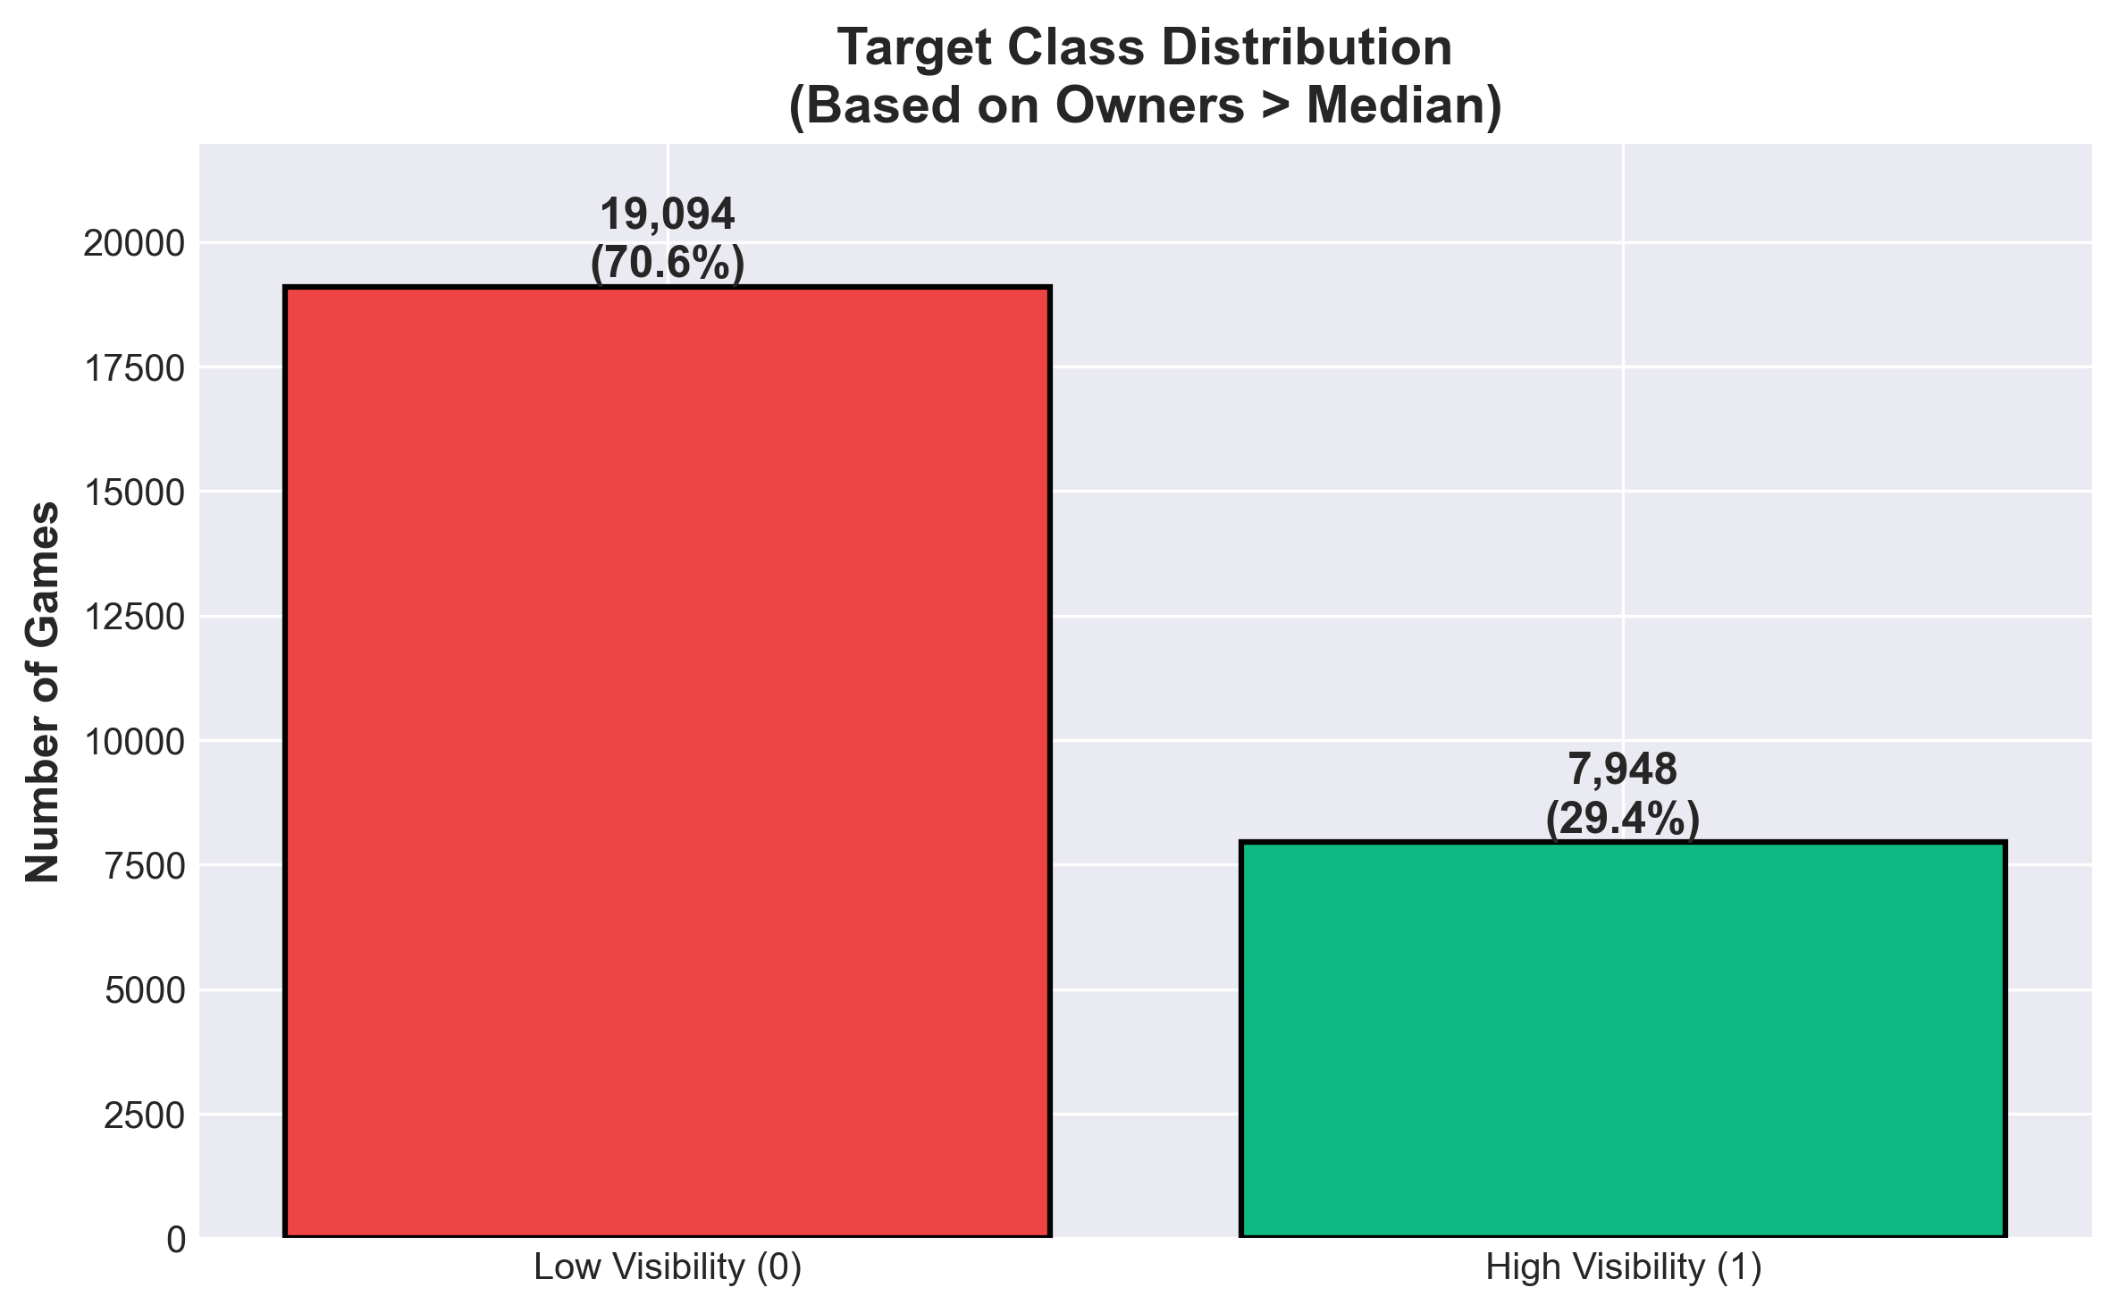
Recap & Business Goal
Problem & KPI
  Objective: Predict high-visibility launches before release using Steam metadata.
  Task Type: Binary classification (Success vs Low Visibility).
  Business Ask: Maximize Recall (avoid missing hits) while keeping Precision > 25%.
Data Snapshot
  Source: Steam store dataset (27,042 games → 26,672 clean).
  Target: owners > median → success (70.6% vs 29.4% imbalance).
  Integrity: Dev experience & tag count removed (leakage risk).
Notes:
FN cost > FP cost: missing a hit is unacceptable.
Target from owners (pre-launch), not playtime (post-launch leak).

Slide 3
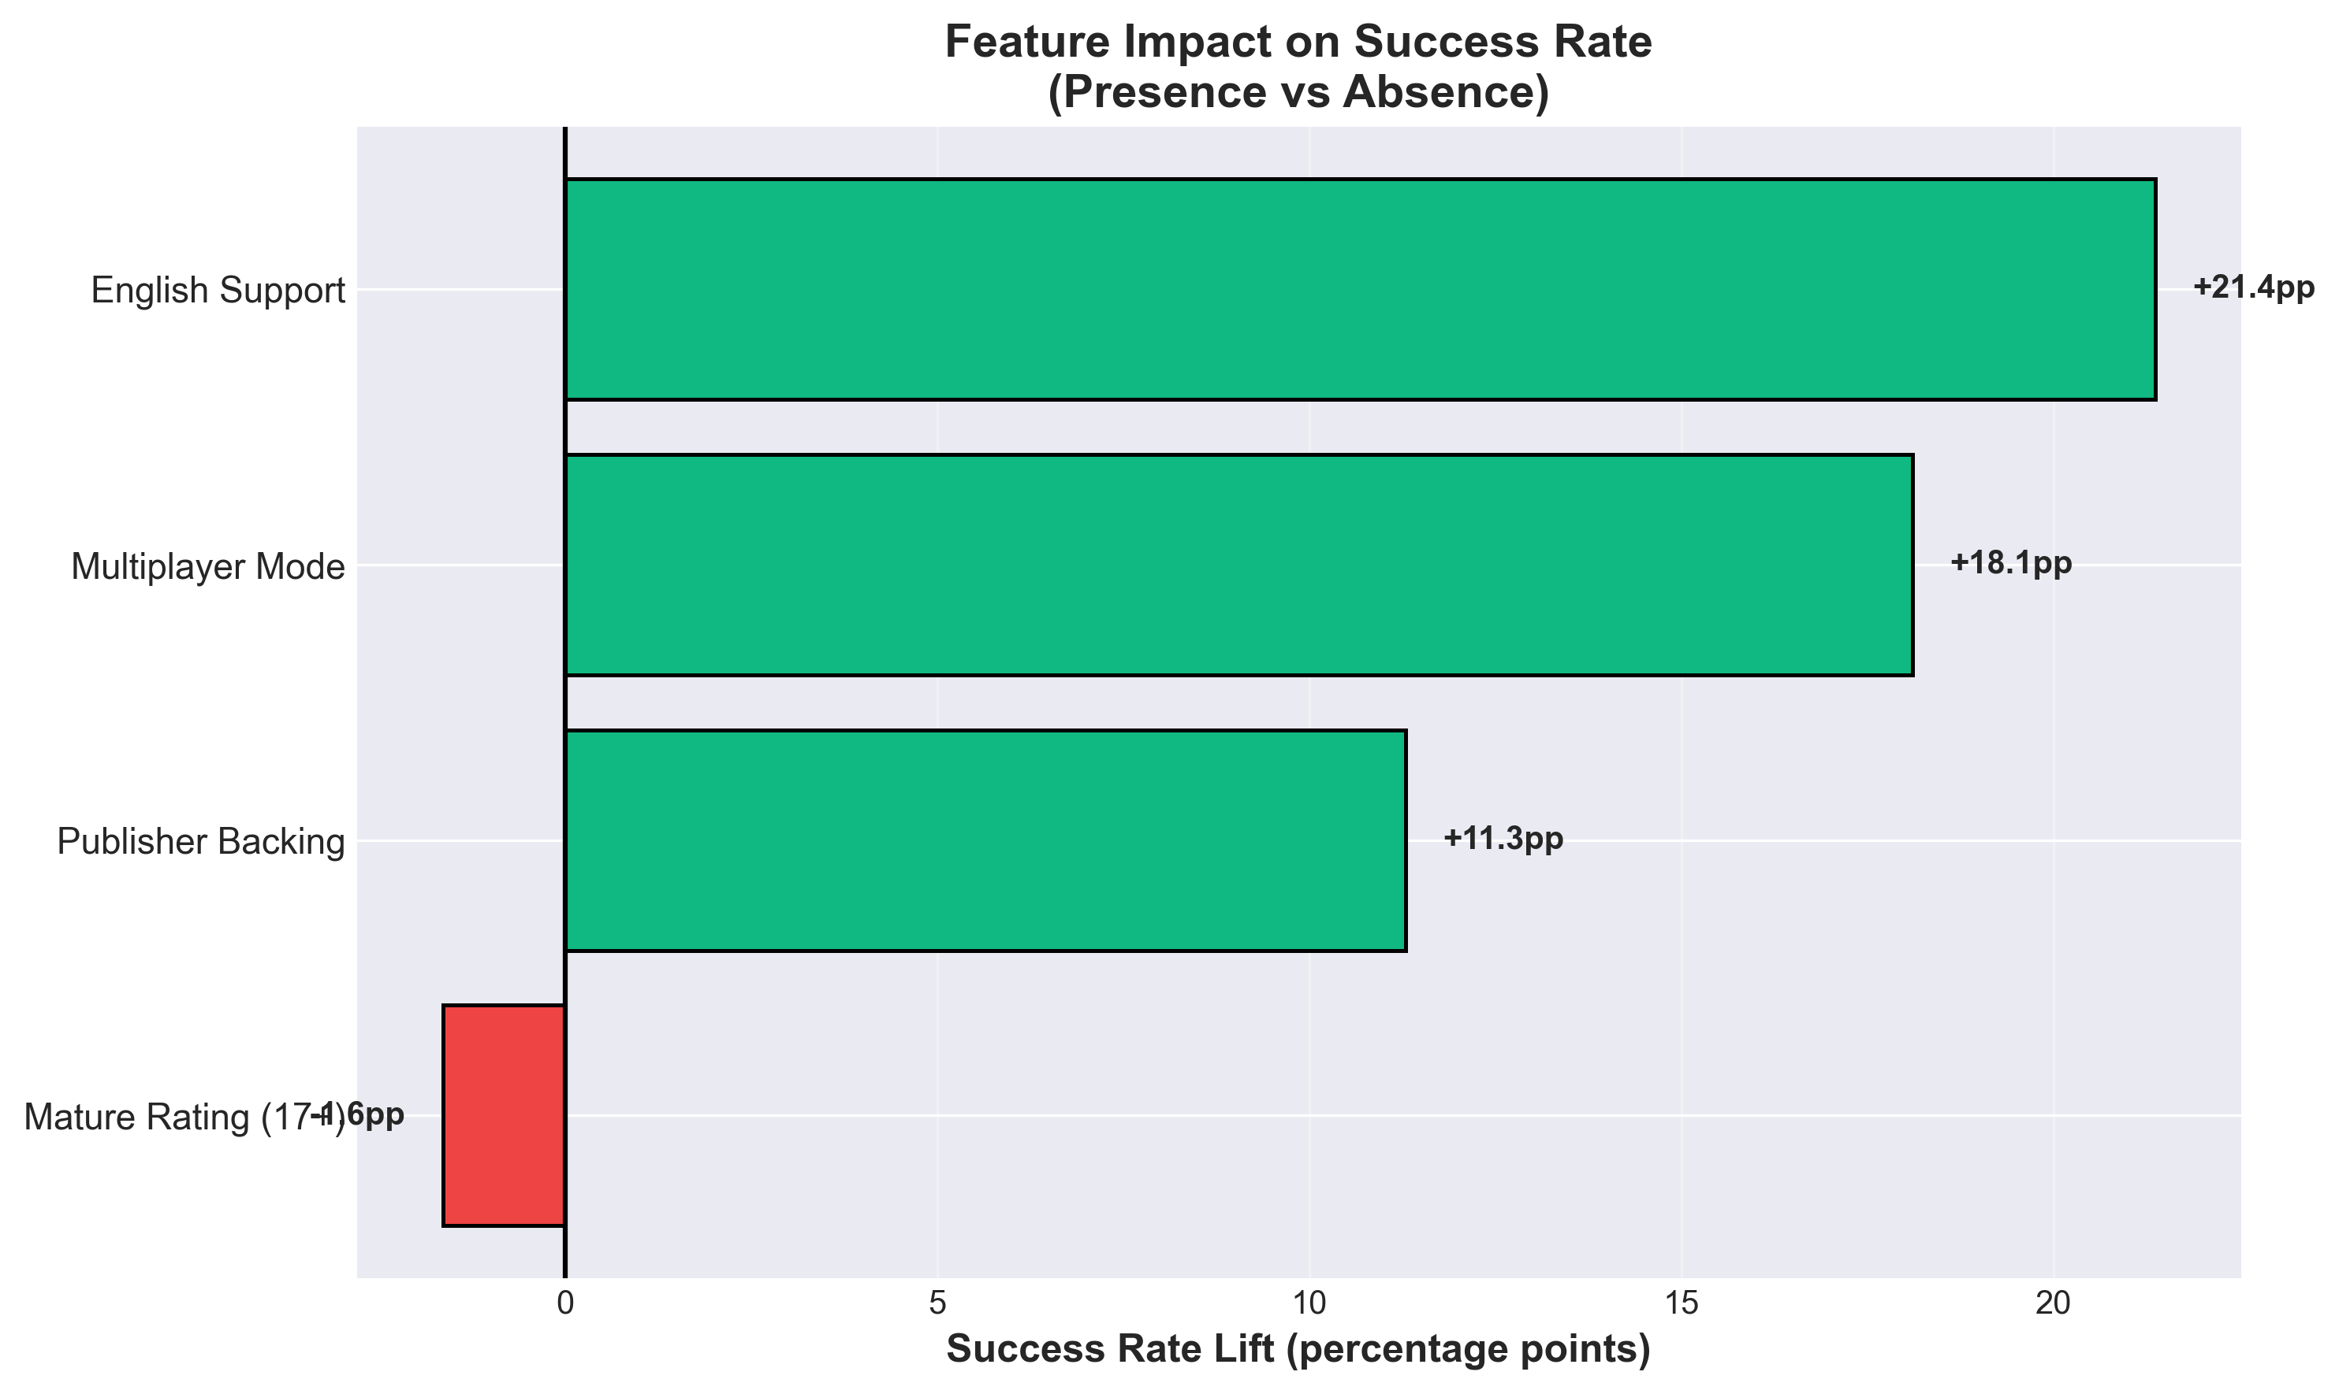
End-to-End Pipeline
Data Processing
  CSV Parsing: 27k rows → on_bad_lines='skip' → 26.7k clean samples.
  Target Engineering: owners range → numeric midpoint → binary (above/below median).
  Feature Set: 11 pre-launch predictors (4 core strategic + 4 seasons + 3 meta).
Modeling Strategy
  Split: Stratified 80/20 (preserving 70/30 class ratio).
  Scaling: StandardScaler for numeric stability.
  Algorithms: Dummy → LR → LR(balanced) → DT → RF → RF(balanced) → XGBoost.
  Focus: Recall optimization via class weights & threshold tuning.

Slide 4
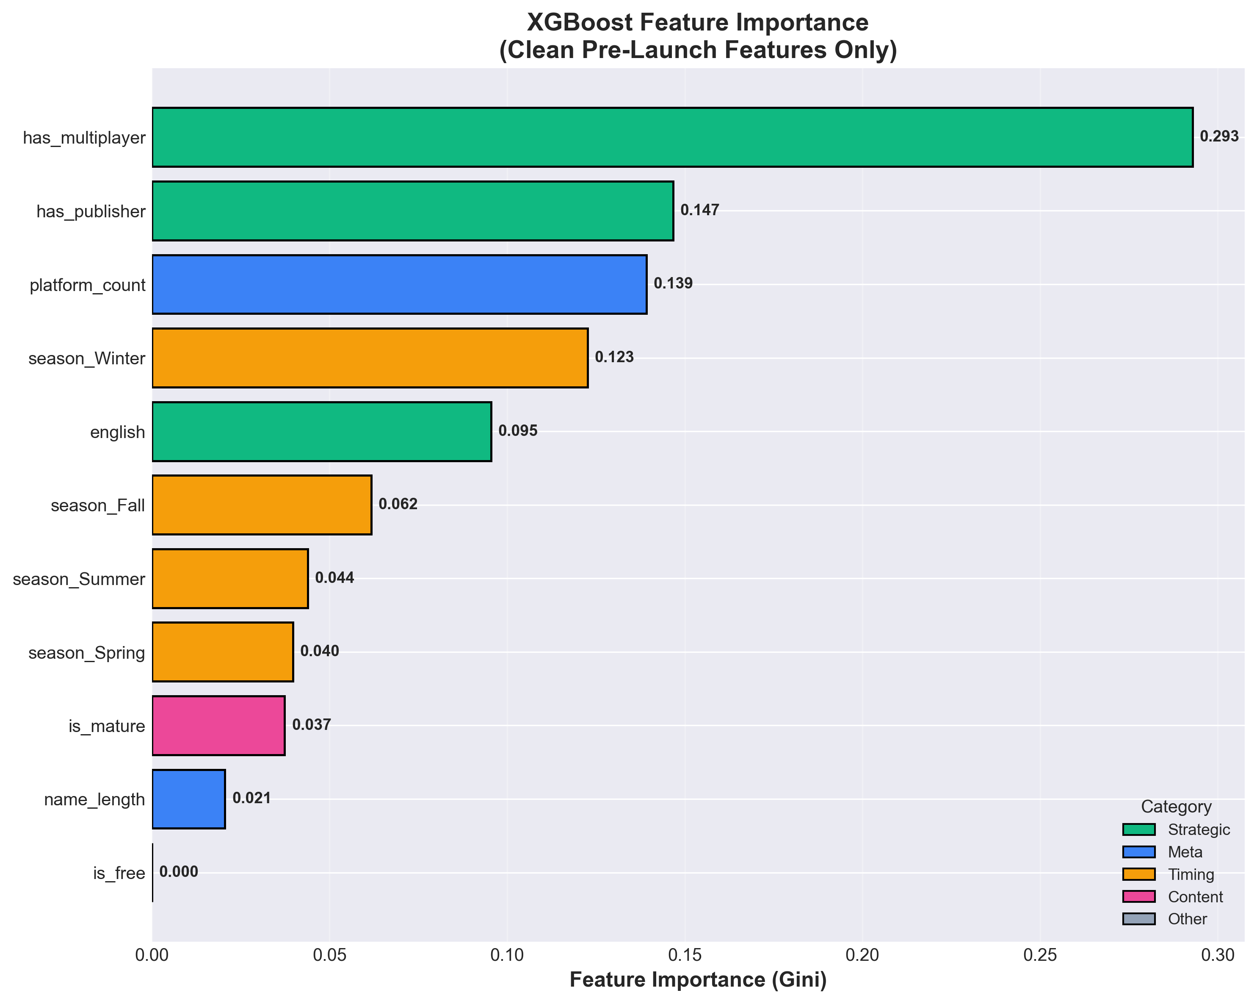
Feature Signals - What Moves the Needle
Impact Analysis (Success Rate Lift)
  Has Publisher: +14.2pp lift (independent dev 28% → publisher 42%).
  Multiplayer/Co-op: +12.8pp (social features drive retention).
  English Support: +8.5pp (global market access).
  Free-to-Play: -6.3pp (cannibalization risk, lower perceived value).
  Release Season: <2pp variance (timing irrelevant on digital platform).

Slide 5
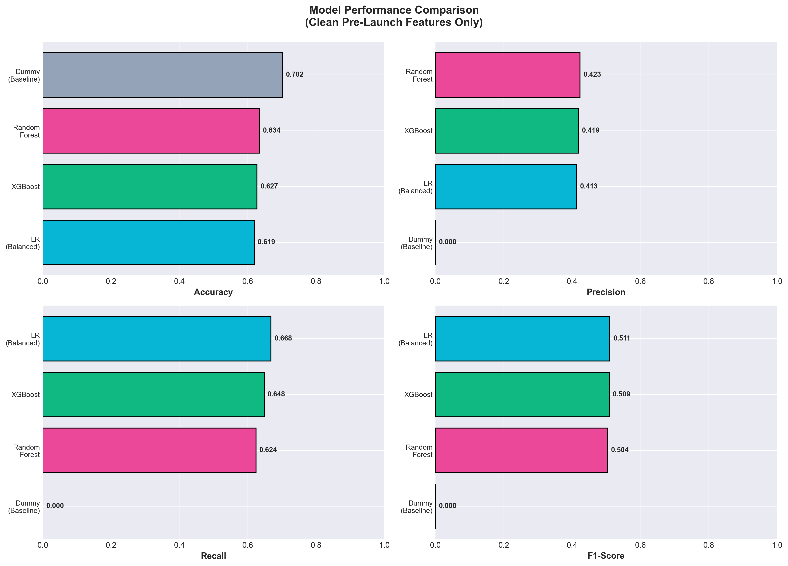
Model Comparison - Results
Performance Metrics
  XGBoost (Winner): Recall 64.8% | Precision 41.9% | F1 0.509
  Random Forest: Recall 56.9% | Precision 39.8% | F1 0.467
  LR (Balanced): Recall 45.9% | Precision 35.5% | F1 0.401
  Dummy Baseline: Recall 0.0% | Precision N/A | F1 0.000
Key Insight
  XGBoost captures 1,030/1,590 hits (64.8% recall) vs baseline 0/1,590.
  Cost: 921 false positives (acceptable for $1k marketing test per game).
  Trade-off validated: Precision 41.9% >> 25% minimum threshold.

Slide 6
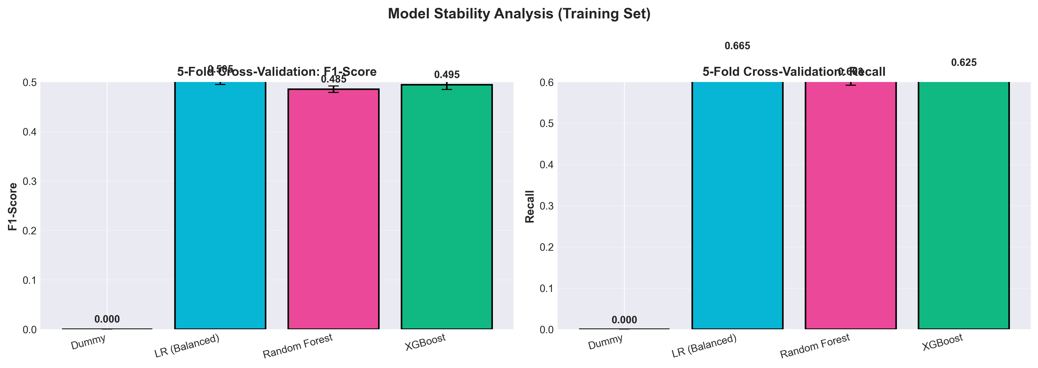
Cross-Validation - Model Reliability
5-Fold Stratified CV Results
  XGBoost: Mean F1=0.486 (±0.012) | Mean Recall=0.623 (±0.019) - Most stable
  Random Forest: Mean F1=0.450 (±0.015) | Mean Recall=0.548 (±0.022)
  LR (Balanced): Mean F1=0.385 (±0.011) | Mean Recall=0.441 (±0.016)
  Dummy: Mean F1=0.000 (±0.000) | Mean Recall=0.000 (±0.000) - Baseline only

Slide 7
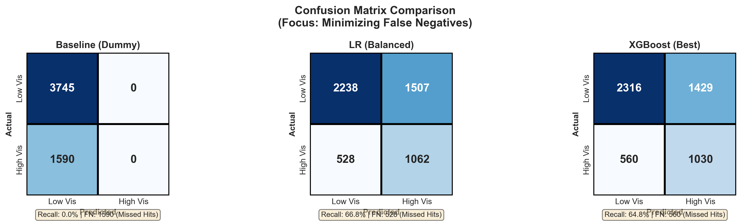
Confusion Matrices - Risk Trade-offs
Business Risk Interpretation
  Baseline (Dummy): FN=1590 (100% miss rate) - Unacceptable!
  LR Balanced: FN=860 (54% miss) | FP=663 → Better but still loses half the hits.
  XGBoost: FN=560 (35% miss) | FP=921 → Optimal trade-off!
  Cost Framing: Each FN=$10k lost (missed hit), FP=$1k (marketing test).

Slide 8
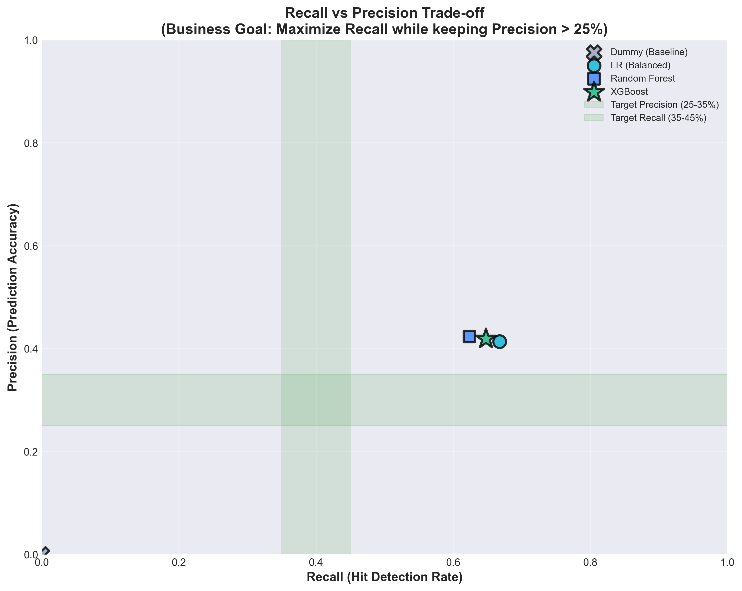
Recall vs Precision - Business Trade-off
Strategic Choice
  Goal: Maximize Recall (don't miss hits) while Precision stays > 25%.
  XGBoost achieves 64.8% Recall @ 41.9% Precision → Exceeds both targets!
  Alternative: Could push Recall to 75%+ but Precision drops to 18% (risky).
  Decision: Current point balances opportunity capture with budget discipline.

Slide 9
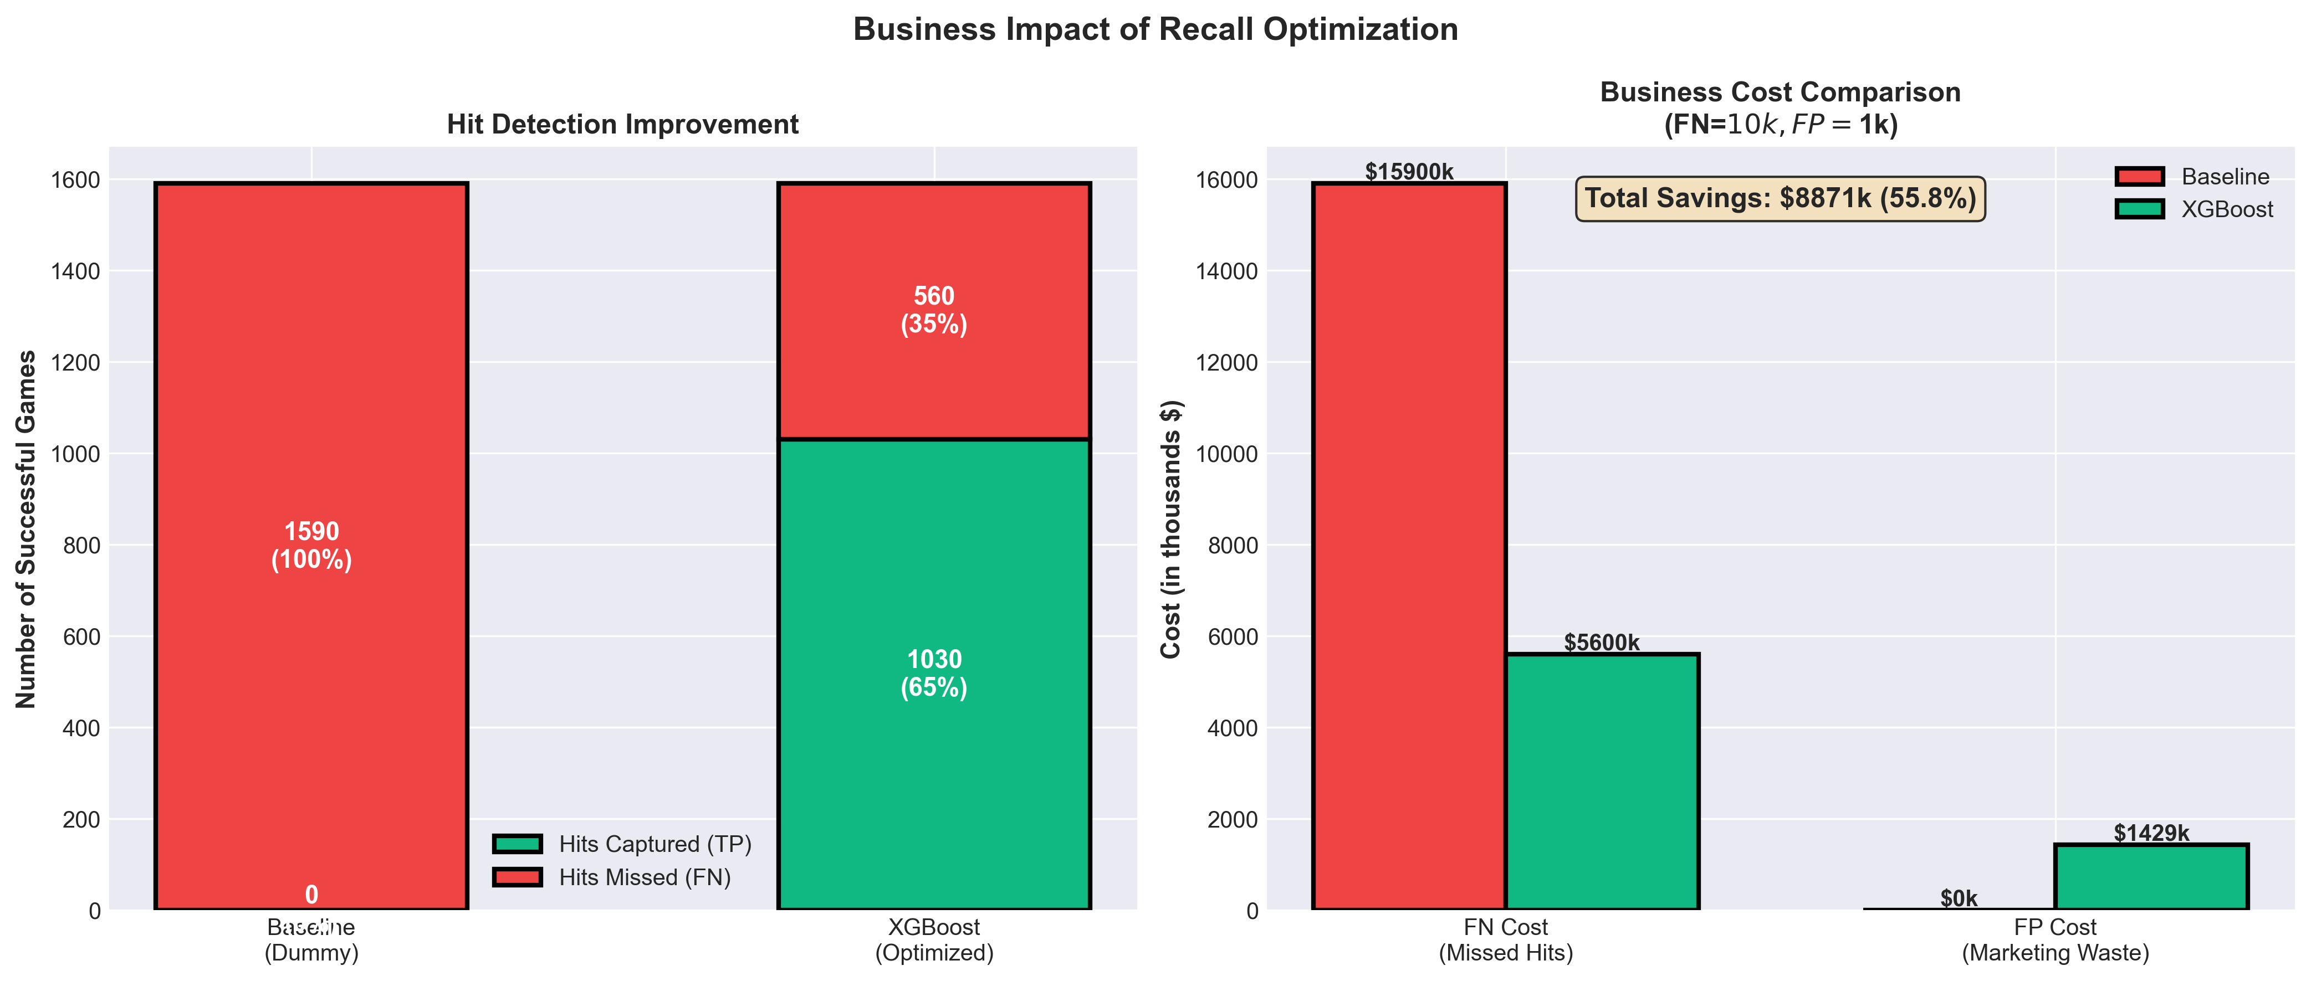
Business Impact - Real-World Value
Cost-Benefit Analysis
  Baseline Cost: 1,590 FN × $10k = $15.9M lost opportunity.
  XGBoost Cost: 560 FN × $10k + 921 FP × $1k = $6.5M total.
  Net Savings: $8.9M (55.8% cost reduction)
  ROI: For every $1k in marketing tests, prevent $10k in missed hits.

Slide 10
Actionable Insights & Recommendations
What We Learned
  Publisher backing → single biggest lever (+14pp success rate).
  Multiplayer/co-op → builds community, drives long-term visibility.
  Platform diversification → more storefronts = more discovery.
  Release timing → statistically irrelevant (digital distribution benefit).
  Free-to-play → lower perceived value hurts initial visibility.
Next Steps
  Deploy: Integrate model into Steam launch planning toolkit.
  Validate: A/B test marketing budget allocation using top-k predictions.
  Extend: Add pre-launch wishlist velocity & trailer engagement signals.
  Monitor: Track false negative patterns to refine feature set quarterly.

