Slide 1
Chapter 6: Link Analysis

Slide 2
Road map
Introduction
Social network analysis
Co-citation and bibliographic coupling
PageRank
HITS
Summary
CS583, Bing Liu, UIC

Slide 3
Introduction
Early search engines mainly compare content similarity of the query and the indexed pages. I.e.,
  They use information retrieval methods, cosine, TF-IDF, ...
From 1996, it became clear that content similarity alone was no longer sufficient.
  The number of pages grew rapidly in the mid-late 1990’s.
    Try “classification technique”, Google estimates: 10 million relevant pages.
    How to choose only 30-40 pages and rank them suitably to present to the user?
  Content similarity is easily spammed.
    A page owner can repeat some words and add many related words to boost the rankings of his pages and/or to make the pages relevant to a large number of queries.
CS583, Bing Liu, UIC

Slide 4
Introduction (cont …)
Starting around 1996, researchers began to work on the problem. They resort to hyperlinks.
  In Feb, 1997, Yanhong Li (Robin Li), Scotch Plains, NJ, filed a hyperlink based search patent. The method uses words in anchor text of hyperlinks.
Web pages on the other hand are connected through hyperlinks, which carry important information.
  Some hyperlinks: organize information at the same site.
  Other hyperlinks: point to pages from other Web sites. Such out-going hyperlinks often indicate an implicit conveyance of authority to the pages being pointed to.
Those pages that are pointed to by many other pages are likely to contain authoritative information.
CS583, Bing Liu, UIC

Slide 5
Introduction (cont …)
During 1997-1998, two most influential hyperlink based search algorithms PageRank and HITS were reported.
Both algorithms are related to social networks. They exploit the hyperlinks of the Web to rank pages according to their levels of “prestige” or “authority”.
  HITS: Jon Kleinberg (Cornel University), at Ninth Annual ACM-SIAM Symposium on Discrete Algorithms, January 1998
  PageRank: Sergey Brin and Larry Page, PhD students from Stanford University, at Seventh International World Wide Web Conference (WWW7) in April, 1998.
PageRank powers the Google search engine.
CS583, Bing Liu, UIC

Slide 6
Introduction (cont …)
Apart from search ranking, hyperlinks are also useful for finding Web communities.
  A Web community is a cluster of densely linked pages representing a group of people with a special interest.
Beyond explicit hyperlinks on the Web, links in other contexts are useful too, e.g.,
  for discovering communities of named entities (e.g., people and organizations) in free text documents, and
  for analyzing social phenomena in emails..
CS583, Bing Liu, UIC

Slide 7
Road map
Introduction
Social network analysis
Co-citation and bibliographic coupling
PageRank
HITS
Summary
CS583, Bing Liu, UIC

Slide 8
Social network analysis
Social network is the study of social entities (people in an organization, called actors), and their interactions and relationships.
The interactions and relationships can be represented with a network or graph,
  each vertex (or node) represents an actor and
  each link represents a relationship.
From the network, we can study the properties of its structure, and the role, position and prestige of each social actor.
We can also find various kinds of sub-graphs, e.g., communities formed by groups of actors.
CS583, Bing Liu, UIC

Slide 9
Social network and the Web
Social network analysis is useful for the Web because the Web is essentially a virtual society, and thus a virtual social network,
  Each page: a social actor and
  each hyperlink: a relationship.
Many results from social network can be adapted and extended for use in the Web context.
We study two types of social network analysis, centrality and prestige, which are closely related to hyperlink analysis and search on the Web.
CS583, Bing Liu, UIC

Slide 10
Centrality
Important or prominent actors are those that are linked or involved with other actors extensively.
A person with extensive contacts (links) or communications with many other people in the organization is considered more important than a person with relatively fewer contacts.
The links can also be called ties. A central actor is one involved in many ties.
CS583, Bing Liu, UIC

Slide 11
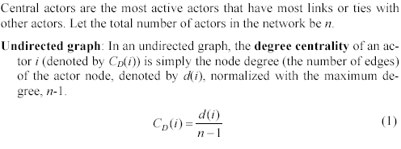
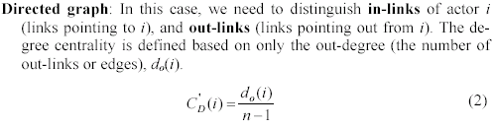
Degree Centrality
CS583, Bing Liu, UIC

Slide 12
Prestige
Prestige is a more refined measure of prominence of an actor than centrality.
  Distinguish: ties sent (out-links) and ties received (in-links).
A prestigious actor is one who is object of extensive ties as a recipient.
  To compute the prestige: we use only in-links.
Difference between centrality and prestige:
  centrality focuses on out-links
  prestige focuses on in-links.
We study three prestige measures. Rank prestige forms the basis of most Web page link analysis algorithms, including PageRank and HITS.
CS583, Bing Liu, UIC

Slide 13

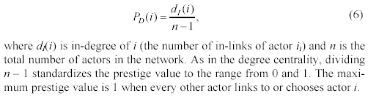
Degree prestige
CS583, Bing Liu, UIC

Slide 14
Rank prestige
In the previous two prestige measures, an important factor is considered,
  the prominence of individual actors who do the “voting”
In the real world, a person i chosen by an important person is more prestigious than chosen by a less important person.
  For example, if a company CEO votes for a person is much more important than a worker votes for the person.
If one’s circle of influence is full of prestigious actors, then one’s own prestige is also high.
  Thus one’s prestige is affected by the ranks or statuses of the involved actors.
CS583, Bing Liu, UIC

Slide 15
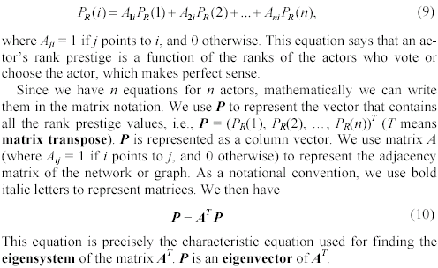
Rank prestige (cont …)
Based on this intuition, the rank prestige P_{R}(i) is define as a linear combination of links that point to i:
CS583, Bing Liu, UIC

Slide 16
Road map
Introduction
Social network analysis
Co-citation and bibliographic coupling
PageRank
HITS
Summary
CS583, Bing Liu, UIC

Slide 17
Co-citation and Bibliographic Coupling
Another area of research concerned with links is citation analysis of scholarly publications.
  A scholarly publication cites related prior work to acknowledge the origins of some ideas and to compare the new proposal with existing work.
When a paper cites another paper, a relationship is established between the publications.
  Citation analysis uses these relationships (links) to perform various types of analysis.
We discuss two types of citation analysis, co-citation and bibliographic coupling. The HITS algorithm is related to these two types of analysis.
CS583, Bing Liu, UIC

Slide 18
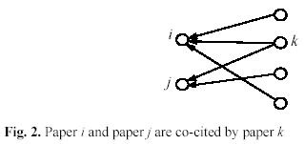
Co-citation
If papers i and j are both cited by paper k, then they may be related in some sense to one another.
The more papers they are cited by, the stronger their relationship is.
CS583, Bing Liu, UIC

Slide 19
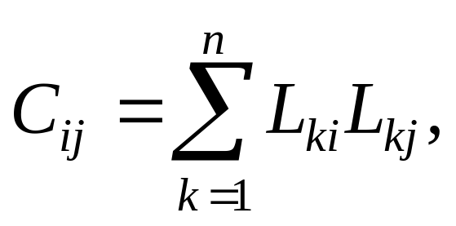
Co-citation
Let L be the citation matrix. Each cell of the matrix is defined as follows:
  L_{ij} = 1 if paper i cites paper j, and 0 otherwise.
Co-citation (denoted by C_{ij}) is a similarity measure defined as the number of papers that co-cite i and j,
C_{ii} is naturally the number of papers that cite i.
A square matrix C can be formed with C_{ij}, and it is called the co-citation matrix.
CS583, Bing Liu, UIC

Slide 20
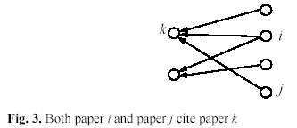
Bibliographic coupling
Bibliographic coupling operates on a similar principle.
Bibliographic coupling links papers that cite the same articles
  if papers i and j both cite paper k, they may be related.
The more papers they both cite, the stronger their similarity is.
CS583, Bing Liu, UIC

Slide 21
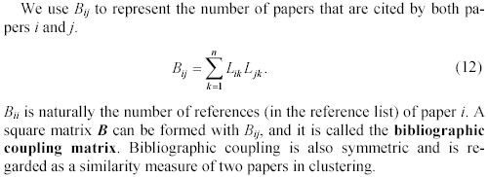
Bibliographic coupling (cont …)
CS583, Bing Liu, UIC

Slide 22
Road map
Introduction
Social network analysis
Co-citation and bibliographic coupling
PageRank
HITS
Summary
CS583, Bing Liu, UIC

Slide 23
PageRank
The year 1998 was an eventful year for Web link analysis models. Both the PageRank and HITS algorithms were reported in that year.
The connections between PageRank and HITS are quite striking.
Since that eventful year, PageRank has emerged as the dominant link analysis model,
  due to its query-independence,
  its ability to combat spamming, and
  Google’s huge business success.
CS583, Bing Liu, UIC

Slide 24
PageRank: the intuitive idea
PageRank relies on the democratic nature of the Web by using its vast link structure as an indicator of an individual page's value or quality.
PageRank interprets a hyperlink from page x to page y as a vote, by page x, for page y.
However, PageRank looks at more than the sheer number of votes; it also analyzes the page that casts the vote.
  Votes casted by “important” pages weigh more heavily and help to make other pages more "important."
This is exactly the idea of rank prestige in social network.
CS583, Bing Liu, UIC

Slide 25
More specifically
A hyperlink from a page to another page is an implicit conveyance of authority to the target page.
  The more in-links that a page i receives, the more prestige the page i has.
Pages that point to page i also have their own prestige scores.
  A page of a higher prestige pointing to i is more important than a page of a lower prestige pointing to i.
  In other words, a page is important if it is pointed to by other important pages.
CS583, Bing Liu, UIC

Slide 26
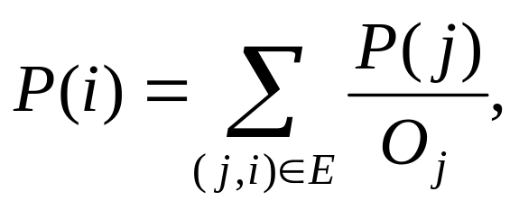
PageRank algorithm
According to rank prestige, the importance of page i (i’s PageRank score) is the sum of the PageRank scores of all pages that point to i.
Since a page may point to many other pages, its prestige score should be shared.
The Web as a directed graph G = (V, E). Let the total number of pages be n. The PageRank score of the page i (denoted by P(i)) is defined by:
O_{j} is the number of out-link of j
CS583, Bing Liu, UIC

Slide 27
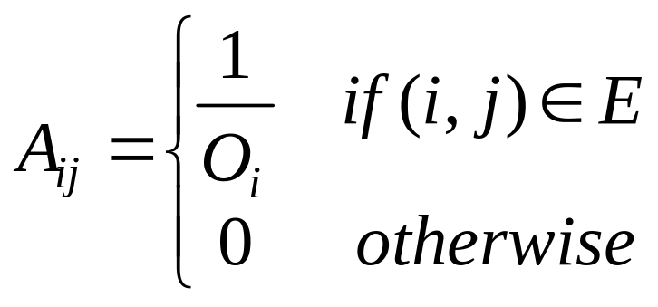
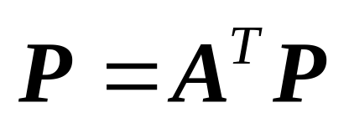
Matrix notation
We have a system of n linear equations with n unknowns. We can use a matrix to represent them.
Let P be a n-dimensional column vector of PageRank values, i.e., P = (P(1), P(2), …, P(n))^{T}.
Let A be the adjacency matrix of our graph with
We can write the n equations with (PageRank)
(14)
(15)
CS583, Bing Liu, UIC

Slide 28
Solve the PageRank equation
(15)
This is the characteristic equation of the eigensystem, where the solution to P is an eigenvector with the corresponding eigenvalue of 1.
It turns out that if some conditions are satisfied, 1 is the largest eigenvalue and the PageRank vector P is the principal eigenvector.
A well known mathematical technique called power iteration can be used to find P.
Problem: the above Equation does not quite suffice because the Web graph does not meet the conditions.
CS583, Bing Liu, UIC

Slide 29
Using Markov chain
To introduce these conditions and the enhanced equation, let us derive the same Equation (15) based on the Markov chain.
  In the Markov chain, each Web page or node in the Web graph is regarded as a state.
  A hyperlink is a transition, which leads from one state to another state with a probability.
This framework models Web surfing as a stochastic process.
It models a Web surfer randomly surfing the Web as state transition.
CS583, Bing Liu, UIC

Slide 30
Random surfing
Recall we use O_{i} to denote the number of out-links of a node i.
Each transition probability is 1/O_{i} if we assume the Web surfer will click the hyperlinks in the page i uniformly at random.
  The “back” button on the browser is not used and
  the surfer does not type in an URL.
CS583, Bing Liu, UIC

Slide 31
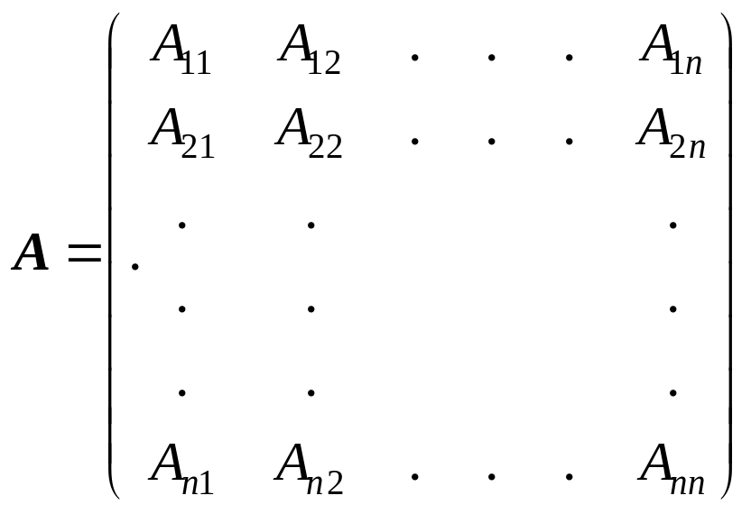
Transition probability matrix
Let A be the state transition probability matrix,,
A_{ij} represents the transition probability that the surfer in state i (page i) will move to state j (page j). A_{ij} is defined exactly as in Equation (14).
CS583, Bing Liu, UIC

Slide 32
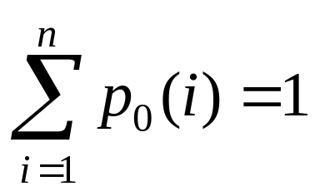
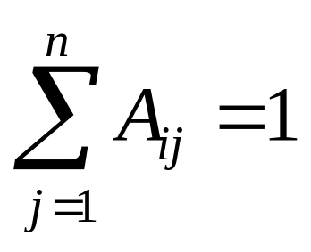
Let us start
Given an initial probability distribution vector that a surfer is at each state (or page)
  p₀ = (p₀(1), p₀(2), …, p₀(n))^{T} (a column vector) and
  an n×n transition probability matrix A,
  we have
If the matrix A satisfies Equation (17), we say that A is the stochastic matrix of a Markov chain.
(16)
(17)
CS583, Bing Liu, UIC

Slide 33
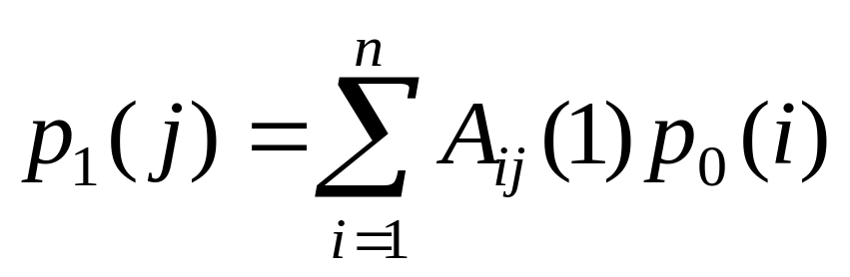
Back to the Markov chain
In a Markov chain, a question of common interest is:
  Given p₀ at the beginning, what is the probability that m steps/transitions later the Markov chain will be at each state j?
We determine the probability that the system (or the random surfer) is in state j after 1 step (1 transition) by using the following reasoning:
(18)
CS583, Bing Liu, UIC

Slide 34
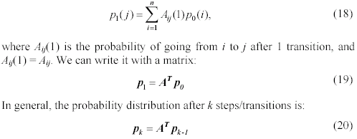
State transition
CS583, Bing Liu, UIC

Slide 35
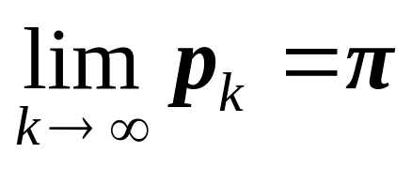
Stationary probability distribution
By a Theorem of the Markov chain,
  a finite Markov chain defined by the stochastic matrix A has a unique stationary probability distribution if A is irreducible and aperiodic.
The stationary probability distribution means that after a series of transitions p_{k} will converge to a steady-state probability vector π regardless of the choice of the initial probability vector p₀, i.e.,
(21)
CS583, Bing Liu, UIC

Slide 36
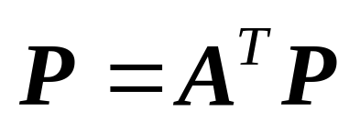
PageRank again
When we reach the steady-state, we have p_{k} = p_{k+1} =π, and thus
π =A^{T}π.
π is the principal eigenvector of A^{T} with eigenvalue of 1.
In PageRank, π is used as the PageRank vector P. We again obtain Equation (15), which is re-produced here as Equation (22):
(22)
CS583, Bing Liu, UIC

Slide 37
Is P = π justified?
Using the stationary probability distribution π as the PageRank vector is reasonable and quite intuitive because
  it reflects the long-run probabilities that a random surfer will visit the pages.
  A page has a high prestige if the probability of visiting it is high.
CS583, Bing Liu, UIC

Slide 38
Back to the Web graph
Now let us come back to the real Web context and see whether the above conditions are satisfied, i.e.,
  whether A is a stochastic matrix and
  whether it is irreducible and aperiodic.
None of them is satisfied.
Hence, we need to extend the ideal-case Equation (22) to produce the “actual PageRank” model.
CS583, Bing Liu, UIC

Slide 39
A is a not stochastic matrix
A is the transition matrix of the Web graph
It does not satisfy equation (17)
because many Web pages have no out-links, which are reflected in transition matrix A by some rows of complete 0’s.
  Such pages are called the dangling pages (nodes).
CS583, Bing Liu, UIC

Slide 40

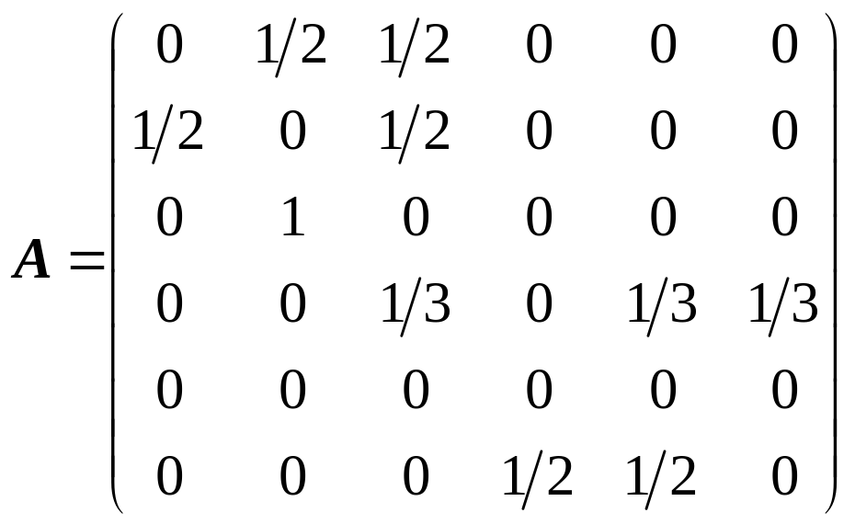
An example Web hyperlink graph
CS583, Bing Liu, UIC

Slide 41
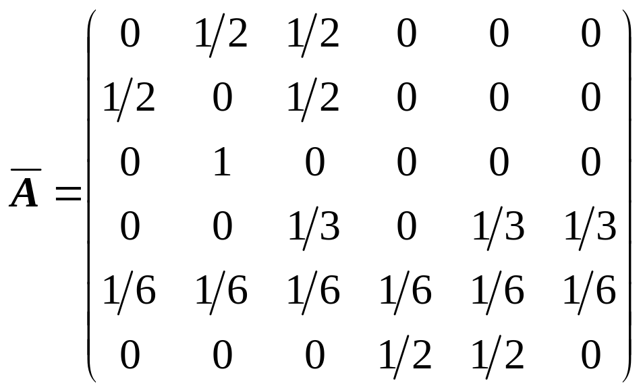
Fix the problem: two possible ways
Remove those pages with no out-links during the PageRank computation as these pages do not affect the ranking of any other page directly.
Add a complete set of outgoing links from each such page i to all the pages on the Web.
Let us use the second way
CS583, Bing Liu, UIC

Slide 42
A is a not irreducible
Irreducible means that the Web graph G is strongly connected.
Definition: A directed graph G = (V, E) is strongly connected if and only if, for each pair of nodes u, v ∈ V, there is a path from u to v.
A general Web graph represented by A is not irreducible because
  for some pair of nodes u and v, there is no path from u to v.
  In our example, there is no directed path from nodes 3 to 4.
CS583, Bing Liu, UIC

Slide 43
A is a not aperiodic
A state i in a Markov chain being periodic means that there exists a directed cycle that the chain has to traverse.
Definition: A state i is periodic with period k > 1 if k is the smallest number such that all paths leading from state i back to state i have a length that is a multiple of k.
  If a state is not periodic (i.e., k = 1), it is aperiodic.
  A Markov chain is aperiodic if all states are aperiodic.
CS583, Bing Liu, UIC

Slide 44
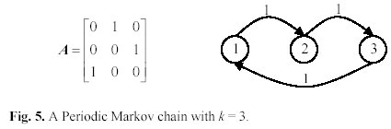
An example: periodic
Fig. 5 shows a periodic Markov chain with k = 3. Eg, if we begin from state 1, to come back to state 1 the only path is 1-2-3-1 for some number of times, say h. Thus any return to state 1 will take 3h transitions.
CS583, Bing Liu, UIC

Slide 45
Deal with irreducible and aperiodic
It is easy to deal with the above two problems with a single strategy.
Add a link from each page to every page and give each link a small transition probability controlled by a parameter d.
Obviously, the augmented transition matrix becomes irreducible and aperiodic
CS583, Bing Liu, UIC

Slide 46
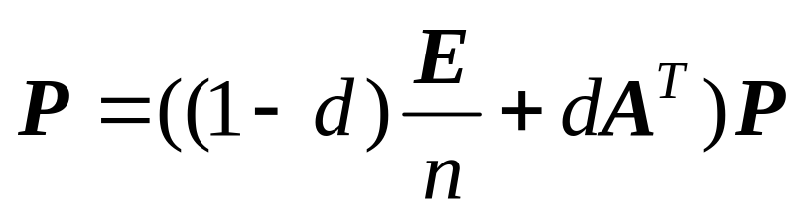
Improved PageRank
After this augmentation, at a page, the random surfer has two options
  With probability d, he randomly chooses an out-link to follow.
  With probability 1-d, he jumps to a random page
Equation (25) gives the improved model,
where E is ee^{T} (e is a column vector of all 1’s) and thus E is a n×n square matrix of all 1’s.
(25)
CS583, Bing Liu, UIC

Slide 47
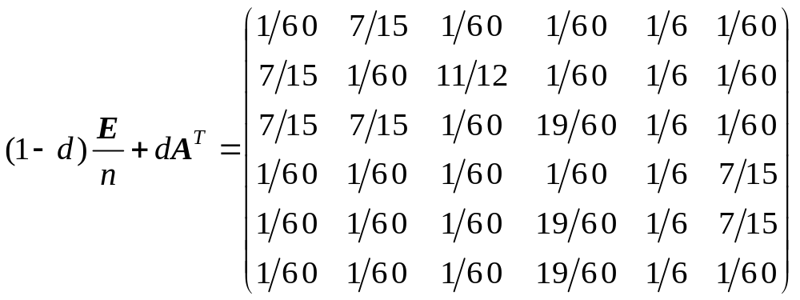
Follow our example
CS583, Bing Liu, UIC

Slide 48
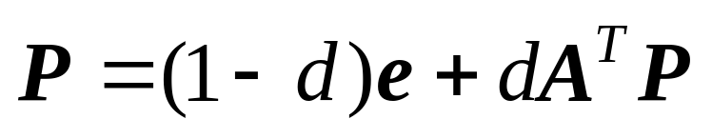
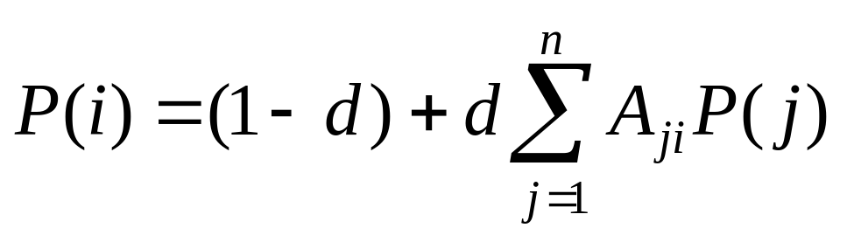
The final PageRank algorithm
(1-d)E/n + dA^{T} is a stochastic matrix (transposed). It is also irreducible and aperiodic
If we scale Equation (25) so that e^{T}P = n,
PageRank for each page i is
(27)
(28)
CS583, Bing Liu, UIC

Slide 49
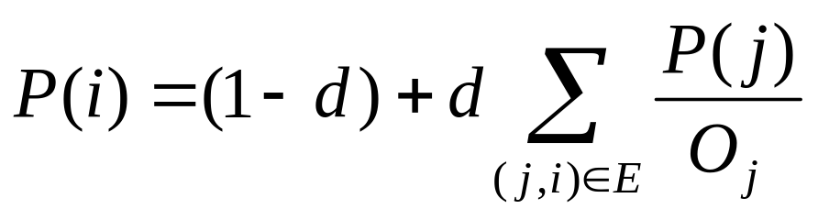
The final PageRank (cont …)
(28) is equivalent to the formula given in the PageRank paper
The parameter d is called the damping factor which can be set to between 0 and 1. d = 0.85 was used in the PageRank paper.
CS583, Bing Liu, UIC

Slide 50
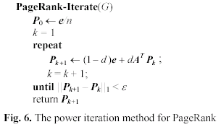
Compute PageRank
Use the power iteration method
CS583, Bing Liu, UIC

Slide 51
Advantages of PageRank
Fighting spam. A page is important if the pages pointing to it are important.
  Since it is not easy for Web page owner to add in-links into his/her page from other important pages, it is thus not easy to influence PageRank.
PageRank is a global measure and is query independent.
  PageRank values of all the pages are computed and saved off-line rather than at the query time.
Criticism: Query-independence. It could not distinguish between pages that are authoritative in general and pages that are authoritative on the query topic.
CS583, Bing Liu, UIC

Slide 52
Road map
Introduction
Social network analysis
Co-citation and bibliographic coupling
PageRank
HITS
Summary
CS583, Bing Liu, UIC

Slide 53
HITS
HITS stands for Hypertext Induced Topic Search.
Unlike PageRank which is a static ranking algorithm, HITS is search query dependent.
When the user issues a search query,
  HITS first expands the list of relevant pages returned by a search engine and
  then produces two rankings of the expanded set of pages, authority ranking and hub ranking.
CS583, Bing Liu, UIC

Slide 54
Authorities and Hubs
Authority: Roughly, a authority is a page with many in-links.
  The idea is that the page may have good or authoritative content on some topic and
  thus many people trust it and link to it.
Hub: A hub is a page with many out-links.
  The page serves as an organizer of the information on a particular topic and
  points to many good authority pages on the topic.
CS583, Bing Liu, UIC

Slide 55
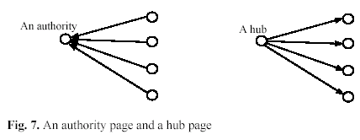
Examples
CS583, Bing Liu, UIC

Slide 56
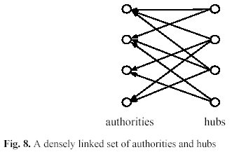
The key idea of HITS
A good hub points to many good authorities, and
A good authority is pointed to by many good hubs.
Authorities and hubs have a mutual reinforcement relationship. Fig. 8 shows some densely linked authorities and hubs (a bipartite sub-graph).
CS583, Bing Liu, UIC

Slide 57
The HITS algorithm: Grab pages
Given a broad search query, q, HITS collects a set of pages as follows:
  It sends the query q to a search engine.
  It then collects t (t = 200 is used in the HITS paper) highest ranked pages. This set is called the root set W.
  It then grows W by including any page pointed to by a page in W and any page that points to a page in W. This gives a larger set S, base set.
CS583, Bing Liu, UIC

Slide 58
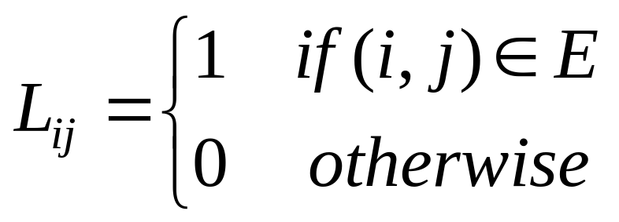
The link graph G
HITS works on the pages in S, and assigns every page in S an authority score and a hub score.
Let the number of pages in S be n.
We again use G = (V, E) to denote the hyperlink graph of S.
We use L to denote the adjacency matrix of the graph.
CS583, Bing Liu, UIC

Slide 59
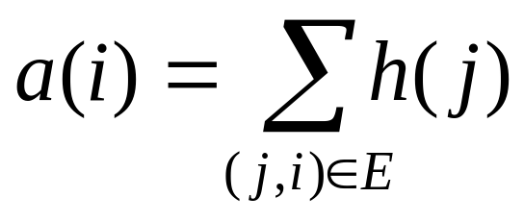
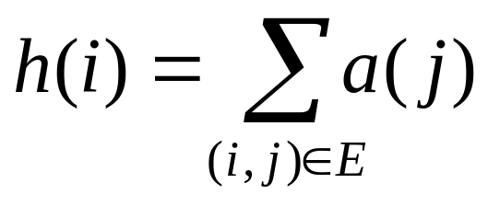
The HITS algorithm
Let the authority score of the page i be a(i), and the hub score of page i be h(i).
The mutual reinforcing relationship of the two scores is represented as follows:
(31)
(32)
CS583, Bing Liu, UIC

Slide 60
HITS in matrix form
We use a to denote the column vector with all the authority scores,
a = (a(1), a(2), …, a(n))^{T}, and
use h to denote the column vector with all the authority scores,
h = (h(1), h(2), …, h(n))^{T},
Then,
a = L^{T}h
h = La
(33)
(34)
CS583, Bing Liu, UIC

Slide 61
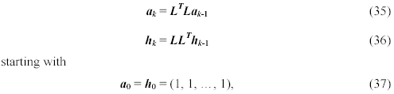
Computation of HITS
The computation of authority scores and hub scores is the same as the computation of the PageRank scores, using power iteration.
If we use a_{k} and h_{k} to denote authority and hub vectors at the kth iteration, the iterations for generating the final solutions are
CS583, Bing Liu, UIC

Slide 62
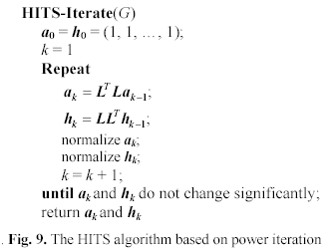
The algorithm
CS583, Bing Liu, UIC

Slide 63
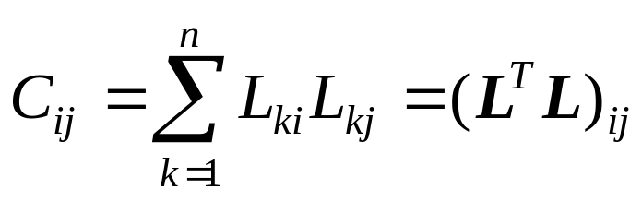
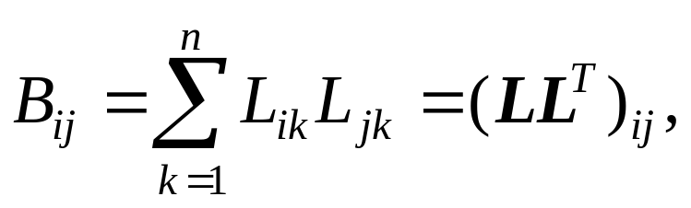
Relationships with co-citation and bibliographic coupling
Recall that co-citation of pages i and j, denoted by C_{ij}, is
  the authority matrix (L^{T}L) of HITS is the co-citation matrix C
bibliographic coupling of two pages i and j, denoted by B_{ij} is
  the hub matrix (LL^{T}) of HITS is the bibliographic coupling matrix B
CS583, Bing Liu, UIC

Slide 64
Strengths and weaknesses of HITS
Strength: its ability to rank pages according to the query topic, which may be able to provide more relevant authority and hub pages.
Weaknesses:
  It is easily spammed. It is in fact quite easy to influence HITS since adding out-links in one’s own page is so easy.
  Topic drift. Many pages in the expanded set may not be on topic.
  Inefficiency at query time: The query time evaluation is slow. Collecting the root set, expanding it and performing eigenvector computation are all expensive operations
CS583, Bing Liu, UIC

Slide 65
Road map
Introduction
Social network analysis
Co-citation and bibliographic coupling
PageRank
HITS
Summary
CS583, Bing Liu, UIC

Slide 66
Summary
In this chapter, we introduced
  Social network analysis, centrality and prestige
  Co-citation and bibliographic coupling
  PageRank, which powers Google
  HITS
Yahoo! and MSN have their own link-based algorithms as well, but not published.
Important to note: Hyperlink based ranking is not the only algorithm used in search engines. In fact, it is combined with many content based factors to produce the final ranking presented to the user.
CS583, Bing Liu, UIC

Slide 67
Summary
Links can also be used to find communities, which are groups of content-creators or people sharing some common interests.
  Web communities
  Email communities
  Named entity communities
Focused crawling: combining contents and links to crawl Web pages of a specific topic.
  Follow links and
  Use learning/classification to determine whether a page is on topic.
CS583, Bing Liu, UIC

