Slide 1
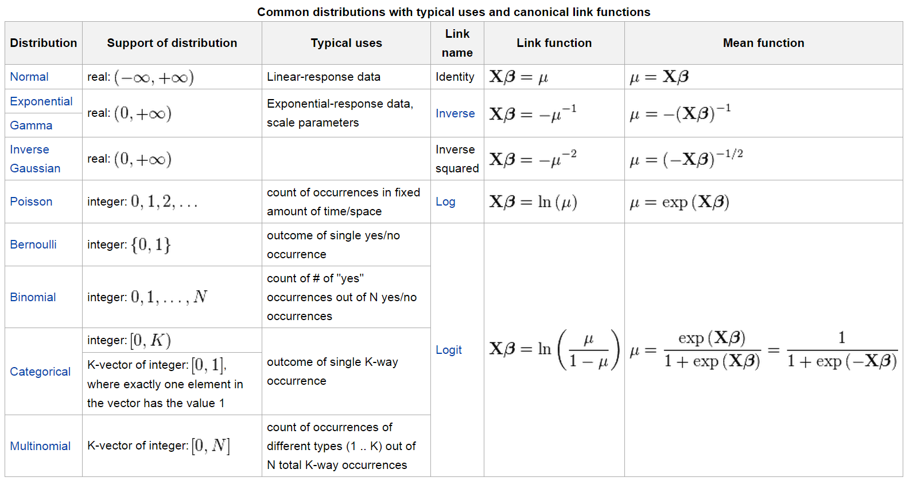

Slide 2
Numerical Example (Logistic Regression)
  This analysis examines whether the probability of voting for Obama versus Romney in the 2012 Presidential election is related to a respondent’s feelings about the two main political parties, their own race, and their income level.
    Are respondents with more positive feelings about the Democratic Party more likely to vote for Obama as the Democratic candidate?
    Are respondents with more positive feelings about the Republican Party less likely to vote for Obama as the Democratic candidate?
    Are members of any racial or ethnic minority groups more likely to vote for Obama than are white voters?
    Are those with higher incomes less likely to vote for Obama?

Slide 3
Null Hypothesis for Each Research Question
  H(0) a = After accounting for the effects of other variables in the model, feelings about the Democratic Party will be unrelated to the probability of voting for Obama.
  H(0) b = After accounting for the effects of other variables in the model, feelings about the Republican Party will be unrelated to the probability of voting for Obama.
  H(0) c = After accounting for the effects of other variables in the model, members of minority groups will be no more or less likely to vote for Obama compared to whites.
  H(0) d = After accounting for the effects of other variables in the model, income will be unrelated to the probability of voting for Obama.

Slide 4
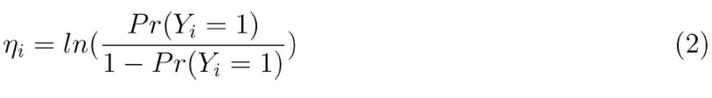
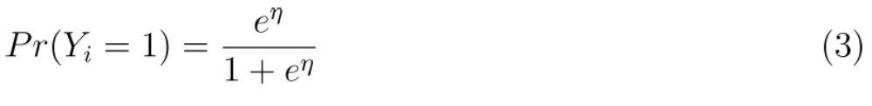
Logit Model

Slide 5
Assumptions Behind the Model (Logit Model)
  The dependent variable must be dichotomous (categorical)
  The model is correctly specified (e.g. we have the right independent variables in the model properly measured).
  The values of the independent variables are fixed in repeated samples.
  The individual residuals are independent of each other.
  Because it is generally estimated via MLE, logistic regression requires moderate to large sample sizes.

Slide 6
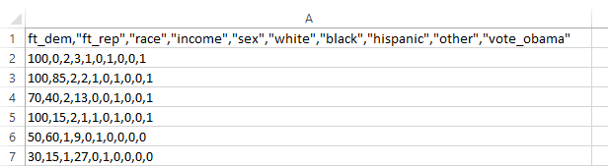
Data
  Presidential vote choice (vote_obama) (1 = Obama, 0 = Romney)
  Democratic Party feeling thermometer (ft_dem) (0 to 100)
  Republican Party feeling thermometer (ft_rep) (0 to 100)
  Black voters (black) (0 or 1)
  Hispanic voters (Hispanic) (0 or 1)
  Non-white races or ethnicities (other) (0 or 1)
  Respondent income (income) (1 to 28)

Slide 7
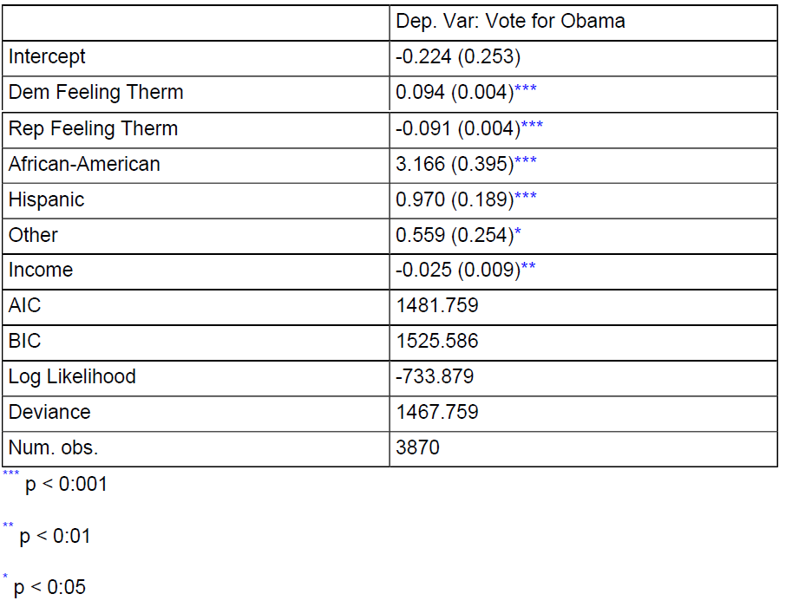
Results of the Logistic Regression Model
(constant)

Slide 8
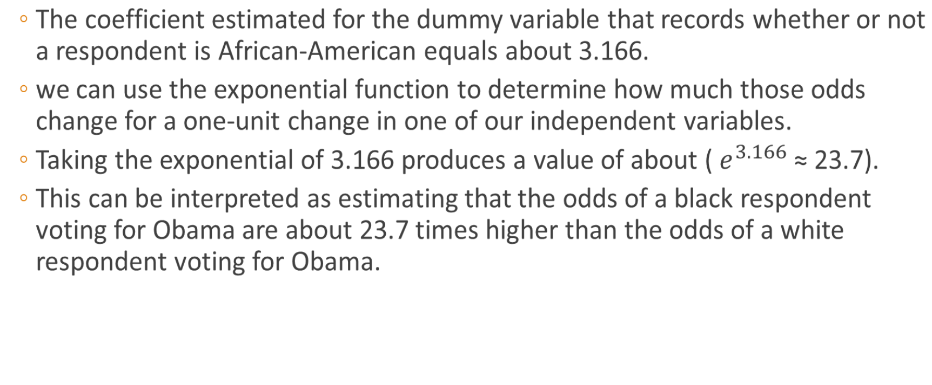
Factor Change in the Odds

Slide 9
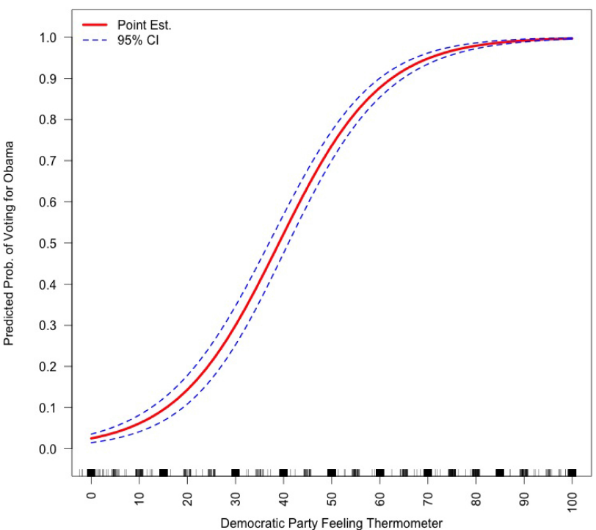
Predicted Probabilities
Predicted probability of voting for Obama over the complete range of the Democratic Party feeling thermometer while holding all other variables constant at their means, 2012 ANES.

