Slide 1
Training as Optimization
Learning Basics

Slide 2
Corpus-wide Loss with respect to the parameters Θ
L: a per-instance loss function

Slide 3
Minimizing the loss at all costs results in overfitting the training data.

Slide 4
Regularization
Optimization needs to balance between low loss and low complexity:

Slide 5
Hinge Loss
Enforce to separate the data with a margin using the model as the boundary.
The loss is zero is the real and estimate have the same sign. Otherwise it is linear.

Slide 6
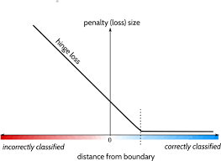
Hinge Loss

Slide 7
Hinge Loss

Slide 8
Binary Cross Entropy

Slide 9
Cross Entropy
The cross entropy loss does not only predict the one-best class label
but also predicts a distribution over the possible labels.

Slide 10
Regularization
Optimization needs to balance between low loss and low complexity:
A hyperparameter λ is used to control the amount of regularization:
do we favor simple model over low loss ones or vice versa.
A single regularization function and λ value for all the parameters.
A hyperparameter is a parameter of the model which is not learned as part of the optimization process,
but needs to be set by hand.

Slide 11
Regularizers
In practice, the regularizers R equate complexity with large weights, and work to keep the parameter values low. In particular, the regularizers R measure the norms of the parameter matrices, and drive the learner toward solutions with low norms.

Slide 12
L2 Regularization
Also known as Gaussian prior or weight decay.

Slide 13
L1 Regularization
Also known as a sparse prior or lasso.

Slide 14
Elastic Net
Combines both L1 and L2 regularization.

