Slide 1
INTRODUCTION TO CLUSTERING
Jean-Charles Lamirel
Synalp team – LORIA
University of Strasbourg

Slide 2
WHAT IS CLUSTERING ?
Clustering relates to the unsupervised classification of objects into different groups, or more precisely, the partitioning of a data set into subsets (clusters), so that the data in each subset (ideally) share some common characteristics - often according to some defined distance measure,
The clustering process goal is often considered to achieve two complementary goals, that are maximizing the similarity of the objects within clusters whilst maximizing the dissimilarity or the distance between clusters themselves.

Slide 3
APPLICATIONS OF CLUSTERING
Clustering has many applications in many different domains :
Image processing and pattern recognition,
Spatial data analysis,
Recommender systems,
Marketing and market analysis and segmentation,
Text mining, natural language processing and information retrieval,
Social networks analysis,
Study of gene-pathology interaction in medicine,
Anomaly, novelty and fraud detection (without predefined model).

Slide 4
APPLICATIONS OF CLUSTERING
Applications in scientometrics and webometrics and patentometrics are also numerous:
Scientific communities, research groups and collaboration networks detection,
Diachronic science and science topics analysis,
Emerging research and technologies identification,
Science policy analysis,
Citation content relationships identification (incl. Web data).

Slide 5
BASIC TYPES OF CLUSTERING
Hierarchical algorithms: these methods find successive clusters using previously established clusters.
Agglomerative ("bottom-up") (AHC): Agglomerative algorithms begin with each element as a separate cluster and merge them into successively larger clusters.
Usually these methods need computation of a matrix of distance between data.
Graph-based clustering (based on community detection and exploiting specific criteria like modularity) is a variation of AHC,
Single link clustering is a simplified version of agglomerative clustering that discard the use of such distance thanks to the exploitation of ultrametric,
Divisive ("top-down"): Divisive algorithms begin with the whole set and proceed to divide it into successively smaller clusters.
Usually these methods exploit entropy criteria to operate splitting.

Slide 6
BASIC TYPES OF CLUSTERING
Partitioned clustering: Partitional algorithms determine all clusters at once. They include:
K-means and derivatives (K-medoid, AK-means, VQ, ….),
Fuzzy c-means clustering,
Density-based clustering,
Spectral clustering (based on similarity graphs and eigenvector decomposition),
Neural clustering (exploit neighborhood relationships during learning and novelty detection),
Minimal description length (MDL) method (based on information theory and optimal compression principle),
Latent Dirichlet Analysis (LDA) (use generative models and generally applied for text clustering and topic detection).

Slide 7
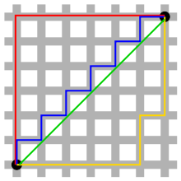

COMMON DISTANCE MEASURES
Distance measure will determine how the similarity of two elements is calculated and it will influence the shape of the clusters.
They include:
1. The Euclidean distance (also called 2-norm distance) is given by:
$$d\left(x,y\right)= \sqrt[2]{\sum_{l=1}^{p}{{\left|x_{l}−y_{l}\right|}^{2}}}$$
2. The Manhattan distance (also called taxicab norm or 1-norm) is given by:
$$d\left(x,y\right)= \sum_{l=1}^{p}{\left|x_{l}−y_{l}\right|}$$

Slide 8
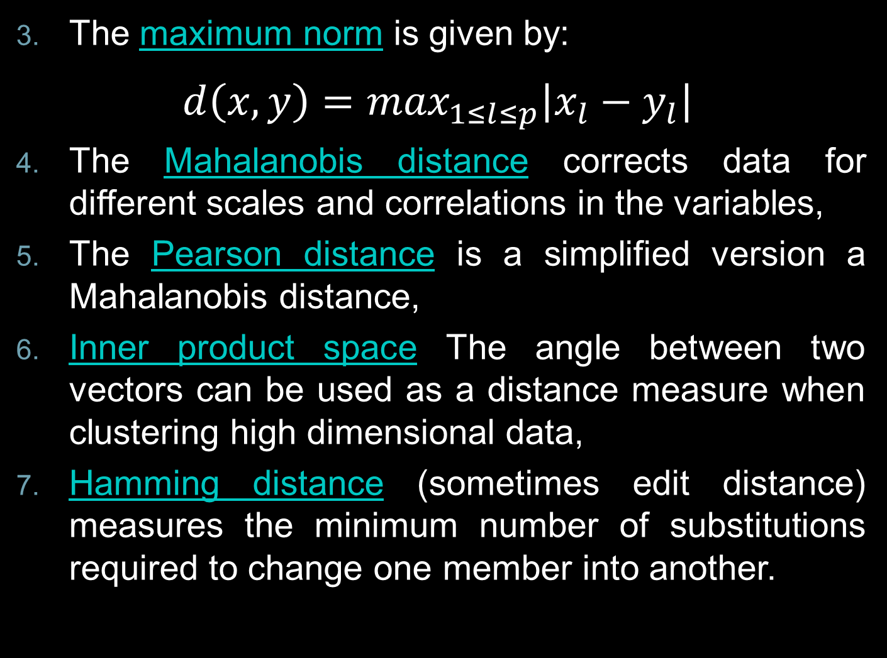
The maximum norm is given by:
$$d\left(x,y\right)=\max_{1≤l≤p}\left|x_{l}−y_{l}\right|$$
The Mahalanobis distance corrects data for different scales and correlations in the variables,
The Pearson distance is a simplified version a Mahalanobis distance,
Inner product space The angle between two vectors can be used as a distance measure when clustering high dimensional data,
Hamming distance (sometimes edit distance) measures the minimum number of substitutions required to change one member into another.

Slide 9
INNER PRODUCT SPACE
Distance also known as cosine correlation,
Widely used by search engines.
1
D₁
D₂
Q
α₂
1
t₁
Similarity:
Query:
t₃

Slide 10
SIMILARITY MEASUREMENTS
Pearson Correlation
Two profiles (vectors)
and
+1 ≥ Pearson Correlation ≥ – 1

Slide 11
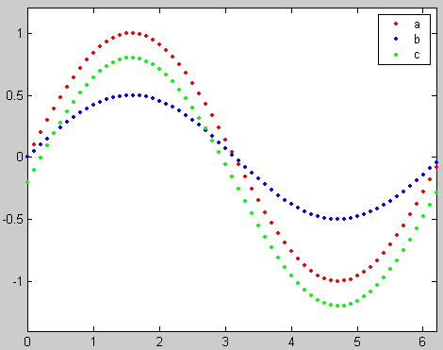
SIMILARITY MEASUREMENTS
Pearson Correlation: Trend Similarity

Slide 12
SIMILARITY MEASUREMENTS
Euclidean Distance

Slide 13
SIMILARITY MEASUREMENTS
Euclidean Distance: Absolute difference

Slide 14
SIMILARITY MEASUREMENTS
Cosine Correlation
+1 ≥ Cosine Correlation ≥ – 1

Slide 15
SIMILARITY MEASUREMENTS
Cosine Correlation: Trend + Mean Distance

Slide 16
SIMILARITY MEASUREMENTS

Slide 17
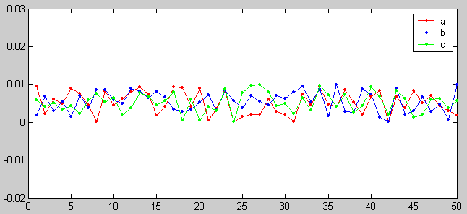
SIMILARITY MEASUREMENTS
Similar?

Slide 18
K-MEANS CLUSTERING
The k-means algorithm is an algorithm to cluster n objects based on attributes into K partitions, where K < n,
It is similar to the expectation-maximization algorithm for mixtures of Gaussians in that they both attempt to find the centers of natural clusters in the data,
It assumes that the object attributes form a vector space.

Slide 19

K-MEANS CLUSTERING
An algorithm for partitioning N data points into K disjoint subsets S_{j} containing data points so as to minimize the sum-of-squares criterion:
$$J= \sum_{j=1}^{K}{\sum_{n∈S}{{\left|x_{n}−μ_{j}\right|}^{2}}}$$
where x_{n} is a vector representing the n^{th} data point and u_{j} is the geometric centroid of the data points in S_{j}.

Slide 20
K-MEANS CLUSTERING
Simply speaking, k-means clustering is an algorithm to classify or to group the objects based on attributes/features into K number of groups,
K is positive integer number,
The grouping is done by minimizing the sum of squares of distances between data and the corresponding clusters centroids.

Slide 21
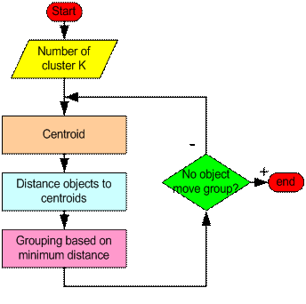
HOW IT WORKS ?

Slide 22
ALGORITHM
Step 1: Begin with a decision on the value of K= number of clusters,
Step 2: Put any initial partition that classifies the data into K clusters. You may assign the training samples randomly, or systematically as the following:
Take the first K training sample as single element clusters,
Assign each of the remaining (N-K) training samples to the cluster with the nearest centroid. After each assignment, recompute the centroid of the gaining cluster.

Slide 23
ALGORITHM
Step 3: Take each sample in sequence and compute its distance from the centroid of each of the clusters. If a sample is not currently in the cluster with the closest centroid, switch this sample to that cluster and update the centroid of the cluster gaining the new sample and the cluster losing the sample,
Step 4: Repeat step 3 until convergence is achieved, that is until a pass through the training sample causes no new assignments.

Slide 24
SIMPLE EXAMPLE (K=2)
Individual (data) | Variable 1 | Variable 2
1 | 1.0 | 1.0
2 | 1.5 | 2.0
3 | 3.0 | 4.0
4 | 5.0 | 7.0
5 | 3.5 | 5.0
6 | 4.5 | 5.0
7 | 3.5 | 4.5

Slide 25
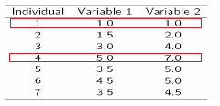
Step 1:
Initialization: Randomly we choose following two centroids (k=2) for two clusters.
In this case the 2 centroid are: m1=(1.0,1.0) and m2=(5.0,7.0).

Slide 26



Step 2:
Thus, we obtain two clusters containing:
{1,2,3} and {4,5,6,7},
Their new centroids are:
Individual | Centroid 1 | Centroid 2
1 | 0 | 7.21
2(1.5, 2.0) | 1.12 | 6.10
3 | 3.61 | 3.61
4 | 7.21 | 0
5 | 4.72 | 2.5
6 | 5.31 | 2.06
7 | 4.30 | 2.92

Slide 27
Step 3:
Now using these centroids we compute the Euclidean distance of each object, as shown in table,
Therefore, the new clusters are: {1,2} and {3,4,5,6,7},
Next centroids are: m1=(1.25,1.5) and m2 = (3.9,5.1).
Individual | Centroid 1 | Centroid 2
1 | 1.57 | 5.38
2 | 0.47 | 4.28
3 | 2.04 | 1.78
4 | 5.64 | 1.84
5 | 3.15 | 0.73
6 | 3.78 | 0.54
7 | 2.74 | 1.08

Slide 28
Step 4:
The clusters obtained are: {1,2} and {3,4,5,6,7},
Therefore, there is no change in the clusters,
Thus, the algorithm comes to a halt here and final result consist of 2 clusters {1,2} and {3,4,5,6,7}.
Individual | Centroid 1 | Centroid 2
1 | 0.56 | 5.02
2 | 0.56 | 3.92
3 | 3.05 | 1.42
4 | 6.66 | 2.20
5 | 4.16 | 0.41
6 | 4.78 | 0.61
7 | 3.75 | 0.72

Slide 29
CLUSTERS PLOT (K=2)

Slide 30
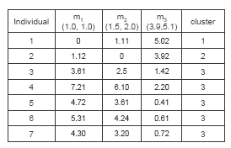
SIMPLE EXAMPLE (K=3)
Step 2
Step 1

Slide 31
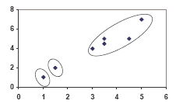
CLUSTERS PLOT (K=3)

Slide 32
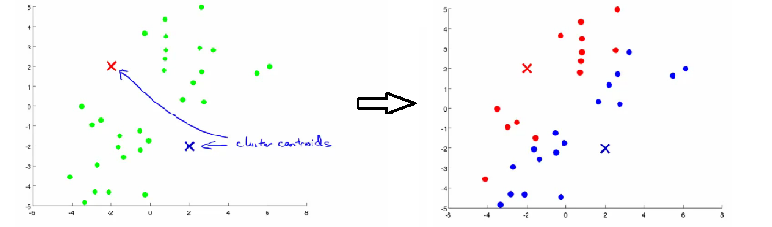
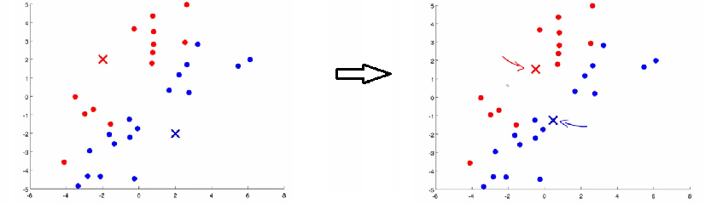
STEPWISE VIEW
1- Data assignation step
2- Moving centroids step

Slide 33
APPLICATIONS
K-means is the most general purpose clustering algorithm with ascending hierarchical clustering (AHC),
It is relatively efficient and fast (much faster than AHC). It computes result at O(tKn), where n is number of objects or points, K is number of clusters and t is number of iterations,
Used on acoustic data in speech understanding to convert waveforms into one of K categories (known as Vector Quantization or Image Segmentation),
Also used for choosing color palettes on old fashioned graphical display devices and Image Quantization.

Slide 34
WEAKNESSES
It is sensitive to initial condition. Different initial condition may produce different result of clustering:
The number of cluster, K, must be determined before hand. Its disadvantage is that it does not yield the same result with each run, since the resulting clusters depend on the initial random assignments,
Initial grouping will determine the cluster significantly.
We never know the real cluster, using the same data, because if it is inputted in a different order it may produce different cluster,
The algorithm is easy to be trapped in a local optimum,
The min-square error criteria is no more working in high dimensional and sparse spaces.

Slide 35
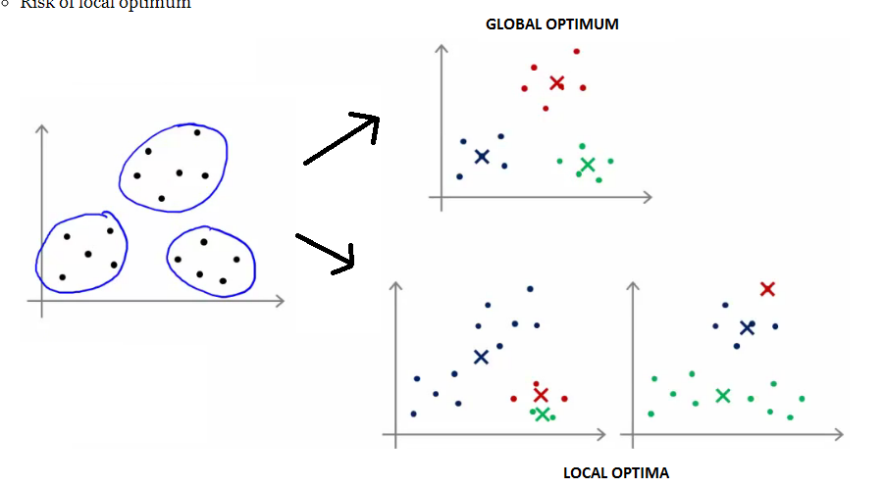
LOCAL OPTIMA PROBLEM

Slide 36
HOW TO OPTIMIZE SEEDING ?
There are many alternatives. One interesting method has been proposed by Arthur and Vassilvitskii (K-means++):
Choose one center uniformly at random from among the data points,
For each data point x, compute D(x), the distance between x and the nearest center that has already been chosen,
Choose one new data point at random as a new center, using a weighted probability distribution where a point x is chosen with probability proportional to D(x)²,
Repeat Steps 2 and 3 until K centers have been chosen,
Now that the initial centers have been chosen, proceed using standard k-means clustering.
This method remains however sensitive to outliers data.

Slide 37
HOW TO FIX K ?
A first way to fix K is to use the elbow method,
Another way is to make use of an external cost function.
Ex:
A company went to manufacture and to sell tee-shirt,
It investigates to find out the number of sizes that must be taken into account,
K-means clustering is used for that purpose.

Slide 38
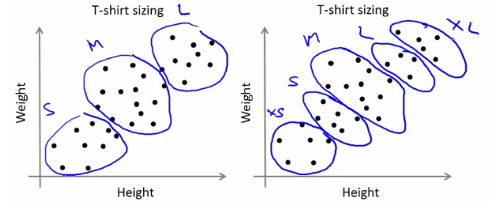
HOW TO FIX K : EXAMPLE
External criteria like additional manufacturing cost vs. diffusion increase or customer satisfaction analysis could be considered.

Slide 39
SOME REFERENCES
Tutorial - Tutorial with introduction of Clustering Algorithms (k-means, fuzzy-c-means, hierarchical, mixture of gaussians) + some interactive demos (java applets). http://home.deib.polimi.it/matteucc/Clustering/tutorial_html/AppletKM.html
Digital Image Processing and Analysis-byB.Chanda and D.Dutta Majumdar.
H. Zha, C. Ding, M. Gu, X. He and H.D. Simon. "Spectral Relaxation for K-means Clustering", Neural Information Processing Systems vol.14 (NIPS 2001). pp. 1057-1064, Vancouver, Canada. Dec. 2001.
J. A. Hartigan (1975) "Clustering Algorithms". Wiley.
J. A. Hartigan and M. A. Wong (1979) "A K-Means Clustering Algorithm", Applied Statistics, Vol. 28, No. 1, p100-108.
D. Arthur, S. Vassilvitskii (2006): "How Slow is the k-means Method?“.
D. Arthur, S. Vassilvitskii: "k-means++ The Advantages of Careful Seeding" 2007 Symposium on Discrete Algorithms (SODA).
http://www.wikipedia.com

