Slide 1
Introduction to Data Mining and Machine Learning

Slide 2
What is Data Mining?
Discovery of useful, possibly unexpected, patterns in data
Non-trivial extraction of implicit, previously unknown and potentially useful information from data
Exploration & analysis, by automatic or semi-automatic means, of large quantities of data in order to discover meaningful patterns
Data mining mostly using machine learning techniques

Slide 3
Data Mining Tasks
Classification [Predictive]
Clustering [Descriptive]
Association Rule Discovery [Descriptive]
Sequential Pattern Discovery [Descriptive]
Regression [Predictive]
Deviation and Anomaly Detection [Predictive]
Collaborative Filtering [Predictive]

Slide 4
Machine Learning
Machine learning has recently become so big party because of the huge amount of data being generated
Sources of data include
Web data (click-stream or click through data)
Mine to understand users better
Medical records
Electronic records -> turn records into knowledge
Biological data
Gene sequences, ML algorithms give a better understanding of human genome
Astronomical data
Telescopes data -> tracking known stars, finding new stars
Engineering info
Data from sensors, log reports, photos, …
Social data ..

Slide 5
Machine Learning Scope
Applications that we cannot program by hand (non deterministic)
Some examples :
Autonomous drones
Handwriting recognition
This is very inexpensive because when you write an envelope, algorithms can automatically route envelopes through the post
Natural language processing (NLP)
AI pertaining to language
Computer vision
AI pertaining vision

Slide 6
Machine Learning Area
Self customizing programs
Netflix
Amazon
iTunes genius
Take users infos: behavior based learning
Understand human learning and the brain
If we can build systems that mimic (or try to mimic) how the brain works, this may push our own understanding of the associated neurobiology

Slide 7
What is Machine Learning ?
Define what it is
When to use it
Not a well defined definition
Couple of examples of how people have tried to define it

Slide 8
What is Machine Learning ?
Arthur Samuel (1959)
Machine learning: "Field of study that gives computers the ability to learn without being explicitly programmed"
Samuels wrote a checkers playing program
Had the program play 10000 games against itself
Work out which board positions were good and bad depending on wins/losses

Slide 9
What is Machine Learning ?
Tom Michel (1999)
Well posed learning problem: "A computer program is said to learn from experience E with respect to some class of tasks T and performance measure P, if its performance at tasks in T, as measured by P, improves with experience E."
The checkers example,
E = 10000s games
T is playing checkers
P if you win or not

Slide 10
Types of Learning Algorithms
Supervised learning
Teach the computer how to do something, then let it use it;s new found knowledge to do it
Unsupervised learning
Let the computer learn how to do something, and use this to determine structure and patterns in data
Reinforcement learning
Recommender systems

Slide 11
Supervised Learning
Probably the most common problem type in machine learning
Starting with an example
How do we predict housing prices
Collect data regarding housing prices and how they relate to size in feet

Slide 12
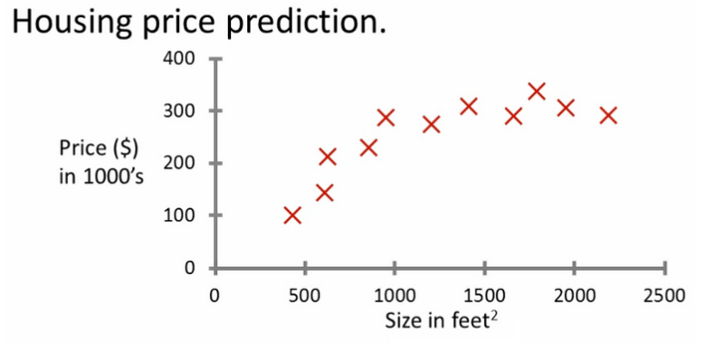
Supervised: Prediction

Slide 13
Supervised: Prediction
"Given this data, a friend has a house 750 square feet - how much can they be expected to get?“
What approaches can we use to solve this?
Straight line through data
Maybe $150 000
Second order polynomial
Maybe $200 000
How to chose straight or curved line?
Each of these approaches represent a way of doing supervised learning

Slide 14
Supervised: Prediction
What does this mean?
We gave the algorithm a data set where a "right answer" was provided
So we know actual prices for houses
The idea is we can learn what makes the price a certain value from the training data
The algorithm should then produce more right answers based on new training data where we don't know the price already (i.e. predict the price)
We also call this a regression problem
Predict continuous valued output (price)
No real discrete delineation

Slide 15
Classification: Definition
Given a collection of records (training set)
Each record contains a set of attributes, one of the attributes is the class.
Find a model for class attribute as a function of the values of other attributes.
Goal: previously unseen records should be assigned a class as accurately as possible.
A test set is used to determine the accuracy of the model. Usually, the given data set is divided into training and test sets, with training set used to build the model and test set used to validate it.

Slide 16
Supervised: Classification 1
Conducted survey to see what customers were interested in new model car
Want to select customers for advertising campaign
training
set

Slide 17
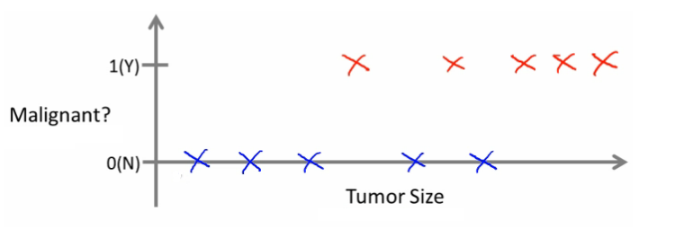
Supervised: Classification 2
Can we define breast cancer as malignant or benign based on tumor size ?

Slide 18
Supervised: Classification 2
Looking at data
Five of each
Can you estimate prognosis based on tumor size?
This is an example of a classification problem
Classify data into one of two discrete classes - no in between, either malignant or not
In classification problems, can have a discrete number of possible values for the output
e.g. maybe have four values
0 - benign
1 - type 1
2 - type 2
3 - type 4

Slide 19
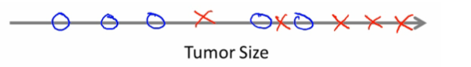
Supervised: Classification 2
In classification problems we can plot in different ways
Using one single attribute

Slide 20
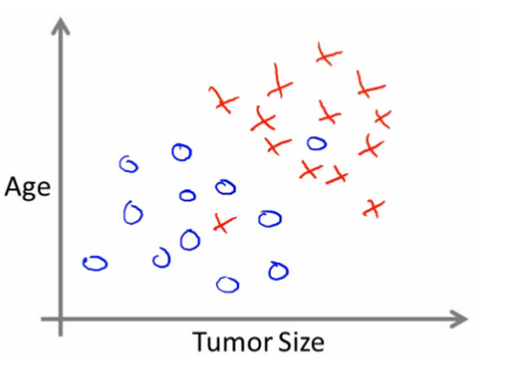
Supervised: Classification 2
In other problems may have multiple attributes: for example, know age and tumor size

Slide 21
Supervised: Classification 2
Based on that data, you can try and define separate classes by
Drawing a straight line between the two groups
Using a more complex function to define the two groups (which we'll discuss later)
Then, when you have an individual with a specific tumor size and who is a specific age, you can hopefully use that information to place them into one of your classes

Slide 22
Supervised: Classification 2
You might have many features to consider
Clump thickness
Uniformity of cell size
Uniformity of cell shape

Slide 23
Supervised: Classification 2
Some preprocessing methods permit to characterize the most important features (feature selection)
The most exciting algorithms can deal with an infinite number of features

Slide 24
Summary
Supervised learning lets you get the "right" data a
Regression problem
Classification problem

Slide 25
Unsupervised Learning
Second major problem type
In unsupervised learning, we get unlabeled data
Just told - here is a data set, can you structure it
One way of doing this would be to cluster data into to groups
This is a clustering algorithm

Slide 26
Clustering: Examples
Organize computer clusters
Identify potential weak spots or distribute workload effectively
Social network analysis
Customer data
Astronomical data analysis
Algorithms give amazing results
Basically
Can you automatically generate structure
Because we don't give it the answer, it's unsupervised learning

Slide 27
Clustering: algorithm
income
education
age

Slide 28
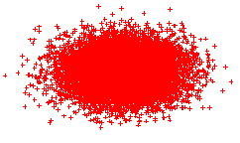


Clustering: K-means

Slide 29
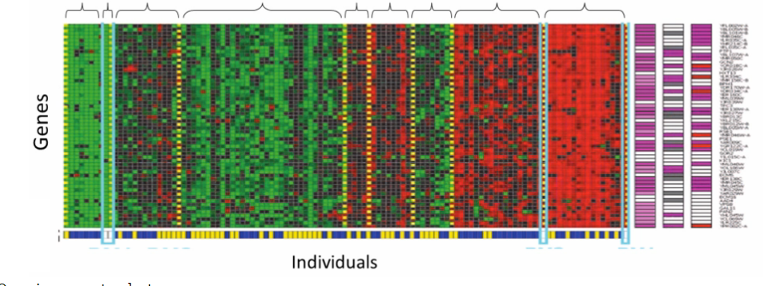
Clustering: Application

Slide 30
Association Rule Mining
transaction
id
customer
id
products
bought
sales
records:
market-basket
data
Trend: Products p5, p8 often bough together
Trend: Customer 12 likes product p9

Slide 31
Association Rule Discovery
Marketing and Sales Promotion:
Let the rule discovered be
{Bagels, … } --> {Potato Chips}
Potato Chips as consequent => Can be used to determine what should be done to boost its sales.
Bagels in the antecedent => can be used to see which products would be affected if the store discontinues selling bagels.
Bagels in antecedent and Potato chips in consequent => Can be used to see what products should be sold with Bagels to promote sale of Potato chips!
Supermarket shelf management.
Inventory Management.
Notes:
If a customer buys diaper and milk, then he is very likely to buy beer.
So, don’t be surprised if you find six-packs stacked next to diapers!

Slide 32
Collaborative Filtering
Goal: predict what movies/books/… a person may be interested in, on the basis of
Past preferences of the person
Other people with similar past preferences
The preferences of such people for a new movie/book/…
One approach based on repeated clustering
Cluster people on the basis of preferences for movies
Then cluster movies on the basis of being liked by the same clusters of people
Again cluster people based on their preferences for (the newly created clusters of) movies
Repeat above till equilibrium
Above problem is an instance of collaborative filtering, where users collaborate in the task of filtering information to find information of interest

Slide 33
Other Types of Mining
Text mining: application of data mining to textual documents
cluster Web pages to find related pages
cluster pages a user has visited to organize their visit history
classify Web pages automatically into a Web directory
Graph Mining:
Deal with graph data

Slide 34
Data Streams
What are Data Streams?
Continuous streams
Huge, Fast, and Changing
Why Data Streams?
The arriving speed of streams and the huge amount of data are beyond our capability to store them.
“Real-time” processing
Window Models
Landscape window (Entire Data Stream)
Sliding Window
Damped Window
Mining Data Stream

Slide 35
Open Problems in Machine Learning
Computation complexity
Multi-dimensionality
Multiple sources
Evolving data
Visualization and labeling of the results
Text mining

Slide 36
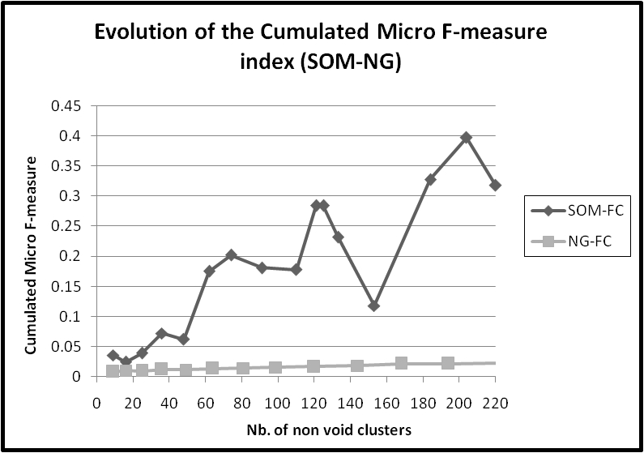
Clustering: Problem with Usual Distances
Notes:
L’idée de l’algorithme de recherche de classification optimale est celui de trouver le point d’équilibre entre le rappel et la précision et puis d’appliquer une phase d’amélioration autour du point d’équilibre pour augmenter la qualité globale de résultats en augmentant la précision pour un rappel similaire.

Slide 37
Example: Diachronic Mining
Divergence
?
Apparing
Disapearing
Stability
Time period T1
Time period T2

Slide 38
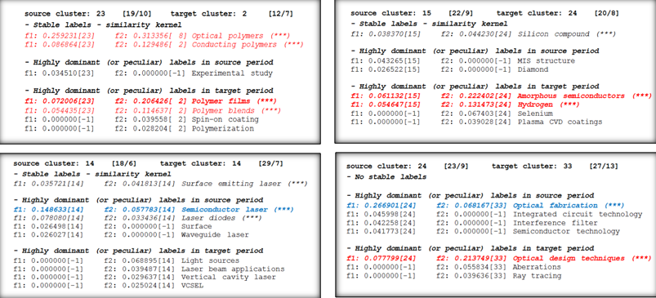
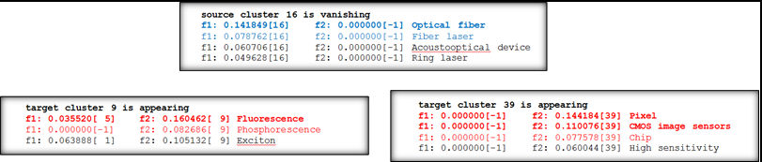
Example: Diachronic Mining
Théorie vers pratique
Nouveau composant
Théorie vers pratique
Changement de vocabulaire

Slide 39
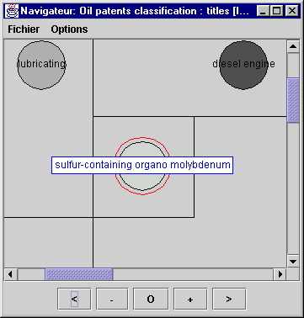
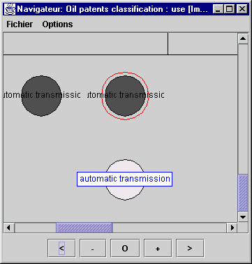
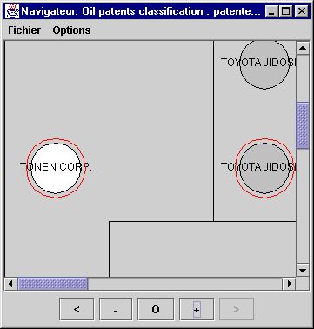
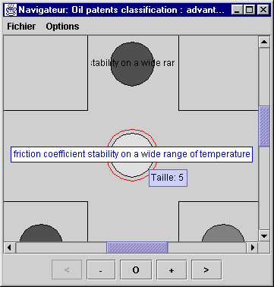
Example: Multiple Source Mining
It is also specialized on oils based on « organo-molybdenic compounds » whose main property is « stability of friction coefficient on a wide range of temperatures ».
" TONEN CORP." patentee is specialized on oils used in " automatic transmissions ".
Titles
Use
Patentees
Advantages

Slide 40
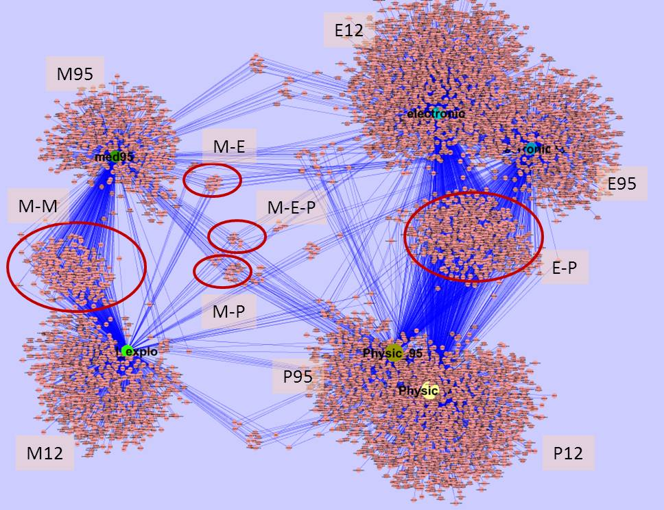
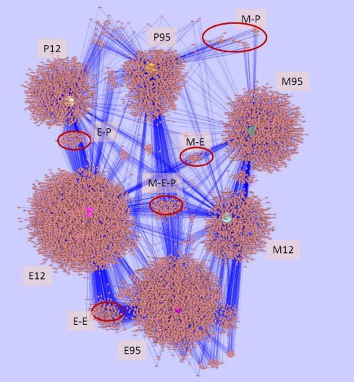
Example: Enhanced Graph Mining
Principle is:
Classifying data fisrt and exploiting existing classes,
Operating feature selection on class data descriptions,
Exploiting gain between selected features and classes,
Visualizing results.
Graph classes-mots/domaines (P=Physics; E=Electronics; M=Medicine; 12=2012; 95=1995)
Graph classe-authors/domains (P=Physics; E=Electronics; M=Medicine; 12=2012; 95=1995)

