Slide 1
Single-link clustering example
Cluster building process
1
4
Orange
6
Potato
3
7
5
Leek
Lemon
2
Grapefruit
Carrot
8
Tomato
C2
External association : link between clusters
C1

Slide 2
Single-link clustering example
Cluster labeling process
Cluster labeling :
Manual
Automatic
Potato is the most central keyword in C1
Orange
Potato
Σassoc.= 7/9
Leek
Lemon
Σassoc.= 7/9
Grapefruit
Σassoc.= 2/3
Carrot
Tomato
C2 : Citrus fruit (ou Orange - Lemon)
Orange and Lemon are the keywords that get the strongest associations in C2
C1 : Vegetable (ou Potatoe)

Slide 3
AHC
6
5
Selection threshold
4
3
2
1
0
Potato
Leek
Carrot
Tomato
Orange
Lemon
Grapefruit

Slide 4
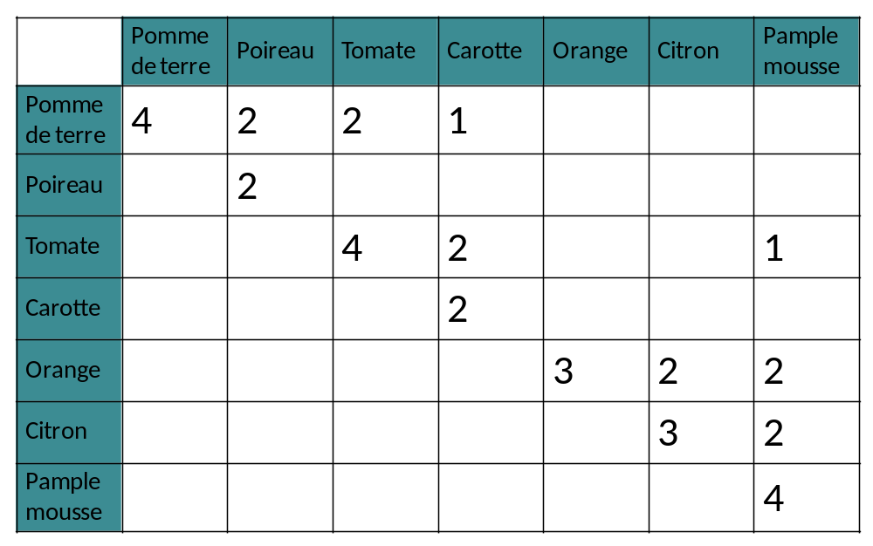
Association rules
Potato
Leek
Tomato
Carrot
Orange
Lemon
Grape
fruit
Potato
Leek
Tomato
Carrot
Orange
3 ?
≡
Lemon
Grape
fruit

Slide 5


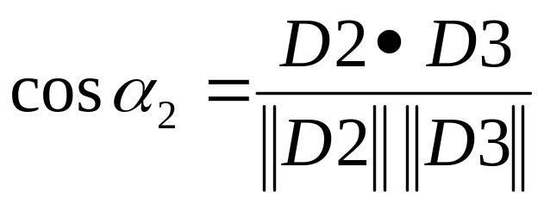

Vector model for document features representation
Very flexible model: authorizes document feature weighting
Approach used by most of the clustering methods
t₂
C2
1
D1
C1
D2
D3
α₂
1
t₁
Cosine similarity:
t₃

