Slide 1
Ceng 471 - Cryptography
Asst. Prof. Dr. Serap Şahin
Izmir Institute of Technology
Department of Computer Engineering

Slide 2
Outline
What is the Cryptography?
A Brief History
Cryptographic Goals and Evaluation Criteria for Cryptographic Tools
Basic Terminology and Concepts

Slide 3
What is the Cryptography for your daily life?

Slide 4
What is the Cryptography?
Computer security is an important field of study for most day-to-day transactions.
Our cellular phones, check our voice mail and e-mail, use debitor credit cards, order a pay-per view movie, use a transponder through EZ-Pass, login to social services, sign on to online video games, and even during visits to the doctor.
It is also often used to establish virtual private networks (VPNs) and Secure Shell connections (SSH), which allows employees to telecommute and access computers remotely.

Slide 5
What is the Cryptography?
Cryptography is the automated (or algorithmic) method in which security goals are accomplished.
Typically, when we say "crypto algorithm" we are discussing an algorithm meant to be executed on a computer. These algorithms operate on messages in the form of groups of bits.
It is perhaps most popular, as it is the oldest cryptography related security goal and feeds into our natural desire to have secrets. Secrets in the form of desires, wants, faults, and fears are natural emotions and thoughts all people have. It of course helps that modern Hollywood plays into this with movies such as Swordfish and Mercury Rising.

Slide 6
What is the Cryptography?
Definition of Cryptography
Cryptography is the study of mathematical techniques related to aspects of information security such as confidentiality, data integrity, entity authentication, and data origin authentication.
Cryptography is about the prevention and detection of cheating and other malicious activities.

Slide 7
Information Security
InfoSec:
Computer Security: deals mostly with access control
Network Security: deals with communications security
Layers of a Security System:
includes everything: policy management,
administration, personnel training, etc.
Whole system security
Security protocols
how to achieve a certain functionality
using the crypto algorithms
Crypto algorithms
fundamental building blocks

Slide 8
Main Issues
confidentiality, privacy, secrecy
authentication
data integrity
anonymity
non-repudiation
availability
traceability

Slide 9
Cryptographic Goals
Confidentiality is a service used to keep the content of information from all but those authorized to have it. Secrecy is a term synonymous with confidentiality and privacy.
There are numerous approaches to providing confidentiality, ranging from physical protection to mathematical algorithms which render data unintelligible.

Slide 10
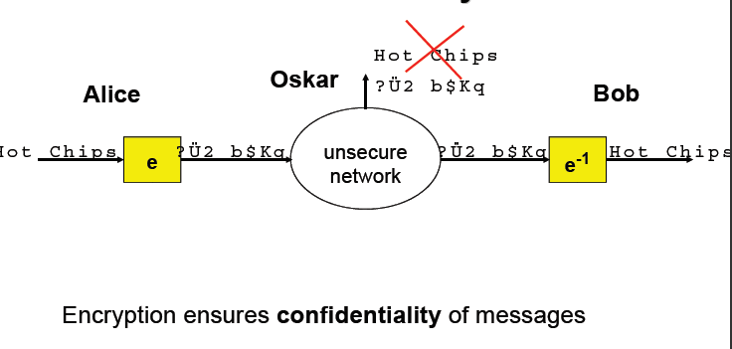
Confidentiality

Slide 11
Cryptographic Goals
Data integrity is a service which addresses the unauthorized alteration of data.
To assure data integrity, one must have the ability to detect data manipulation by unauthorized parties.
Data manipulation includes such things as insertion, deletion, and substitution.

Slide 12
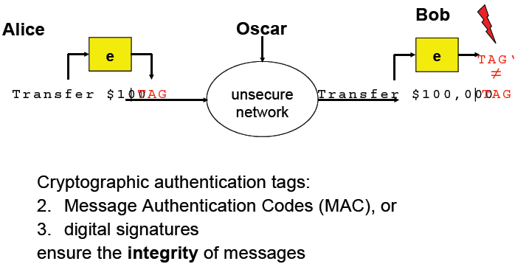
Integrity of Messages

Slide 13
Cryptographic Goals
Authentication is a service related to identification.
Two parties entering into a communication should identify each other.
Information delivered over a channel should be authenticated as to origin, date of origin, data content, time sent, etc.

Slide 14
Cryptographic Goals
Non-repudiation is a service which prevents an entity from denying previous commitments or actions.
When disputes arise due to an entity denying that certain actions were taken, a means to resolve the situation is necessary.
For example, one entity may authorize the purchase of property by another entity and later deny such authorization was granted. A procedure involving a trusted third party is needed to resolve the dispute.

Slide 15
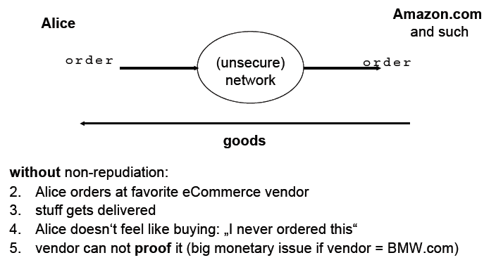
Non-Repudiation: Why we need it?

Slide 16
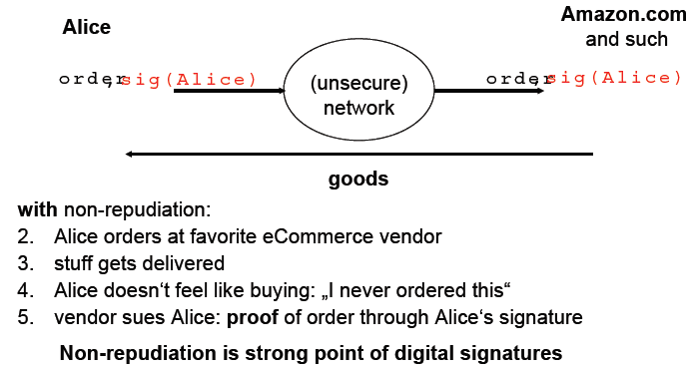
Non-Repudiation: How it works?

Slide 17
Basic Terminology and Concepts
Encryption domains and codomains
“A” denotes a finite set called the alphabet of definition. For example, A = {0; 1}, the binary alphabet, is a frequently used alphabet of definition. Note that any alphabet can be encoded in terms of the binary alphabet.
“M” denotes a set called the message space. M consists of strings of symbols from an alphabet of definition. An element of M is called a plaintext message or simply a plaintext. For example, M may consist of binary strings, English text, computer code, etc.
“C” denotes a set called the ciphertext space. C consists of strings of symbols from an alphabet of definition, which may differ from the alphabet of definition for M. An element of C is called a ciphertext.

Slide 18
Basic Terminology and Concepts
Encryption and decryption transformations
K denotes a set called the key space. An element of K is called a key.
Each element e Є K uniquely determines a bijection from M to C, denoted by E_{e}.
E_{e} is called an encryption function or an encryption transformation. Note that E_{e} must be a bijection if the process is to be reversed and a unique plaintext message recovered for each distinct ciphertext.
For each d Є K, D_{d} denotes a bijection from C to M (i.e., D_{d} : C →M). D_{d} is called a decryption function or decryption transformation.
The process of applying the transformation E_{e} to a message m Є M is usually referred to as encrypting m or the encryption of m.
The process of applying the transformation D_{d} to a ciphertext c is usually referred to as decrypting c or the decryption of c.

Slide 19
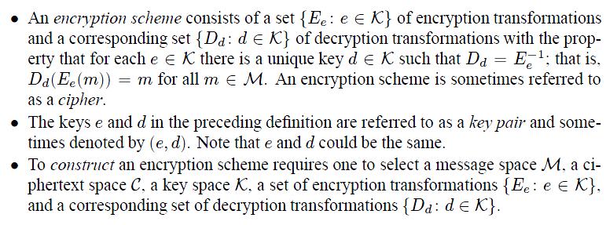
Basic Terminology and Concepts

Slide 20
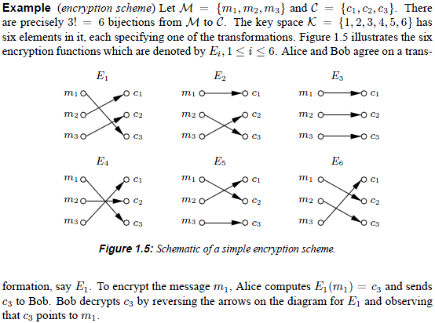
Basic Terminology and Concepts

Slide 21
Basic Terminology and Concepts
In cryptography, the set M is typically of astronomical proportions and, in these cases, new mathematical algorithms should use to describe the encryption and decryption transformations.

Slide 22
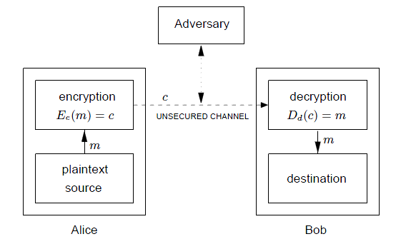
Basic Terminology and Concepts
Schematic of a two-party communication using encryption.

Slide 23
Basic Terminology and Concepts
Communication participants
An entity or party is someone or something which sends, receives, or manipulates information. Alice and Bob are entities. An entity may be a person, a computer terminal, etc.
A sender is an entity in a two-party communication which is the legitimate transmitter of information. In figure, the sender is Alice.
A receiver is an entity in a two-party communication which is the intended recipient of information. In Figure, the receiver is Bob.
An adversary is an entity in a two-party communication which is neither the sender nor receiver. Various other names are synonymous with adversary such as enemy, attacker, opponent, tapper, eavesdropper, intruder, and interloper.
An adversary will often attempt to play the role of either the legitimate sender or the legitimate receiver.

Slide 24
Basic Terminology and Concepts
Channels
A channel is a means of conveying information from one entity to another.
A physically secure channel or secure channel is one which is not physically accessible to the adversary.
An unsecured channel is one from which parties other than those for which the information is intended can reorder, delete, insert, or read.
A secured channel is one from which an adversary does not have the ability to reorder, delete, insert, or read.

Slide 25
Basic Terminology and Concepts
An information security service is a method to provide some specific aspect of security.
For example, integrity of transmitted data is a security objective, and a method to ensure this aspect is an information security service.
Breaking an information security service (which often involves more than simply encryption) implies defeating the objective of the intended service.
A passive adversary is an adversary who is capable only of reading information from an unsecured channel.
An active adversary is an adversary who may also transmit, alter, or delete information on an unsecured channel.

Slide 26
Basic Terminology and Concepts
Cryptology
Cryptanalysis is the study of mathematical techniques for attempting to defeat cryptographic techniques, and, more generally, information security services.
A cryptanalyst is someone who engages in cryptanalysis.
Cryptology is the study of cryptography and cryptanalysis.
A cryptosystem is a general term referring to a set of cryptographic tools used to provide information security services. Most often the term is used in conjunction with primitives providing confidentiality, i.e., encryption.

Slide 27
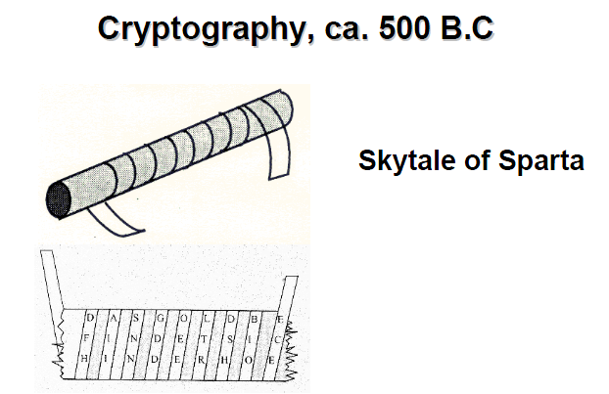
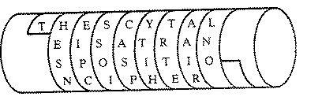
A Brief History for Cryptography
THE SCYTALE IS A TRANSPOSITION CIPHER

Slide 28
A Brief History for Cryptography
Old cryptography methods relied on elementary operations on the symbols of the initial text, a simple example being to replace each letter by another one following a given rule which was supposed to be known only by the sender and the receiver. (Julius Caesar)
it is easy to decipher such messages without knowing the key, and one can even recover the key from an encoded message.
To break such a code, one efficient process is to perform a statistical study of occurrences of the different letters. This idea was used as early as IX th. century by Abu Youssouf Yaqub Ishaq Al Kindi.

Slide 29
Some Historical Examples
Shift Cipher:
For an n-letter alphabet, P,C,K ∈ Z_{n} E_{K}(P) = P + K mod n D_{K}(C) = C - K mod n.
Cryptanalysis: exhaustive key search
Substitution Cipher:
P,C ∈ Z_{n}; K is a bijection, f, over Z_{n} E_{K}(P) = f(P) D_{K}(C) = f ⁻¹(C).
Cryptanalysis: frequency analysis

Slide 30
A Brief History for Cryptography
During the XIII-th century, in his Letter concerning the Marvelous Power of Art and Nature and the Nullity of Magic, Roger Bacon described seven methods to encrypt messages in 1200s.
In the XVI-th century, the French diplomat Blaisede Vigenere was also a cryptographer. He invented Vigenere cyphering.
C. Babbage (1791-1871 ), who invented the computer, pointed out the usefulness of statistics for deciphering encrypted messages.
After the war in 1870 between France and Germany, the French Government realized that one strong point of the German army was communication; it was decided to create military centers for the study of carrier-pigeons.
At the same time, James C. Maxwell was developing electromagnetism theory, and H. H. Herz and Acharya J. C. Bose, was going to give rise to radio and modern means of transmitting data.

Slide 31
A Brief History for Cryptography
In a visionary paper on the military cryptography published in the Journal of Military Sciences in 1883, A. Kerckhoffs proposed a number of principles which are still valid .
Such as; the security of the system must rely only on the choice of the keys, which should be renewed on a regular basis.

Slide 32
Cryptographic Fundamentals
Basic encryption: Key: An easy-to-change, variable parameter of the encryption algorithm.
Kerckhoffs’ principle (1883): Security should not rely on the secrecy of the algorithm; everything may be known but the key.
key K
K
plaintext
P
ciphertext
C = E_{K}(P)
plaintext
P = D_{K}(C)
E
D

Slide 33
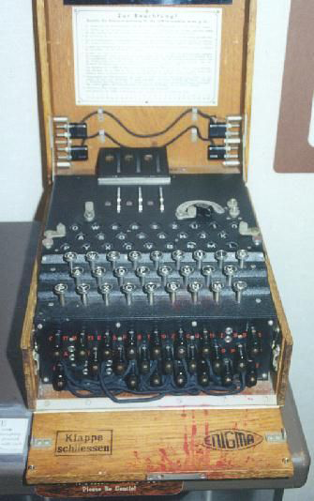
A Brief History for Cryptography
The red phone (which was a fax ) between White House and Kremlin during the cold war used the disposable mask technique which had been invented by G. Vernam in 1917.
During World War II (1940), most German communications were enciphered on the Enigma cipher machine. It was comprised a series of rotor wheels with internal cross-connections, providing a substitution using a continuously changing alphabet.

Slide 34
Some Historical Examples
Vernam Cipher (1917):
P, C, K ∈ {0,1}^{n}, for some n ≥ 1. E_{K}(P) = P ⊕ K D_{K}(C) = C ⊕ K
Problem: Key needs to be transmitted, which is as long as the message.
Used for top-secret applications (E.g., Washington-Moscow red line)

Slide 35
Vernam Cipher (cont.)
Perfect Secrecy (Shannon, 1949): Ciphertext leaks no information about the message.
Theorem: Vernam cipher has perfect secrecy if each key bit is generated uniformly randomly.
Theorem: For perfect secrecy, the entropy of the key has to be at least as high as the entropy of the message. (i.e. the key has to be at least as long as the message.)

Slide 36
A Brief History for Cryptography
The mathematician A.Turing invented a code breaking machine, the Bomb, which gave birth to the first electronic programmable computer by Max Newman.
The work done by him and his colleagues at Bletchley Park brought cryptology in to the modern world .
It required in genius logic, statistical theory, the beginnings of information theory, advanced technology, and superb organization.

Slide 37
A Brief History for Cryptography
C. Shannon, an American electrical engineer and mathematician, has been called `the father of information theory':
He pioneered the modern mathematical theory of data transmission.
The principles of using public keys for enciphering messages was suggested by W. Diffie and M. E. Hellman in 1976 ;
Its first realization in 1978 by R. L. Rivest, A.Shamir and L.M.Adleman produced the RSA system which is now a days the most efficient.

Slide 38
Modern Ciphers
Shortcomings of historical systems:
Substitution cipher: Small size of the input domain, which enables frequency analysis.
Vernam cipher: Unlimited key size, which makes key generation and exchange a problem.
Modern ciphers:
Block ciphers: Increasing the size of the input alphabet (i.e. blocks) for substitution
Stream ciphers: Using a PRNG for generating the key stream

Slide 39
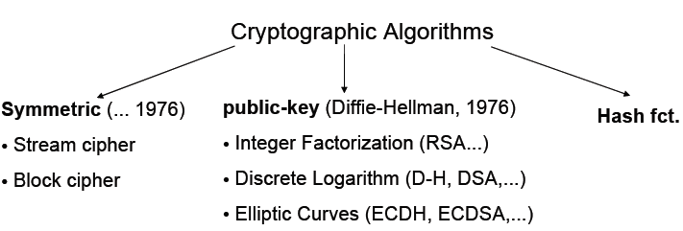
Cryptographic Toolkit

Slide 40
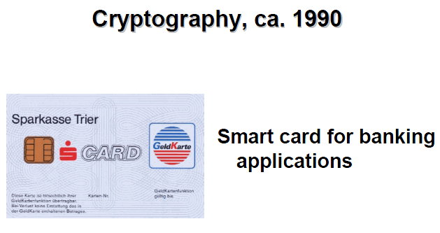

Slide 41
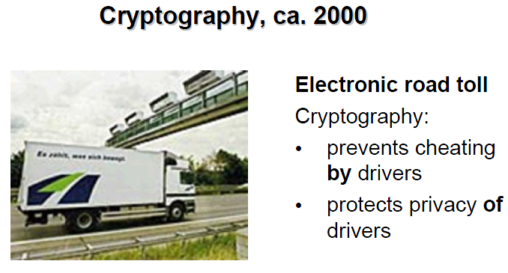

Slide 42
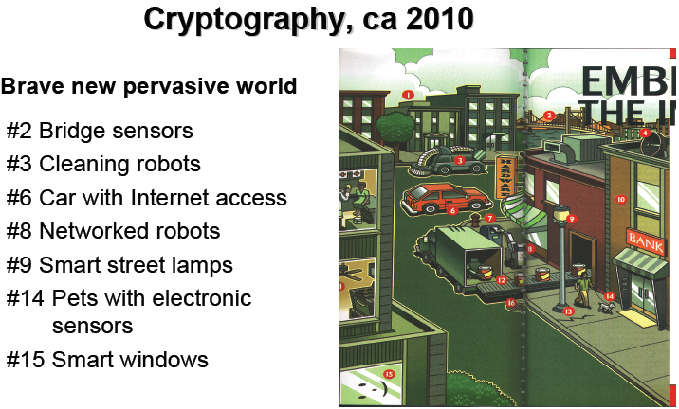

Slide 43
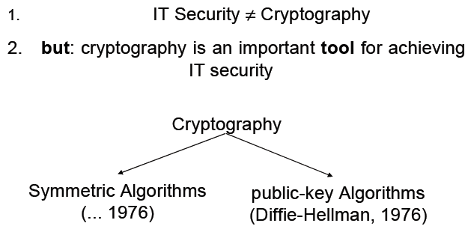
IT Security and Cryptography

Slide 44
Evaluation Criteria for Cryptographic Tools
Level of Security
Functionality
Methods of Operation
Performance
Easy of Implementation
The relative importance of various criteria is very much dependent on the application and resources available.
For example, in an environment where computing power is limited one may have to trade off a very high level of security for better performance of the system as a whole.

Slide 45
Evaluation Criteria for Cryptographic Tools: Level of Security
This is usually difficult to quantify. Often it is given in terms of the number of operations required (using the best methods currently known) to defeat the intended objective.
Typically the level of security is defined by an upper bound on the amount of work necessary to defeat the objective.(Work Factor, W_{d})

Slide 46
Evaluation Criteria for Cryptographic Tools: Functionality
Tools will need to be combined to meet various information security objectives.
Which tools are most effective for a given objective will be determined by the basic properties of the tools.

Slide 47
Evaluation Criteria for Cryptographic Tools: Methods of Operation
Tools, when applied in various ways and with various inputs, will typically exhibit different characteristics;
thus, one tool could provide very different functionality depending on its mode of operation or usage.

Slide 48
Evaluation Criteria for Cryptographic Tools: Performance
This refers to the efficiency of a tool in a particular mode of operation.
For example, an encryption algorithm may be rated by the number of bits per second which it can encrypt.

Slide 49
Evaluation Criteria for Cryptographic Tools: Easy of Implementation
This refers to the difficulty of realizing the tool in a practical instantiation.
This might include the complexity of implementing the tool in either a software or hardware environment.

