Slide 1

Chapter 9
Using Telephone
and Cable Networks
for Data Transmission
Copyright © The McGraw-Hill Companies, Inc. Permission required for reproduction or display.

Slide 2
9-1 TELEPHONE NETWORK
Telephone networks use circuit switching. The telephone network had its beginnings in the late 1800s. The entire network, which is referred to as the plain old telephone system (POTS), was originally an analog system using analog signals to transmit voice.
Topics discussed in this section:
Major Components
LATAs
Signaling
Services Provided by Telephone Networks

Slide 3
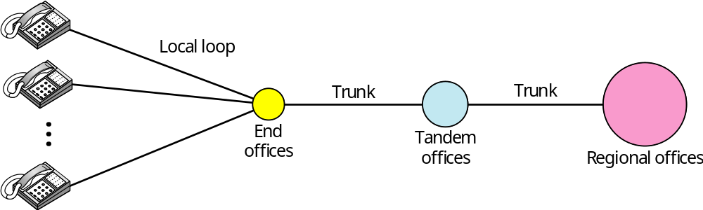
Figure 9.1 A telephone system

Slide 4

Note
Intra-LATA services are provided by local exchange carriers.
Since 1996, there are two
types of LECs: incumbent local exchange carriers and competitive
local exchange carriers.

Slide 5
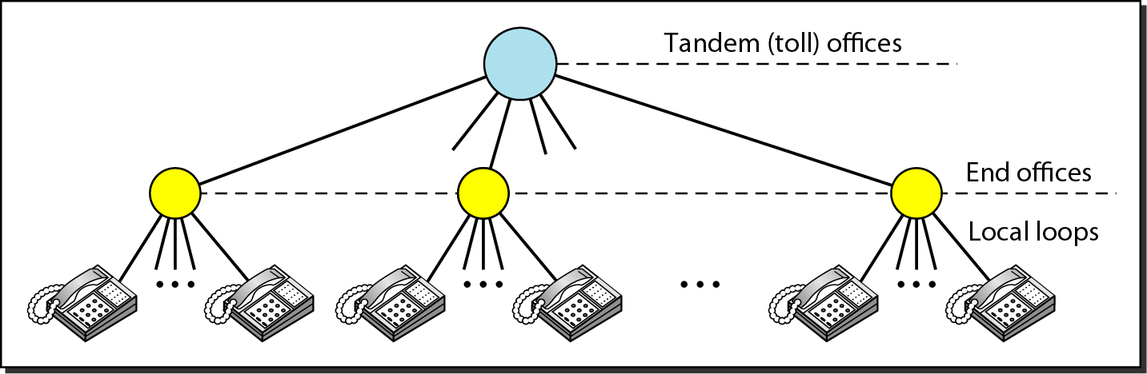
Figure 9.2 Switching offices in a LATA

Slide 6
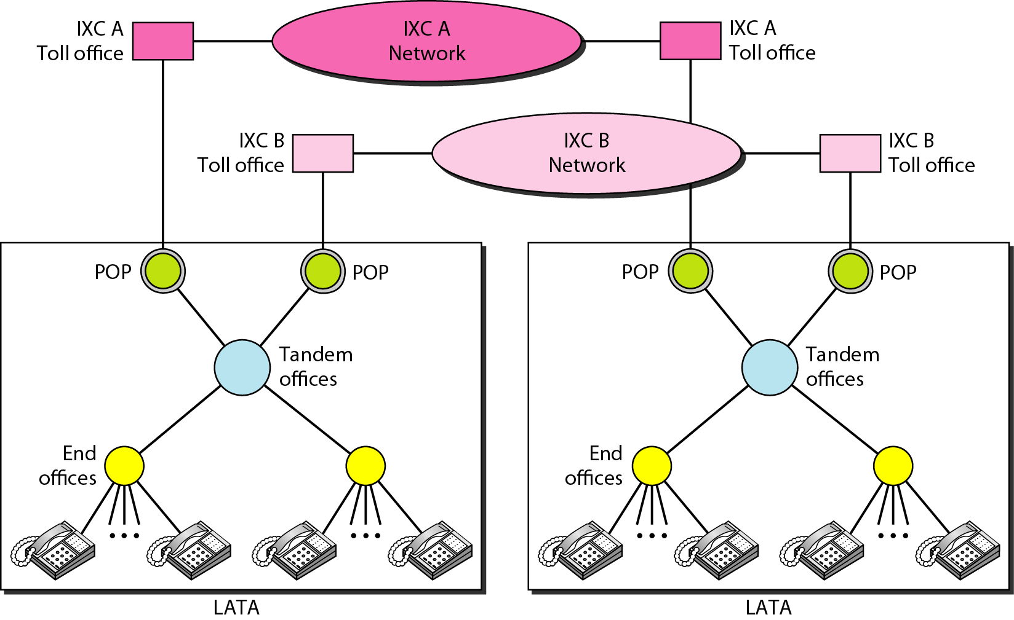
Figure 9.3 Point of presences (POPs)

Slide 7
Note
The tasks of data transfer and signaling are separated in modern telephone networks: data transfer is done by one network, signaling by another.

Slide 8
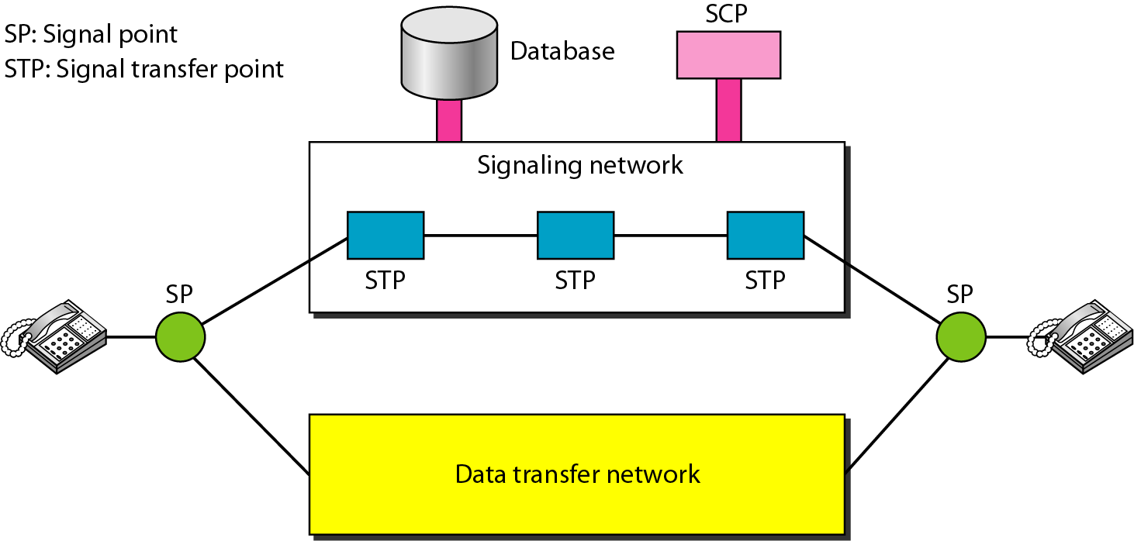
Figure 9.4 Data transfer and signaling networks

Slide 9
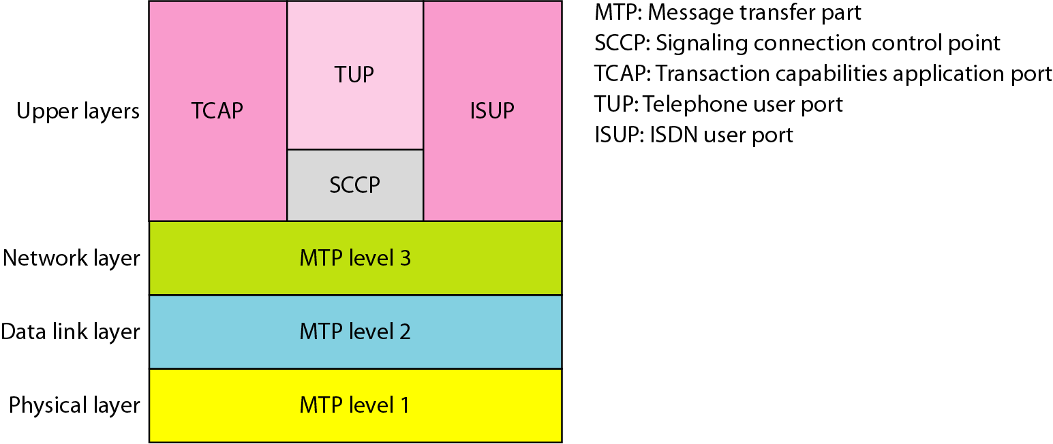
Figure 9.5 Layers in SS7

Slide 10
Services Provided by Telephone Networks
- Analog Switched Services
- Local loop: analog signal
- 800 Service
- 900 – WATS service
- Analog Leased Services
- Dedicated analog line
- Digital Services
- Switched/56 Service
- Digital Data Service

Slide 11
9-2 DIAL-UP MODEMS
Traditional telephone lines can carry frequencies between 300 and 3300 Hz, giving them a bandwidth of 3000 Hz. All this range is used for transmitting voice, where a great deal of interference and distortion can be accepted without loss of intelligibility.
Topics discussed in this section:
Modem Standards

Slide 12
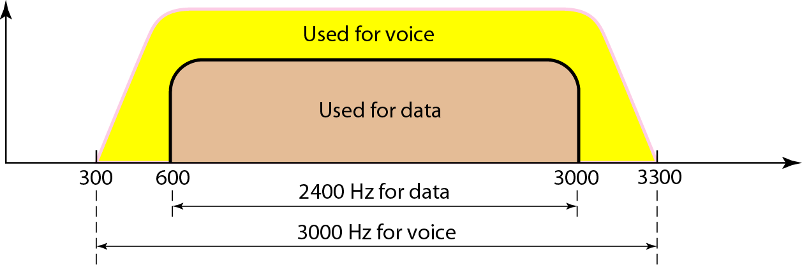
Figure 9.6 Telephone line bandwidth

Slide 13
Note
Modem
stands for modulator/demodulator.

Slide 14
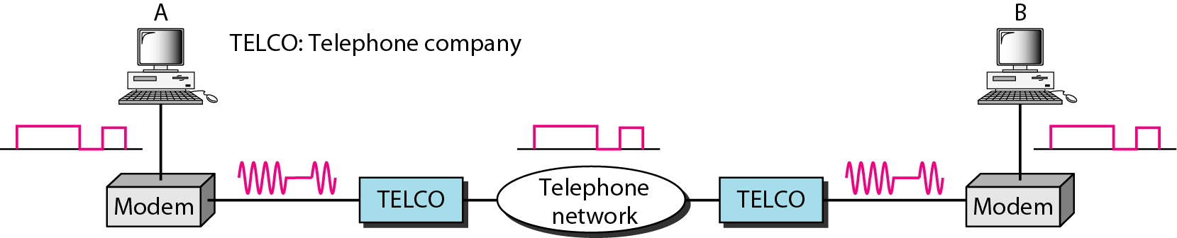
Figure 9.7 Modulation/demodulation

Slide 15
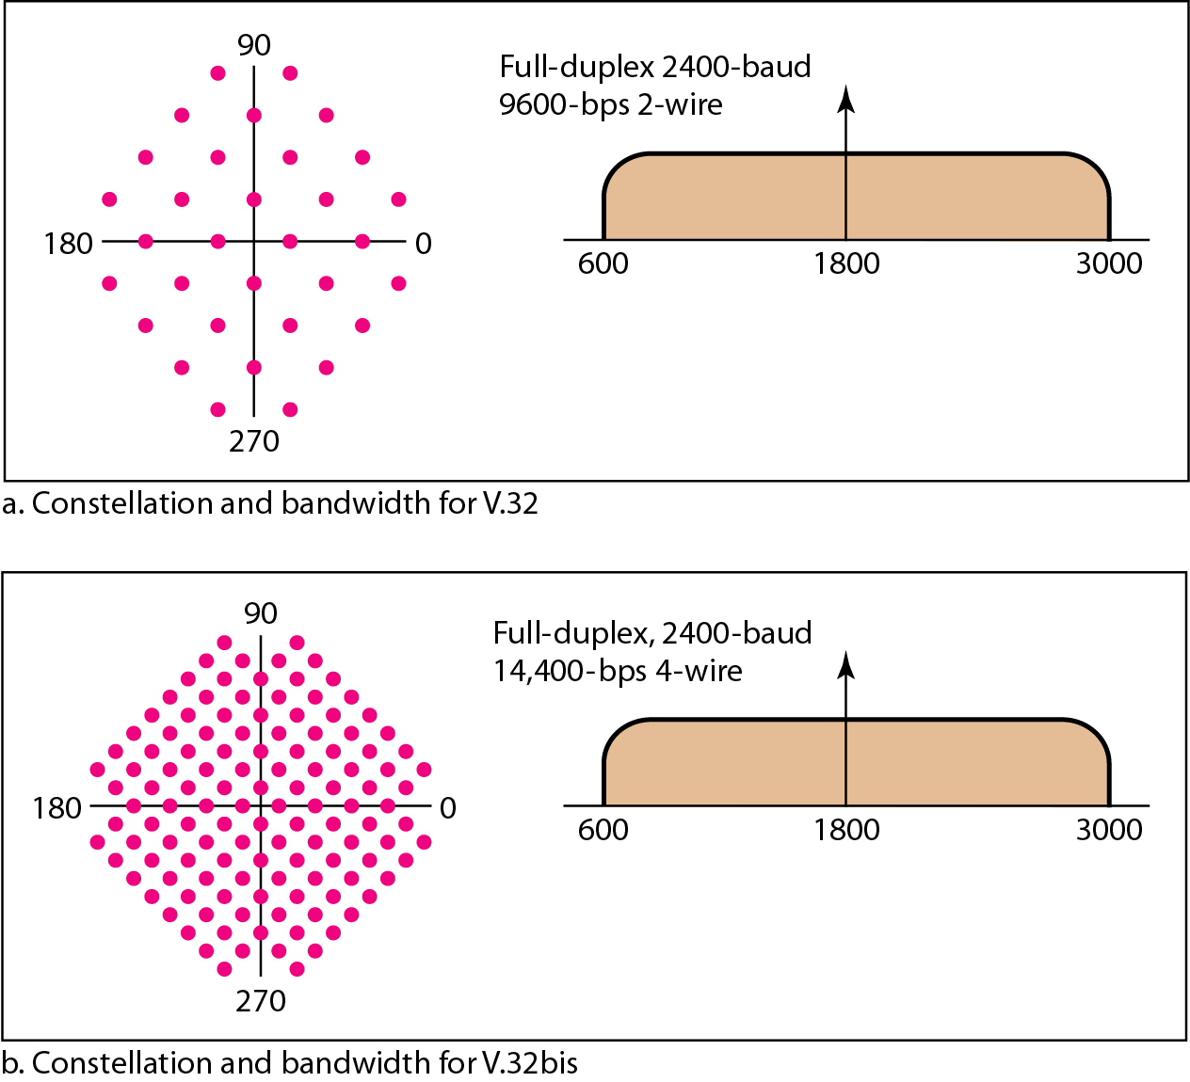
Figure 9.8 The V.32 and V.32bis constellation and bandwidth

Slide 16
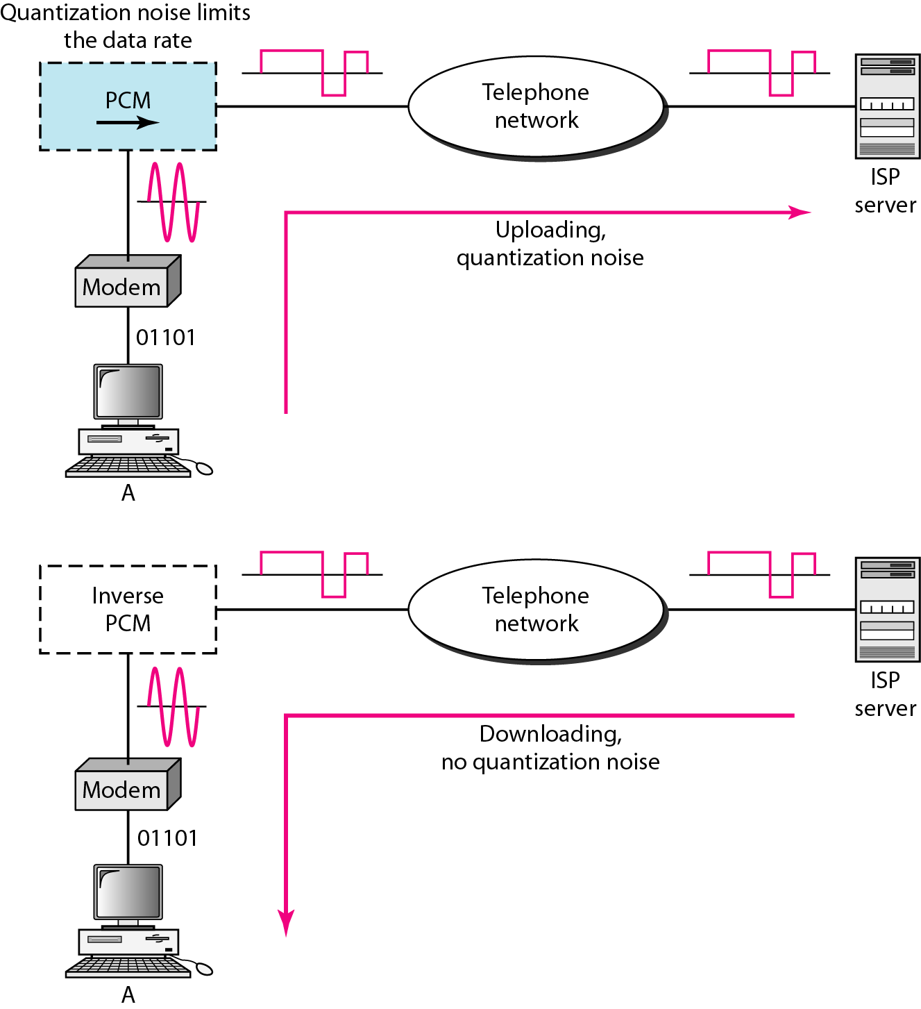
Figure 9.9 Uploading and downloading in 56K modems

Slide 17
9-3 DIGITAL SUBSCRIBER LINE
After traditional modems reached their peak data rate, telephone companies developed another technology, DSL, to provide higher-speed access to the Internet. Digital subscriber line (DSL) technology is one of the most promising for supporting high-speed digital communication over the existing local loops.
Topics discussed in this section:
ADSL
ADSL Lite
HDSL
SDSL
VDSL

Slide 18
Note
ADSL is an asymmetric communication technology designed for residential users; it is not suitable for businesses.

Slide 19
Note
The existing local loops can handle bandwidths up to 1.1 MHz.

Slide 20
Note
ADSL is an adaptive technology.
The system uses a data rate
based on the condition of
the local loop line.

Slide 21
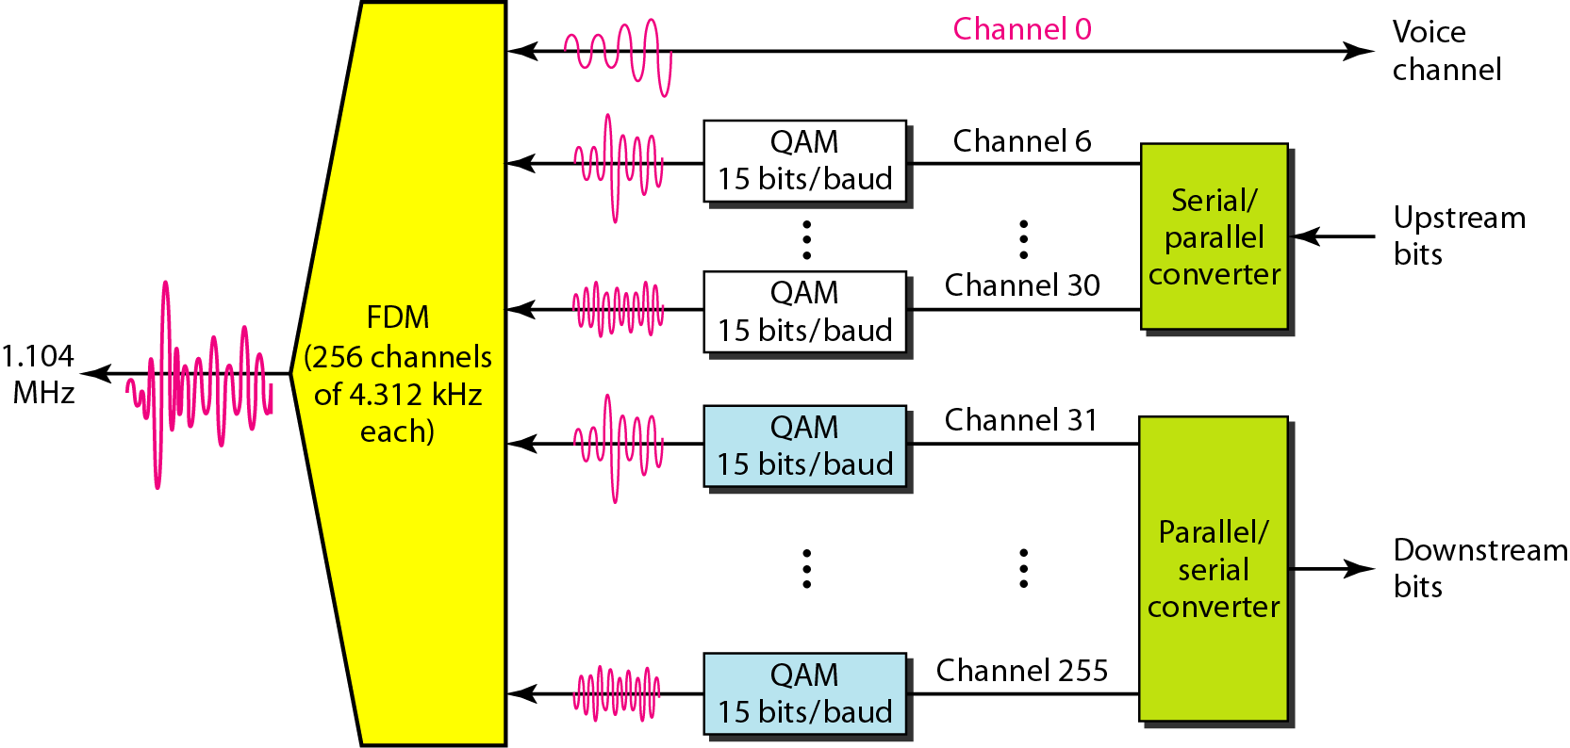
Figure 9.10 Discrete multitone technique

Slide 22
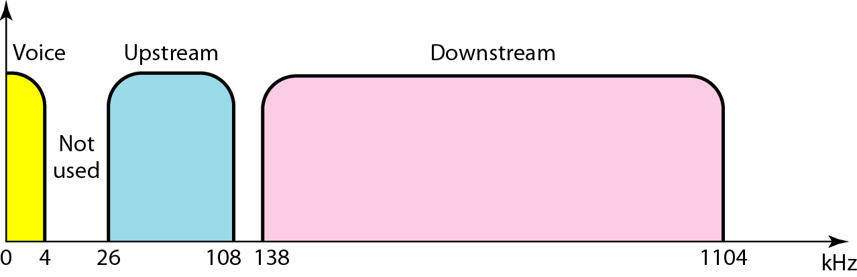
Figure 9.11 Bandwidth division in ADSL

Slide 23
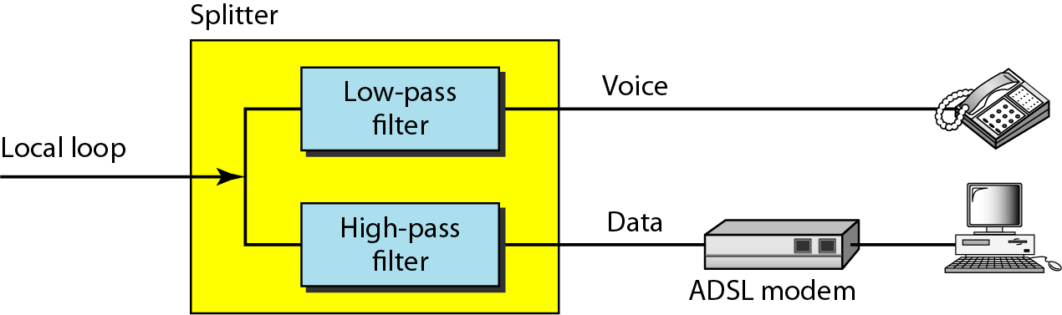
Figure 9.12 ADSL modem

Slide 24
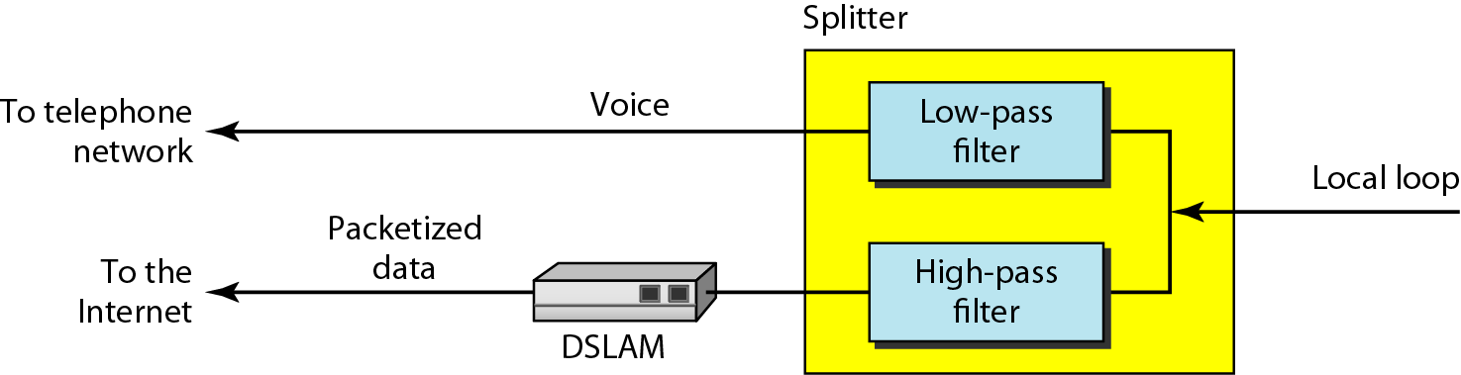
Figure 9.13 DSLAM

Slide 25
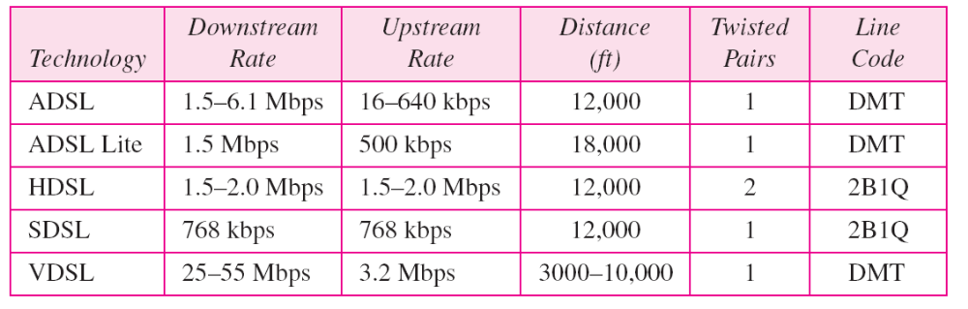
Table 9.2 Summary of DSL technologies

Slide 26
9-4 CABLE TV NETWORKS
The cable TV network started as a video service provider, but it has moved to the business of Internet access. In this section, we discuss cable TV networks per se; in Section 9.5 we discuss how this network can be used to provide high-speed access to the Internet.
Topics discussed in this section:
Traditional Cable Networks
Hybrid Fiber-Coaxial (HFC) Network

Slide 27
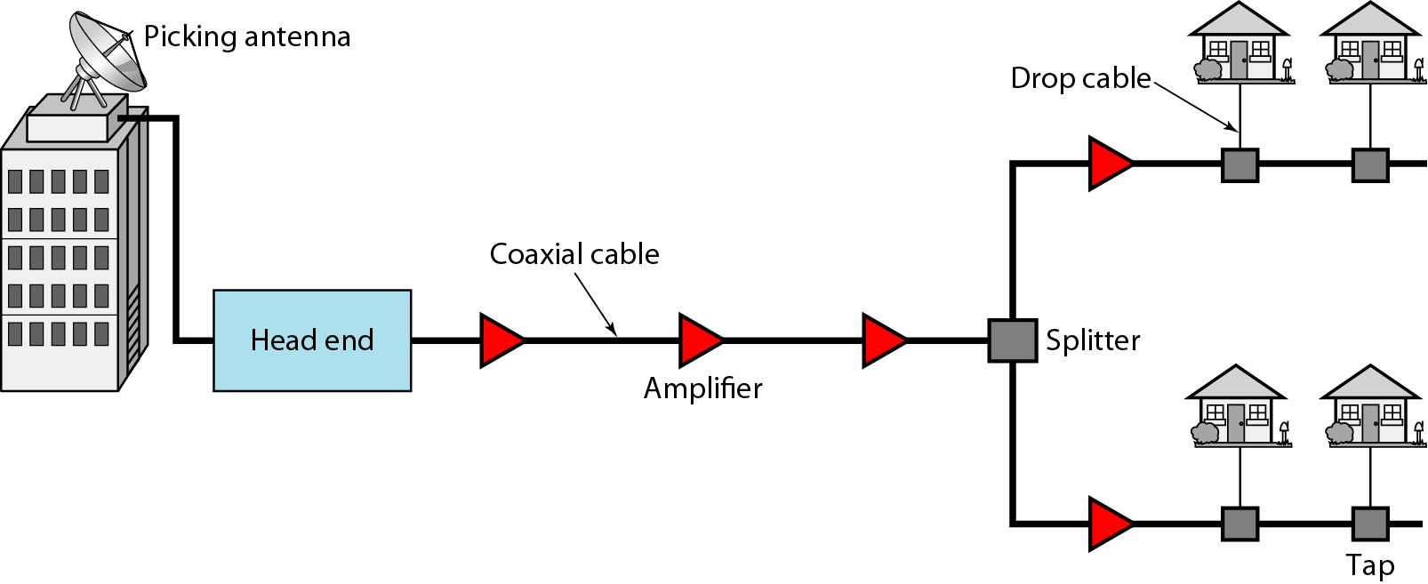
Figure 9.14 Traditional cable TV network

Slide 28
Note
Communication in the traditional cable TV network is unidirectional.

Slide 29
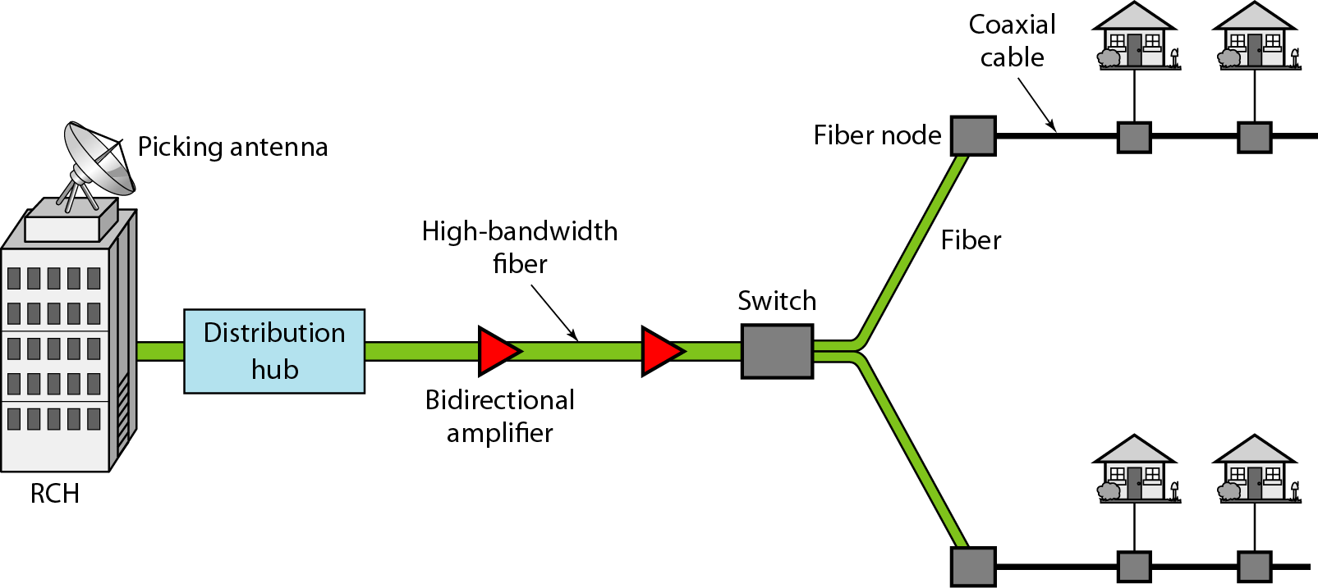
Figure 9.15 Hybrid fiber-coaxial (HFC) network

Slide 30
Note
Communication in an HFC cable TV network can be bidirectional.

Slide 31
9-5 CABLE TV FOR DATA TRANSFER
Cable companies are now competing with telephone companies for the residential customer who wants high-speed data transfer. In this section, we briefly discuss this technology.
Topics discussed in this section:
Bandwidth
Sharing
CM and CMTS
Data Transmission Schemes: DOCSIS

Slide 32
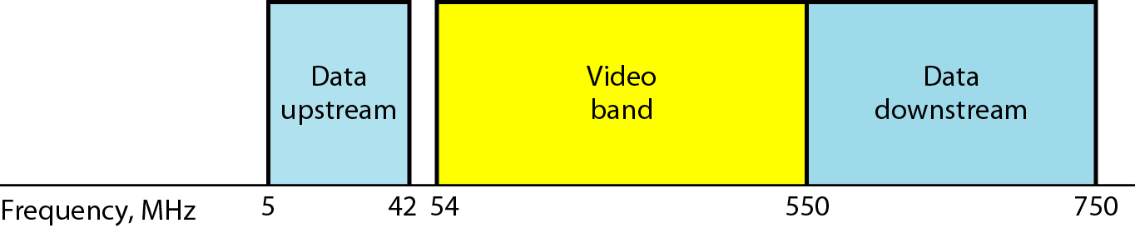
Figure 9.16 Division of coaxial cable band by CATV

Slide 33
Note
The theoretical downstream data rate
is 30 Mbps.

Slide 34
Note
The theoretical upstream data rate
is 12 Mbps.

Slide 35
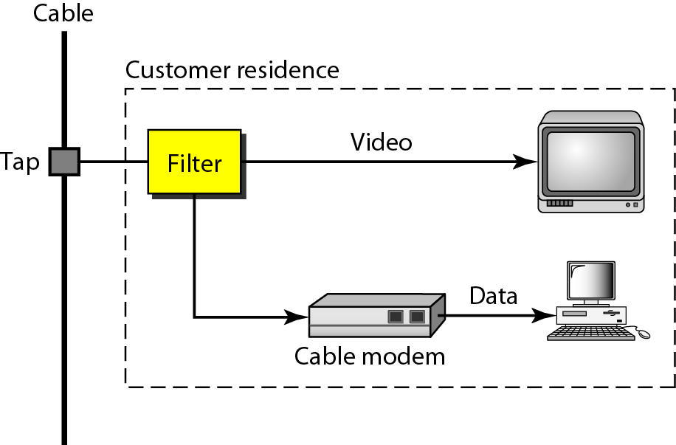
Figure 9.17 Cable modem (CM)

Slide 36
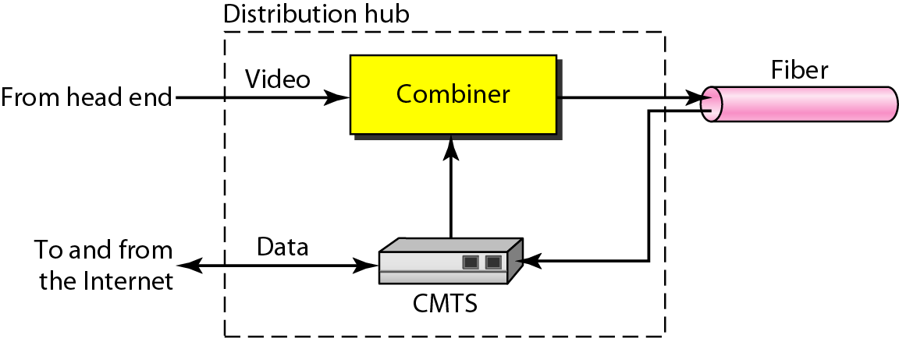
Figure 9.18 Cable modem transmission system (CMTS)

