Slide 1
MOVIEVERSE

Slide 2
Features
CRUD
Loading data from external file
User Interactivity

Slide 3
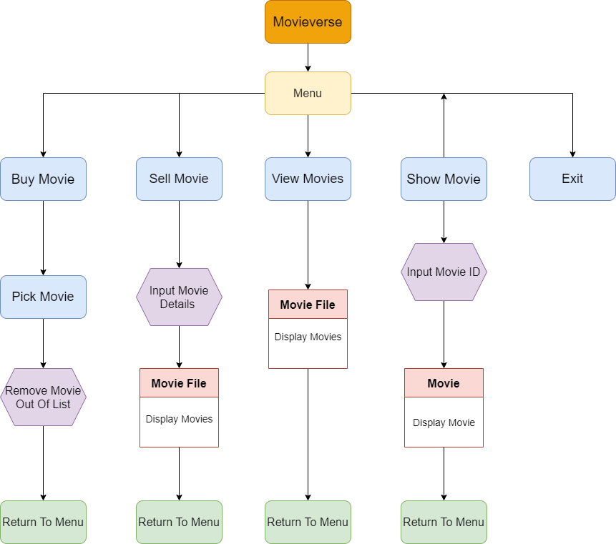
Flowchart

Slide 4
Application Demonstration

Slide 5
Challenges
Struggling with class and OOP concept

Slide 6
Favourite Parts
Trying to come up with solutions

