Slide 1
Ahmet Erturk Portfolio

Slide 2
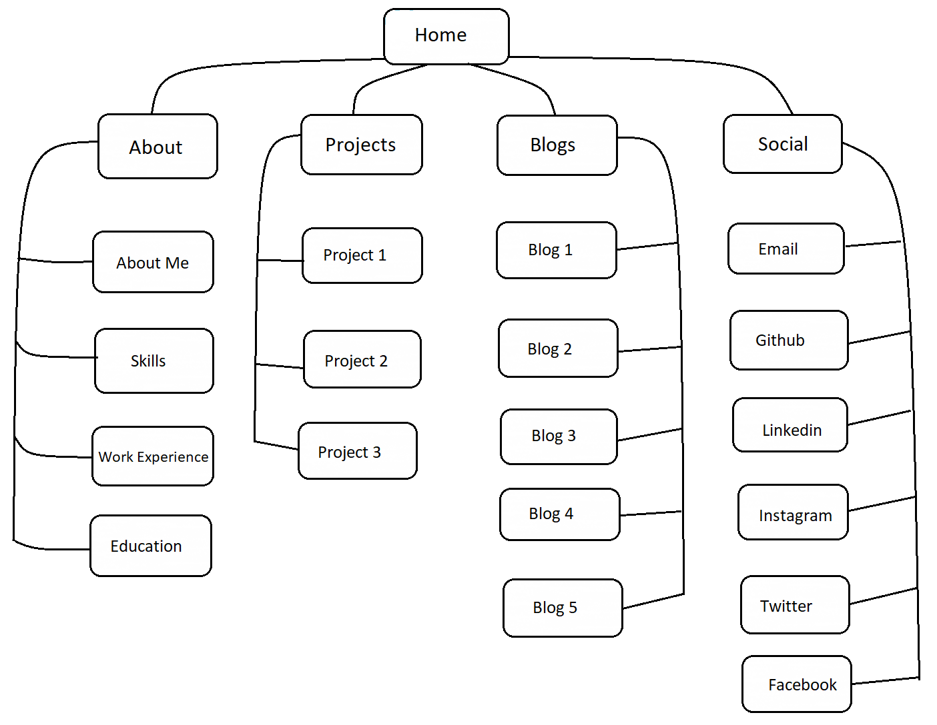
PORTFOLIO SITEMAP

Slide 3
WIREFRAMES
HTML
STYLING
INTERACTIVE DESIGN
ACCESSIBLE
DECISION MAKING PROCESS AND WIREFRAMES

Slide 4
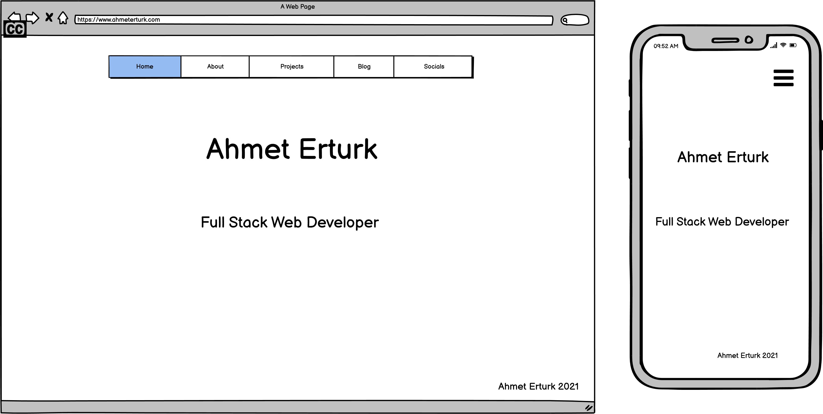
HOME PAGE

Slide 5
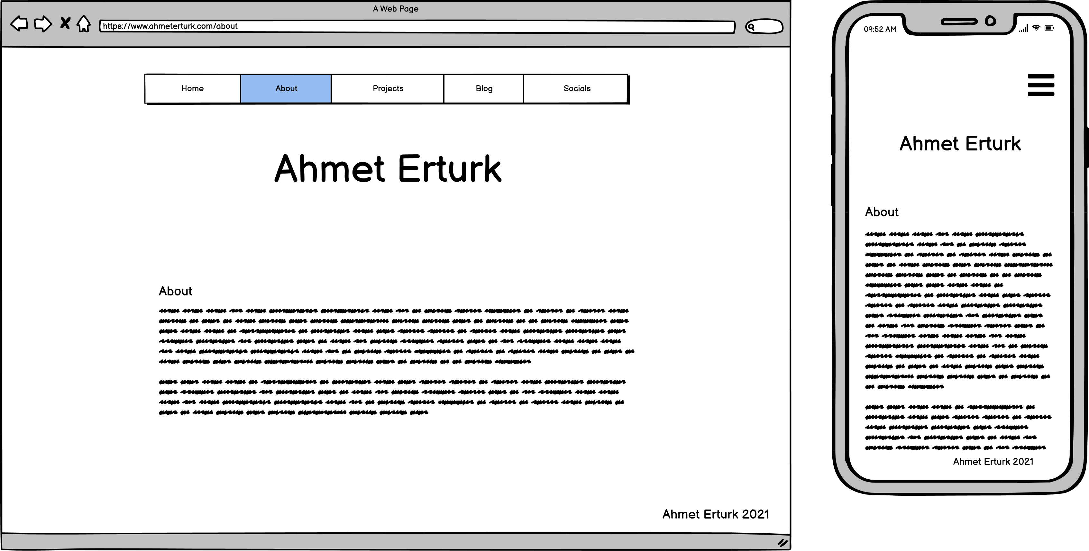
ABOUT PAGE

Slide 6
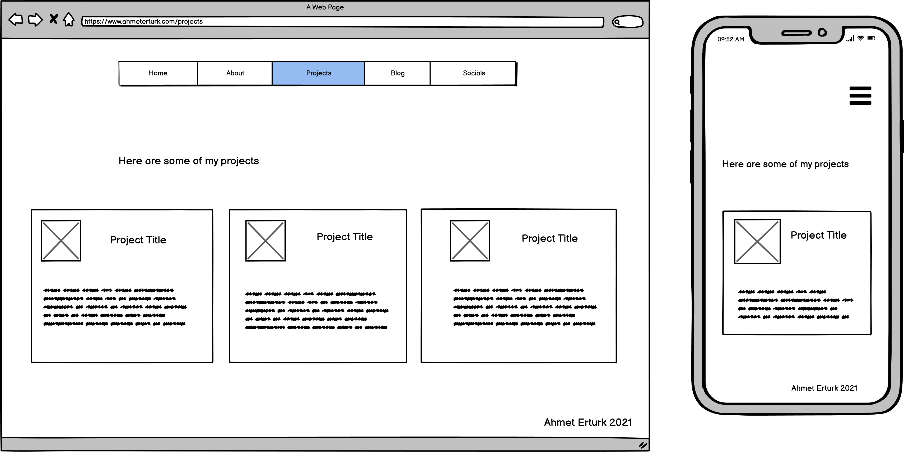
PROJECTS

Slide 7
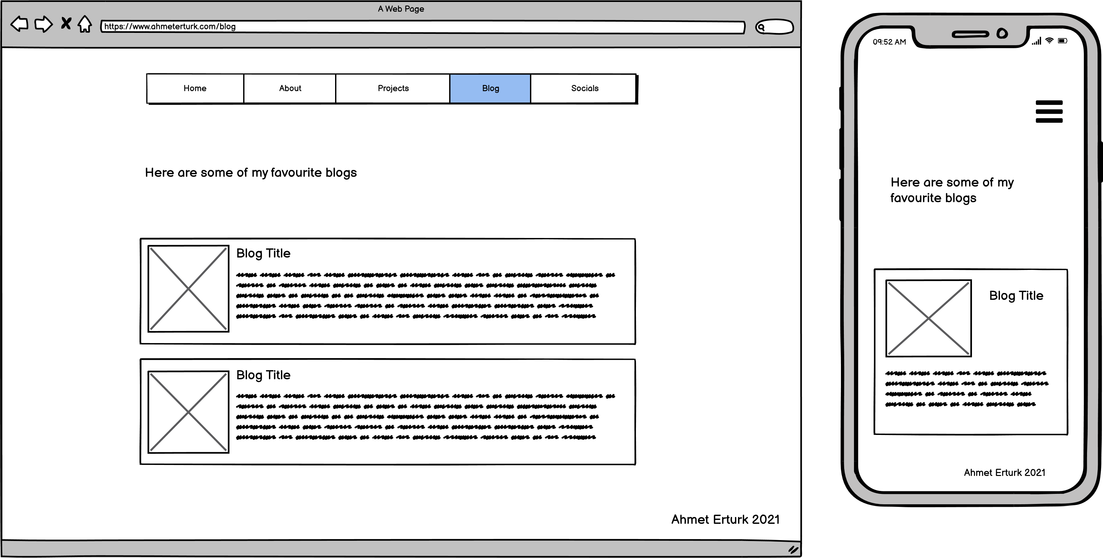
BLOGS

Slide 8
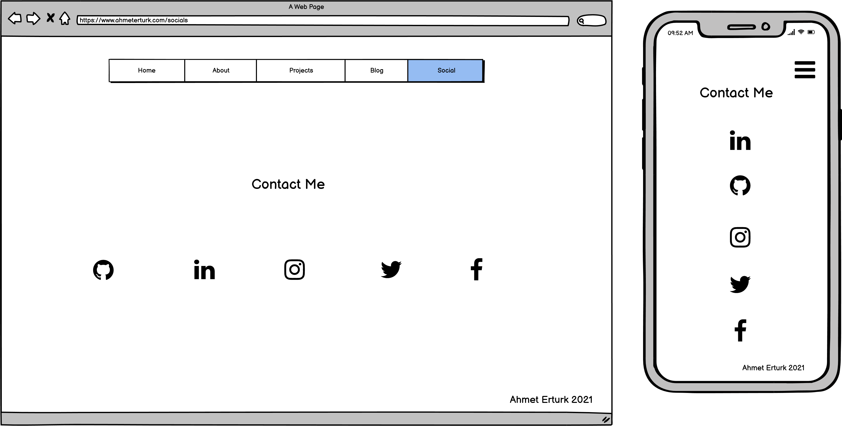
SOCIAL

Slide 9
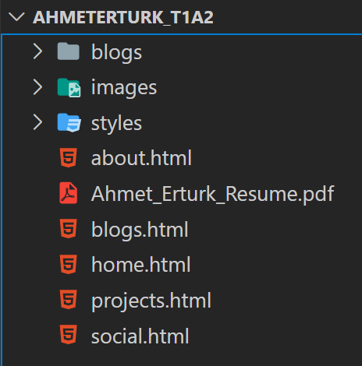
FILE STRUCTURE

Slide 10
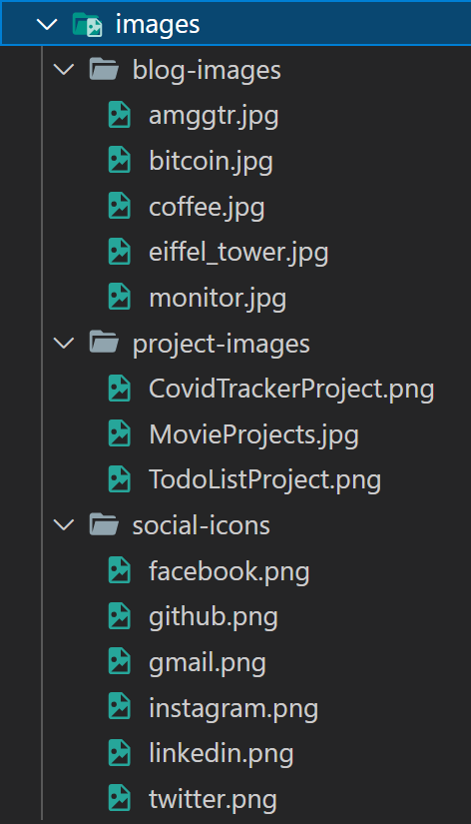
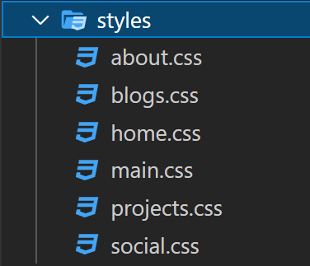
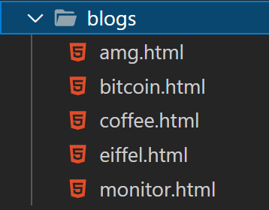
FILE STRUCTURE

Slide 11

COMPONENTS
NAVIGATION BAR
MUTUAL COMPONENT OF ALL PAGES
INTERACTIVE HOVER EFFECT
RESPONSIVE

Slide 12
COMPONENTS
FOOTER
MUTUAL COMPONENT OF ALL PAGES

Slide 13
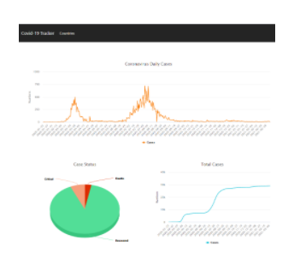
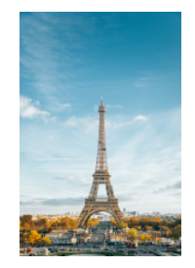
COMPONENTS
IMAGES
VISUAL AESTHETIC AND CONTEXT

Slide 14


COMPONENTS
BUTTONS
INTERACTIVE

Slide 15

COMPONENTS
IMAGE LINKS
ADDS VISUAL AESTHETIC

Slide 16
COMPONENTS
SEMANTIC ELEMENTS
NAV
FOOTER
SECTION
MAIN
ARTICLE

Slide 17
LIVE DEMONSTRATION

