Slide 1



THE attraction FORCE OF
ElectroMAGNETS
Ahmet topak
Toprak Talu Firat
Serhat otmar
Gizem Birol
Gülçin semen
29 november 2021
FocsanI, romanIa
Notes:
Tanıtma kısmı
(Gülçin)

Slide 2
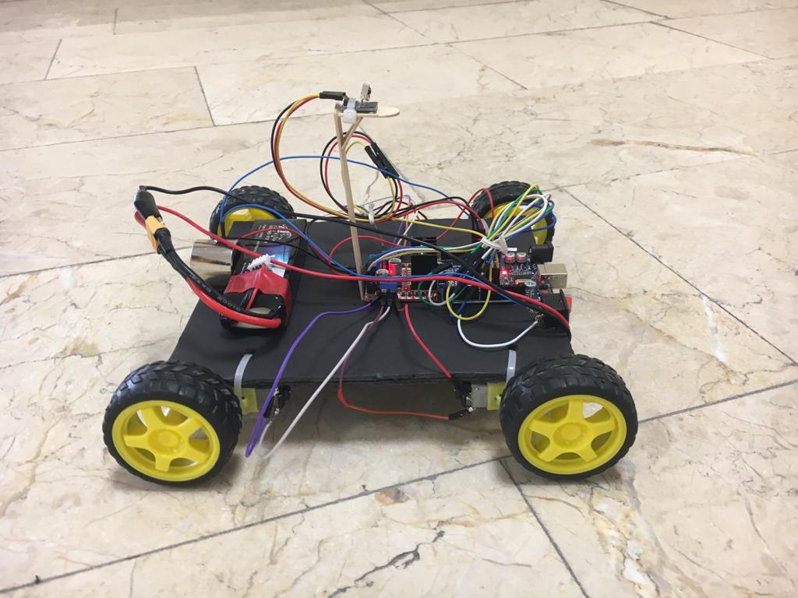
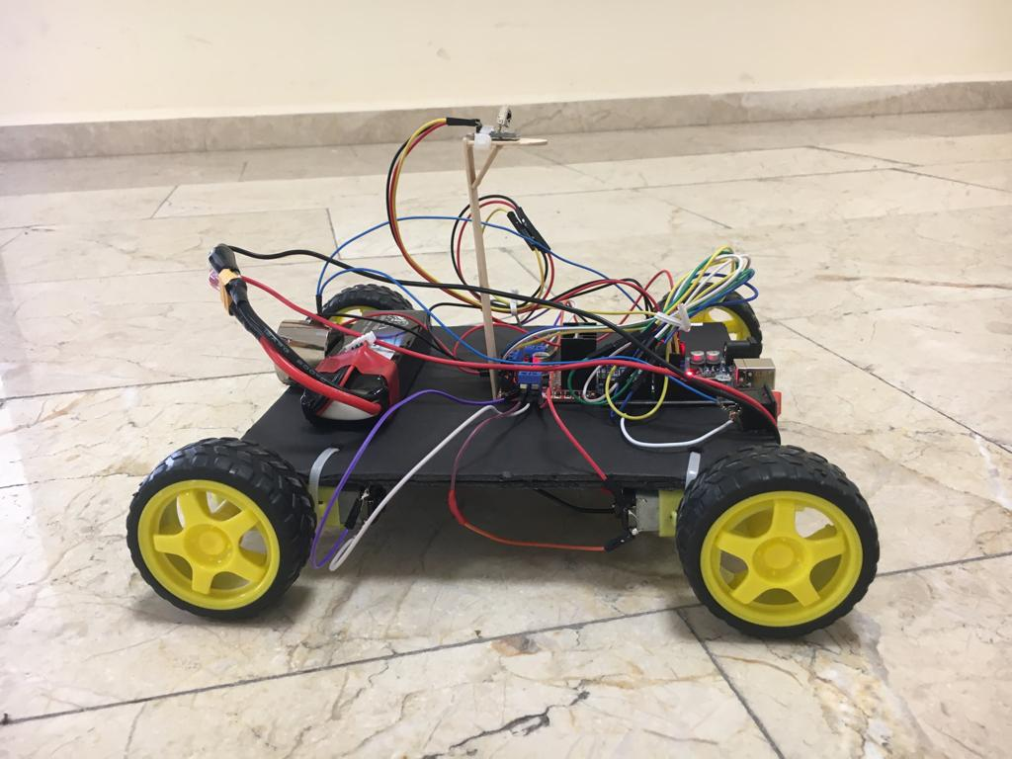
THE attractIon FORCE OF
ElectroMAGNETS
Notes:
lets begin
Our project is about the attracting force of electromagnets.
Because electromagnets are everywhere in our daily lives, we are trying to find answers to some questions about speed and the use of the electromagnets.
(Gülçin)

Slide 3
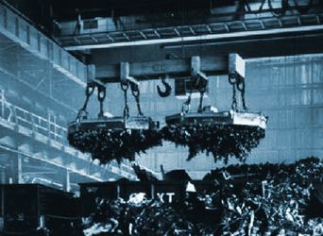
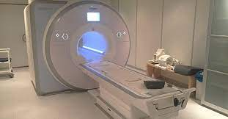
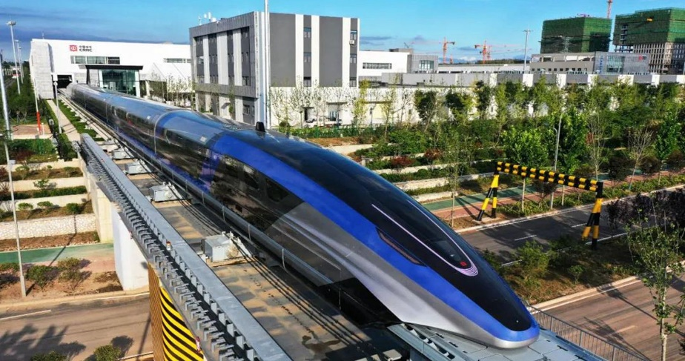
areas of use of Electromagnets in everyday life
Cranes
Magnetic resonance imaging (MRI) machine
Trains
Notes:
All of you can see in this presentation, electromagnets are used in our daily lifes
For example ; electromagnetic Cranes, MRI machines, Trains, etc.
(Gizem)

Slide 4
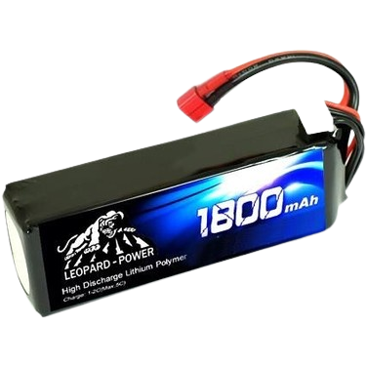
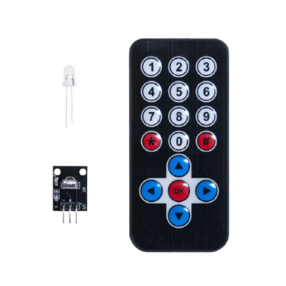
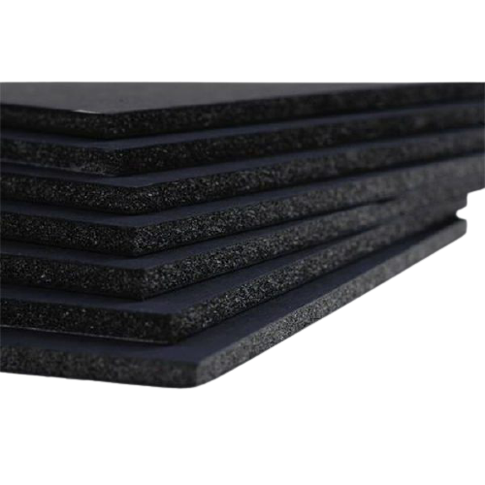
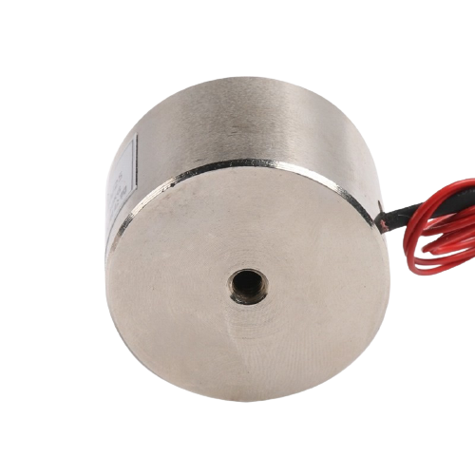
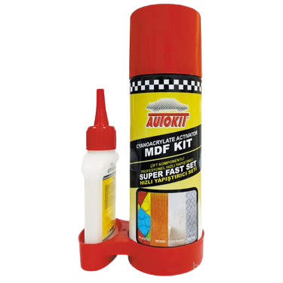
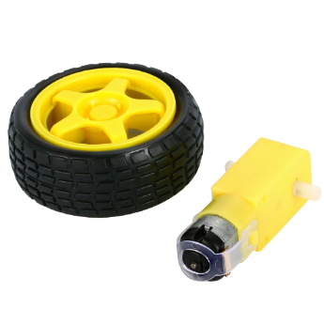
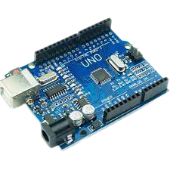
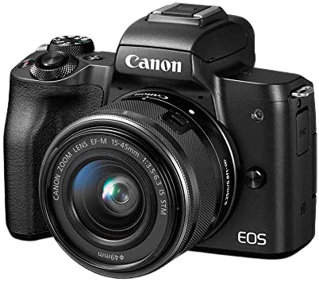

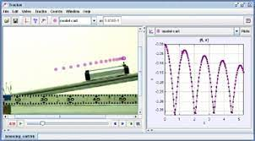
materials
BATTERY
Remote contorol
Cardboard
Glue
eLECTROMAGNET
Wheel &
engine
Arduino BOARD
Camera
Computer
Tracker
Notes:
To build this Project all you need is (Ahmet)
Cardboard
Glue
Electromagnet
Battery
Remote Control
Engine
Arduino Board (pc board),
Camera,
Computer,
AND the most important of all is the Tracker Program.

Slide 5
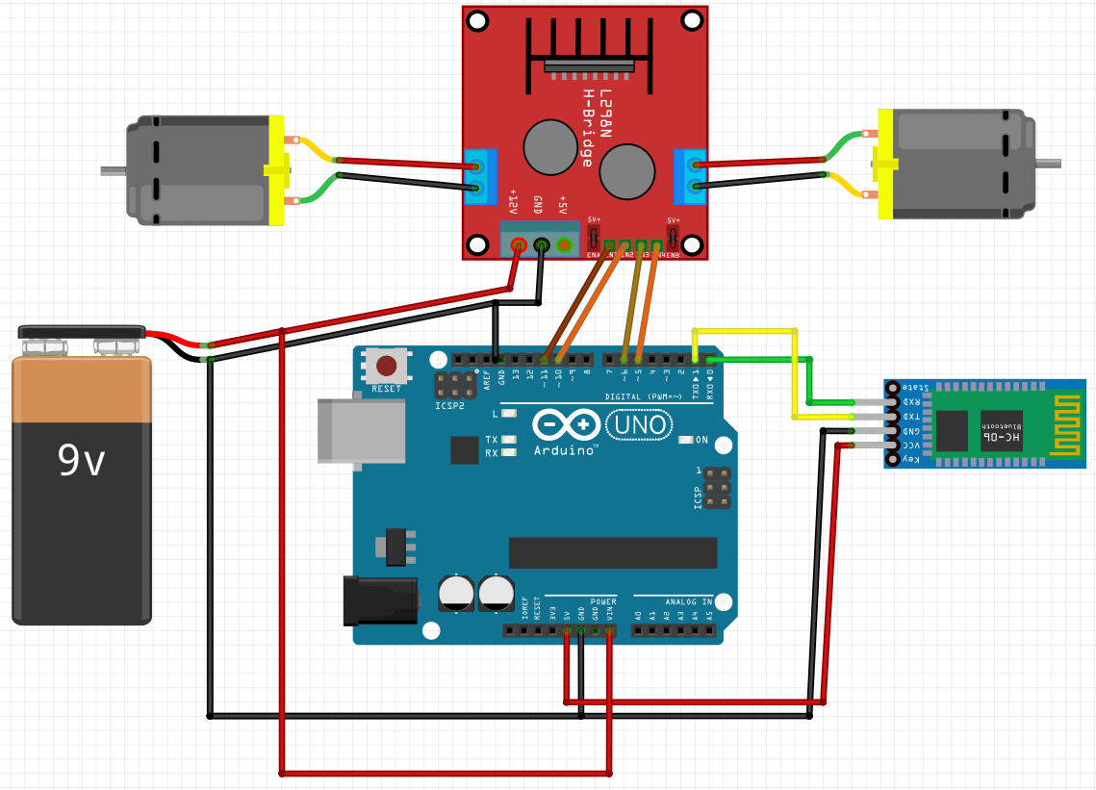
procedure
Arduino Board Diagram showing the connections
Notes:
(Ahmet)

Slide 6
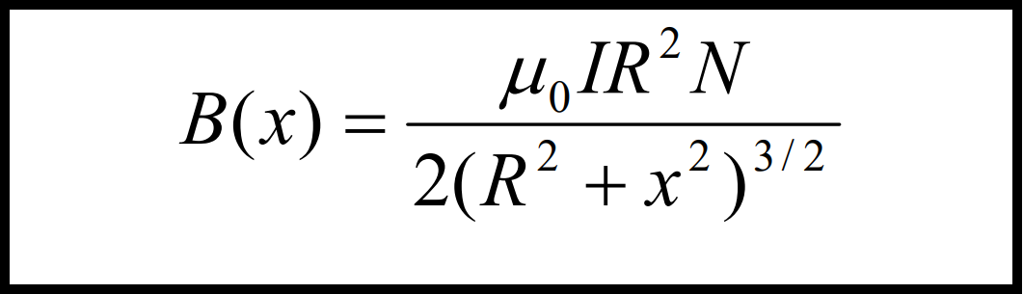
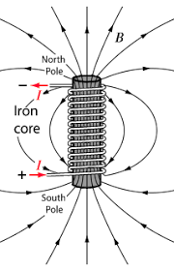
procedure
Here,
N : Number of turns of the coil,
R : The radius of the coil,
I : The magnitude of the electric current passing through the coil,
x: Distance from the center of the coil on the axis of symmetry,
❍ 0
: Magnetic field constant.
Notes:
(Serhat)
As all of you can see, this is the electromagnet formula.
Electromagnets and normal magnets have 2 poles (north and south).
Between these 2 poles, there are magnetic fields.
These fields are stronger in the center but as they go out they get weaker.
Magnetic fields strenght increases or decreases according to the electric current input.
After the presentation, each team will be given a small example to work with.
This will help to see how magnetic fields work.

Slide 7
procedure
Build the car’s chassis
Attach the wheels to the car
Mount the arduino board & motor board to the chassis using 4 screws (Use 2 screws per PC board at opposite ends)
Attach the electromagnet to the chassis
Attach a power switch to the chassis (turns off/on the electromagnet)
Attach the remote control connections to the arduino board
Notes:
Once the building of the car is finished, we can proceed with the testing and filming.
(Serhat)

Slide 8
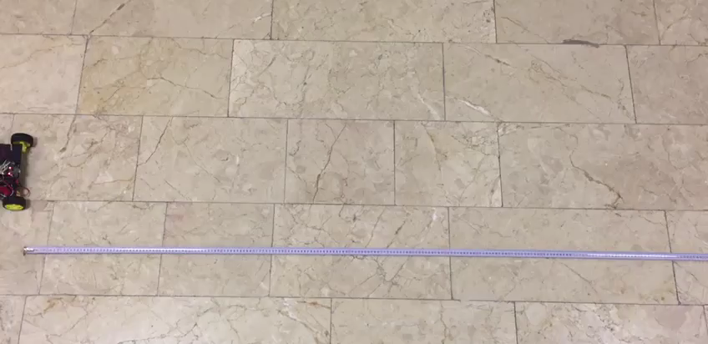
Notes:
Now we can watch the video
(Gizem)

Slide 9
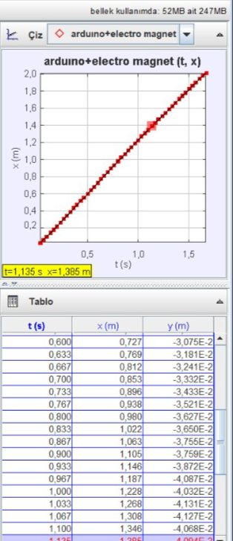
Data Analysis
Notes:
After the data analysis was completed, it showed that the electromagnet had no negative effect on the speed of the car.
If the weight of the car changes, the ground changes, the energy supplyied changes, then the tracker results may change.
(Gülçin)

Slide 10
will the electromagnet be able to attract the car
Concepts
Materials
Opposite poles attract each other.
Same poles repel each other. (Natural made or electrically made)
Cardboard
Glue
Electromagnet
Battery
Remote Control
Engine
Arduino Board
Camera
Computer
Tracker
?
Principals
And laws
YES.
Conclusion
Gauss’s Law for Magnetism: Magnets exist as dipoles (2 poles). A North Pole always comes with a South Pole. There are Permanent magnetism versus Electromagnetism using electricity to create a magnet that can be turned On/Off.
YES, It can. By using Gauss’s Law for magnetism: Electromagnets can be use with different electricity voltages to help control the strength of attraction for a metal object. Also, electromagnets with same poles can be used to create a repelling force.
Procedure
Electromagnets consist of wires wound on an iron rod. When the electric magnet is energized, metal close to the electromagnet will attract the objects in our experiment. Our goal was to see
whether the electromagnet can attract the car, and then be able to pull the car with an Arduino controlled device.
Notes:
Here we have a small summary of the project’s process.
As for the question ‘Will the electromagnet be able to attract the car?’ the answer is YES because when the electromagnet is powered, a magnetic field is created and attracts the metal object.
(Toprak)

Slide 11
Conclusions
Electromagnets can be use with different electricity voltages to help control the strength of attraction for a metal object.
Also, electromagnets with same poles can be used to create a repelling force.
Notes:
Now we have reached our project’s conclusion.
(Read the Conclusion)
(Toprak)

Slide 12
THANK YOU FOR LISTENING
Notes:
And now we have come to the end of this experiment presentation.
We hope that you have gained some knowledge about how magnets work ın our daily lives. We have time to repeat the experiment together with our international teams.
Thank you. ☺

