Slide 1
Autism Spectrum Disorder Detection
BBM469 Data Intensive Applications Laboratory
Data Science Capstone Project
Ali Baran Tasdemir – Ahmet Kasim Toptas

Slide 2
Introduction
Autism Spectrum Disorder (ASD) is a complex neurodevelopmental disorder that impacts how a person socializes with others, causing problems in social interaction and communication.
There is any cure for ASD. But early and intensive treatment can make a big difference in the lives of many adults and children.
Almost half of the children who are diagnosed early and received special education for controlling their behavior make decent developmental progress.
The main problem is that there is no medical test for diagnosing autism. Diagnosis made by specialized doctors with interviews, observations, developmental testing, and analyzing the history of the patient. So diagnosing autism is a time consuming and expensive process.
The most used technique for the interviewing process is the "AQ-10" test. The AQ-10 test has 10 questions for different age groups of patients. This test tries to detect some stereotyped behaviors and symptoms for ASD patients.

Slide 3
Problem

Slide 4
The main problems with the diagnosis of the ASD are time and cost. The specialist doctor tries to examine patients' background and applies some sort of tests to the patient. And the time to diagnose a patient is time consuming.
Early diagnosed patients are more likely to be adapt rest of the world with social relations, etc. So diagnosing early is crucial. Also diagnosing phase needs a specialized doctor. In the era of the computers and AI, we think this problem as a machine learning and data science problem. And we are asking ourselves "Can we diagnose ASD for a patient?".

Slide 5
Data Understanding

Slide 6
We used a dataset gathered via an application named ASDTests developed by Fadi Thabtah. In the dataset we have 10 answers given to AQ-Test questions, and some personal information about the test taker.

Slide 7
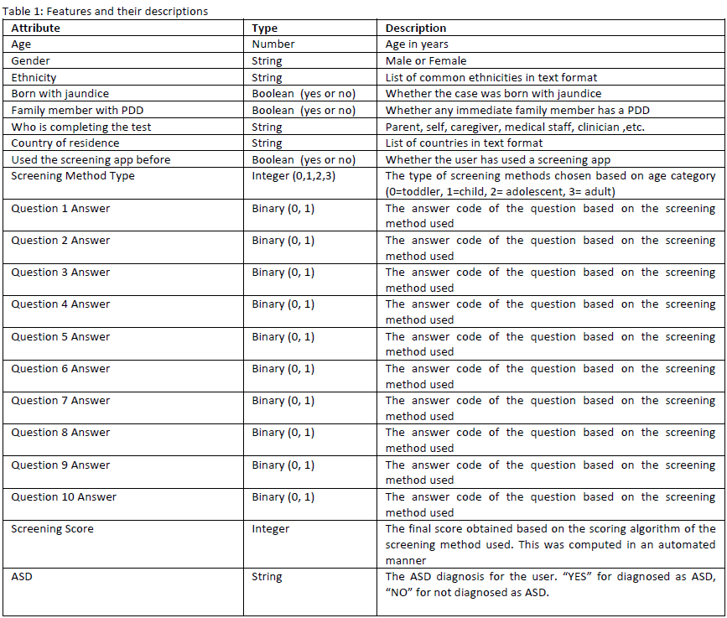

Slide 8
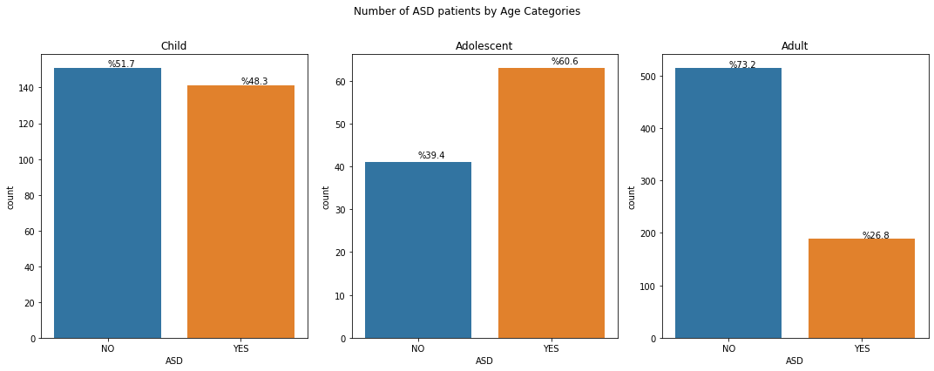
The dataset we use is a combination of 3 different datasets; Child, Adolescent, and Adult. The test takers with different ages has different numbers of ASD labeled, and not ASD labeled samples. But the other thing to notice here, there are more Adult samples than the summation of Child and Adolescent samples.

Slide 9
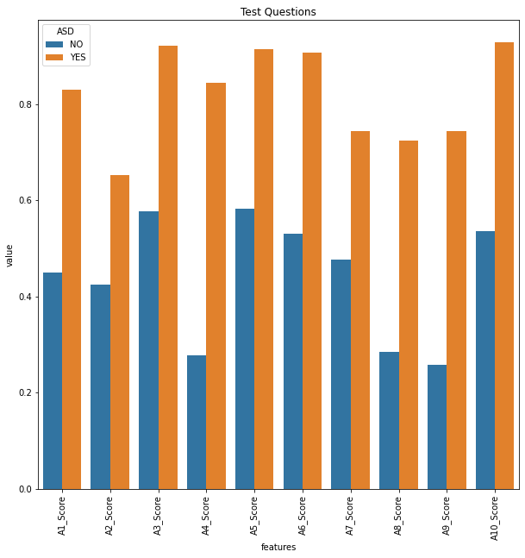
In the graph here, we have shown the average responses for test takers.
The one observation here is that some questions answered almost average 1 for all ASD labeled test takers. These questions are Q3, 5, 6 and 10. This questions has very high averages for ASD labeled test takers.
The other observation is the opposite of the first one. Some questions are answered by not ASD test takers has very low averages. For example, Q4, 8 and 9.

Slide 10
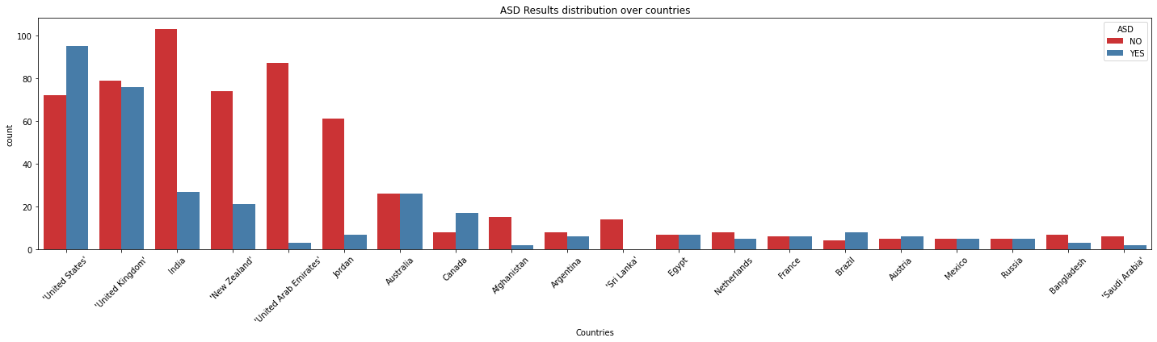
In this graph, we see the distribution of the test takers by their country. We have high participation from USA, UK, India, New Zealand, UAE, and Jordan. But the data from India, New Zealand, UAE and Jordan are imbalanced. There are much more sample with “No ASD” label than “ASD” label.

Slide 11
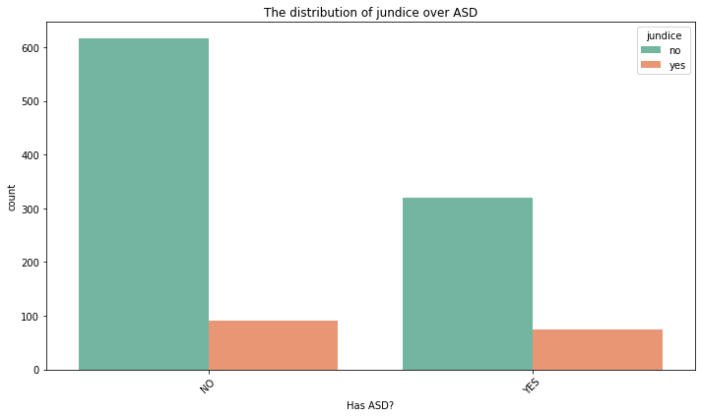
There are some medical history data in the dataset. And this data can be important for detection. For example, in this graph we see that the relation between the jaundice condition of the test takers and ASD label.
The orange bars shows jaundice positive test takers’ ASD label. We can see that, these two bars are almost at the same level.
By looking at this graph, we can say that jaundice background is not a very valuable information for ASD detection.

Slide 12
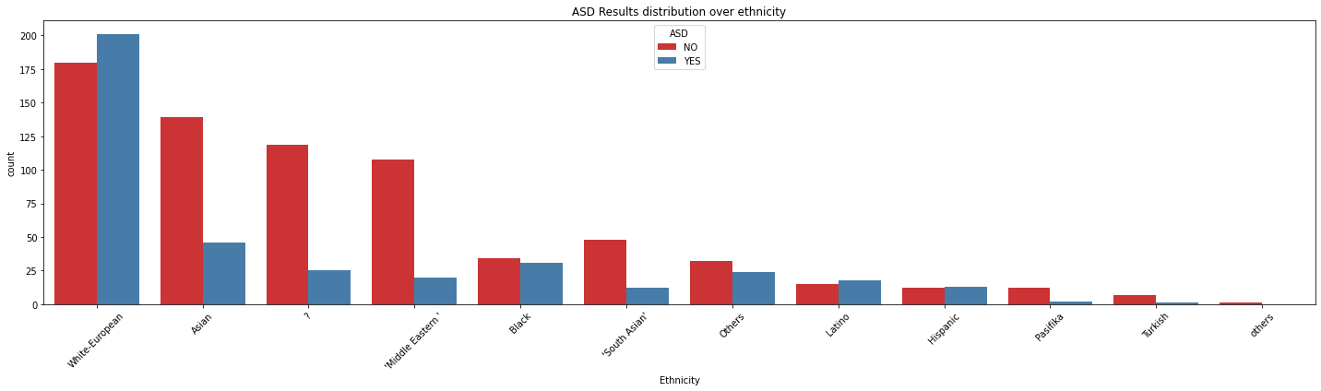
In this graph, we see the ASD distribution over ethnicity label. As we can predict the majority of the data is “White-European”. But one other important observation here, at the 3rd value (labeled as ‘?’) is null values. So we have lots of missing data in this column.

Slide 13
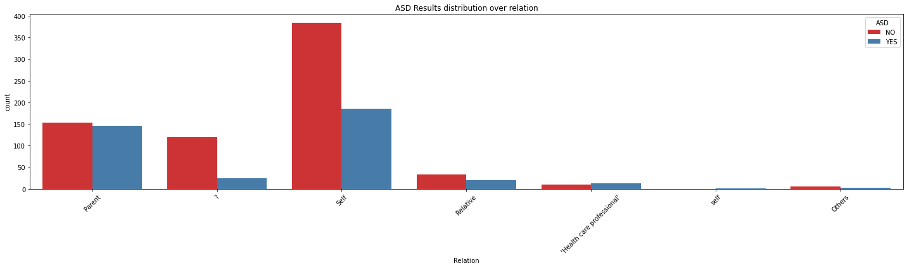
One other important feature is relation. This feature means, who responds the questions. This feature is important because in graph self-answering test takers has more “Not ASD” labels. But the questions answered by health care professional of the patient is more likely to be labeled as “ASD”.

Slide 14
Data Preparation

Slide 15
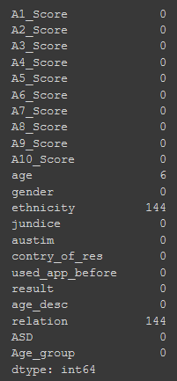
Data Preparation for our dataset has some steps. Firstly, we will check the null or missing values and handle them. After that, we will handle the categorical values and data type issues (i.e.., integers represented as strings in the dataset) and finally we will inspect features and we will choose some strategies for using them more effective.
First of all we examine the null(missing) values in the features :
There are 6 missing in age, 144 missing in relation and ethnicity features.
So we will start working on these columns first to determine the strategy for handling missing data.

Slide 16
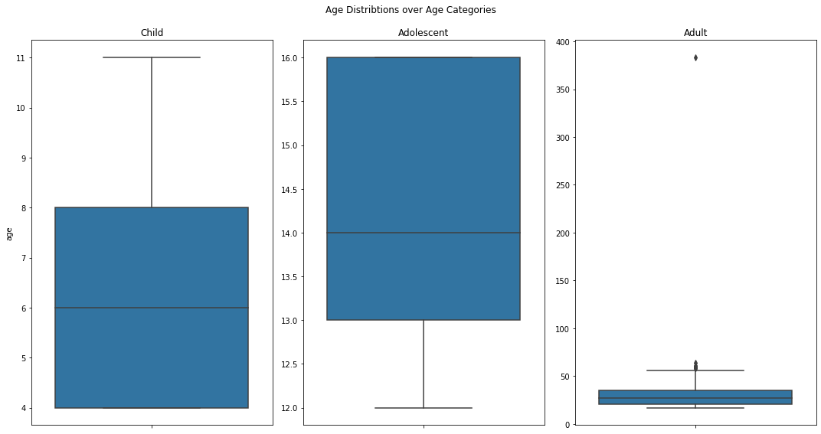
When we look closely to age data we can see another problem here. In the adult data there are an extreme value near 400. It may cause the inaccurate results later or wrong replacements for missing data by shifting mean or etc.
So we remove the extreme value and replace all the missing values with the mean of the corresponding data sets' median age.

Slide 17
Also there are some badly labeled features in the dataset. For example, in the relation feature there are some features labeled as “self” and there are some labeled as “Self”. These two means same thing but represented as two different labels. So we merge this kind of labels.
Finally, we replace the ethnicity data with “White-European”. The reason for that is the big majority of the data is “White-European”. So a random missing data more likely to has “White-European” on the ethnicity column. And we replace missing relation data with “Others”.
The last phase of the data preparation is the converting categorical features to binarized form.

Slide 18
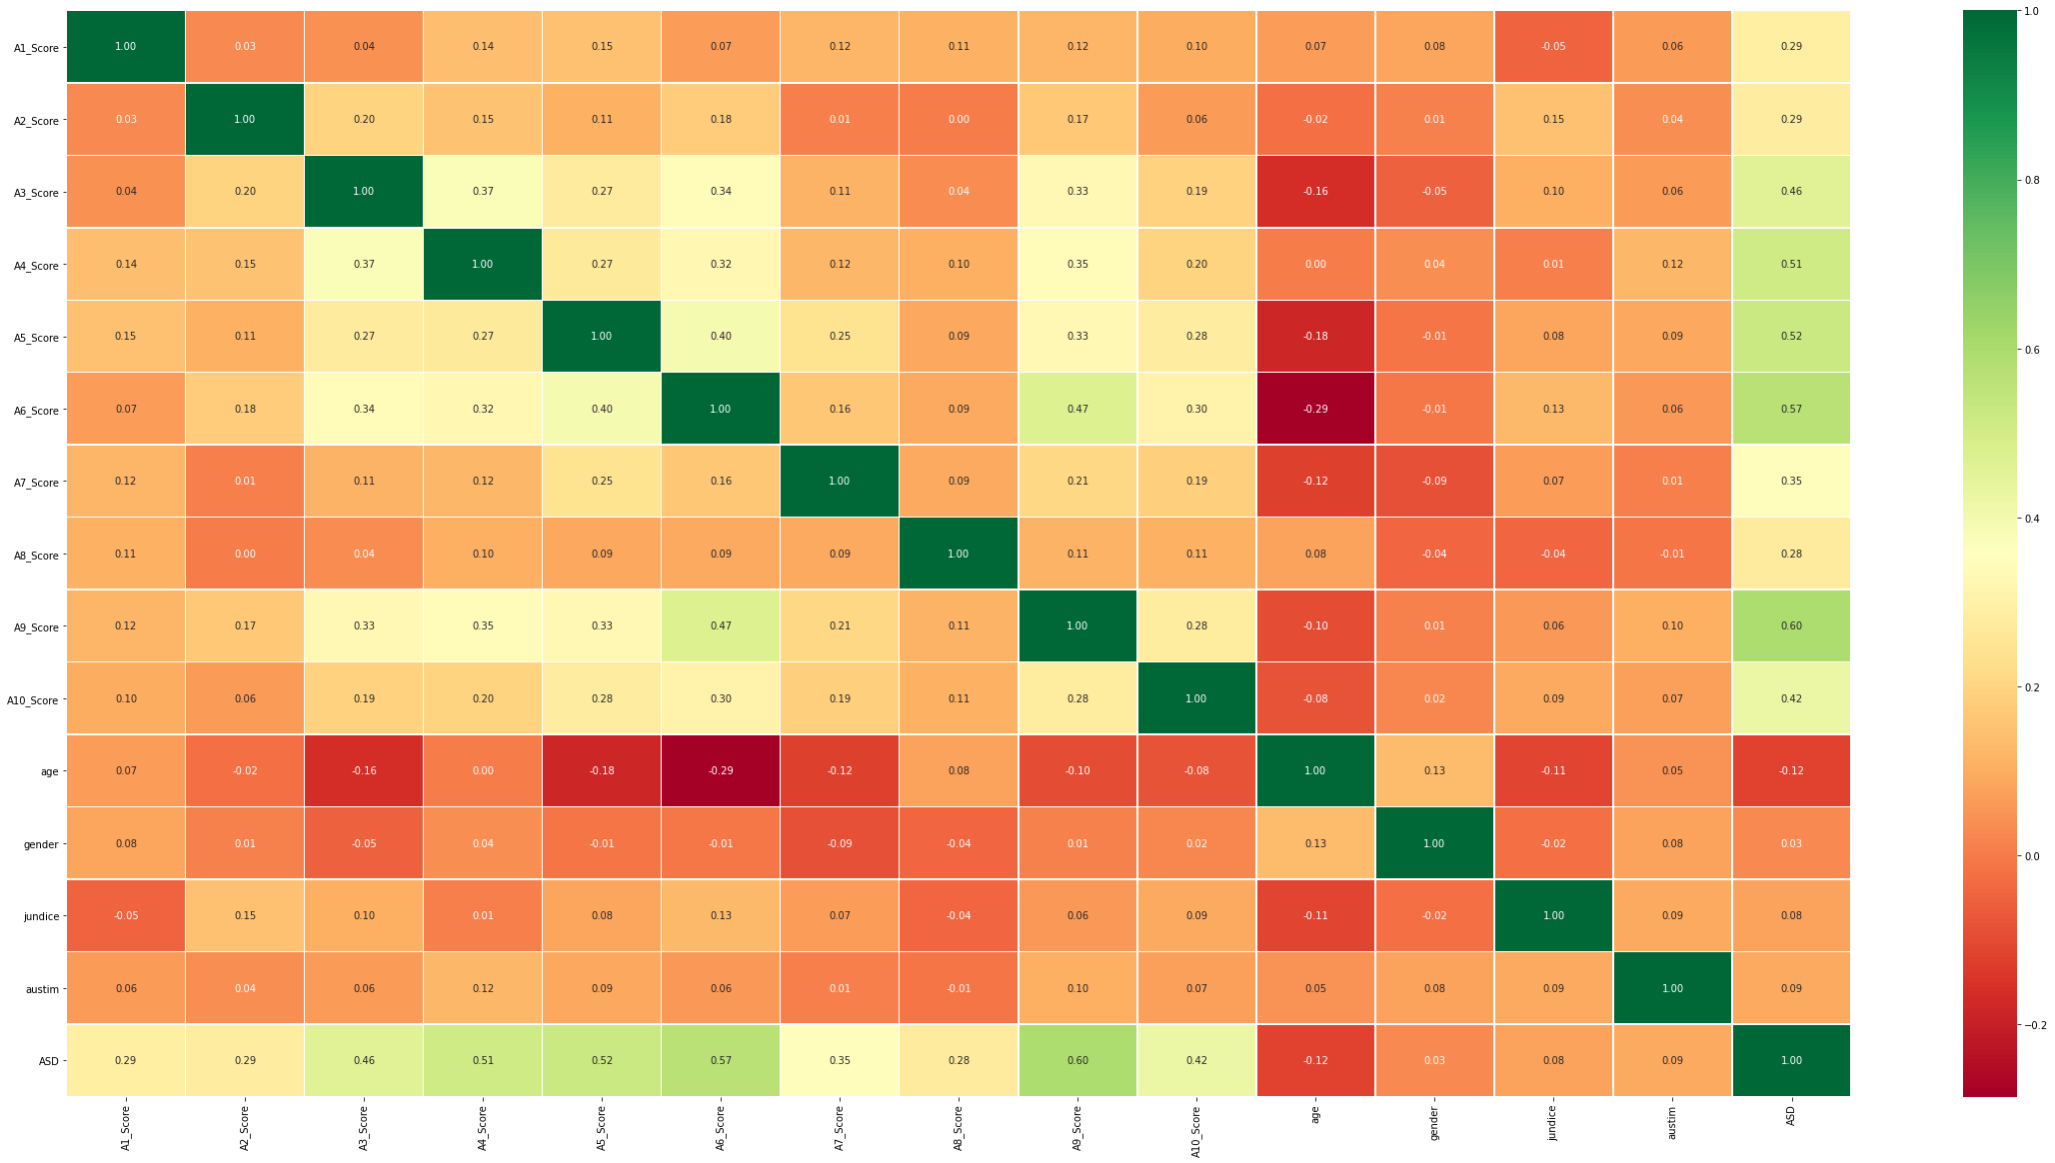
In the correlation matrix there is no strong positive or negative correlation which requires elimination. So our features are not strongly connected to each other. This is a good result for our feature processing phase. So in result, we don't need to delete any results.
ASD column is the target column. We can see how other features correlated with this column and can predict the importance on the classification model. For example in correlation map, questions has strong positive correlation with the target. Also we can see that jundice, gender and age columns are not strongly correlated. We had seen these relations in the data exploration by looking the distributions.

Slide 19
Modeling

Slide 20
We will use Random Forest Trees for this task.
Random Forest Trees algorithm is an ensemble learning method for both classification and regression problems. It separates the data and constructs multiple decision trees. The result is a combination of these decision trees.
The reason for choosing random forest trees is that, it is an ensemble method. Because of that the probability to face with overfitting problem is more unlikely. And also random forest trees can handle with data with high dimensions.
 | Precision | Recall | F1-Score
0 | 0.99 | 1.00 | 0.99
1 | 1.00 | 0.98 | 0.99
Accuracy |  |  | 0.99
Macro Avg. | 0.99 | 0.99 | 0.99
Weighted Avg. | 0.99 | 0.99 | 0.99
We used random forest trees for this task. And trained this model with the training dataset. To choose the best resulting parameters we used Grid Search with 5-fold cross validation. 5-fold cross validation is a validation method that splits the data into 5 equal pieces and for every piece uses them as test data and the other for as training data. And grid search is a brute force method to test the model for every given parameter to find the best resulting one.

Slide 21
Evaluation

Slide 22
The training score for our model is 99.32%. The best parameters chosen by Grid Search:
'class_weight': None, 'criterion': 'entropy', 'max_features': 0.2, 'n_estimators': 100
To see the real performance of our model we need to test it with unseen test data. After data preparation phase we split our dataset to train and test. The 80% of the data is train and the remaining is test data. We used training data for training the model.
The result of the testing is %93.60 accuracy.
 | Precision | Recall | F1-Score
0 | 0.93 | 0.98 | 0.95
1 | 0.95 | 0.85 | 0.90
Accuracy |  |  | 0.94
Macro Avg. | 0.94 | 0.92 | 0.93
Weighted Avg. | 0.94 | 0.94 | 0.94

Slide 23
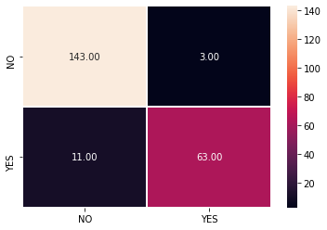
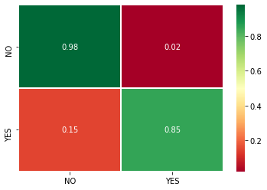
As we see in the resulting graphs and tables the resulting predictions was pretty high. At the final, our predictor reached 93.6% accuracy rate.
As we mention at the beginning of the project, our main goal was to train a model that can "help" to the real specialized doctors before or after the interview process. So in a limited time, instead of face-to-face interviews, doctors can apply an online test and call for face-to-face interviews for positive cases by looking at the online results.

Slide 24
References
Data Sources
Data gathered from:
[1] Tabtah, F. (2017). Autism Spectrum Disorder Screening: Machine Learning Adaptation and DSM-5 Fulfillment. Proceedings of the 1st International Conference on Medical and Health Informatics 2017, pp.1-6. Taichung City, Taiwan, ACM.
[2] Thabtah, F. (2017). ASDTests. A mobile app for ASD screening. www.asdtests.com [accessed May 25th, 2020].
[3] Thabtah, F. (2017). Machine Learning in Autistic Spectrum Disorder Behavioural Research: A Review. Informatics for Health and Social Care Journal. December, 2017 (in press)
Data links:
Adolescent Data - Children - Adult
To download datasets and notebook: Github

