Slide 1




CS Bridge, Lecture 11 Lists

Slide 2
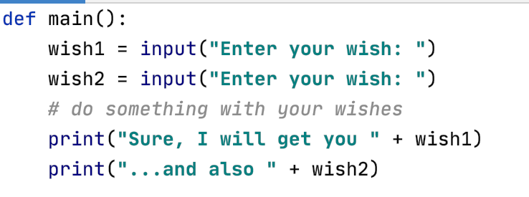
Wish List
Consider this very kind program that asks for wishes

Slide 3
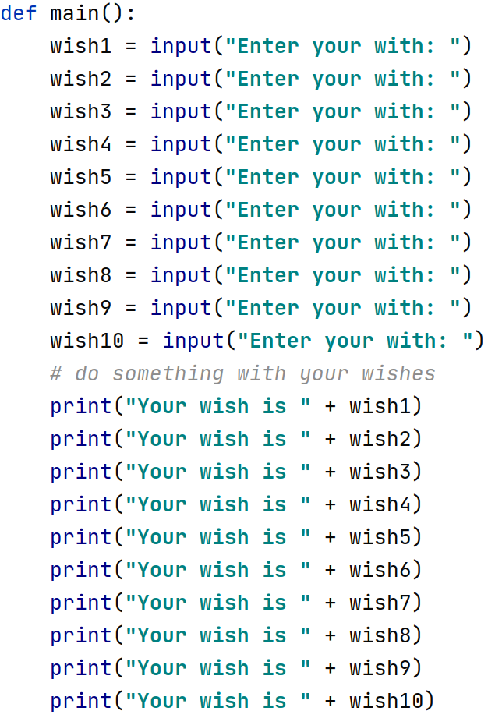
Wish List
What if the user has many wishes?
Then we would keep a wish list
wishlist10.py

Slide 4
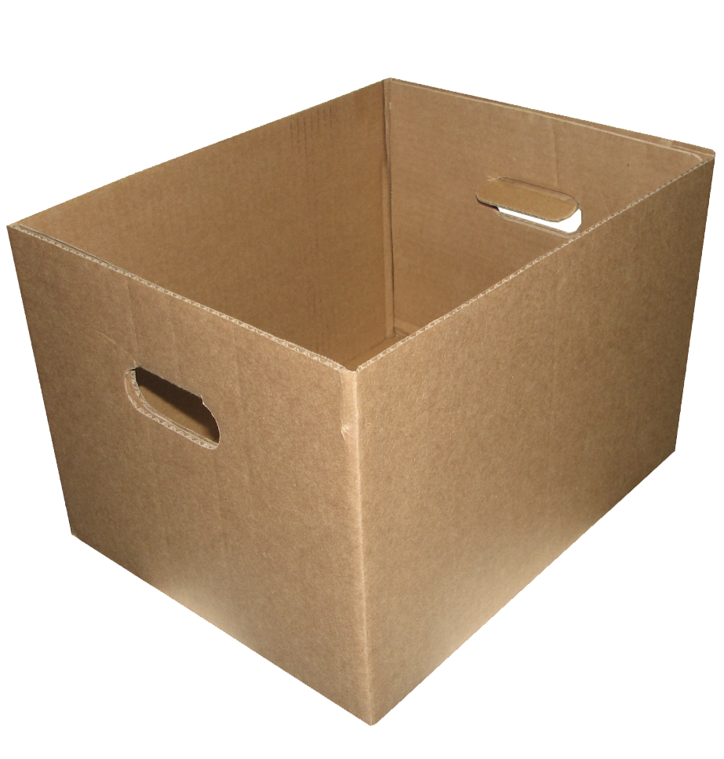
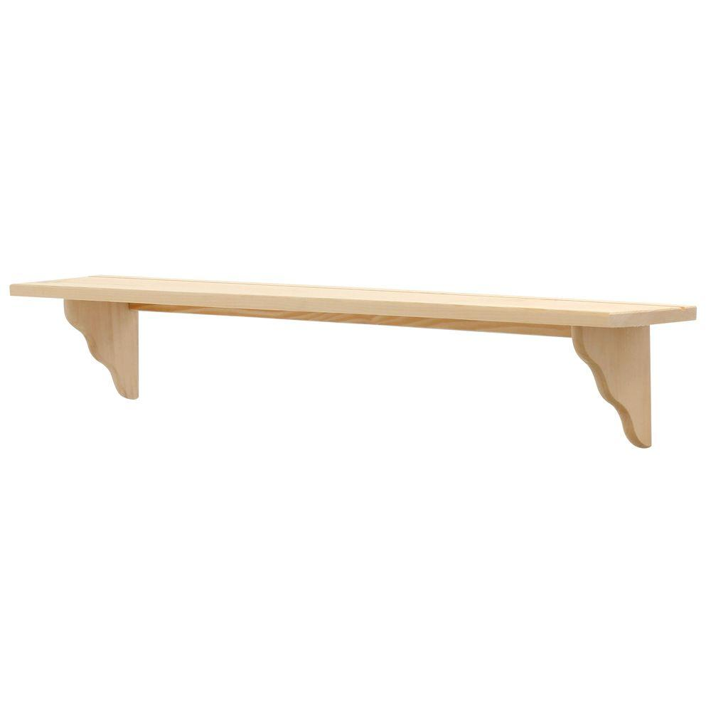
Lists
A list is way to keep track of an ordered collection of items
0
1
2
3
4
5
6

Slide 5
Lists
The list dynamically adjusts its size as elements are added or removed
0
1
2
3

Slide 6
Lists
You can create them using [], empty or containing elements separated by comma
fruits_list = []

Slide 7
Lists
You can create them using [], empty or containing elements separated by comma
fruits_list = []
fruits_list.append(“Apple”)
“Apple”
0

Slide 8
Lists
You can create them using [], empty or containing elements separated by comma
…
fruits_list.append(“Banana”)
“Apple” “Banana”
0
1

Slide 9
Lists
You can create them using [], empty or containing elements separated by comma
fruits_list = [“Apple”, “Banana”]
“Apple” “Banana”
0
1

Slide 10
Lists
Items in the list are called "elements"
0
1
2
3
4
5
6

Slide 11
Lists
Ordered: can refer to elements by their position
0
1
2
3
4
5
6
fruits_list[0]
is like an individual variable

Slide 12
Lists
You can access and use the value and/or modify the value
0
1
2
3
4
5
6
fruits_list[0] = “Banana”

Slide 13
Lists
You can access and use the value and/or modify the value
0
1
2
3
4
5
6
fruits_list[2] = “Banana”

Slide 14
Intro to Lists
# A list of strings
some_str_list = ["Elma", "Armut"] # initialising the list with two elements
some_str_list.append("Kel Mahmut") # adding new element to the list
print(some_str_list)
# A list of integers
int_list = [10, 20, 30, 40, 50, 60]
Outputs:
An element
['Elma', 'Armut', 'Kel Mahmut']
10
20
30
40
50
60
# A list containing different types of data
mixed_list = [2, True, "Hi", 6.8]
print(mixed_list)
Indices:
0
1
2
3
4
5
Negative Indices:
-6
-5
-4
-3
-2
-1
Outputs:
[2, True, 'Hi', 6.8]
int_list[2]
int_list[-1]
lists_intro.py

Slide 15
Cycling through elements of a list
It is often practical to create indices using a for loop, use the loop variable as the index and access elements in order
# A list of integers
int_list = [10, 20, 30, 40, 50, 60]
for i in range(len(int_list)):
print(int_list[i])
elements
10
20
30
40
50
60
Outputs:
Indices:
0
1
2
3
4
5
10
20
30
40
50
60
lists_intro.py

Slide 16
Cycling through elements of a list
# Creating an empty list and appending random integer values
random_ints_list = []
for i in range(10):
random_ints_list.append(random.randint(0, 9))
print(random_ints_list)
Outputs: (a different set of values in each run)
[6, 2, 8, 7, 9, 8, 8, 7, 9, 0]
# Accessing values of a list and modifying them
for i in range(len(random_ints_list)):
random_ints_list[i] *= 10
print(random_ints_list)
Outputs:
[60, 20, 80, 70, 90, 80, 80, 70, 90, 0]
lists_intro.py

Slide 17
Wish List
Write a program that asks for wishes from a user. The program should continue receiving new wishes until the user clicks enter without typing a character. Then the program should inform the user that some of her wishes will be fulfilled.
Example run:
Enter your wish: icecream
Enter your wish: wings
Enter your wish: hotdog
Enter your wish: water
Enter your wish: coffee
Enter your wish: rocket
Enter your wish:
I'll get you icecream, no worries
Sorry, I cannot get you wings
I'll get you hotdog, no worries
I'll get you water, no worries
I'll get you coffee, no worries
I'll get you rocket, no worries
wishlist.py

Slide 18
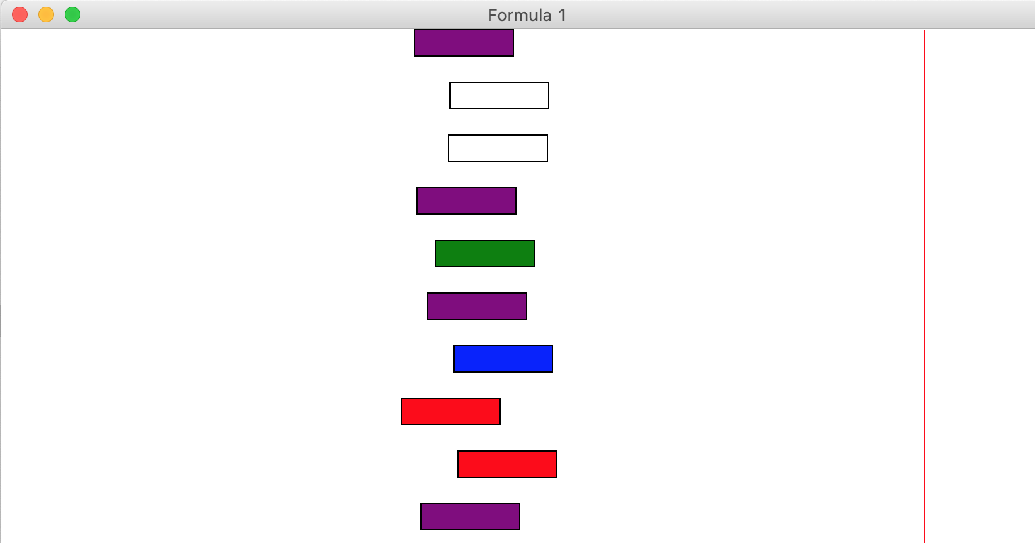
List of graphical objects
Sometimes you need to create many graphical objects and move them
cars[0]
cars = []
rect1 = canvas.create_rectangle(x1,y1,x2,y2)
cars.append(rect1)
cars[1]
cars[2]
rect2 = canvas.create_rectangle(x3,y3,x4,y4)
cars.append(rect2)
cars[3]
cars[4]
cars[5]
As usual, we will prefer a for loop to add many new elements
cars[6]
cars[7]
for i in range(10):
cars.append(………..)
cars[8]
cars[9]

Slide 19
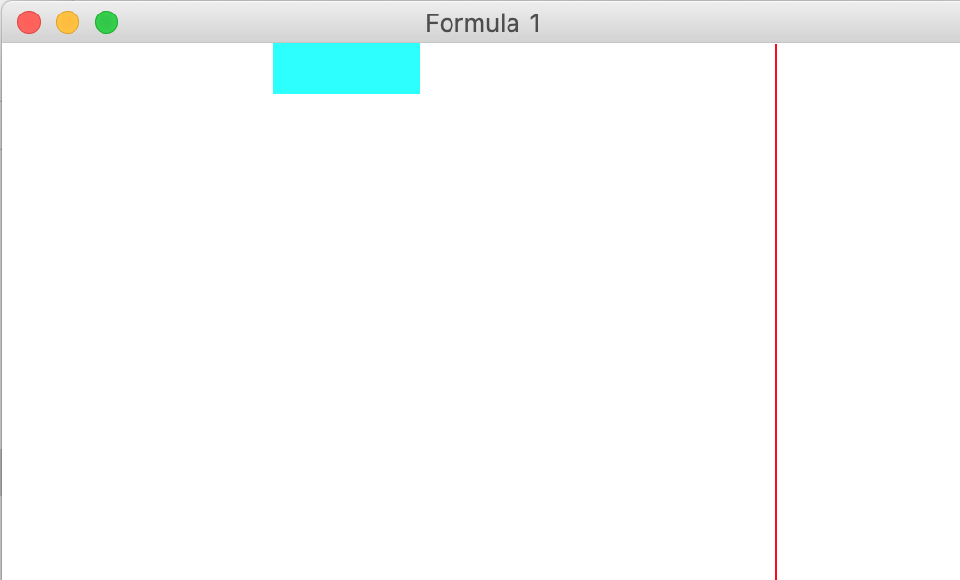
Time to implement ‘Car Race’ using the starter code
car_race_starter.py

