Slide 1




CS Bridge, Lecture 9 Graphics and Nested Loops

Slide 2
Creating Graphical Objects
Recap

Slide 3
Operations on Graphical Objects
Recap

Slide 4
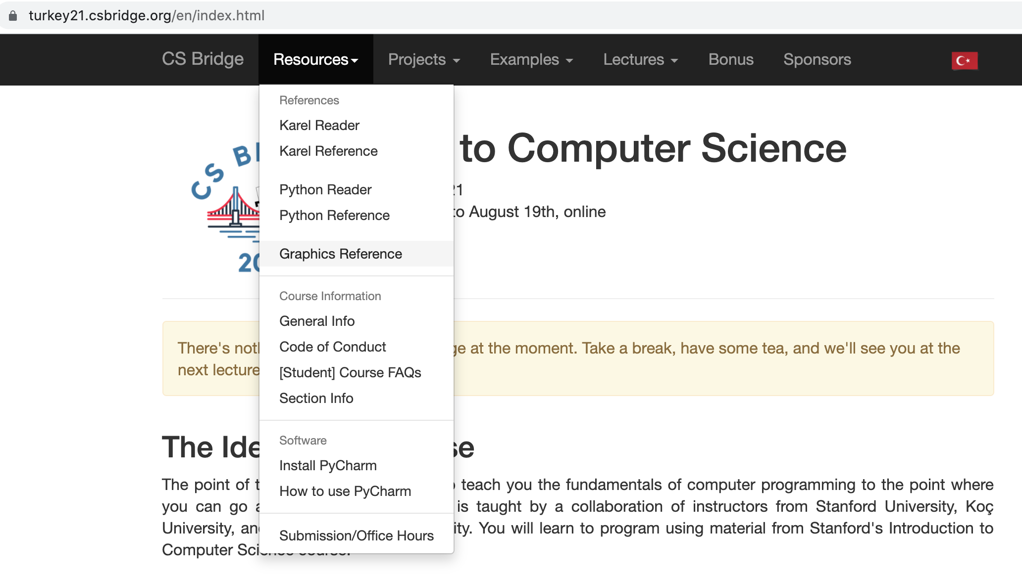
Creating Graphical Objects
Recap

Slide 5

Drawing with Loops
Goal for today: draw checker board
64 squares

Slide 6
Drawing with Loops
Loop variable is used to control location
Both circle_x and circle_y
Recap

Slide 7
Drawing with Loops
Decomposition
draw_column()

Slide 8
Drawing with Loops
Decomposition
draw_row()
…

Slide 9
Drawing with Loops
Decomposition
draw_square()
draw_row()
What should be the parameters of each of these functions?
(Assume constant square size)
Is black or not
draw_row(??)
x0, y0
Number of squares/columns
draw_square(??)
x, y
Is black or not

Slide 10
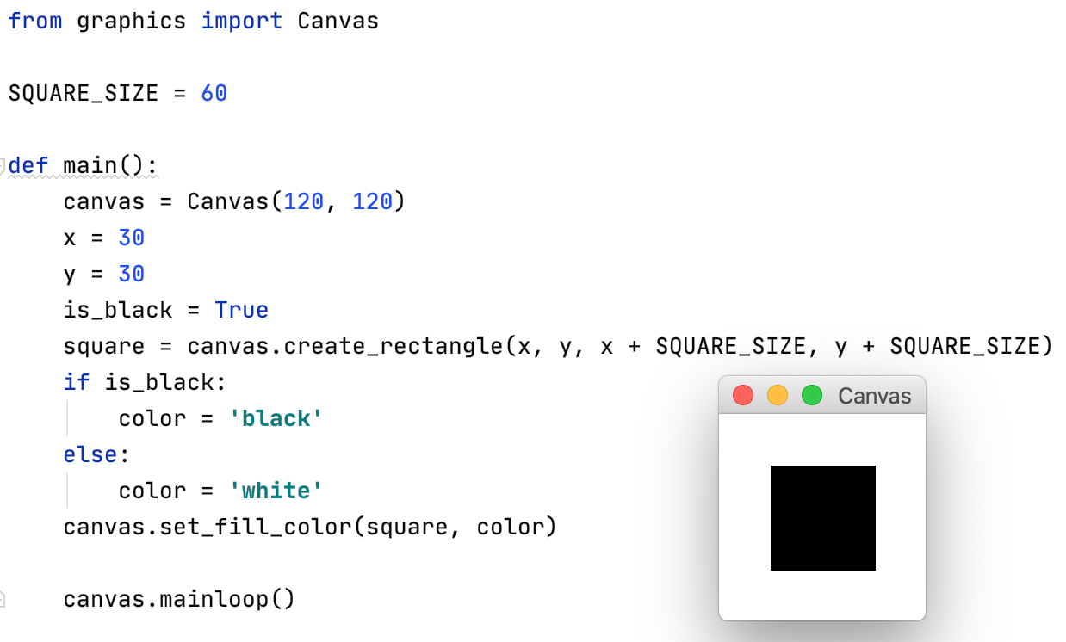
Draw square without using a function
x, y
Is black or not
As the next step, let’s implement a draw_square() function
and call it
drawSquare_noFunc.py

Slide 11
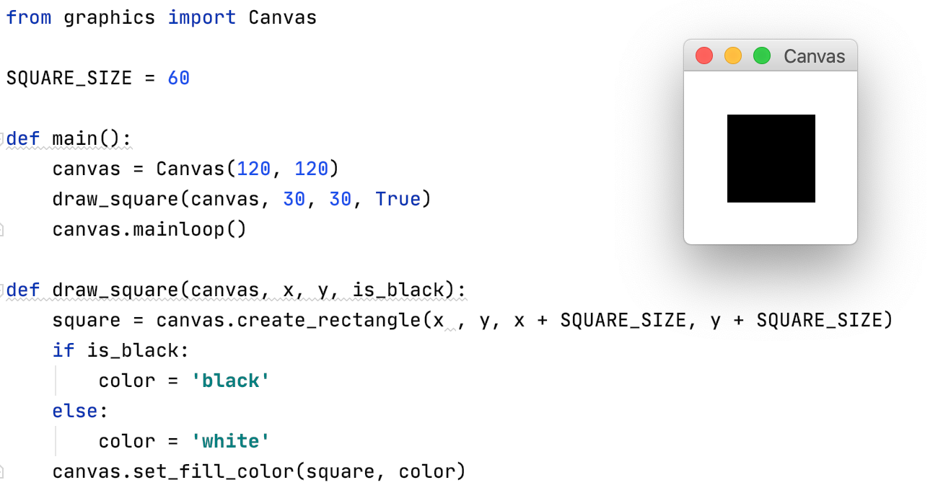
Draw square via defining and calling a function
Calling the function
x, y
Is black or not
drawSquare.py

Slide 12
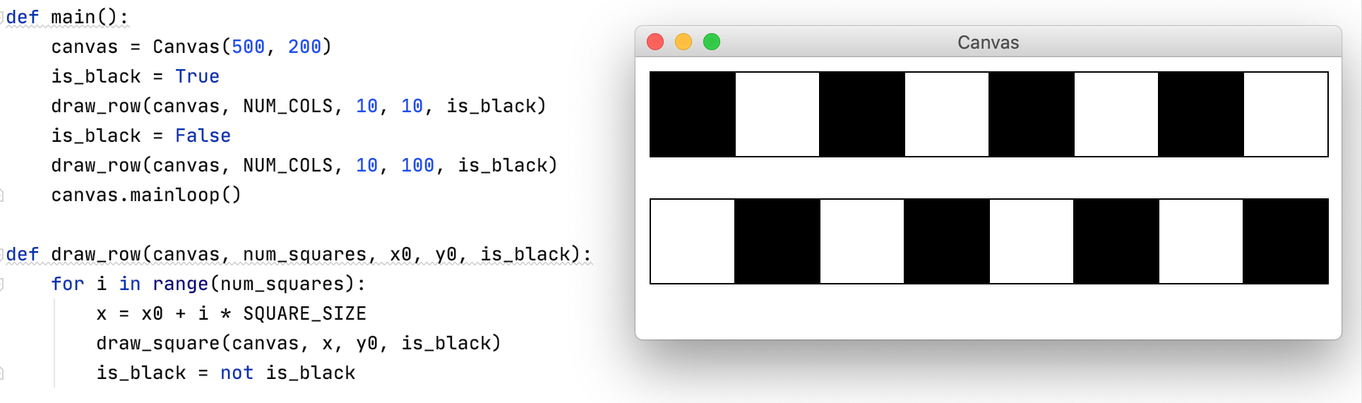
Implement draw_row() that calls the draw_square() function
Is black or not
x0, y0
Number of squares/columns
NUM_COLS = 8
drawRow.py

Slide 13
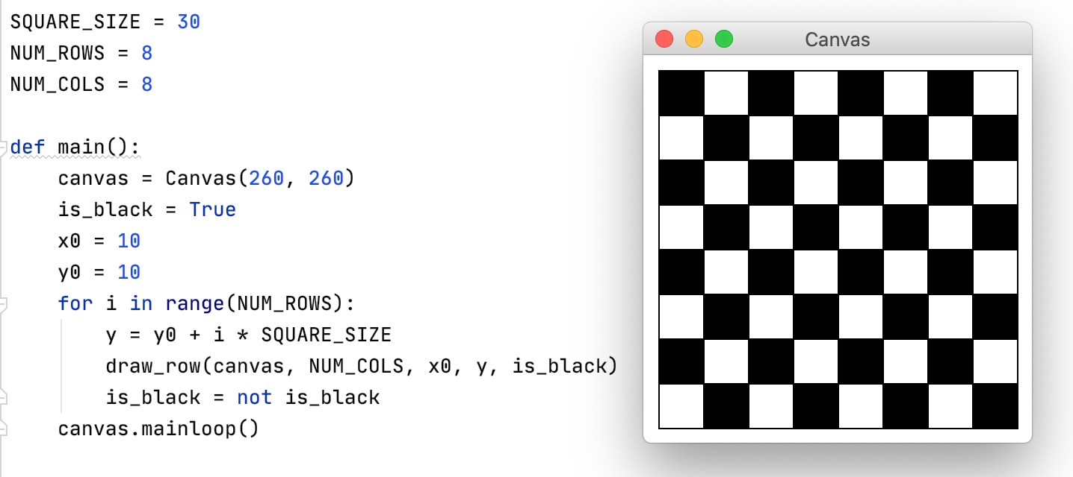
Draw checker board calling draw_row()
checkerboard_viaRows.py

Slide 14
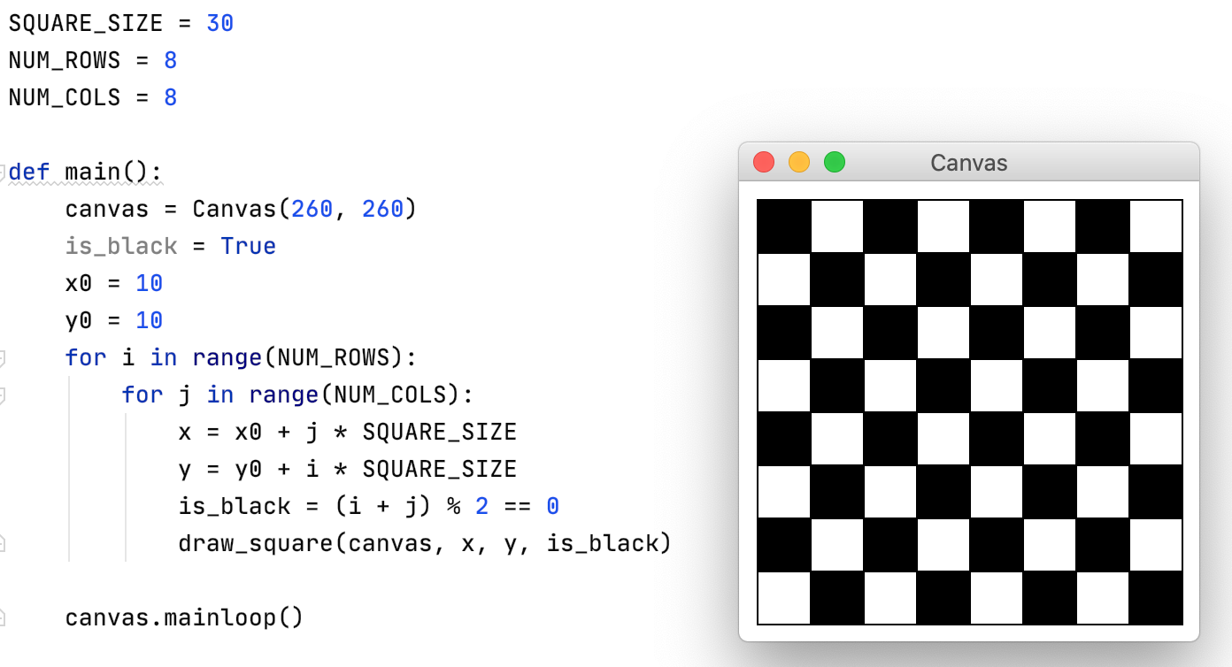
Drawing checker board using nested loops
x, y
Is black or not
checkerboard_nestedLoops.py

Slide 15
Drawing checker board using nested loops
SQUARE_SIZE = 30
i = 0

Slide 16
Drawing checker board using nested loops
SQUARE_SIZE = 30
i = 0
j = 0

Slide 17
Drawing checker board using nested loops
SQUARE_SIZE = 30
i = 0
j = 0
x = 10

Slide 18
Drawing checker board using nested loops
SQUARE_SIZE = 30
i = 0
j = 0
x = 10
y = 10

Slide 19
Drawing checker board using nested loops
SQUARE_SIZE = 30
i = 0
j = 0
x = 10
y = 10
is_black = True

Slide 20
Drawing checker board using nested loops
SQUARE_SIZE = 30
i = 0
j = 0
x = 10
y = 10
is_black = True

Slide 21
Drawing checker board using nested loops
SQUARE_SIZE = 30
i = 0
j = 1

Slide 22
Drawing checker board using nested loops
SQUARE_SIZE = 30
i = 0
j = 1
x = 40

Slide 23
Drawing checker board using nested loops
SQUARE_SIZE = 30
i = 0
j = 1
x = 40
y = 10

Slide 24
Drawing checker board using nested loops
i = 0
j = 1
x = 40
y = 10
is_black = False

Slide 25
Drawing checker board using nested loops
i = 0
j = 1
x = 40
y = 10
is_black = False

Slide 26
Drawing checker board using nested loops
SQUARE_SIZE = 30
i = 0
j = 2

Slide 27
Drawing checker board using nested loops
SQUARE_SIZE = 30
i = 0
j = 2
x = 70

Slide 28
Drawing checker board using nested loops
SQUARE_SIZE = 30
i = 0
j = 2
x = 70
y = 10

Slide 29
Drawing checker board using nested loops
i = 0
j = 2
x = 70
y = 10
is_black = True

Slide 30
Drawing checker board using nested loops
i = 0
j = 2
x = 70
y = 10
is_black = True

Slide 31
Many loops pass….

Slide 32
Drawing checker board using nested loops
SQUARE_SIZE = 30
i = 5
j = 2

Slide 33
Drawing checker board using nested loops
SQUARE_SIZE = 30
i = 5
j = 2
x = 70
y = 160

Slide 34
Drawing checker board using nested loops
i = 5
j = 2
x = 70
y = 160
is_black = False

Slide 35
Drawing checker board using nested loops
0
1
2
i = 5
j = 2
3
x = 70
4
y = 160
0
1
5,2
is_black = False

Slide 36
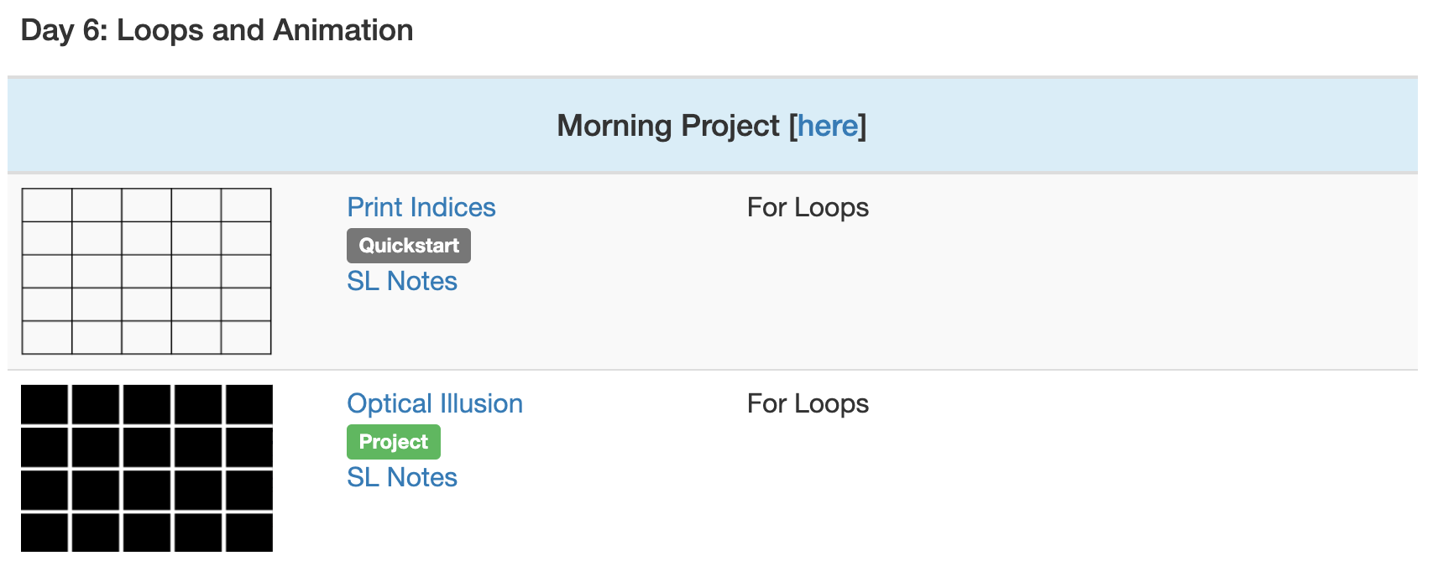
Rest of this morning

