Slide 1
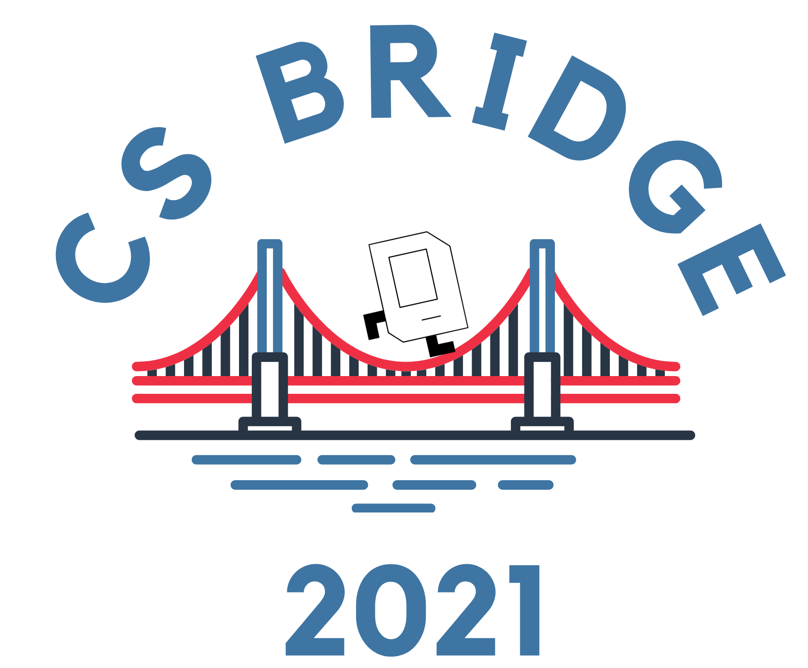



CS Bridge, Lecture 14 Breakout Extra

Slide 2
Plan for Today
“Sticky paddle”
Keyboard events

Slide 3
How is Breakout going so far?
Post in the chat or unmute yourself for questions or comments!

Slide 4
Plan for Today
“Sticky paddle”
Keyboard events

Slide 5
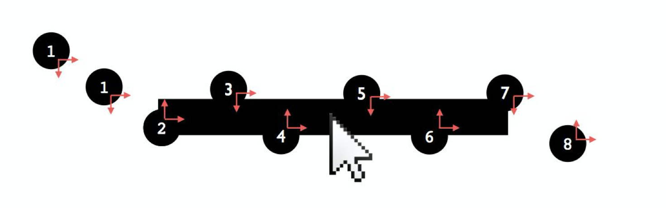
Sticky Paddle
Common Breakout bug: “sticky paddle” where ball sometimes gets stuck on the paddle.
To see it: try moving the paddle very quickly sideways into the ball so they overlap. Easier with larger paddle.

Slide 6
Demo: Sticky Paddle

Slide 7
Sticky Paddle
Common Breakout bug: “sticky paddle” where ball sometimes gets stuck on the paddle.
Hint: unlike for bricks, when bouncing off the paddle we always want the ball to then go up.

Slide 8
Plan for Today
“Sticky paddle”
Keyboard events

Slide 9
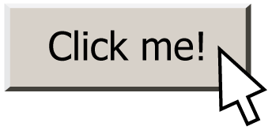
Responding To The Mouse
event: Some external stimulus that your program can respond to.

Slide 10
Events
Mouse clicking
Keyboard keys pressed
Etc.

Slide 11
Events
In our programs, we can ask the canvas if any events have occurred since the last time we asked.
If there are, then we do something.
If there are not, we do nothing and check again later.
while True:
# Handle any new keyboard events
# ...
canvas.update()

Slide 12
Mouse Clicks
At any time, we can ask the canvas for a list of mouse clicks that have happened since the last time we asked.
clicks = canvas.get_new_mouse_clicks()

Slide 13
Mouse Clicks
Each element in the list has an x and y coordinate of where that click happened.
clicks = canvas.get_new_mouse_clicks()
for click in clicks:
print(click.x, click.y)

Slide 14
Events
Pattern: we make a loop (like for animation), and each time through the loop we check for new mouse clicks, and act on them.
while True:
# Handle any new mouse clicks
# ...
canvas.update()

Slide 15
Example: Polka Dots
while True:
clicks = canvas.get_new_mouse_clicks()
# Add a circle each time the user clicks
for click in clicks:
circle = canvas.create_oval(click.x, click.y,
click.x + CIRCLE_SIZE,
click.y + CIRCLE_SIZE)
canvas.set_color(circle, 'blue')
canvas.update()

Slide 16
Example: Polka Dots
while True:
clicks = canvas.get_new_mouse_clicks()
# Add a circle each time the user clicks
for click in clicks:
circle = canvas.create_oval(click.x, click.y,
click.x + CIRCLE_SIZE,
click.y + CIRCLE_SIZE)
canvas.set_color(circle, 'blue')
canvas.update()

Slide 17
NEW: Key Presses
At any time, we can ask the canvas for a list of keyboard presses that have happened since the last time we asked.
presses = canvas.get_new_key_presses()

Slide 18
Key Presses
Each element in the list has a keysym which is the name of the key that was pressed.
presses = canvas.get_new_key_presses()
for press in presses:
print(press.keysym)

Slide 19
Mouse Clicks
Each element in the list has a keysym which is the name of the key that was pressed.
Letters are themselves (e.g. “a”, “b”, …), and can be uppercase if holding down Shift (e.g. “A”, “B”, …)
Arrow keys are “Left”, “Right”, “Up” and “Down”
Space is “space”
…etc.

Slide 20
Demo: keysym

Slide 21
Key Presses
Each element in the list has a keysym which is the name of the key that was pressed.
We can check its keysym to know what key was pressed.
presses = canvas.get_new_key_presses()
for press in presses:
if press.keysym == "a":
# user hit ‘a’ key
...

Slide 22
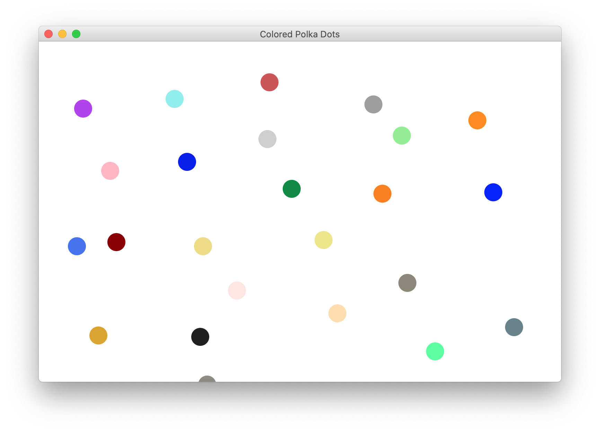
Colored Polka Dots
Challenge: let’s add to our polka dot program to randomize all the dot colors when the user hits the space bar.

Slide 23
Demo: Colored Polka Dots

Slide 24
Recap
“Sticky paddle”
Keyboard events
We hope you have fun working on Breakout! There are many pieces, so work step by step, and ask us for help!

