Slide 1




CS Bridge, Lecture 16 Dictionaries

Slide 2
Today’s questions
How can I organize my data so it’s easier to use?

Slide 3
How can I organize my data so it’s easier to use?

Slide 4
Think/Share:
Store names of habitat animals and their corresponding diet
Notes:
Active learning exercise callout

Slide 5
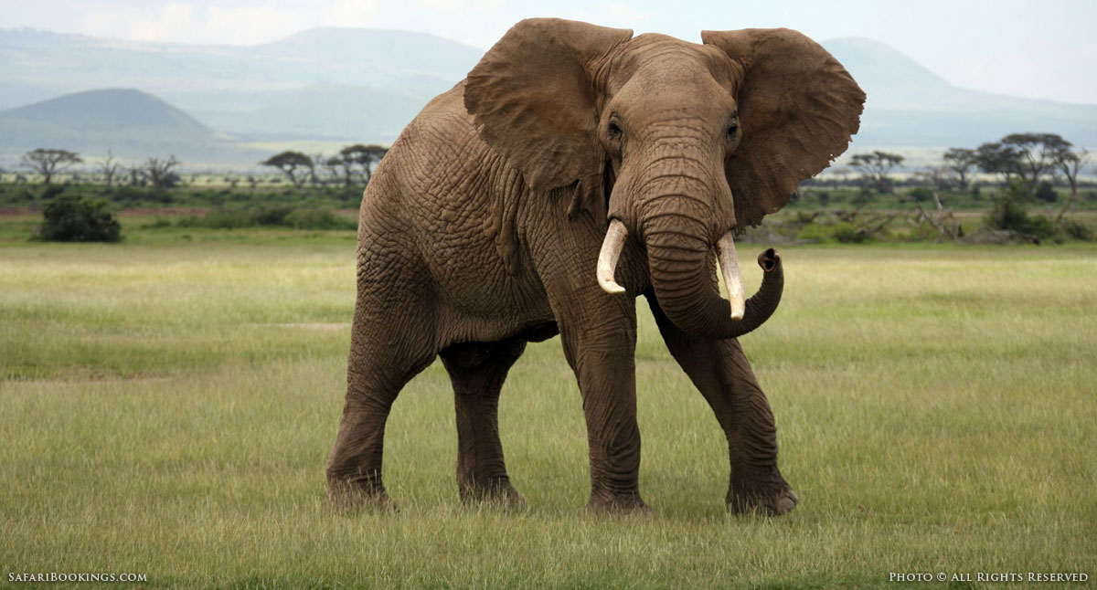
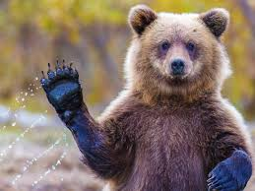
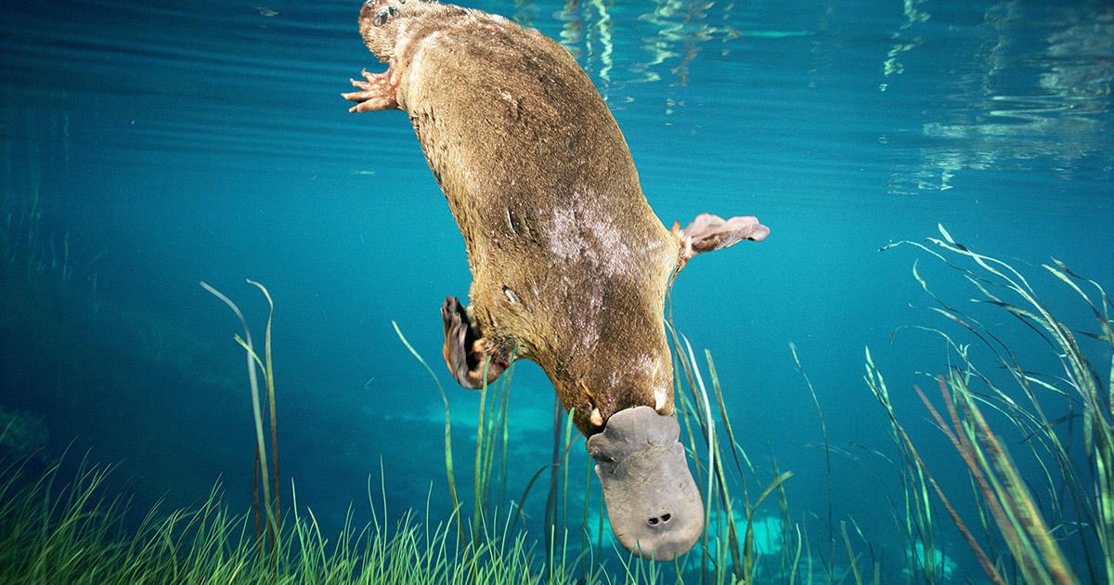
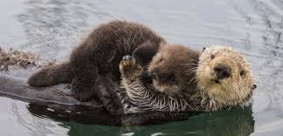
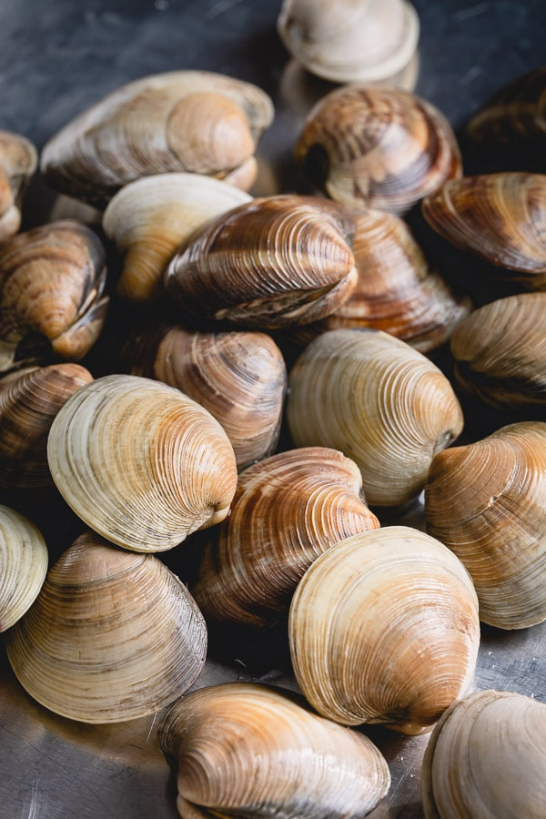
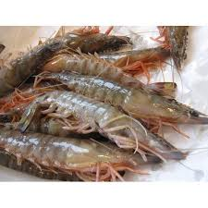
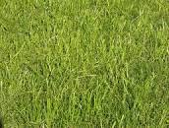
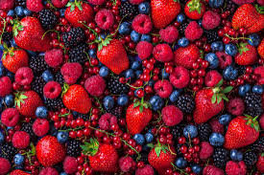
elephant bear otter platypus
clams grass shrimp berries
Notes:
Woodchuck tongue twister

Slide 6
Task - Relating data with each other
['elephant', ‘bear', ‘otter', ‘platypus']
['grass', ‘berries', ‘clams’, ‘shrimp']
Notes:
Woodchuck tongue twister

Slide 7

Task - Relating data with each other
['elephant', ‘bear', ‘otter', ‘platypus']
['grass', ‘berries', ‘clams’, ‘shrimp']
These pieces of information are linked!
Notes:
Woodchuck tongue twister

Slide 8
Task - Relating data with each other
['elephant', ‘bear', ‘otter', ‘platypus']
['grass', ‘berries', ‘clams’, ‘shrimp']
These pieces of information are linked!
Can we store them so they’re associated with each other?

Slide 9
Dictionaries!

Slide 10
Definition
Dictionary
A container data type that maps “keys” to their associated “values”.

Slide 11
Anatomy of a Dictionary
name_of_dic = {}
name_of_dic = {'elephant': 'grass', 'bear': ‘berries', 'otter': ‘clams’, 'platypus': ‘shrimp'}

Slide 12
Anatomy of a Dictionary
name_of_dic = {'elephant': 'grass', 'bear': ‘berries', 'otter': ‘clams’, 'platypus': ‘shrimp'}
This is a dictionary literal

Slide 13
Anatomy of a Dictionary
name_of_dic = {'elephant': 'grass', 'bear': ‘berries', 'otter': ‘clams’, 'platypus': ‘shrimp'}
It is easier to visualize it this way:
dict
keys
values
‘elephant'
‘bear'
‘otter'
‘platypus'
‘grass’
‘berries'
‘clams’
shrimp’

Slide 14
Anatomy of a Dictionary
dict
keys
values
‘elephant'
‘bear'
‘otter'
‘platypus'
‘grass’
‘berries'
‘clams'
‘shrimp’
Each key can store one value

Slide 15
Anatomy of a Dictionary
dict
keys
values
>>> d[‘elephant’]
‘elephant'
‘bear'
‘otter'
‘platypus'
‘grass’
‘berries'
‘clams'
‘shrimp’
Each key can store one value

Slide 16
Anatomy of a Dictionary - Get/Set
dict
keys
values
>>> d[‘elephant’]
‘elephant'
‘bear'
‘otter'
‘platypus'
‘grass’
‘berries'
‘clams'
‘shrimp’
This operation is called ‘‘get’’

Slide 17
Anatomy of a Dictionary - Get/Set
dict
keys
values
>>> d[‘elephant’]
‘elephant'
‘bear'
‘otter'
‘platypus'
‘grass’
‘berries'
‘clams'
‘shrimp’
This operation is called ‘‘get’’

Slide 18
Anatomy of a Dictionary - Get/Set
dict
keys
values
>>> d[‘elephant’]
‘grass’
‘elephant'
‘bear'
‘otter'
‘platypus'
‘grass’
‘berries'
‘clams'
‘shrimp’

Slide 19
Anatomy of a Dictionary - Get/Set
dict
keys
values
>>> d[‘elephant’]
‘grass’
‘elephant'
‘bear'
‘otter'
‘platypus'
‘grass’
‘berries'
‘clams'
‘shrimp’

Slide 20
Anatomy of a Dictionary - Get/Set
dict
keys
values
>>> d[‘elephant’]
‘grass’
>>> d[‘elephant’] = ‘leaves’
‘elephant'
‘bear'
‘otter'
‘platypus'
‘grass’
‘berries'
‘clams'
‘shrimp’
This operation is called ‘‘set’’

Slide 21
Anatomy of a Dictionary - Get/Set
dict
keys
values
>>> d[‘elephant’]
‘grass’
>>> d[‘elephant’] = ‘leaves’
‘elephant'
‘bear'
‘otter'
‘platypus'
‘leaves’
‘berries'
‘clams'
‘shrimp’
This operation is called ‘‘set’’

Slide 22
Anatomy of a Dictionary - Get/Set
dict
keys
values
>>> d[‘elephant’]
‘grass’
>>> d[‘elephant’] = ‘leaves’
>>> d[‘cat’]
‘elephant'
‘bear'
‘otter'
‘platypus'
‘leaves’
‘berries'
‘clams'
‘shrimp’

Slide 23
Anatomy of a Dictionary - Get/Set
dict
keys
values
>>> d[‘elephant’]
‘grass’
>>> d[‘elephant’] = ‘leaves’
>>> d[‘cat’]
‘elephant'
‘bear'
‘otter'
‘platypus'
‘leaves’
‘berries'
‘clams'
‘shrimp’
KeyError

Slide 24
Anatomy of a Dictionary - Get/Set
dict
keys
values
>>> d[‘elephant’]
‘grass’
>>> d[‘elephant’] = ‘leaves’
>>> d[‘cat’]
‘elephant'
‘bear'
‘otter'
‘platypus'
‘leaves’
‘berries'
‘clams'
‘shrimp’
“get” errors if the key is not in the dict

Slide 25
Dictionary - in
dict
keys
values
>>>‘elephant’ in d
‘elephant'
‘bear'
‘otter'
‘platypus'
‘leaves’
‘berries'
‘clams'
‘shrimp’

Slide 26
Dictionary - in
dict
keys
values
>>>‘elephant’ in d
True
‘elephant'
‘bear'
‘otter'
‘platypus'
‘leaves’
‘berries'
‘clams'
‘shrimp’

Slide 27
Dictionary - in
dict
keys
values
>>>‘elephant’ in d
True
>>>‘cat’ not in d
True
‘elephant'
‘bear'
‘otter'
‘platypus'
‘leaves’
‘berries'
‘clams'
‘shrimp’

Slide 28
Dictionary - in
dict
keys
values
>>>‘elephant’ in d
True
>>>‘cat’ not in d
True
‘elephant'
‘bear'
‘otter'
‘platypus'
‘leaves’
‘berries'
‘clams'
‘shrimp’
Common pattern: Check if key is present. If it is, do something. If it isn’t, do something else.

Slide 29
Building a dictionary
>>> d = {}

Slide 30
Building a dictionary
>>> d = {}
Create an empty dictionary

Slide 31
Building a dictionary
>>> d = {}
>>> d[‘elephant’] = ‘grass’

Slide 32
Building a dictionary
>>> d = {}
>>> d[‘elephant’] = ‘grass’
We can add keys using ‘‘set’’

Slide 33
Building a dictionary
>>> d = {}
>>> d[‘elephant’] = ‘grass’
>>> d
We can add keys using ‘‘set’’

Slide 34
Building a dictionary
>>> d = {}
>>> d[‘elephant’] = ‘grass’
>>> d
{‘elephant’: ‘grass'}
We can add keys using ‘‘set’’

Slide 35
Building a dictionary
>>> d = {‘elephant’: ‘grass’}

Slide 36
Types of Dictionaries
So far, we’ve seen dictionaries mapping from strings to ints
This is not the only type of dictionary!
You can map from string/int/float to string/int/float...

Slide 37
Think/Share:
Store names of CS lecturers and their ages
Notes:
Active learning exercise callout

Slide 38
Accessing a Dictionary’s Keys
>>> d = {‘Buket’: 31, ‘Nick’: 28, ‘Baris’: 35}

Slide 39
Building a dictionary
>>> d = {‘Buket’: 31}
>>> d[‘Buket’] += 2

Slide 40
Building a dictionary
>>> d = {‘Buket’: 31}
>>> d[‘Buket’] += 2
we can get/set on the same line!
(same as d[‘Buket’] = d[‘Buket'] + 2)

Slide 41
Building a dictionary
>>> d = {‘Buket’: 31}
>>> d[‘Buket’] += 2
>>> d[‘Buket’]
{‘Buket’: 33}
we can get/set on the same line!
(same as d[‘Buket'] = d[‘Buket'] + 2)

Slide 42
Accessing a Dictionary’s Keys
>>> d = {‘Buket’: 31, ‘Nick’: 28, ‘Baris’: 35}
>>> d.keys()

Slide 43
Accessing a Dictionary’s Keys
>>> d = {‘Buket’: 31, ‘Nick’: 28, ‘Baris’: 35}
>>> d.keys()
dict_keys(['Buket', ‘Nick’, 'Baris'])
Iterable collection of all the keys.
Iterable means it can be used in foreach

Slide 44
Accessing a Dictionary’s Keys
>> d = {‘Buket’: 31, 'Nick': 28, 'Baris':35}
>>> list(d.keys())
[‘Buket’, ‘Nick’, 'Baris']
we are using list() to convert d.keys() into a list

Slide 45
Accessing a Dictionary’s Values
>> d = {‘Buket’: 31, ‘Nick’: 28, ‘Baris’: 35}

Slide 46
Accessing a Dictionary’s Values
>> d = {‘Buket’: 31, ‘Nick’: 28, ‘Baris’: 35}
>>> list(d.values())

Slide 47
Accessing a Dictionary’s Values
>> d = {‘Buket’: 31, ‘Nick’: 28, ‘Baris’: 35}
>>> list(d.values())
we are using list() to convert d.values() into a list

Slide 48
Accessing a Dictionary’s Values
>> d = {‘Buket’: 31, ‘Nick’: 28, ‘Baris’: 35}
>>> list(d.values())
[31,28,35]
we are using list() to convert d.values() into a list

Slide 49
Looping over a Dictionary’s Keys
>> d = {‘Buket’: 31, ‘Nick’: 28, ‘Baris’: 35}

Slide 50
Looping over a Dictionary’s Keys
>> d = {‘Buket’: 31, ‘Nick’: 28, ‘Baris’: 35}
>>> for name in d.keys():

Slide 51
Looping over a Dictionary’s Keys
>> d = {‘Buket’: 31, ‘Nick’: 28, ‘Baris’: 35}
>>> for name in d.keys():
... print(name)

Slide 52
Looping over a Dictionary’s Keys
>> d = {‘Buket’: 31, ‘Nick’: 28, ‘Baris’: 35}
>>> for name in d.keys():
... print(name)
Buket
Nick
Baris

Slide 53
Looping over a Dictionary’s Keys
>> d = {‘Buket’: 31, ‘Nick’: 28, ‘Baris’: 35}
>>> for name in d.keys():
... print(name)
Buket
Nick
Baris
we can use foreach on the dictionary’s keys!

Slide 54
Looping over a Dictionary’s Values
>> d = {‘Buket’: 31, ‘Nick’: 28, ‘Baris’: 35}

Slide 55
Looping over a Dictionary’s Values
>> d = {‘Buket’: 31, ‘Nick’: 28, ‘Baris’: 35}
>>> for age in d.values():

Slide 56
Looping over a Dictionary’s Values
>> d = {‘Buket’: 31, ‘Nick’: 28, ‘Baris’: 35}
>>> for age in d.values():
... print(age)

Slide 57
Looping over a Dictionary’s Values
>> d = {‘Buket’: 31, ‘Nick’: 28, ‘Baris’: 35}
>>> for age in d.values():
... print(age)
31
28
35

Slide 58
Looping over a Dictionary’s Values
>> d = {‘Buket’: 31, ‘Nick’: 28, ‘Baris’: 35}
>>> for age in d.values():
... print(age)
31
28
35
we can use foreach on the dictionary’s values!

Slide 59
Looping over a Dictionary’s Keys and Values
>> d = {‘Buket’: 31, ‘Nick’: 28, ‘Baris’: 35}

Slide 60
Looping over a Dictionary’s Keys and Values
>> d = {‘Buket’: 31, ‘Nick’: 28, ‘Baris’: 35}
>>> for name, age in d.items():

Slide 61
Looping over a Dictionary’s Keys and Values
>> d = {‘Buket’: 31, ‘Nick’: 28, ‘Baris’: 35}
>>> for name, age in d.items():
items() gives us key, value pairs

Slide 62
Looping over a Dictionary’s Keys and Values
>> d = {‘Buket’: 31, ‘Nick’: 28, ‘Baris’: 35}
>>> for name, age in d.items():
... print(name, ‘is’, age, ‘years old.’)
items() gives us key, value pairs

Slide 63
Looping over a Dictionary’s Keys and Values
>> d = {‘Buket’: 31, ‘Nick’: 28, ‘Baris’: 35} >>> for name, age in d.items():
... print(name, ‘is’, age, ‘years old.’)
Buket is 31 years old.
Nick is 28 years old.
Baris is 35 years old.
items() gives us key, value pairs

Slide 64
Looping over a Dictionary’s Keys and Values
>> d = {‘Buket’: 31, ‘Nick’: 28, ‘Baris’: 35}
>>> for name, age in d.items():
... print(name, ‘is’, age, ‘years old.’)
Buket is 31 years old.
Nick is 28 years old.
Baris is 35 years old.
.
print() will automatically concatenate args separated by commas!

Slide 65
Printing with sep=
>> d = {‘Buket’: 31, ‘Nick’: 28, ‘Baris’: 35}
>>> for name, age in d.items():
... print(name, age, sep=‘: ’)

Slide 66
Printing with sep=
>> d = {‘Buket’: 31, ‘Nick’: 28, ‘Baris’: 35}
>>> for name, age in d.items():
... print(name, age, sep=‘: ’)
sep is an optional argument like end!

Slide 67
Printing with sep=
>> d = {‘Buket’: 31, ‘Nick’: 28, ‘Baris’: 35}
>>> for name, age in d.items():
... print(name, age, sep=‘: ’)
Buket: 34
Nick: 28
Baris: 35
sep is an optional argument like end!

Slide 68
Printing with sep=
>> d = {‘Buket’: 31, ‘Nick’: 28, ‘Baris’: 35}
>>> for name, age in d.items():
... print(name, age, sep=‘: ’)
Buket: 34
Nick: 28
Baris: 35
the separating string will be printed between the arguments you pass into print()

Slide 69
Printing with sep=
>> d = {‘Buket’: 31, ‘Nick’: 28, ‘Baris’: 35}
>>> for name, age in d.items():
... print(name, age, sep=‘: ’)
Buket: 34
Nick: 28
Baris: 35
the default is sep=‘ ’ (insert space)

Slide 70
Getting a Sorted List of Keys
>> d = {‘Buket’: 31, ‘Nick’: 28, ‘Baris’: 35}

Slide 71
Getting a Sorted List of Keys
>> d = {‘Buket’: 31, ‘Nick’: 28, ‘Baris’: 35}
>>> sorted(d.keys())

Slide 72
Getting a Sorted List of Keys
>> d = {‘Buket’: 31, ‘Nick’: 28, ‘Baris’: 35}
>>> sorted(d.keys())
[‘Buket’, ‘Nick’, ‘Baris’]

Slide 73
Getting a Sorted List of Keys
>> d = {‘Buket’: 31, ‘Nick’: 28, ‘Baris’: 35}
>>> sorted(d.keys())
[‘Buket’, ‘Nick’, ‘Baris’]
sorted() returns a list in alphabetical order!

Slide 74
Getting a Sorted List of Keys
>> d = {‘Buket’: 31, ‘Nick’: 28, ‘Baris’: 35}
>>> sorted(d.keys())
[‘Baris’, ‘Buket’, ‘Nick’]
>>> d
{'Buket': 31, 'Nick': 28, 'Baris': 35}

Slide 75
Getting a Sorted List of Keys
>> d = {‘Buket’: 31, ‘Nick’: 28, ‘Baris’: 35}
>>> sorted(d.keys())
[‘Baris’, ‘Buket’, ‘Nick’]

Slide 76
Sorting a Dictionary’s Values
>> d = {‘Buket’: 31, ‘Nick’: 28, ‘Baris’: 35}

Slide 77
Sorting a Dictionary’s Values
>> d = {‘Buket’: 31, ‘Nick’: 28, ‘Baris’: 35}
>>> sorted(d.values())

Slide 78
Sorting a Dictionary’s Values
>> d = {‘Buket’: 31, ‘Nick’: 28, ‘Baris’: 35}
>>> sorted(d.values())
[28, 31, 35]

Slide 79
Sorting a Dictionary’s Values
>> d = {‘Buket’: 31, ‘Nick’: 28, ‘Baris’: 35}
>>> sorted(d.values())
[28, 31, 35]
sorted() returns a list in numerical order!

Slide 80
Retrieving Min/Max Values
>> d = {‘Buket’: 31, ‘Nick’: 28, ‘Baris’: 35}

Slide 81
Retrieving Min/Max Values
>> d = {‘Buket’: 31, ‘Nick’: 28, ‘Baris’: 35}
>>> min(d.values())

Slide 82
Retrieving Min/Max Values
>> d = {‘Buket’: 31, ‘Nick’: 28, ‘Baris’: 35}
>>> min(d.values())
returns the smallest element!

Slide 83
Retrieving Min/Max Values
>> d = {‘Buket’: 31, ‘Nick’: 28, ‘Baris’: 35}
>>> min(d.values())
28
returns the smallest element!

Slide 84
Retrieving Min/Max Values
>> d = {‘Buket’: 31, ‘Nick’: 28, ‘Baris’: 35}
>>> min(d.values())
28
>>> max(d.values())
returns the smallest element!

Slide 85
Retrieving Min/Max Values
>> d = {‘Buket’: 31, ‘Nick’: 28, ‘Baris’: 35}
>>> min(d.values())
28
>>> max(d.values())
returns the smallest element!
returns the biggest element!

Slide 86
Retrieving Min/Max Values
>> d = {‘Buket’: 31, ‘Nick’: 28, ‘Baris’: 35}
>>> min(d.values())
28
>>> max(d.values())
35
returns the smallest element!
returns the biggest element!

Slide 87
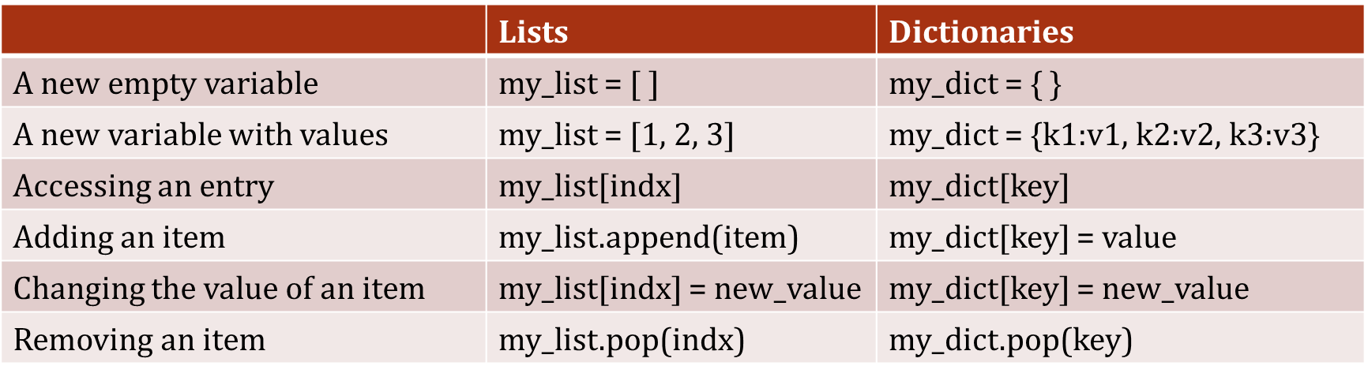
List & dictionary operations

Slide 88
What’s next?

Slide 89
Nested Data Structures
We can nest data structures!
Lists in lists
grid/game board
Lists in dicts
animals to feeding times
Dicts in dicts
your phone’s contact book
... and so on!

Slide 90
How to organize data
Ice cream sales
 | June | July | August
2018 | 500 | 700 | 600
2019 | 550 | 750 | 700
2020 | 250 | 500 | 400

Slide 91
How to organize data
Ice cream sales
 | June | July | August
2018 | 500 ice[0][0] | 700 ice[0][1] | 600 ice[0][2]
2019 | 550 ice[1][0] | 750 ice[1][1] | 700 ice[1][2]
2020 | 250 ice[2][0] | 500 ice[2][1] | 400 ice[2][2]
ice = [[500,700,600], [550,750,700], [250,500,400]]
Example: June 2020 ice cream sales is accessed as ice[2][0]

Slide 92
How to organize data
Ice cream sales
 | June | July | August
2018 | 500 | 700 | 600
2019 | 550 | 750 | 700
2020 | 250 | 500 | 400
ice = {2018: {'june':500, 'july':700, 'august':600}, 2019: {'june':500, 'july':700, 'august':600}, 2020: {'june':500, 'july':700, 'august':600}}
Example: June 2020 ice cream sales is accessed as ice[2020]['june']

Slide 93
Think/Share:
Implement a phone book using dictionaries
Notes:
Active learning exercise callout

