Slide 1


Slide 2

Constant Variables
If/elif/else statements
Comparison Operators
Random Library

Slide 3
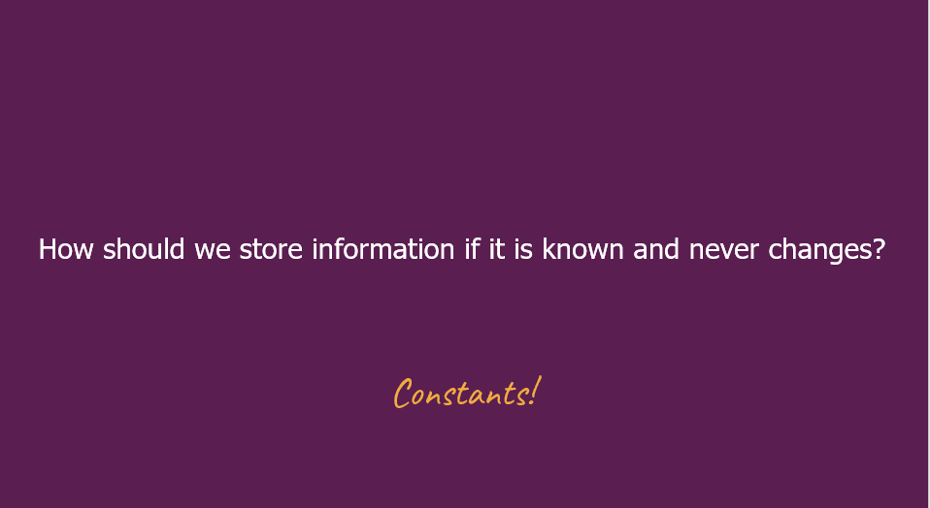

Slide 4
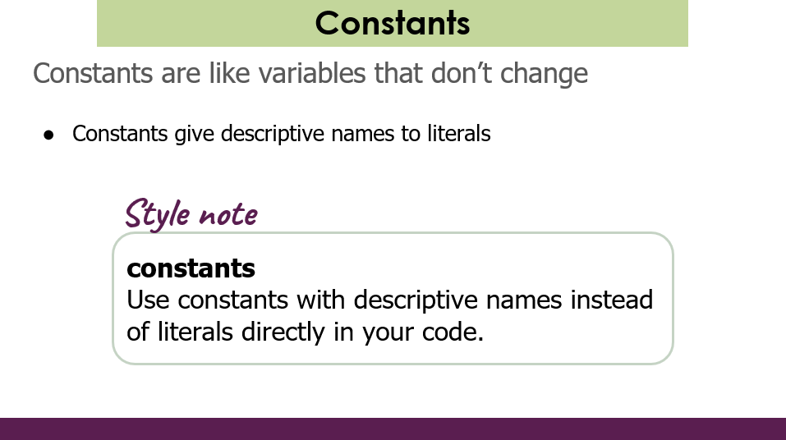

Slide 5
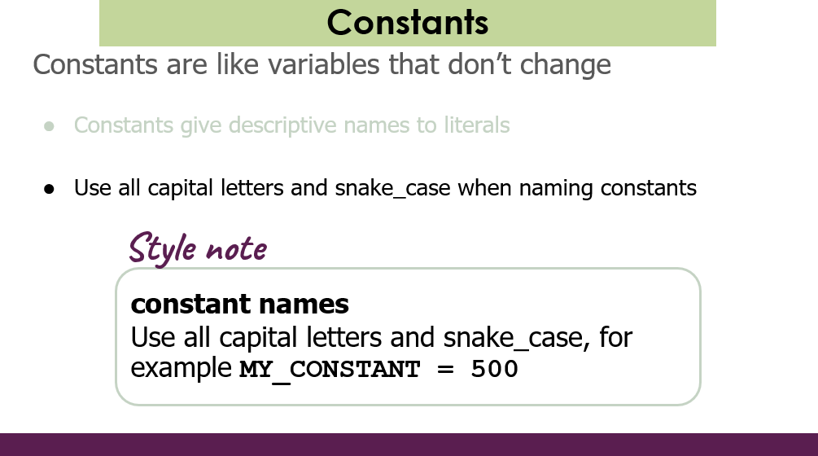

Slide 6
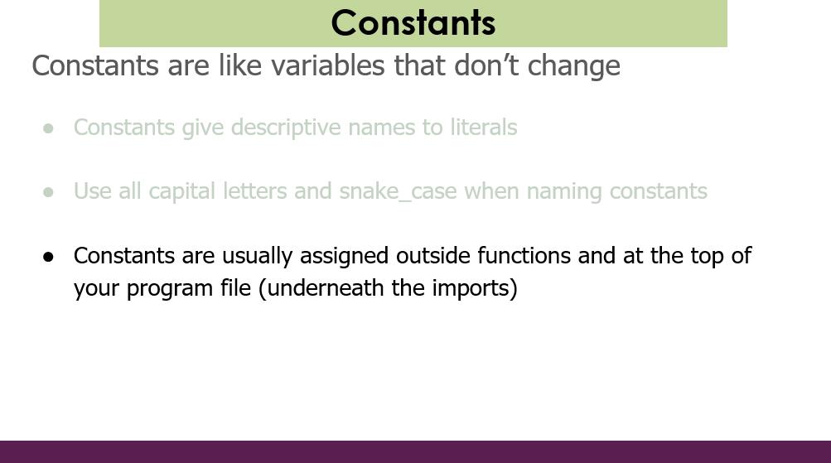

Slide 7
""" File: constants.py ------------------An example program with constants """ INCHES_IN_FOOT = 12 def main(): feet = float(input("Enter number of feet: ")) inches = feet * INCHES_IN_FOOT print("That is " + str(inches) + " inches!") # This provided line is required at the end of a Python file # to call the main() function. if __name__ == '__main__': main()

Slide 8
If/Else Revisited
num = int(input("Enter a number: "))
if num == 0:
print("Your number is 0 ")
else:
if num > 0:
print("Your number is positive")
else:
print("Your number is negative")

Slide 9
Program-0
Area of a triangle

Slide 10

Area of a triangle
What is the area of this triangle?
$$Area= \frac{bh}{2}$$
h
b

Slide 11
Area of a triangle
b= float(input('Enter base length: '))
h= float(input('Enter height: '))
print('')
area= b*h/2
print('Area of triangle with b=',b,'and h=',h,'is',area)
Result:
Enter base length: 8
Enter height: 4.5
Area of triangle with b= 8.0 and h= 4.5 is 18.0

Slide 12
Area of a triangle
What if the user gives a negative value?
Example:
Enter base length: 4
Enter height: -5
Area of triangle with b= 4.0 and h= -5.0 is -10.0
Example:
Enter base length: -4
Enter height: 5
Area of triangle with b= -4.0 and h= 5.0 is -10.0

Slide 13
Invalid values
We cannot stop the user from giving negative (invalid) values; but we can detect them and choose not to do further evaluations with them.
This requires writing our program with branches or conditional statements or control flow.
In programming languages this is achieved with the IF command.
The IF command involves a logical expression, which evaluates to a TRUE or a FALSE.

Slide 14
Logical operators
Logical operator NOT operates on one, AND and OR operate on two logical quantities.
All three of them give a logical quantity (TRUE or FALSE) as a result.
p | q | not p | p and q | p or q
False | False | True | False | False
False | True | True | False | True
True | False | False | False | True
True | True | False | True | True

Slide 15
Comparison Operators
Comparison operators operate on (or compare) two comparable quantities of any type (integers, floats, strings, etc.)
All of them give a logical quantity (TRUE or FALSE) as a result.
Operator | Meaning
< | Is less than
> | Is greater than
<= | Is less than or equal to
>= | Is greater than or equal to
== | Is equal to
!= | Is not equal to

Slide 16

= vs ==
In python:
==
is a comparison operator
=
is used for variable assignment

Slide 17
Example
if 1 < 2 :
print("1 is less than 2")
num = int(input("Enter a number: "))
if num == 0: print("That number is 0")
else :
print("That number is not 0.")

Slide 18
Opposite of logical expressions
Assume we have a logical expression of the form:
p ⊗ q
where ⊗ represents either and or or logical operator.
The opposite of this expression is:
not (p ⊗ q)
which is:
(not p) (not ⊗) (not q)

Slide 19
Opposite of logical expressions
What are the opposites of the following expressions?
a>2
a==0 or b<5
c>4 and is_even
f==1 or f==2 or f==3
a<=2
a!=0 and b>=5
c<=4 or not is_even
f!=1 and f!=2 and f!=3

Slide 20
Operator Precedence
Parentheses ( ( ) )
Power (**)
Unary plus (+), unary minus (-)
Multiplication (*), division (/), integer division(//), modulus (%)
Addition (+), subtraction (-)
Comparison operators (<, <=, >, >=, ==, !=)
Logical NOT (not)
Logical AND (and)
Logical OR (or)

Slide 21
Conditional statements
The biggest power of computer programs come from their ability to do computations at a very fast rate.
Their second most important property is the ability of making decisions (by use of conditional statements).
The main building block of a conditional statement is a logical expression that yields a TRUE or FALSE value.
We will now explore different ways of building conditional statements (or control flow).

Slide 22
IF statement (1)
Logical
expression
False
if logical-expression:
statement
True
Statement

Slide 23
IF statement (1) example
grade= int(input('Enter your exam grade: '))
if grade>=90:
print('Well done!')

Slide 24
IF statement (2)
Logical
expression
False
if logical-expression:
statement-1
statement-2
...
statement-n
True
Statement-1
Statement-2
Statement-n

Slide 25
IF statement (2) example
grade= int(input('Enter your exam grade: '))
if grade>=90:
print('Well done!')
print('You are an A student')

Slide 26
IF statement (3)
Logical
expression
if logical-expression:
statement-1
...
statement-n
else:
statement-1
...
statement-m
True
False
Statement-1
Statement-1
Statement-2
Statement-2
Statement-n
Statement-m

Slide 27
IF statement (3) example
grade= int(input('Enter your exam grade: '))
if grade>=50:
print('You pass.')
else:
print('You fail.')
print('Try harder next time.')

Slide 28
IF statement (4)
Logical
expression
if logical-expression:
statement-1
statement-2
...
statement-n
else:
if logical-expression:
statement-1
...
statement-n
else:
statement-1
...
statement-n
True
False
Statement-1
Logical
expression
True
False
Statement-2
Statement-1
Statement-1
Statement-n
Statement-n
Statement-n
Embedded in the outer IF

Slide 29
IF statement (4) example
age= int(input('Enter your age: '))
if age<13:
print('You are a child.')
else:
if age>=18:
print('You are an adult.')
else:
print('You are a teenager.')

Slide 30
IF statement (5)
if logical-expression:
statement-1
statement-2
...
statement-n
elif logical-expression:
statement-1
...
statement-n
else:
statement-1
...
statement-n
Logical
expression
True
False
Statement-1
Logical
expression
True
False
Statement-2
Statement-1
Statement-1
Statement-n
Statement-n
Statement-n

Slide 31
IF statement (5) example
age= int(input('Enter your age: '))
if age<13:
print('You are a child.')
elif age>=18:
print('You are an adult.')
else:
print('You are a teenager.')

Slide 32
IF command general format
You can place any number of ELIF parts into an IF block.
if <logical expression-1>:
<some commands>
elif <logical expression-2>:
<some commands>
elif <logical expression-3>:
<some commands>
elif <logical expression-4>:
<some commands>
...
else:
<some commands>
The ELSE part, if it exists, is always the last branch.
Note that there is always a logical expression on an ELIF line. There is never a logical expression on the ELSE line.
ELSE can be interpreted as "if all previous logical expression tests have failed, then do this".

Slide 33
Program-1
Area of a triangle improved

Slide 34
Area of a triangle
We were discussing the following problem.
Example:
Enter base length: 4
Enter height: -5
Area of triangle with b= 4.0 and h= -5.0 is -10.0
Example:
Enter base length: -4
Enter height: 5
Area of triangle with b= -4.0 and h= 5.0 is -10.0

Slide 35
Area of a triangle
This is what we want:
Example:
Enter base length: -4
Enter height: 5
Base must be positive!
Example:
Enter base length: 4
Enter height: -5
Height must be positive!
Fix it with an IF structure

Slide 36
Area of a triangle
# Version 1 with ELSE and embedded IF
b= float(input('Enter base length: '))
h= float(input('Enter height: '))
print('')
if b<=0:
print('Base must be positive!')
else:
if h<=0:
print('Height must be positive!')
else:
area= b*h/2
print('Area of triangle with b=',b,'and h=',h,'is',area)

Slide 37
Area of a triangle
# Version 2 with ELIF
b= float(input('Enter base length: '))
h= float(input('Enter height: '))
print('')
if b<=0:
print('Base must be positive!')
elif h<=0:
print('Height must be positive!')
else:
area= b*h/2
print('Area of triangle with b=',b,'and h=',h,'is',area)

Slide 38
Area of a triangle
What happens when both base and height are negative?
Example:
Enter base length: -4
Enter height: -5
Base must be positive!
Fix it with a better IF structure

Slide 39
Area of a triangle
# Version 3 handles both b and h being negative
b= float(input('Enter base length: '))
h= float(input('Enter height: '))
print('')
if b<=0 and h<=0:
print('Both base and height must be positive!')
elif b<=0:
print('Base must be positive!')
elif h<=0:
print('Height must be positive!')
else:
area= b*h/2
print('Area of triangle with b=',b,'and h=',h,'is',area)

Slide 40
Area of a triangle
# Version 4 with independent IFs
# Prints two warning lines if both negative
b= float(input('Enter base length: '))
h= float(input('Enter height: '))
print('')
if b<=0:
print('Base must be positive!')
if h<=0:
print('Height must be positive!')
if b>0 and h>0:
area= b*h/2
print('Area of triangle with b=',b,'and h=',h,'is',area)

Slide 41
Area of a triangle
# Version 5 prints one generic message
# in case of any invalid input
b= float(input('Enter base length: '))
h= float(input('Enter height: '))
print('')
if b<=0 or h<=0:
print('Base and height must be positive!')
else:
area= b*h/2
print('Area of triangle with b=',b,'and h=',h,'is',area)

Slide 42
Program-2
Day of time greeting

Slide 43
Day of time greeting
night
morning
afternoon
evening
night
0
5
12
18
21
24
Example:
What hour is it? 2
Good night
Example:
What hour is it? 18
Good evening
Write your program

Slide 44
Day of time greeting
h= int(input('What hour is it? '))
if h>=0 and h<5 or h>=21 and h<24:
print('Good night')
elif h>=5 and h<12:
print('Good morning')
elif h>=12 and h<18:
print('Good afternoon')
elif h>=18 and h<21:
print('Good evening')
else:
print('Are you living on Mars???')

Slide 45
Day of time greeting
h= int(input('What hour is it? '))
if h<0 or h>=24:
print('Are you living on Mars???')
elif h<5 or h>=21:
print('Good night')
elif h<12:
print('Good morning')
elif h<18:
print('Good afternoon')
else:
print('Good evening')

Slide 46
Random numbers

Slide 47
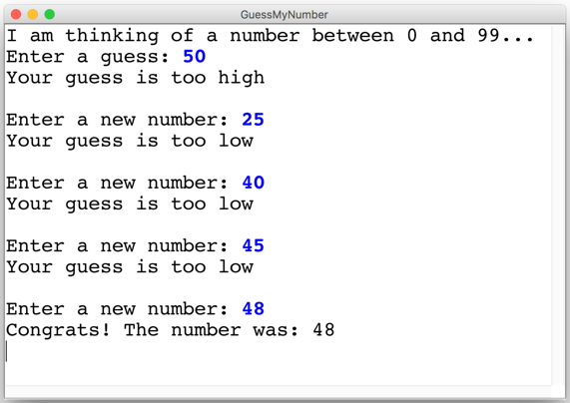

Guess My Number

Slide 48
Random numbers
Python has a built-in module for generating random numbers.
You have to include the following statement at the beginning of your program:
import random
There are only a few functions we will use from this module.

Slide 49
Random numbers
randint( ) is a function for generating a random integer.
It requires a first value and a last value as argument:
random.randint(first,last)
The result is any number between [first,last](both inclusive).
Example:
for i in range(10):
print(random.randint(1,6),end=' ')
Result:
6 2 1 5 5 2 3 1 6 2

Slide 50
Random numbers
random( ) is a function for generating a random floating point number.
It requires no arguments:
random.random()
The result is any number between 0.0 (inclusive) and 1.0 (exclusive).
Example:
a= random.random()
Result:
0.7285270343303428

Slide 51
Guess My Number
secret_number = random.randint(1, 99)
print("I am thinking of a number between 1 and 99...")
guess = int(input("Enter a guess: "))
# True if guess is not equal to secret number
while guess != secret_number:
# True if guess is less than secret number
if guess < secret_number:
print("Your guess is too low")
else:
print("Your guess is too high")
print("") # an empty line
guess = int(input("Enter a new guess: "))
print("Congrats! The number was: " , secret_number)

Slide 52
The end

