Slide 1




CS Bridge, Lecture 15 Breakout - Extra Features

Slide 2
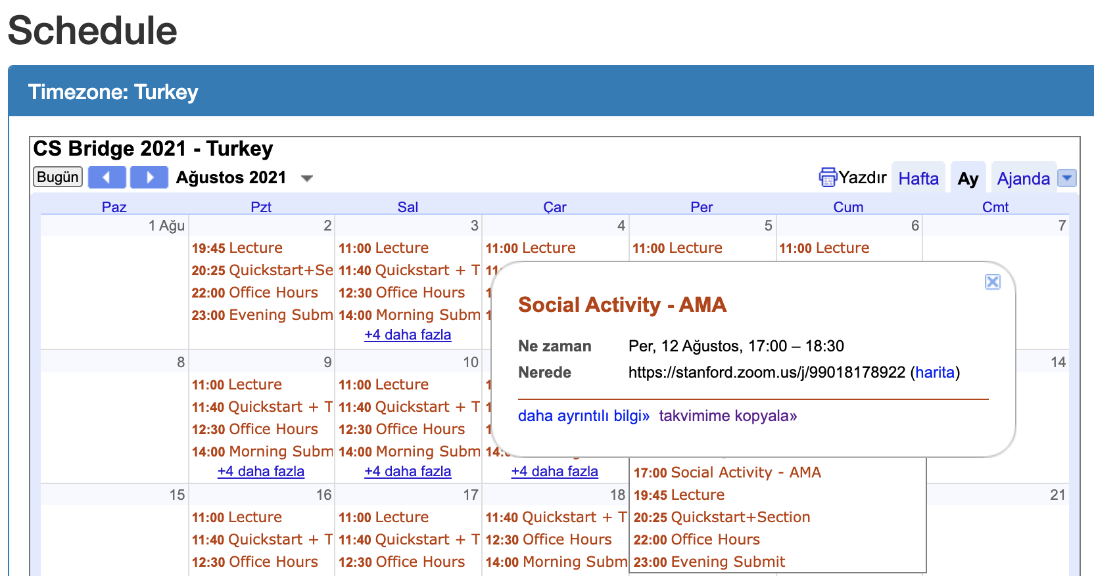
Reminder before we start

Slide 3
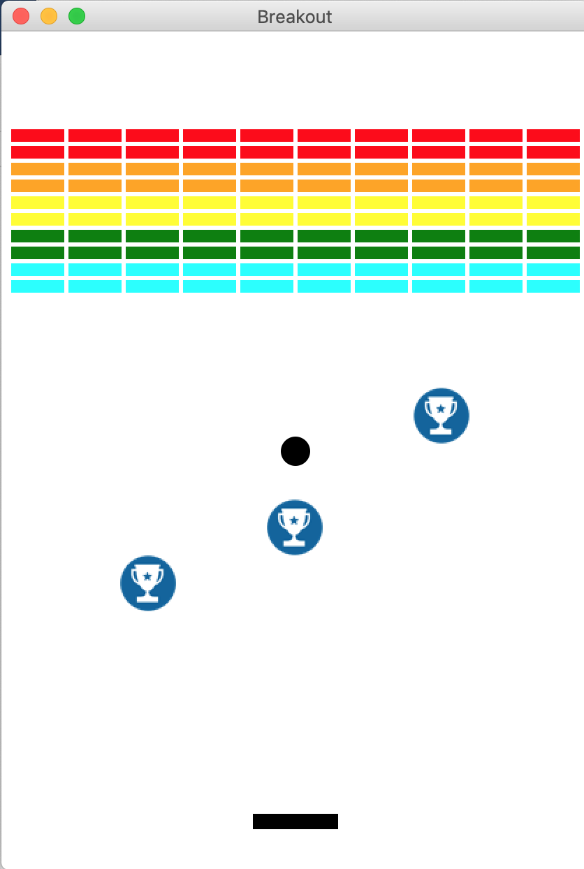
Before we start, a few points to consider
Breaking a loop
Creating a list of objects in a function
and returning them

Slide 4
Creating a list of objects in a function
and returning them
Play time

Slide 5
Returning graphical objects from functions
# A function to create a single graphical object and return
def setup_graphical_object(canvas):
object_x = … <some expression to compute x> …
object_y = … <some expression to compute y> …
my_object = canvas.create_….(object_x, object_y, object_x+SIZE, object_y+SIZE)
return my_object
# A function to create multiple graphical objects, put those in a list and return the list of objects
def setup_graphical_objects(canvas):
objects_list = []
for i in range(NUM_OBJECTS):
object_x = … <some expression to compute x> …
object_y = … <some expression to compute y> …
objects_list.append(canvas.create_….(object_x, object_y, object_x+SIZE, object_y+SIZE))
return objects_list

Slide 6
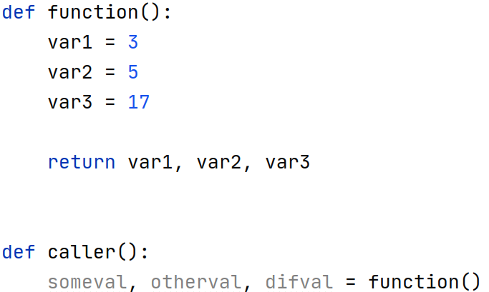
Returning multiple values from functions

Slide 7
Breaking a loop
# A script that takes some time: check-prime
import time
start_time = time.time()
n = 151153234
is_prime = True
for i in range(2, n):
if n % i == 0:
is_prime = False
if is_prime:
print("Is prime")
else:
print("Is not prime")
print("--- {} seconds ---".format(time.time() - start_time))
Better to stop the loop here
Output:
Is not prime
--- 9.443579196929932 seconds ---

Slide 8
Breaking a loop
# A script that takes some time: check-prime
import time
start_time = time.time()
n = 151153234
is_prime = True
for i in range(2, n):
if n % i == 0:
is_prime = False
break
if is_prime:
print("Is prime")
else:
print("Is not prime")
print("--- {} seconds ---".format(time.time() - start_time))
We add a break statement
Output:
Is not prime
--- 3.123283386230469e-05 seconds ---

Slide 9
Breaking an infinite loop
Reading positive integers from a user:
user_ints= []
value = int(input("Enter an integer:"))
while value > 0:
user_ints.append(value)
value = int(input("Enter an integer:"))
print("Your inputs:" + str(user_ints))
user_ints= []
while True:
value = int(input("Enter an integer:"))
if value > 0:
user_ints.append(value)
else:
break
print("Your inputs:" + str(user_ints))
Output:
Enter an integer:1
Enter an integer:2
Enter an integer:3
Enter an integer:-8
Your inputs:[1, 2, 3]
Output:
Enter an integer:3
Enter an integer:2
Enter an integer:4
Enter an integer:5
Enter an integer:-7
Your inputs:[3, 2, 4, 5]

Slide 10
Breaking a loop in Breakout
You may like to implement the paddle move by key-strokes and collect objects.
In case of multiple colliding object, you may prefer to remove only one of the colliding objects
<list of colliding objects> = canvas.find_overlapping(<paddle coordinates>)
for collider in <list of colliding objects>:
if collider in <list of objects paddle can remove>:
canvas.delete(collider)
break
Checking if colliding object is one of the objects in the list

Slide 11
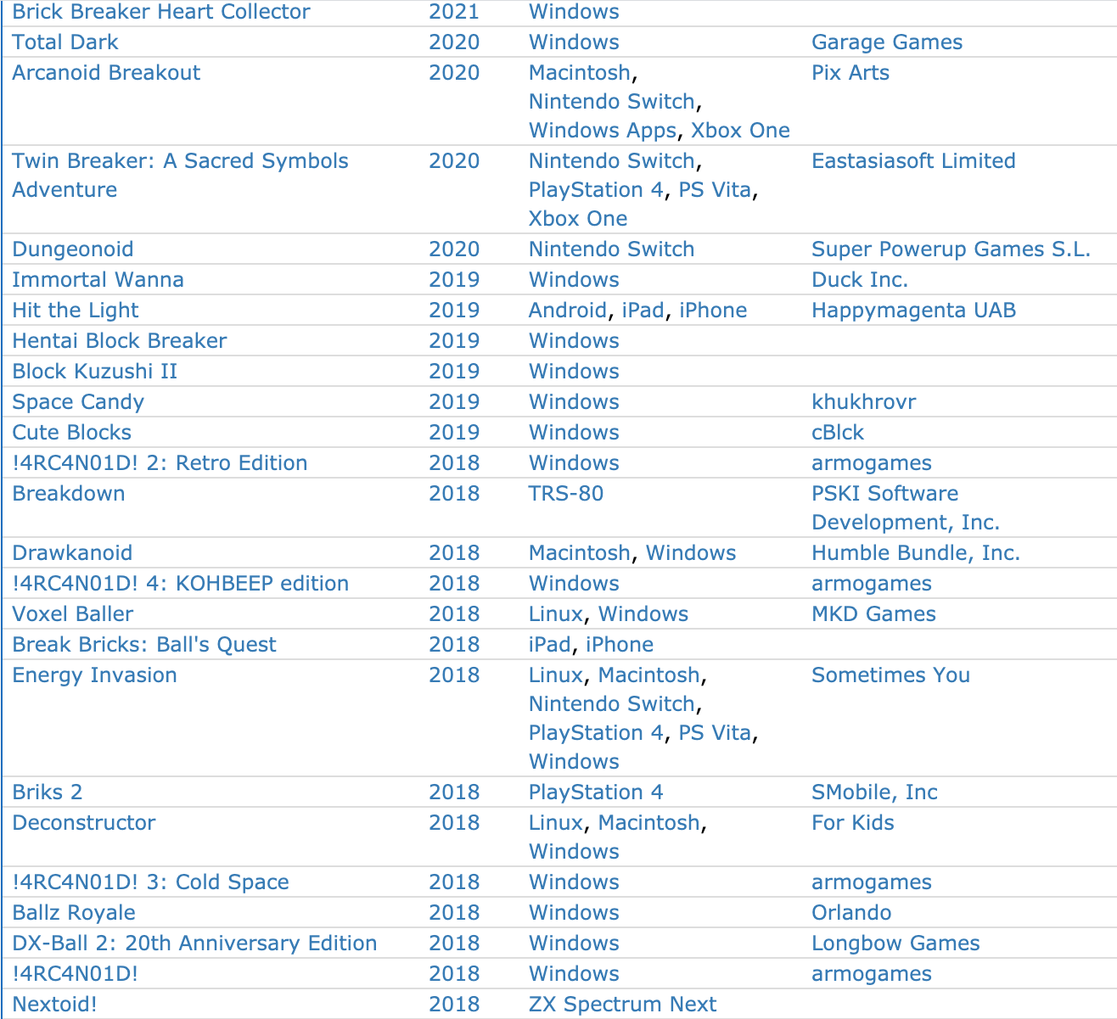
Extra Features for Breakout
https://www.mobygames.com/game-group/breakout-variants

Slide 12

Extra Features for Breakout

Slide 13
Collecting objects with paddle
….
bullet = None
# animation loop
while <some condition>:
…
if bullet:# checking existence
<Move bullet>
if <some condition>:
canvas.delete(bullet)
bullet = None
…
def get_key_press(canvas):
presses = canvas.get_new_key_presses()
for press in presses:
….
return ….

Slide 14
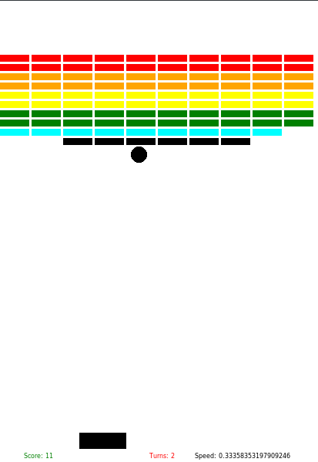
Special Bricks
Extra Features for Breakout
How would you implement that?
Complete reference for class canvas: https://turkey21.csbridge.org/en/resources/api-docs/graphics.html

Slide 15
Extra Features for Breakout
Increasing speed
User selected game level - difficulty control
Cheats
Showing score
Tracking time
Lives
… any other suggestions?

