Slide 1




CS Bridge, Lecture 7 Graphics

Slide 2
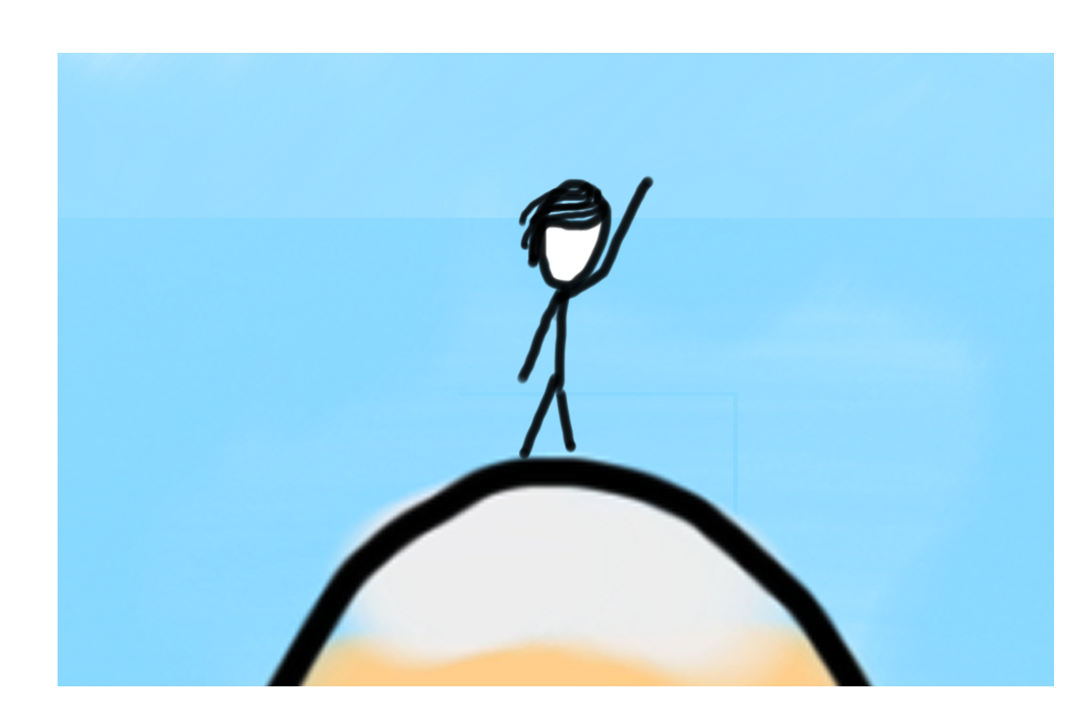

Learning Goals
Learn how we can make graphical programs
Learn about the different ways to draw shapes on-screen

Slide 3
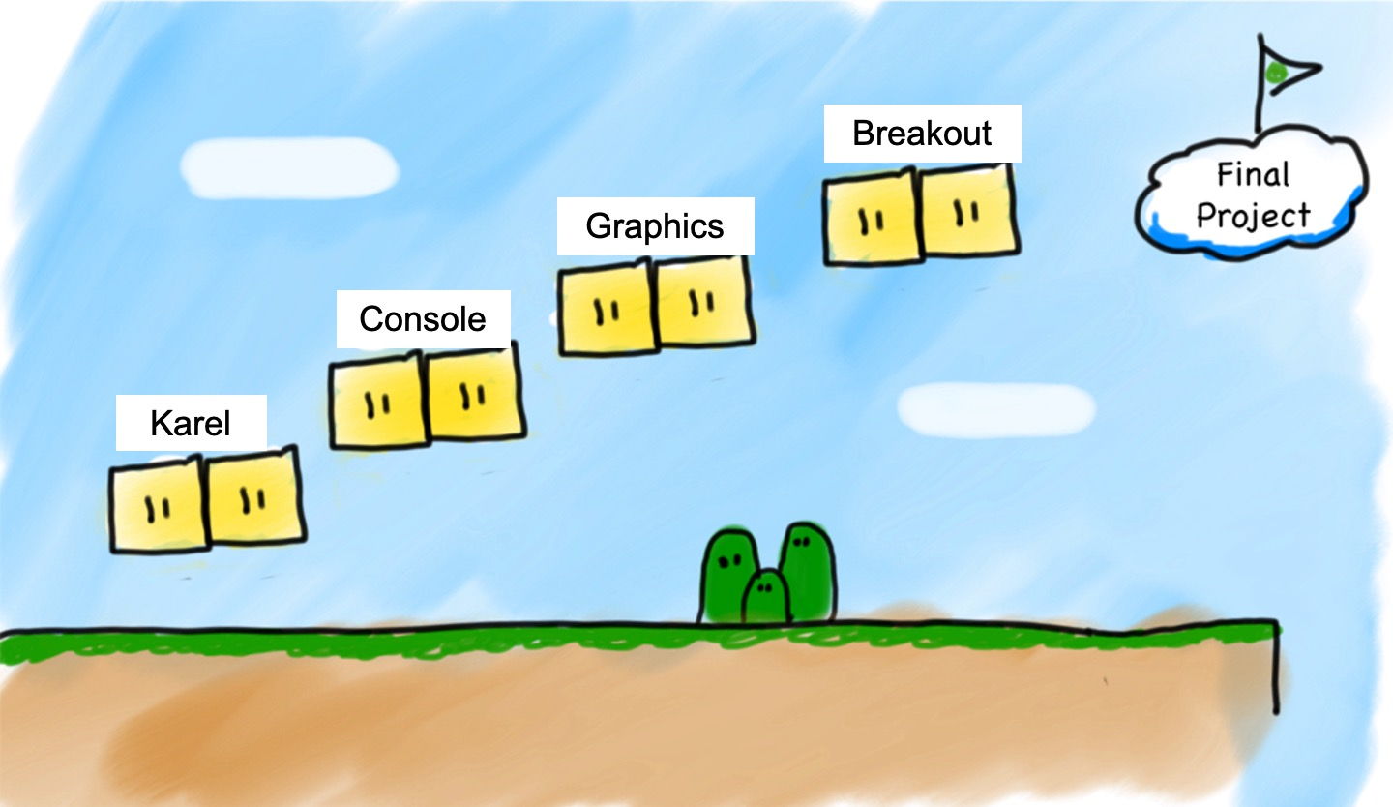
We Are Here

Slide 4
Lecture Plan
Review: Python So Far
Graphics Programs
Practice: Centering Objects
Practice: Drawing a Car
Practice: Graphics and Loops

Slide 5
Lecture Plan
Review: Python So Far
Graphics Programs
Practice: Centering Objects
Practice: Drawing a Car
Practice: Graphics and Loops

Slide 6

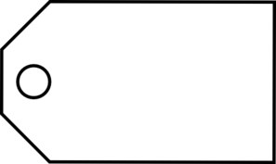
Review: Variables
A variable is a “suitcase”. We can use it to store a value.
num_students = 700
num_students
int
700
name
type
value

Slide 7
Review: Variables
We can change the values of variables and use them in expressions.
num_flowers = 5
flowers_planted = 6
num_flowers = num_flowers + flowers_planted

Slide 8
Review: User Input
We can ask the user for input and store it in a variable.
num1 = input("Enter first number: ")
Remember that user input is always text (“string”).
num1 = input("Enter first number: ")
print(int(num1) + 2)

Slide 9
Review: Printing
We can print out information to the user:
num1 = random.randint(1, 6)
print("You rolled a " + str(num1))
Remember we must convert to a string before adding to another string.
num1 = random.randint(1, 6)
print("You rolled a " + num1) # error

Slide 10

Review: Control Flow
We can use if/elif/else to conditionally perform tasks:
if condition1:
statement
...
elif condition2:
statement
...
else:
statement
...
Runs the first group of statements if condition1 is true; otherwise, runs the second group of statements if condition2 is true. Otherwise, runs the third group of statements.

Slide 11
Review: Control Flow
We can use while loops to repeat until some condition is false:
while condition:
statement
statement
...
Repeats the statements in the body until condition is no longer true. Each time, we execute all statements, and then check the condition.
Notes:
We talked about while, which uses these conditions, and also if/else, which uses these conditions

Slide 12
Conditions in Python
while condition:
body
if condition:
body
The condition should be a “boolean” which is either True or False

Slide 13
Relational Operators
Operator | Meaning | Example | Value
== | equals | 1 + 1 == 2 | true
!= | does not equal | 3.2 != 2.5 | true
< | less than | 10 < 5 | false
> | greater than | 10 > 5 | true
<= | less than or equal to | 126 <= 100 | false
>= | greater than or equal to | 5.0 >= 5.0 | true

Slide 14
Relational Operators
Operator | Meaning | Example | Value
== | equals | 1 + 1 == 2 | true
!= | does not equal | 3.2 != 2.5 | true
< | less than | 10 < 5 | false
> | greater than | 10 > 5 | true
<= | less than or equal to | 126 <= 100 | false
>= | greater than or equal to | 5.0 >= 5.0 | true
Notes:
Equals is weird because single equals is assignment!

Slide 15
Relational Operators
if 1 < 2:
print("1 is less than 2!")
num = int(input("Enter a number: "))
if num == 0: print("That number is 0!")
else:
print("That number is not 0.")

Slide 16
Practice: Sentinel Loops
sentinel: A value that signals the end of user input.
sentinel loop: Repeats until a sentinel value is seen.
Example: Write a program that prompts the user for numbers until the user types -1, then output the sum of the numbers.
In this case, -1 is the sentinel value.
Type a number: 10
Type a number: 20
Type a number: 30
Type a number: -1
Sum is 60

Slide 17
Practice: Sentinel Loops
# fencepost problem!
# ask for number - post
# add number to sum - fence
sum = 0
num = int(input("Enter a number: "))
while num != -1:
sum += num
num = int(input("Enter a number: ")
print("Sum is " + str(sum))

Slide 18
Practice: Sentinel Loops
# fencepost problem!
# ask for number - post
# add number to sum - fence
sum = 0
num = int(input("Enter a number: "))
while num != -1:
sum += num
num = int(input("Enter a number: ")
print("Sum is " + str(sum))

Slide 19
Practice: Sentinel Loops
# fencepost problem!
# ask for number - post
# add number to sum - fence
sum = 0
num = int(input("Enter a number: "))
while num != -1:
sum += num
num = int(input("Enter a number: ")
print("Sum is " + str(sum))

Slide 20
Practice: Sentinel Loops
# fencepost problem!
# ask for number - post
# add number to sum - fence
sum = 0
num = int(input("Enter a number: "))
while num != -1:
sum += num
num = int(input("Enter a number: ")
print("Sum is " + str(sum))

Slide 21
Practice: Sentinel Loops
# fencepost problem!
# ask for number - post
# add number to sum - fence
sum = 0
num = int(input("Enter a number: "))
while num != -1:
sum += num
num = int(input("Enter a number: ")
print("Sum is " + str(sum))

Slide 22
Practice: Sentinel Loops
# fencepost problem!
# ask for number - post
# add number to sum - fence
sum = 0
num = int(input("Enter a number: "))
while num != -1:
sum += num
num = int(input("Enter a number: ")
print("Sum is " + str(sum))

Slide 23
Review: Control Flow
We can use for loops to repeat a certain number of times:
for i in range(max):
statement
statement
...
Repeats the statements in the body max times.

Slide 24
Using the For Loop Variable
This is a variable that, every time through the loop, becomes the next value in the range 0…49.
for i in range(50):
print(i * 2)
Question: what does this code do?

Slide 25
Using the For Loop Variable
This is a variable that, every time through the loop, becomes the next value in the range 0,2,4,6,8,..98.
for i in range(0, 100, 2):
print(i)
Question: what does this code do?

Slide 26
Concepts So Far
We have covered many concepts quickly, and they can be challenging to understand!
If you have any questions, or feel stuck with any of the concepts, please visit us in office hours
There is a “conceptual help” room where we can walk through any concepts again

Slide 27
Lecture Plan
Review: Python So Far
Graphics Programs
Practice: Centering Objects
Practice: Drawing a Car
Practice: Graphics and Loops

Slide 28
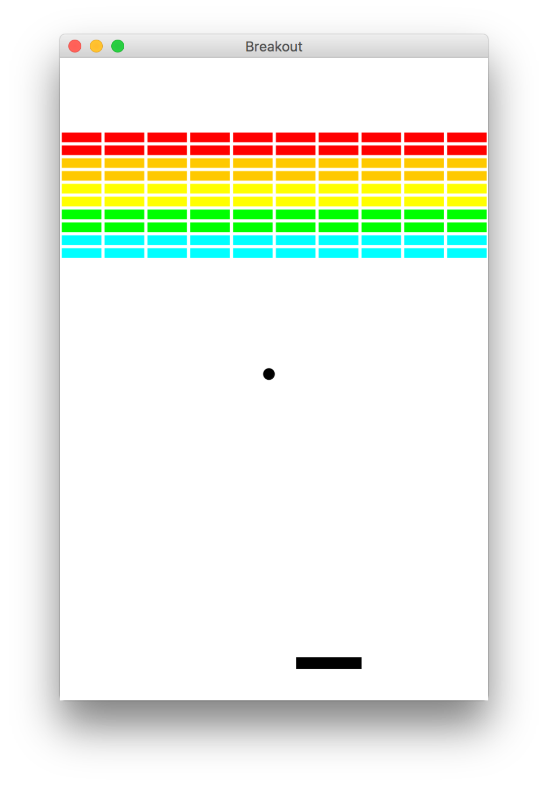
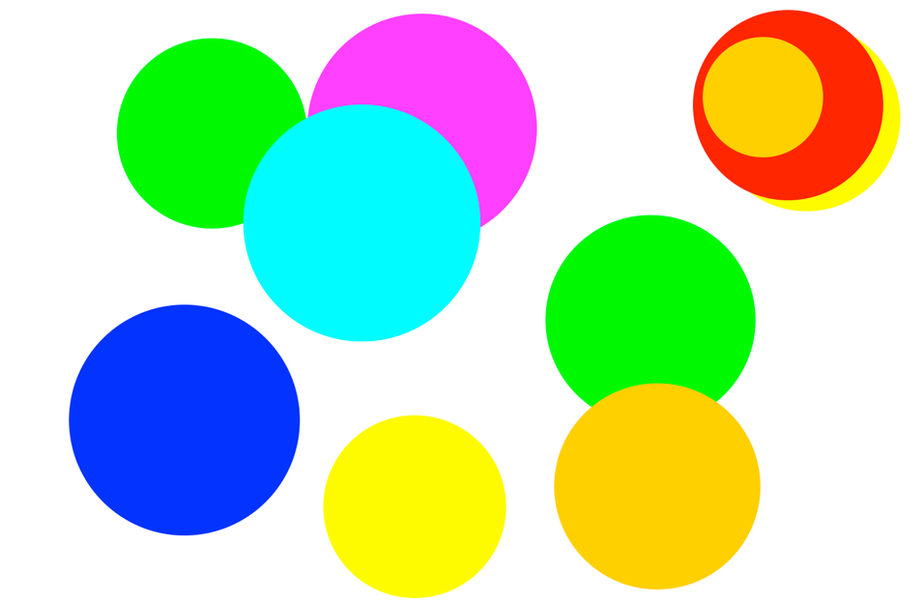
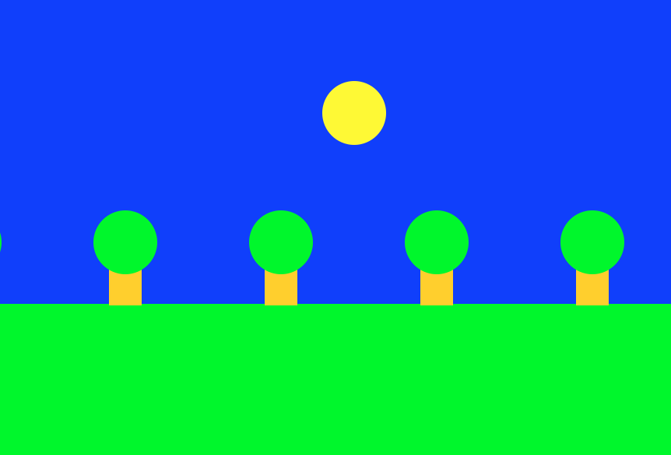
Graphics Programs

Slide 29
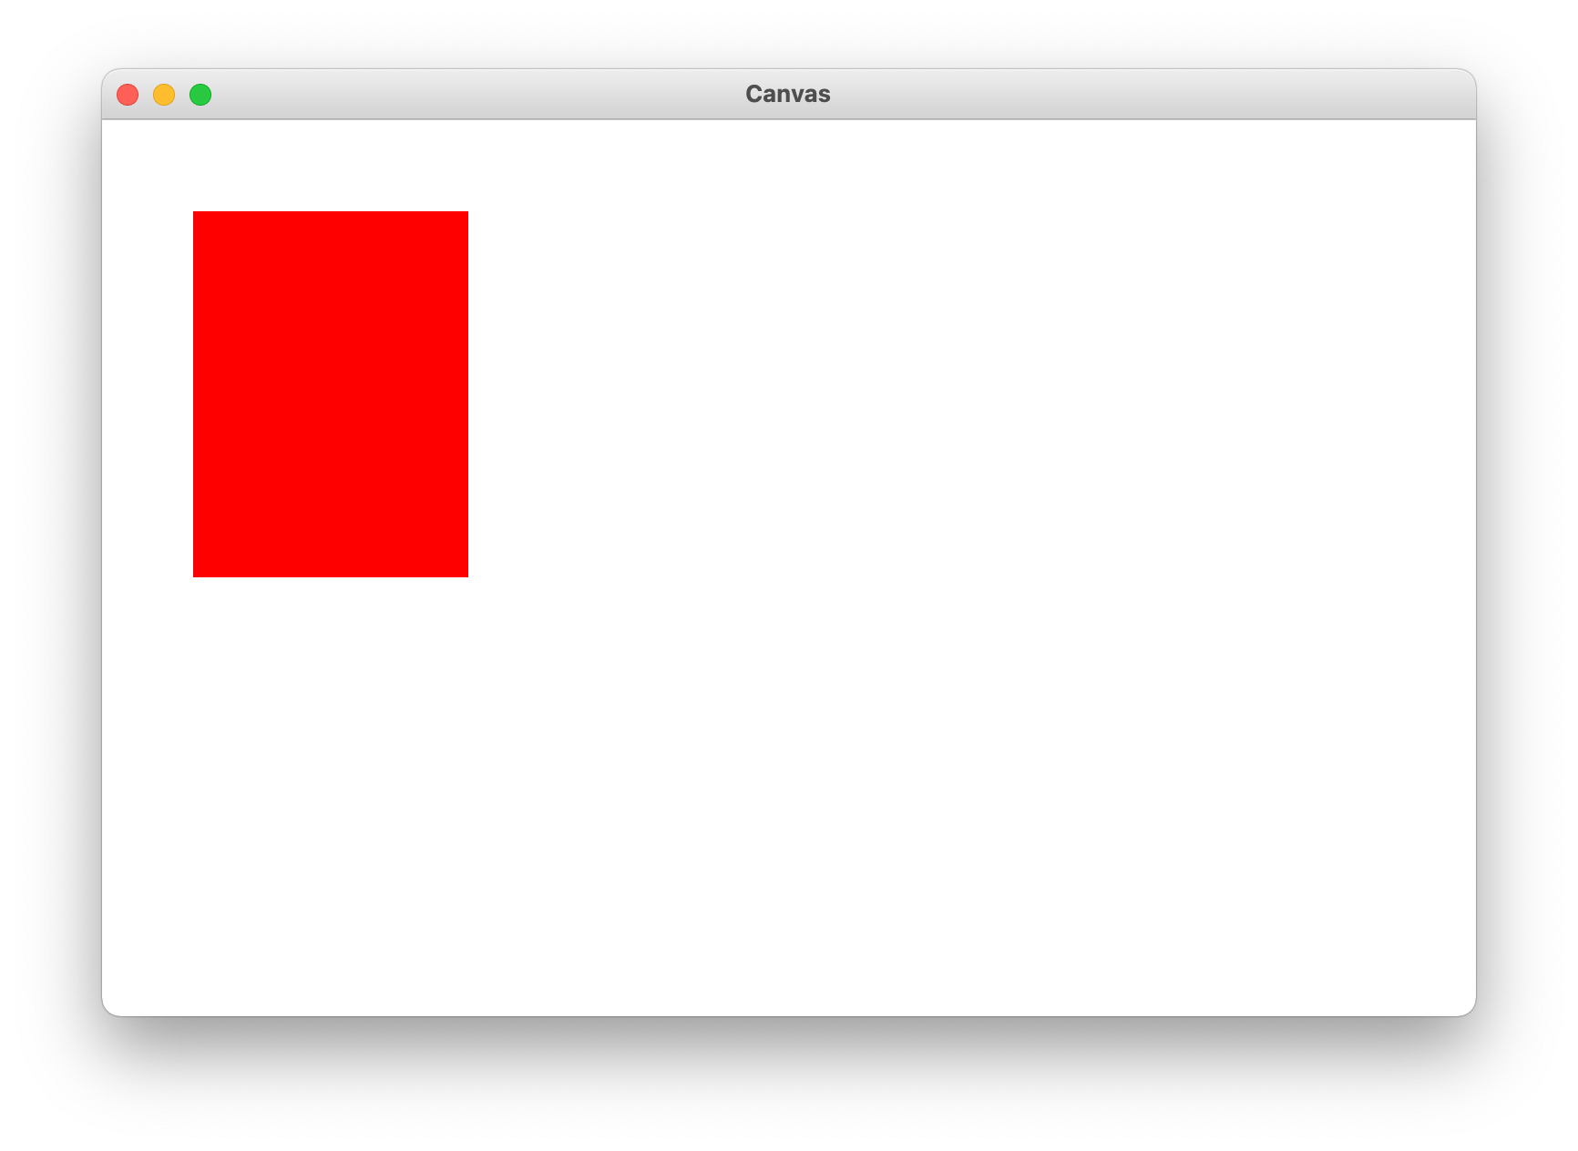
Our First Graphics Program

Slide 30
Our First Graphics Program
from graphics import Canvas # Import graphics library def main():
canvas = Canvas() rect = canvas.create_rectangle(50, 50, 200, 250) canvas.set_color(rect, 'red') canvas.mainloop()

Slide 31
Our First Graphics Program
from graphics import Canvas # Import graphics library def main():
canvas = Canvas() rect = canvas.create_rectangle(50, 50, 200, 250) canvas.set_color(rect, 'red') canvas.mainloop()

Slide 32
Our First Graphics Program
# Create a new graphical canvas window
canvas = Canvas()
# Create a rect from (50, 50) to (200, 250)
rect = canvas.create_rectangle(50, 50, 200, 250)
# Set some properties
canvas.set_color(rect, 'red')
# Draw the canvas
canvas.mainloop()

Slide 33
Our First Graphics Program
# Create a new graphical canvas window
canvas = Canvas()
# Create a rect from (50, 50) to (200, 250)
rect = canvas.create_rectangle(50, 50, 200, 250)
# Set some properties
canvas.set_color(rect, 'red')
# Draw the canvas
canvas.mainloop()

Slide 34
Our First Graphics Program
# Create a new graphical canvas window
canvas = Canvas()
# Create a rect from (50, 50) to (200, 250)
rect = canvas.create_rectangle(50, 50, 200, 250)
# Set some properties
canvas.set_color(rect, 'red')
# Draw the canvas
canvas.mainloop()

Slide 35
Our First Graphics Program
# Create a new graphical canvas window
canvas = Canvas()
# Create a rect from (50, 50) to (200, 250)
rect = canvas.create_rectangle(50, 50, 200, 250)
# Set some properties
canvas.set_color(rect, 'red')
# Draw the canvas
canvas.mainloop()

Slide 36
Our First Graphics Program
# Create a new graphical canvas window
canvas = Canvas()
# Create a rect from (50, 50) to (200, 250)
rect = canvas.create_rectangle(50, 50, 200, 250)
# Set some properties
canvas.set_color(rect, 'red')
# Draw the canvas
canvas.mainloop()

Slide 37
Our First Graphics Program
# Create a new graphical canvas window
canvas = Canvas()
# Create a rect from (50, 50) to (200, 250)
rect = canvas.create_rectangle(50, 50, 200, 250)
# Set some properties
canvas.set_color(rect, 'red')
# Draw the canvas
canvas.mainloop()

Slide 38
The Graphics Canvas
0,0
40,20
120,40
40,120

Slide 39
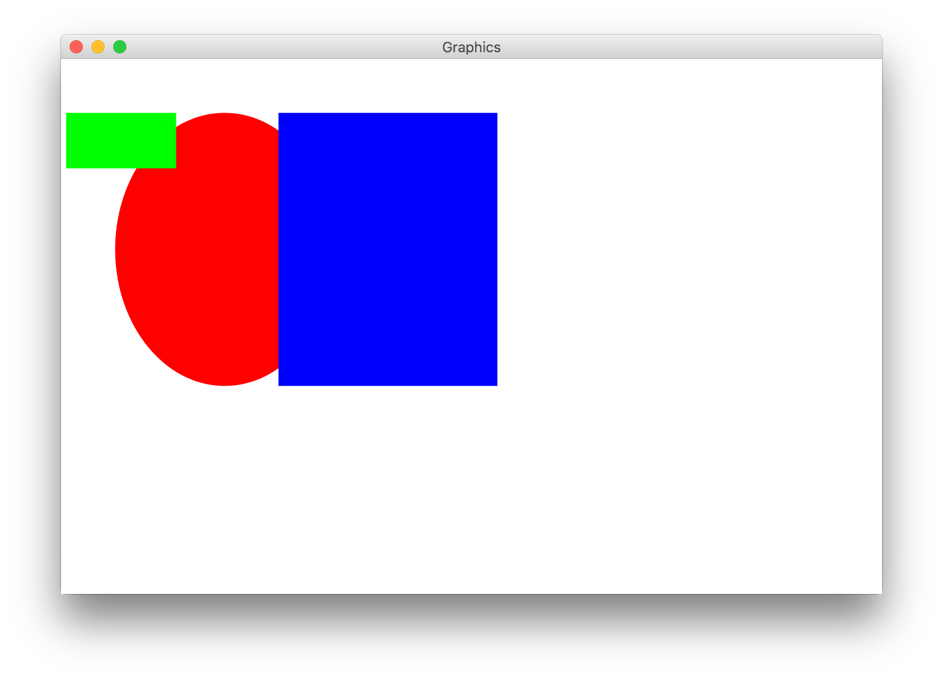
Collage Model

Slide 40
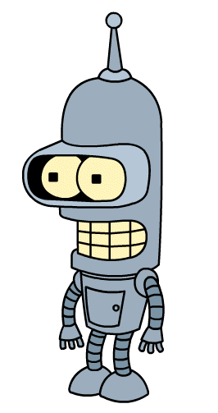
Graphical Objects
rectangle oval line
text image
(x₁, y₁)
(x₁, y₁)
(x₁, y₁)
(x₂, y₂)
(x₂, y₂)
(x₂, y₂)
Hello there!

Slide 41
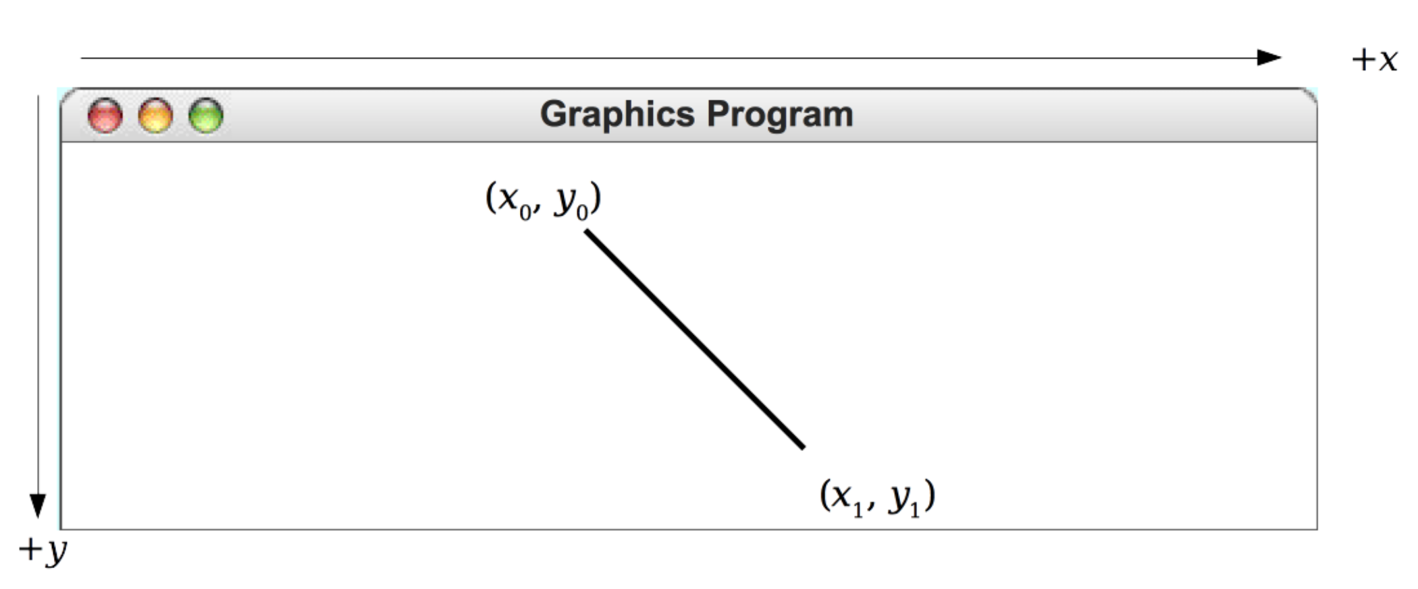
Drawing Lines
canvas.create_line(x₀, y₀, x₁, y₁)

Slide 42
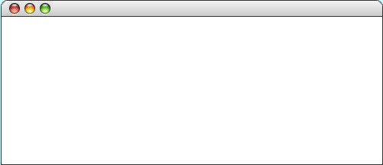
Drawing Rectangles
canvas.create_rectangle(x₀, y₀, x₁, y₁)
Hello Rect
(x₀, y₀)
(x₁, y₁)

Slide 43
Drawing Ovals
canvas.create_oval(x₀, y₀, x₁, y₁)
Hello Rect
(x₀, y₀)
(x₁, y₁)

Slide 44
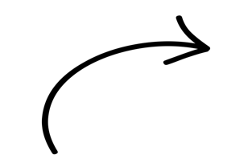
Drawing Text
canvas.create_text(x, y, “text”)
hi
(x, y)

Slide 45
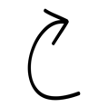

Drawing Images
canvas.create_image(x, y, “name of the file”)
(x, y)
canvas.create_image(x, y, width, height, “name of the file”)
(x, y)
height
width

Slide 46
Creating Graphical Objects
You can create graphical objects as follows:
canvas.create_line(x₀, y₀, x₁, y₁)
Creates a new line connecting (x0, y0) and (x1, y1).
canvas.create_rectangle(x₀, y₀, x₁, y₁)
Creates a new rectangle on the canvas the size of this bounding box.
canvas.create_oval(x₀, y₀, x₁, y₁)
Creates a new oval on the canvas contained within this bounding box.
canvas.create_text(x, y, text)
Creates text on the canvas with the specified contents, centered at (x, y).
canvas.create_image(x, y, filepath)
Creates a new image on the canvas from the specified file, with top-left corner at (x, y).
canvas.create_image(x, y, width, height, filepath)
Creates a new image on the canvas from the specified file, with top-left corner at (x, y) and the specified width and height.

Slide 47
Operations on Graphical Objects
canvas.moveto(object, x, y)
Sets the location of obj to the specified coordinates.
canvas.set_color(object, color)
Sets the outline and fill color (if applicable) of the object.
canvas.set_outline_color(object, color)
Sets the outline color of the object.
canvas.set_fill_color(object, color)
Sets the fill color of the object.
canvas.set_font(object, font, size)
Sets the font and font size for the given text object.
canvas.delete(object)
Deletes the object from the canvas
See the Graphics reference under the “Resources” tab on the course website for the full list!

Slide 48
Operations on the Canvas
We can perform some operations with the Canvas itself:
You can optionally specify the Canvas size (width/height) when you create it:
Method | Description
canvas.get_canvas_width(), canvas.get_canvas_height() | Get the width and height of the Canvas window
canvas.set_canvas_title(text) | Sets the text in the window title bar
canvas.set_canvas_background_color(color) | Sets the background color of the canvas
def main():
canvas = Canvas(500, 400) rect = canvas.create_rectangle(50, 50, 200, 250) ...
canvas.mainloop()

Slide 49
Lecture Plan
Review: Python So Far
Graphics Programs
Practice: Centering Objects
Practice: Drawing a Car
Practice: Graphics and Loops

Slide 50
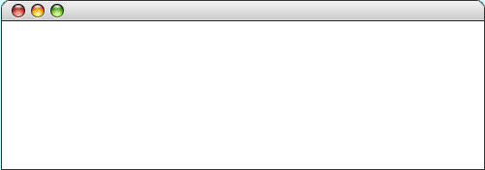
Practice: Centering
Graphics Program
(?, ?)
Notes:
One common graphics challenge: how do we center things?
1st: horizontally
2nd: vertically

Slide 51
Practice: Centering
canvas.get_canvas_width()
Graphics Program
canvas.get_canvas_width() / 2
W
W / 2
rectangle's x value = canvas.get_canvas_width() / 2 – W / 2

Slide 52
Practice: Centering
Graphics Program
canvas.get_canvas_height()
rectangle's y value = canvas.get_canvas_height() / 2 – H / 2

Slide 53
Lecture Plan
Review: Python So Far
Graphics Programs
Practice: Centering Objects
Practice: Drawing a Car
Practice: Graphics and Loops

Slide 54
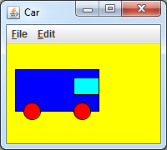
Practice: Car
Write a graphical program named Car that draws a figure that looks (kind of) like a car.
Red wheels at (20, 70) and (80, 70), size 20x20
Cyan windshield at (80, 40), size 30x20
Blue body at (10, 30), size 100x50
yellow background

Slide 55
Car Solution
# When 2 shapes occupy the same pixels, the last one drawn "wins"
def main():
canvas = Canvas()
canvas.set_canvas_title("Car")
canvas.set_canvas_background_color("yellow")
# Car body
body = canvas.create_rectangle(10, 30, 110, 80)
canvas.set_fill_color(body, "blue")
# Car wheels
wheel1 = canvas.create_oval(20, 70, 40, 90)
canvas.set_fill_color(wheel1, "red")
wheel2 = canvas.create_oval(80, 70, 100, 90)
canvas.set_fill_color(wheel2, "red")
# Windshield
windshield = canvas.create_rectangle(80, 40, 110, 60)
canvas.set_fill_color(windshield, "cyan")
canvas.mainloop()
Notes:
Can’t add same object more than once – will just move it

Slide 56
Lecture Plan
Review: Python So Far
Graphics Programs
Practice: Centering Objects
Practice: Drawing a Car
Practice: Graphics and Loops

Slide 57
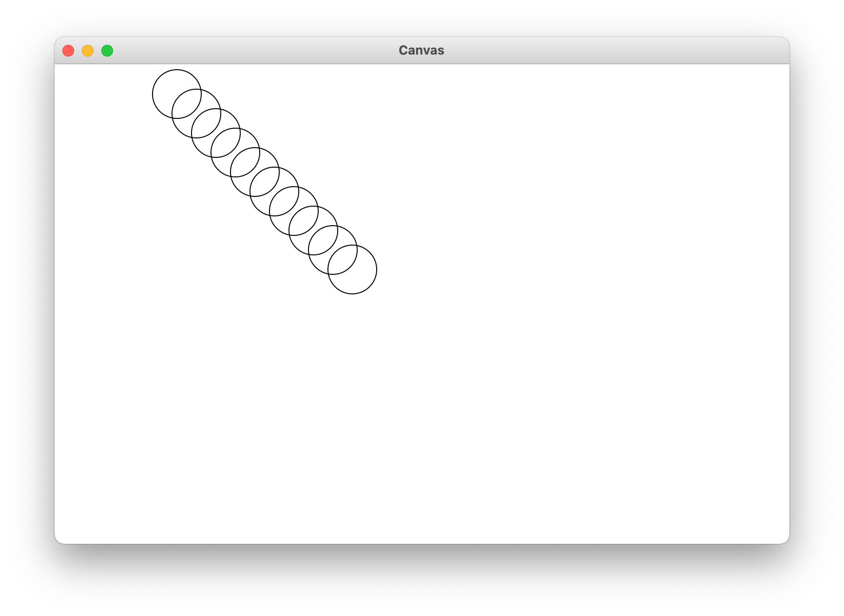
Practice: Drawing w/ Loops
We can combine loops and graphics to draw cool patterns:

Slide 58
Practice: Drawing w/ Loops
We can combine loops and graphics to draw cool patterns:
def main(): canvas = Canvas() for i in range(10): circle_x = 100 + 20 * i circle_y = 5 + 20 * i canvas.create_oval(circle_x, circle_y, circle_x + 50, circle_y + 50) canvas.mainloop()

Slide 59
Lecture Recap
Review: Python So Far
Graphics Programs
Practice: Centering Objects
Practice: Drawing a Car
Practice: Graphics and Loops

Slide 60
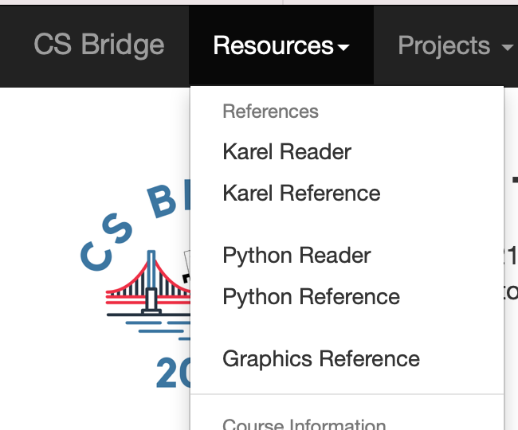
Graphics Resources

Slide 61
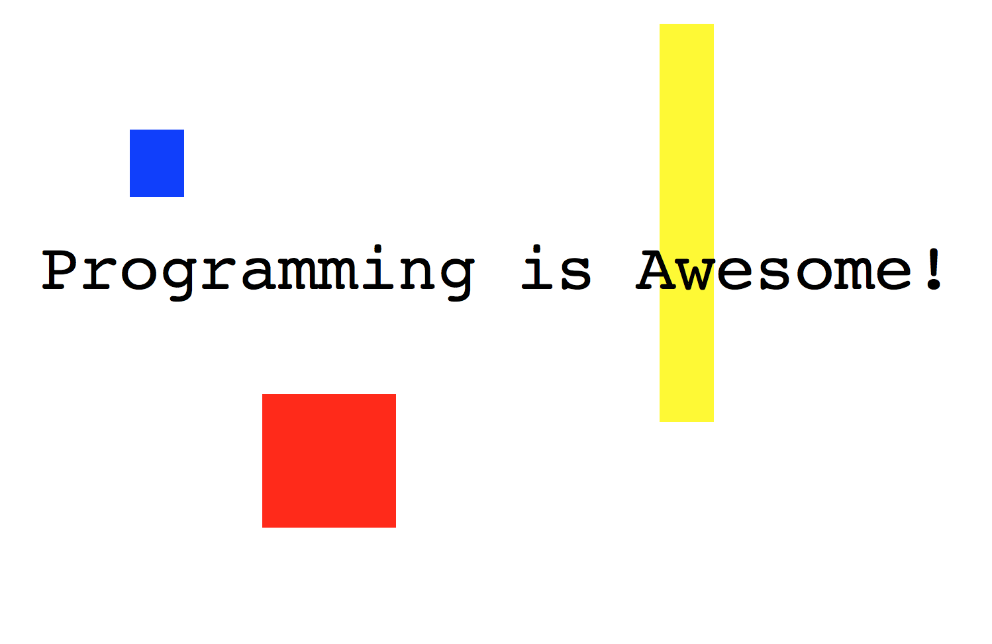
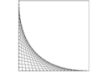

Rest Of Today
Quickstart: Make your own art!
Section: Combine loops and graphics to make beautiful patterns
Project: Use randomness to draw colorful circle art that is different each time

Slide 62
What’s Next?
Time for your section’s quickstart time!
Check your section’s Ed group for more information

