Slide 1




CS Bridge, Lecture 12 The Mouse

Slide 2
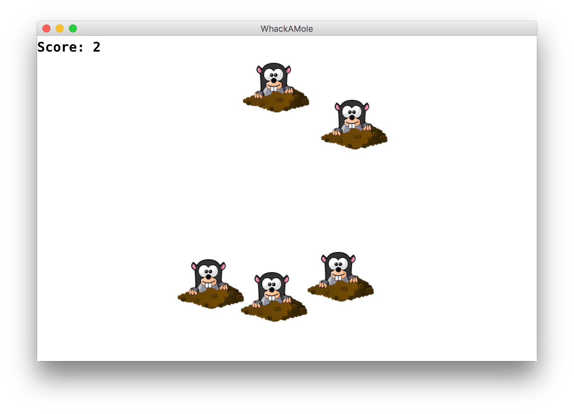
Learning Goals
Learn to respond to mouse events in graphics programs
Notes:
DEMO

Slide 3
Plan for Today
Recap: Lists
Mouse Location
Demo: Doodler
Mouse Clicks
Demo: Polka Dots
find_element_at
Demo: Whack-a-Mole

Slide 4
Plan for Today
Recap: Lists
Mouse Location
Demo: Doodler
Mouse Clicks
Demo: Polka Dots
find_element_at
Demo: Whack-a-Mole

Slide 5
Lists
A list is way to keep track of an ordered collection of items
Items in the list are called "elements"
Ordered: can refer to elements by their position
Collection: list can contain multiple items
The list dynamically adjusts its size as elements are added or removed
Lists have a lot of built-in functionality to make using them more straightforward

Slide 6
Lists
len(list) – get the length of a list
list.append(elem) – add elem to the end
list[i] - get ith element
list[i] = elem – set ith element to elem
list.insert(i, elem) – insert elem at ith index
list.remove(elem) – remove first occurrence of elem
list.count(elem) – get number of occurrences of elem
list.pop(i) – get and remove ith elem
del list[i] - remove ith element
list.clear() – remove all elements from the list
list.index(elem) – get index of elem in the list
You don’t need to memorize these! Just look them up when you need them.

Slide 7
Looping Through Elements
str_list = ['Leia', 'Luke', 'Han’]
for i in range(len(str_list)):
elem = str_list[i]
...

Slide 8
Looping Through Elements
str_list = ['Leia', 'Luke', 'Han']
for i in range(len(str_list)):
elem = str_list[i]
print(elem)
Output:
Leia
Luke
Han

Slide 9
Looping Through Elements
str_list = ['Leia', 'Luke', 'Han']
for i in range(len(str_list)):
elem = str_list[i]
print(elem)
-----
for elem in str_list:
print(elem)
Output:
Leia
Luke
Han

Slide 10
Looping Through Elements
str_list = ['Leia', 'Luke', 'Han']
for i in range(len(str_list)):
elem = str_list[i]
print(elem)
-----
for elem in str_list:
print(elem)
# no i variable here to use
Output:
Leia
Luke
Han

Slide 11
Looping Through Elements
str_list = ['Leia', 'Luke', 'Han']
for i in range(len(str_list)):
elem = str_list[i]
print(elem)
if i + 1 < len(str_list):
# do something with str_list[i + 1]

Slide 12
Plan for Today
Mouse Location
Demo: Doodler
Mouse Clicks
Demo: Polka Dots
find_element_at
Demo: Whack-a-Mole

Slide 13
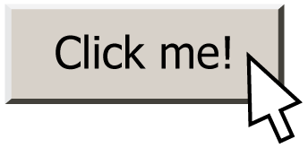
Responding To The Mouse
event: Some external stimulus that your program can respond to.

Slide 14
Events
Mouse clicking
Keyboard keys pressed
Etc.

Slide 15
Events
In our programs, we can ask the canvas if any events have occurred since the last time we asked.
If there are, then we do something.
If there are not, we do nothing and check again later.
while True:
# Handle any new mouse events
# ...
canvas.update()

Slide 16
Plan for Today
Mouse Location
Demo: Doodler
Mouse Clicks
Demo: Polka Dots
find_element_at
Demo: Whack-a-Mole

Slide 17
Mouse Location
At any time, we can ask the canvas for the current location of the mouse.
mouse_x = canvas.get_mouse_x()
mouse_y = canvas.get_mouse_y()

Slide 18
Plan for Today
Mouse Location
Demo: Doodler
Mouse Clicks
Demo: Polka Dots
find_element_at
Demo: Whack-a-Mole

Slide 19
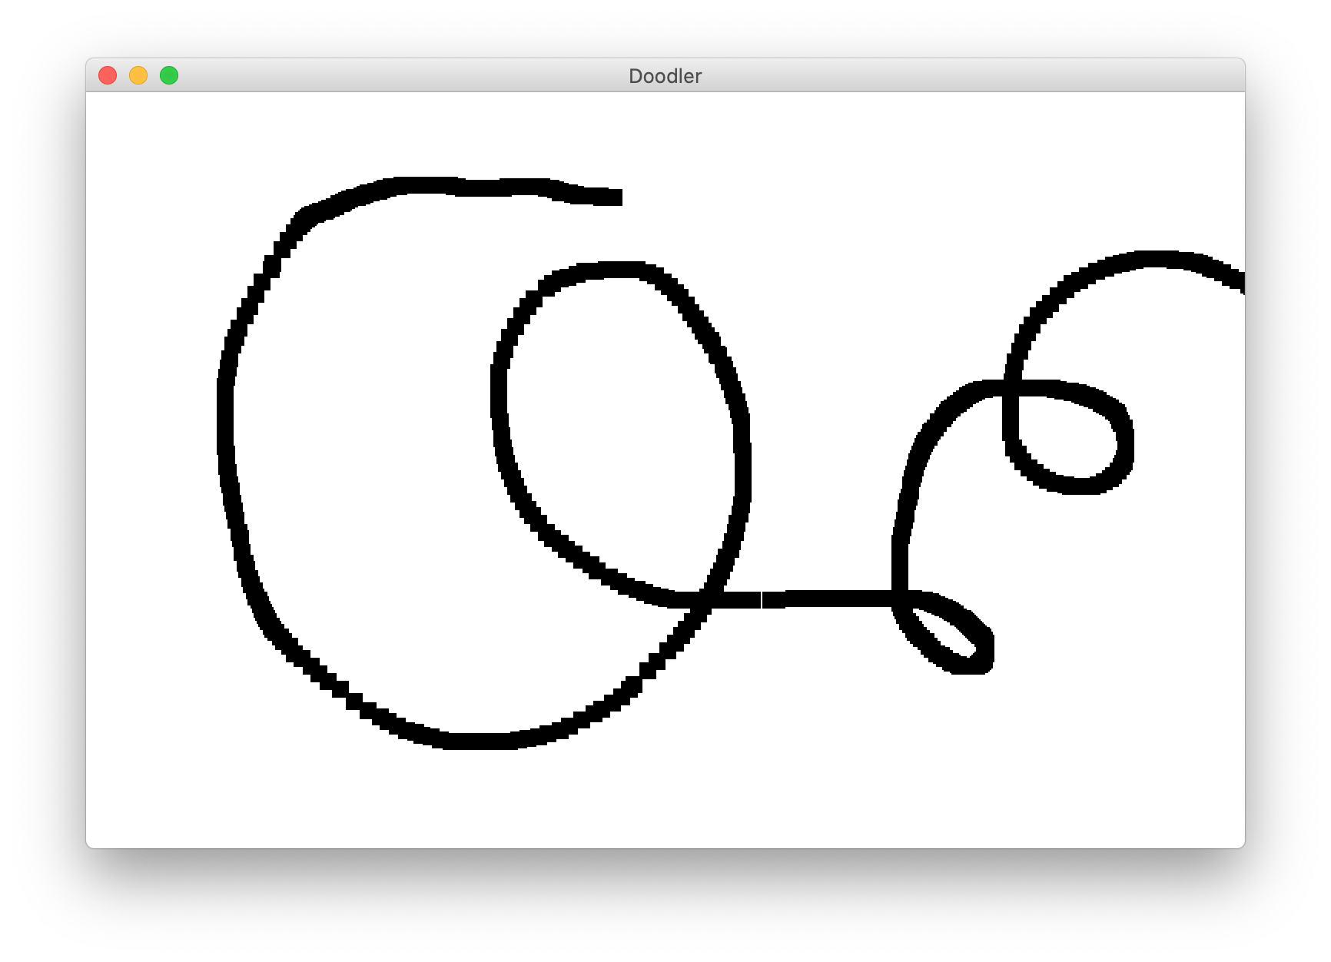
Doodler
Notes:
DEMO

Slide 20
Doodler
SQUARE_SIZE = 10
...
while True:
# Get the mouse location
mouse_x = canvas.get_mouse_x()
mouse_y = canvas.get_mouse_y()
# Create a black rectangle at this location
rect = canvas.create_rectangle(mouse_x, mouse_y,
mouse_x + SQUARE_SIZE,
mouse_y + SQUARE_SIZE)
canvas.set_color(rect, 'black')
canvas.update()
Notes:
Let’s step through

Slide 21
Doodler
SQUARE_SIZE = 10
...
while True:
# Get the mouse location
mouse_x = canvas.get_mouse_x()
mouse_y = canvas.get_mouse_y()
# Create a black rectangle at this location
rect = canvas.create_rectangle(mouse_x, mouse_y,
mouse_x + SQUARE_SIZE,
mouse_y + SQUARE_SIZE)
canvas.set_color(rect, 'black')
canvas.update()
Notes:
Let’s step through

Slide 22
Doodler
SQUARE_SIZE = 10
...
while True:
# Get the mouse location
mouse_x = canvas.get_mouse_x()
mouse_y = canvas.get_mouse_y()
# Create a black rectangle at this location
rect = canvas.create_rectangle(mouse_x, mouse_y,
mouse_x + SQUARE_SIZE,
mouse_y + SQUARE_SIZE)
canvas.set_color(rect, 'black')
canvas.update()
Notes:
Let’s step through

Slide 23
Doodler
SQUARE_SIZE = 10
...
while True:
# Get the mouse location
mouse_x = canvas.get_mouse_x()
mouse_y = canvas.get_mouse_y()
# Create a black rectangle at this location
rect = canvas.create_rectangle(mouse_x, mouse_y,
mouse_x + SQUARE_SIZE,
mouse_y + SQUARE_SIZE)
canvas.set_color(rect, 'black')
canvas.update()
Notes:
Let’s step through

Slide 24
Doodler
SQUARE_SIZE = 10
...
while True:
# Get the mouse location
mouse_x = canvas.get_mouse_x()
mouse_y = canvas.get_mouse_y()
# Create a black rectangle at this location
rect = canvas.create_rectangle(mouse_x, mouse_y,
mouse_x + SQUARE_SIZE,
mouse_y + SQUARE_SIZE)
canvas.set_color(rect, 'black')
canvas.update()
Notes:
Let’s step through

Slide 25
Plan for Today
Mouse Location
Demo: Doodler
Mouse Clicks
Demo: Polka Dots
find_element_at
Demo: Whack-a-Mole

Slide 26
Mouse Clicks
At any time, we can ask the canvas for a list of mouse clicks that have happened since the last time we asked.
clicks = canvas.get_new_mouse_clicks()

Slide 27
Mouse Clicks
Each element in the list has an x and y coordinate of where that click happened.
clicks = canvas.get_new_mouse_clicks()
for click in clicks:
print(click.x, click.y)

Slide 28
Events
Pattern: we make a loop (like for animation), and each time through the loop we check for new mouse clicks, and act on them.
while True:
# Handle any new mouse clicks
# ...
canvas.update()

Slide 29
Plan for Today
Mouse Location
Demo: Doodler
Mouse Clicks
Demo: Polka Dots
find_element_at
Demo: Whack-a-Mole

Slide 30
Example: Polka Dots
while True:
clicks = canvas.get_new_mouse_clicks()
# Add a circle each time the user clicks
for click in clicks:
circle = canvas.create_oval(0, 0,
CIRCLE_SIZE, CIRCLE_SIZE)
canvas.set_color(circle, 'blue')
canvas.update()

Slide 31
Example: Polka Dots 2
while True:
clicks = canvas.get_new_mouse_clicks()
# Add a circle each time the user clicks
for click in clicks:
circle = canvas.create_oval(click.x, click.y,
click.x + CIRCLE_SIZE,
click.y + CIRCLE_SIZE)
canvas.set_color(circle, 'blue')
canvas.update()

Slide 32
Example: Polka Dots 2
while True:
clicks = canvas.get_new_mouse_clicks()
# Add a circle each time the user clicks
for click in clicks:
circle = canvas.create_oval(click.x, click.y,
click.x + CIRCLE_SIZE,
click.y + CIRCLE_SIZE)
canvas.set_color(circle, 'blue')
canvas.update()

Slide 33
Revisiting Doodler
What if we wanted the same square to track the mouse, instead of making a new one each time?

Slide 34
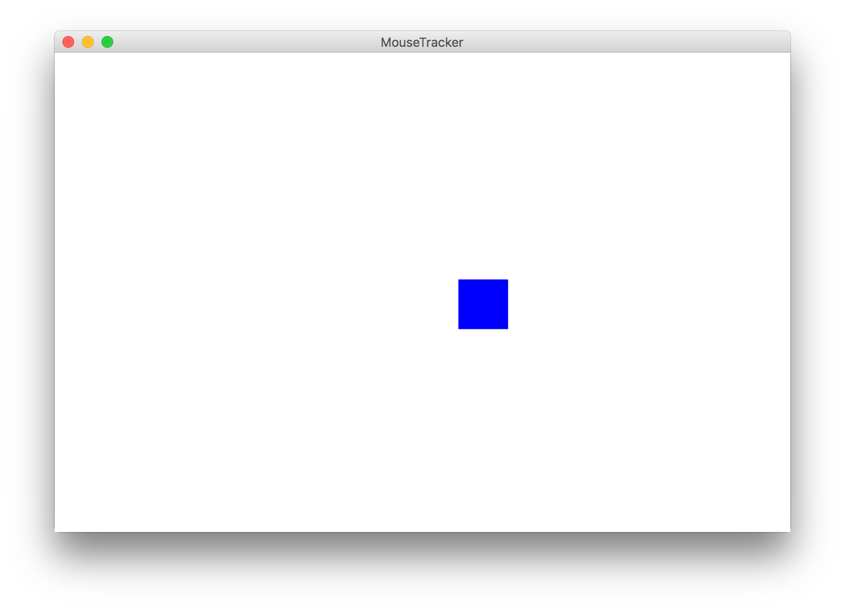
Example: Mouse Tracker

Slide 35
Plan for Today
Mouse Location
Demo: Doodler
Mouse Clicks
Demo: Polka Dots
find_element_at
Demo: Whack-a-Mole

Slide 36
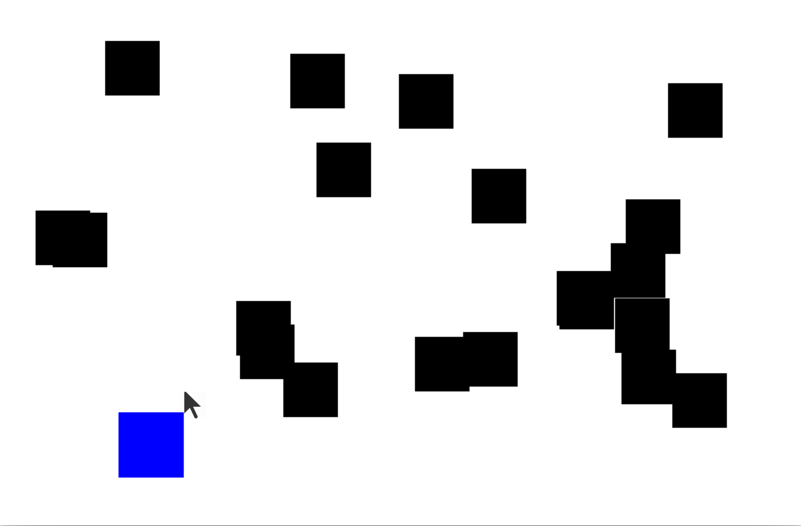
find_element_at

Slide 37
find_element_at
find_element_at returns the object at this location on the canvas.
object_here = canvas.find_element_at(x, y)
Notes:
What is there is no object? How can we check that?

Slide 38
find_element_at
find_element_at returns the object at this location on the canvas.
object_here = canvas.find_element_at(x, y)
if object_here:
// do something with object_here
else:
// nothing at that location
Notes:
This is how we can finish dribbleCastle!

Slide 39
Putting it all together

Slide 40
Plan for Today
Mouse Location
Demo: Doodler
Mouse Clicks
Demo: Polka Dots
find_element_at
Demo: Whack-a-Mole

Slide 41
Whack-A-Mole
Let’s make Whack-A-Mole!
Moles should appear at random locations on the screen over time
If the user clicks a mole, remove it

Slide 42
Recap
Mouse Location
Demo: Doodler
Mouse Clicks
Demo: Polka Dots
find_element_at
Demo: Whack-a-Mole

Slide 43

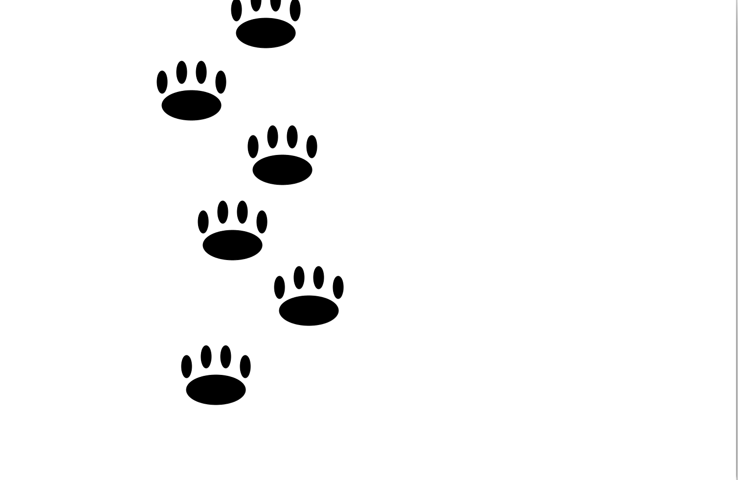

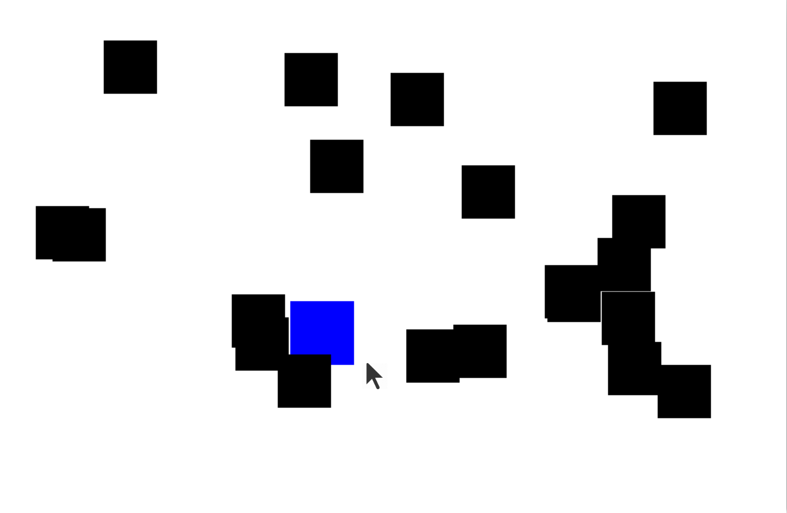
Rest Of Today
Quickstart: Display the coordinates of the mouse as it moves around the screen
Section: Let the user click to make animal tracks. Write a program that animates snow fall.
Project: Make a game where the user must catch the blue square with their mouse!

