Slide 1
AWS
Retail Adjudication
Demo
Prepared by: Ahmet Yazar
Date: Aug.3, 2017

Slide 2
Agenda
Introduction to Lambda(15 mins)
Serverless microservices (30 mins)
Broadcasting messages with SNS (15 mins)
Saga implementation using AWS step functions (15 mins)
Q&A (15 mins)

Slide 3
AWS Lambda
Run code without provisioning or managing servers
Pay only for the compute time you consume
Scales automatically
Built-in Fault Tolerance - AWS Lambda maintains compute capacity across multiple Availability Zones in each region
Supports Java, Node.js, C#, and Python code
Run code in response to multiple events such as
  HTTP requests via Amazon API Gateway
  Modifications to objects in Amazon S3 buckets
  Table updates in Amazon DynamoDB
  State transitions in AWS Step Functions
  SNS notifications
Choose the amount of memory you want to allocate to your functions and AWS Lambda allocates proportional CPU power, network bandwidth, and disk I/O

Slide 4
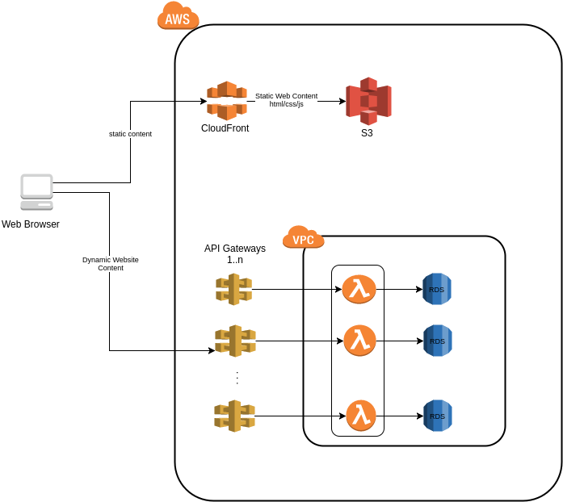
Typical Serverless microservices web architecture

Slide 5
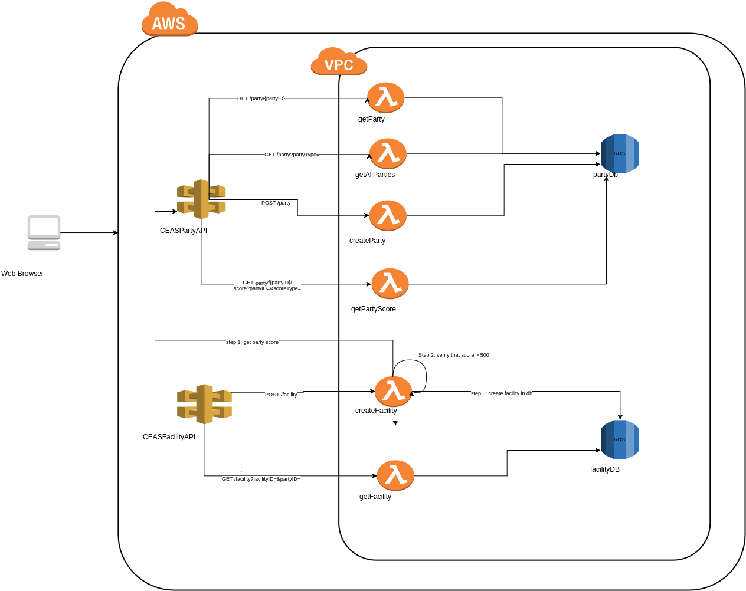
Serverless Microservices for Retail Adjudication Demo

Slide 6
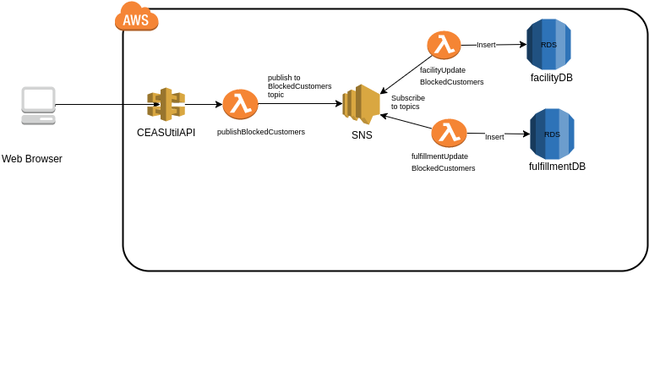
Serverless Microservices for Retail Adjudication Demo

Slide 7
Sagas
Maintains data consistency across services
Long lived transaction is a saga that can be written as a sequence of transactions that can be interleaved with other transactions
Each transaction has a compensating transaction
Either all transactions in a saga are executed or compensating transactions are run to amend a partial execution
Compensating transaction C_i undoes, from a semantic point of view, any of the actions performed by transaction T_i, but does not necessarily return the system to the state existed prior to the execution of T_i was begun.
Compensating actions can also fail, so we need to be able to retry them until success, which means they have to be idempotent.
When a failure interrupts a saga, apply either backward recovery by running compensating transactions, or forward recovery by executing remaining transactions from the last save point.

Slide 8
AWS Step Functions
Creates cloud state machines to execute the steps and coordinate the components of your application in a reliable and scalable fashion
Provides a graphical console to arrange and visualize the components of your application as a series of steps
Automatically triggers and tracks each step, and retries when there are errors, so your application executes in order and as expected
Step Functions logs the state of each step, so when things do go wrong, you can diagnose and debug problems quickly
Automatic scaling
Built-in fault tolerance. Step Functions maintains service capacity across multiple Availability Zones in each region

Slide 9
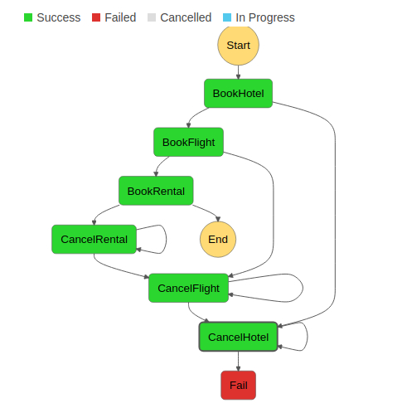
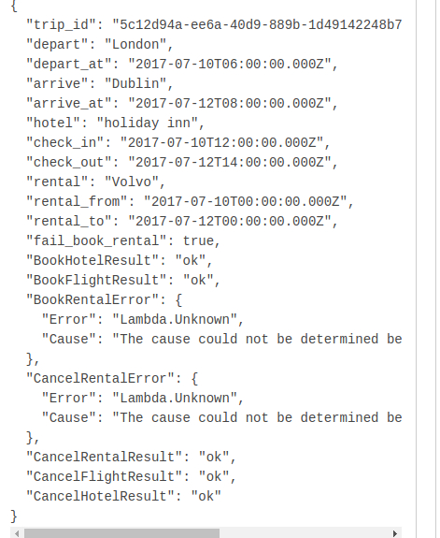
Saga with AWS Step Functions
Acknowledgement: This is taken from http://theburningmonk.com/2017/07/applying-the-saga-pattern-with-aws-lambda-and-step-functions/

Slide 10

Q&A

