Slide 1
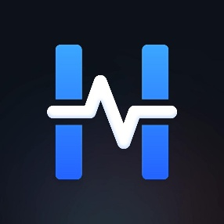

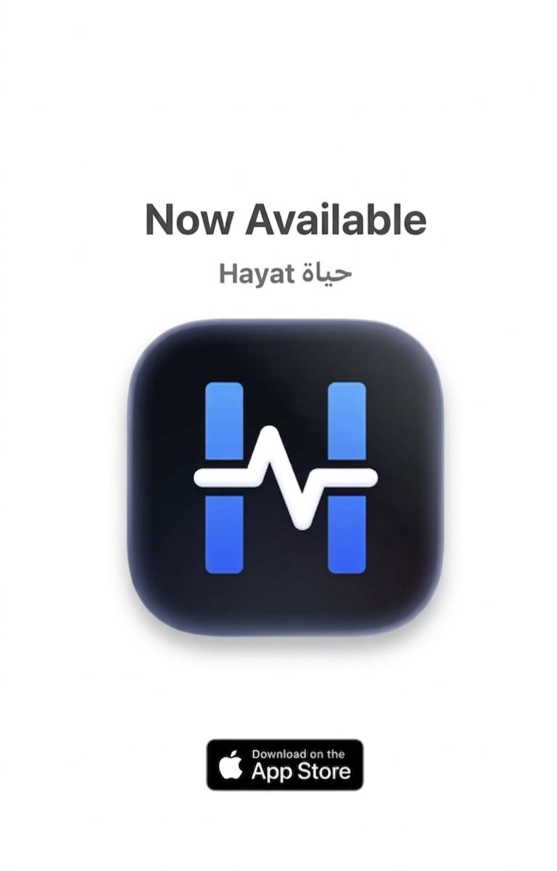
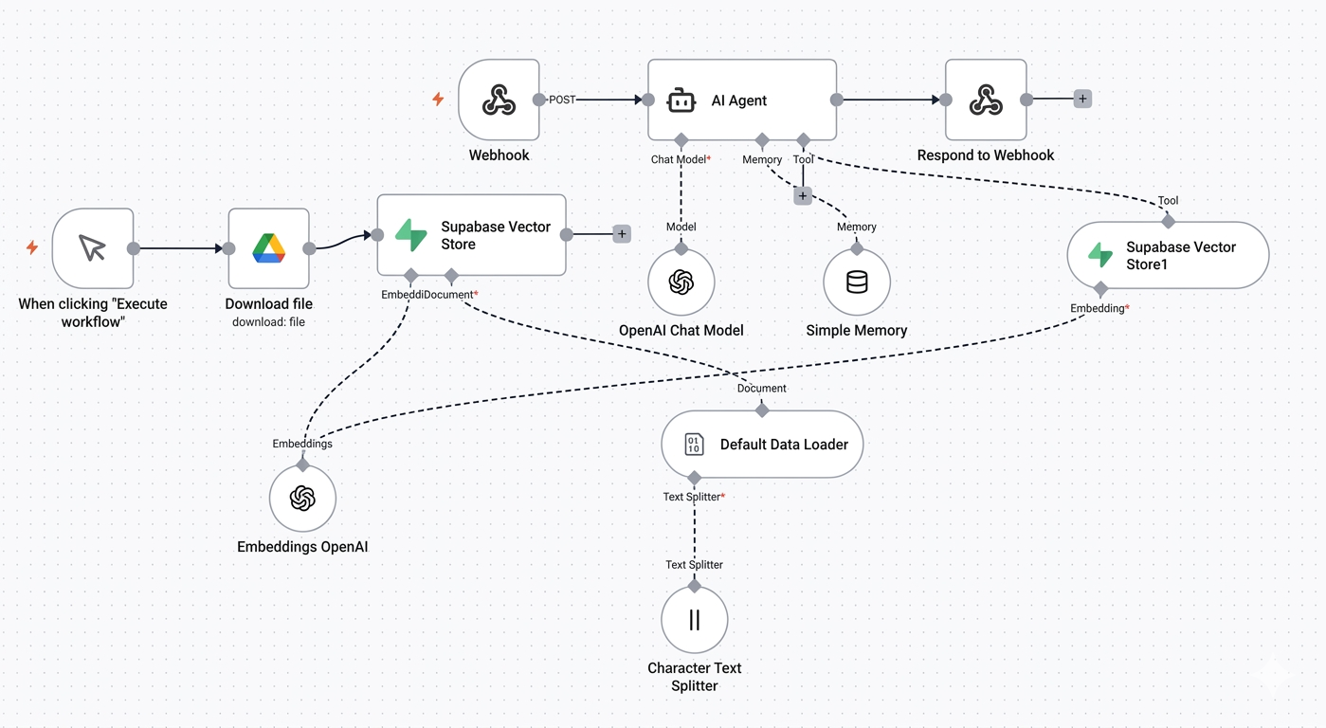
Hayat
Authors: Ahmed Almuhanna, Adam Aljuwayed, Abdulaziz Alabdullatif, Nawaf Aljarrah
Advisor: Dr. Omaia Al-Omari
Introduction
Hayat is a unified mobile healthcare platform that integrates hospitals, practitioners, and medical services into a single digital ecosystem. By centralizing access to care, it streamlines the patient journey from hospital discovery to health management. The platform’s core innovation, Morafiq, is an AI-driven assistant that utilizes intelligent symptom analysis to triage patients toward the most appropriate medical specialties. Ultimately, Hayat enhances healthcare accessibility and efficiency through smart, user-centric technology, aligning with the objectives of digital transformation in health informatics.
Objective
Methodology
Hayat’s main objectives are to:
Provide a unified mobile app that connects hospitals across Riyadh.
Allow users to easily search for hospitals, book appointments, and view doctors
Implement an AI-based assistant (Morafiq) that analyzes and recommends the most suitable doctor
Integrate healthcare services such as prescriptions and allergy tracking
The implementation phase followed an Agile-incremental framework, facilitating continuous development and iterative refinement. The system architecture was decomposed into distinct functional modules, each developed within specific sprints to ensure feature-complete delivery. To maintain technical integrity, Git-based version control was utilized for source code management and collaborative tracking. The implementation strategy prioritized three core pillars: UI/UX usability, secure data encapsulation, and architectural scalability, ensuring the system meets high-performance benchmarks in a healthcare context.
Figure 1. Hayat mobile application
Results
Figure 2. N8n Workflow
-Functional AI-based symptom assistant (Morafiq)
-Integrated modules for prescriptions and allergies
-Fully functional hospital search and filtering system.
-Real-time appointment booking module with availability management.
Conclusion
The development of Hayat confirms that a unified, secure, and intelligent healthcare ecosystem significantly mitigates system fragmentation while optimizing the patient experience. By bridging the gap between disparate providers, the platform establishes a scalable model for interoperable health informatics. The successful delivery of this prototype underscores its viability for large-scale deployment and its capacity for future integration with advanced diagnostic technologies, directly supporting the digital transformation objectives of the Saudi healthcare sector.
Future Directions
- Integration with real hospital APIs.
- Expansions to cities beyond Riyadh
- Cloud deployment for scalability.

