Slide 1
Title: Hayat – Unified Hospital App
Students Names:
Ahmed Almuhanna
Adam Aljuwayed
Abdulaziz Alabdullatif
Nawaf Aljarrah
Supervisor: Dr. Omaia Al-Omari

Slide 2
Problem & Proposed Solution
Healthcare services in Saudi Arabia are fragmented across multiple hospital systems.
Problem
Impact
Solution
Patients must use multiple hospital apps for appointments, lab results and prescriptions.
Patient Challenges
Time Delays
Inefficient booking
Confusion during emergencies
Hayat solution
Unified healthcare platform
AI-powered symptom assistant
Secure centralized access

Slide 3
Project Objectives
The following objectives define the functional scope and strategic direction of the Hayat unified hospital app.
Develop a unified mobile healthcare platform
Enable hospital search and appointment booking
Implement AI-based assistant (Morafiq)
Ensure secure access to medical records

Slide 4

Morafiq
AI Symptom Assistant – Morafiq
• Reduces patient uncertainty during symptom confusion
• Guides users to appropriate medical specialty
• Improves decision making before booking appointments
• Supports faster response during urgent cases
• Enhances overall patient experience

Slide 5
Key Features
1
Secure Login & Authentication
2
Hospital Search & Filtering
3
Real-time Appointment Booking
4
Medical Record Access
5
AI-based Doctor Recommendation
6
Prescription & Allergy Tracking

Slide 6
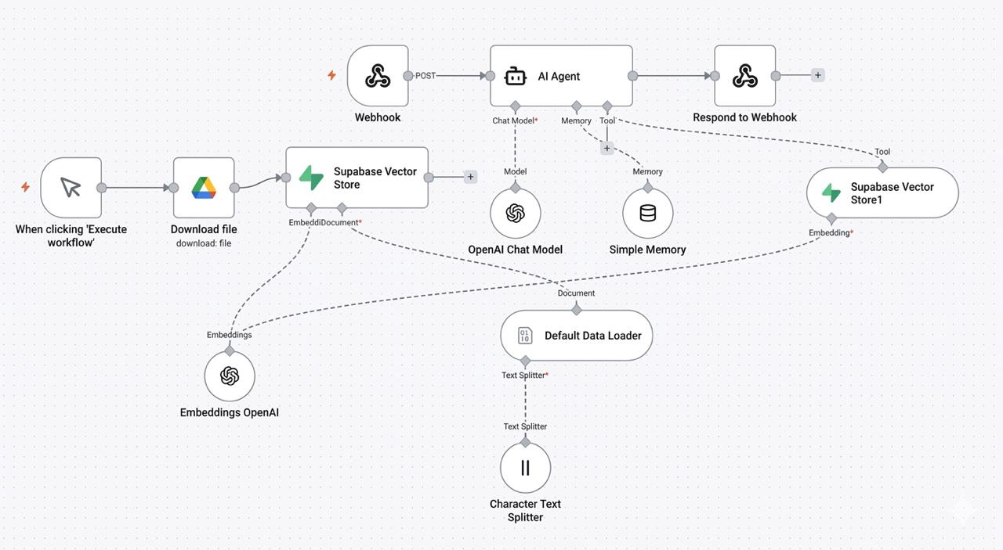
AI-Integrated Healthcare Architecture
• Patient enters symptoms
• Backend triggers n8n workflow
• AI analyzes symptom patterns
• Recommended doctor/specialty returned
• Results displayed in app
Sample Text

Slide 7
System Components
Mobile Application
  Provides patient interface for hospital search, appointment booking, and symptom input.
Backend Server
  Handles authentication, business logic, and communication with hospital APIs.
AI & Integration Layer
  n8n workflow processes symptoms and returns doctor recommendations.

Slide 8
Thank you

