Slide 1
01
02
03
04
8Bit Microprocessor Project
Flowchart
2D Design
Collecting statistics
Results
Supervisor:-DR.Mohamed Youssef

Slide 2
Introduction:
01
02
03
04
An 8-bit microprocessor is a simplified version of the processors used in computers. It can process 8 bits of data at a time and is commonly used for educational purposes. In this project, we designed and simulated a basic 8-bit microprocessor to understand how data flows through different components like the ALU, registers, and control unit.
Flowchart
2D Design
Collecting statistics
Results

Slide 3
01
02
03
04
Our project
Flowchart
2D Design
Collecting statistics
Results

Slide 4
01
02
03
04
Mainly
Components
8Bit Microprocessoror Design
Codes
Project Live Demo

Slide 5
01-Mainly Components
-Program Counter (PC)
-Instruction Memory
-4 × 8-bit Registers
-Arithmetic Logic Unit (ALU)
-Control Unit

Slide 6
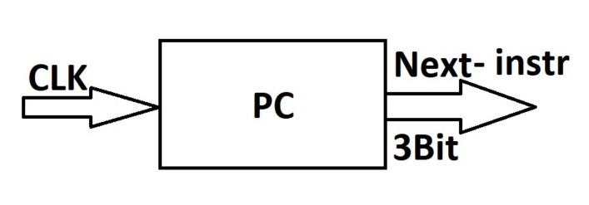
01-Mainly Components
Program Counter (PC):-
-The Program Counter is a small register that holds the address of the next instruction.
-After the processor fetches an instruction, the PC increases automatically to point to the next one.
-Simply, it tells the processor “what to do next.”

Slide 7
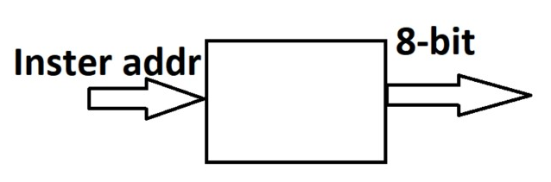
01-Mainly Components
Instruction Memory:-
-Instruction Memory is where all the program instructions are stored.
The processor uses the address from the Program Counter to fetch the instruction from this memory.
-It’s a read-only memory during execution — we don’t change it while the program is running.
-Simply, it’s the place that holds “what to do.”

Slide 8
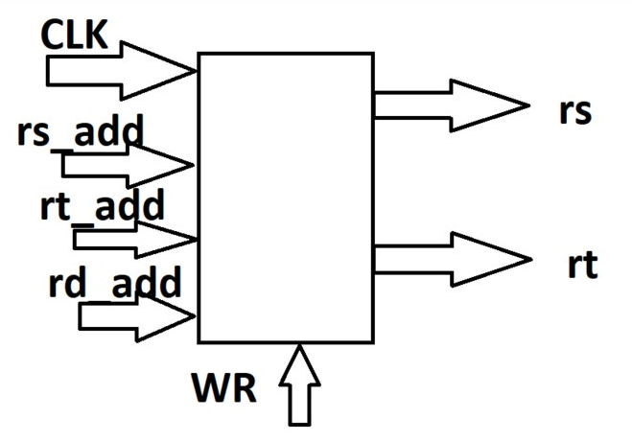
01-Mainly Components
Registers:-
-Our processor has 4 general-purpose registers, each one is 8-bit wide.
We use them to temporarily store data during instruction execution.
-For example, when we load a value, do a calculation, or store a result — we use these registers.
-They are fast and directly connected to the ALU, so they help speed up operations.

Slide 9
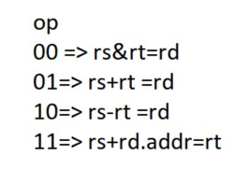
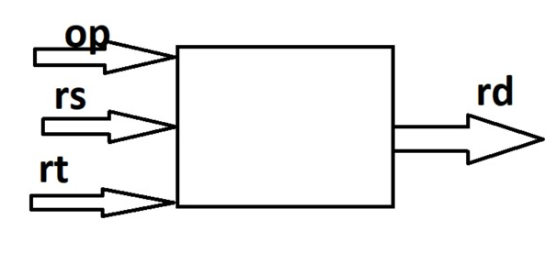
01-Mainly Components
ALU:-
-The ALU is like the calculator of the processor.
-It does math and logic — like add two numbers, or check if values are equal.

Slide 10
01-Mainly Components
Control Unit:-
The Control Unit is like the brain inside the processor.
It reads the instruction and tells all other components what to do.
For example, it decides which registers to use, what operation the ALU should perform, and when to read or write data.
Simply, it controls the flow of the entire microprocessor.

Slide 11
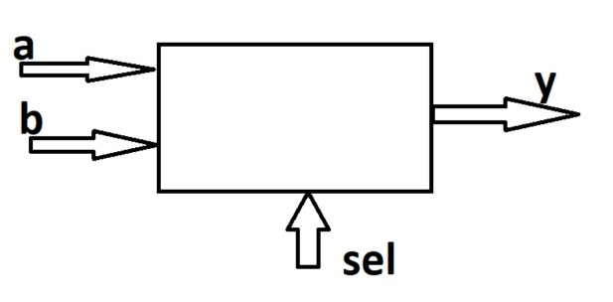
01-Mainly Components
MUX0:- MUX1:-
a=> addr of reg2 a=>default data
b=>default destination addr b=>constant data
y=>distination addr y=>output data
2Bit 8Bit

Slide 12
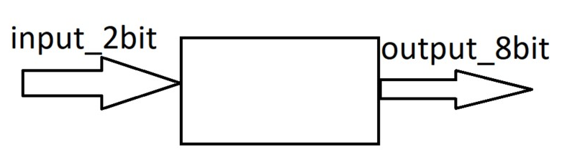
01-Mainly Components
Signal Extend:-
-Convert 2 bits to 8 bits

Slide 13
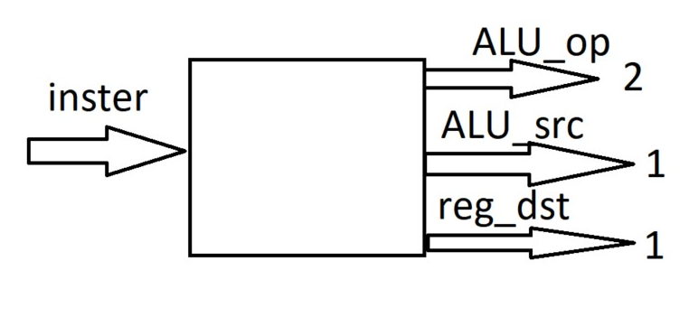
01-Mainly Components
Control Unit:-
ALU_src=> selection line of mux1
Reg_dst=> selection line of mux0

Slide 14
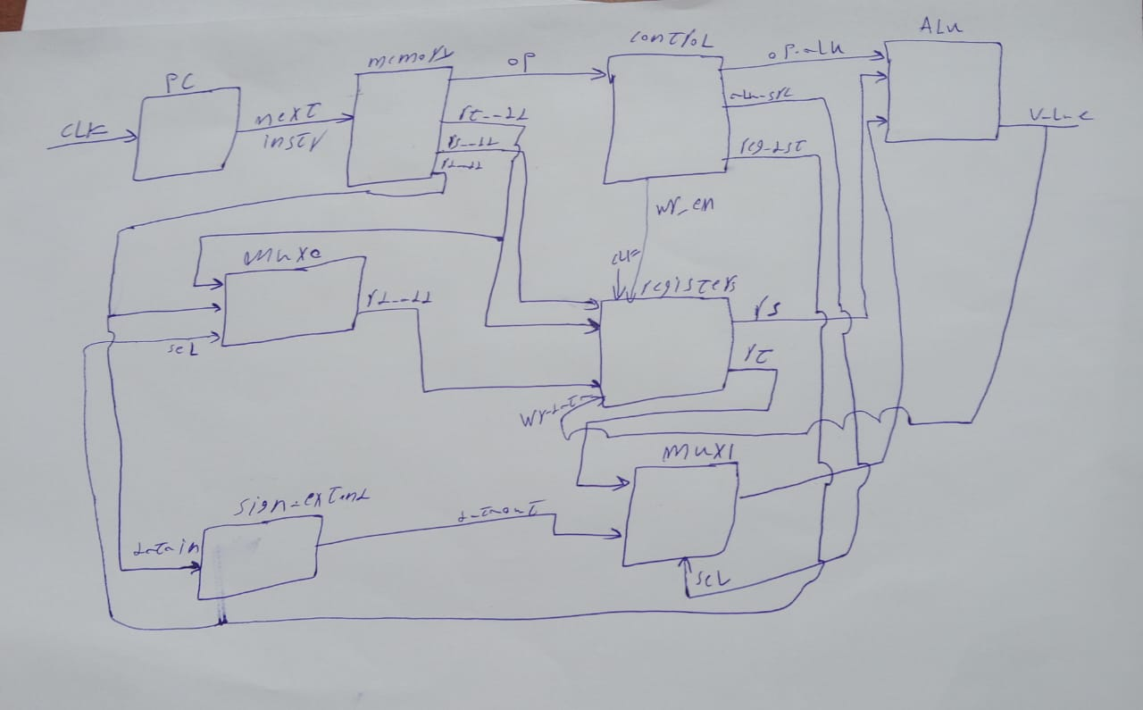
02-8Bit Microprocessoror Design

Slide 15
03-Codes

Slide 16
04- Project Live Demo

Slide 17
Thank you

