Slide 1

Telecom Egypt
Intelligent Assistant
Local On-Prem RAG Assistant for WE Services and Uploaded Documents
Ahmed Mohamed Ahmed
Assessment focus
Fully local retrieval, generation, uploaded-document processing, and monitoring.
GitHub: https://github.com/ahmudmuhamad/telecom-egypt-rag
Local/on-prem RAG assistant | 01

Slide 2
PROBLEM STATEMENT
Customers need trusted answers across scattered WE knowledge.
Many question types
Fragmented sources
Citations required
Packages, codes, services, devices, bills, and uploaded documents.
Information is spread across web pages, FAQs, scraped content, and files.
Answers need reliable source markers, not generic chatbot confidence.
Assessment constraint
The project must operate locally/on-premise, so the core assistant cannot depend on a cloud API-only chatbot pattern.
Local/on-prem RAG assistant | 02

Slide 3
SOLUTION OVERVIEW
The assistant grounds answers in local indexes and local model execution.
Official WE
knowledge base
Hybrid retrieval
Grounded
answers with
citations
Streamlit UI
+
Prometheus/Grafana
→
Dense Qdrant + sparse BM25
RRF fusion
Optional reranker
→
→
Uploaded
documents
Everything runs inside the local/on-prem environment: user queries, uploaded files, indexes, models, and monitoring.
Local/on-prem RAG assistant | 03

Slide 4
END-TO-END ARCHITECTURE
The answer path stays local from interface to citations.
Local machine / on-prem server boundary
User
→
Streamlit
UI
→
Query
Router
→
Hybrid
Retriever
→
Qdrant
+ BM25
→
Optional
Reranker
→
Answer
Generator
→
Ollama
↓
Answer with
citations
Uploaded documents
Local monitoring
Docling/OCR extracts PDF, DOCX, TXT, HTML, images, and screenshots locally.
Prometheus and Grafana track latency, errors, fallbacks, reranking, and citation quality.
Local/on-prem RAG assistant | 04

Slide 5
DATA PIPELINE
Scraped WE content becomes a unified local knowledge base.
Scraping
→
Post-processing
→
Unified KB
→
Chunking
→
Embeddings
→
Qdrant Index
+ BM25 Index
Current categories
Expansion path
FAQ | Devices | Services | WE Home
More categories can be added through config/kb_sources.yaml.
Local/on-prem RAG assistant | 05

Slide 6
HYBRID RETRIEVAL
Dense semantics and exact matching cover different failure modes.
Dense retrieval
Sparse retrieval
RRF fusion
Qdrant finds semantically similar WE service chunks.
BM25 preserves exact codes, prices, package names, and keywords.
Reciprocal Rank Fusion combines both result lists before generation.
Exact terms the retriever must respect
*550# 5 قروش 500 EGP WE Space packages
Local/on-prem RAG assistant | 06

Slide 7
RERANKING LAYER
A lightweight precision step is available when retrieval returns similar chunks.
Hybrid candidate set
CrossEncoder reranker
Qwen/Qwen3-Reranker-0.6B
Sharper context
for generation
→
→
• Improves precision when many chunks look relevant.
• Useful for close package names, service variants, and document overlap.
• Can be disabled for faster CPU inference.
Local/on-prem RAG assistant | 07

Slide 8
GROUNDED ANSWER GENERATION
The assistant answers from retrieved sources and falls back safely.
Grounding rules
Fallback safety
Example
• Use retrieved sources only.
• Require citation markers like [1], [2].
• Keep answer concise and user-facing.
• If the model omits citations, deterministic grounded fallback is used.
• Fallback keeps the answer tied to visible source snippets.
كود معرفة الرصيد هو *550#، ورسوم الخدمة 5 قروش. [1]
Local/on-prem RAG assistant | 08

Slide 9
UPLOADED DOCUMENTS
Docling/OCR brings user files into the same local retrieval path.
PDF
DOCX
TXT
HTML
Images
Screenshots
↓
Docling/OCR extracts text locally
Citation shape
[1] Uploaded document — test_doc.txt
↓
Uploaded-doc hybrid retrieval: dense Qdrant + BM25
Local/on-prem RAG assistant | 09

Slide 10
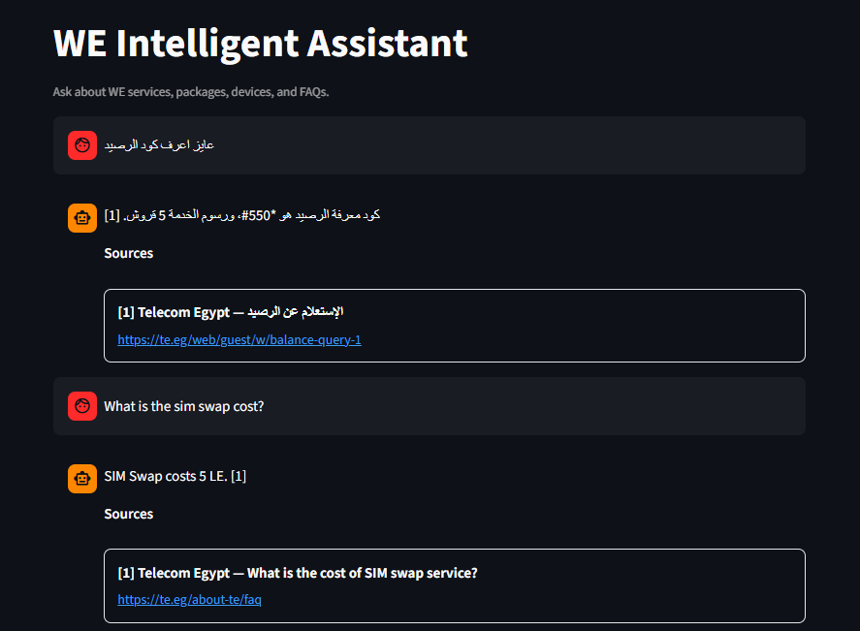
STREAMLIT END-USER UI
The chat surface exposes answers and citations, not debug internals.
• Clean user-facing chat.
• Shows only answer and citations.
• No debug/model/retrieval details.
• Source mode: Official, Uploaded, Both.
Reviewer experience
Ask a WE question, get a cited local answer.
Local/on-prem RAG assistant | 10

Slide 11
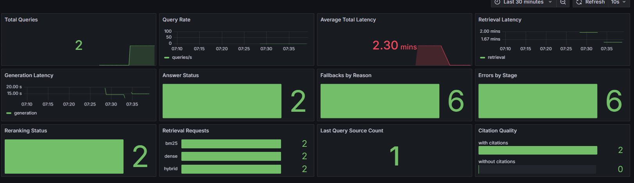
OBSERVABILITY
Local metrics make answer quality and system health visible.
• Prometheus metrics.
• Grafana dashboard.
• Queries, latency, fallbacks, errors.
• Reranking and citation quality.
• Monitoring stays local.
Local/on-prem RAG assistant | 11

Slide 12
COST OPTIMIZATION STRATEGY
The system avoids expensive local generation work when cheaper paths are enough.
Query routing
Pipeline routing
Model routing
Hybrid retrieval
Avoid unnecessary generation.
Fast / standard / deep paths.
Architecture ready for model tiers.
Smaller, more relevant prompt context.
Context compression
Optional reranking
Deterministic fallback
Future cache
Reduce tokens before generation.
Use precision only when it pays off.
Answer safely without repeat inference.
Redis exact cache + Qdrant semantic cache.
Local/on-prem RAG assistant | 12

Slide 13
EVALUATION AND VALIDATION
Current validation proves the flow without publishing retrieval metrics yet.
✓
Generation validation script exists
✓
Uploaded TXT test passed
Next metrics gate
✓
Screenshot/image OCR test passed
Retrieval evaluation will be rerun after full website scraping and re-indexing.
✓
Observability dashboard validated
✓
Streamlit UI tested end-to-end
Local/on-prem RAG assistant | 13

Slide 14
ON-PREMISE LOCAL DEPLOYMENT
The project is designed for local infrastructure, aligned with the assessment requirement.
• No external LLM API is required.
• Ollama runs local embedding and generation models.
• Qdrant stores vectors locally; BM25 indexes are local files.
• Docling/OCR processes uploaded files locally.
• Streamlit, Prometheus, and Grafana run locally.
• Uploaded documents and user queries stay inside the environment.
• Docker Compose orchestrates local infrastructure.
• Development can use Docker infrastructure + local Streamlit; demos can be fully Dockerized.
Local Machine / On-Prem Server
Streamlit
Ollama
Qdrant
BM25
Docling/OCR
Prometheus/Grafana
Local/on-prem RAG assistant | 14

Slide 15
FUTURE WORK
The roadmap expands source coverage, product depth, and production readiness.
Knowledge scale
Agentic advisor
Full website scraping and re-indexing
WE Home post-processing cleanup
Compare requested Max plan with the user's current plan
Suggest upgrade or renewal options
Performance
Productization
Redis exact cache and semantic cache
Context and retrieval tuning
FastAPI backend
Authentication and persistent sessions
Production deployment
Local/on-prem RAG assistant | 15

Slide 16
DEMO FLOW
The reviewer can see official answers, uploaded-document answers, and live metrics.
1
Ask official WE question
كود معرفة الرصيد كام؟
2
Ask FAQ
What is the SIM swap cost?
3
Upload TXT/image document
Docling/OCR extracts locally
4
Ask about uploaded content
Answer cites uploaded source
5
Show Grafana update
Metrics change after queries
Local/on-prem RAG assistant | 16

Slide 17
CONCLUSION
The project is a local RAG foundation ready to expand into full WE support.
Local/on-prem assistant
Hybrid retrieval
Citations and fallback safety
Uploads with Docling/OCR
Observability
Ready for full-site and agentic support
Telecom Egypt Intelligent Assistant
Local/on-prem RAG assistant | 17

