Slide 1
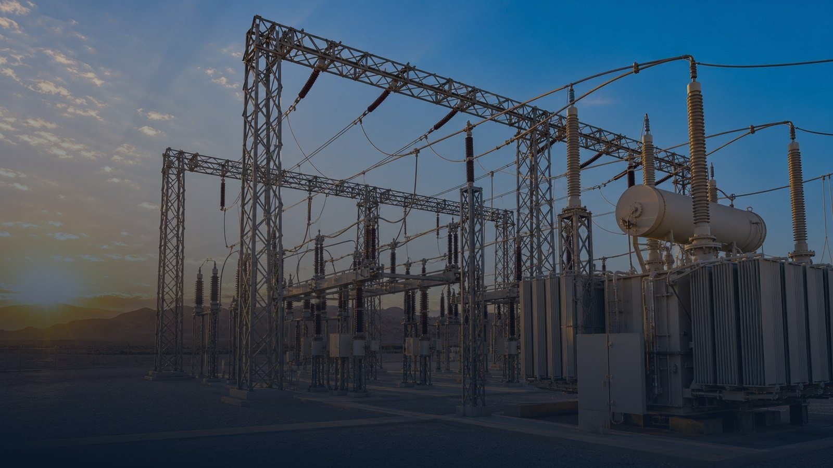

Management & Staff EHS Induction
KAZ Power Plant Upgrade Project
Khor Al-Zubair Gas Turbine Power Plant · Basrah, Iraq
Client: Ministry of Electricity (MoE) & Basrah Gas Company (BGC) · Principal Contractor: Siemens Energy
Subcontractor: Al-Mial Company
Prepared by: Ahmed Al-Mansoury | EHS Manager – Siemens
KAZ-EHS-IND-001 · Rev. 06 · For review and approval
Restricted · © Siemens Energy · Siemens Energy is a trademark licensed by Siemens AG
Notes:
Welcome participants, confirm fire exits and assembly point for the training room, and state that attendance is recorded. Introduce yourself and the EHS team.

Slide 2

01
Introduction and Objectives
How this session runs, what you will learn and what is recorded.
Session format · Learning objectives · Validity · Assessment
KAZ-EHS-IND-001 · Rev. 06 · Restricted
Slide 2 of 63
Notes:
Chapter 01 — Introduction and Objectives. How this session runs, what you will learn and what is recorded. This chapter covers: Session format, Learning objectives, Validity, Assessment.

Slide 3

CHAPTER 01 · INTRODUCTION AND OBJECTIVES
How This Session Runs
Emergency instructions for the training room
تعليمات الطوارئ لقاعة التدريب — عند سماع الإنذار المستمر اتبع علامات الخروج إلى نقطة التجمع
▪
If an emergency occurs during this induction: stop, follow the exit signs and go to the nearest assembly point.
▪
Alarm signals: continuous siren = evacuate · intermittent = stand by · all-clear = return to work.
▪
Mobile phones on silent — keep your phone available for emergencies.
▪
Smoking is prohibited except in the designated smoking area, and never in red / restricted zones.
▪
Duration: approx. 90 minutes, including the knowledge check and questions.
Emergency numbers are on slide 54 — know them before you leave this room.
KAZ-EHS-IND-001 · Rev. 06 · Management & Staff EHS Induction · Restricted
01 · Introduction and Objectives
Slide 3 of 63
Notes:
Read the emergency arrangements of the training venue aloud. Confirm the assembly point location and the site emergency line before starting the content.

Slide 4
COURSE STRUCTURE
Contents
Six chapters — about 90 minutes, including the knowledge check
01
Introduction and Objectives
02
EHS Leadership and Responsibilities
How this session runs, what you will learn and what is recorded.
The EHS Policy, the governing Standard and who is accountable for what on this site.
03
The Project, the Site and Daily Rules
04
Permit to Work and Electrical Safety
Where you are working, how the site is organised and the rules that always apply.
The control system for hazardous work and the rules that keep the plant safe.
05
High-Risk Activities and Occupational Health
06
Environment, Emergency and Security
The activities that cause the most serious injuries and how each one is controlled.
Protecting the environment, responding to emergencies, security and the consequences of breaking the rules.
KAZ-EHS-IND-001 · Rev. 06 · Management & Staff EHS Induction · Restricted
01 · Introduction and Objectives
Slide 4 of 63
Notes:
Walk through the six chapters quickly. Point out that the operators' own rule set is issued separately and that the knowledge check comes at the end.

Slide 5
CHAPTER 01 · INTRODUCTION AND OBJECTIVES
Learning Objectives
At the end of this induction you will be able to:
▪
State the Siemens EHS target and the EHS Policy commitments, and explain what they mean for your work.
▪
Describe your personal responsibilities and the authority you hold to stop unsafe work.
▪
Apply the general site rules and select the correct PPE for your task.
▪
Read a risk assessment, complete an LMRA and know when an SJA is required.
▪
Explain how the Permit to Work and LOTO systems operate on this site.
▪
Recognise the electrical, height, lifting, excavation, confined-space and hot-work hazards of KAZ.
▪
Respond correctly to a fire, an emergency, an injury, a spill or a security event.
▪
Report incidents, near misses and unsafe conditions within the required timeframes.
KAZ-EHS-IND-001 · Rev. 06 · Management & Staff EHS Induction · Restricted
01 · Introduction and Objectives
Slide 5 of 63
Notes:
Link each objective to the participant's own role — managers and staff are expected to lead, verify and coach, not only comply.

Slide 6
CHAPTER 01 · INTRODUCTION AND OBJECTIVES
Validity, Assessment and Records
This induction is part of your site authorisation
▪
Validity: 12 months from the date of attendance; renewal is required on expiry.
▪
Re-induction is required after a serious incident or when the hazards of your work change.
▪
Knowledge check: 11 questions — pass mark 80% (9 correct). Below 80% you are retrained before site access.
▪
Your attendance and signature are recorded in the site training register.
▪
You must also complete Personal Safety Instruction (PSI) and, for high-risk activities, the Siemens Energy Safe Start session.
▪
The induction card must be carried and shown on request — it does not replace the Permit to Work.
▪
Minimum age for site access: 18 years.
KAZ-EHS-IND-001 · Rev. 06 · Management & Staff EHS Induction · Restricted
01 · Introduction and Objectives
Slide 6 of 63
Notes:
Confirm that supervisors will be checked for valid induction, PSI and task certificates. Underline that the card is not a work permit.

Slide 7
02
EHS Leadership and Responsibilities
The SE EHS Policy, the governing Standard, the Zero Harm target and who is accountable on this site.
Zero Harm · EHS Policy · Standard 000050 · Leadership · Everyone · Contractors
KAZ-EHS-IND-001 · Rev. 06 · Restricted
Slide 7 of 63
Notes:
Chapter 02 — EHS Leadership and Responsibilities. The Siemens EHS target and who is accountable for what on this site. This chapter covers: Zero Harm, EHS Target, Leadership, Everyone, Contractors.

Slide 8

CHAPTER 02 · EHS LEADERSHIP AND RESPONSIBILITIES
Siemens EHS Target — Our Vision
Derived from the KAZ Project EHS Plan (Section 5)
▪
Our standard for EHS is excellence — it must exceed customer expectations.
▪
The project will promote a Zero-Harm culture that prevents damage to people, the environment and equipment.
▪
Project target: zero harm — measured as Zero H1 = ZERO (no lost-time injuries).
▪
Where EHS, progress and finances appear to conflict, EHS always prevails.
▪
Health and safety are conditions of every activity — never a trade-off against schedule.
Zero Harm is not a slogan: it is the way we plan, verify and behave on this site.
Zero Harm — we take care of each other
KAZ-EHS-IND-001 · Rev. 06 · Management & Staff EHS Induction · Restricted
02 · EHS Leadership and Responsibilities
Slide 8 of 63
Notes:
This is the vision slide. Connect the EHS Plan target to the daily reality: every task planned, every control verified, every person home safely.

Slide 9
CHAPTER 02 · EHS LEADERSHIP AND RESPONSIBILITIES
The Zero Harm Framework
Principles · Behaviours · Essentials
صفر حوادث هدف ممكن التحقيق · لا نساوم على السلامة · نعتني ببعضنا البعض
▪
Principles:
•
Zero incidents is achievable.
•
Health and safety — no compromises.
•
We take care of each other.
▪
Behaviours:
•
Take the time to assess risk — plan and organise every job before you start.
•
Talk about safety before the work and again during the shift.
•
If a task cannot be done safely, or conditions change — stop and re-assess.
•
Follow the rules and procedures, including site-specific rules and PPE.
•
Intervene when you see risk — never walk by.
▪
Essentials: Stop principle · safe systems of work · competency · risk assessment · permit to work · PPE · emergency preparedness.
KAZ-EHS-IND-001 · Rev. 06 · Management & Staff EHS Induction · Restricted
02 · EHS Leadership and Responsibilities
Slide 9 of 63
Notes:
Ask the group for one example of intervening on an unsafe act. Reinforce that interventions are expected and will never be penalised.

Slide 10
CHAPTER 02 · EHS LEADERSHIP AND RESPONSIBILITIES
The Siemens Energy EHS Policy
Signed by the Executive Board · Version 4 · December 2024 · Annex 1 to SE Standard 000050
تحدّث ولا تمرّ بجانب الخطأ — من حقك إيقاف أي عمل أو سلوك غير آمن
▪
The Siemens Energy EHS Policy (V4, December 2024) is signed by the SE Executive Board and binds every SE unit, project and affiliated company — guided by our values: Caring, Agility, Respect and Accountability.
▪
Four principles drive our Zero Harm culture: Zero Harm is achievable · we do not compromise · we take care of each other · we develop locally and share globally.
▪
We identify, assess and manage hazards and risks; we prevent injury and ill health; we report and investigate all incidents to prevent reoccurrence.
▪
Speak up — don't walk by: every employee is empowered to stop any unsafe behaviour or situation.
▪
We protect people, the environment, energy and natural resources — and promote health and well-being.
▪
We comply with legislation, regulations and standards, working in partnership with our customers on EHS — on this site the stricter of Iraqi law and SE requirements always applies.
▪
Managers own EHS decisions in their areas; employees are trained, qualified and competent, responsible for their own safety and that of others — and everyone acts as a role model.
▪
We engage and communicate with employees, subcontractors, suppliers and stakeholders on EHS, and the policy is reviewed and continuously improved with full Executive Board support.
KAZ-EHS-IND-001 · Rev. 06 · Management & Staff EHS Induction · Restricted
02 · EHS Leadership and Responsibilities
Slide 10 of 63
Notes:
This is the corporate EHS Policy (Version 4, December 2024), Annex 1 of SE Standard 000050, signed by the full SE Executive Board — CEO Christian Bruch, CFO Maria Ferraro and the board members. It covers four commitment blocks: the four Zero-Harm principles; protecting people and the environment; embedding the principles through leadership, competent employees and role-modelling; and sustaining the culture through engagement, consultation, partnership with customers and continuous improvement. The full policy text must be displayed in the EHS office and training room. Stress 'Speak up - don't walk by': everyone on this site is empowered to stop unsafe work.

Slide 11
CHAPTER 02 · EHS LEADERSHIP AND RESPONSIBILITIES
EHS Governance — SE Standard 000050
Where the rules of this induction come from
مصدر قواعد هذا الاندكشن: معيار سيمينز 000050 وأنظمة ISO 45001 / ISO 14001
▪
This induction implements SE Standard 000050 (V3) 'EHS Principles and Core Responsibilities' — valid worldwide for all Siemens Energy units and affiliated companies.
▪
The Standard defines EHS roles and responsibilities and the governance of EHS, aligned with the Zero Harm Framework (Standard 000118).
▪
EHS management systems across SE follow ISO 45001 (occupational health and safety) and ISO 14001 (environment) — our site system uses the same structure.
▪
All work activities are risk-assessed before they start; hazards that threaten life or the environment must be eliminated before work begins or continues.
▪
All incidents are reported in the SE EHS reporting tool (Enablon) — Standard 000051 'EHS Reporting'.
▪
Everyone must be trained, qualified and competent; awareness of the Zero Harm Principles, Behaviours and Essentials is mandatory.
▪
Emergency plans are established, exercised and evaluated — drills are part of site life.
▪
Consultation and participation: your feedback on safety is required, two-way and protected — speak to your supervisor or EHS.
KAZ-EHS-IND-001 · Rev. 06 · Management & Staff EHS Induction · Restricted
02 · EHS Leadership and Responsibilities
Slide 11 of 63
Notes:
Explain the governance chain: SE Standard 000050 (V3) defines EHS roles and responsibilities and aligns with the Zero Harm Framework (Standard 000118). The site EHS system mirrors ISO 45001 / ISO 14001. Highlight what reaches the worker: risk assessment before every activity, elimination of life-threatening hazards, Enablon reporting (Standard 000051), competency, emergency preparedness and consultation.

Slide 12
CHAPTER 02 · EHS LEADERSHIP AND RESPONSIBILITIES
Core Responsibilities by Role
From the Executive Board to every worker — SE Standard 000050, Section 2
▪
Executive Board — owns the EHS policy, monitors implementation and reviews EHS performance; EHS is integrated into strategic decisions.
▪
Senior management (n-1) — implements EHS management systems, provides resources, ensures legal compliance and delegates EHS roles to competent people.
▪
Management (n-2) — accountable for EHS processes and procedures, incident investigation and root cause analysis, and performance monitoring.
▪
Project Entity and Global Functions — apply the EHS Policy on projects: hazard identification, risk assessment, training, consultation and reporting.
▪
EQS / EHS function — governance, targets, performance monitoring, competency and investigation support.
▪
Country EHS Lead / Regional Hub — legal compliance, KPI reporting and best-practice sharing.
▪
Employees (including temporary workers) — care for yourself and others, report hazards and near misses, follow risk assessments, comply with law and SE requirements, protect the environment.
▪
On this site the chain becomes: Project Director → EHSMIP → Contractor EHS → Supervisors → You (see slide 21).
KAZ-EHS-IND-001 · Rev. 06 · Management & Staff EHS Induction · Restricted
02 · EHS Leadership and Responsibilities
Slide 12 of 63
Notes:
Walk the responsibility ladder from the Executive Board down to every worker, per SE Standard 000050 section 2. Stress that accountability flows downward but duties exist at every level; temporary and contractor workers carry the same employee duties. Then map the ladder to the KAZ organisation chart on slide 20.

Slide 13
CHAPTER 02 · EHS LEADERSHIP AND RESPONSIBILITIES
Leadership Responsibilities
For managers, engineers and supervisors
▪
Own EHS in your area — you are accountable for the people and the tasks you control.
▪
Provide the resources: competent people, correct tools, valid PPE, adequate time.
▪
Verify compliance — check permits, certificates, controls and housekeeping every day.
▪
Lead visibly: safety walks, toolbox talks, safety stand-downs and recognition of good practice.
▪
Make EHS the first agenda item in every formal meeting and record it in the minutes.
▪
Stop any work you consider unsafe, and support anyone who stops work.
▪
Ensure incidents and near misses are reported and investigated — and lessons are applied.
KAZ-EHS-IND-001 · Rev. 06 · Management & Staff EHS Induction · Restricted
02 · EHS Leadership and Responsibilities
Slide 13 of 63
Notes:
This is the key audience for this induction. Ask each manager to commit to one visible action within the next 7 days.

Slide 14
CHAPTER 02 · EHS LEADERSHIP AND RESPONSIBILITIES
Everyone's Responsibilities
Applies to employees, contractors and visitors
اعتنِ بسلامتك وسلامة من حولك · التزم بالقواعد والتصاريح · أبلغ عن كل خطر وحادث
▪
Take care of your own health and safety and that of everyone around you.
▪
Comply with site rules, permits, method statements and instructions.
▪
Report hazards, incidents, near misses, unsafe acts and unsafe conditions.
▪
Use and maintain PPE correctly; never work with defective equipment.
▪
Attend inductions, PSI, toolbox talks and task-specific training.
▪
Never work under the influence of alcohol or drugs — random testing is enforced.
▪
Protect the environment: prevent spills, segregate waste, conserve energy and water.
▪
Participate in risk assessments for your own tasks — you know the job best.
KAZ-EHS-IND-001 · Rev. 06 · Management & Staff EHS Induction · Restricted
02 · EHS Leadership and Responsibilities
Slide 14 of 63
Notes:
Emphasise the duty to report. Remind the group that honest reporting is protected by the just-culture approach: no blame for reporting.

Slide 15
CHAPTER 02 · EHS LEADERSHIP AND RESPONSIBILITIES
Contractor & Subcontractor Obligations
How we work together
▪
Each contractor works to its own EHS system, enriched with Siemens Energy, Client and project requirements.
▪
Every contractor appoints a competent Contractor EHS Representative.
▪
Contractors provide: risk assessments, method statements, permits, competency certificates and equipment certificates.
▪
Monthly man-hours and incident data are submitted to the EHS Department.
▪
Siemens Energy may stop work, suspend, exclude or ban individuals for EHS violations — at the contractor's cost.
▪
Where local legal requirements differ from Siemens Energy requirements, the stricter requirement applies.
KAZ-EHS-IND-001 · Rev. 06 · Management & Staff EHS Induction · Restricted
02 · EHS Leadership and Responsibilities
Slide 15 of 63
Notes:
Remind subcontractor managers of the documentation they must keep current; the EHS team audits it.

Slide 16
03
The Project, the Site and Daily Rules
Where you are working, how the site is organised and the rules that always apply.
Project scope · Site layout · Base camp · EHS organisation · General rules · Stop Work Authority · Risk assessment · Daily routine
KAZ-EHS-IND-001 · Rev. 06 · Restricted
Slide 16 of 63
Notes:
Chapter 03 — The Project, the Site and Daily Rules. Where you are working, how the site is organised and the rules that always apply. This chapter covers: Project scope, Site layout, Base camp, EHS organisation, General rules, Stop Work Authority, Risk assessment, Daily routine.

Slide 17
CHAPTER 03 · THE PROJECT, THE SITE AND DAILY RULES
The Project
KAZ Power Plant Upgrade Project
▪
Modernisation and expansion of the existing 400/132/11 kV Air Insulated Switchgear (AIS) facilities.
▪
New 400 kV and 132 kV bays: circuit breakers, disconnectors, earthing switches, current and voltage transformers, surge arresters and busbar extensions.
▪
Civil works: foundations, earthing grid enhancement, steel structures, cable trenches and ducts.
▪
Electrical works: control, protection, metering, telecom and SCADA/DAS interfacing.
▪
Activities: installation, testing, commissioning and trial operation.
▪
Duration: 13.5 months. Client: MoE & BGC. Principal Contractor: Siemens Energy.
Critical context: the works are executed inside a LIVE power plant — coordination with MoE Operations is mandatory for every activity.
KAZ-EHS-IND-001 · Rev. 06 · Management & Staff EHS Induction · Restricted
03 · The Project, the Site and Daily Rules
Slide 17 of 63
Notes:
Stress the live-plant context: the greatest single risk on this project is electrical. Every activity needs operational coordination.

Slide 18
CHAPTER 03 · THE PROJECT, THE SITE AND DAILY RULES
Site Layout and Emergency Facilities
Know your location before you start work
▪
Your work area, mobilisation and laydown area, warehouses, camp and offices — shown on the site plot plan.
▪
Emergency layer you must know:
•
Assembly points (Muster points) for your area.
•
First-aid points, site clinic and the route to the nearest hospital.
•
Fire points, extinguishers and eyewash stations.
•
Emergency exits and the route for fire, ambulance and emergency vehicles.
▪
Red zones: high-voltage areas where access is restricted and controlled.
▪
The plot plan is posted at the site entrance, offices and assembly points — check it on your first day.
KAZ-EHS-IND-001 · Rev. 06 · Management & Staff EHS Induction · Restricted
03 · The Project, the Site and Daily Rules
Slide 18 of 63
Notes:
Use the actual plot plan from the project drawing set when presenting. Walk the group to their nearest assembly point after the session, if practical.

Slide 19
CHAPTER 03 · THE PROJECT, THE SITE AND DAILY RULES
Base Camp and Site Offices
The main office, the camp and the facilities you will use — layout on the next slide
▪
**Main office block** — project management, EHS office, document control, meeting rooms and the site clinic.
▪
**Base camp** — accommodation, canteen, prayer room, laundry and recreation areas. Camp rules apply at all times.
▪
**Camp and office safety:** keep escape routes and extinguishers clear; no cooking, no smoking and no unauthorised electrical appliances inside rooms or offices.
▪
**Utilities** — potable water points, generators and UPS areas, waste collection points and the sewage / grey-water system.
▪
**Housekeeping** — bins are provided in every block; report damage, leaks, pests or a faulty air conditioner to the camp supervisor immediately.
INSERT SITE PHOTOGRAPH
Right-click the frame in PowerPoint
then choose Change Picture
▪
**Transport** — only approved site buses and drivers; report to the camp marshal before boarding and never leave site without authorisation.
Base camp and main office — insert site photograph
▪
**Emergency at the camp** — the camp assembly point is marked, and the clinic, first aiders and security gate are manned at all times.
KAZ-EHS-IND-001 · Rev. 06 · Management & Staff EHS Induction · Restricted
03 · The Project, the Site and Daily Rules
Slide 19 of 63
Notes:
Insert the current site photograph of the camp and main office before presenting. Camp rules apply at all times; escape routes and extinguishers stay clear; only approved buses and drivers.

Slide 20
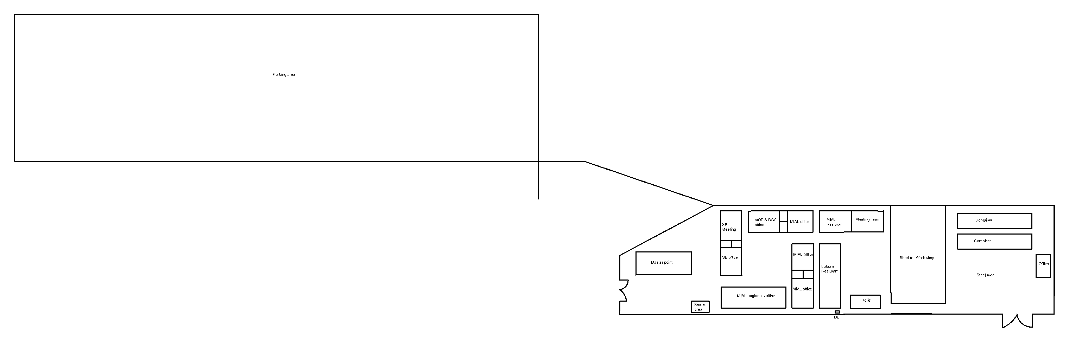
CHAPTER 02 · EHS LEADERSHIP AND RESPONSIBILITIES
Camp and Offices Layout
The camp model — parking, gates, offices, restaurants, workshop and muster point
Parking area · muster point (marked 'Master point' on the drawing) · smoking area · SE, MoE & BGC and MIAL offices · MIAL and laborer restaurants · meeting rooms · workshop shed · containers · steel area · toilets · DG · gates
KAZ-EHS-IND-001 · Rev. 06 · Management & Staff EHS Induction · Restricted
02 · EHS Leadership and Responsibilities
Slide 20 of 63
Notes:
The model is taken from 'camp Model (21).pdf'. Walk the participants through the facilities: parking area on the left connected by the access road; the muster point is marked 'Master point'; smoking area; offices (SE, MoE & BGC, MIAL engineers); MIAL and laborer restaurants and meeting rooms; workshop shed, containers and steel area; DG beside the toilets; gates at left, right and bottom. Confirm the current layout at site; the site plot plan is posted at the entrance, offices and assembly points (slide 18).

Slide 21
CHAPTER 03 · THE PROJECT, THE SITE AND DAILY RULES
Project EHS Organisation
Who is responsible for what
▪
Project Director / Site Manager — overall responsibility for EHS performance of the project.
▪
Siemens Energy EHS Manager in Projects (EHSMIP) — governance, audits, verification and stop-work authority.
▪
Contractor EHS Manager and EHS Officers — daily supervision, permits, inspections and training.
▪
Area Authority / MoE Operations — authorises work in live operational areas.
▪
Authorized Electrical Person (AEP) / Isolation Authority — energy isolation, LOTO and energisation.
▪
First aiders, fire wardens and gas testers — appointed and posted in every area.
▪
Several organisations share this site (MoE, BGC, Siemens Energy, contractors) — coordinate and look out for each other (SE 'Zebra site' principle).
Rule: No EHS supervision = No work.
KAZ-EHS-IND-001 · Rev. 06 · Management & Staff EHS Induction · Restricted
03 · The Project, the Site and Daily Rules
Slide 21 of 63
Notes:
Introduce the real people behind each role and their contact numbers. Participants should know who to call for each situation.

Slide 22
CHAPTER 03 · THE PROJECT, THE SITE AND DAILY RULES
General Site Rules (1)
Applies from the moment you enter the gate
لا عمل بدون تصريح · لا عمل بدون إشراف · قيّم المخاطر (LMRA) قبل كل مهمة
▪
Complete site induction and PSI before starting any work — and carry your induction card.
▪
No work without a valid Permit to Work; no work without EHS supervision.
▪
Complete an LMRA before every task and attend the daily toolbox talk.
▪
Read and understand the risk assessment and method statement for your task — ask if anything is unclear.
▪
Wear the mandatory minimum PPE at all times (slide 45).
▪
Stay within your authorised area — never enter red or restricted zones without authorisation.
▪
Keep your workplace clean and tidy — 'Clean everything, always.'
▪
Report every near miss, unsafe act, unsafe condition and incident.
KAZ-EHS-IND-001 · Rev. 06 · Management & Staff EHS Induction · Restricted
03 · The Project, the Site and Daily Rules
Slide 22 of 63
Notes:
Repeat the two absolutes: no permit = no work; no EHS supervision = no work.

Slide 23
CHAPTER 03 · THE PROJECT, THE SITE AND DAILY RULES
General Site Rules (2)
Working hours, competency and behaviour
▪
Working hours: 06:00–15:00 (8 hours per day), six days per week; subcontractor hours must be approved by Siemens Energy.
▪
Maximum 11 hours daytime / 7.5 hours night work, excluding breaks; one rest day in every seven. No fatigue working or driving.
▪
Only competent, certified persons operate plant, equipment and electrical systems.
▪
No horseplay, no sleeping on site, no unauthorised removal of materials (Material Gate Pass required).
▪
Zero tolerance: alcohol, drugs, weapons, fighting, harassment and theft.
▪
Photography and video recording on site are prohibited without written authorisation from the Site EHS/Security Manager.
▪
Report to the site medic any illness, injury or medication that could affect your work.
KAZ-EHS-IND-001 · Rev. 06 · Management & Staff EHS Induction · Restricted
03 · The Project, the Site and Daily Rules
Slide 23 of 63
Notes:
Have the site rule list available as a handout. Working hours confirmed by site management: 06:00–15:00 (8 h/day), six days a week. Point out that hours and rest days are monitored.

Slide 24
CHAPTER 03 · THE PROJECT, THE SITE AND DAILY RULES
Stop Work Authority
You are empowered — and expected — to use it
من حقك ومن واجبك إيقاف أي عمل خطر — ولن تُعاقب على ذلك أبداً
▪
Anyone — employee, contractor or visitor — may stop any task where there is imminent danger, a rule violation, a missing control or a change in conditions.
▪
How to apply it:
•
1. Stop the activity.
•
2. Intervene with the people involved — calmly and respectfully.
•
3. Escalate to the supervisor or area authority.
•
4. Verify and implement the required controls.
•
5. Restart only when authorised.
•
6. Record the event and give positive feedback.
▪
You will not be punished, prosecuted or harassed for stopping work — this is a Siemens Energy commitment.
KAZ-EHS-IND-001 · Rev. 06 · Management & Staff EHS Induction · Restricted
03 · The Project, the Site and Daily Rules
Slide 24 of 63
Notes:
This is the single most important empowerment message in the deck. Ask each participant to state one situation in which they would stop work.

Slide 25
CHAPTER 03 · THE PROJECT, THE SITE AND DAILY RULES
Risk Management
Risk Assessment · SJA · LMRA · Management of Change
▪
Risk assessment (RA): prepared before work starts and communicated to the team. Read it, follow the controls, never work outside its scope.
▪
Safe Job Analysis (SJA): required for high-risk or non-routine tasks; prepared with the crew before work starts.
▪
Last Minute Risk Assessment (LMRA): a short check before every task — What can hurt me? What has changed? Are the controls in place? The method and the form are on the next slide.
▪
Hierarchy of controls: eliminate · substitute · engineering controls · administrative controls · PPE (PPE is the last line of defence).
▪
Management of Change: if the method, equipment, people or conditions change, stop work and revise the assessment.
▪
After any incident or high-potential near miss, the risk assessment is reviewed and updated.
KAZ-EHS-IND-001 · Rev. 06 · Management & Staff EHS Induction · Restricted
03 · The Project, the Site and Daily Rules
Slide 25 of 63
Notes:
Explain the difference between RA (planned), SJA (task) and LMRA (moment). Use a real job from the site as the example. The LMRA method and SE form 000480 are explained on the next slide.

Slide 26
CHAPTER 03 · THE PROJECT, THE SITE AND DAILY RULES
Hierarchy of Controls
Applies to employees, contractors and visitors
اعتنِ بسلامتك وسلامة من حولك · التزم بالقواعد والتصاريح · أبلغ عن كل خطر وحادث
1 · ELIMINATE — إزالة الخطر كلياً
2 · SUBSTITUTE — الاستبدال بطريقة أو مادة أقل خطورة
3 · ENGINEERING CONTROLS — ضوابط هندسية (حواجز، عزل، تهوية)
4 · ADMINISTRATIVE CONTROLS — ضوابط إدارية (تصاريح، إجراءات، لافتات، تدريب)
5 · PPE — معدات الوقاية الشخصية (خط الدفاع الأخير)
Most effective ↑ — الأقل فاعلية في الأسفل: لا تعتمد على معدات الوقاية وحدها ما أمكن ضبط الخطر من مصدره
KAZ-EHS-IND-001 · Rev. 06 · Management & Staff EHS Induction · Restricted
03 · The Project, the Site and Daily Rules
Slide 26 of 63
Notes:
Walk through the five levels with a site example (e.g. working at height: eliminate by pre-assembling at ground level; substitute; engineering = guardrails and platforms; administrative = permit and TBT; PPE = harness). Stress: PPE is the last line of defence, never the first choice.

Slide 27
CHAPTER 02 · EHS LEADERSHIP AND RESPONSIBILITIES
The LMRA in Practice
The last check before touching the work — SE form 000480 (V2)
▪
The LMRA is the last check before touching the job — completed by the crew at the workface on SE form 000480 (V2), signed by team leader, workers and (where applicable) client representative.
▪
The rule: every question is answered YES or N/A. If you cannot answer YES or N/A — do not start: state the required measures and report to your direct supervisor and the EHS specialist.
▪
Basics: client safety briefing received · an authorised, competent supervisor is assigned · minimum PPE plus task-specific PPE is appropriate and complete.
▪
Height and electricity: fall controls and inspected ladders and scaffolding · safe approach distances respected · the five safety rules applied for de-energised work · operational earthing in place.
▪
Equipment: certified lifting gear and operators · tools inspected · a suitable extinguisher at hand.
▪
Area: the work zone is demarcated with signs and barriers · slip, trip, fall and open-gap hazards controlled · vehicle routes checked for pits, ducts and ground failure.
▪
Look around: identify nearby activities that could interfere with your work, and record any other chemical, mechanical or physical hazards together with the measures taken.
▪
The LMRA verifies at the workface that every control is in place — it never replaces the RA, SJA or permit.
KAZ-EHS-IND-001 · Rev. 06 · Management & Staff EHS Induction · Restricted
02 · EHS Leadership and Responsibilities
Slide 27 of 63
Notes:
Based on the SE LMRA form 000480 (V2). Stress the escalation rule: any question that cannot be answered YES or N/A means DO NOT START — state the measures and report to the direct supervisor and the EHS specialist. The form is signed by team leader, workers and client representative. It verifies controls at the workface; it never replaces the RA, SJA or the permit.

Slide 28
CHAPTER 03 · THE PROJECT, THE SITE AND DAILY RULES
The Daily Safety Routine
Start of shift · during work · end of shift
▪
Start of shift: toolbox talk → LMRA → permit verification → PPE and equipment pre-use checks.
▪
During work: supervision present, barriers and signage in place, housekeeping maintained, no lone working on high-risk tasks.
▪
End of shift: close and endorse permits, restore isolations per the LOTO register, secure the area.
▪
Shift handover for isolated work: joint re-verification of permit conditions, isolation status and zero-energy state, signed by all parties.
▪
Any change of plan during the shift is briefed to the crew and, where required, re-approved.
KAZ-EHS-IND-001 · Rev. 06 · Management & Staff EHS Induction · Restricted
03 · The Project, the Site and Daily Rules
Slide 28 of 63
Notes:
Walk through a typical day of a subcontractor crew, step by step, so the routine is concrete.

Slide 29
04
Permit to Work and Electrical Safety
The control system for hazardous work and the rules that keep the plant safe.
Permit to Work · Lock-Out / Tag-Out · Electrical rules · Arc flash · Live plant
KAZ-EHS-IND-001 · Rev. 06 · Restricted
Slide 29 of 63
Notes:
Chapter 04 — Permit to Work and Electrical Safety. The control system for hazardous work and the rules that keep the plant safe. This chapter covers: Permit to Work, Lock-Out / Tag-Out, Electrical rules, Arc flash, Live plant.

Slide 30
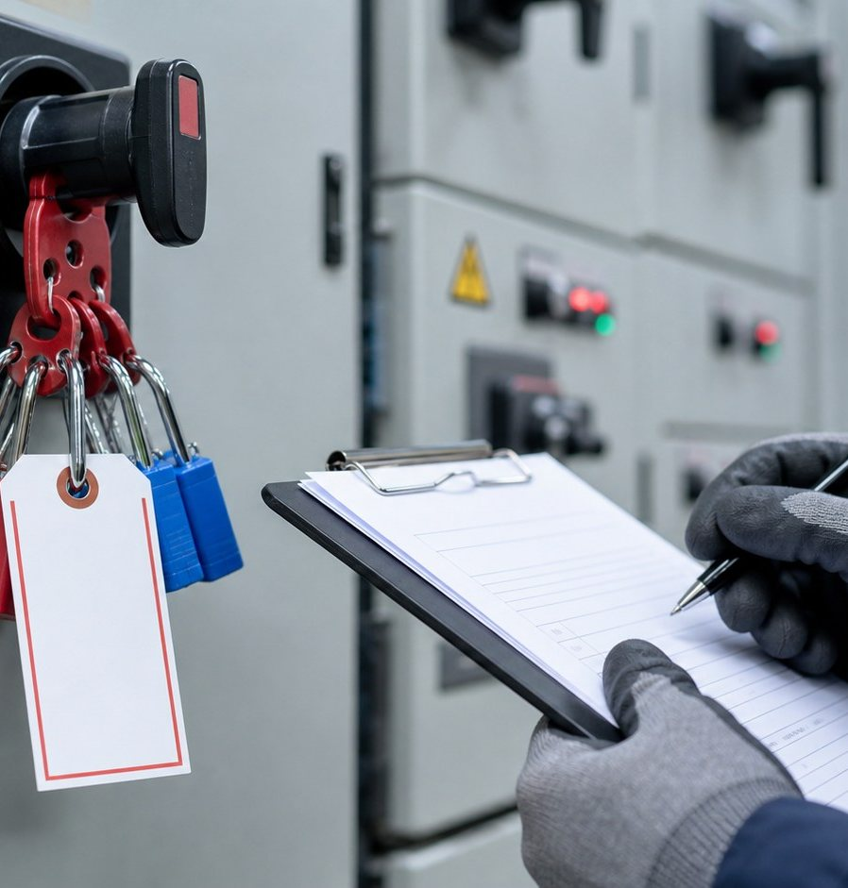
CHAPTER 04 · PERMIT TO WORK AND ELECTRICAL SAFETY
Permit to Work (1)
System, roles and principles
▪
No permit = no work. The PTW system is administered and controlled by Siemens Energy.
▪
For work on live or operational plant and client-controlled areas, the MoE/BGC permit system and its Area/Isolation Authority take precedence.
▪
Roles: Permit Issuer (SE) · Permit Holder (contractor supervisor) · Area Authority (operations) · Isolation Authority / AEP · EHS Reviewer · Authorized Gas Tester.
▪
Every permit requires: approved JSA / method statement, controls verified on site, briefed working party, valid certificates and inspections.
▪
EHS reviews and audits permits; technical approval belongs to the Area Authority; isolation authority belongs to the AEP.
▪
Never work outside the scope, time or conditions stated on the permit.
No permit — no work
KAZ-EHS-IND-001 · Rev. 06 · Management & Staff EHS Induction · Restricted
04 · Permit to Work and Electrical Safety
Slide 30 of 63
Notes:
Explain that the permit is a contract between the issuer and the holder. Removing or bypassing a permit condition is a dismissible offence.

Slide 31
CHAPTER 04 · PERMIT TO WORK AND ELECTRICAL SAFETY
Permit to Work (2)
Permit types and validity on this project
Permit
Typical validity
General Cold Work Permit
7 days with daily endorsement
Electrical Cold Work Permit
Daily / each shift
Electrical Hot Work & Commissioning Permit
Daily / each shift
Energy Isolation (LOTO) Permit
Daily / each shift
Hot Work Permit (welding, cutting, grinding)
Daily / each shift
Excavation & Trenching Permit (over 30 cm)
7 days with daily endorsement
Lifting Permit (all lifts; engineered plan for critical lifts)
Daily / each shift
Work at Height Permit (1.8 m and above)
Daily / each shift
Confined Space Entry Permit
Daily / each shift
KAZ-EHS-IND-001 · Rev. 06 · Management & Staff EHS Induction · Restricted
04 · Permit to Work and Electrical Safety
Slide 31 of 63
Notes:
Confirmed validities: general cold work and excavation permits 7 days with daily endorsement; ALL other permits (electrical cold, electrical hot & commissioning, LOTO, hot work, lifting, work at height, confined space) are daily / each shift.

Slide 32
CHAPTER 04 · PERMIT TO WORK AND ELECTRICAL SAFETY
Lock-Out / Tag-Out and Energy Isolation
Control every energy source
▪
Cover all energy sources: electrical, mechanical, pneumatic, hydraulic, thermal and stored energy.
▪
Sequence: notify → isolate → lock and tag → release stored energy → verify zero energy → work.
▪
Every worker applies their own personal lock; keys are controlled in the lockbox by the AEP.
▪
PTW validity and LOTO validity are managed separately — permit expiry never releases an isolation.
▪
Only the AEP de-isolates, through the controlled de-isolation process and the key register.
▪
Never remove another person's lock or tag — this is a dismissible offence.
▪
Test before touch: prove the tester, prove dead, and prove the tester again.
KAZ-EHS-IND-001 · Rev. 06 · Management & Staff EHS Induction · Restricted
04 · Permit to Work and Electrical Safety
Slide 32 of 63
Notes:
Use the isolation certificate and lockbox as physical props if available. Explain the personal lock principle clearly.

Slide 33
CHAPTER 04 · PERMIT TO WORK AND ELECTRICAL SAFETY
Energy Isolation Sequence
Applies to employees, contractors and visitors
اعتنِ بسلامتك وسلامة من حولك · التزم بالقواعد والتصاريح · أبلغ عن كل خطر وحادث
1
NOTIFY
إخطار
2
ISOLATE
عزل
3
LOCK & TAG
قفل وتعليق
4
RELEASE STORED ENERGY
تفريغ الطاقة المختزنة
5
VERIFY ZERO ENERGY
التحقق من صفر الطاقة
6
TEST BEFORE TOUCH
اختبر قبل اللمس ثم اعمل
Only the AEP de-isolates · every worker applies his own personal lock · never remove another person's lock — dismissible offence
فك العزل من صلاحية AEP فقط · كل عامل يضع قفله الشخصي · لا تُزل قفل غيرك أبداً — مخالفة تستوجب الفصل
KAZ-EHS-IND-001 · Rev. 06 · Management & Staff EHS Induction · Restricted
04 · Permit to Work and Electrical Safety
Slide 33 of 63
Notes:
Use this flow every time energy isolation is discussed. Emphasise 'test before touch': prove the tester, prove dead, prove the tester again. A permit expiring never releases an isolation.

Slide 34

CHAPTER 04 · PERMIT TO WORK AND ELECTRICAL SAFETY
Electrical Safety Rules
The golden rule of this project
القاعدة الذهبية: اعزل — أقفل — علّق — اختَبِر قبل اللمس
▪
Treat every electrical circuit as live until proven dead.
▪
Isolate the source and apply LOTO before starting any work.
▪
Only an Authorized Electrical Person may isolate, de-isolate or energise.
▪
Verify absence of voltage with an approved, calibrated tester — prove the tester before and after.
▪
Use insulated tools rated for the voltage; inspect them before use.
▪
Maintain safe approach distances at all times; respect barriers, interlocks and signage.
▪
Never work on live equipment unless formally authorised and only under an Electrical Hot Work / Commissioning Permit.
GOLDEN RULE: ISOLATE — LOCK OUT — TAG OUT — TEST BEFORE TOUCH.
Arc-rated PPE and approach boundary
KAZ-EHS-IND-001 · Rev. 06 · Management & Staff EHS Induction · Restricted
04 · Permit to Work and Electrical Safety
Slide 34 of 63
Notes:
This is the highest-risk topic of the project. Slow down here and check understanding with questions.

Slide 35
CHAPTER 04 · PERMIT TO WORK AND ELECTRICAL SAFETY
Arc Flash and Safe Approach Distances
Boundaries must be approved for this site — do not use generic values
Nominal voltage
Minimum approach distance
Arc flash boundary
Notes
11 kV
per approved project table
per arc flash study
Limited / restricted approach per NFPA 70E and client rules
132 kV
per approved project table
per arc flash study
Client operational rules apply
400 kV
per approved project table
per arc flash study
Highest risk on this site — client operational rules apply
Work within 30 m of HV system
Agreement with plant owner + physical demarcation
—
Mandatory before any activity
KAZ-EHS-IND-001 · Rev. 06 · Management & Staff EHS Induction · Restricted
04 · Permit to Work and Electrical Safety
Slide 35 of 63
Notes:
IMPORTANT for the presenter: insert the values approved by the Siemens Energy EHSMIP and the client before delivering this slide. Generic or imperial values from other sites must not be used — this was a critical finding in the audit of the previous induction.

Slide 36
CHAPTER 04 · PERMIT TO WORK AND ELECTRICAL SAFETY
Working in a Live Power Plant
Coordination with MoE Operations
▪
Work near or on live systems is governed by the client's operational rules in addition to ours.
▪
A nominated Operations Manager is responsible for the installation; a Switching Supervisor controls switching.
▪
No work starts without: agreed method, permit, isolation and the operational authority's confirmation that the plant condition is safe.
▪
Maintain physical demarcation between live and work areas; never breach a barrier or open a panel without authorisation.
▪
Stop all work during thunderstorms — cranes, lifts, scaffolding and installation work are suspended (lightning and induced voltage).
▪
Report any contact with a conductor, any flash and any damaged insulation immediately.
▪
Never touch an electric-shock casualty before the supply is isolated.
KAZ-EHS-IND-001 · Rev. 06 · Management & Staff EHS Induction · Restricted
04 · Permit to Work and Electrical Safety
Slide 36 of 63
Notes:
Explain the difference between our responsibility and the client's operational responsibility, and how both are coordinated daily.

Slide 37
05
High-Risk Activities and Occupational Health
The activities that cause the most serious injuries and how each one is controlled.
Work at height · Lifting · Excavation · Confined space · Hot work · Tools · Manual handling · PPE · Heat stress · First aid
KAZ-EHS-IND-001 · Rev. 06 · Restricted
Slide 37 of 63
Notes:
Chapter 05 — High-Risk Activities and Occupational Health. The activities that cause the most serious injuries and how each one is controlled. This chapter covers: Work at height, Lifting, Excavation, Confined space, Hot work, Tools, Manual handling, PPE, Heat stress, First aid.

Slide 38

CHAPTER 05 · HIGH-RISK ACTIVITIES AND OCCUPATIONAL HEALTH
Work at Height
Fall protection from 1.8 m
حماية من السقوط من ارتفاع 1.8 متر · ربط دائم بحبل مزدوج بنقطة تثبيت معتمدة
▪
Fall protection is required from 1.8 m, or wherever a fall hazard exists.
▪
Use approved scaffolding, work platforms or MEWPs — with guardrails and toe boards.
▪
Harness with double lanyard and shock absorber, 100% tie-off to a certified anchor point (above 22 kN).
▪
Scaffolding: erected and altered only by certified scaffolders; green tag valid; inspected before each shift and after any alteration. Never work on a red-tagged scaffold.
▪
Ladders: short-duration work only, secured, three points of contact, no loads carried.
▪
Barricade the area below, tether tools, protect openings and edges, and never work at several levels without protection.
100% tie-off to certified anchor
KAZ-EHS-IND-001 · Rev. 06 · Management & Staff EHS Induction · Restricted
05 · High-Risk Activities and Occupational Health
Slide 38 of 63
Notes:
Ask who has a valid working-at-height certificate. Verify harness inspection records.

Slide 39

CHAPTER 05 · HIGH-RISK ACTIVITIES AND OCCUPATIONAL HEALTH
Lifting Operations
Every lift is planned and permitted
▪
All lifts require a permit; critical lifts require a detailed engineered lifting plan.
▪
Critical lifts include: loads above 75% of rated capacity, multi-crane lifts, lifts over live plant, and non-routine rigging.
▪
Only certified cranes and lifting tackle (third-party certificates), competent operators, riggers and banksmen.
▪
Outriggers fully extended on timber pads on firm, verified ground.
▪
Exclusion zone barricaded — nobody under the load, no side pulls, no shock loading.
▪
No lifting when wind exceeds 9.5 m/s (≈34 km/h) or in poor visibility.
▪
Taglines for load control; the banksman is the only person who signals the operator.
Exclusion zone · taglines · banksman
KAZ-EHS-IND-001 · Rev. 06 · Management & Staff EHS Induction · Restricted
05 · High-Risk Activities and Occupational Health
Slide 39 of 63
Notes:
Wind limit confirmed by site management: lifting stops at 9.5 m/s. Emphasise exclusion zones, taglines and the banksman as the only signaller. Critical lifts over live plant need an engineered plan.

Slide 40

CHAPTER 05 · HIGH-RISK ACTIVITIES AND OCCUPATIONAL HEALTH
Excavation and Trenching
Permit required beyond 30 cm
▪
A permit is required for any ground penetration deeper than 30 cm.
▪
Obtain the signed underground utility clearance before digging; hand-dig trial pits near services and the earthing grid.
▪
Protective systems — shoring, benching or sloping — are mandatory for excavations deeper than 1.2 m.
▪
Spoil heaps set back at least 1.0 m from the edge; materials and plant kept away from the crest.
▪
Barricade, sign and light all excavations; access ladders every 7.5 m for emergency egress.
▪
Inspect after rain or any ground movement; never enter an unprotected trench.
▪
A competent banksman controls plant movement around the excavation.
Shoring · barriers · access ladder
KAZ-EHS-IND-001 · Rev. 06 · Management & Staff EHS Induction · Restricted
05 · High-Risk Activities and Occupational Health
Slide 40 of 63
Notes:
Highlight that excavations can also be confined spaces depending on risk assessment — but not automatically.

Slide 41

CHAPTER 05 · HIGH-RISK ACTIVITIES AND OCCUPATIONAL HEALTH
Confined Space Entry
Permit · gas test · attendant · rescue plan
▪
Entry only with a Confined Space Entry Permit, trained entrants and attendants, and a rescue plan in place.
▪
Atmospheric testing before entry and continuously during the work: oxygen, LEL, H2S and CO, by an Authorized Gas Tester.
▪
Ventilation and isolation (LOTO) in place before entry.
▪
The attendant remains at the entry at all times and maintains communication with the entrant.
▪
Never enter to rescue without breathing apparatus and the rescue team — most confined-space fatalities are would-be rescuers.
▪
Classification as a confined space is based on risk assessment of the actual conditions.
Gas monitoring · attendant · tripod
KAZ-EHS-IND-001 · Rev. 06 · Management & Staff EHS Induction · Restricted
05 · High-Risk Activities and Occupational Health
Slide 41 of 63
Notes:
Emphasise the rescue rule: the instinct to help is the biggest killer. Call the rescue team.

Slide 42

CHAPTER 05 · HIGH-RISK ACTIVITIES AND OCCUPATIONAL HEALTH
Hot Work and Fire Watch
Sparks and flames are controlled, permitted activities
▪
Hot Work Permit required for welding, cutting, grinding, soldering, thermal spraying or any activity producing sparks, flames or heat above 100 °C.
▪
Certified welder or cutter; PPE and screens to protect others.
▪
Fire blanket containment and at least 10 m clearance of combustible materials.
▪
A dedicated Fire Watch is present during the work and for 30 minutes after it ends.
▪
Minimum three extinguishers (more where the activity requires) and a fire blanket at the work site.
▪
Gas cylinders secured upright, caps fitted, oxygen and fuel gas stored separately.
▪
Gas test required near fuel, chemical or potentially flammable areas — never hot work in a flammable atmosphere.
Fire watch · containment · 10 m clearance
KAZ-EHS-IND-001 · Rev. 06 · Management & Staff EHS Induction · Restricted
05 · High-Risk Activities and Occupational Health
Slide 42 of 63
Notes:
Confirmed: fire watch stays 30 minutes after the work ends; minimum 3 extinguishers at the hot work site (more according to the activity). Gas test near flammables is mandatory.

Slide 43
CHAPTER 05 · HIGH-RISK ACTIVITIES AND OCCUPATIONAL HEALTH
Hand and Power Tools
The right tool, inspected, used correctly
▪
Use the right tool for the job; inspect before use; remove defective tools from service immediately.
▪
Portable electrical tools: 30 mA RCD protection, undamaged armoured cables, earthing verified, no taped joints.
▪
Angle grinders: guard in place, correct disc for the material, never over-speed a disc.
▪
Wear a full face shield (EN 166) plus safety glasses and gloves for grinding and cutting.
▪
Secure the workpiece; never cut towards your body; keep hands clear of the cutting line.
▪
No loose clothing, no jewellery, no rings; tie back long hair.
▪
Never use compressed air to clean clothing or skin.
KAZ-EHS-IND-001 · Rev. 06 · Management & Staff EHS Induction · Restricted
05 · High-Risk Activities and Occupational Health
Slide 43 of 63
Notes:
This is a common source of hand injuries. Ask the group which tools are most frequently misused on site.

Slide 44
CHAPTER 05 · HIGH-RISK ACTIVITIES AND OCCUPATIONAL HEALTH
Manual Handling and Ergonomics
Plan the lift, not just the job
▪
Assess the load: weight, size, grip, centre of gravity, distance and destination.
▪
Use mechanical aids or ask for help — team lifts need a leader and clear commands.
▪
Lift technique: bend the knees, keep the load close, no twisting while lifting.
▪
Plan breaks and vary tasks to reduce repetition and strain.
▪
Report pain early — discomfort today becomes an injury tomorrow.
▪
Consider the environment: heat, uneven ground and confined spaces all increase the risk.
KAZ-EHS-IND-001 · Rev. 06 · Management & Staff EHS Induction · Restricted
05 · High-Risk Activities and Occupational Health
Slide 44 of 63
Notes:
Tie this to the heat stress session: dehydration and fatigue make manual handling injuries far more likely.

Slide 45
CHAPTER 05 · HIGH-RISK ACTIVITIES AND OCCUPATIONAL HEALTH
Personal Protective Equipment
Mandatory minimum on site — additional PPE per task risk assessment
الحد الأدنى إلزامي دائماً: خوذة · نظارات · قفازات · حذاء سلامة · ملابس مقاومة للهب عالية الرؤية
PPE item
Requirement on this site
Safety helmet
Mandatory — with chin strap; replaced after impact
Flame-retardant coverall
Mandatory — visibility class 1 (high-visibility)
Safety footwear
Mandatory — S3 / S1P, toe protection and puncture resistance
Safety glasses
Mandatory — ANSI/EN certified
Protective gloves
Mandatory — task-specific (electrical, chemical, cut-resistant)
Hearing protection
Mandatory above 85 dB(A) or where indicated
Arc-rated PPE
For electrical work — Category 2/4, face shield, insulated gloves
Full-body harness
Working at height — double lanyard with shock absorber
Respiratory protection
Where dust or vapour is identified — face-fit tested (e.g. FFP3)
High-visibility vest
Mandatory in areas with mobile plant and vehicle movement
KAZ-EHS-IND-001 · Rev. 06 · Management & Staff EHS Induction · Restricted
05 · High-Risk Activities and Occupational Health
Slide 45 of 63
Notes:
PPE is the last line of defence. Remind everyone that PPE is provided free of charge and damaged PPE must be replaced, not repaired.

Slide 46

CHAPTER 05 · HIGH-RISK ACTIVITIES AND OCCUPATIONAL HEALTH
Heat Stress Management
Our most predictable environmental hazard
اشرب الماء باستمرار · استرح في الظل · انتبه لأعراض الإجهاد الحراري وأبلغ فوراً
▪
Heat stress is managed by WBGT monitoring — monitoring starts when ambient temperature exceeds 40 °C.
▪
Published work / rest cycles apply for light, moderate and heavy work; follow them.
▪
Acclimatisation: new arrivals and anyone returning from leave start with reduced workload and increased rest.
▪
Drink water regularly — about 1.0 to 1.2 litres per hour for light work in high heat. Use oral rehydration salts.
▪
Shaded, ventilated rest areas and chilled drinking water are provided — use them.
▪
Lone working is prohibited on high-risk tasks — use the buddy system.
▪
Warning signs: headache, dizziness, cramps, nausea, confusion, hot dry skin, fainting. Heat stroke is a medical emergency — cool the casualty and call the medic immediately.
Shade · hydration · work-rest cycles
KAZ-EHS-IND-001 · Rev. 06 · Management & Staff EHS Induction · Restricted
05 · High-Risk Activities and Occupational Health
Slide 46 of 63
Notes:
WBGT monitoring and the published work/rest cycles apply; monitoring starts above 40 °C ambient. Acclimatisation for new arrivals. Hydration approx. 1.0–1.2 L/hour in high heat. Buddy system on high-risk tasks.

Slide 47
CHAPTER 05 · HIGH-RISK ACTIVITIES AND OCCUPATIONAL HEALTH
First Aid and Medical Emergency
Know your nearest help
▪
Know: your nearest first-aid point; the site medic 07707313604 (day shift only); emergency line 911; and the route to Al-Zubair hospital (approx. 45 min).
▪
Do not move a casualty unless there is immediate danger to life.
▪
Electric shock: do not touch the casualty before the supply is isolated.
▪
Keep the airway open; start CPR / AED if the casualty is not breathing and you are trained.
▪
Preserve the incident scene; do not disturb equipment involved in the incident.
▪
Meet the ambulance at the main gate and escort it to the casualty.
▪
Report every injury — including first-aid cases — to the EHS Department and the site medic.
Fitness for work: a valid medical certificate is required; report any condition or medication that affects your ability to work safely. Mental health matters — stress, fatigue and personal problems affect safety; support is available from your supervisor and the site medic.
KAZ-EHS-IND-001 · Rev. 06 · Management & Staff EHS Induction · Restricted
05 · High-Risk Activities and Occupational Health
Slide 47 of 63
Notes:
Confirmed: one medic on site, morning (day) shift only. Outside medic hours the emergency line 911 and trained first aiders apply. Nearest hospital: Al-Zubair, about 45 minutes. Do not move casualties; do not touch electric-shock casualties before isolation.

Slide 48
06
Environment, Emergency and Security
Protecting the environment, responding to emergencies, security and the consequences of breaking the rules.
Environment · Waste · Fire · Emergency · Incident reporting · Security · Driving · Penalties
KAZ-EHS-IND-001 · Rev. 06 · Restricted
Slide 48 of 63
Notes:
Chapter 06 — Environment, Emergency and Security. Protecting the environment, responding to emergencies, security and the consequences of breaking the rules. This chapter covers: Environment, Waste, Fire, Emergency, Incident reporting, Security, Driving, Penalties.

Slide 49
CHAPTER 06 · ENVIRONMENT, EMERGENCY AND SECURITY
Environmental Protection
Prevent pollution — it is part of every task
▪
No spill of oil, fuel, chemical or concrete washwater to soil, drains or watercourses.
▪
Use drip trays, secondary containment, funnels and spill kits; keep spill kits stocked and accessible.
▪
Dust suppression on unpaved roads and during cutting, grinding or excavation.
▪
Control noise and vibration through plant selection and work methods; respect site noise limits.
▪
Chemicals: no substance on site without a Safety Data Sheet (SDS) and registration in the electronic substance register.
▪
Asbestos and PCBs are prohibited on site — report any suspected material immediately.
▪
Protect flora, fauna and heritage: no uncontrolled clearing, no hunting, no littering.
▪
Report environmental incidents (spills, leaks, uncontrolled emissions) immediately — they are EHS incidents.
KAZ-EHS-IND-001 · Rev. 06 · Management & Staff EHS Induction · Restricted
06 · Environment, Emergency and Security
Slide 49 of 63
Notes:
Explain where spill kits and SDS are kept, and how the electronic substance register is used.

Slide 50
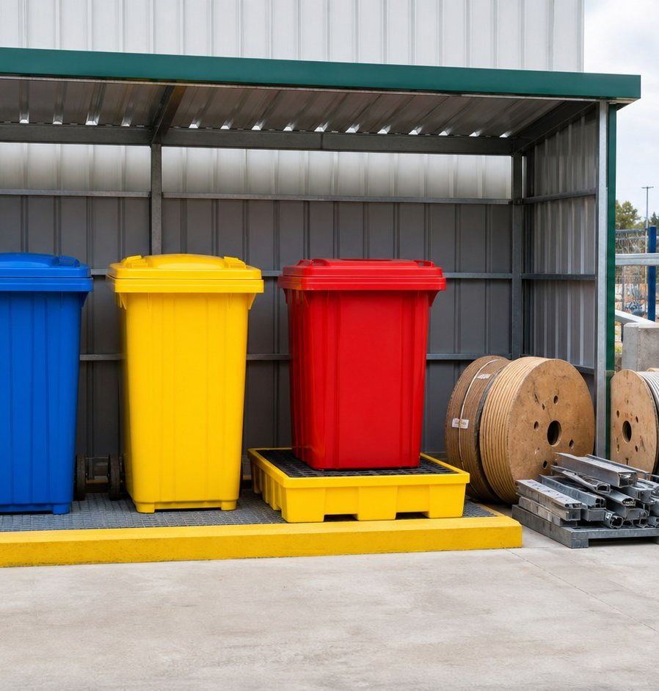
CHAPTER 06 · ENVIRONMENT, EMERGENCY AND SECURITY
Waste Management
Segregate at source — every day
▪
Segregate at source into the colour-coded containers: 🟨 yellow = spill kit · 🟥 red = hazardous waste · ⬛ black = general waste · 🟦 blue = paper & cardboard · 🟩 green = glass / recyclable · 🟫 brown = organic waste.
▪
Hazardous waste (oils, filters, batteries, chemicals, e-waste) is stored in labelled, covered, bunded areas.
▪
Hazardous waste leaves site only with MOTAT records and a licensed transporter.
▪
Never burn waste, never mix hazardous with general waste, never dump into trenches or open ground.
▪
Material and waste removal requires a Material Gate Pass.
▪
Keep waste areas tidy, marked and away from drains; report overflowing or damaged bins.
Segregated bins · bunded store
KAZ-EHS-IND-001 · Rev. 06 · Management & Staff EHS Induction · Restricted
06 · Environment, Emergency and Security
Slide 50 of 63
Notes:
Colour coding confirmed for the site: yellow spill kit, red hazardous, black general, blue paper/cardboard, green glass/recyclable, brown organic. Hazardous waste leaves site only with MOTAT records and a licensed transporter.

Slide 51
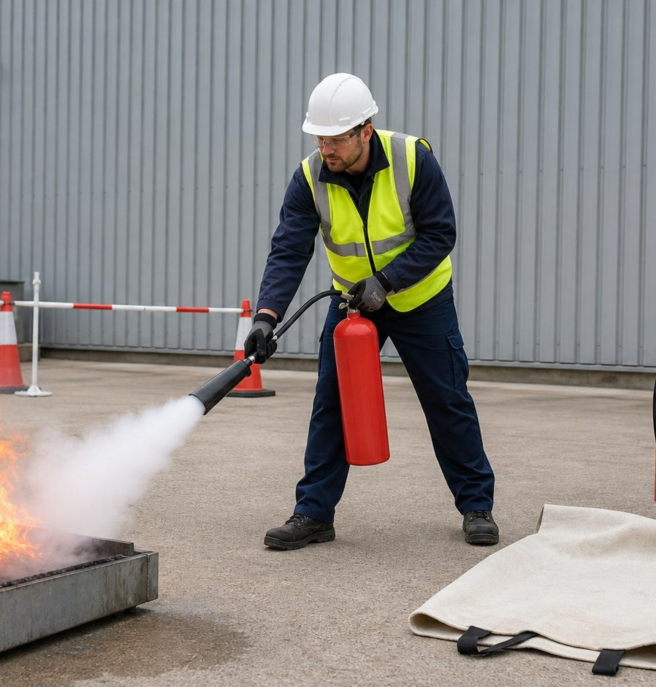
CHAPTER 06 · ENVIRONMENT, EMERGENCY AND SECURITY
Fire Safety and Firefighting
Classes, extinguishers and the PASS method
▪
Class A — wood, paper, cloth, rubber, plastics → water or foam (DCP is acceptable but less effective).
▪
Class B — gasoline, kerosene, paint, propane → foam, DCP, CO2.
▪
Class C — energised electrical equipment → CO2 or clean agent, plus de-energise the supply. Never use water.
▪
Class D — metals such as magnesium, titanium and sodium → special metal powder (graphite or sodium chloride). Never water or standard DCP.
▪
Class K / F — cooking oils and fats → wet chemical (camp kitchen).
▪
PASS method: Pull the pin · Aim at the base of the fire · Squeeze the handle · Sweep side to side.
▪
For CO2 extinguishers hold the insulated horn, never the metal parts.
Aim at the base · keep an escape route
▪
Only fight a small fire if you are trained and have a clear escape route. Otherwise raise the alarm and evacuate. Always alarm first.
KAZ-EHS-IND-001 · Rev. 06 · Management & Staff EHS Induction · Restricted
06 · Environment, Emergency and Security
Slide 51 of 63
Notes:
Correct the previous deck's error: Class D requires special metal powder, not DCP. Never use water on energised electrical equipment.

Slide 52
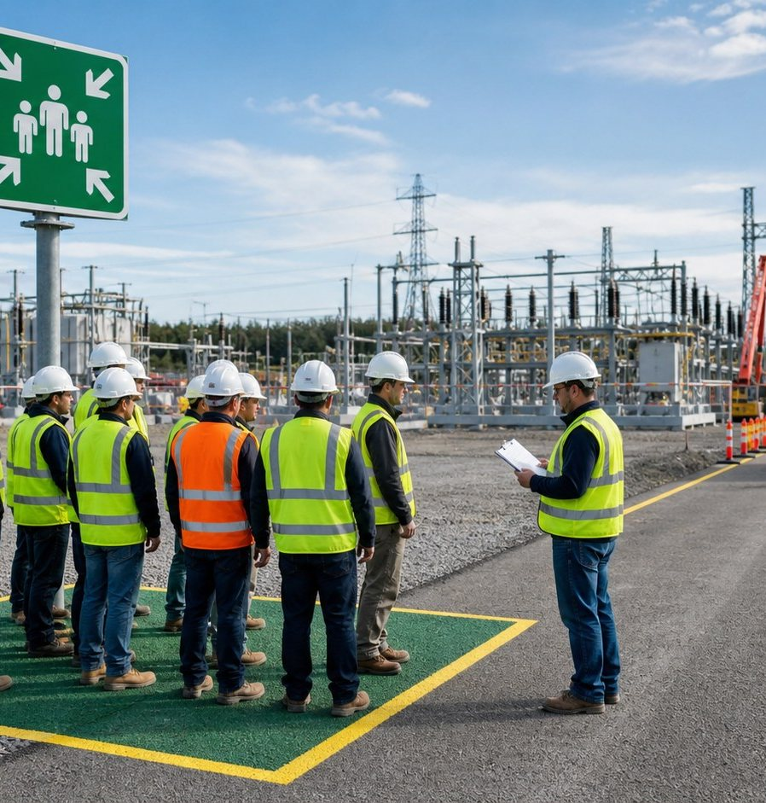
CHAPTER 06 · ENVIRONMENT, EMERGENCY AND SECURITY
Emergency Response and Evacuation
Alarm · assembly · head count
الإنذار المستمر = إيقاف العمل والتوجه إلى نقطة التجمع وتسجيل الحضور
▪
Alarm signals: continuous siren = evacuate · intermittent = stand by · all-clear = return to work.
▪
On evacuation: stop the job, isolate your equipment, proceed to the nearest assembly point.
▪
Report to your supervisor or the EHS Department at the assembly point for the head count; report any missing person immediately. The camp assembly point is inside the camp.
▪
Do not use vehicles; do not block emergency routes; keep the gate clear for emergency services.
▪
Do not leave or return to the area until instructed by the emergency controller.
▪
For security incidents (threat, intrusion, civil disturbance) follow the same assembly principle and the security team's instructions.
Assembly point · roll call · clear routes
▪
Fire wardens sweep their areas, including visitors and subcontractor crews.
KAZ-EHS-IND-001 · Rev. 06 · Management & Staff EHS Induction · Restricted
06 · Environment, Emergency and Security
Slide 52 of 63
Notes:
Alarm signals and head count: supervisors and EHS take the count at the assembly points; the camp assembly point is inside the camp. Fire wardens sweep their areas. No vehicles during evacuation.

Slide 53
CHAPTER 06 · ENVIRONMENT, EMERGENCY AND SECURITY
Emergency Classification and Notification
Know the level — and who to tell
Level
Description
Notification
Level 1
Minor injury or health effect, minor damage or minor environmental impact, manageable on site with site resources.
Supervisor → EHS → Site Manager (verbal immediately, written within 24 hours)
Level 2
Significant event manageable locally with support from the Company or local authorities — major injury, local damage, local impact.
EHS → SE EHSMIP → Project Director + Client (immediately)
Level 3
Major event or crisis beyond the contractor's control, with broader implications, requiring Company / corporate resources.
Project Director → SE Corporate / Regional Hub + Client (immediately)
Escalate immediately
Life-threatening injury, fatality, high-potential incident, major environmental release, security crisis — never treated as a locally managed event.
Verbal immediately · written within 24 hours · investigation report within 7 days
KAZ-EHS-IND-001 · Rev. 06 · Management & Staff EHS Induction · Restricted
06 · Environment, Emergency and Security
Slide 53 of 63
Notes:
Verbal immediately, written within 24 hours, investigation report within 7 days. A fatality or life-threatening injury is never a locally-managed Level 1/2 event — escalate immediately to the Project Director and client.

Slide 54
CHAPTER 06 · ENVIRONMENT, EMERGENCY AND SECURITY
Emergency Contacts
Posted at every assembly point, office and camp
احفظ الأرقام: إسعاف 122 · دفاع مدني / إطفاء 115 · شرطة 104
Contact
Number / channel
Site EHS control room / emergency line
911 (24/7)
UHF radio
Channel 1
Site medic / first aiders
07707313604
Contractor emergency numbers
0785-285-7404 · 0786-162-9706
Siemens Energy emergency number
+90 533 625 9494
Ambulance (Iraq)
122
Civil Defence / Fire (Iraq)
115
Police (Iraq)
104
Nearest hospital / medevac
Al-Zubair Hospital — approx. 45 min
KAZ-EHS-IND-001 · Rev. 06 · Management & Staff EHS Induction · Restricted
06 · Environment, Emergency and Security
Slide 54 of 63
Notes:
Numbers confirmed by site management (Sept 2026): site emergency line 911 (24/7); site medic 07707313604 (day shift only); nearest hospital: Al-Zubair, approx. 45 minutes. Iraqi national numbers: ambulance 122, civil defence 115, police 104. Read the numbers aloud and verify the posted cards weekly.

Slide 55
CHAPTER 02 · EHS LEADERSHIP AND RESPONSIBILITIES
The Site Alarm Card
The notification card you must know before you need it
▪
The alarm card is your personal emergency notification card — posted in every work area, office, camp and vehicle; know it before you need it.
▪
Inform in all cases: every accident and every severe injury is reported immediately through the site central emergency line (numbers on slide 54).
▪
Start your message with where you are — location, area and nearest landmark — then what happened, how many are hurt and what dangers remain.
▪
The notification chain: site emergency line → your supervisor → control room → EHS; where needed, the Site Manager, Project Manager and client contacts are informed.
▪
Know your nearest first-aid station, AED and the site medic before your first day of work — not after the first casualty.
▪
External emergencies: ambulance 122 · fire 115 · police 104 — always inform the site control room as well.
▪
Serious injuries: the hospital route and any special treatment are organised by the EHS Department — never transport a casualty alone.
▪
Names and numbers on the card must stay current — report any change to the EHS Department immediately.
KAZ-EHS-IND-001 · Rev. 06 · Management & Staff EHS Induction · Restricted
02 · EHS Leadership and Responsibilities
Slide 55 of 63
Notes:
Format follows the Siemens Energy site alarm card. All names and numbers must be the KAZ-specific ones from the Emergency Contacts slide — the reference alarm card in the SIEMENS EHS DOC folder belongs to another (Turkish) project and its data must NOT be used. Verify that a current card is posted at every work area.

Slide 56
CHAPTER 06 · ENVIRONMENT, EMERGENCY AND SECURITY
Incident, Near Miss and Unsafe Condition Reporting
Report immediately — reporting is protected
▪
Report immediately: all injuries (including first aid), near misses, unsafe acts, unsafe conditions, property damage, environmental releases and security events.
▪
Report through your supervisor and the EHS Department; incidents are recorded in the Siemens Energy EHS reporting tool (Enablon).
▪
Timelines:
•
Verbal notification — immediately.
•
Written notification — within 24 hours.
•
Investigation report — within 7 days (unless an extension is agreed).
•
Corrective action status — reported weekly until closed.
▪
A formal investigation team is formed by the Contractor, the Company and subcontractors; root causes and actions are documented.
▪
Never withhold information, alter the scene or delay reporting. Honest reporting carries no blame.
KAZ-EHS-IND-001 · Rev. 06 · Management & Staff EHS Induction · Restricted
06 · Environment, Emergency and Security
Slide 56 of 63
Notes:
Give a practical example of a near miss report that prevented an accident. Encourage reporting rather than hiding.

Slide 57
CHAPTER 06 · ENVIRONMENT, EMERGENCY AND SECURITY
Learning from Incidents
Every event makes the site safer
▪
Lessons Learned and safety alerts are issued after incidents and high-potential near misses.
▪
Each lesson triggers a risk assessment review, a toolbox talk and verification that controls are effective.
▪
Siemens Energy may conduct Eye on Safety reviews and its own investigations.
▪
If you are involved in or witness a serious incident: preserve the scene, cooperate fully and provide a written statement.
▪
Investigations classify errors, mistakes, violations and consequences — the purpose is learning and prevention, not blame.
▪
Share your experience — it prevents the next accident.
KAZ-EHS-IND-001 · Rev. 06 · Management & Staff EHS Induction · Restricted
06 · Environment, Emergency and Security
Slide 57 of 63
Notes:
Show one recent lesson learned from the project or from Siemens Energy safety alerts.

Slide 58
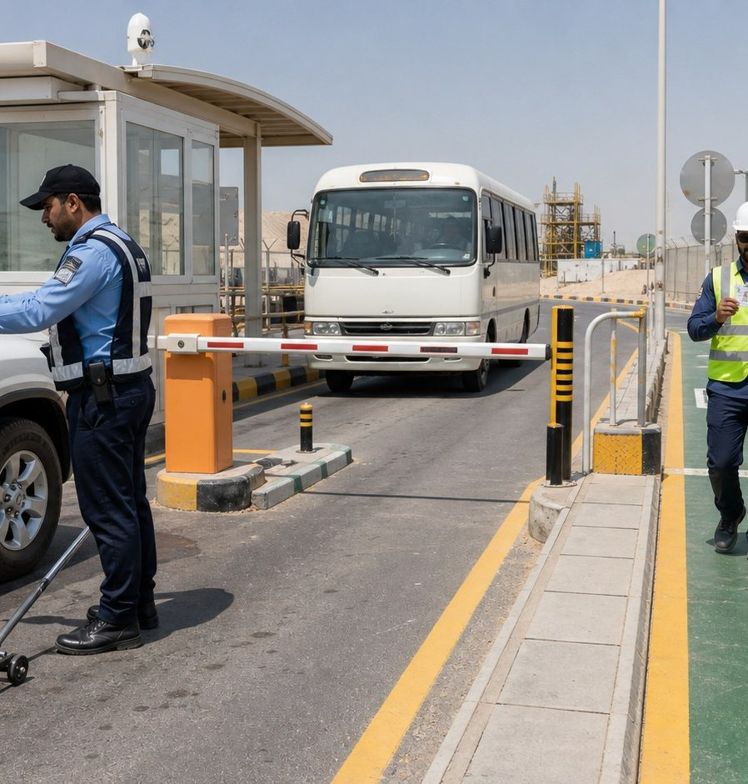
CHAPTER 06 · ENVIRONMENT, EMERGENCY AND SECURITY
Security and Access Control
Everyone is searched — everyone is protected
▪
Site and camps are protected by the Iraqi Police and site security; persons, belongings, vehicles and deliveries may be searched on entry and exit.
▪
Wear your Site ID / Gate Pass visibly at all times; access without it is refused.
▪
Visitors: pre-approval 24 hours in advance, photo ID deposited at the gate, escorted by a host at all times; no work, no plant operation, no photography.
▪
Report immediately: unauthorised access, theft, suspicious persons or vehicles, security breaches or threats.
▪
Lost or damaged ID card must be reported; a replacement fee applies.
▪
Security personnel are authorised to carry weapons — cooperate calmly and follow their instructions.
Access control · vehicle search
▪
Never resist or interfere with security checks; the minimum age for site access is 18 years.
KAZ-EHS-IND-001 · Rev. 06 · Management & Staff EHS Induction · Restricted
06 · Environment, Emergency and Security
Slide 58 of 63
Notes:
Cover the visitor process and the material gate pass. Security incidents follow the same reporting route as EHS incidents.

Slide 59
CHAPTER 06 · ENVIRONMENT, EMERGENCY AND SECURITY
Driving Safety and Journey Management
The road is our highest-risk journey
▪
Seat belts for all occupants, in every vehicle, at all times.
▪
Valid Iraqi driving licence for the vehicle class; only authorised drivers and vehicles.
▪
Site speed limit: 5 km/h. Obey traffic signs, signals and marshals.
▪
No mobile phone use while driving — including hands-free. No other distractions.
▪
Reverse parking only in designated areas; reversing requires a trained banksman.
▪
Daily pre-use checks and valid third-party inspection certificates for all vehicles.
▪
Journey management: plan the route, rest at least every two hours, no night driving without approval, no driving when tired.
▪
Driving is restricted in adverse weather — fog, heavy rain and dust storms.
KAZ-EHS-IND-001 · Rev. 06 · Management & Staff EHS Induction · Restricted
06 · Environment, Emergency and Security
Slide 59 of 63
Notes:
Adapt the route and rest requirements to the actual Basrah–site conditions. Report all road incidents immediately.

Slide 60
CHAPTER 06 · ENVIRONMENT, EMERGENCY AND SECURITY
Violations and Penalties
Consequences are applied consistently — matrix aligned with OSHA & NEBOSH practice
Violation
1st offence
2nd offence
3rd offence / critical
Speeding (over 5 km/h)
Warning + 2-day vehicle ban
1-week vehicle and driver ban
Permanent site ban
PPE non-compliance
Work stoppage + written warning
Contractor fine
ID cancellation and site removal
Red zone / LOTO breach
Work stoppage + 1-week suspension
—
Permanent site expulsion
Lost or damaged ID card
Replacement fee
—
—
Positive alcohol / drugs test
Immediate permanent site ban
—
—
Unauthorised material removal
Confiscation and investigation
—
—
Unauthorised photography
Media deletion and warning
—
Permanent site ban
KAZ-EHS-IND-001 · Rev. 06 · Management & Staff EHS Induction · Restricted
06 · Environment, Emergency and Security
Slide 60 of 63
Notes:
The penalty matrix is aligned with OSHA and NEBOSH best practice and is applied consistently to employees and contractors. Security instruction governs searches and site bans.

Slide 61
CHAPTER 06 · ENVIRONMENT, EMERGENCY AND SECURITY
Knowledge Check
11 questions — pass mark 80% (9 correct)
▪
1. What is the site speed limit, and when is a banksman required?
▪
2. At what height does fall protection become mandatory?
▪
3. When is a protective system required for an excavation?
▪
4. Which gases are tested before confined space entry?
▪
5. What is the maximum wind speed for lifting operations?
▪
6. Which extinguisher would you use on an energised electrical panel fire?
▪
7. What are the reporting deadlines for an incident?
▪
8. What must you do before touching any electrical conductor?
▪
9. What are the official emergency numbers in Iraq?
▪
10. What happens if you stop work because you believe it is unsafe?
▪
11. According to the Siemens Energy EHS Policy, what are the four principles that drive our Zero Harm culture?
KAZ-EHS-IND-001 · Rev. 06 · Management & Staff EHS Induction · Restricted
06 · Environment, Emergency and Security
Slide 61 of 63
Notes:
Run the check individually, mark it immediately, and retrain anyone below 80% before site access. Keep the answer sheets in the training register.

Slide 62
CHAPTER 06 · ENVIRONMENT, EMERGENCY AND SECURITY
Induction Card and Acknowledgement
Before you leave this room
▪
Collect your numbered induction card — valid 12 months, must be carried and shown on request.
▪
Sign the attendance and acknowledgement register.
▪
The card does not replace the Permit to Work, PSI, Safe Start or task-specific training.
▪
Acknowledgement: 'I attended the KAZ Management & Staff EHS Induction, I understood its content, and I accept that compliance with safety rules, permits and Stop Work Authority is a condition of my access to this site.'
الإقرار: أشهد أنني حضرت اندكشن البيئة والصحة والسلامة للإدارة والموظفين في موقع KAZ وفهمت محتواه، وألتزم بالالتزام بقواعد السلامة وتصاريح العمل وصلاحية إيقاف العمل كشرط لدخولي هذا الموقع.
▪
Report any content gaps or unclear points to the EHS Department — this induction is reviewed regularly.
KAZ-EHS-IND-001 · Rev. 06 · Management & Staff EHS Induction · Restricted
06 · Environment, Emergency and Security
Slide 62 of 63
Notes:
Collect signatures before participants leave. File the register with the training records.

Slide 63

Everyone Goes Home Safely — Every Day
Zero Harm · We take care of each other
Questions? Contact the EHS Department — UHF Channel 1 / Site EHS control room.
Thank you for your attention and for the work you do safely.
Prepared by: Ahmed Al-Mansoury | EHS Manager – Siemens
No task is so urgent that it cannot be done safely.
KAZ-EHS-IND-001 · Rev. 06 · Restricted · Subcontractor: Al-Mial Company
Notes:
Close positively, thank the participants, and remind them of the induction card and the acknowledgement signature.

