Slide 1
Afterspot
Big Data, Machine Learning, Data Science
GVC Day 1 Assignment: Project Scope
What is your project type:
Design Sprint,
Code, or
Tech Analysis
Business Analysis
Team: Nathaly Toledo (nathaly12toledo@gmail.com), Garry Putranto (garput2@gmail.com), Zuzana Jankovská (zuzana.jankovska@gmail.com)
Mentor: Lukáš Hnilička (lukas@mihybrid.com)

Slide 2
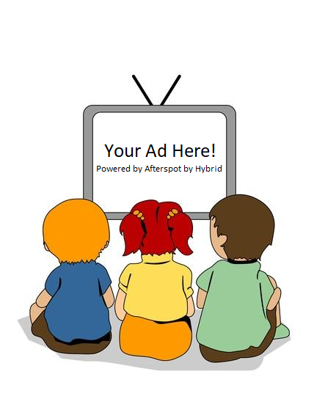
Afterspot NABC
Need:
TV consumption needs to be measured more effectively to allow TV advertisers better assess user preference and marketing strategies.
Approach:
We collect and analyze TV viewers’ behavior from each TV set’s activity log.
Benefit:
With accurate insights from viewer behavior, advertisers can increase the effectiveness and efficiency of their advertisement placement to provide personalized ads to TV viewers.
Competition:
The other solutions are not approaching every TV set individually and can't used targeted advertising approach based on TV viewers behavior

Slide 3
Background / Context
Working/Known:
What do we know. What has worked so far?
TV industry faces new invaders such as Netflix, Hulu, Disney+ and other services
Advertisers are getting heavily oriented on data in order to maximize their potential and effectiveness
Raise of competitors striving TV Ads budgets – such as Youtube and other video platforms
For more than a decade television advertising has mostly relied on third party audience tracking companies that usually don't reflect customers' needs
Not working / Not Known:
What has not worked? What do we need to learn, try, or test?
Not working:
Current TV measurement solutions are based on small samples.
Not known:
Overall size of data collected for market players at the end of the project
Retaliation from current TV measurement authority
Project’s consequences on TV broadcasters– Advertisers business relations

Slide 4
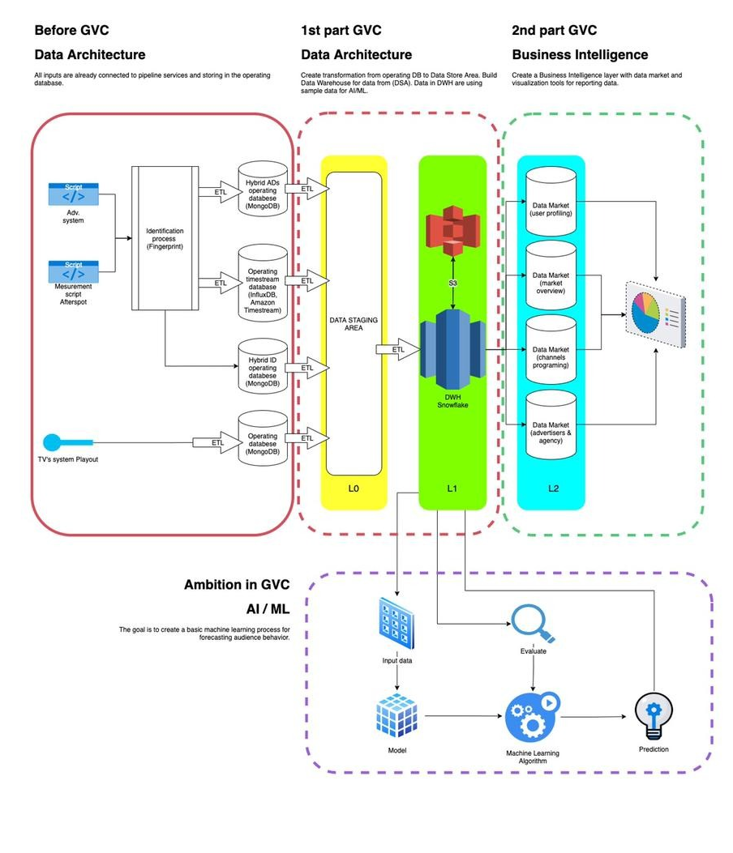
Deliverable
Nathaly (Lead): ETL & ML Developer
Garry: ETL & ML Developer
Zuzana: Data Architect & Business Intelligence

